Slide 1
Legionella—and other Fastidious Gram-Negative Bacilli (GNR)

Slide 2
LEGIONELLA
CHAPTER EIGHTEEN

Slide 3
Legionella General Characteristics
Ubiquitous gram-negative bacilli
Approximately 26 species isolated from humans
Primarily acquired through inhalation from environmental sources
Patients present with wide range of conditions
Methods of isolation
Isolation on special media
MALDI-TOF mass spectrometry
Urine antigen detection
DFA detection
Nucleic acid amplification (PCR multiplex)
Serology

Slide 4
Legionella Virulence Factors
Ability to exist as intracellular pathogens, in amoebae and mammalian cells
Bacteria can survive inside phagosomes and prevent phagolysosome formation
Ability to enter, survive, and multiply within the host’s cells (especially bronchoalveolar macrophages)
Ability to produce proteolytic enzymes

Slide 5
Infections Caused by Legionella— General Comments
Produce spectrum of symptoms
Asymptomatic or mild upper respiratory tract infections to life-threatening pneumonia
Febrile diseases
Legionnaires’ disease
Pontiac fever—an influenza-like febrile disease
Asymptomatic infection

Slide 6
Legionella Location and Epidemiology
Intracellular parasite
Enter and multiply within host cells
Particularly bronchoalveolar macrophages
Predisposition for disease
Immunocompromised
Patients with chronic lung disease
Alcoholics and heavy smokers

Slide 7
Legionnaires’ Disease
Manifests in three major patterns
Sporadic cases, which are most common and usually occur in the community
Epidemic outbreaks, characterized by short duration and low attack rates
Healthcare-associated clusters, occurring in compromised patient populations

Slide 8
Legionnaires’ Disease— Disease Progression
Atypical pneumonia
Type of pneumonia that produces symptoms different from that caused by S. pneumoniae
Most common causative agent: L. pneumophila serogroup 1
Incubation 2 to 14 days
Nonproductive cough, fever, headache, and myalgia
Later, pulmonary infiltrate develops
Sputum may be bloody or purulent
Rales, dyspnea and shaking may occur
Dissemination to other body areas may occur

Slide 9
Pontiac Fever
Non-pneumonic form of legionellosis
Short incubation period of about 2 days
In previously healthy individuals
Flu-like symptoms last 2 to 5 days then subside without medical intervention
Disease might be caused by inhalation of a bacterial toxin, such as endotoxin or an acute allergic reaction to a bacterium

Slide 10
Legionella Epidemiology
Approximately 5000 cases of legionellosis reported/year in the US
Many cases likely go undiagnosed
Physicians might not suspect it and many laboratories do not routinely culture for these agents
Legionella is associated with
Healthcare-associated infections often linked to contaminated equipment and water lines

Slide 11
Legionella Epidemiology—Facts and Figures
Cause 2% to 15% of community-acquired pneumonia
Incidence is likely higher than reported
Tolerance of 3 mg/L chlorine contributes to viability of organisms

Slide 12
Legionella Sources of Infection
Most aquatic sources
Lake, river, springs, man-made water treatment systems
Can survive in chlorinated water up to 3 mg/L
L. longbeachae: associated with gardening materials such as compost and potting soil
Significant source of infection in New Zealand and Australia
Specialized sources
Heating and cooling towers of buildings
Fountains

Slide 13
Legionella Colonization Characteristics
Can colonize a variety of sources due to
Ability to multiply at a large range of temps
20 to 43° C
Survive in temps
40 to 60° C
Adherence to pipes, rubber, and plastics
The ability to survive and multiply within free-living protozoa and in the presence of commensal bacteria and algae

Slide 14
Laboratory Diagnosis
Multiple methods are available including
direct examination, culture, and antigen and antibody detection.
Best diagnosed using a combination of culture and urine antigen detection
Multiplex PCR pneumonia panel
Pontiac fever diagnosis is based on
Laboratory findings, environmental studies, and epidemiology

Slide 15
Legionella Specimen Collection and Handling
Specimens
Predominantly respiratory specimens
Bronchoalveolar lavage (BAL), bronchial washings
Culture and direct detection
Urine specimens for antigen test
Soluble antigen found in the urine for serogroup 1
Stays positive for a long time, thus only confirms infection happened
Other tissues or fluids (i.e., pleural fluid) are acceptable when suspicion is high
Process within 2 hours of collection or refrigerate for short delay and freeze at -70°C if several day delay

Slide 16
Legionella Microscopic Morphology
Pleomorphic, thin, weakly staining, gram-negative bacilli
Extending safranin stain to at least 10 minutes can enhance staining intensity of organisms
Found within macrophages and neutrophils as well as extracellularly
Acid-fast or modified Kinyoun procedure may yield the desired microorganisms

Slide 17
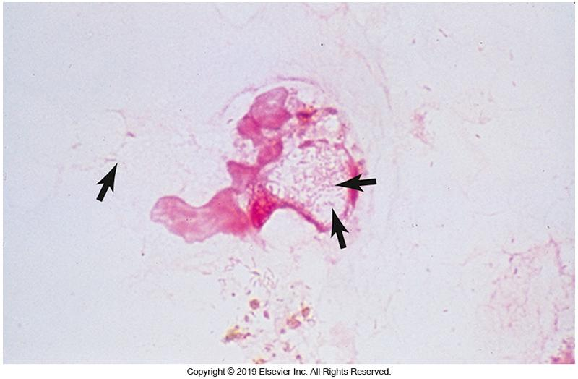
Gram Stain of L. pneumophila

Slide 18
Legionella Isolation Methods
Most important test for Legionnaires’ disease is culture of the organism
Acid treatment of contaminated specimens (with other bacteria), before inoculation enhances isolation
Dilute sample 1:10 in 0.2N potassium chloride-hydrochloric acid (KCl-HCl) solution for no more than 4 minutes

Slide 19
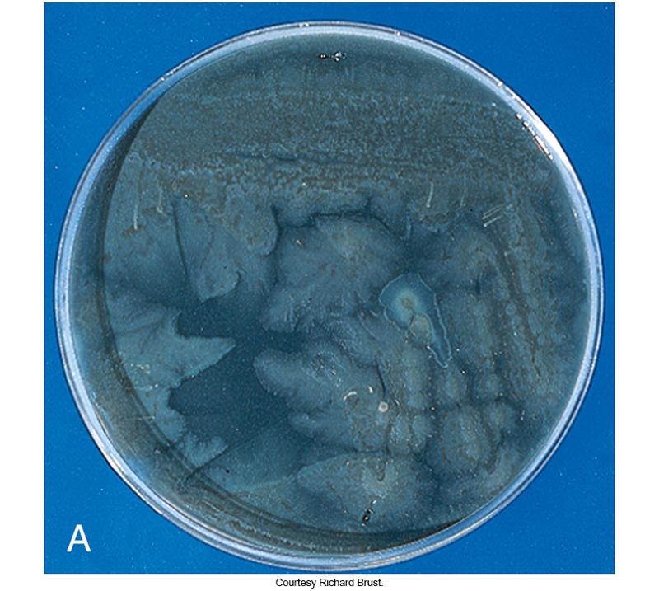
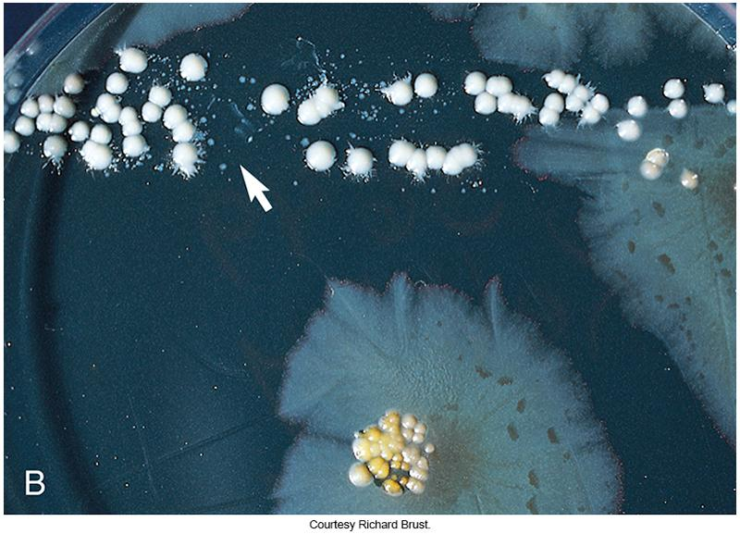
Legionella on BCYE Agar
Nonselective BCYE agar
Selective BCYE agar

Slide 20
Legionella Isolation Methods (Cont.)
Aerobic bacteria
Require L-cysteine for growth
Chocolate agar that contains L-cysteine
May result in growth of tiny colonies
Grow best on BCYEα agar
Selective BCYEα
Contains polymyxin B, anisomycin, and vancomycin or cefamandole
Can reduce contaminants but also inhibits Legionella
Inoculated media are incubated at 35°C in air
Increased CO₂ can enhance fastidious growth

Slide 21
Legionella Colony Morphology
On BCYEα agar
Colonies appear grayish white or blue-green, convex and glistening
Under dissecting microscope illuminated from above
“Ground-glass,” light gray, and granular appearance in center of young colonies
Periphery of colony has pink or light blue or bottle green bands with a furrowed appearance
Examine daily as older colonies lose these characteristics
Testing older colonies with long-wave UV light can be helpful

Slide 22
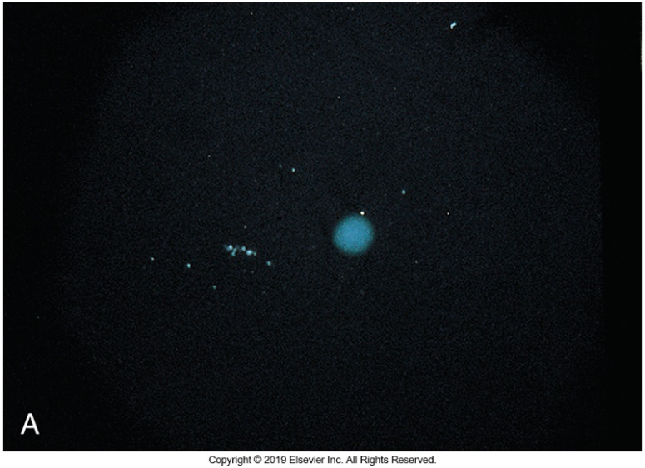
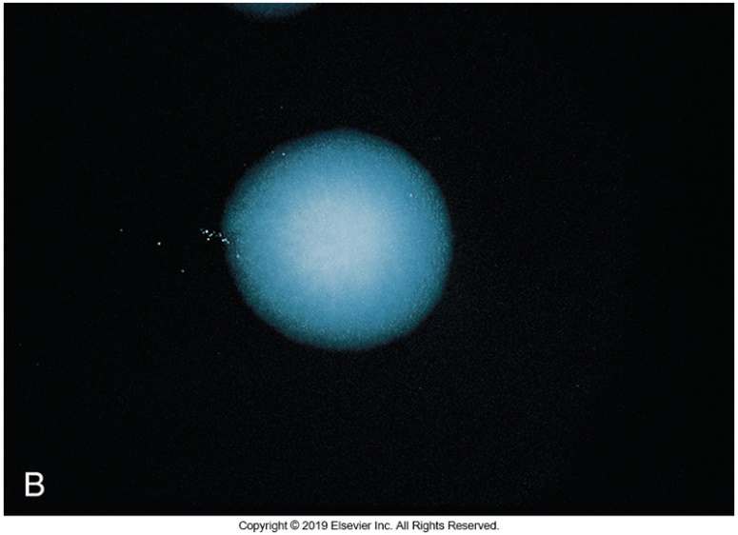
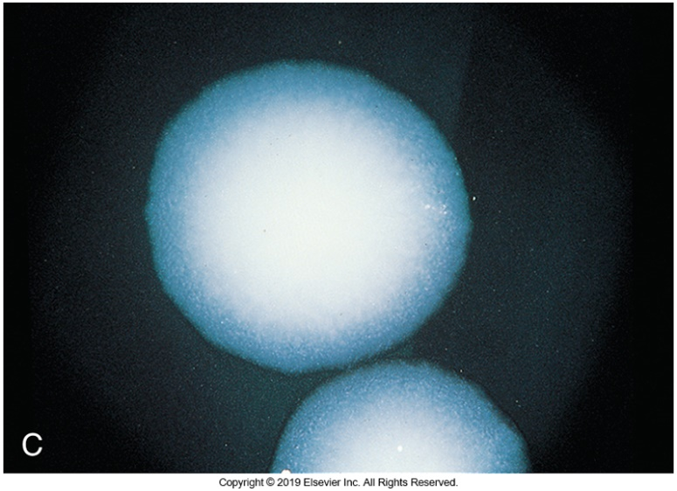
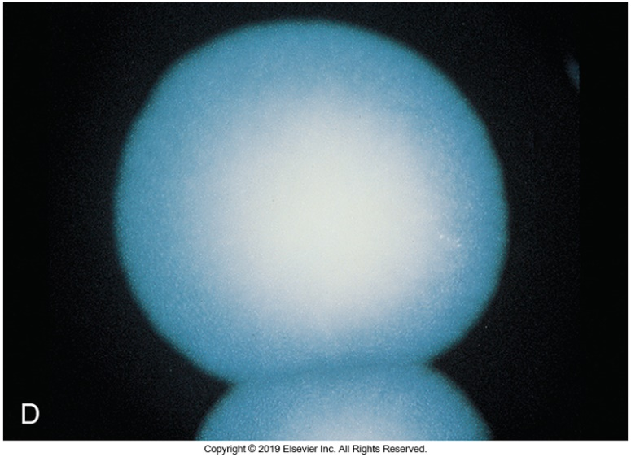
BCYE Agar with L. pneumophila

Slide 23
Conventional ID Methods
Presumptive ID
Demonstration of L-cysteine requirement
Immunofluorescent antibody test
MALDI-TOF mass spectrometry
Biochemical testing
Of limited value
Identification of species is usually not necessary

Slide 24
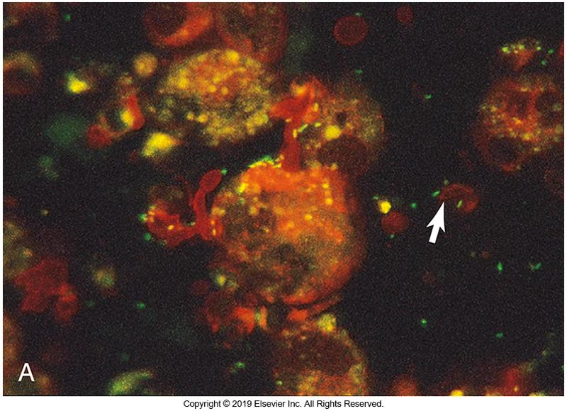
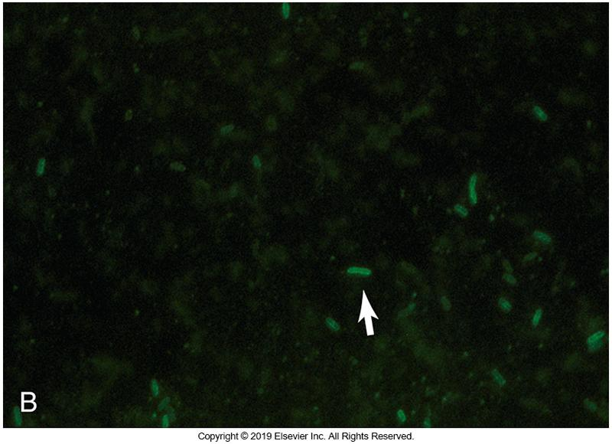
Example of DFA Test for Legionella
Notes:
24

Slide 25
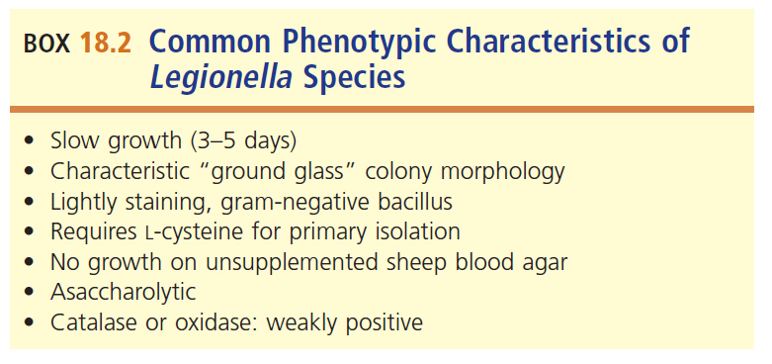
Common Physical and Biochemical Characteristics of Legionella

Slide 26
Legionella Rapid Methods and Serologic Testing
Rapid Methods
Urine antigen test
Immunochromatographic assays for Legionella antigen detection
Enzyme immunoassays are used by many clinical laboratories
Serologic Testing
Indirect fluorescent antibody (IFA) assay is the most common

Slide 27
Legionella Antimicrobial Susceptibility
Susceptibility not standardized or routinely performed
When diagnosed early, successful treatment with these antimicrobials can usually be done
Macrolide
Ketolide
Doxycycline

Slide 28
BORDETELLA B. pertussis/parapertussis

Slide 29
Bordetella Species
Major pathogens—the focus of this discussion
B. pertussis and B. parapertussis
Both of these are agents of whooping cough
B. parapertussis is usually milder
Other Bordetella Species
B. bronchiseptica
B. avium
B. hinzii
B. holmesii
B. ansorpii
B. trematum

Slide 30
Bordetella Species General Characteristics
Small gram-negative bacilli or coccobacilli
Obligate aerobic bacteria that grow best at 35 to 37° C
Do not ferment carbohydrates
Oxidize amino acids
Produce catalase
Require special collection, transport systems, and media to grow

Slide 31
Bordetella Species Virulence Factors
Filamentous hemagglutinin (FHA) and pertactin
Facilitates attachment to epithelial cells
Pertussis toxin (PT)
Interferes with signal transduction
Adenylate cyclase toxin
Increases cyclic adenosine monophosphate (cAMP) levels
Tracheal cytotoxin
Ciliostasis, inhibiting DNA synthesis, promoting cell death

Slide 32
Bordetella Species Clinical Infections
Whooping cough
Exposure and incubation period of 1 to 3 weeks
Initially cold or flulike symptoms, sneezing, runny nose
Catarrhal phase 1 to 2 weeks (highly contagious)
Paroxysmal phase
Sudden severe repetitious coughing followed by “whoop”
Rapid gasp for air
Can be followed by vomiting

Slide 33
Bordetella Species Clinical Infections (Cont.)
Can cause serious infection in young children
Cyanosis from lack of oxygen
Sometimes need assistance in keeping airway open
Convalescent phase
Begin recovery about 4 weeks after initial symptoms
Decrease in bouts of coughing but may take weeks or months for complete resolution
Adults: may or may not experience respiratory symptoms & if they do, symptoms can vary
Persistent cough to chronic bronchitis

Slide 34
Bordetella Species Epidemiology
No known animal or vector reservoir has been found.
Infections acquired through respiratory tract via respiratory aerosols or direct contact with infectious secretions.
One of the most highly communicable diseases of childhood.
Vaccination series for children now available.

Slide 35
Bordetella Miscellaneous Species
Opportunistic human pathogens
B. bronchoseptica is the cause of kennel cough in animals
B. bronchospeptica in humans
Nonspecific cough
Bronchitis
Symptoms common in patients with underlying conditions

Slide 36
Bordetella Laboratory Diagnosis
Contemporary diagnosis of B. pertussis and B. parapertussis employs culture isolation with or without PCR testing
DFA assays have low sensitivity and are not recommended
Other stains have no role in identification
Organisms do not survive well outside host
Culture can lack sensitivity

Slide 37
Bordetella Specimen Collection and Transport of Swabs
Nasopharyngeal aspirates or Dacron swabs with nonwire shaft.
Specimen of choice for PCR
When using swabs, two are best placing one up each nasal passage as deep as possible
Swabs for culture should be directly plated to culture media or transferred to transport system at the bedside
Casamino acid or Ames with charcoal can preserve sample viability for up to 48 hours

Slide 38
Bordetella Specimen Collection and Handling of PCR Swabs and Specimens for Culture
Swabs for PCR
Transport at room temperature
Specimens for culture
Transport at room temperature
Transfer to culture media as soon as they arrive in the laboratory.

Slide 39
Bordetella Nucleic Acid Detection
Nucleic acid amplification methods
Can circumvent many of the problems associated with specimen transport and bacterial cultivation
May produce false-positive results due to lack of standardization and single target testing
Laboratories should use at least 2 DNA targets

Slide 40
Bordetella Isolation Methods
Culture
Bordet-Gengou potato infusion agar with glycerol and horse or sheep blood
Example of alternative media is Regan-Lowe
Incubate plates
35°C in ambient air for minimum of 7 days
Detected in ~3 to 5 days | hold negative plates at least 7 days
Ensure adequate moisture to prevent plate drying
A stereomicroscope should be used to detect the colonies before they are seen with unaided eye

Slide 41
Bordetella Colony Morphology
Colonies are smooth silver pinpoint colonies resembling mercury droplets
Colonies turn gray as they age
On Bordet-Gengou agar, colonies are β-hemolytic

Slide 42
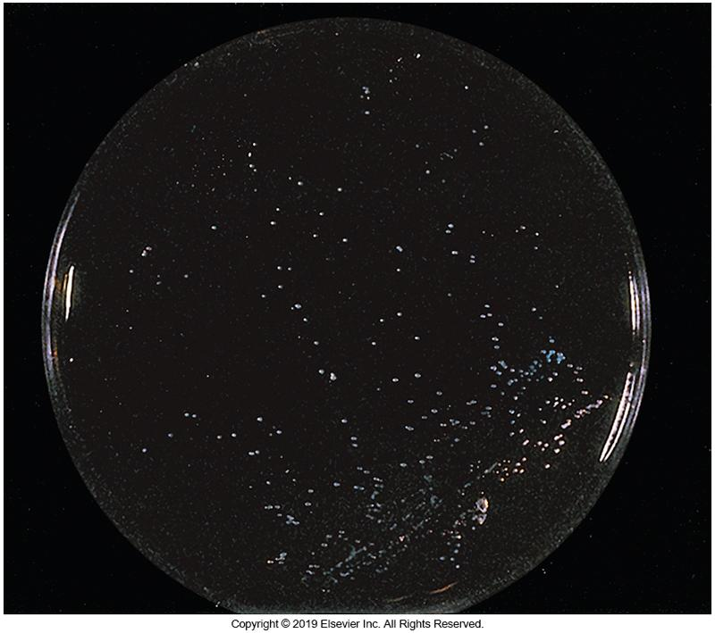
Colonies of B. pertussis

Slide 43
Bordetella Species Identification Methods
Tiny gram-negative coccobacilli
May become elongated if recovered from media containing cephalexin
May need to increase safranin counterstaining time to 2 minutes to see typical morphology
Biochemical testing is difficult
MALDI-TOF mass spectrometry and 16S rRNA gene sequencing provide accurate identification
Depends on the databases used

Slide 44
Summary of Laboratory Diagnosis of Pertussis by Culture

Slide 45
Differential Characteristics of Bordetella Species

Slide 46
Bordetella Species Serologic Testing
Used to study outbreaks and document seroconversion after immunization or infection
Antibody levels do not correlate well to immunity.
Not approved for diagnostic use
Can identify more cases in older vaccinated children, adolescents, and adults
Assays cannot distinguish an immune response between vaccination or infection

Slide 47
Bordetella Species Serologic Testing
Detecting antipertussis toxin antibody by enzyme immunoassay or bead-based assays is recommended for diagnosing exposure
Demonstrating a fourfold rise in titer in paired sera is optimal for diagnosis
A single IgG antibody titer greater than 100 IU/mL is indicative of recent infection, where as a titer of less than 40 IU/mL is not
Assays in need of better standardization
Detecting IgM is not recommended

Slide 48
Antimicrobial Susceptibility
Erythromycin
Most common recommended for treatment and prophylaxis
Must be started during catarrhal phase of disease
Possible alternatives
Azithromycin
Trimethoprim-sulfamethoxazole
Routine antimicrobial testing on B. pertussis or B. parapertussis is not necessary because of predictable sensitivity to macrolides

Slide 49
Points to Remember
The points to remember are too numerous to state here
The complete list of points to remember can be found on page 414 of the textbook.

