Slide 1
HAEMOPHILUS spp.
CHAPTER 18

Slide 2
What’s Ahead?
Descriptions of miscellaneous, fastidious, pleomorphic, small, gram-negative bacilli:
Haemophilus

Slide 3
General Characteristics
The organisms discussed in this chapter:
Require special nutrients for isolation and identification
Primarily reside in human oral cavity, nasopharynx, and respiratory tract

Slide 4
Microscopic Morphology and Biochemical Reactions
Haemophilus gram-stain appearance
Gram-negative pleomorphic coccobacilli or rods
Coccobacilli in direct smears
Rods with occasionally long filamentous rods from colony growth
Haemophilus biochemical reactions
Nonmotile, oxidase positive, catalase positive, nitrate reduction, ferments carbohydrates

Slide 5
Location and Species Notes
Haemophilus location in the body
Obligate parasites on the mucous membranes
Haemophilus species
Approximately 13 species known to exist
8 species associated with humans
H. influenzae, H. parainfluenzae, H. haemolyticus, H. parahaemolyticus, H. paraphrohaemolticus, H. pittmaniae, H. aegyptius, H. ducreyi
Note: H. segnis, H. aphrophilus, and H. paraphrophilus moved to the genus Aggregatibacter

Slide 6
ID of Pathogenic Species
Most Haemophilus species are nonpathogenic or produce opportunistic infections.
The major pathogenic species
H. influenza, H. aegyptius, H. ducreyi

Slide 7
Haemophilus Definition and Growth Requirements
Haemophilus definition—Greek word meaning “blood lover”
Organisms prefer growth factors present in blood
Require X and V factors
X factor is hemin, hematin (X for “unknown”)
V (for Vitamin) factor is nicotinamide adenine dinucleotide (NAD)
Species with the prefix Para require only V factor
H. parainfluenzae
Produces X factor, requires V factor

Slide 8
Differential Characteristics
Production of hemolysis of 5% horse or rabbit blood agar
Certain species are also hemolytic on SBA, the organisms do not grow in pure culture on this medium
Both X and V factors are found within RBCs
Only X factor is directly available
V factor dependent Haemophilus spp. do not grow on SBA because RBCs are still intact, and the sheep RBCs contain NADase enzymes that hydrolyze V factor

Slide 9
Differential Characteristics
In preparing CHOC agar, heat lyses RBCs releasing both X and V factors and inactivates NADases
Supplemental nutritional factors are added

Slide 10
Growth Patterns-Satellitism
Growth of fastidious organisms around other bacteria that release the necessary growth factors or break down toxic products
S. aureus, S. pneumoniae, and Neisseria species that cause hemolysis release the factors or naturally produce V factor.
Except for the clinically significant H. ducreyi

Slide 11
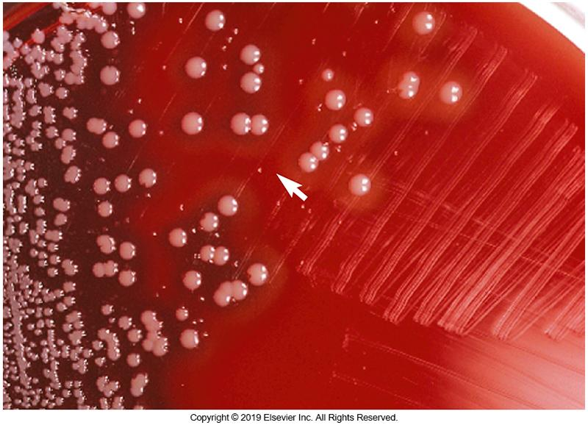
Example of Satellitism

Slide 12
Presence in the Upper Respiratory Tract
Haemophilus species constitutes approximately 10% of normal microbiota of the upper respiratory tract in adults.
Most are H. parainfluenzae and to a lesser extent H. influenzae
This combination of organisms is carried by greater than 90% of healthy individuals.
Colonization by Haemophilus spp. begins in infancy

Slide 13
H. influenzae Historical Perspective
H. influenzae was erroneously named during the influenza worldwide pandemic of 1889-1890
Infections characterized by acute inflammation of the upper airways with progression to other symptoms (i.e., headache, bronchitis, severe generalized muscle pain (myalgia)

Slide 14
H. influenzae Historical Perspective
Reason for erroneous name
H. influenzae was frequently isolated from nasopharynx specimens taken from infected people
After viral culture techniques were developed
It became clear that influenza was caused by a virus
H. influenzae was a secondary (opportunistic) invader

Slide 15
H. influenzae Virulence Factors
Capsule
Immunoglobulin A (IgA) proteases
Adherence by fimbriae and other structures
Outer membrane proteins and lipopolysaccharide (LPS)

Slide 16
H. Influenzae Capsule Classification and Serotypes
Classification based on capsule serotype
Possible antigenic distinct types—a, b, c, d, e, and f
Type is based on differences in the capsular polysaccharide
Serotype b (Hib)
Consists of unique polymer composed of ribose, ribitol, and phosphate
Evidence suggests antiphagocytic and anticomplement activity

Slide 17
Nontypable H. influenzae (NTHi)
Some strains are not encapsulated (no capsule)
Referred to as nontypable strains
Invade the respiratory tract and tissues located around the same area
Cause localized infections

Slide 18
H. influenzae Virulence Factors
Immunoglobulin A (IgA) protease
IgA can bind to bacteria and block their attachment
Cleaves secretory IgA
Adherence mechanisms
Not well defined
Studies suggest that most NTHi strains are adherent to human epithelial cells whereas most Hibs are not
May explain the tendency for Hibs to cause systemic infections while NTHi strains cause localized infections
Outer membrane components
Not well defined
Antibody directed against antigen may play significant role in immunity.

Slide 19
Clinical Manifestations of H. influenzae Infections
Two patterns of disease
Invasive disease caused by encapsulated strains
Bacteremia plays significant role
Examples—septicemia, meningitis, arthritis, epiglottitis, tracheitis, pneumonia
A more localized infection by contiguous spread of NTHi
Examples—conjunctivitis, sinusitis, otitis media with effusion (middle ear infection)

Slide 20
Clinical Manifestations of H. influenzae Meningitis
History and Characteristics
Before development of a Hib vaccine, most cases occurred in children ages 3 months to 6 years
Bloodstream invasion and bacteremic spread follow colonization, invasion, and organism replication in the respiratory mucous membranes
Headache, stiff neck, and other meningeal signs are usually preceded by mild respiratory disease

Slide 21
Clinical Manifestations of H. influenzae Epiglottitis
Characteristics
Rapid onset
Acute inflammation
Intense edema that may cause airway obstruction that may require an emergency tracheostomy
To avoid further possible damage the area is not swabbed for culture, but is treated empirically based on signs and symptoms
Peak incidence occurs in children between 2-4 years of age
Maintenance of a secure airway-most important aspect of treatment

Slide 22
Clinical Manifestations of H. influenzae Bacterial Tracheitis
Characteristics
Life-threatening disease in young children
Arises after an acute, viral respiratory infection
Mild to moderate illness for 2 to 7 days that progresses rapidly
Use of broad-spectrum antibiotics imperative because
Thick secretions can occlude trachea
Disease must be differentiated from epiglottitis

Slide 23
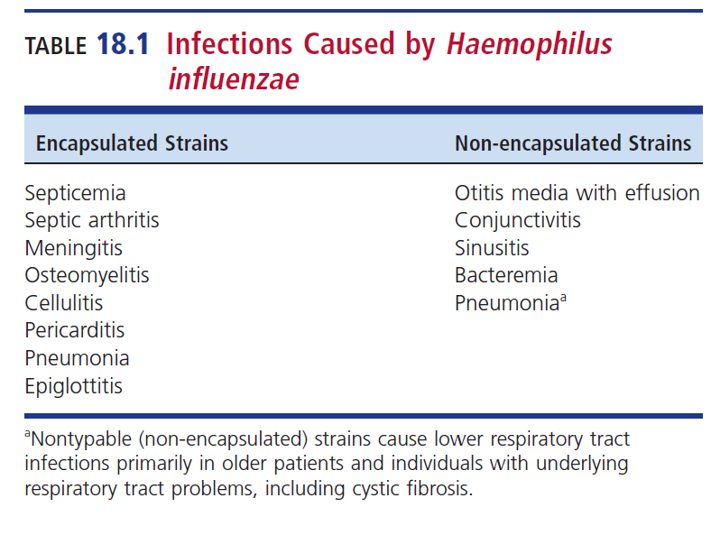
Infections Caused by H. influenzae

Slide 24
Infections Associated with H. influenzae biogroup aegyptius
H. aegyptius (Koch-Weeks bacillus) can cause conjunctivitis
Pinkeye
Acute, contagious, purulent conjunctivitis
Particularly in children
H. influenzae biogroup aegyptius
Conjuctivitis, primarily in pediatric populations
Brazilian purpuric fever (BPF)
Occurs in warm tropical climates
Recurrent or concurrent conjunctivitis, high fever, petechiae/ purpural rash, septicemia, shock, and vascular collapse
High mortality, as high as 70% within 48 hours after onset

Slide 25
Infections Associated with H. ducreyi
Sexually transmitted infection called genital ulcer disease (GUD)
Not part of normal microbiota, causes chancroid
Incubates 4 to 14 days
Painful lesion with an irregular edge
Genital and perianal areas
Penis
Labia or vagina
Enlarged and draining lymph nodes
Buboes

Slide 26
Infections Associated with H. ducreyi
Because chancroid facilitates the transmission of other STDs, all patients with GUD should also be tested for
HIV
Syphilis
Herpesvirus
Less than 15 cases are reported in the US annually
Cases are probably underreported

Slide 27
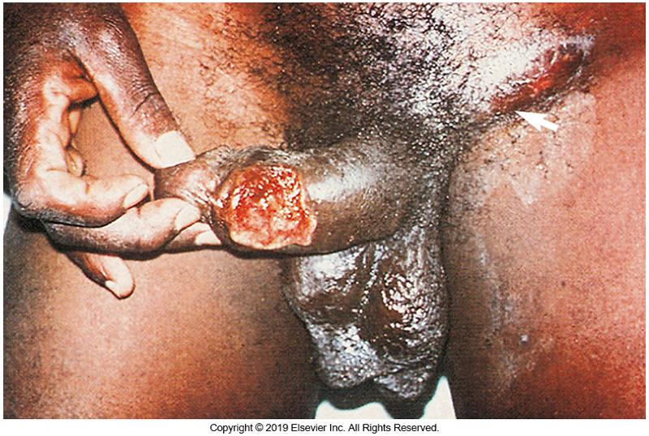
Chancroid Lesions

Slide 28
Infections Associated with H. parainfluenzae
Low incidence of pathogenicity
Otitis media, acute sinusitis
Endocarditis (rare)
Insidious onset
First symptoms appear about 1 month after routine dental procedures.
Primary site of infection—mitral valve
In absence of other pathogens, organism may be a cause of some cases of pharyngitis.

Slide 29
Specimen Processing and Isolation
Organisms known to die rapidly
Prompt transportation and processing are vital for maximum recovery
H. ducreyi- extremely fastidious
Clean specimen site with sterile saline and sterile gauze
Swab base of ulcer with cotton swab moistened with sterile phosphate-buffered saline, and plate immediately
Can also aspirate pus from buboes

Slide 30
Media Selection
H. influenzae
CHOC agar with bacitracin (300mg/L)
Helps inhibit other organisms, especially respiratory biota
H. aegyptius
CHOC agar supplemented with 1% IsoVitaleX or Vitox
H. ducreyi
GC agar (hemoglobin, fetal bovine serum [FBS], vancomycin to reduce genital flora), enriched chocolate, or Mueller-Hinton agar with 5% chocolatized lysed horse blood

Slide 31
Media Selection (Cont.)
H. Ducreyi
Nairobi biplate
GC agar base + 2% bovine hemoglobin + 5% fetal calf serum on one half
Mueller Hinton agar with 5% chocolatized horse blood on the other
Both sides contain 3mg/L vancomycin

Slide 32
Growth Requirements
For growth of H. ducreyi
Incubate in a 5% to 10% CO₂
Grows best at 33° C
Place culture media into atmosphere with high humidity to prevent drying
Incubate for at least 7 days before reporting a negative result
Incubate H. aegyptius for at least 4 days
Optimal growth for most Haemophilus spp.
35° to 37°C

Slide 33
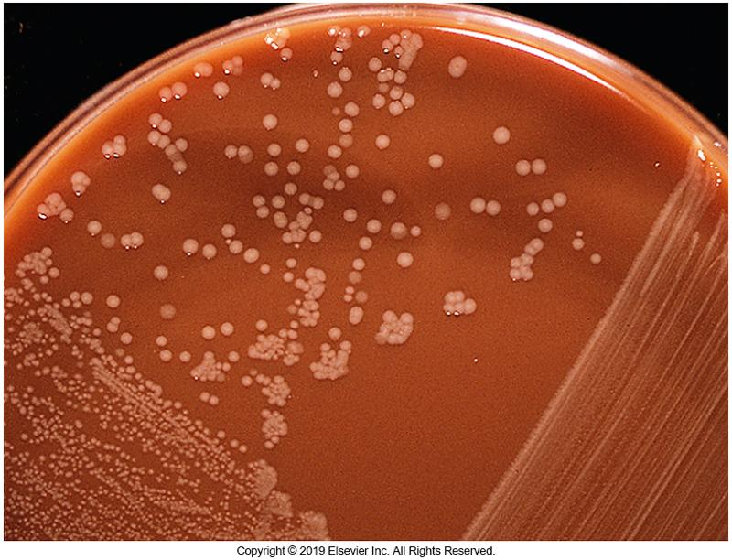
Colony Morphology of H. influenzae
Translucent, tannish, moist, smooth, convex
Mousy or bleach-like odor
Encapsulated strains appear more mucoid.
No growth on MAC agar

Slide 34
Colony Morphology of H. parainfluenzae and H. ducreyi
H. parainfluenzae as compared to H. influenzae
Tannish
Drier
Medium to large size
b-hemolytic on BAP
H. ducreyi
Small
Flat
Smooth
Nonmucoid
Transparent to opaque or tan to yellow on CHOC agar

Slide 35
Microscopic Morphology
H. influenzae
Gram stain: small gram-negative coccobacilli or small rods to long filaments; clear nonstaining areas (halos) may be seen.
H. ducreyi
Gram stain : coccobacilli arranged in groups resembling “school of fish,” “railroad tracks,” or “fingerprints”

Slide 36
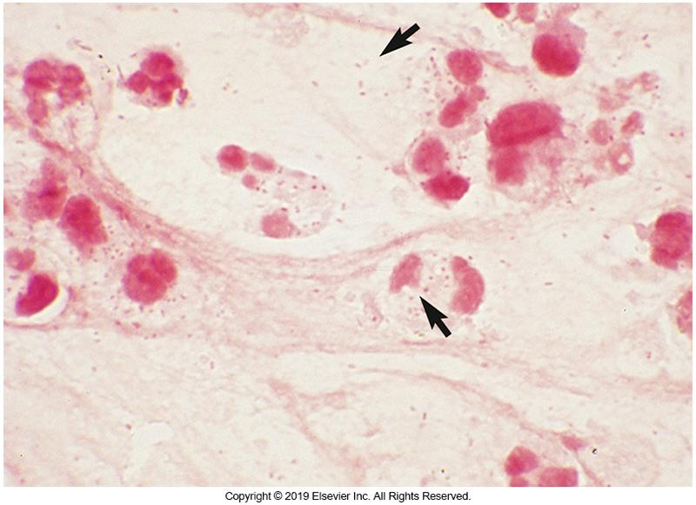
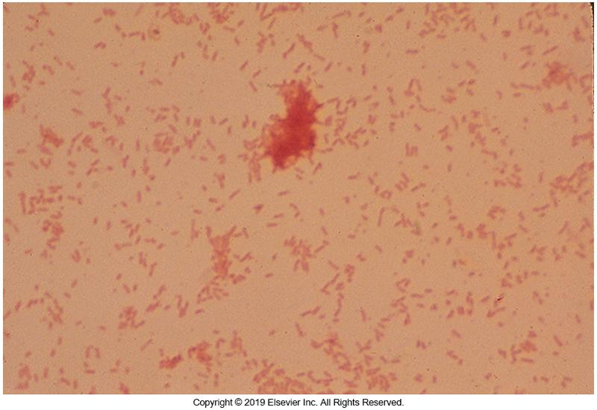
Gram Stain Morphology of H. influenzae
Direct smear
Smear of colony growth

Slide 37
Laboratory Identification
First clues that Haemophilus may be present
Gram-negative pleomorphic coccobacilli on CHOC agar
No growth on SBA or on MacConkey (MAC) agar
Other tests
Testing for growth factors (X and V)
Oxidase
Catalase
Traditional biochemicals
Hemolysis on media containing rabbit or horse RBCs
Commercial systems / MALDI-TOF mass spectrometry

Slide 38
X and V Factor Requirements
Traditional approach
Uses impregnated strips or disks
Care must be taken not to transfer X factor-containing medium to agar plates for testing
Avoids carry-over and inaccurate or inclusive results
Haemophilus ID Quad Plate
Contains four zones:
Media with X factor only
Media with V factor only
Media with X and V factors
Media with X and V factor with horse RBCs

Slide 39
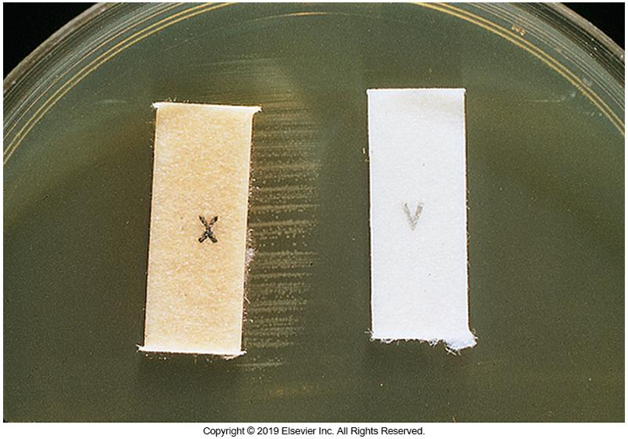
Organism Requiring X and V Factors H. influenzae

Slide 40
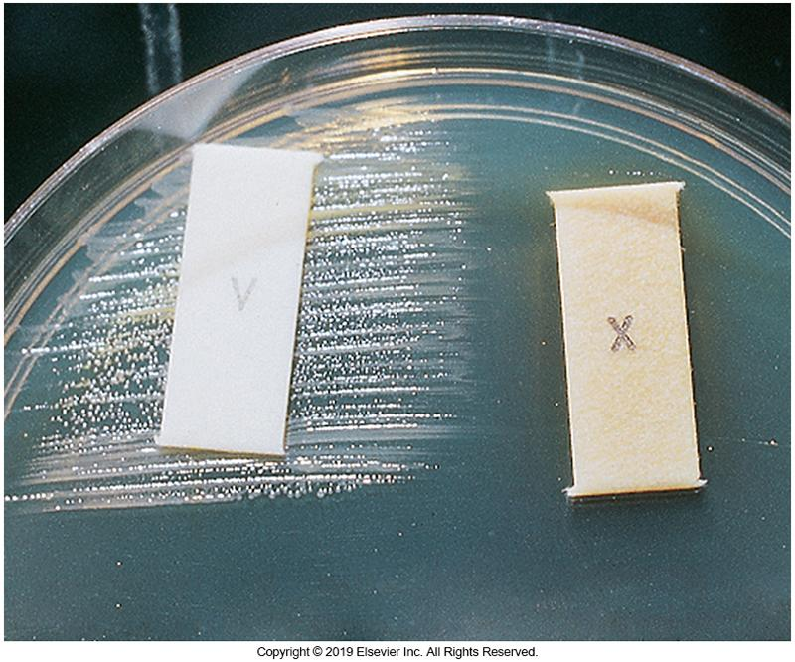
Organism Requiring V Factor Only H. parainfluenzae

Slide 41
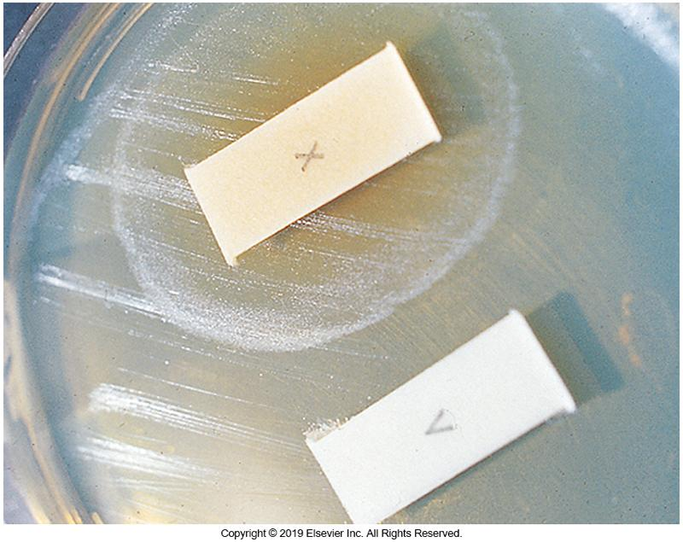
Organism Requiring X Factor Only Aggregatibacter spp. [oxidase negative]

Slide 42
Porphyrin Test
Alternative method for differentiating the heme-producing Haemophilus species
Can be done in agar, in broth, or on a disk
δ-aminolevulinic acid (ALA) gets converted to porphyrins or porphobilinogen
Intermediates in the synthesis of X factor
Kovacs reagent added after incubation
If red color forms in lower aqueous phase if positive for porphobilinogen is present
Can also use a Wood ultraviolet (UV) lamp
Fluoresce reddish-orange under UV light

Slide 43
Porphyrin Test
If Haemophilus species does not require X factor
Porphyrin positive (make X factor)
δ-aminolevulinic acid (ALA) gets converted to porphyrins or porphobilinogen
With Kovacs reagent, red color produced in lower part of the tube is positive if porphobilinogen is present.
Wood ultraviolet (UV) lamp
Fluoresce reddish-orange under UV light

Slide 44
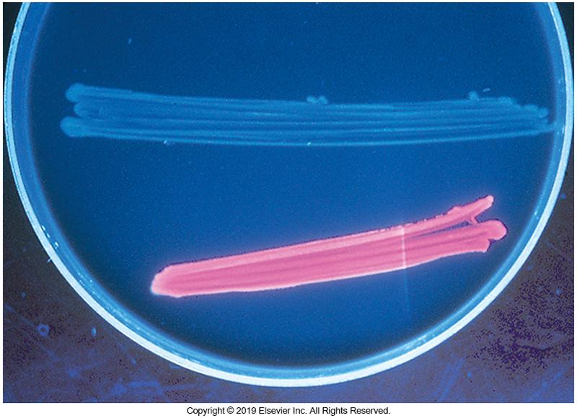
Example of Porphyrin Test on Agar Under UV Light
Note: Organism on top is porphyrin negative, that on the bottom is porphyrin positive.

Slide 45
CLSI Guidelines for ID of Commonly Isolated Bacteria
Clinical and Laboratory Standards Institute (CLSI) guidelines
Respiratory tract or cerebrospinal fluid (CSF) specimens
Gram-negative bacilli or coccobacilli that exhibit colonies greater than 1 mm on CHOC agar
No growth or satellitism on SBA
Negative porphyrin
Can identify as H. influenzae

Slide 46
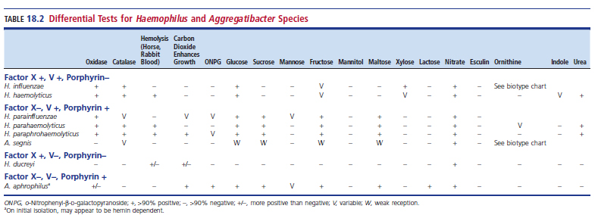
Differential Tests for Haemophilus Species

Slide 47
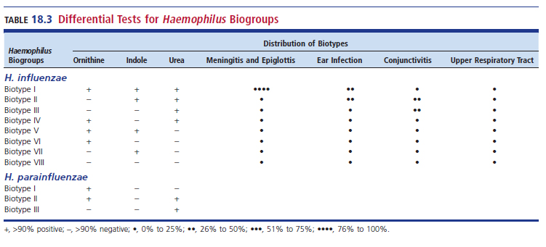
Differential Tests for Haemophilus Biogroups

Slide 48
Treatment
Invasive H. influenzae often requires hospitalization
Recommended for life-threatening illness
Cefotaxime or ceftriaxone
Alternative choices
Trimethoprim sulfamethoxazole, imipenem, ciprofloxacin, and chloramphenicol with ampicillin
H. ducreyi
Azithromycin, ceftriaxone, ciprofloxacin, or erythromycin

Slide 49
β-Lactamase Production Chromogenic Cephalosporin Test
Rapid test designed in response to increased ampicillin resistance of Haemophilus spp.
Disk impregnated with nitrocefin is moistened
Smear several colonies onto disk
If β-lactam ring is broken, a red color develops on the disk
Reaction usually occurs within 5 minutes

Slide 50
β-Lactamase Production Acidometric Test
Rapid test designed in response to increased ampicillin resistance of Haemophilus spp.
Test strip contains benzylpenicillin and bromocresol purple.
Strip is moistened with 1 or 2 drops of sterile distilled water.
Smear several colonies onto the strip.
If β-lactam ring is broken, penicilloic acid develops, causing a decrease in pH which is demonstrated by a color change from purple (negative) to yellow (positive) within 5 to 10 minutes.

Slide 51
Treatment (Cont.)
Antimicrobial testing should be limited only to isolates known to be clinically significant
In most cases, β-lactamase activity to assess ampicillin and amoxicillin efficiency is necessary
Special media and protocols must be followed due to fastidious nature

Slide 52
Points to Remember
The points to remember are too numerous to state here.
The complete list of points to remember can be found on page 414 of the textbook.

