Slide 1
HACEK Group
Chapter 18

Slide 2
What’s Ahead?
Descriptions of miscellaneous, fastidious, pleomorphic, small, gram-negative bacilli:
HACEK Group

Slide 3
General Characteristics
The organisms discussed in this chapter:
Require special nutrients for isolation and identification
Primarily reside in human oral cavity, nasopharynx, and respiratory tract

Slide 4
HACEK Members
H—Haemophilus spp.
Now Aggregatibacter aphrophilus
A—Aggregatibacter actinomycetemcomitans
Formerly Actinobacillus actinomycetemcomitans
and A. aphrophilus, formerly H. aphrophilus
C—Cardiobacterium hominis
E—Eikenella corrodens
K—Kingella spp.

Slide 5
HACEK General Characteristics
Gram-negative bacilli
Fastidious nutritional requirements
Require an increased CO₂ (5%–10%) environment
Significant cause of endocarditis
Can be normal biota of the oral cavity
Opportunists and generally require a compromised host

Slide 6
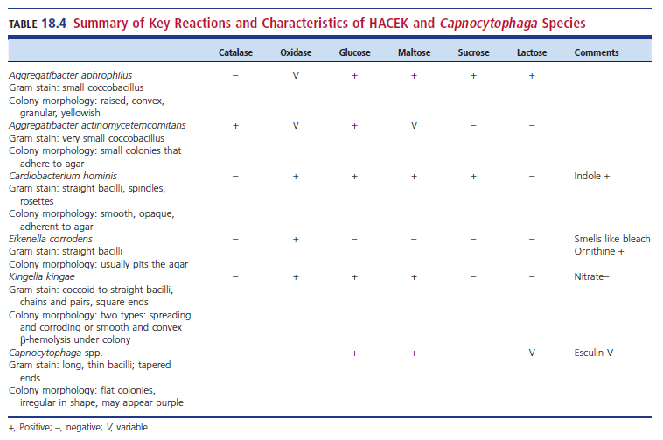
Differential Tests for HACEK and Capnocytophaga species

Slide 7
A. aphrophilus Characteristics
From the Greek words aphros and philia for foam-loving or desiring high concentration of CO₂
Key causative agent of endocardititis
Found in dental plaque and gingival scrapings
Colony morphology on CHOC agar
Yellow, granular, convex colonies with opaque zone near centers

Slide 8
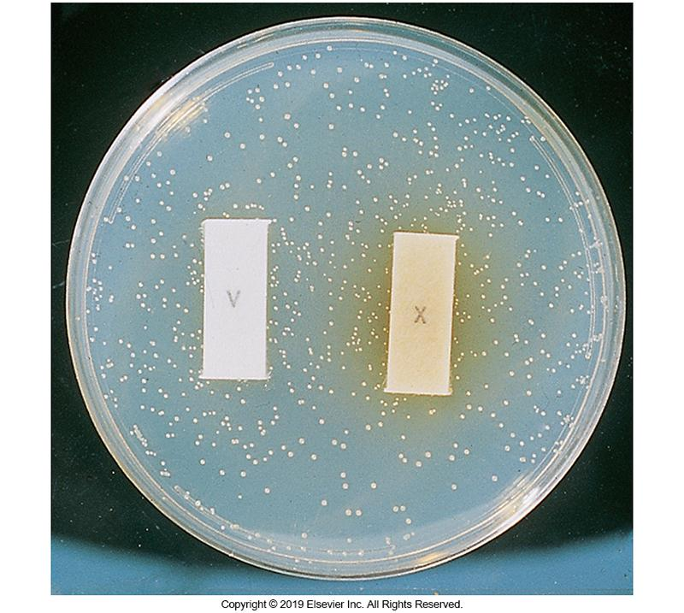
A. aphrophilus X and V Test on Agar

Slide 9
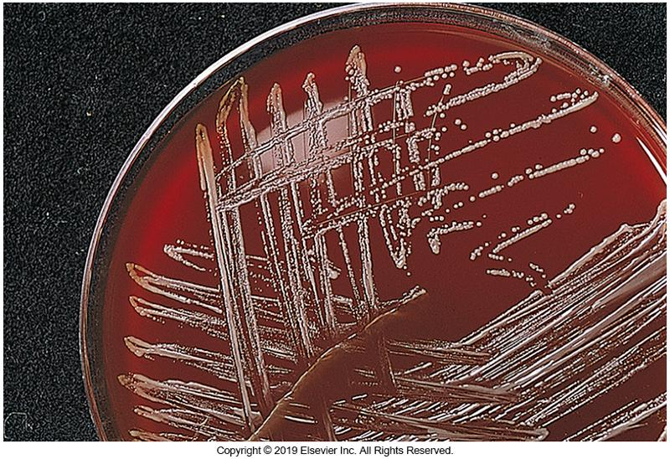
A. aphrophilus Colony Morphology

Slide 10
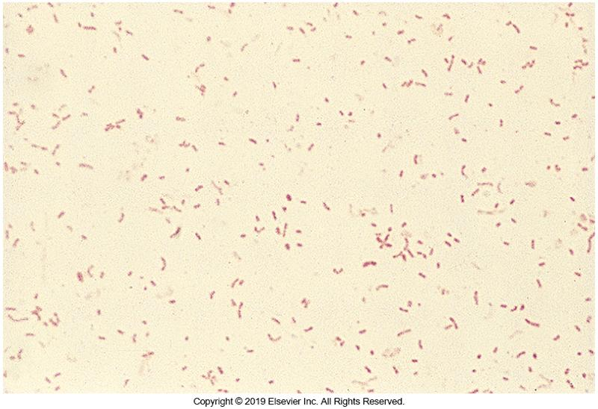
A. aphrophilus Gram Stain Morphology

Slide 11
A. actinomycetemcomitans Characteristics
Primarily an animal pathogen but has been found in human oral cavity
Human tissue infections are attributed to
cattle, sheep, pig, and horse bites or through contact with infected animals.
Six serotypes a–f
a, b, c are most common
Major contributor to periodontitis

Slide 12
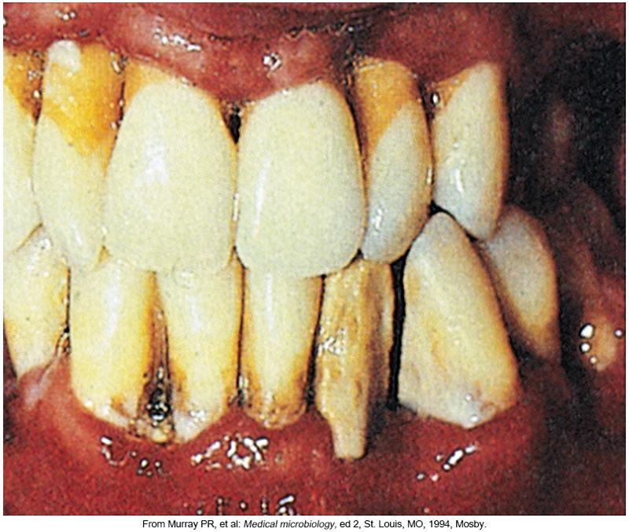
Advanced Periodontitis

Slide 13
A. actinomycetemcomitans Growth Requirements and Morphology
24 to 48 hours to grow
Grows better with increased CO₂
Distinctive star formation in the center of the colonies
Best viewed under ×100 magnification under a light microscope when grown on clear medium or via stereomicroscope at the highest magnification available

Slide 14
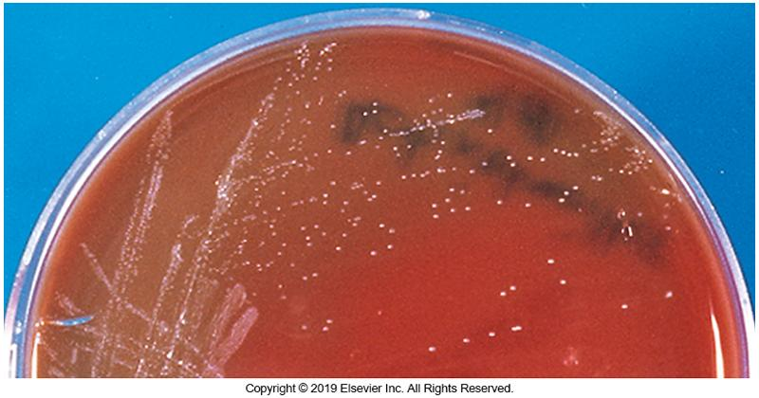
Colony of A. actinomycetemcomitans

Slide 15
A. actinomycetemcomitans Key Reactions and Treatment
Key reactions
Ferments carbohydrates often in the presence of serum
Not lactose or sucrose
Catalase positive, oxidase variable
No growth on MAC plates
Negative for X and V growth factors
Negative for urease, indole, esculin, and citrate
Treatment
Aminoglycosides, third-generation cephalosporins, quinolones, chloramphenicol, tetracycline

Slide 16
C. hominis Description
Pleomorphic, nonmotile, fastidious, gram-negative bacillus
Sometimes appear false positive on Gram-stained smears
Show rosettes, swellings, or long filaments
Normal biota of the nose, mouth, and throat
Can be present in gastrointestinal (GI) tract

Slide 17
C. hominis Significance and Growth Characteristics
Involved in endocarditis
Infects the aortic valve
Grow on SBA, CHOC agar
Not MAC plates
Growth requires 5% CO₂
Pitting may be produced on agar plates

Slide 18
C. hominis Biochemical Reactions and Usual Therapy
Biochemical reactions
Oxidase positive
Catalase negative
Indole positive
Negative for
Urease, nitrate, gelatin, and esculin
Fermenter, reactions may be weak, serum might be needed
Usual therapy
Penicillin and an aminoglycoside

Slide 19
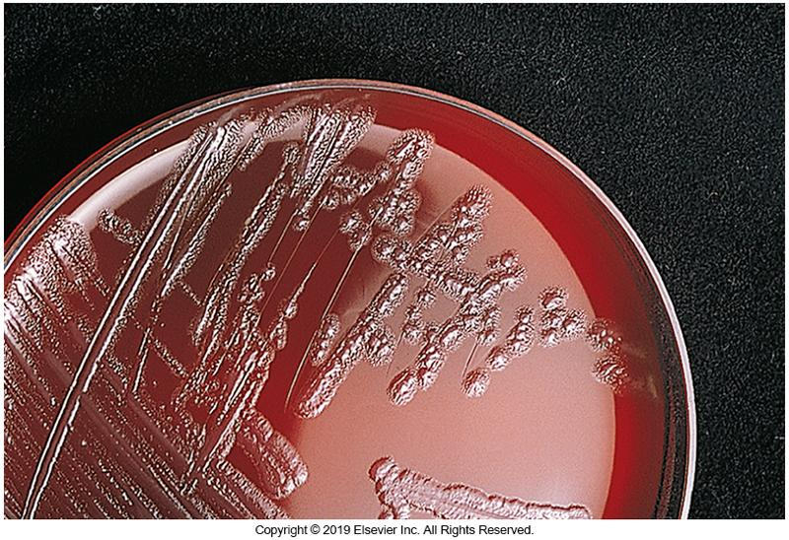
C. hominis Colony Morphology

Slide 20
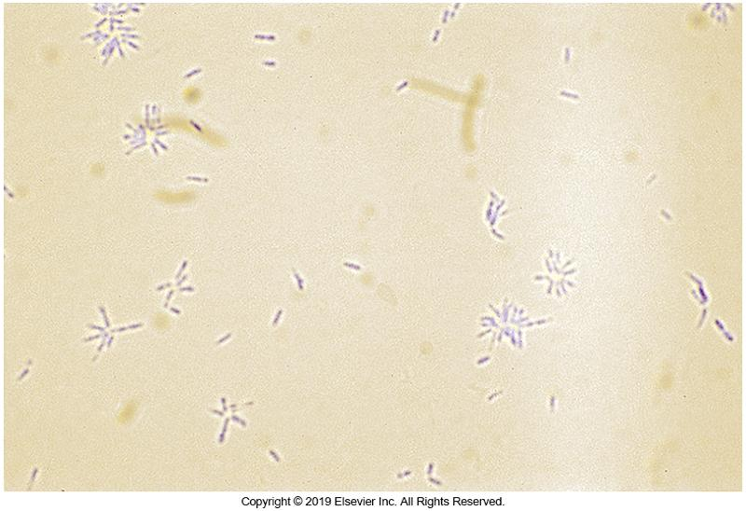
C. hominis Gram Stain Morphology

Slide 21
E. corrodens Location and Corresponding Infections
Normal biota of oral and bowel cavities
Fight and bite wound
Opportunistic, especially in the immunocompromised
Infections
Adult periodontitis
Meningitis
Pneumonia
Osteomyelitis
Arthritis
Postoperative tissue infections usually from bacteremia associated with wounds
Cellulitis
Inoculation with needles “licked clean”

Slide 22
E. corrodens Growth and Gram Stain Characteristics
Grows best under conditions of increased CO₂ with hemin
Fastidious, gram-negative coccobacilli
Bleach-like odor with yellow colonies pitting the agar (hence the name corrodens) (about 45% of isolates)
Often yellow pigment present
Nonhemolytic on SBA with a slight greening effect secondary to growth may occur around the colonies

Slide 23
E. corrodens Identification Characteristics
Nonmotile
Nonfermenter
Oxidase positive
Catalase negative

Slide 24
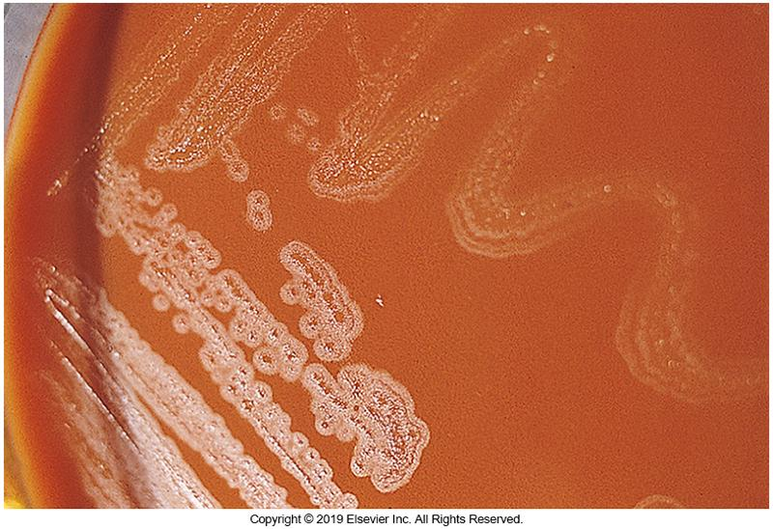
E. corrodens Colony Morphology

Slide 25
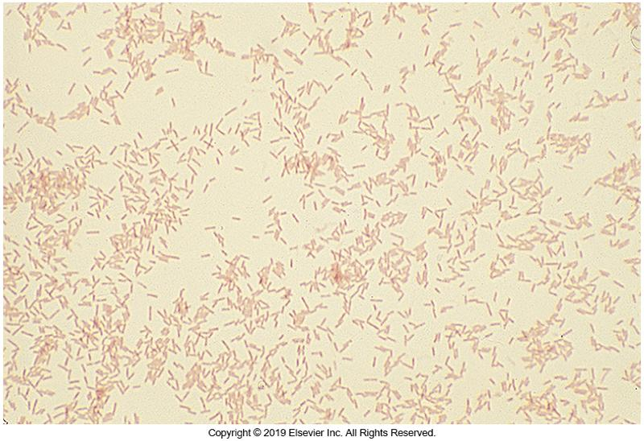
E. corrodens Gram Stain Morphology

Slide 26
Kingella Species Members
Six species in genus
K. kingae
K. denitrificans
K. oralis
K. potus
K. bonacorsii
K. negevensis

Slide 27
Kingella General Characteristics
Kingella spp., especially K. kingae
Important in pediatric population
Causes osteoarthritis infection in children less than 4 years old
Predilection for bones and joints

Slide 28
Kingella Clinical Importance by Species
K. kingae
Member of normal oropharynx microbiota
Associated with HACEK endocarditis
Particularly in immunocompromised patients
Isolates have been found in
blood, bone, joint fluid, urine, and wounds.
K. denitrificans
Associated with endocarditis

Slide 29
Kingella General Characteristics (Cont.)
Gram stain appearance
Coccobacilli or short bacilli with square ends in pairs or chains.
Resist decolorization in the Gram stain
Growth characteristics
Can grow on Neisseria selective media, no pitting
Biochemical reactions
Nonmotile, oxidase positive, catalase negative; ferments carbohydrates without gas production
Usually susceptible to most agents

Slide 30
Kingella kingae CLSI ID Requirements
Strains that meet the following CLSI abbreviated test requirements may be identified as K. kingae.
Gram-negative short coccoid bacilli forming large white to beige β-hemolytic colonies on SBA
No growth on MAC
Catalase negative
Oxidase positive

Slide 31
Kingella kingae Colony Types and Biochemical Reactions
Colony types
Spreading, corroding colony
Smooth, convex, and β-hemolytic colony
Hemolysis may appear beneath colony or in close proximity after 24 hours.
Hemolysis more prevalent after 48 hour
Biochemical reactions
Glucose and maltose—weak fermentation
Sucrose—negative

Slide 32
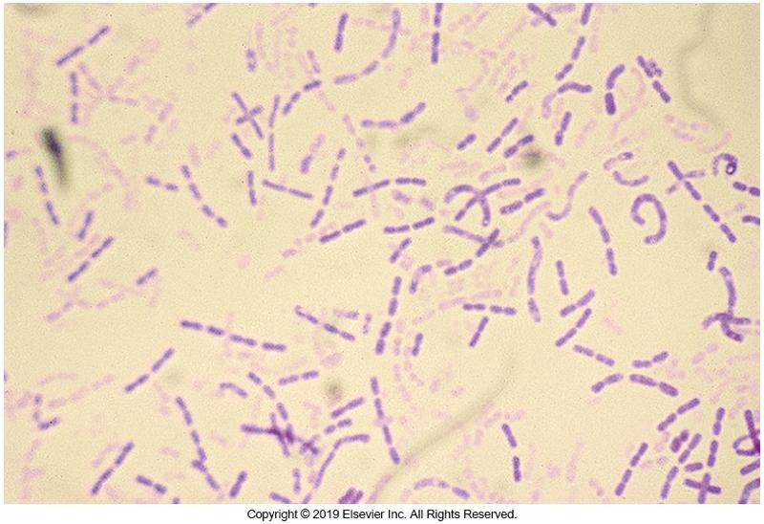
Kingella kingae Gram Stain Morphology

Slide 33
Kingella denitrificans
Two colony types
Smooth, convex type
Spreading corroding type
Growth characteristics
Might grow at 42° C
No growth on MAC
Biochemical reactions
Glucose fermentation—positive
Nitrate reduction—positive

Slide 34
Points to Remember
The points to remember are too numerous to state here
The complete list of points to remember can be found on page 414 of the textbook.

