Slide 1
Chapter 22
Anaerobes of Clinical Importance

Slide 2
Chapter Components
Anaerobes of clinical importance and their role in disease
  Serious and fatal intoxications and infections
  Endogenous bacteria
Proper techniques for recovery and identification of anaerobes
Procedures for identifying and testing their susceptibility
Treatment

Slide 3
IMPORTANT CONCEPTS IN ANAEROBIC BACTERIOLOGY
CHAPTER TWENTY-TWO

Slide 4
Anaerobes Defined
Anaerobes
  Able to replicate in the absence of oxygen
  Differ in response to oxygen
Obligate (strict) anaerobes
  Killed in the presence of oxygen
    Almost immediately

Slide 5
Anaerobes Defined
Capnophilic
  Increased carbon dioxide (CO₂) (5%–10%), reduced oxygen (O₂) to 15%
  Conditions still sufficient to allow aerobic organisms to replicate
Microaerophilic
  Oxygen reduced to 5% or less

Slide 6
Anaerobes Defined (Cont.)
Facultative
  Preferentially use oxygen as an electron acceptor if it is available but can grow in the absence of oxygen, just slower
Aerotolerant (a.k.a., moderate anaerobes)
  Organisms can survive in a short exposure to oxygen but are not able to perform metabolic processes unless placed into an anaerobic environment

Slide 7
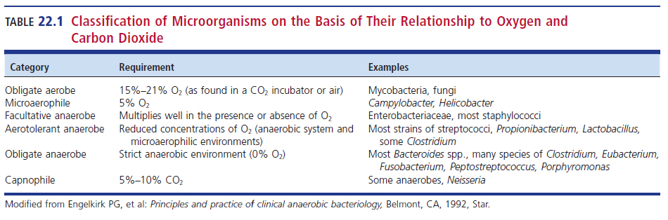
Classification of Bacteria on the Basis of Their Relationship to O₂ and CO₂

Slide 8
Why Some Organisms Are
Anaerobes
Molecular oxygen has a direct toxic effect to some anaerobes.
  Lack enzymes to break down toxic products
    O₂⁻: superoxide anion
    H₂O₂: hydrogen peroxide
    OH⁻: hydroxyl radical
O₂ + e⁻ → O₂⁻ (superoxide anion)
O₂ + e⁻ + 2H⁺ → H₂O₂ (hydrogen peroxide)

Slide 9
Why Some Organisms Are
Anaerobes (Cont.)
Strict aerobic and facultative anaerobic bacteria can protect themselves.
  Possess enzymes to break down toxic products
    Superoxide dismutase
    Catalase
  4O₂⁻ + 4H⁺ → 2H₂O₂ + O₂ via superoxide dismutase
  2H₂O₂ → 2H₂O + O₂ via catalase

Slide 10
Why Some Organisms Are
Anaerobes (Cont.)
Anaerobes are particularly susceptible to these toxic derivatives of oxygen because they lack the protective enzymes superoxide and/or catalase, or if present they are in low concentrations.
Anatomic sites colonized with mixtures of organisms, such as those found on mucosal surfaces, frequently provide favorable conditions for the growth of obligate anaerobes.

Slide 11
Where Anaerobes Are Found
Exogenous
  Organisms exist outside of the bodies of animals.
  Infections develop when the agent is ingested or has gained entrance through trauma.
  Exogenous infections are usually caused by Clostridium (gram-positive and spore-forming)
Endogenous
  Organisms exist inside the bodies of animals and become sources of infection.
  Example: Bacteroides, Porphyromonas, Prevotella, Clostridium, Propionibacterium, and anaerobic cocci

Slide 12
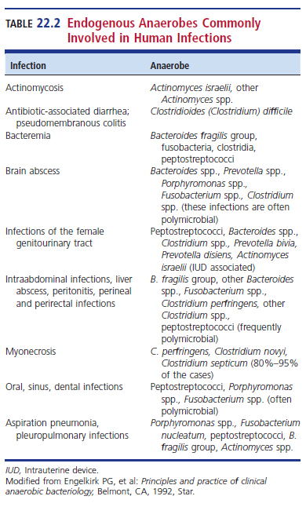
Endogenous Anaerobes Commonly Involved in Human Infections

Slide 13
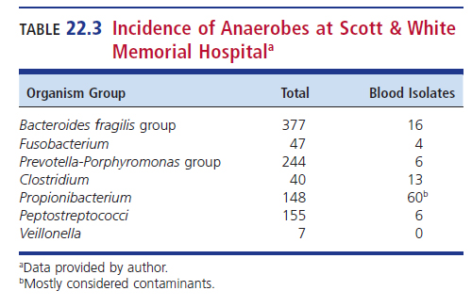
Incidence of Anaerobes at a University Medical Center

Slide 14
Anaerobes at Specific
Anatomic Sites
Skin
  Cutibacterium acnes, Peptostreptococcus
Respiratory tract
  Prevotella, Porphyromonas, Fusobacterium, and anaerobic cocci
Gastrointestinal (GI) tract
  Bacteroides, Bifidobacterium, Clostridium, Eubacterium, anaerobic cocci
Genitourinary (GU) tract
  Fusobacterium, Prevotella, Bacteroides, Lactobacillus

Slide 15
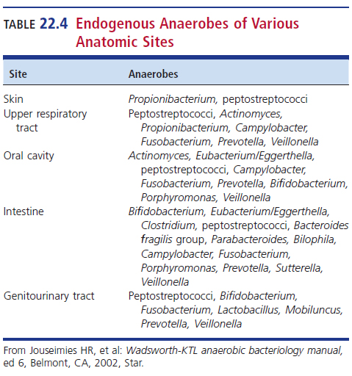
Endogenous Anaerobes of Various Anatomic Sites

Slide 16
Factors That Predispose Patients to Anaerobic Infections
Anaerobes produce a variety of virulence factors
Trauma to protective barriers
  Skin and mucous membranes
Vascular stasis
  Prevention of oxygen flow to site
  Environment is now conducive to growth and multiplication of any anaerobe that might be present at that site
Similar results can occur in instance of tissue necrosis

Slide 17
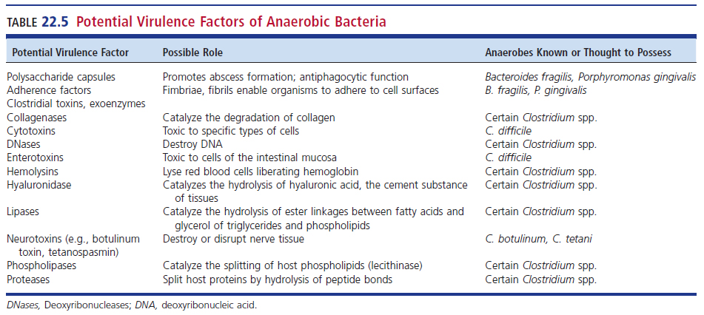
Potential Virulence Factors of Anaerobic Bacteria

Slide 18
Conditions that Predispose Individuals ….

Slide 19
Indications of Anaerobic Involvement in Human Disease
Polymorphonuclear leukocytes are usually present but absence of them does not rule out this possibility.
  Some anaerobes like Clostridium perfringens, produce enzymatic virulence factors that destroy neutrophils, macrophages, and other cells.

Slide 20
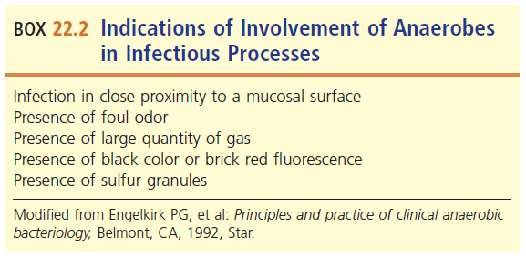
Examples of Predisposing Conditions

Slide 21
FREQUENTLY ENCOUNTERED ANAEROBES AND THEIR ASSOCIATED DISEASES
CHAPTER TWENTY-TWO

Slide 22
Anaerobic BacteriaTaxonomy
Gram-negative
Gram-positive
  Spore formers
  Nonspore formers
  Gram stain reaction, presence or absence of spores, and cellular morphology of culture isolates can be helpful in determining presumptive identification and the appropriate identification tests to be performed.

Slide 23
Gram-Positive, Spore-Forming Anaerobic Bacilli

Slide 24
Introduction
All anaerobes in this category belong to the Clostridia
All species are capable of producing spores
  Some do so readily
  Some require extremely harsh conditions
Spores are often not observed in Gram-stained smears of clinical specimens containing clostridia or in smears of colonies from an agar plate unless the culture has been incubated for many days.

Slide 25
Introduction (Cont.)
Sporulation may be induced via heat or alcohol shock
Clostridia can be grouped according to location of the endospore within the cell
  Terminal- located at the end of a bacterial cell
    Typically cause swelling of the cell
  Subterminal- located in location other then end of a bacterial cell
  Spores located in the center of a cell are called central spores

Slide 26
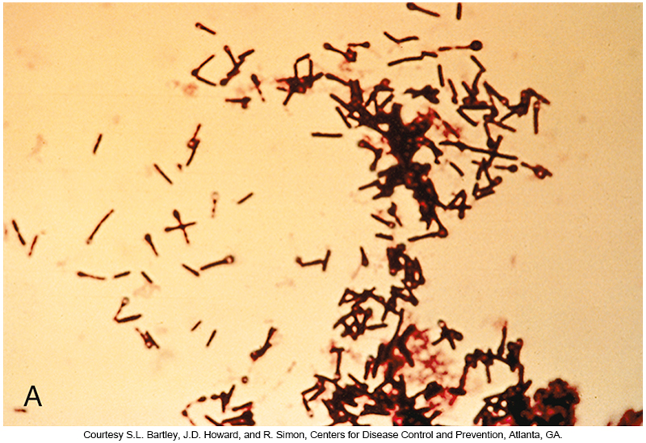
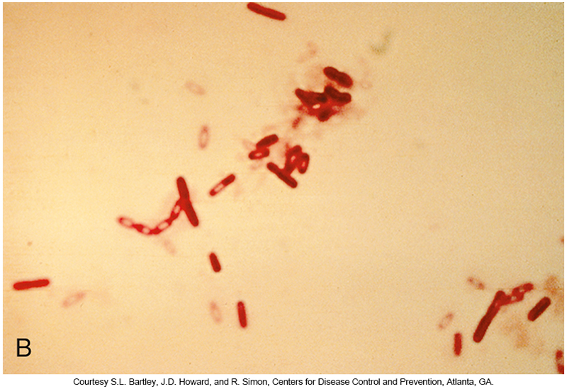
Classification of Clostridia by Endospore Location
A. Gram-stained terminal spores of C. tetani
B. Gram-stained subterminal spores of C. sordellii

Slide 27
Clinical Infections
Most frequently encountered in exogenous anaerobic infections or intoxications.
Mode of transmission
  Ingestion or open wounds that have become contaminated with soil
Almost any Clostridium spp. can cause wound or abscess infection, usually as part of mixed biota, and most can be isolated from the blood in cases of bacteremia.
One clostridial infection of endogenous origin
  Antibiotic-associated pseudomembranous colitis caused the C. difficile

Slide 28
Clostridium perfringens
Food Poisoning
Type A
  Ingestion of enterotoxin causing diarrhea and cramps
  Relative mild, usually self-limiting
Type C
  Enteritis necroticans
    Acute onset of severe abdominal pain and diarrhea, which is often bloody, and may be accompanied by vomiting
      Followed by necrotic inflammation of the small intestines, at times leading to bowel perforation
      Without treatment it can be fatal.

Slide 29
Botulism
Food-borne
  Ingestion of preformed botulinum toxin, produced in food by C. botulinum
There are seven antigenically distinct botulinum toxins (A to G)
  Only types A, B, and E are associated with human disease

Slide 30
Botulism
Botulinum toxin
  An extremely potent neurotoxin, only small amount needed to produce paralysis and death
Botulinum toxin A (botox®) is used to treat
  watery eye, chronic migraines, beauty enhancer

Slide 31
Botulism (Cont.)
Sources of infection
  Home canning
  Home-cured meats
Symptoms
  2 hours to 8 days later
Infant botulism
  Ingestion of spores in contaminated honey
  Colonize the colon and produce toxins

Slide 32
Botulism (Cont.)
Wound botulism
  Contamination of wounds with spores of C. botulinum
  Similar clinical manifestations to those of foodborne origin
Botulism toxin and C. botulinum
  Considered as potential bioterrorism agents
  Laboratories are required to report suspected cases to public health laboratories

Slide 33
Tetanus
Causative agent
  Clostridium tetani
Attributed to tetanospasmin neurotoxin production
  Inhibits neurons by inhibiting neurotransmitters
  Results in a spastic type of paralysis, with continuous muscular spasms leading to trismus (lockjaw), risus sardonicus (distorted grin), and difficulty breathing.

Slide 34
Tetanus (Cont.)
Mode of transmission
  Spores in the environment enter the skin through puncture wounds
Symptoms appear approximately 7 days after injury, incubation period can range from 3 to 21 days.
  Length of incubation is related to the distance from the injury to the central nervous system

Slide 35
Tetanus (Cont.)
Clinical manifestations
  Muscular rigidity, usually in the jaw, neck, and lumbar region.
  Difficulty swallowing results from muscular spasms in the pharyngeal area
  Rigidity of the abdomen, chest, back, and limbs
Tetanus is no longer a common disease in the United States as a result of the widespread use of the diphtheria-tetanus–acellular pertussis (DTaP) vaccine
Therapy requires injection of antitoxin, muscle relaxants, intensive therapy

Slide 36
Myonecrosis
Also known as gas gangrene
  Contaminated wounds from trauma or surgery
Caused by several species
  C. perfringens: most common cause
  C. histolyticum
  C. septicum
  C. novyi
  C. bifermentans

Slide 37
Myonecrosis (Cont.)
Grow, multiply, and release potent exotoxins
  Alpha toxin causes tissue necrosis and deeper invasion.
  Causes death of tissue that can require amputation
Symptoms
  Pain
  Swelling
  Bullae (fluid-filled blisters)
  Serous discharge, discoloration
  Tissue necrosis

Slide 38
Myonecrosis (Cont.)
The onset and spread of myonecrosis can be rapid, and extensive surgical debridement of the necrotic tissue is often required.
If treatment is delayed, amputation of the affected limb is not uncommon.

Slide 39
Bacteremia
C. perfringens
  Most common isolate from blood cultures
C. septicum
  Marker organism for malignancy of GI tract
C. tertium and C. bifermentans
  Both isolated from patients with underlying disease

Slide 40
Antibiotic-Associated Diarrhea
C. difficile
  Most common isolate in antibiotic-associated diarrhea
  Can cause pseudomembranous colitis
    Necrosis of colonic mucosa and bloody diarrhea
Develops when normal flora are destroyed by antimicrobials that do not affect clostridium
  Increased growth causing toxin production
    Toxin A: enterotoxin
    Toxin B: cytotoxin

Slide 41
Antibiotic-Associated Diarrhea (Cont.)
Commonly transmitted as a nosocomial infection
  Transferred among patients
  Hands of hospital personnel
  Frequency is increasing in outpatients who have received antimicrobial therapy

Slide 42
Gram-Positive, Non-spore-Forming Anaerobic Bacilli

Slide 43
Gram-Positive, Non-spore-Forming Anaerobic Bacilli
Members
  Actinomyces
  Bifidobacterium
  Eggerthella
  Mobiluncus
  Propionibacterium
  Lactobacillus

Slide 44
Actinomycosis
Chronic, granulomatous, infectious disease characterized by:
  The development of sinus tracts and fistulae which erupt to the surface and drain pus that may contain “sulfur granules”
    Dense wet clumps of bacteria that may be colored
Diagnostic procedures
  Gram-stained preparations of pus from draining sinuses that reveal non-spore-forming, thin, gram-positive bacilli that frequently exhibit branching

Slide 45
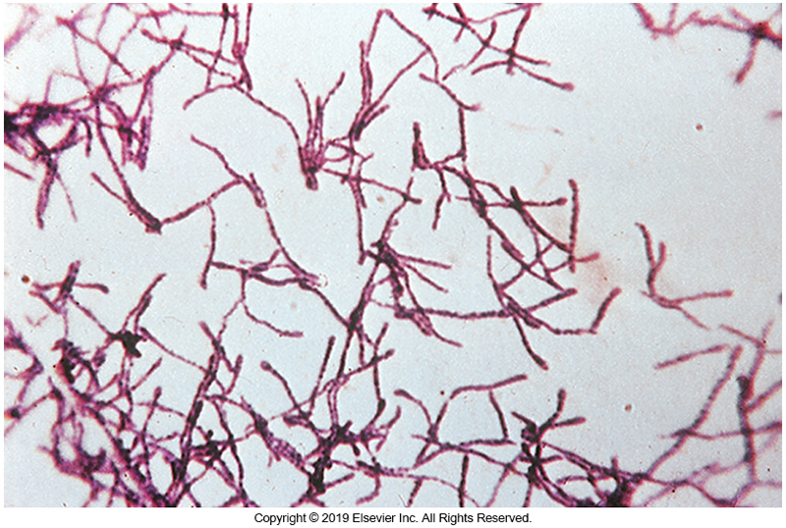
Gram Stain of
Actinomyces israelii

Slide 46
Actinomycosis (Cont.)
Many cases of actinomycosis occur in the maxillary region with draining in the neck and thorax
Cases can also be seen in the female genital tract
  long-standing use of intrauterine devices
Most common cause is Actinomyces israellii
  Other possible causative agents are Propionibacterium and Bifidobacterium

Slide 47
Bacterial Vaginosis (BV)
Thought to arise from a change/shift in the endogenous microbiota of the vagina
  Results in decrease in normal lactobacilli and overgrowth of other endogenous anaerobes of the vagina
    Mobiluncus spp.
    Bacteroides spp.
    Prevotella spp.
    Anaerobic cocci
    Gardnerella vaginalis (covered in Chapter 16)

Slide 48
BV (Cont.)
Clinical features
  Gray-white, homogenous, malodorous vaginal discharge, with little or no discomfort or inflammation
Associated with increased risk of
  acquiring HIV infection
  experiencing adverse outcome in pregnancy
Possibly associated with the pathogenesis of pelvic inflammatory disease

Slide 49
Lactobacillus
Gram-positive, highly pleomorphic bacilli
More than 100 identified species
Aerotolerant anaerobes
Widely distributed in nature, in foods, and as part of normal biota in human mouth, GI tract, female genital tract
Play an important role in the health of the female genital tract

Slide 50
Lactobacillus (Cont.)
Lactobacillus acidophilus complex constitutes most of the lactobacilli of the healthy vagina
Specimens of choice
  Urine, genital cultures
Systemic human infections are rare but when present typically originate from the oral cavity
Serious infections in immunocompromised patients
  Bacteremia and endocarditis

Slide 51
Anaerobic Gram-Negative Bacilli

Slide 52
Anaerobic Gram-Negative Bacilli
All non-spore-forming organisms are members of the endogenous microbiota
  Bacteroides fragilis
  Prevotella
  Porphyromonas
  Fusobacterium
All part of microbiota of the oral cavity and GI and GU tracts.

Slide 53
Clinical Infections
B. fragilis most common isolate in
  Blood
  Ulcers
  Intrabdominal abscesses
  Others
Brain abscesses
  Prevotella, Porphyromonas, Fusobacterium
    All endogenous microbiota of the oral cavity

Slide 54
Anaerobic Cocci

Slide 55
Group Members
Currently five genera; taxonomy of genera is in flux
  Peptostreptococcus
  Anaerococcus
  Finegoldia
  Gallicola
  Parvimonas
  Peptoniphilus
Only implicated pathogen
  Veillonella spp.

Slide 56
Clinical Infections
Anaerobic cocci are weakly pathogenic.
May be found in wide variety of infections
  Examples: brain abscess, aspiration pneumonia, lung abscess, gingivitis, other periodontal diseases
  Most often associated with polymicrobial infections
Finegoldia magna most pathogenic anaerobic cocci
  Associated with endocarditis, meningitis, pneumonia

Slide 57
Clinical Infections (Cont.)
Peptostreptococcus anaerobius linked to polymicrobial abscesses of the
  Brain, ear, jaw, pleural cavity, other sites
Evaluating the significance of anaerobic gram-positive cocci isolated in clinical specimens is often difficult.

Slide 58
SPECIMEN SELECTION, COLLECTION, TRANSPORT, AND PROCESSING
CHAPTER TWENTY-TWO

Slide 59
Specimen Quality
When physicians suspect an infection involving anaerobes, the specimen collected must be from the actual site of the infection and not just a swab of a mucosal surface.
  Its important that there is no prolonged exposure to oxygen and must be transported as quickly as possible to the laboratory under anaerobic conditions.

Slide 60
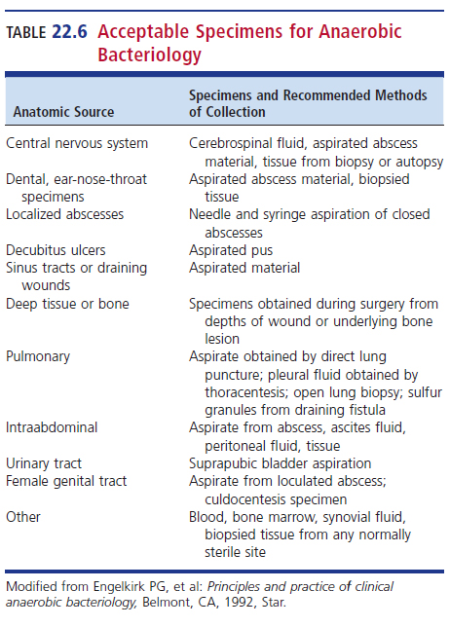
Acceptable Specimens for Anaerobic Bacteriology

Slide 61
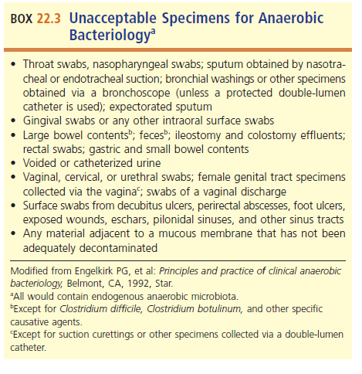
Unacceptable Specimens for Anaerobic Bacteriology

Slide 62
Specimen Transport and Processing
Regardless of the type of specimen submitted for anaerobic bacteriology, it must be transported and processed as rapidly as possible and with minimum exposure to oxygen.
Specimens are usually collected from a warm, moist environment that is low in oxygen.

Slide 63
Specimen Transport and Processing (Cont.)
It is important to avoid shocking the anaerobes by exposing them to oxygen or permitting them to dry out.
Specimens should not be refrigerated, and the amount of time they remain at room temperature should be minimized.

Slide 64
Aspirates
Needle and syringe
  Less contamination and can expel any air
Best to inject specimen into prereduced anaerobically sterilized (PRAS) media
  Once in laboratory, vortex to mix sample and plate to appropriate isolation media.
  Use a few drops on PRAS media and streak for isolated colonies
  Vital since most anaerobic infections are polymicrobial.
    Need isolated colonies to verify relevant organisms

Slide 65
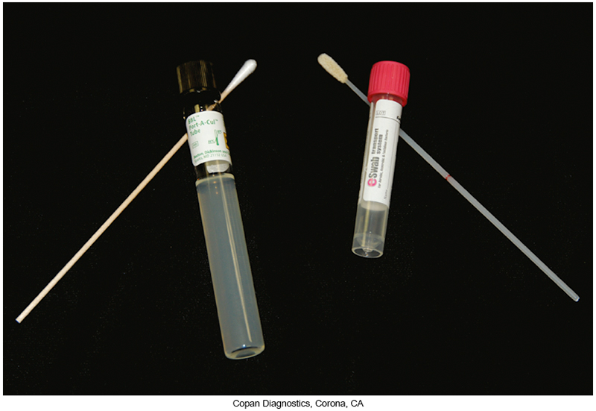
PRAS Transport Medium

Slide 66
Swabs
Not appropriate for anaerobic culture
  should only be used if aspiration is not possible and a biopsy specimen is not available
When swabs are deemed necessary, they should always be transported under anaerobic conditions.
  A number of swab transport systems suitable for anaerobes are commercially available.

Slide 67
Swabs (Cont.)
Once in the laboratory
  Swab should be placed into a tube containing about 0.5 mL of sterile thioglycolate broth.
  Swab should be vortexed vigorously to remove material from the swab and then pressed firmly on the inner wall of the tub
    Remove as much liquid as possible
  Media are inoculated to the media using liquid suspension
  Alternatively, a swab transport system can be used

Slide 68
Tissue
Small pieces of tissue can be placed in an anaerobic transport tubes of vials containing PRAS medium
Larger samples can be sent in a sterile container with sterile, wet gauze
  If a delay in transport is expected, tissue may be transported in pouches containing an oxygen-free atmosphere.

Slide 69
Tissue (Cont.)
To process a piece of tissue or bone fragment
  1 mL or sterile thioglycolate broth is added to a sterile tissue grinder
  The piece of tissue or bone fragment is homogenized until a thick suspension is obtained
  Ideally this process is performed in an anaerobic chamber
    If not available, grinding must be done as quickly as possible in a biological safety cabinet.
  The suspension is used to inoculate media.

Slide 70
Blood
Aseptic specimen collection and subsequent inoculation of both anaerobic and aerobic blood culture bottles
  Venipuncture site is prepared for specimen collection with a bactericidal agent in combination with 70% isopropyl alcohol.
Once inoculated, bottles should be rapidly transported to the laboratory where they are incubated at 35ºC to 37ºC.

Slide 71
Processing of Clinical Samples for Recovery of Anaerobic Pathogens
Anaerobic chambers provide oxygen-free environment to work with anaerobic cultures.
Required safety measures
  Gloves should be worn
  Biosafety hood should be used when manipulating samples

Slide 72
Procedures Performed on Clinical Specimens for Recovery of Anaerobic Bacteria
Macroscopic examination of the specimen
Preparation of Gram-stained smears for microscopic examination
Inoculation of appropriate plated and tubed media
Anaerobic incubation of inoculated media

Slide 73
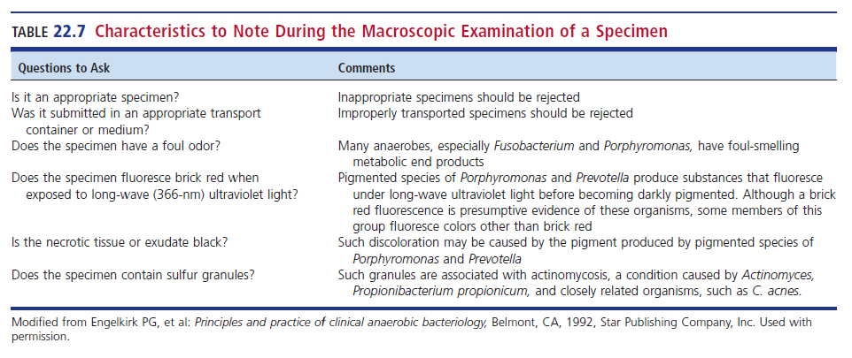
Characteristics to Note During the Macroscopic Examination of a Specimen

Slide 74
Direct Microscopic Examination of Specimens
Reasons for performing direct microscopic examinations
  Reveals the various morphotypes and relative number of microorganisms present in the sample
  Establishes a polymicrobial or monomicrobial infection
  Provides a presumptive identification of organisms possibly present
  Guides media selection

Slide 75
Direct Microscopic Examination of Specimens (Cont.)
Reasons for performing direct microscopic examinations
  Reveals the presence of leukocytes, indicating inflammatory response at infection site
    Certain anaerobes produce necrotizing toxins that destroy leukocytes
    Absence of leukocytes can never rule out the involvement of anaerobes
  Determines the quality of specimen collected
  Can serve as a valuable quality control tool

Slide 76
Direct Microscopic Examination of Specimens (Cont.)
When Gram stain technique is used
  use methanol as fixative instead of heat.
Gram-negative anaerobes frequently stain a pale pink when safranin is used as the counterstain and thus may be overlooked in Gram-stained smears of clinical specimens and blood cultures.
To enhance the red color of gram-negative anaerobes, the use of 0.1% basic fuchsin as the counterstain or extension of the counterstaining with safranin for 3 to 5 minutes is recommended.

Slide 77
Inoculation of Appropriate Plated and Tubed Media
Choice of anaerobic media is extremely important.
  Anaerobes are fastidious and have special nutritional requirements.
    Horse or sheep red blood cells
    Vitamin K
    Hemin
    Yeast Extract
  CDC blood agar provides the best recovery.

Slide 78
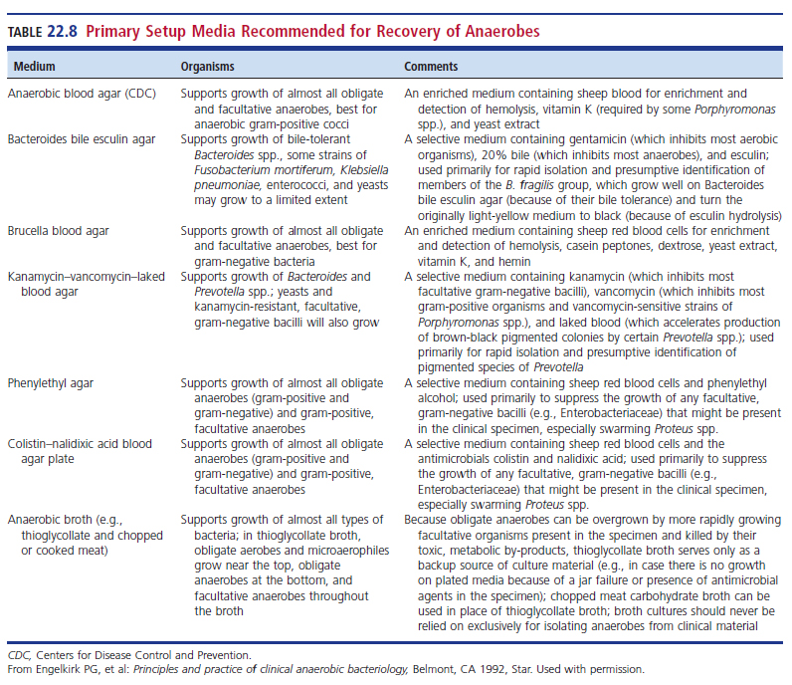
Primary Setup Media Recommended for Recovery of Anaerobes

Slide 79
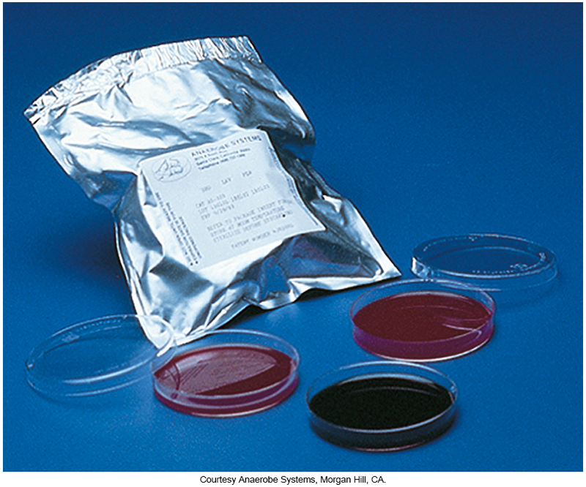
PRAS Plated Media

Slide 80
Media and Media Inoculation
Aerobic Isolation
Specimens submitted for anaerobes typically also have a request for aerobic culture.
CHOC, BAP, MAC and in some laboratories CNA (selective media for gram-positive bacteria)

Slide 81
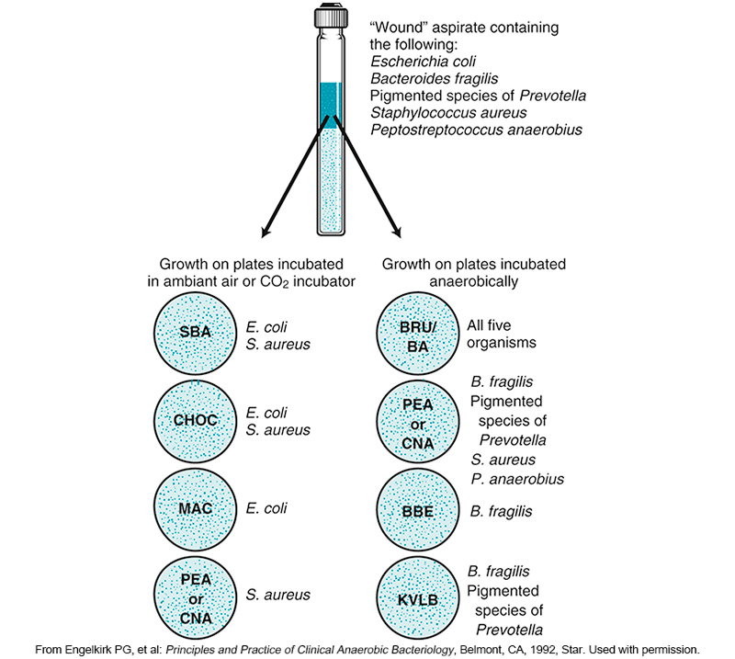
Culture Results from a Hypothetical Wound Specimen

Slide 82
Inoculation Procedures
Alternative—inoculate in an area with a suitable nitrogen gas holding system
  Jar
  Box
  Other small chamber
It is important not to keep inoculated plates out at room temperature more than 1 hour.
  Maintaining environment keeps cultures viable.

Slide 83
Anaerobic Chambers
Basic components of anaerobic chambers
  Gases
    Hydrogen gas (5%–10%)
    CO₂ gas (5%–10%)
    Nitrogen gas (80%–90%)
  Catalysts
    Palladium-coated alumina pellets
      Remove any residual oxygen

Slide 84
Anaerobic Chambers (Cont.)
  Desiccant
    Absorb excess water produced when catalyst removes oxygen to form water
  Indicator
    Colorless when no oxygen present
    Blue or pink when oxygen present, depending on dye

Slide 85
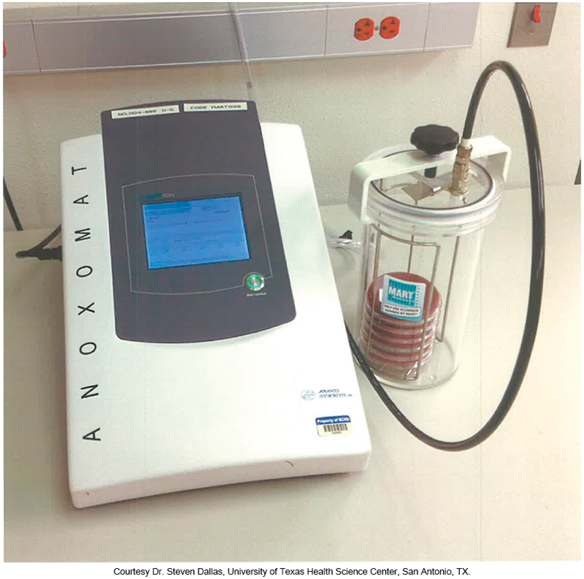
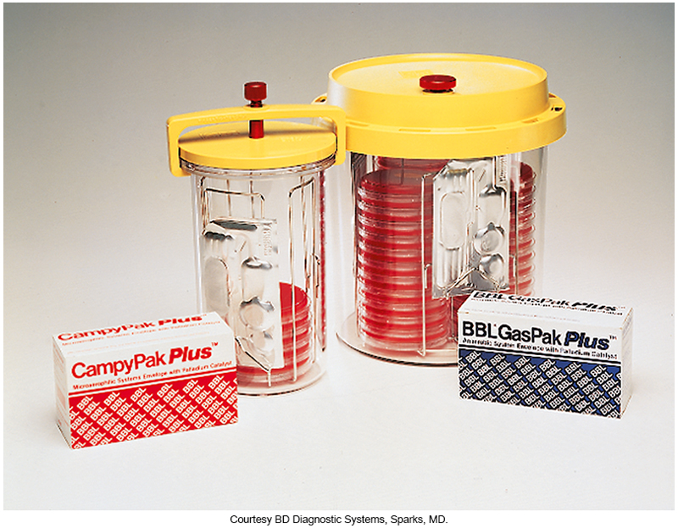
Anaerobic Jars (Left) and Anoxomat System (Right)

Slide 86
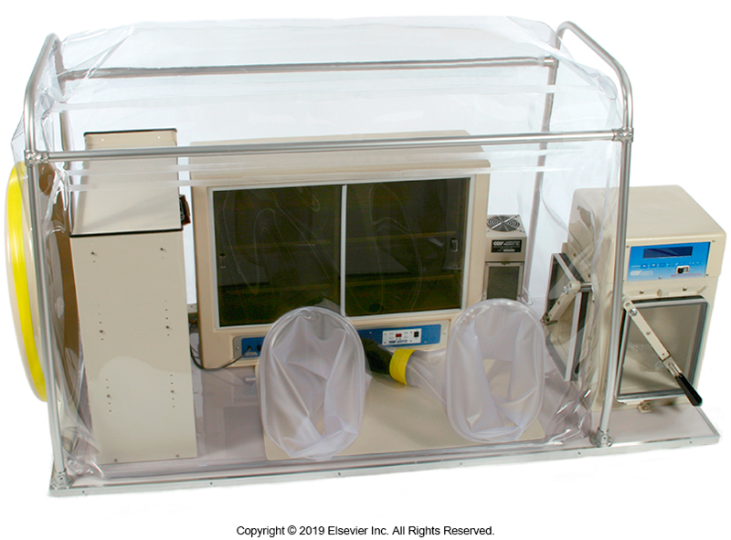
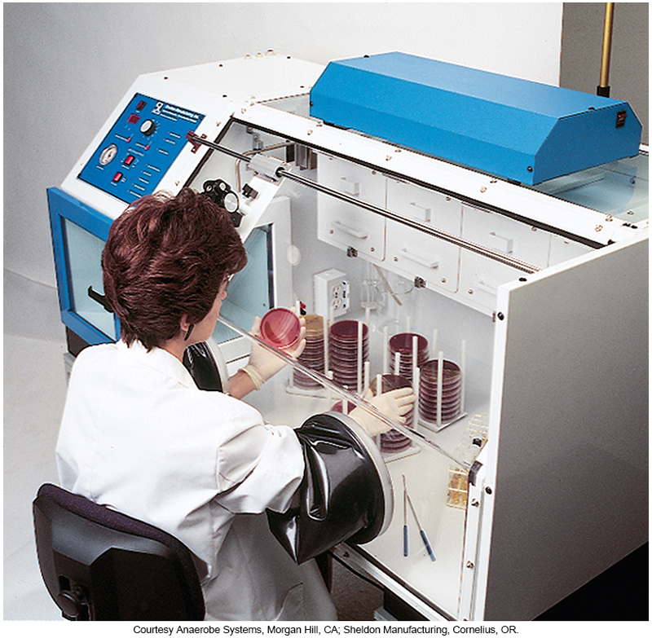
Anaerobic Chambers (Cont.)

Slide 87
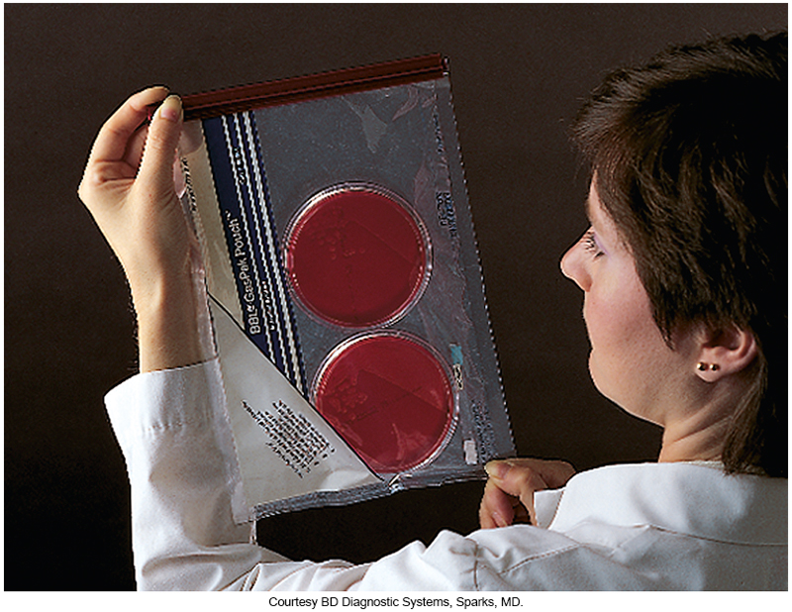
Anaerobic Bag

Slide 88
PROCEDURES FOR IDENTIFYING ANAEROBIC ISOLATES
CHAPTER TWENTY-TWO

Slide 89
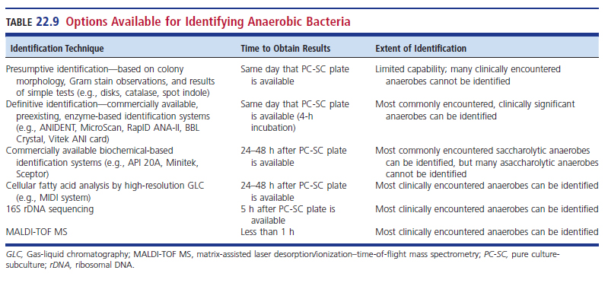
Options Available for Identifying Anaerobic Bacteria

Slide 90
Preliminary Procedures

Slide 91
When to Examine Primary Plates
Because many anaerobic infections consist of a mixture of aerobic and anaerobic organisms,
  The most actionable information that can be provided to the physician is a rapid answer about whether or not the specimen contains anaerobes. The physician can then select the most appropriate empiric antimicrobial agents to treat the infection

Slide 92
When to Examine Primary Plates (Cont.)
Examination of primary plates depends on incubation conditions.
  Anaerobic chamber—plates can be examined at any time
  Jars, bags, pouches—incubate 48 hours before examination
Anaerobic cultures are routinely held for 5 to 7 days to allow growth of particularly slow-growing anaerobes and at least 10 days whenever Actinomyces is suspected.

Slide 93
Indications of the Presence of Anaerobes in Cultures
Foul odor when opening an anaerobic jar or bag
Characteristic colonial morphology on anaerobic agar plates but not on aerobic culture plates
Unique morphology on Gram-stained smears of clinical specimens or isolates
Good growth on Bacteroides bile esculin (BBE) agar
Double zone of hemolysis on blood agar
Brick-red fluorescence on kanamycin vancomycin laked blood (KVLB) agar

Slide 94
Processing Colonies Suspected of Being Anaerobes
Describe colony morphology and growth on selective media
Describe the Gram stain reaction and cell morphology
Set up an aerotolerance test
Inoculate pure culture/subculture plate and add appropriate disks

Slide 95
Colony Morphology and Gram Stain Reaction
The use of a dissecting microscope to observe the fine details of each colony morphotype and pick colonies for isolation is recommended.
Growth of a particular morphotype can be semiquantitated using these naming conventions
  Light, moderate, Heavy
  1+, 2+, 3+
The Gram stain reaction and morphologic appearance of the organism aid in the presumptive identification of isolates.

Slide 96
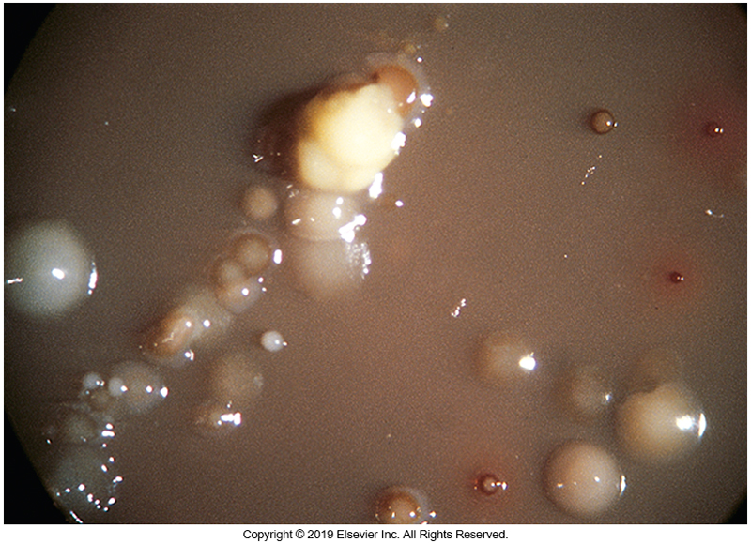
Anaerobic BAP from Intrauterine Device via Dissection Microscope

Slide 97
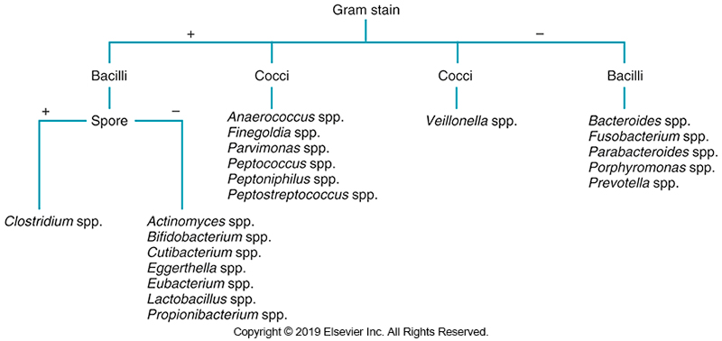
Schematic Diagram for Initial Identification of Anaerobic Isolates Based on Gram Stain Morphology

Slide 98
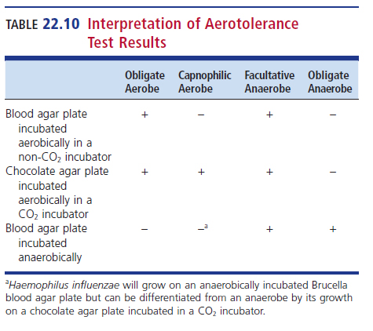
Aerotolerance Testing
Determines whether a microorganism isolated under anaerobic conditions is a strict anaerobe or a facultative anaerobe
Suspicious colonies are inoculated with a short streak onto a chocolate agar plate for incubation in a CO₂ incubator and an anaerobic blood agar incubated anaerobically for 48 hours

Slide 99
Presumptive ID of Clinically Significant Anaerobes

Slide 100
Fluorescence
Ultraviolet (UV) light
  Porphyromonas and Prevotella spp.
    Brick-red fluorescence (picture A next slide)
  Fusobacterium nucleatum and C. difficile
    Chartreuse fluorescence (picture B next slide)

Slide 101
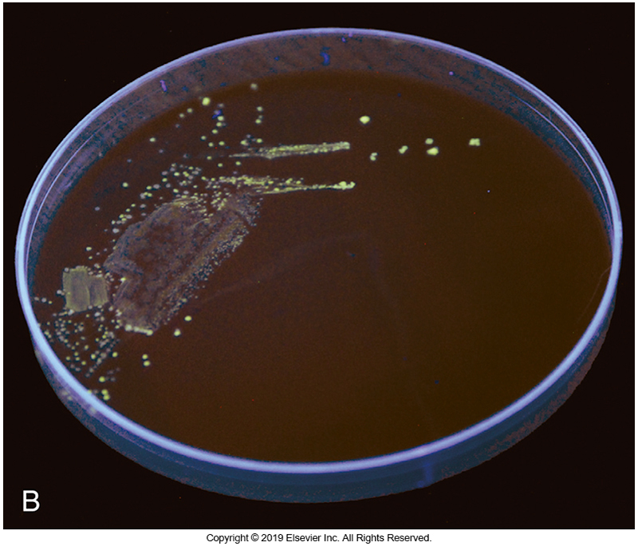
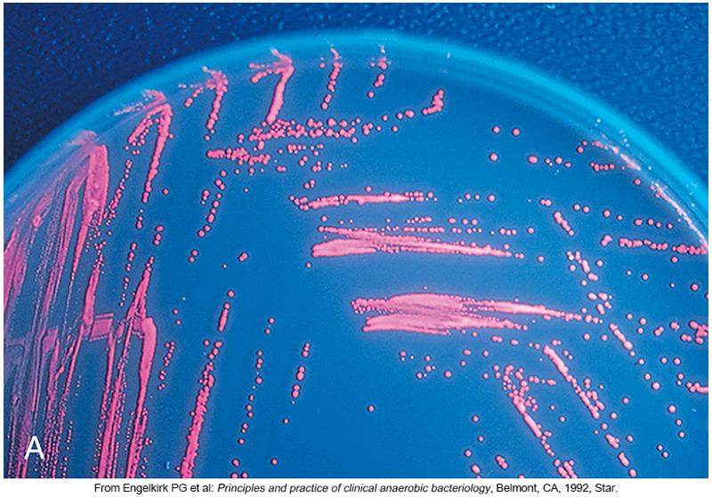
Examples of Anaerobic Fluorescence

Slide 102
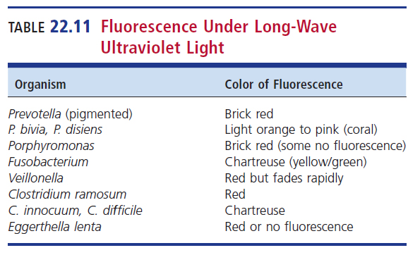
Fluorescence Under Long-Wave UV Light

Slide 103
Other Tests
Catalase test
  15% hydrogen peroxide added to organism on slide
    Bubbling is positive.
      Separates Clostridium (negative) from Bacillus (positive)
Spot indole test
  Filter paper saturated with para-dimethylaminocinnamaldehyde
  Turns a blue or green color (positive)
  Pink or orange color (negative)
Rapid urease test
Rapid motility test

Slide 104
Special Potency Antimicrobial Disks
Used to determine the true Gram stain reaction of an isolate (not to predict treatment options)
  Vancomycin disk (5 µg)
  Kanamycin disk (100 µg)
  Colistin disk (10 µg)
Procedure highlights
  Disks are placed on heavily inoculated area of plate, usually the first quadrant of a subculture plate
  Disks are pressed firmly on plate surfact

Slide 105
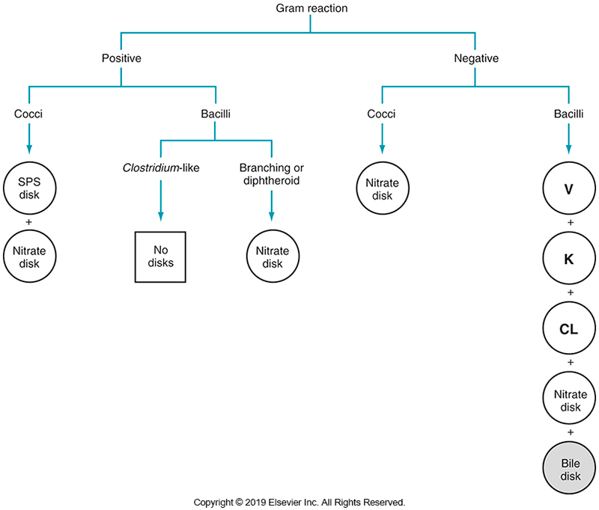
Disks to Add to the Pure-Subculture Plate

Slide 106
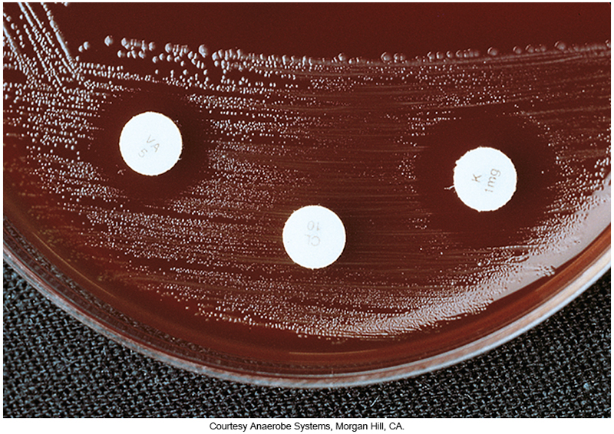
Special Potency Antimicrobial Disk Results for C. ramosum

Slide 107
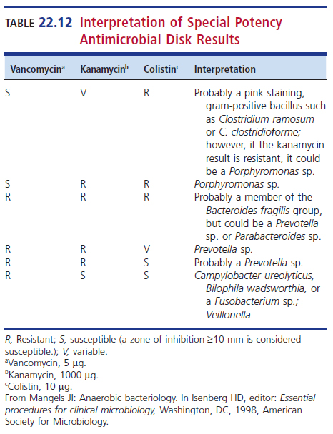
Interpretation of Special-Potency Antimicrobial Disk Results

Slide 108
Other Special Potency Disks
Nitrate disk
  Ability to reduce nitrate
Sodium polyanethol sulfonate (SPS) disk
  Peptostreptococcus anaerobius is susceptible.
  Peptoniphilus asaccharolyticus is resistant.
Bile disk
  Growth in 20% bile
  Bile-tolerant, gram-negative bacillus is most likely a member of the B. fragilis group.

Slide 109
Lecithinase and Lipase Reactions
Egg yolk agar (EYA)
  Lecithinase cleaves lecithin found in egg yolk
    Releases insoluble fat
      Forms opaque zone around colony
      C. perfringens
Lipase
  Hydrolyzes triglycerides and diglycerides to fatty acids and glycerol
    Positive organisms are iridescent, multicolored sheen
      F. necrophorum

Slide 110
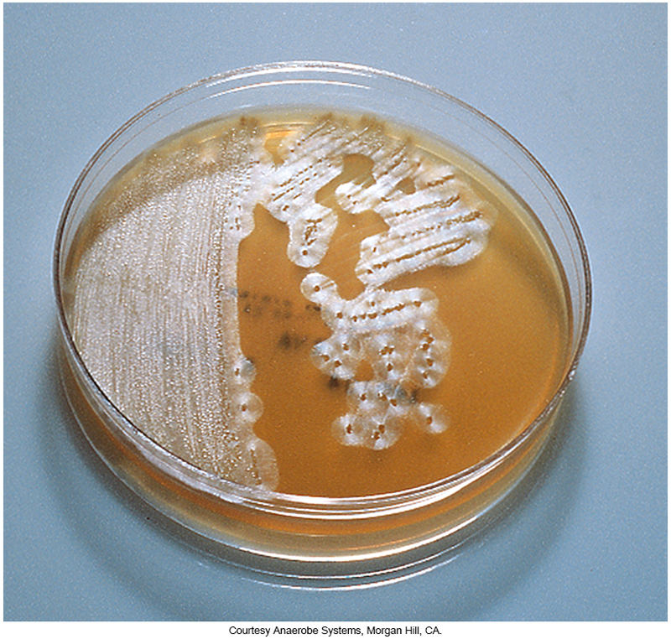
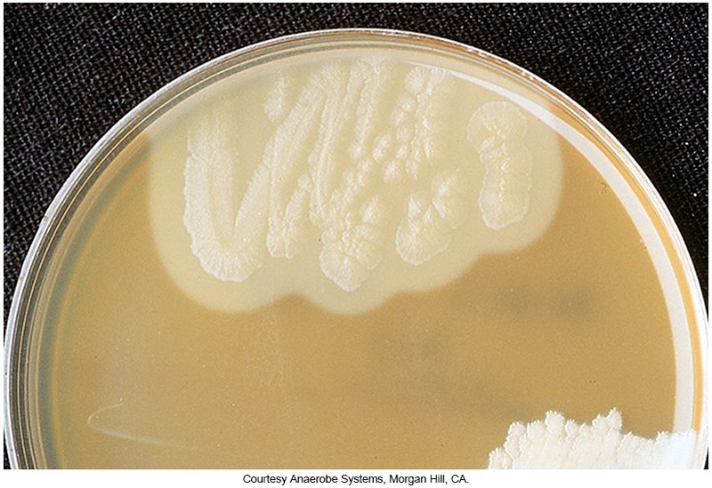
Positive Lecithinase and Lipase Reactions on Culture Media

Slide 111
Proteolytic Reactions
Organisms that produce proteolytic enzymes (proteases) exhibit
  Completely clear zone
  Often narrow around their colonies
Best observed by
  Holding plate up to strong light source
  Reminiscent of the complete clearing seen with β-hemolytic organisms on SBA plates

Slide 112
Presumptive ID of Gram-Positive Anaerobes

Slide 113
Overview
Some gram-positive anaerobes can also be presumptively identified with simple procedures.
None of these organisms will grow on BBE agar or LKVB agar medium, so identification is based on the colony appearance on nonselective anaerobic blood agar and EYA.

Slide 114
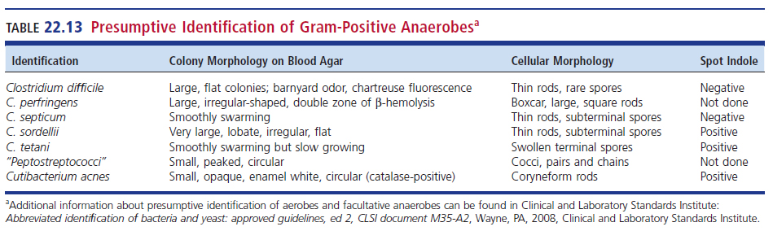
Presumptive Identification of Gram-Positive Anaerobes

Slide 115
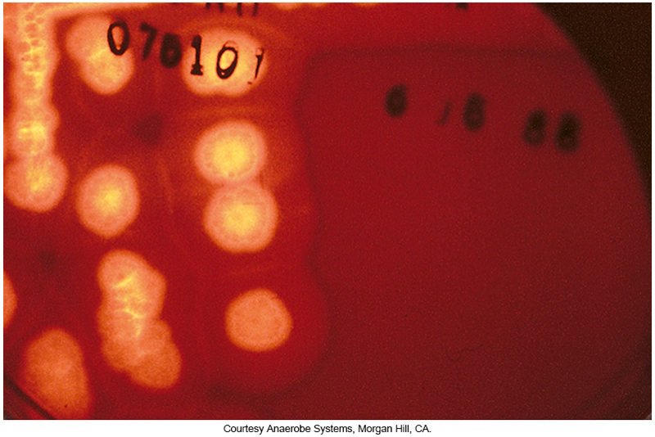
Double Zone Hemolysis
C. perfringens

Slide 116
Presumptive ID of Gram-Negative Anaerobes

Slide 117
Overview
Using Gram stain results, growth characteristics on primary plating media (e.g., nonselective anaerobic blood agar, BBE agar, KVLB agar), and a few rapid tests, many gram-negative anaerobes can be presumptively identified, often within 24hours of inoculation.

Slide 118
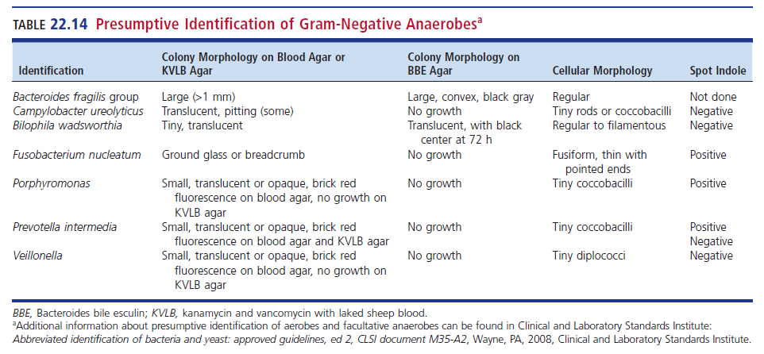
Presumptive Identification of Gram-Negative Anaerobes

Slide 119
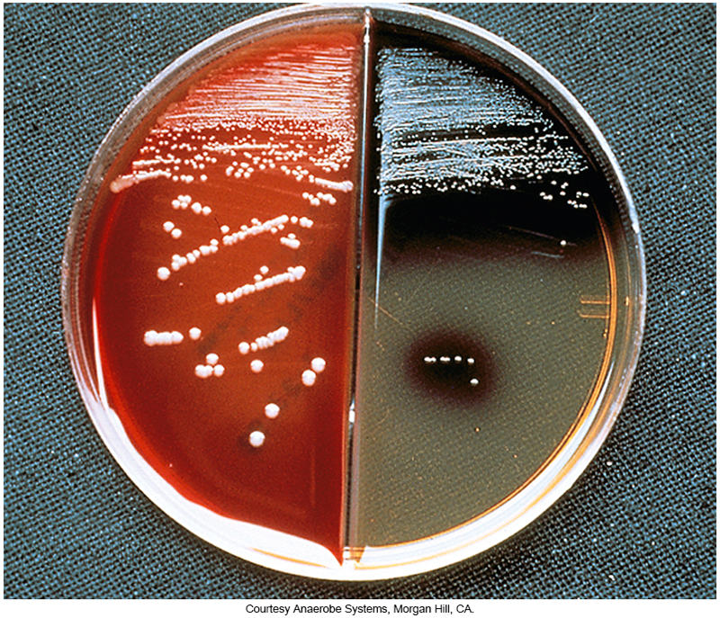
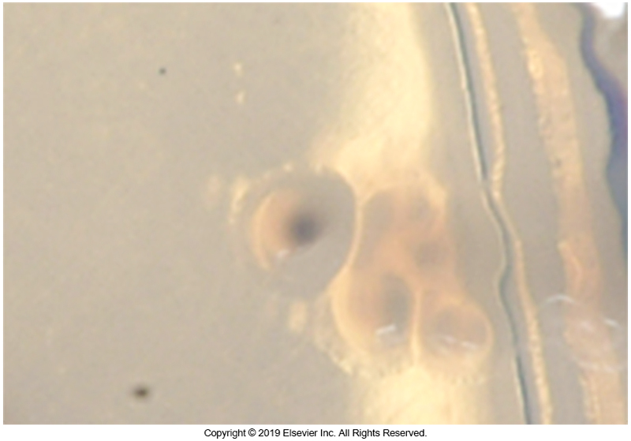
Colonies on BBE Agar B. fragilis on
Anaerobic KVLB and BBE (Left) and
B. wadsworthia on BBE (Right)

Slide 120
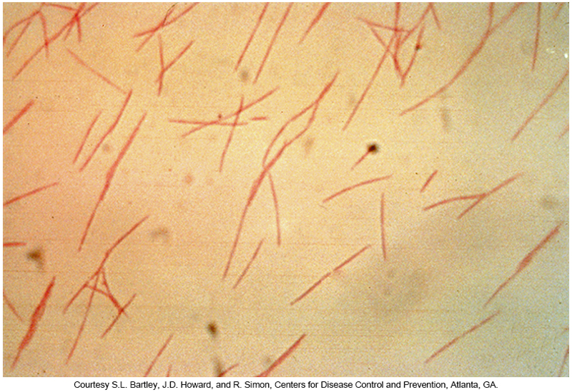
Gram Stain of F. nucleatum

Slide 121
Definitive ID of Anaerobic Isolates

Slide 122
Overview
For sterile site and some surgical isolates, it is important for the laboratory to provide full identification.
Many clinical microbiology laboratories use one of the commercially available biochemical-based or preexisting enzyme-based minisystems for making definitive identifications, but it is important to remember that none of these will identify all anaerobes that could potentially be isolated from clinical specimens.

Slide 123
Overview
Most (definitive identification systems) are designed to identify anaerobes that are most frequently encountered in clinical specimens. It is far more important for a system to identify these organisms than to identify obscure anaerobes that are only rarely isolated from clinical specimens or involved in infectious processes.

Slide 124
Options Available for Identifying Anaerobic Bacteria

Slide 125
Biochemical-Based Multitest Systems
API system
  Has many of the tests as the aerobic version
Biochemical-based multitest systems
  Easier and faster to inoculate than a conventional system of plates and tubes
These systems required anaerobic incubation
After 24 to 48 hours of incubation, test results are read

Slide 126
Preformed Enzyme-Based Systems
Based on the presence of preexisting (preformed) bacterial enzymes.
Results are available in about 4 hours.
There are numerous systems that all use the same or similar substrates.
Methods are being replaced by MALDI-TOF mass spectrometry

Slide 127
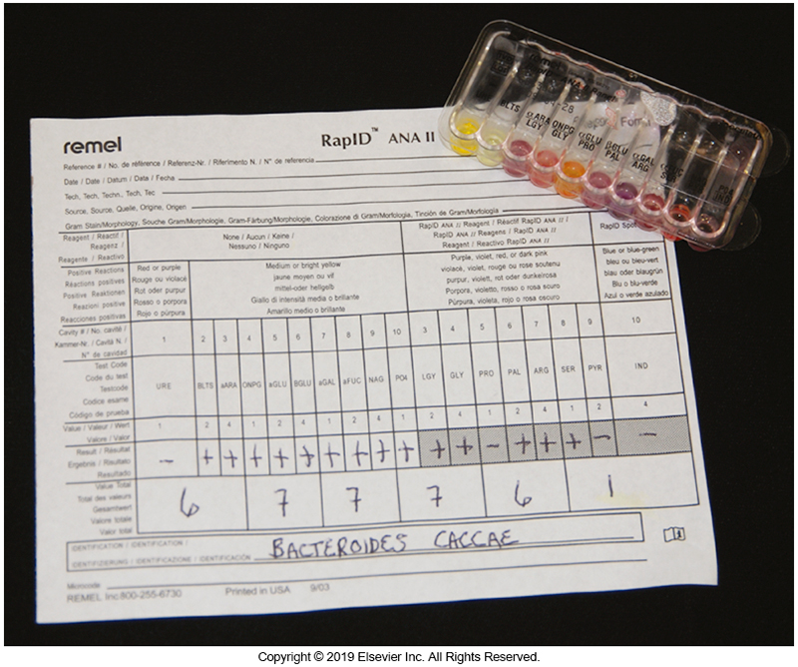
RapID ANA-II Preformed Enzyme System

Slide 128
Cellular Fatty Acid Analysis by High Resolution Gas-Liquid Chromatography
Cellular fatty acids are:
  Fatty acids and related compounds present within organisms as cellular components.
  Coded for bacterial chromosomes, as opposed to plasmids, and are not affected by simple mutations or plasmid loss.
Fatty acid composition of a particular organism is relatively stable when the organism is grown under specific growth conditions.
  Medium, temperature, time

Slide 129
Cellular Fatty Acid Analysis by High Resolution Gas-Liquid Chromatography (Cont.)
Fatty acid profiles can be identified
  Manually
  Computerized
  High-resolution gas-liquid chromatography
  Specialized software programs
Patterns of known bacteria are compared with those of unknown bacteria

Slide 130
MALDI-TOF Mass Spectrometry
MALDI-TOF mass spectrometry measures the mass-to-charge ratio of ionized particles such as proteins from an organism.
The technique produces a proteomic fingerprint that can be compared with reference strains. Results can be obtained in minutes, and this process has the potential of rapid identification of anaerobes.
Note: The database for anaerobes is still somewhat limited-only identifies the most commonly encountered anaerobes.

Slide 131
16S Ribosomal RNA Gene Sequencing
Anaerobes that are difficult to identify often can be definitively identified using 16S rRNA gene sequencing.
DNA is first extracted from the organism; the target segment of about 500 base pairs is amplified through polymerase chain reaction technology then sequenced on an automatic sequencer.

Slide 132
16S Ribosomal RNA Gene Sequencing (Cont.)
The resulting nucleotide sequence is compared with known sequences in public databases such as GenBank, a repository of sequences maintained by the National Institutes of Health.
The results can be obtained in approximately 5 hours.

Slide 133
Identification of Clostridium and Clostridiodes species

Slide 134
Double Zone Hemolysis
C. perfringens

Slide 135
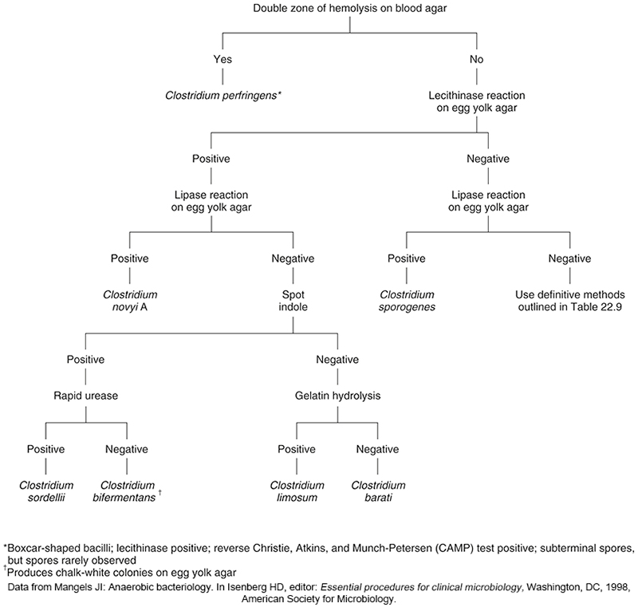
Identification Algorithm for Some Clinically Encountered Clostridium Species

Slide 136
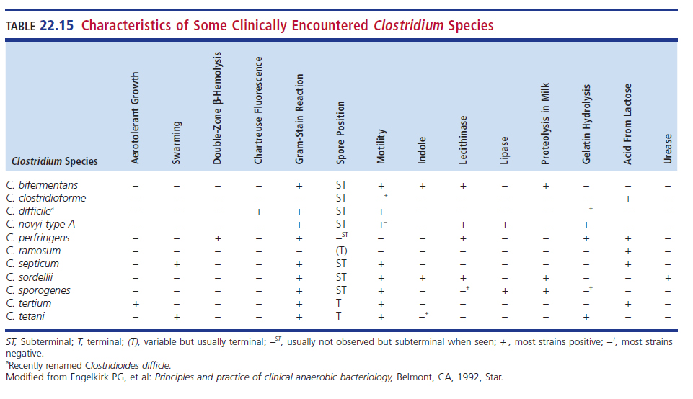
Characteristics of Some Clinically Encountered Clostridium Species

Slide 137
Identification of Anaerobic-Nonspore-Forming Gram-Positive Bacilli

Slide 138
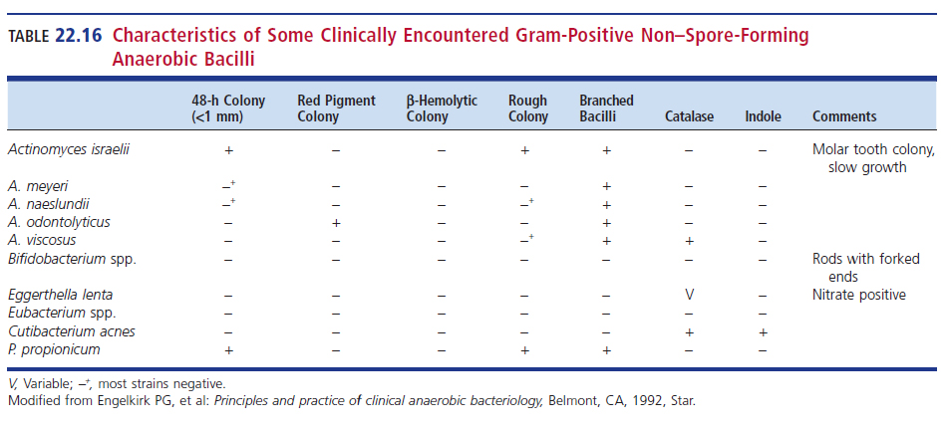
Characteristics of Gram-Positive Nonspore-Forming Anaerobic Bacilli

Slide 139
Identification of Nonspore-Forming Gram-Positive Bacilli
Actinomyces spp.
Bifidobacterium spp.
Lactobacillus spp.
Propionibacterium and Cutibacterium spp.

Slide 140
Gram Stained Appearance of A. israelii

Slide 141
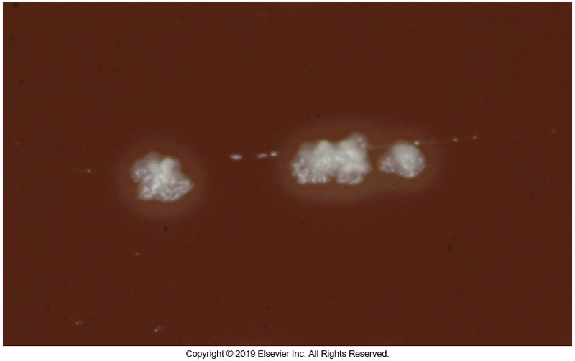
“Molar Tooth” Colonies of A. israelii

Slide 142
Bifidobacterium spp.
Variable in shape
  Ranges from coccobacilli to long branching rods
  Ends may be pointed, bent, club-shaped, spatulated, bifurcated (forked)
Cells may appear in/as
  singly or in chains, Starlike aggregates, V arrangements, palisade clusters.
Colony appearance
  Convex, entire, cream to white, smooth, glistening, soft

Slide 143
Lactobacillus spp.
Morphology varies greatly.
  Some species appear as pinpoint α-hemolytic colonies on SBA.
  Others are medium in size with a rough appearance and gray color
Catalase-negative
Differentiation from Streptococcus species difficult unless a Gram stain is performed

Slide 144
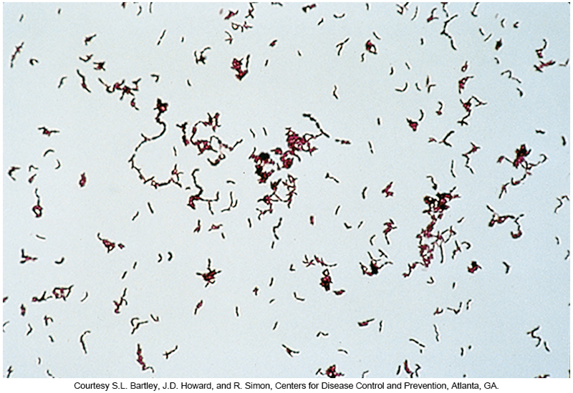
Propionibacterium acnes
Microscopic morphology

Slide 145
Identification of Anaerobic Gram-Negative Bacilli

Slide 146
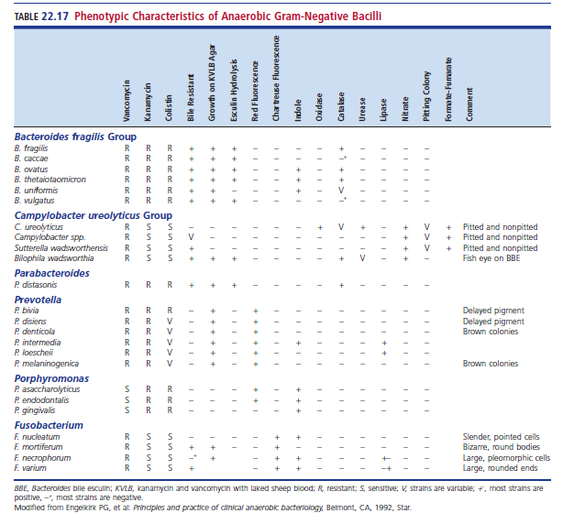
Phenotypic Characteristics of Anaerobic Gram-Negative Bacilli

Slide 147
Bacteroides Species
Previously divided into two categories
  Bile-tolerant species
    B. fragilis group
    Grow in the presence of 20% bile, colonies present on BBE, robust growth on KVLB agar
  Bile-sensitive pigmented species
    Porphyromonas
    Prevotella

Slide 148
B. fragilis Culture Characteristics
Colonies on BBE
  Gray and a minimum of 1 mm in diameter after 24 hours incubation
  The pale yellow of the culture plate turns brown to black in the area around the colonies.
  Dark precipitate (stippling) in the medium around areas of heavy growth suggests presence of B. fragilis.

Slide 149
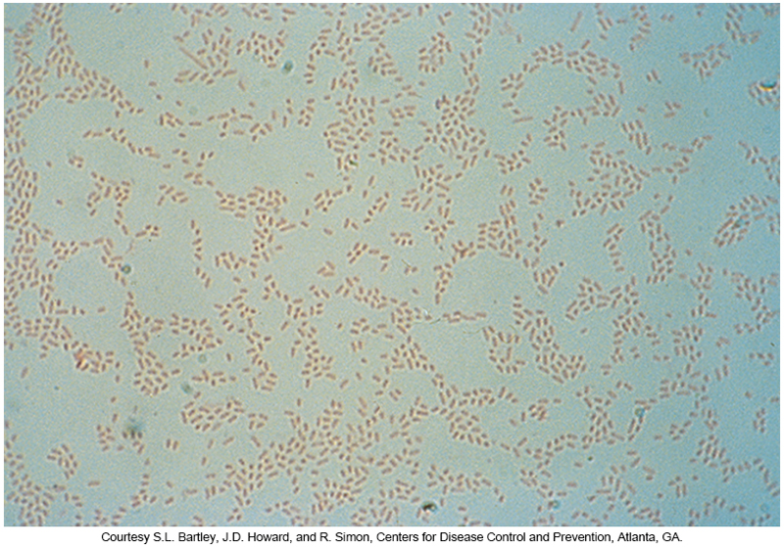
Gram Stain of B. fragilis
Gram-negative coccobacilli or bacilli
Frequently pleomorphic when organisms are present in broth cultures

Slide 150
B. fragilis on KVLB (Left) and BBE (Right)

Slide 151
Phenotypic Characteristics of Anaerobic Gram-Negative Bacilli

Slide 152
Bilophila wadsworthia
Characteristic fish-eye appearance
Grows on BBE, as shown on the right, and KVLB
Strongly catalase-positive
Strongly nitrate-positive

Slide 153
Prevotella species
Produce protoporphyrin, causing a brown-black color shift of macroscopic colonies over 2 to 3 weeks
Gram-negative coccobacilli or bacilli
Brick-red (or other colors) fluorescence under long-wave UV light
Some do not fluoresce at al

Slide 154
Type of Fluorescence Associated with Prevotella spp.

Slide 155
Porphyromonas spp.
Brick-red fluorescence under long-wave UV light
Some species do not fluoresce
Usually usceptible to vancomycin
  Therefore, organisms do no grow in KVLB
Resistance to colistin with special potency disks
Most species are spot-indole positive.

Slide 156
Campylobacter ureolyticus Group
Contains bile-sensitive and bile-tolerant nonpigmented members
Actually microaerophiles (not obligate anaerobes)
Colony appearance helpful in ID
  Many have colonies that appear to pit the agar
Growth in broth is enhanced by addition of formate or fumarate (unique to this group).
Members are nitrate positive.

Slide 157
Fusobacterium spp.
Generally considered gram-negative long, thin, tapered rods (fusiform)
  May appear pleomorphic
Resistant to vancomycin but susceptible to colistin and kanamycin with special potency disks
Grows on KVLB agar
Indole positive (except F. mortiferum)
All fluoresce chartreuse under long-wave UV light

Slide 158
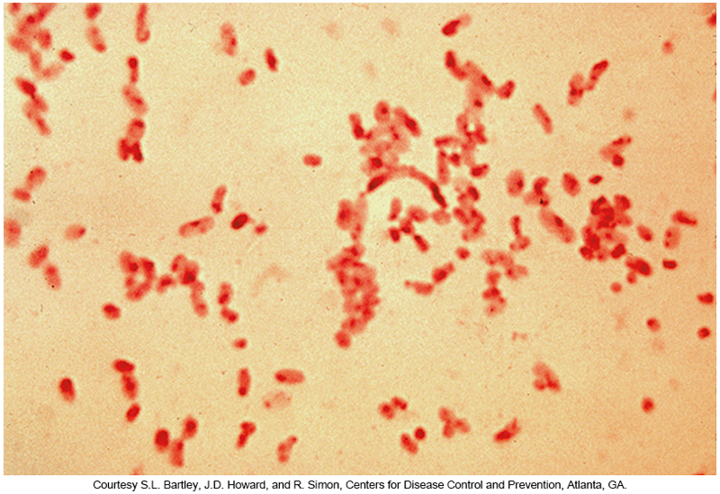
Gram Stains of Fusobacterium
F. nucleatum (Left) and F. mortiferum (Right)

Slide 159
Identification of Anaerobic Cocci

Slide 160
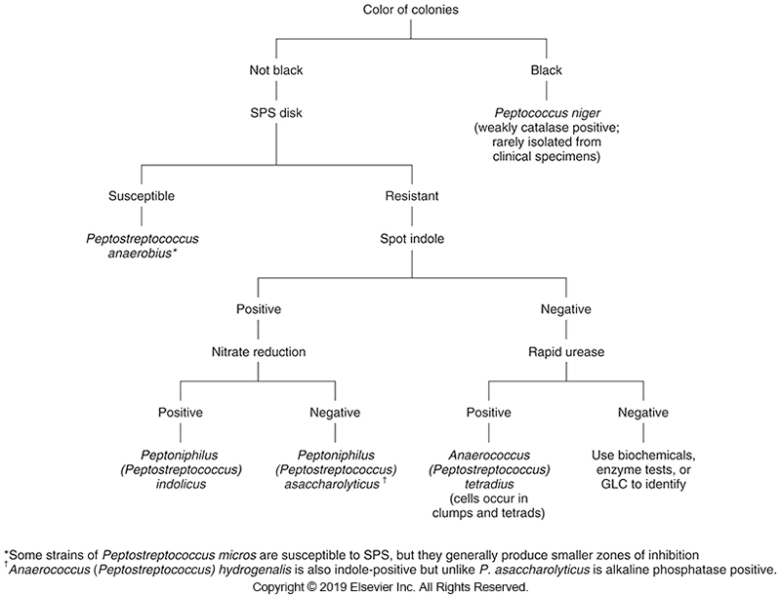
Identification of Anaerobic
Gram-Positive Cocci

Slide 161
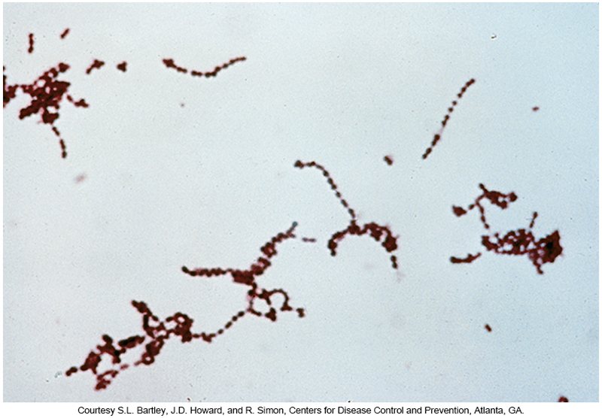
Anaerobic
Gram-Positive Cocci
Microscopic morphology

Slide 162

Characteristics of Select Clinically Encountered Anaerobic Cocci

Slide 163
Presumptive and Full ID Methods
Presumptive identification can be reported as
  Peptostreptococcus spp.
  Anaerobic gram-positive cocci
Available full ID techniques
  Enzyme systems
  16S rRNA sequencing
  MALDI-TOF MS

Slide 164
Presumptive and Full ID Methods (Cont.)
Black-pigmented, anaerobic, gram-positive cocci can be identified as Peptococcus niger.
Peptostreptococcus anaerobius
  Zone of inhibition around an SPS disk
Veillonella parvula
  Gram-negative cocci
  Positive catalase reaction
  Red fluorescence under long-wave UV light
  Nitrate reduction-positive
  Resistant to vancomycin special potency disk

Slide 165
ANTIMICROBIAL SUSCEPTIBILITY TESTING
CHAPTER TWENTY-TWO

Slide 166
Antimicrobial Susceptibility Testing Guidelines
Clinical and Laboratory Standards Institute (CLSI)
  Methods for Antimicrobial Susceptibility Testing of Anaerobic Bacteria (Approved Standard, M11-A8)
Performed when anaerobes are recovered in
  brain abscess
  endocarditis
  infection of a prosthetic device or vascular graft
  joint infections
  osteomyelitis
  bacteremia

Slide 167
Antimicrobial Susceptibility Testing
Highly virulent and/or commonly resistant
  B. fragilis group
  Prevotella
  Clostridium
  Fusobacterium
  Bilophila wadsworthia
  Sutterella wadsworthensis

Slide 168

CLSI Recommendations for Anaerobic Antimicrobial Susceptibility Testing

Slide 169
Problems in Susceptibility Testing of Anaerobic Isolates
Lack of reproducibility
Failure of some anaerobes to grow appropriately
Lack of comparability between methods
Cost
Complexity of testing

Slide 170
Susceptibility Testing Options
CLSI standards identify two methods
  Agar dilution
    Gold standard but labor-intensive
    Not practical for use in smaller clinical laboratories
    Primarily used in reference and larger laboratories
  Broth microdilution-only for members of the B. fragilis group
Some laboratories report out published susceptibilities
  They do not do the testing in-house.

Slide 171
Etest
Mueller-Hinton agar supplemented with 5% sheep red blood cells
Plates can be incubated in anaerobic bags, jars, or chambers
Testing is limited to 6 antimicrobial agents on one agar plate
One critical aspect of the Etest procedure is limiting exposure to oxygen during setup and quickly achieving anaerobiasis. This is because the commonly used antimicrobial agent metronidazole is very oxygen sensitive.

Slide 172
TREATMENT OF ANAEROBE-ASSOCIATED DISEASES
CHAPTER TWENTY-TWO

Slide 173
Approaches to the Management of Anaerobic Infections
Five recognized approaches
  Surgical therapy—i.e., débridement
  Hyperbaric oxygen—create environment not conducive to anaerobic bacterial growth
  Antimicrobial therapy
  Antitoxins—to reduce virulence factors
  Fecal microbiota transplant (FMT)
    Involves the insertion via colonoscopy or endoscopy of donor feces into the patient

Slide 174
Points to Remember
There are numerous points to remember at the end of this chapter in the textbook.
Learners are encouraged to review this list during chapter study and in preparation for quizzes or exams.

