Slide 1
Clinical Laboratory Hematology
WBC Counting

Slide 2
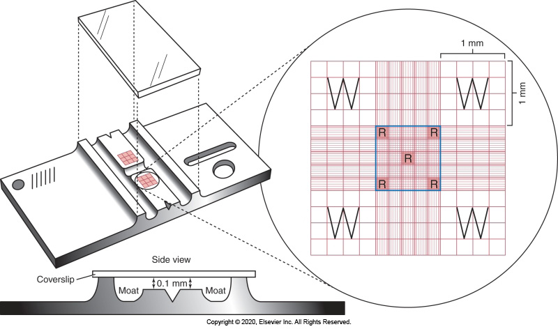
The Neubauer Hemocytometer

Slide 3
Manual Counts
The Hemocytometer
  Specialized slide with a counting grid used for the counting of cells using a light microscope.
  Used for WBCs, RBCs, PLTs, and EOS in a clinical lab (as a backup for automated cell count results) and WBCs & RBCs on body fluids.
  Typically – uses a different diluent corresponding to the different areas of the hemocytometer.

Slide 4
Manual Counts
Made to exact specifications
Parts of the hemocytometer—
  The platform
  The counting grid
  Regulation coverslip (not used when couting phase platelets).

Slide 5
Manual Counts
Made to exact specifications
Parts of the hemocytometer—
  The platform
  The counting grid
  Regulation coverslip (not used when couting phase platelets).

Slide 6
Manual Counts
The outer platform
  Are exactly 0.1 mm higher than the center.
  They function to hold the hemocytometer cover glass and to regulate the volume of sample used for cell counts.
The center platform
  Contains the counting grids
    Engraved into the slide
    On an eGrid at either end of the hemocytometer.

Slide 7
Manual WBC-Counting
Matching the counts
  The counts from the 2 sides of the hemocytometer must agree within a certain range. If they do not—clean the hemocytometer and start again—
    5-20 cells (± 3 cells)
    20-30 cells (± 5 cells)
    30-50 cells (± 10 cells)
    50-100 cells (± 15 cells)
    >100 cells (± 15%)

Slide 8
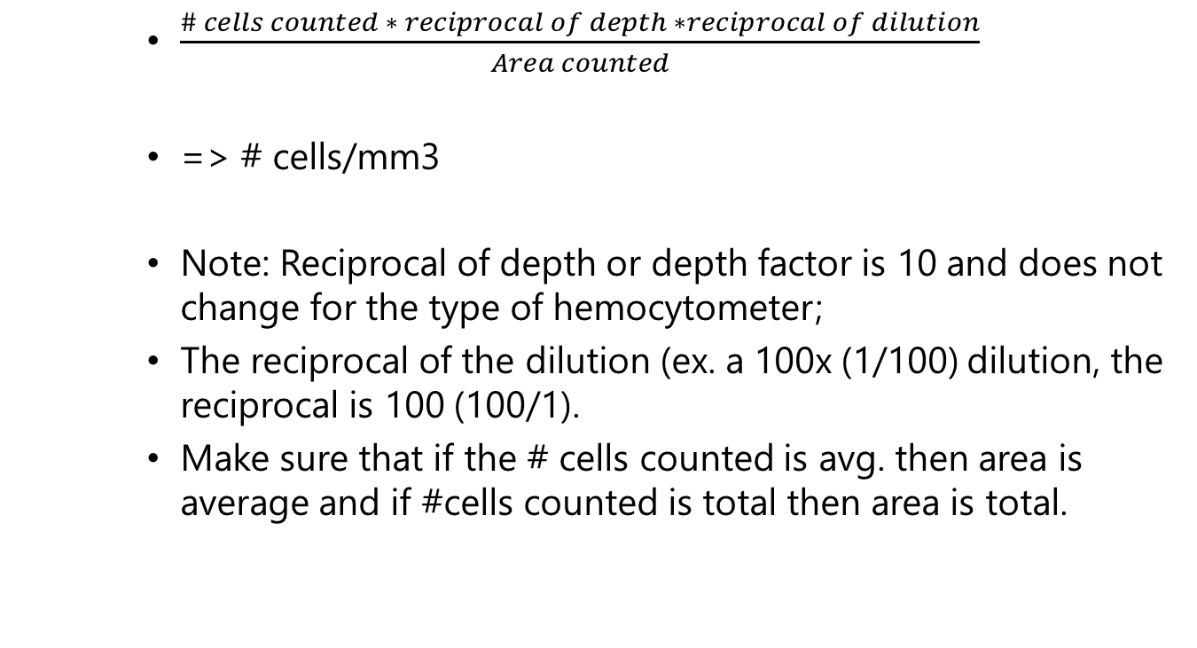
Hemocytometer Calculation
    $\frac{\# cells counted ∗ reciprocal of depth ∗reciprocal of dilution}{Area counted}$
    => # cells/mm3
    Note: Reciprocal of depth or depth factor is 10 and does not change for the type of hemocytometer;
    The reciprocal of the dilution (ex. a 100x (1/100) dilution, the reciprocal is 100 (100/1).
    Make sure that if the # cells counted is avg. then area is average and if #cells counted is total then area is total.

Slide 9
Hemocytometer Counting
  RBCs – saline is used as diluent in either the Thoma pipette or unopette system, a 1/200 dilution is normal, and the 4 counter and 1 center secondary squares within the center primary square is counted on both sides of the hemocytometer. (NO LONGER AVAILABLE).
  PLTs – ammonium oxalate is used as the diluent with either the Thoma pipette or the unopette system, a 1/100 dilution is normal and the entire center primary square is counted on both sides. WBC can also be counted with this unopette since acetic acid unopette is no longer available.

Slide 10
Manual Counting - Use
Interference with instrument counts and smear estimate do not agree.
Body fluids – WBC and RBC – counts will vary therefore different dilutions and counting areas will be used. Statistically—50 cells must be counted on each side (100 on both sides) of the hemocytometer or you must count more area, up to and including the entire hemocytometer.

Slide 11
The Manual Differential
Performed using:
  Whole blood smears
  Buffy coat smears-peripheral
  Albumin smears

Slide 12
The Manual Differential
Making the smear
  Using a “smearing slide” at a 45° angle to the sample slide.
  Smear with a smooth lifting motion.
  Smear should be approx. 2/3 the length of the slide (at least ½)
    Too short → not enough area for performing the differential.
    Too long → may be no feathered edge.

Slide 13
The Manual Differential
Making the smear
  Using a “smearing slide” at a 45° angle to the sample slide.
  Smear with a smooth lifting motion.
  Smear should be approx. 2/3 the length of the slide (at least ½)
    Too short → not enough area for performing the differential.
    Too long → may be no feathered edge.

Slide 14
The Manual Differential
Making the smear
  Using a “smearing slide” at a 45° angle to the sample slide.
  Smear with a smooth lifting motion.
  Smear should be approx. 2/3 the length of the slide (at least ½)
    Too short → not enough area for performing the differential.
    Too long → may be no feathered edge.

Slide 15
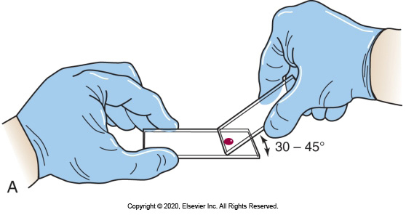
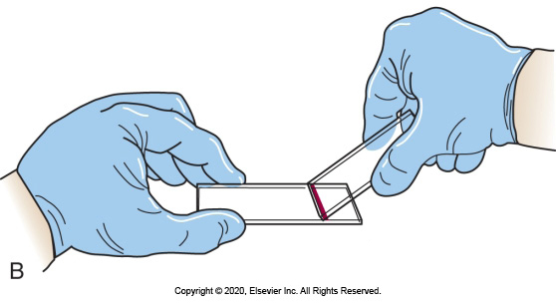
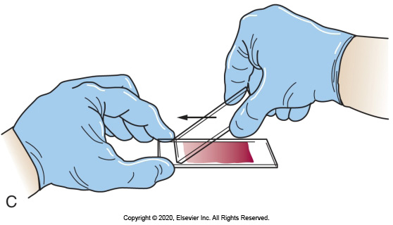
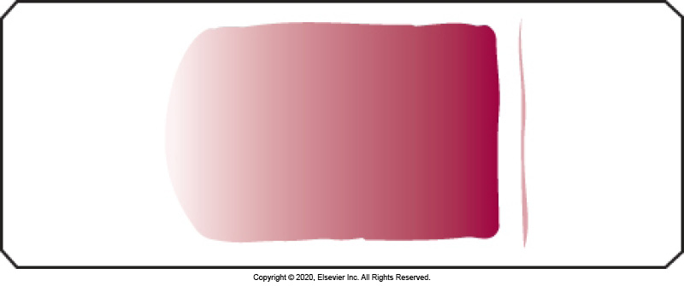
The Manual Differential

Slide 16
The Manual Differential
Buffy coat smear
  Sample spun at ~3000 RPM for 3 minutes.
  Buffy coat is the layer of cells between the Plasma and the RBCs after settling or centrifugation.
  Plasma is drawn off except for 1-2 mm
  The buffy coat layer is taken off with 0.1 mm of RBC.
  Removed cells are mixed and smears made;
  When WBC count is <1.0/mm3.

Slide 17
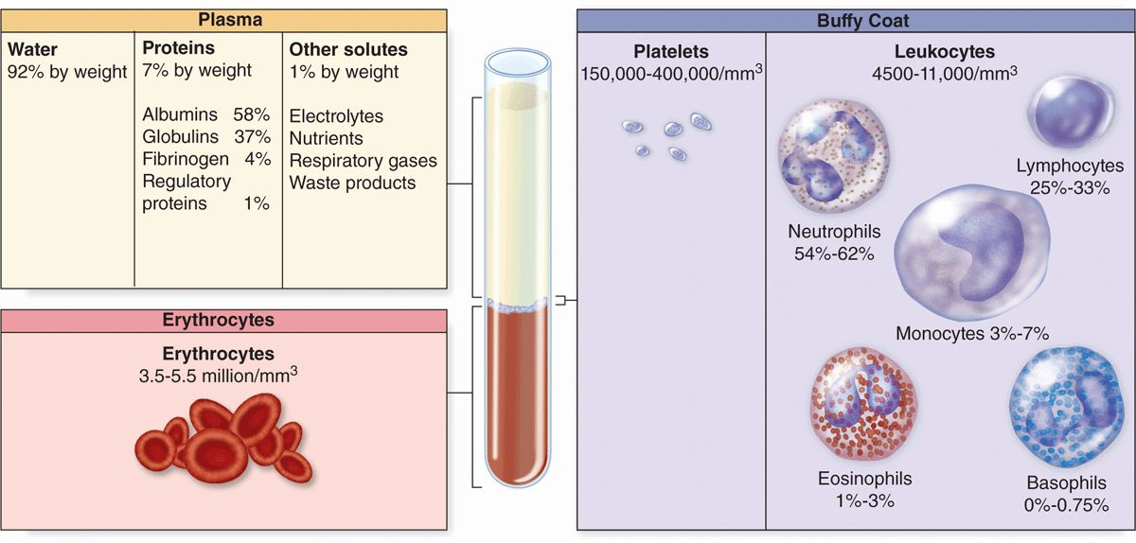
HCT Layers

Slide 18
The Manual Differential
Albumin smears – albumin helps to hold fragile cells together during the smearing process.
Made when there is evidence of fragile cells – ex. CLL lymphs, blasts, reactive lymphs, lymphoma cells (i.e., reactive, immature, or malignant cells).
1 drop of Albumin to 9 drops of EDTA whole blood (10x dilution), mix → make smear.
Too much albumin will introduce artifact.

Slide 19
Performing WBC Differential
In the middle area of the feathered edge where the RBCS are touching but only occasionally overlapping.
  Thin and thick areas, morphology distorted. In thin area, cells are stretched out and may not see areas like central pallor whereas in thick areas, cells are squished and morphological are missing (pseudo-Rouleaux). However, you may find rare events in the thick area – malaria, inclusions, &c.
  Start away from the edge, move in 1 direction side to side counting consecutive WBCs. When you get to the edge—move over 1 objective and reverse direction, continuing to count consecutive WBC until you reach 100.

Slide 20
Manual Differential – 95% CI Chart
The more cells counted the narrower the range for statistical comparison.
Ex: Look at a – 100 along the top which is 100 cell WBC differential. Then say you counted 48% lymphocytes and the instrument had counted 40%. Now the instrument had counts thousands of WBCs not just 100 so use them as ‘a’ and go down to 40. You could get 30.3-50.3% lymphs and have statistically the same % of lymphs.

Slide 21
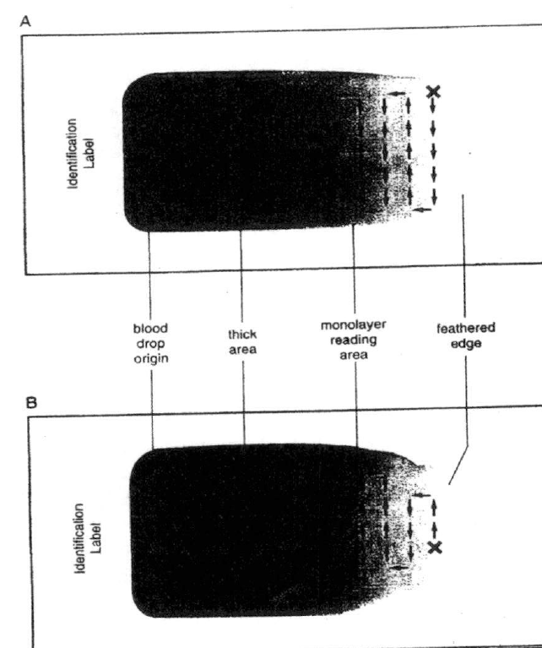
Manual Differential

Slide 22
Identification of Cells
Basic criteria:
  Size
  N:C ratio
  Nuclear characteristics
  Chromatin thickness
  Degree of clumping
  Chromatin pattern?
  Staining properties
  Presence of Nucleoli?
Cytoplasmic characteristics
  Staining properties
  Presence of granules? If so, what size and how stain?
  Presence of inclusions? If so, what size and how stain?

Slide 23
The Complete Manual WBC Differential
WBC component
  WBC estimate
  WBC 100 cell differential
RBC component
  RBC morphology
Platelet components
  PLT estimate
  PLT morphology
In total—there are ~5 parts of a manual WBC differential.

Slide 24
Impedance WBC Counting
Coulter principle
EDTA
Dilution where RBC lysed and the threshold set at 35fL, normally only WBC counted; platelets much smaller (under the 35fL; normally not >20fL)
Histogram
Interference:
  NRBCs, hypochormic cells, target cells, HGB S, and HGB C (i.e., RBCs resistant to lysis)
  Giant platelets and platelet clumps
  Cytoplasmic fragments
  Megakaryocyte nuclei

Slide 25
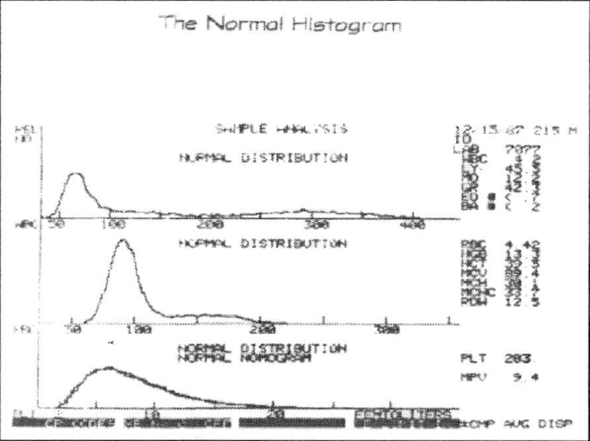
Impedance WBC Counting

Slide 26
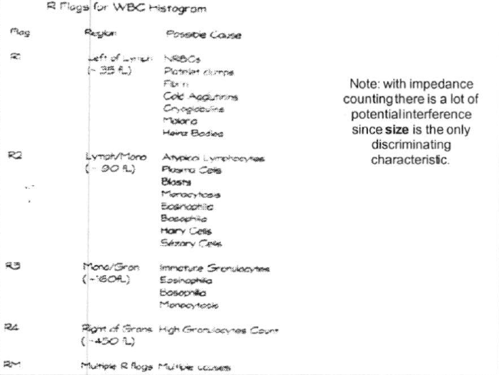
Impedance WBC Counting

Slide 27
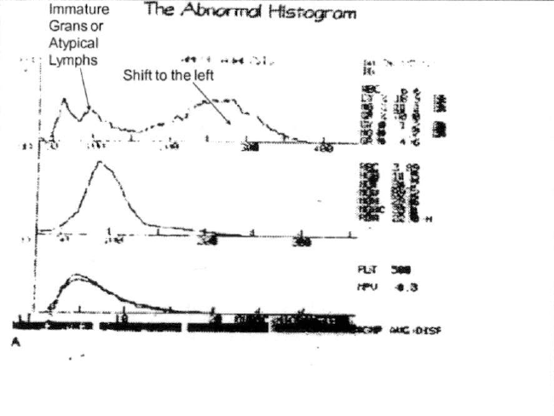
Impedance WBC Counting

Slide 28
Impedance WBC Counting

Slide 29
Impedance WBC Counting

Slide 30
Optical WBC Counting
Characteristics measured:
Scatterplot
  Size
  Complexity
  Granularity
  Polarity

Slide 31
Optical WBC Counting

Slide 32
Optical WBC Counting

Slide 33
Optical WBC Counting
Remember, the darker the scattergram—the higher the concentration of the respective cell population.

