Slide 1
Read pgs. 549-551 – Rodak’s 6th Ed.
Refer to section(s) on staining in the Clinical Hematology Atlas
Clinical Laboratory Hematology
WBCs – Cytochemistry & Special Stains

Slide 2
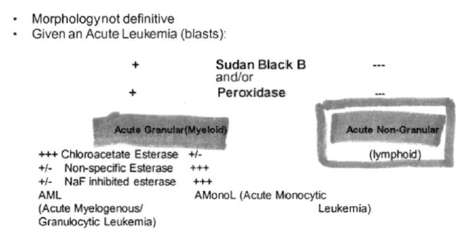
When Special Stains Are Indicated
When morphology is not definitive
Given an Acute leukemia (blasts):

Slide 3
Leukocyte Alkaline Phosphatase Stain (LAP)
Differentiates Leukemoid rxn from CML/CGL
Alkaline phosphatase is located in the specific/secondary granules of the neutrophils;
Neutrophils are the only granulocyte with this type of activity (i.e., not EOS or BASOS).
Increased LAP activity (higher than normal) in Leukemoid rxn—polycythemia vera and Myelofibrosis.
Decreased LAP activity (lower than normal) in CGL/CML, PNH, and aplastic anemia.

Slide 4
LAP – Principle(s)
LAP hydrolyzes the substrate napthiol AS-Biphosphate. The substrate couples with a dye (fast red or fast blue) and precipitates out of the active site of the enzyme. Bright red (or blue) granules can have varying sizes.
Uses EDTA anticoagulated whole blood to make blood smears.
Blood smears are then treated with the above reagent(s).
The smear is then reviewed counting 100 neutrophils; each neutrophil is given a grade (0-4+) depending on the amount of LAP activity noted.
The cell grades are multiplied by the number of cells for said grade—they are then added together to create the LAP score.

Slide 5
LAP – Score Example
4 cells – 0 (no granules) – total 0
32 cells – 1+ (extremely low/trace) – total 32
15 cells – 2+ (few to moderate) – total 30
39 cells – 3+ (moderate to numerous) – total 117
10 cells – 4+(cyt sat’d by closely approx. granules-unusual)-total 40
sum -219
Normal Ranges:
Males – 22-124 (40-100);
Females: 33-149

Slide 6
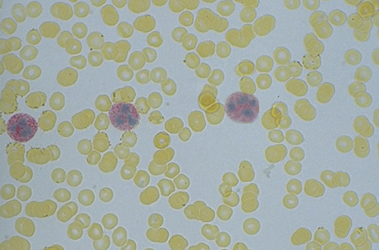
LAP
Notes:
This peripheral blood smear is stained for leukocyte alkaline phosphatase. The neutrophils have bright red reaction product in their cytoplasm.

Slide 7
Peroxidase Stain
Also termed myeloperoxidase.
Marker for primary granules (non-specific) and Auer rods.
Used to differentiate myeloid from lymphoid cells; normally granulocytes and precursors are positive for peroxidase whereas lymphoid cells are negative.
Monocytes are less intense; Erythroid cells are negative.

Slide 8
Peroxidase Stain
In the presence of H2O2, peroxidase will oxidize the substrate 3-amino-9-ethylcarbazole to a red-brown (dk golden-brown/brown-black) color. On a smear, this will be seen at the sight of enzyme activity.
Limitation: Peroxidase is sensitive to light; enzyme deteriorates and should be done on a fresh specimen each time.
Granules in cytosol turn dk golden-brown in neutrophils and precursors. Monocytes are weak; eosinophils are the strongest.

Slide 9
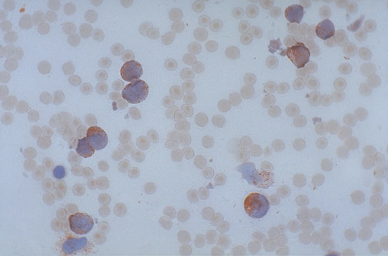
(Myelo)peroxidase stain
Notes:
This peripheral blood smear is stained with the myeloperoxidase stain, and there is red reaction product in these leukemic cells, indicative that this is a myeloid leukemia.

Slide 10
Peroxidase Stain
Interpretation: Peroxidase positive cells include late myeloblast, promyelocytes, metamyelocytes, band, segmented neutrophils, eosinophils, and monocytes.
Peroxidase negative include: Early myeloblasts (even in blast cells without any granules the peroxidase is there waiting to be packaged into the granules; an early blast will not even have the peroxidase yet), lymphoblasts, lymphocytes, plasma cells, and basophils

Slide 11
Sudan B Black Stain
Non-enzymatic;
Used to identify granulocyte precursors and differentiate them from lymphoid cells;
Principle: Sudan black B stains phospholipids and lipids found in primary and secondary granules of granulocytes.
Brown-black granules in granulocytes.
May be minute activity in monocyte lysosome;
Granules (few small granules) and rarely in lymphocytes. Eosinophilic granules appear brown with a central pallor.
The reactions of the Sudan Black B stain should mirror those of the peroxidase stain; Auer rods +

Slide 12
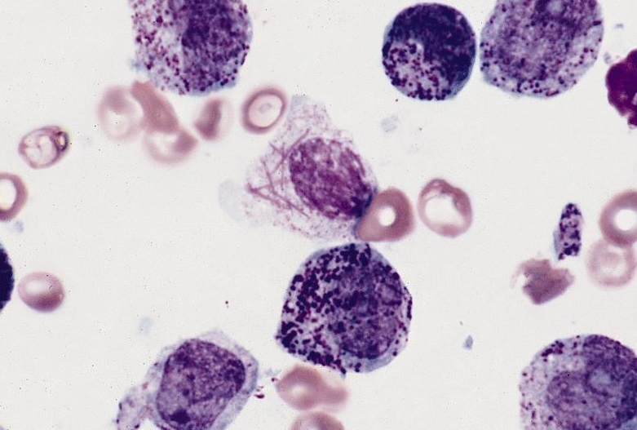
Sudan B Black

Slide 13
Specific Esterase (Naphthol AS-D Chloroacetate)
To differentiate monocytes and lymphocytes from granulocytes are positive for specific esterase.
Principle: the esterase hydrolyzes the substrate naphthol AS-D chloroacetate. The substrate couples with a diazo salt. The diazo salt precipitates out of the active site of the enzyme.
Positive granules appear bright red. The nuclei are counterstained and blue (A different stain is used in the next picture).

Slide 14
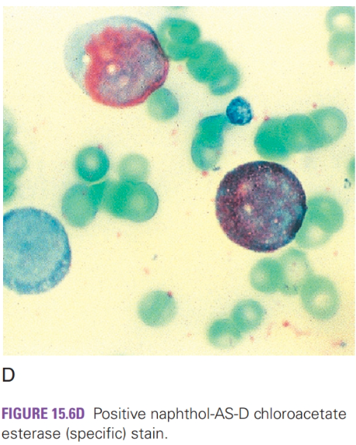
Specific Esterase (Naphthol AS-D Chloroacetate)

Slide 15
Non-Specific Esterase (α-Naphthol Butyrate)
This stain is also used to differentiate monocytes from granulocytes, but the monocytes are positive.
Principle: the esterase in the cell will hydrolyze the substrate α-naphthol butyrate. The substrate couples with a diazo salt and precipitates out of the enzyme active site.
Positive granules appear brick red. Note: there are different substrates such as acetate which can be used as well as other diazo dyes resulting in different colored granules. Acetate may be used both with and without NaF inhibition.
Interpretation: Monocytes, histiocytes, macrophages, and megakaryocytes show brick red granules. Lymphs may show punctate staining. Granulocytes have little or no activity.

Slide 16
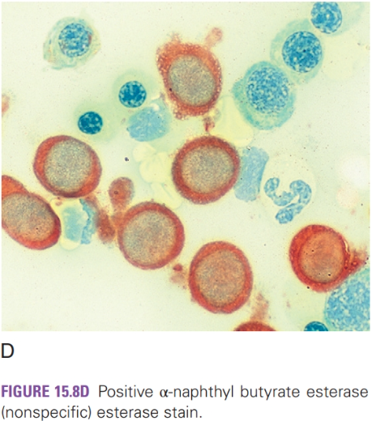
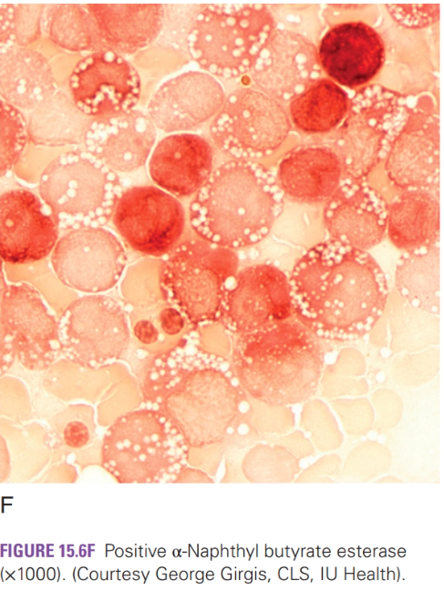
Non-Specific Esterase (α-Naphthol Butyrate)

Slide 17
Combined Esterase
This uses the principle of the two above mentioned esterase stains. The dye that is used results in different colored granules for specific and non-specific esterase: non-specific esterase granules are red (monocytes) and specific esterase granules are blue (granulocytes).

Slide 18
Acid Phosphatase/TRAP Stain
TRAP – Tartrate-resistant Acid Phosphatase
This stain is to help diagnose Hairy-Cell Leukemia. It can also be used to identify T cells in multiple myeloma.
Principle: The acid phosphatase in a cell hydrolyzes the substrate napthol AS-BI phosphoric acid. The substrate couples with a dye and precipitates out of the enzyme active site.
Tartaric acid will inhibit this activity except in Hairy-Cell Leukemia!
Interpretation: Positive granules are orange-red in color. The test is considered positive when two or more cells show 4+ activity.

Slide 19
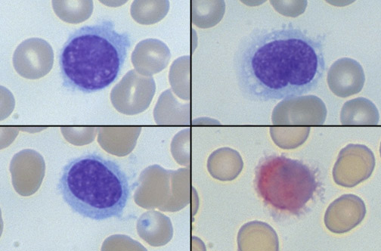
TRAP Stain
Notes:
This collage of cells shows the characteristic lymphocytes of hairy cell leukemia with their indistinct cytoplasmic borders and small projections. The cell at the lower right is stained for tartrate-resistant acid phosphatase (TRAP) and is positive, with red reaction product in the cytoplasm, characteristic for hairy cell leukemia.

Slide 20
Periodic Acid-Schiff Reaction (PAS)
Non-enzymatic;
Used to identify FAB M6 Leukemia = Erythroleukemia.
Principle: Stains glycogen, glycoproteins, mucoproteins and high MWt carbohydrates. PAS oxidizes the glycols to aldehydes. The aldehydes react with the Schiff reagent → bright red staining.

Slide 21
Periodic Acid-Schiff Reaction (PAS)
Interpretation: Normal erythrocytic precursors are negative.
M6 (erythroleukemia) normoblasts stain positive;
PAS positively may be seen in ALL and AML; it should not be used to differentiate ALL from AML.
Lymphocytes, granulocytes, monocytes, and megakaryocytes may be positive.
Burkitt’s lymphoma cells stain PAS negative.

Slide 22
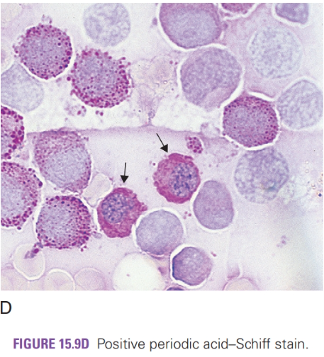
PAS

Slide 23
Terminal Deoxynucleotidyl Transferase (TdT/DNATT)
Used to identify immature or primitive lymphocytes (AML vs ALL);
This is a nuclear stain.
Usually done by Flow Cytometry or Immunohistochemical ABC staining methodologies;
90% of ALL cells are TDT positive.

Slide 24
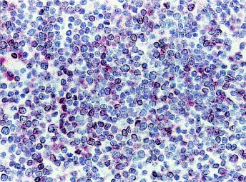
TdT Stain - B-lineage ALL

Slide 25
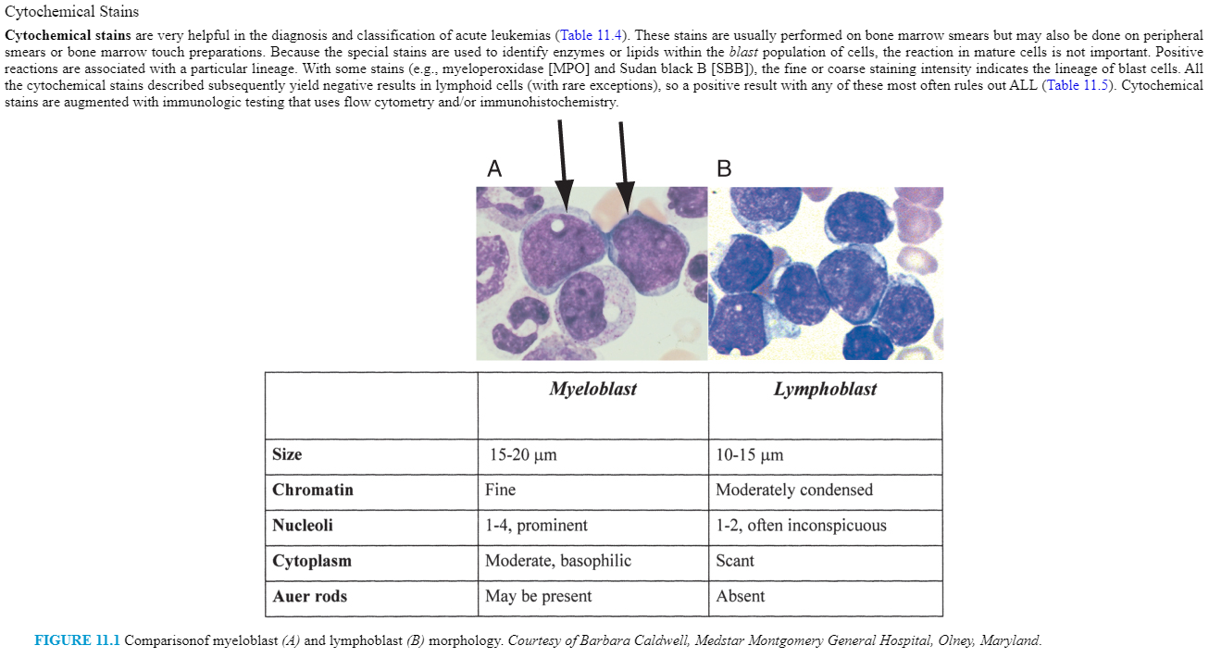
Review

Slide 26
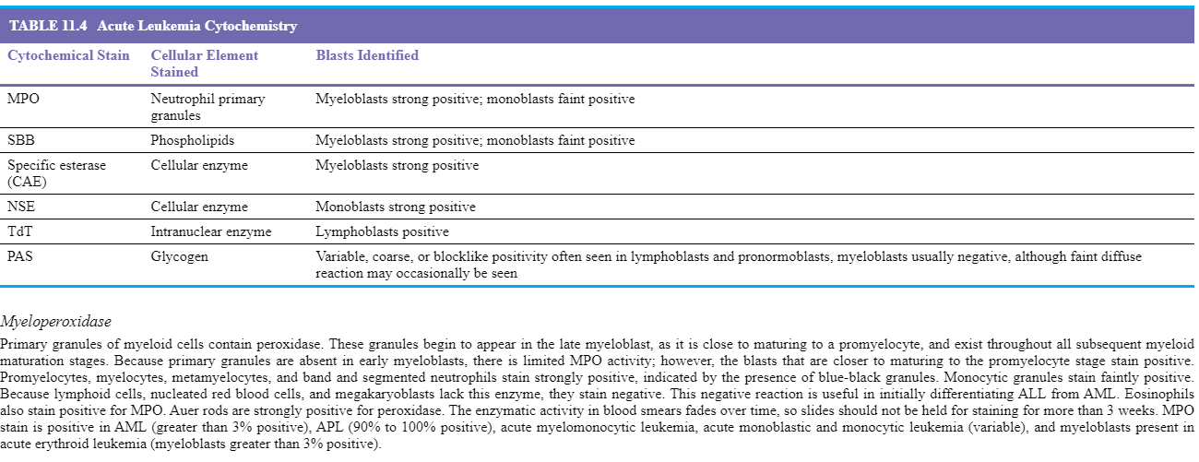
Review

Slide 27
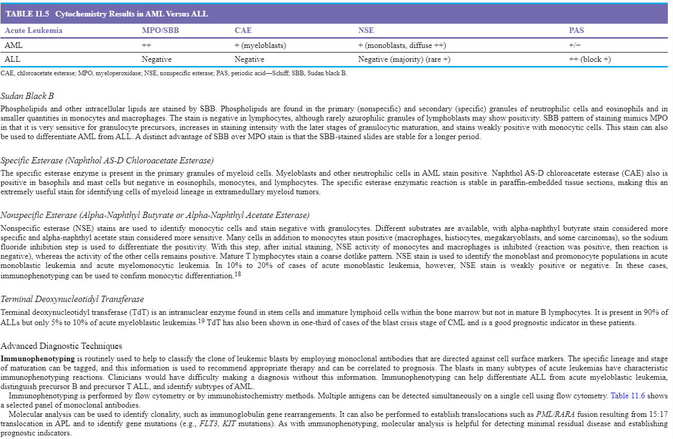
Review

