Slide 1
Chapter 1
CHAPTER 1
Quality Assurance and Regulation of the Blood Industry and Safety Issues in the Blood Bank

Slide 2
Objectives (1 of 5)
Define and list the elements of good manufacturing practices
Describe regulatory agencies that govern activities in the blood bank, and apply their regulations
Apply voluntary agency compliance guidelines to the workplace

Slide 3
Objectives (2 of 5)
Differentiate quality assurance (QA) from quality control
Identify the responsibilities of the QA department
Discuss the importance of job descriptions and personnel qualifications
Compare and contrast proficiency and competency testing

Slide 4
Objectives (3 of 5)
List the elements of, and explain the importance of, a well-written standard operating procedure (SOP)
Compare and contrast good record keeping with poor record keeping
Describe the elements of a good training program
Give examples of methods used to evaluate competency

Slide 5
Objectives (4 of 5)
Define calibration, preventive maintenance, and quality control requirements; discuss the importance of each in reporting accurate results
Define and describe the purpose behind root-cause analysis in error management
Define and apply universal and standard precautions
Properly dispose of laboratory waste material

Slide 6
Objectives (5 of 5)
List safety equipment and protective devices
Recognize the need for accident reporting
Encourage employee education in safety
Conduct testing using safety principles

Slide 7
Regulatory and Accrediting Agencies (1 of 2)
Food and Drug Administration (FDA)
Regulatory agency
Enforces regulations to ensure the safety and efficacy of blood and blood components and reagents used or manufactured by blood establishments
Code of Federal Regulations contains the requirements for safety and efficacy

Slide 8
Regulatory and Accrediting Agencies (2 of 2)
AABB
Voluntary accrediting agency
Publishes guidelines for members seeking accreditation (e.g., Technical Manual)
Standards for Blood Banks and Transfusion Services provides the basis for the inspection and accreditation of blood banks
Compliance with Quality Essentials is mandatory for blood bank accreditation (since 1998)

Slide 9
Elements of Quality Essentials
Table 1.1 Elements of Quality Assurance
● Records and SOPs ● Personnel selection and training ● Validation, calibration, preventive maintenance, proficiency testing ● Supplier qualification ● Error management ● Process improvement ● Process control ● Label control ● Internal auditing
SOPs, Standard operating procedures.

Slide 10
Safety Regulations
Occupational Safety and Health Act
Ensures safe and healthful working conditions
Enforced by the Occupational Safety and Health Administration (OSHA)
Environmental Protection Agency (EPA)
Involved in assessing medical waste as specified in the Medical Waste Tracking Act of 1988

Slide 11
Quality Assurance (QA)
QA comprises the combined activities performed by an organization to ensure the quality of products and services
QA responsibilities include
Compliance
Review and approval of all SOPs
Specifications and validation protocols
Development, review, and approval of training programs
Investigation of product recalls, errors, and complaints
Coordination of internal quality auditing programs

Slide 12
Good Manufacturing Practices
Table 1.2 Elements of Good Manufacturing Practices
● Write SOPs ● Follow SOPs ● Record and document all work performed ● Qualify personnel by training and education ● Design and build proper facilities and equipment ● Clean by following a housekeeping schedule ● Validate equipment, personnel, and processes ● Perform preventive maintenance on facilities and equipment ● Control for quality ● Audit for compliance with all of the above
SOPs, Standard operating procedures.

Slide 13
Records and Documents (1 of 3)
Facilities must have policies, processes, and procedures to ensure document identification, review, approval, and retention
Document Control
Should specify and describe acceptable media to be used, types of documents to be kept, and record-retention intervals
All record systems must be described in the SOPs
Record Keeping
An audit trail recreates every step in the production and distribution of a unit of blood and all its components

Slide 14
Records and Documents (2 of 3)
Manual Record Guidelines
Table 1.5 Good Record Keeping Versus Bad Record Keeping
Goog record keeping | Bad record keeping
Use of indelible (permanent) blue or black ink | Use of correction fluid or white tape when making a correction
Blue ink is preferred | Use of pencil or nonpermanent ink
Recording data on appropriate form or log | Recording data on a piece of scratch paper or sticky notes
Recording date and initials of person making a correction | Not recording date or initials of person making a correction
 | Recording data for someone else
Recording data immediately after performance of task | Recording data later or not immediately after performance of task
Not obliterating or deleting the original entry when making a correction | Obliterating or deleting original entry when making a correction
Indicating “broken,” “closed,” or “not in use” when appropriate | Not recording “broken,” “closed,” or “not in use” when appropriate
Not using “dittos” | Use of “dittos”

Slide 15
Records and Documents (3 of 3)
Computerized Record Guidelines
A computer system should be able to trace the original entry and person making the correction
Processes and procedures support management of computer systems and the backup of data
A backup method for retrieving data must be available

Slide 16
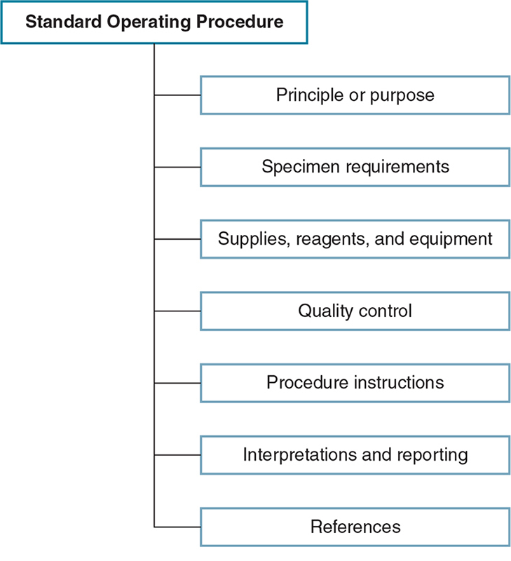
Standard Operating Procedures

Slide 17
Change Control
Change control is a process that develops or changes existing processes or procedures
Changes need to be controlled to prevent oversights that could affect the organization

Slide 18
Personnel Qualifications (1 of 2)
Selection criteria and job descriptions
Criteria must be identified for each type of position
Job description describes the tasks and skills
Training
Training is provided during new employee orientation, whenever there are procedural changes, or whenever an employee is performing poorly

Slide 19
Personnel Qualifications (2 of 2)
Competency assessment
Initial competency evaluates an employee’s knowledge and skills during training
Periodic competency determines whether an employee has maintained the knowledge and skills

Slide 20
Supplier Qualifications
Blood banks and suppliers have written agreements that specify expectations
Some facilities choose to audit suppliers
Facilities should have procedures for inspecting and testing incoming materials

Slide 21
Error Management
Root-cause analysis
Investigation and identification of factors contributing to an error
Ensures continuous quality improvement
Major errors involving a donor or patient are reported to the FDA
Recalls
Issued by manufacturers (or the FDA) to remove faulty products
Recalls are classified based on degree of danger

Slide 22
Validation
Validation establishes that a specific process consistently produces a product that meets predetermined specifications
A process or system should be validated before it is implemented

Slide 23
Facilities and Equipment
Facilities
Design: work area should be organized and free of clutter
Housekeeping: area should be clean
Equipment
Calibration: standardizes an instrument
Quality control: determines accuracy and precision of testing components
Preventive maintenance: periodic maintenance enhances reliability and avoids costly repairs

Slide 24
Proficiency Testing
Required component of the QA program
Ensures test methods and equipment are working properly
Surveys are prepared by accredited agencies
College of American Pathologists (CAP)
Survey samples are sent to laboratories for testing
Test results are recorded and submitted to agency
Test results are scored, and feedback is given

Slide 25
Label Control
Blood banks have instituted label control programs to avoid mislabeling errors
It is the QA department’s responsibility to inspect and approve all labels

Slide 26
Standard and Universal Precautions
Standard Precautions
Centers for Disease Control and Prevention (CDC) term (1987)
Includes policies that treat all body substances as potentially infectious
Incorporates universal precautions and body substance isolation together
Universal Precautions
OSHA term (1991)
Defines policies of treating all body substances as potentially infectious and applying safety measures to reduce possible exposure

Slide 27
Blood Bank Safety Program
Table 1.6 Occupational Safety and Health Administration Regulations for Protection from Bloodborne Pathogens Requirements
Employers must: ● Provide a hazard-free workplace ● Educate and train staff ● Evaluate all procedures for potential exposure risks ● Evaluate each employment position for potential exposure risks ● Implement labeling procedures and post signs ● Apply universal precautions for handling all body substances ● Provide personal protective equipment, such as gloves or other barriers, without cost to the employee ● Make HBV vaccine prophylaxis available to all staff who have occupational exposure, unless previously vaccinated or immune, and provide hepatitis B immune globulin treatment for percutaneous injury at no cost to the employee
HBV, Hepatitis B virus.

Slide 28
Blood Bank Safety (1 of 2)
Physical space
Laboratory attire
Fluid-resistant lab coat should be worn
No open-toed shoes
Personal protective equipment
Safety glasses, face shields, splash barriers
Showers and eyewashes should be available if splashes occur

Slide 29
Blood Bank Safety (2 of 2)
Biologic safety cabinets
Gloves and hand washing
Gloves should be worn when blood exposure occurs or is likely to occur
Hand washing is mandatory after removal of gloves and/or after leaving work area
Warning signs
Biohazard labels alert workers to take precautions

Slide 30
Decontamination
All laboratory surfaces and equipment should be routinely cleaned and decontaminated
Decontamination should occur daily or as needed, using
EPA-approved disinfectant
1:10 dilution of sodium hypochlorite (bleach)

Slide 31
Chemical Storage
Chemicals are classified by corrosiveness, ignitability, reactivity, and toxicity
Toxic substances must be accompanied by a Material Safety Data Sheet (MSDS)
MSDSs are required by OSHA and should be available in the laboratory to all employees

Slide 32
Radiation Safety
Blood banks use gamma irradiators for irradiation of blood components
Nuclear Regulatory Commission requires training for all personnel using irradiators
Employees are properly trained and monitored for exposure

Slide 33
Biohazardous Waste
Blood banks must have policies for handling all waste materials
All personnel are trained in a waste management program
Biohazardous materials must be placed in designated containers that are leak proof
Wastes containing blood and body fluids are autoclaved

Slide 34
Storage and Transportation
Storage
Blood and blood components are separate from reagents and specimens
Transportation
Specimens should be transported in plastic bags within the institution
Shipping of specimens to or from the laboratory must follow regulations of the Department of Transportation and the United States Postal Service

Slide 35
Personal Injury
An accident report MUST be completed when any injuries or possible injuries occur
Investigation of a minor accident may prevent a major accident later
Personnel should report all incidents, no matter how insignificant

Slide 36
Employee Education
OSHA and other regulatory and accrediting agencies mandate employee education
Blood bank safety should be reviewed with new employees before they begin work
The safety program should be reviewed annually by each employee
All participation is documented by a supervisor
Performance evaluations should include employee adherence

