Slide 1
Chapter 3
Blood Banking Reagents: Overview and Applications

Slide 2
Objectives (1 of 4)
Describe the relationship of potency and specificity to blood banking reagents
Compare and contrast polyclonal and monoclonal antibodies
Describe the reagents available for ABO typing
Describe the reagents available for D typing
Define the reagent control, and describe its purpose
Describe the different types and purposes of reagent red blood cells (RBCs)

Slide 3
Objectives (2 of 4)
Describe the basic principles of antiglobulin testing
Distinguish between direct and indirect antiglobulin tests (DATs and IATs)
Identify the indications for implementing DATs and IATs
Discuss the different sources of possible errors in the performance of antiglobulin testing

Slide 4
Objectives (3 of 4)
Compare and contrast the composition and appropriate uses of polyspecific and monospecific antiglobulin reagents
Discuss the role of potentiators in immunohematologic testing
Describe the functions of the following potentiators in immunohematologic testing: low-ionic-strength solution, bovine serum albumin, polyethylene glycol, and proteolytic enzymes

Slide 5
Objectives (4 of 4)
Define and identify common lectins used in blood banking
Describe the principles of gel technology, microplate techniques, and solid-phase RBC adherence techniques

Slide 6
Blood Banking Reagents
4 basic categories of reagents:
RBCs with known antigens
Antisera with known antibodies
Antiglobulin reagents: anti-IgG (anti-immunoglobulin G) and/or complement
Potentiators to enhance antibodies

Slide 7
Reagent Regulation
Commercial blood banking reagents are licensed by the Center for Biologics Evaluation and Research (Food and Drug Administration [FDA])
The FDA’s criteria can be found in the Code of Federal Regulations
Reagents must meet minimum standards before being licensed
Specificity: recognition of the antigenic determinant and its corresponding antibody
Potency: strength of the reaction

Slide 8
Quality Control
Quality Control (QC) is testing to determine the accuracy and precision of equipment, reagents, and procedures
Components of a QC program include
A statement of the criteria for acceptable reagent performance
Documentation of reagent use
Corrective actions for lack of performance

Slide 9
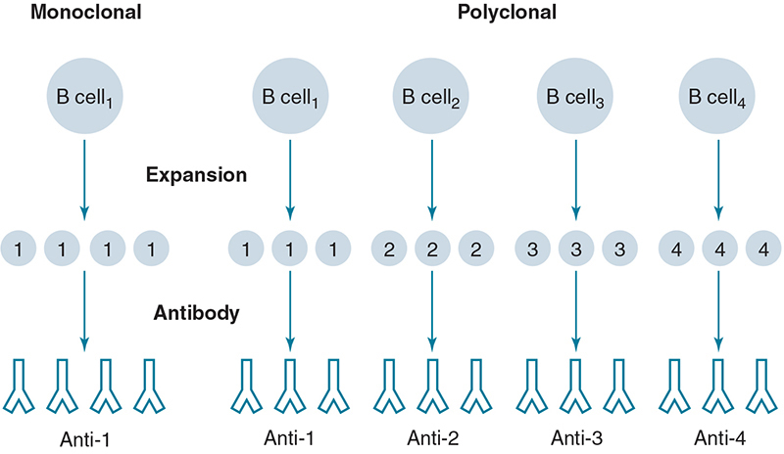
Commercial Antibody Reagents (1 of 2)
Polyclonal antibodies
Made from several different clones of B cells that secrete antibodies of different specificities
Recognize multiple epitopes
Example: antihuman globulin (AHG)

Slide 10
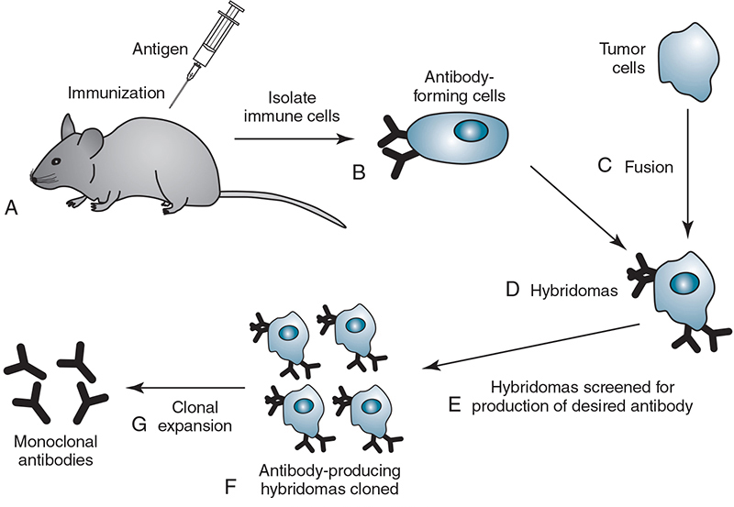
Commercial Antibody Reagents (2 of 2)
Monoclonal antibodies
Made from single clones of B cells that secrete antibodies of the same specificity
Use hybridoma technology
Recognize a single epitope
Examples: anti-A, anti-c, and anti-IgG antibodies
Notes:
A hybridoma is a hybrid cell formed by the fusion of a myeloma cell and an antibody-producing cell; it is used in the production of monoclonal antibodies.

Slide 11
Monoclonal Antibodies versus Polyclonal Antibodies
Table 3.1 Summary of Monoclonal and Polyclonal Antibody Products
Monoclonal antibody | Polyclonal antibody
Secreted by a single clone of antibody-producing B cells | Secreted by several different clones of antibody-producing B cells
One immunoglobulin class (IgG or IgM) | Mixture of IgM and IgG antibodies
Unique specificity for a particular epitope | Mixture of antibodies that may be directed at different epitopes of the same antigen

Slide 12
ABO Typing (1 of 2)
Anti-A and anti-B reagents are used to determine the ABO blood type
Both antisera are directed toward specific antigens on the patient’s RBCs
Anti-A: directed toward A antigen
Anti-B: directed toward B antigen
Table 3.2 ABO Red Cell Testing (ABO Forward Grouping)
ABO blood group antigens | Reaction with anti-A | Reaction with anti-B | ABO phenotype defined
A | + | 0 | A
B | 0 | + | B
AB | + | + | AB
O | 0 | 0 | O
+, Agglutination: 0, no agglutination.
Notes:
This textbook adopts AABB terminology and refers to the determination of an individual’s ABO type, not ABO group.

Slide 13
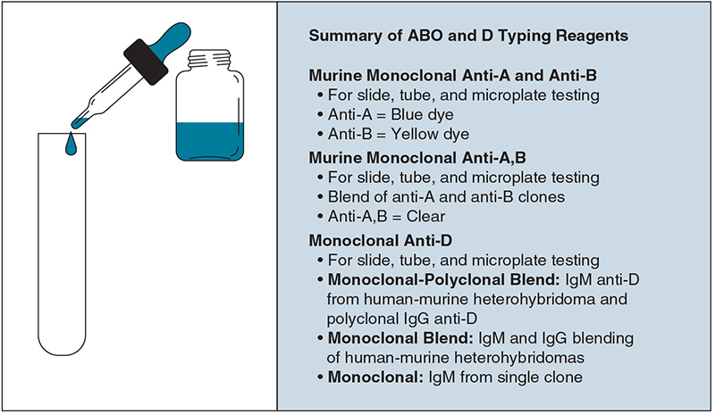
ABO Typing (2 of 2)
Reagents are formulated to give a strong reaction (3+ to 4+)
Testing is performed in the immediate-spin (IS) phase
Confirmation testing should check for expected ABO antibodies

Slide 14
D Antigen Typing
The Rh blood group system (see Chapter 6) contains several antigens, but the D antigen is the most important because of increased immunogenicity
The AABB’s Standards for Blood Banks and Transfusion Services requires that all blood samples be typed for the D antigen

Slide 15
D Antigen Typing Procedure
Commercial anti-D is combined with the patient and donor RBCs. Agglutination indicates the presence of the D antigen; no agglutination indicates the absence of the D antigen. A negative reagent control ensures that a false-positive result has not occurred.
Table 3.3 Typing for D Antigen With Patient or Donor Red Cells
D antigen | Reaction with anti-D | Reaction with reagent control
D-positive | + | 0
D-negative | 0 | 0
Cannot interpret typing | + | +
+, Agglutination; 0, no agglutination.

Slide 16
Anti-D Reagents
High-protein reagents
Contain polyclonal antibodies
Approximately 20% bovine albumin
Promote false-positive agglutination
Low-protein reagents
Contain monoclonal antibodies (IgM) or monoclonal and polyclonal blends
Approximately 6% bovine albumin
Have replaced high-protein reagents

Slide 17
Low-Protein Reagent Control
Controls ensure that typing results are correct
Controls should show no agglutination
False-positive agglutination can result from
Strong cold autoantibodies
Protein abnormalities
When is a separate control used?
A separate control is used if RBCs agglutinate with all ABO antisera
A separate control is not needed if there is a negative result using any of the ABO low-protein reagents

Slide 18
Reagent RBCs
Commercial reagent RBCs contain known antigens to confirm the presence of antibodies in patient serum or plasma
Procedures that use commercial RBCs
ABO serum testing
Screening tests
Antibody identification

Slide 19
A1 and B Cells (1 of 2)
Table 3.5 ABO Serum Testing (Reverse Grouping)
ABO blood group antigens | Reaction with reagent A₁ cells | Reaction with reagent B cells | ABO antibody defined
A | 0 | + | Anti-B
B | + | 0 | Anti-A
AB | 0 | 0 | No anti-A or anti-B present
O | + | + | Anti-A and anti-B
+, Agglutination; 0, no agglutination.
Commercial A1 and B cells are combined with the patient’s serum or plasma to determine the reverse grouping
Patients possess the antibody directed against the antigen of the ABO system that is lacking on their RBCs

Slide 20
A1 and B Cells (2 of 2)
Can be from a single donor or a pool of donors
Resuspended to a 2% to 5% concentration
Negative for Rh antigens (D, C, and E)
Should not be used if red cells darken, agglutinate in the vial, or show hemolysis

Slide 21
Screening Cells (1 of 2)
Screening cells are used in antibody screen (detection) tests for unexpected antibodies
Available in sets of 2 or 3 vials
Each vial may be from a single donor or two donors (pooled together)
Pooled cells can be used for donor testing, but only single-donor vials are used when a person is about to receive a transfusion (e.g., recipient)
Single-donor cells tend to give stronger reactions

Slide 22
Screening Cells (2 of 2)
Each lot of screening cells comes with an antigram that shows the antigen profile
The cells must express antigens associated with the most clinically significant antibodies
Screening cells are regulated by the FDA for:
D, C, E, c, e, M, N, S, s, P1, Leª, Le^{b}, K, k, Fyª, Fy^{b}, Jkª, and Jk^{b}

Slide 23
Panel Cells
Panel cells are similar to screening cells, except they are obtained in vials of 10 or more
Panel cells are used for identifying antibodies in a procedure called an antibody panel
Each lot of panel cells will have an antigram that shows the antigenic profile of each vial

Slide 24
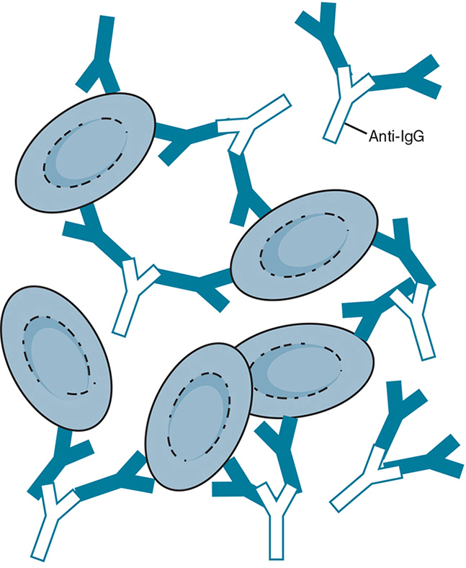
Antiglobulin Test
Principle of test
Commercial antibody with a specificity toward human globulins is used to agglutinate antibody-coated RBCs
Reagent contains antibodies toward:
IgG (anti-IgG) and/or
Complement (anti-C3d, anti-C3b)

Slide 25
Types of Antiglobulin Tests
Detects IgG or complement bound to RBCs in vivo
In the procedure, AHG reagent is added after the RBCs have been washed
Agglutination demonstrates whether IgG or complement was attached to the RBCs
Direct Antiglobulin Test (DAT)

Slide 26
Positive DAT
Table 3.6 Clinical Examples Causing a Positive Direct Antiglobulin Test
Clinical condition | Caused by | Source of IgG
Transfusion reaction | Donor cells coated with IgG | Recipient (patient) antibody
Hemolytic disease of the fetus and newborn | Fetal red cells coated with IgG | Maternal antibody crossing the placenta
Autoimmune hemolytic anemia | IgG or C3 on patient red cells | Patient autoantibody
Drug-related mechanism | IgG-drug complex attached to cells | Immune complex formed with drug

Slide 27
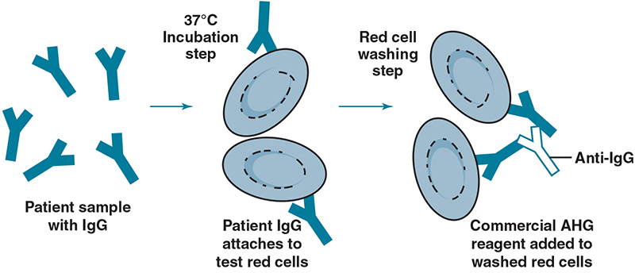
Types of Antiglobulin Tests
Indirect Antiglobulin Test (IAT)
Detects IgG or complement bound to RBCs in vitro
Two-step procedure
Antibodies (in serum) are incubated at 37° C with RBC antigens in vitro
RBC suspension is washed and then combined with AHG reagent to detect agglutination

Slide 28
Applications of IAT
Table 3.7 Applications of Indirect Antiglobulin Test in the Immunohematology Laboratory
Procedure | Purpose
Antibody screening | Detects antibodies with specificity to red cell antigens
Antibody identification | Identifies specificity of red cell antibodies
Crossmatch | Determines serologic compatibility between donor and patient before transfusion
Antigen typing | Identifies a specific red cell antigen in a patient or donor

Slide 29
Sources of Error (1 of 2)
Table 3.9 Common Sources of False-Positive Error in Antiglobulin Testing
False-positive | Possible explanations
Red cells are agglutinated before washing step and addition of antihuman globulin reagent | Potent cold reactive antibody of patient origin
Use of dirty glassware | Particles or contaminants
Improper centrifugation—overcentrifugation | Red cell button packed so tightly on centrifugation that nonspecific clumping cannot be dispersed

Slide 30
Sources of Error (2 of 2)
Table 3.10 Common Sources of False-Negative Error in Antiglobulin Testing
False-negative | Possible explanations
Failure to wash cells adequately during the test procedure before the addition of AHG reagent | Unbound human serum globulins neutralize AHG reagent
Testing is interrupted or delayed; AHG reagent is not added immediately after washing | Bound IgG or complement molecules may detach from the coated red cells
Failure to identify weak positive reactions | Technical error in testing
Loss of reagent activity | Improper reagent storage, bacterial contamination, or contamination with human serum
Failure to add AHG reagent | Technical error in testing
Improper centrifugation: undercentrifugation | Conditions for promoting agglutination are not optimal
Inappropriate red cell concentrations—red cell suspensions fall outside the optimal 2%-5% | Concentration of red cells influences the agglutination reaction
AHG, Antihuman globulin.

Slide 31
Antiglobulin Reagents
Polyspecific AHG
Contains both anti-IgG and anti-C3d antibodies
Derived from polyclonal or monoclonal sources
Agglutination indicates that IgG or complement is coating the RBCs
If positive, a differential DAT is performed
Monospecific AHG
Contains either anti-IgG or anti-C3b/C3d, but not both
Anti-IgG combines with human gamma chains
Anti-C3b/C3d specifically detects complement proteins as a result of activation of the classical pathway
Intravascular hemolysis
Extravascular hemolysis
Notes:
Differential DAT is an immunohematologic test that uses monospecific anti-IgG and monospecific anti-C3d/anti-C3b reagents to determine the cause of a positive DAT with polyspecific antiglobulin reagents.

Slide 32
IgG-Sensitized Cells
Required by AABB as a control system when AHG results are negative
When added to a negative AHG test, reagent should cause agglutination
Commercial reagents are type O RBCs prepared with IgG antibodies attached
False-negative results are caused by
Failure to add the AHG reagent
Failure of the AHG reagent to react
Failure to wash the RBCs adequately

Slide 33
Potentiators
Table 3.12 Summary of Antibody Potentiators
Potentiator | Mechanism of action
Low-ionic-strength saline (LISS) | Increases rate of antibody uptake
Polyethylene glycol (PEG) | Concentrates the antibody in the test environment in LISS
Proteolytic enzymes (papain and ficin) | Removes negative charges from the red cell membrane, which reduces the zeta potential; denatures some red cell antigens
Bovine serum albumin (BSA) | Reduces the repulsion between cells but does not shorten the incubation time
Reagents that enhance the detection of IgG antibodies by increasing their reactivity

Slide 34
Bovine Serum Albumin
Available in 22% or 30% concentration
Allows antibody-sensitized cells to become closer together than is possible with saline
Favors direct agglutination with Rh antibodies
Enhances sensitivity of the IAT

Slide 35
Lectins
Seed extracts that have specificity toward certain RBC antigens
Bind to carbohydrate determinants of RBC antigens
Table 3.13 Summary of Common Lectins in the Blood Bank
Lectin | Antigen specificity
Dolichos biflorus | A₁ phenotype
Ulex europaeus | H
Vicia graminea | N
Iberis amara | M

Slide 36
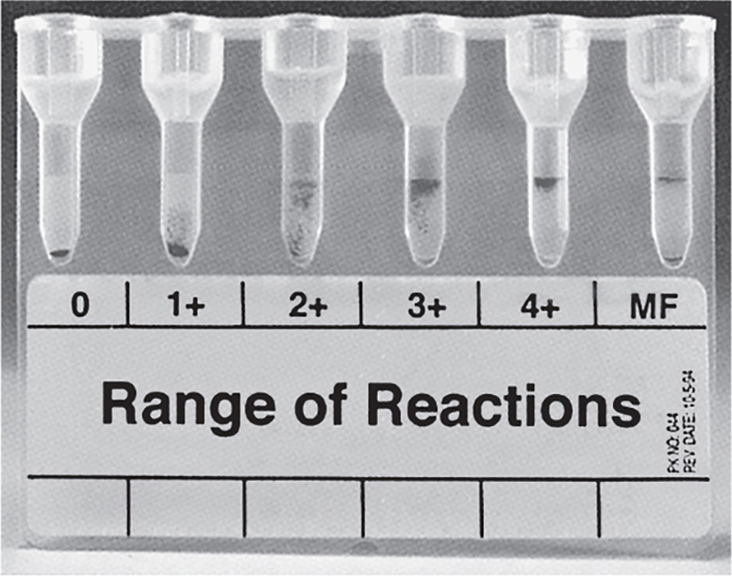
Other Methods: Gel Technology
Uses dextran acrylamide gel particles to trap agglutinated cells
Gel particles are combined with reagents and predispensed in microtubes of plastic cards
RBCs or plasma/serum are added to the microtube and allowed to incubate before centrifugation
Large agglutinates are trapped at the top of the microtubes (4+)
Nonagglutinated cells travel unimpeded to the bottom of the microtube (0)

Slide 37
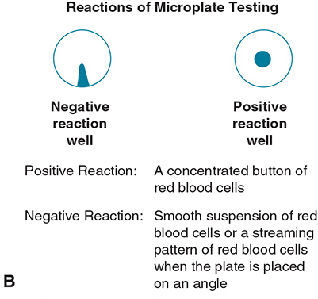
Other Methods: Microplate
A 96-well microtiter plate replaces test tubes
Applies same principle as test tube method
A concentrated button indicates a reaction
Dispersed cells indicate no reaction

Slide 38
Other Methods: Solid Phase
Uses microplate wells with immobilized reagent
Cells that adhere to the sides and bottom of the wells are positive
Cells that settle to the bottom of the wells are negative

