Slide 1
Chapter 4
Genetic Principles in
Blood Banking

Slide 2
Objectives (1 of 5)
Define the term blood group system with regard to genetic terms
Differentiate phenotype from genotype
Define the following terms: gene, allele, haplotype, and polymorphic
Distinguish homozygous from heterozygous, and provide an example using blood group system alleles

Slide 3
Objectives (2 of 5)
Define the dosage effect, and explain its significance in testing
Explain the difference between cis and trans and their effects on gene interactions
Define codominant inheritance
Explain phenotype frequency and how it is used to find compatible red blood cell (RBC) units

Slide 4
Objectives (3 of 5)
Describe the application of the Hardy-Weinberg law in population genetics
Explain the mendelian laws of independent assortment and independent segregation and how they apply to blood group antigen inheritance
Define the terms linkage and crossing over, and explain how they affect independent assortment

Slide 5
Objectives (4 of 5)
Define an amorphic gene
List the applications of molecular testing methods to the field of blood banking
Compare and contrast molecular techniques used to identify human leukocyte antigens (HLAs)
Describe the theory of short tandem repeat (STR) testing and its application to hematopoietic progenitor cell (HPC) chimerism evaluation

Slide 6
Objectives (5 of 5)
Describe the molecular techniques used to identify RBC antigens and their advantages over hemagglutination methods

Slide 7
Blood Group Systems
Blood group systems are groups of antigens on the RBC membrane that share related serologic properties and genetic patterns of inheritance

Slide 8
Blood Group Genetics
Genetic material is found in DNA
DNA is contained in chromosomes that are in the nucleus of every cell
Genetic material is replicated either by mitosis (somatic cells) or meiosis (gametes)

Slide 9
Phenotype Versus Genotype
Phenotype
Physical (observed) expression of traits
The patient’s phenotype is determined by hemagglutination of RBC antigens using antisera
Example: A person who shows no agglutination with anti-A or anti-B antisera is considered to have type O blood
Genotype
Actual genetic makeup
Can only be determined by molecular techniques or family studies
Example: A person with the phenotype A could have the genotype A/A or A/O; family studies would be necessary to confirm which is present

Slide 10
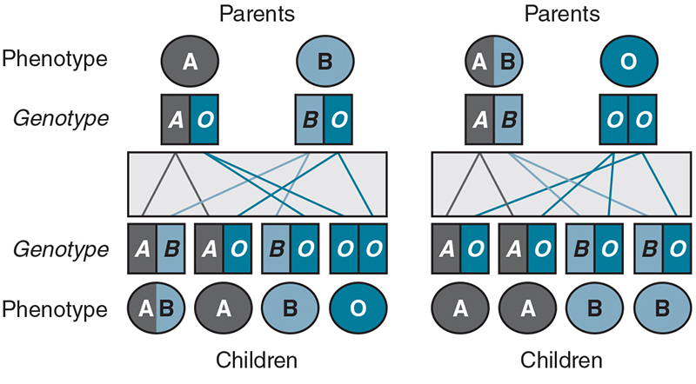
Phenotype and Genotype
Notes:
The difference between the genotype and the phenotype is illustrated in this diagram of ABO system inheritance patterns.

Slide 11
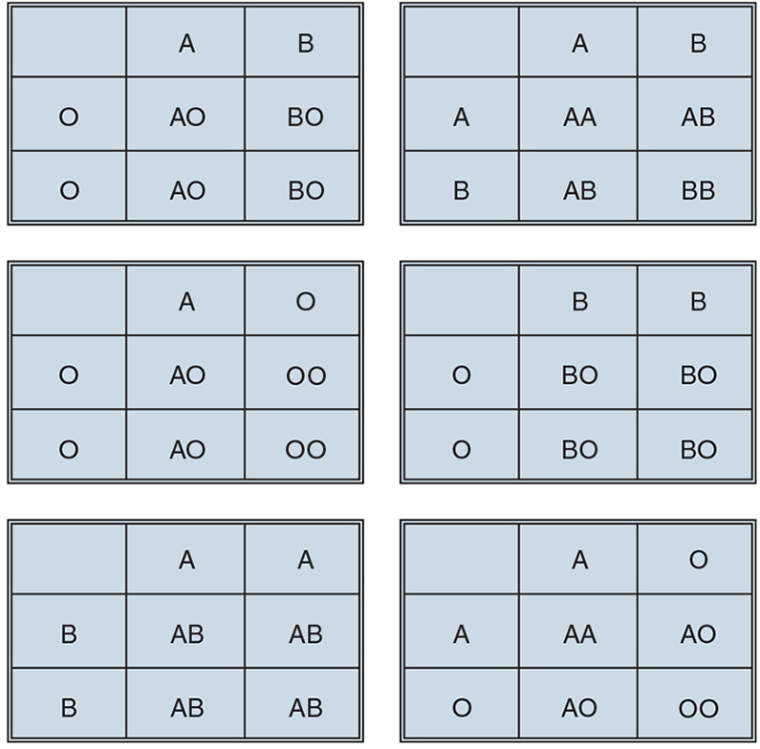
Punnett Square
A Punnett square is used to predict the probability of an offspring’s genotype
It summarizes every possible combination of maternal and paternal alleles of a particular gene

Slide 12
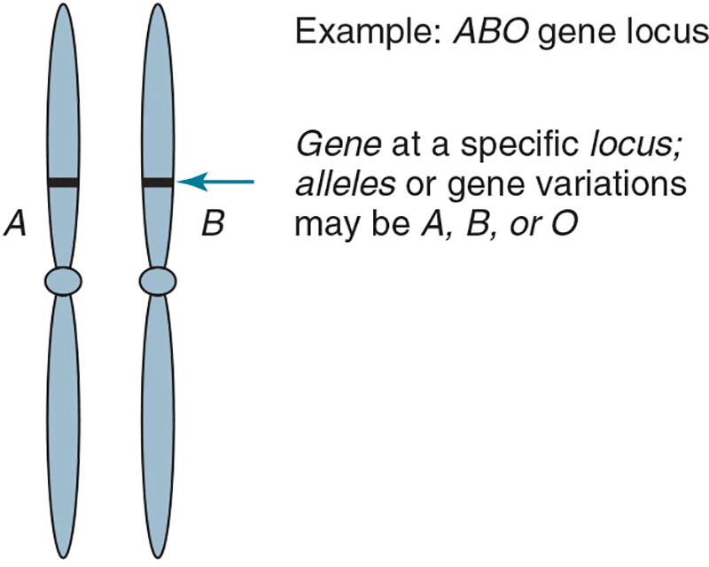
Genes
Genes are basic units of inheritance on a chromosome
A locus is the site at which a gene is located on a chromosome
Alleles, which are alternative forms of a gene, are found at each locus
Antigens produced by opposite alleles are antithetical (e.g., Kpª and Kp^{b} antigens)
Multiple alleles at a single locus are considered polymorphic

Slide 13
Inheritance
Recessive
Gene is expressed only when inherited by both parents
Codominant
Equal expression of two different alleles
Blood group antigens are codominant
Dominant
Gene that is expressed over another gene
Genes that do not express a detectable product are considered amorphic (e.g., O gene)

Slide 14
Mendelian Principles
Mendelian principles can be applied to blood group antigen inheritance
Independent segregation occurs when one gene from each parent is passed to the offspring
Independent assortment is demonstrated when blood group antigens from different chromosomes are expressed separately, resulting in a mixture of genetic material
Two exceptions to this law are linkage and crossing over

Slide 15
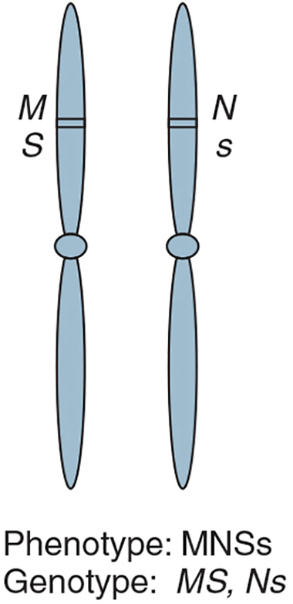
Linkage
Linkage occurs when 2 genes that are close to each other are inherited together
Each set of linked genes is called a haplotype
Haplotypes tend to occur at a higher frequency than for unlinked genes, a phenomenon called linkage disequilibrium

Slide 16
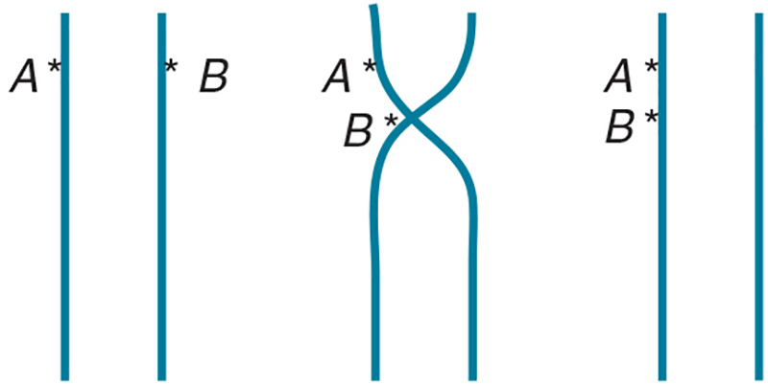
Crossing Over
Crossing over occurs when 2 genes on the same chromosome combine and produce 2 new chromosomes

Slide 17
Chromosomal Assignment
Most blood group system genes are on autosomes, except for those of the Xg system
Xg genes are found on the X chromosome
If the father carries the Xg allele, he will pass it to all of his daughters but not to any of his sons
If the mother carries the Xg allele (not the father), all of their children will express Xg
Notes:
Autosomes are all chromosomes other than sex chromosomes.

Slide 18
Heterozygosity and Homozygosity
A person who inherits identical alleles is called homozygous
AA, BB, MM (M+ N–)
A person who inherits different alleles is called heterozygous
AO, AB, MN (M+ N+)

Slide 19
Dosage
In some blood group systems, persons homozygous for an allele have a “double dose” of an antigen on their RBCs compared with those who are heterozygous for an allele
Dosage is a variation in antigen expression due to the number of alleles present

Slide 20
Dosage Example
Homozygous expression of some antigens will show stronger agglutination compared with antigens that are heterozygous

Slide 21
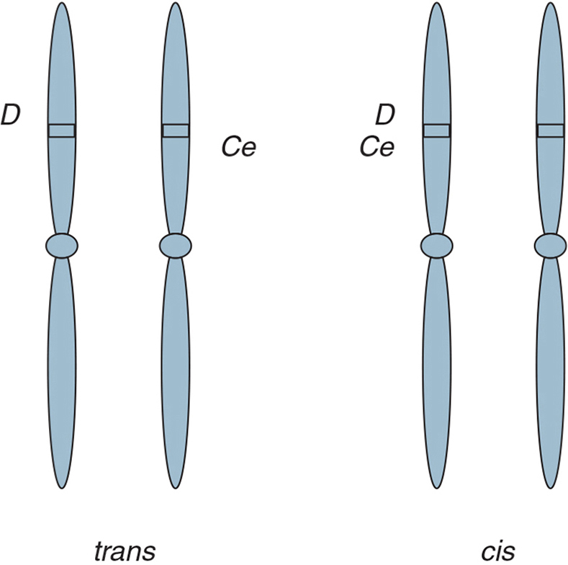
Genetic Interaction
The location of inherited genes in cis or trans positions can affect the expression of the antigen
Alleles on the same chromosome are cis to one another
Alleles on opposite chromosomes are in the trans position

Slide 22
Population Genetics
To determine genotype or phenotype occurrence, two formulas are used:
A phenotype calculation enables finding a unit of RBCs with certain antigen characteristics (i.e., antigen negative)
The Hardy-Weinberg formula calculates a determination of the gene frequencies that produced a trait

Slide 23
Phenotype Calculations (1 of 2)
Example: a patient with multiple antibodies (anti-C, anti-E, anti-S) needs blood
Conclusion: about 10% of the population will be negative for all three antigens; about 1 in 10 units will be compatible
What Is Known | Percentage Negative | Convert to Decimal and Then Multiply
70% C positive | 30% | 0.30
30% E positive | 70% | 0.70
55% S positive | 45% | 0.45
0.30 x 0.70 x 0.45 = 0.0945 or 0.10 (10%)

Slide 24
Phenotype Calculations (2 of 2)
Example: a patient with multiple antibodies needs 2 units
2 units needed / 0.09 (antigen negative frequency) = 22
Conclusion: antigen typing of 22 units may be required to find 2 compatible units
What Is Known | Percentage Negative | Convert to Decimal and Then Multiply
66% Fyª positive | 34% | 0.34
72% Jk^{b} positive | 28% | 0.28
9% K positive | 91% | 0.91
0.34 x 0.28 x 0.91 = 0.087 or 9% negative (9 out of 100)

Slide 25
Hardy-Weinberg Formula
Example
Basic Formula
p is the frequency of allele A
q is the frequency of allele a
What is the frequency of q if p is 0.3?
1 – 0.3 = 0.7
What are the genotype proportions?
AA = p² or 0.09 (homozygous for A)
Aa = 2pq or 0.42 (heterozygous for Aa)
aa = q² or 0.49 (homozygous for a)
p represents allele #1
q represents allele #2
Gene frequency is represented by p + q = 1
Genotype proportions are
(p + q)² = 1.0
or
p² + 2pq + q² = 1.0

Slide 26
Molecular Genetics Applications
Table 4.3 Applications of Molecular Testing in the Blood Bank
Transplantation | HLA antigen-level and allele-level typing for HPC and organ transplants
 | Engraftment studies for HPC transplants
Transfusion | Red cell typing in multiply transfused patients
 | Determine blood type when the DAT is positive
 | Complex Rh genotypes, weak D expression
 | Screen for antigen-negative donor units when antisera are unavailable
 | Donor antigen screening for prevention of alloimmunization
HDFN | Determine parental RhD zygosity
 | Type fetal blood
Donor testing | Detect virus in donors that may be below detectable levels by anti-body detection methods
Relationship testing | Establish paternity and legal relationships for immigration
DAT, direct antiglobulin test; HDFN, hemolytic disease of the fetus and newborn; HLA, human leukocyte antigen; HPC, hematopoietic progenitor cell. From Alexander L: Personalized therapy reaches transfusion medicine, AABB News 13:10, 2011.

Slide 27
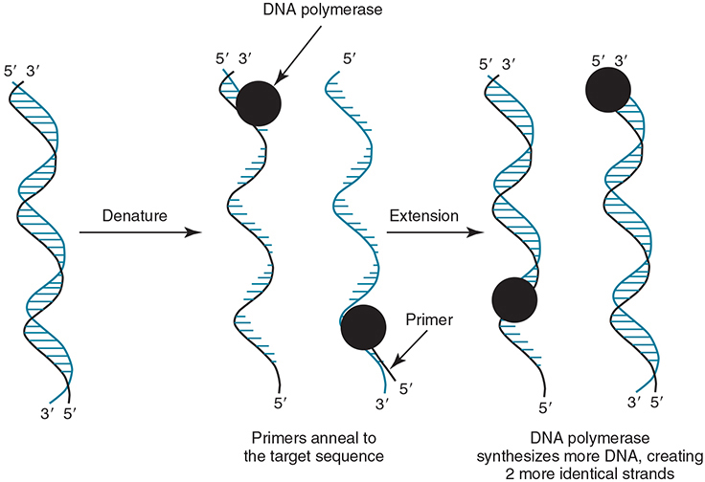
Polymerase Chain Reaction (PCR)
PCR rapidly and precisely multiplies specific DNA sequences
DNA is denatured
A primer is added to attach specific areas of DNA
DNA is amplified and replicated

Slide 28
PCR-Based HLA Typing Procedures (1 of 4)
Sequence-Specific Primers (SSPs)
Primers are available in PCR trays
Low resolution—identifies antigen level
High resolution—defines specific alleles for the antigen
Amplified DNA (amplicons) are assessed using gel electrophoresis

Slide 29
PCR-Based HLA Typing Procedures (2 of 4)
Sequence-Specific Oligonucleotides (SSOs)
A primer for each locus is used
A, B, C, DR, DQ, DP (in separate wells)
A DNA probe allows the hybridized solution to be read and analyzed by a flow cytometer

Slide 30
PCR-Based HLA Typing Procedures (3 of 4)
Sequence-Based Typing (SBT)
Provides high-resolution, allele-level typing
Primers are similar to SSOs
An instrument analyzes the nucleotide and amino acid sequences that correspond to the allele

Slide 31
PCR-Based HLA Typing Procedures (4 of 4)
Donors and recipients have closely matched HLA alleles but may have slight variations in the DNA sequence called polymorphisms
Chimerism evaluation uses these differences to determine the percentage of DNA from the donor in a stem cell recipient
STRs are short sequences of DNA that are amplified to determine the percentage of engraftment in chimerism evaluation
Short Tandem Repeats (STRs)

Slide 32
Molecular Applications of RBC Typing
Table 4.3 Applications of Molecular Testing in the Blood Bank
Transplantation | HLA antigen-level and allele-level typing for HPC and organ transplants
 | Engraftment studies for HPC transplants
Transfusion | Red cell typing in multiply transfused patients
 | Determine blood type when the DAT is positive
 | Complex Rh genotypes, weak D expression
 | Screen for antigen-negative donor units when antisera are unavailable
 | Donor antigen screening for prevention of alloimmunization
HDFN | Determine parental RhD zygosity
 | Type fetal blood
Donor testing | Detect virus in donors that may be below detectable levels by anti-body detection methods
Relationship testing | Establish paternity and legal relationships for immigration
DAT, direct antiglobulin test; HDFN, hemolytic disease of the fetus and newborn; HLA, human leukocyte antigen; HPC, hematopoietic progenitor cell. From Alexander L: Personalized therapy reaches transfusion medicine, AABB News 13:10, 2011.
Notes:
Molecular methods (in several situations) may yield more accurate results and can be more cost-effective for donor RBC antigen typing.

Slide 33
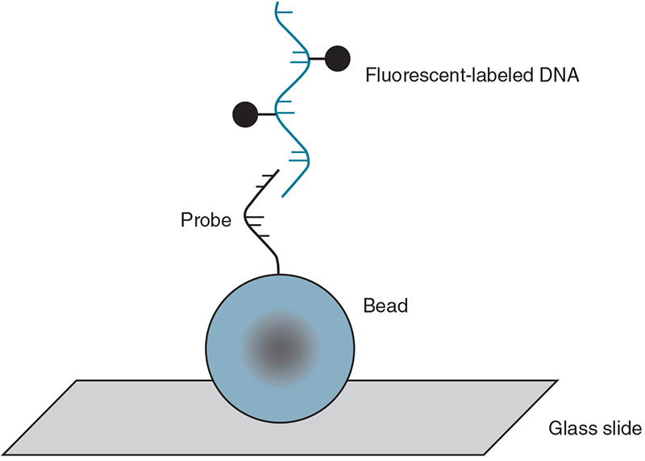
BeadChip Technology
Uses oligonucleotide primers attached to colored silica beads on a substrate (slide)
Amplified and digested DNA in question binds to the primers
Computer analysis determines which primers have attached

