Slide 1
Chapter 5
ABO and H Blood Group Systems and Secretor Status

Slide 2
Objectives (1 of 5)
Define a blood group system with regard to blood group antigens and their inheritance
Explain Landsteiner’s rule
List the cells, body fluids, and secretions where ABO antigens can be located
Describe the relationships among the ABO, H, and Se genes

Slide 3
Objectives (2 of 5)
Differentiate between type 1 and type 2 oligosaccharide structures and state where each is located
Describe the formation of the H antigen from the gene product and its relationship to ABO antigen expression
Discuss the selection of whole blood, red blood cell, and plasma products for transfusions
List the glycosyltransferases and the immunodominant sugars for the A, B, O, and H alleles

Slide 4
Objectives (3 of 5)
Compare and contrast the A₁ and A₂ phenotypes with regard to antigen structure and serologic testing
Describe how to differentiate among A₃, A_{x}, and A_{el} subgroups by serologic testing
Determine the possible ABO genotypes with an ABO phenotype
Describe the ABO blood group system antibodies with regard to immunoglobulin class, clinical significance, and in vitro serologic reactions

Slide 5
Objectives (4 of 5)
Define the terms universal donor and universal recipient as they apply to RBC and plasma products
List the technical errors that may result in an ABO discrepancy
Define the acquired B antigen and B(A) phenotypes; discuss the ABO discrepancies that would result from these phenotypes and methods used in resolving these discrepancies

Slide 6
Objectives (5 of 5)
List reasons for missing or weakly expressed ABO antigens and the test methods used to resolve these discrepancies
Describe ABO discrepancies caused by extra reactions in serum testing and how they can be resolved
Discuss the Bombay phenotype with regard to genetic pathway, serologic reactions, and transfusion implications
Define the terms secretor and nonsecretor

Slide 7
History
Karl Landsteiner discovered the ABO blood group system in 1900
Landsteiner’s rule (law) states that healthy individuals possess ABO antibodies to the ABO blood group antigens absent from their RBCs

Slide 8
General Characteristics
ABO antigens can be intrinsic to the RBC membrane or soluble (body fluids)
ABO antigens are detected in the embryo as early as 5 to 6 weeks’ gestation
Newborns’ RBCs have fewer numbers and partially developed antigens
Full expression occurs at about 2 to 4 years of age

Slide 9
ABO and H Antigen Genetics
Genes at 3 separate loci influence the occurrence and location of ABO antigens: ABO, H, Se
The presence or absence of the ABH antigens on the RBC membrane is controlled by the H gene
The presence or absence of the ABH antigens in secretions is influenced by the Se gene

Slide 10
Genetics
H gene → H and h alleles (h is an amorph)
The Bombay phenotype lacks the H antigen (hh)
Se gene → Se and se alleles (se is an amorph)
ABO genes → A, B, and O alleles

Slide 11
Basic Structure
The oligosaccharide chain is a basic precursor structure for several RBC antigens, including A, B, and H
Attached to a protein or lipid carrier molecule

Slide 12
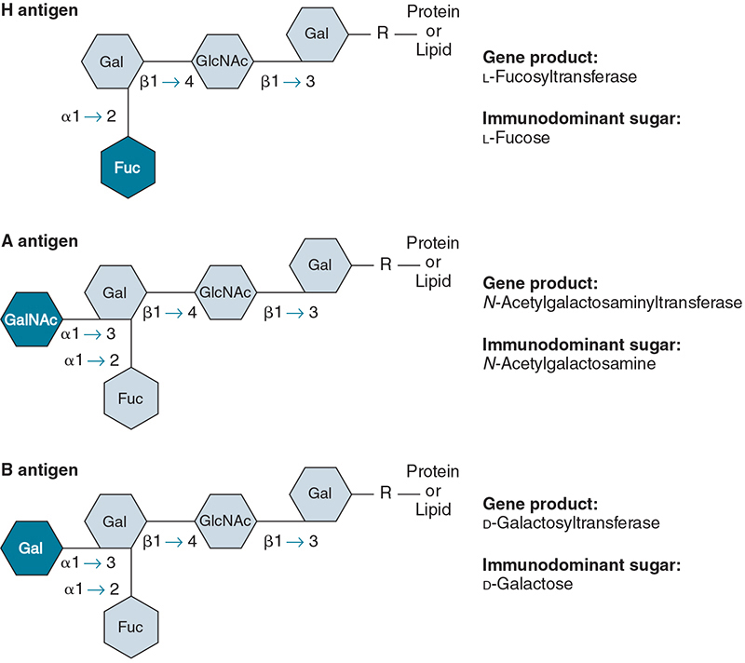
H Antigen
The H gene codes for a glucosyltransferase enzyme that transfers the immunodominant sugar, L-fucose, to the terminal sugar of the oligosaccharide chain (Type 2)
The H antigen is the foundation for the A and/or B antigens

Slide 13
A and B Antigens
The “A” gene codes for a transferase that adds the immunodominant sugar, N-acetylgalactosamine, to the terminal sugar of the H antigen
Gene Product: N-acetylgalactosaminyltransferase
The “B” gene codes for a transferase that adds the immunodominant sugar, D-galactose, to the terminal sugar of the H antigen
Gene Product: D-galactosyltransferase

Slide 14
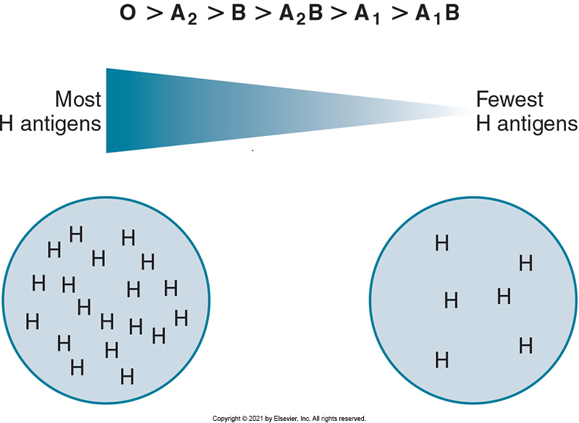
Antigen Concentration
Certain blood types possess more H antigen than others
Group O individuals have many H antigen sites because they have no A or B antigens

Slide 15
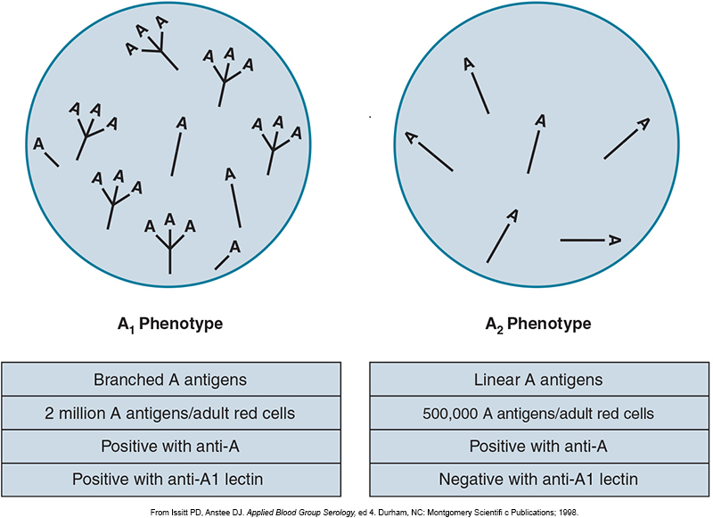
Subgroups of A Type
The 2 main subgroups of A are A₁ and A₂
Both react strongly with reagent anti-A (3+ to 4+)
To distinguish A₁ from A₂ red cells, the lectin Dolichos biflorus is used (anti-A1)
Agglutinates with A₁
Does not agglutinate with A₂
80% of A or AB individuals are A₁
20% are A₂ and A₂B

Slide 16
Additional Subgroups of A and B Types
Rare subgroups of the A type include
A_{int} (intermediate), A₃, A_{x}, A_{m}, A_{end}, A_{el}, A_{bantu}
Subgroups of the B type are less common than subgroups of the A type and typically do not react strongly with anti-B reagents
Rare subgroup of the A type may be present if:
Weak or no agglutination with commercial anti-A and anti-A,B occurs
Anti-A1 is present
Anti-H causes strong agglutination

Slide 17
Subgroup Importance
Why is it important to identify subgroups?
If a weak subgroup is missed in a donor, the incorrect blood group could be given to the recipient
Example: a group A subgroup in the donor is classified as group O; the group O recipient receives the unit and has a transfusion reaction (i.e., the recipient’s anti-A antibody reacts with the donor cells)

Slide 18
ABO Antibodies (1 of 2)
ABO antibodies are non-RBC stimulated, or naturally occurring
Antibody production is unrelated to an RBC antigen
Results from exposure to A and B like antigens in the environment (e.g., normal bacterial flora)
ABO antibodies may not be detected until 3 to 6 months of age
Titers reach maximum levels by 5 to 10 years of age and decrease as an individual grows older

Slide 19
ABO Antibodies (2 of 2)
Most anti-A and anti-B antibodies in group A or B individuals are predominantly immunoglobulin M (IgM)
Clinically significant because they are able to bind complement
React optimally during immediate-spin (IS) crossmatching
Anti-A,B antibody is found in group O individuals
Cross-reacts with both A and B antigens
Blood Group | Antibodies | Antibody Class
A | Anti-B | IgM (some IgG)
B | Anti-A | IgM (some IgG)
O | Anti-A Anti-B Anti-A,B | Mostly IgG

Slide 20
Anti-A1 Antibody
Produced by subgroups of the A type
Has specificity to the A₁ antigen but will not agglutinate A₂ cells
Not clinically significant
May cause incompatible crossmatches on IS testing

Slide 21
Routine ABO Phenotyping
Two components of ABO phenotyping
Forward grouping
RBCs are tested for ABO antigens
Determines ABO phenotype
Reverse grouping
Serum or plasma is tested for ABO antibodies
Acts as a control for RBC testing
Both forward and reverse testing are required on donor and recipient blood samples
Standards for Blood Banks and Transfusion Services

Slide 22
ABO Phenotype Reactions
Table 5.5 ABO Phenotype Reactions
 | Red cell reactions with |  | Serum or plasma reactions with
Phenotype | Anti-A | Anti-B | A₁ cells | B cells
Group A | + | 0 | 0 | +
Group B | 0 | + | + | 0
Group O | 0 | 0 | + | +
Group AB | + | + | 0 | 0
+, Agglutination; 0, no agglutination.

Slide 23
Transfusion Selection
RBC transfusion
ABO-identical unit is preferred, followed by ABO-compatible unit for RBC transfusions
Incompatible RBCs can cause an acute hemolytic transfusion reaction
ABO-identical unit is required in whole blood transfusions
Group O: universal donor
Group AB: universal recipient
Plasma transfusion
ABO-identical unit is preferred or compatible (reverse of RBC transfusions)
Donor unit antibodies must be compatible with recipient’s RBCs
Group AB: universal donor
Group O: universal recipient

Slide 24
ABO Compatibility
Table 5.6 Practical Application: ABO Compatibility for Whole Blood, Red Blood Cells, and Plasma Transfusions
Recipient | Donor
ABO Phenotype | Whole Blood | Red blood cells | Plasma
Group A | Group A | Groups A, O | Groups A, AB
Group B | Group B | Groups B, O | Groups B, AB
Group AB | Group AB | Groups AB, A, B, O | Group AB
Group O | Group O | Group O | Groups O, A, B, AB

Slide 25
ABO Discrepancies
ABO discrepancies occur when the forward grouping does not agree with the reverse grouping
A discrepancy may be present if:
Agglutination is weaker than expected
Expected reactions are missing
Extra reactions are noted

Slide 26
Technical Considerations
Table 5.7 Practical Application: Investigating ABO Technical Errors
Identification or Documentation Errors?
Verify correct sample identification on all tubes Check results for proper recording Verify all interpretations for accuracy and proper documentation
Reagent or Equipment Errors?
Check daily quality control on ABO typing reagents for satisfactory results Reinspect reagents for contamination and hemolysis Confirm accurate centrifugation time and calibration dates
Standard Operating Procedure Errors?
Verify procedure follows manufacturer’s directions in product insert Check for appropriate reagent use in initial testing Check the red blood cell suspensions for correct concentration Verify complete resuspension of red cell buttons before grading the reaction

Slide 27
Sample-Related Discrepancies
Table 5.8 Overview of ABO Discrepancies
Problems with red cell testing | Problems with serum/plasma testing
Extra antigens | Extra antibodies
Group A with acquired B antigen | A subgroup with anti-A1
B(A) phenotype | Cold alloantibodies
Polyagglutination | Cold autoantibodies
Rouleaux | Rouleaux
Hematopoietic progenitor cell transplants | IVIG
Missing or weak antigens | Missing or weak antibodies
ABO subgroup | Newborn
Pathologic etiology | Elderly
Transplantation | Pathologic etiology
 | Immunosuppressive therapy for transplantation
Mixed-field reactions
Transfusion of group O to group A, B, or AB
Hematopoietic progenitor stem cell transplants
A₃ phenotype
IVIG, Intravenous immunoglobulin.

Slide 28
Extra Antigens (1 of 2)
Group A with acquired B
The group A immunodominant sugar is altered by a bacterial deacetylating enzyme
Resembles group B and cross-reacts with anti-B
B(A) phenotype
Mechanism is similar to that of acquired B; however, patient is group B

Slide 29
Extra Antigens (2 of 2)
Polyagglutination
A hidden antigen on the RBCs is exposed and reacts with most human sera
Nonspecific aggregation causes
Rouleaux: abnormal amounts of serum protein
Wharton’s jelly: gelatinous tissue contaminant in cord blood

Slide 30
Missing or Weak Antigens
ABO subgroups may demonstrate weak or no reactivity with anti-A and/or anti-B reagents
Patients with leukemia or Hodgkin’s disease may show weakened A and B antigen expression
Resolution
It is important to check the patient’s diagnosis and transfusion history
Repeat with anti-A,B to enhance subgroup

Slide 31
Mixed-Field Reactions
Mixed-field reactions contain both agglutinated and unagglutinated cells
Mixed-field reactions can be caused by:
Two distinct cell populations (group O RBCs transfused to a group A, B, or AB individual)
Bone marrow transplant
Stem cell transplant
A₃ phenotype
Tn-polyagglutinable RBCs

Slide 32
Extra Antibodies
Additional antibodies occur as extra agglutination reactions in the reverse testing
Causes include
Anti-A₁
Cold alloantibodies
Antibodies specific for human RBC antigens that react at room temperature or below
Cold autoantibodies
Antibodies specific for autologous antigens that react at room temperature or below
Rouleaux: false-positive agglutination

Slide 33
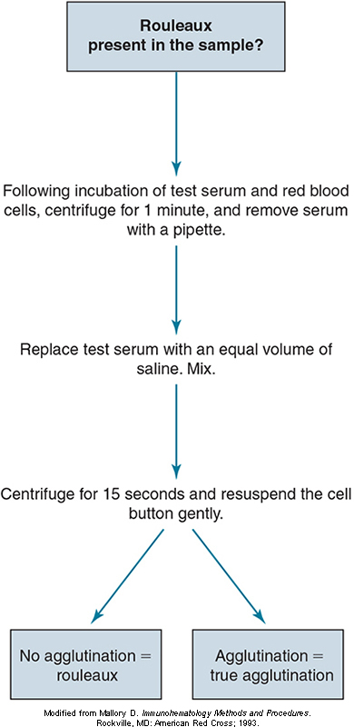
Resolving Rouleaux

Slide 34
Missing or Weak Antibodies
Show weak or negative agglutination in the reverse phase of testing
Reactions may be explained by investigating the patient history, age, diagnosis, and immunoglobulin levels
Newborns and elderly people have reduced antibodies
Pathologic states that lower immunoglobulin levels

Slide 35
Examples of Discrepancies (1 of 2)
Discrepancy | Patient RBCs with |  | Patient Serum with Reagent RBCs |  | Resolution
 | Anti-A | Anti-B | A₁ | B
Acquired B | 4+ | 1+ | 0 | 4+ | Test with autologous RBCs (will be negative)
B(A) phenotype | 1+ | 4+ | 4+ | 0 | Test with monoclonal anti-A from other manufacturers
Subgroup of A | 0 | 0 | 0 | 3+ | Extend incubation or repeat with anti-A,B
Group B transfused with group O RBCs | 0 | 2+mf | 4+ | 0 | Check transfusion history

Slide 36
Examples of Discrepancies (2 of 2)
Discrepancy | Patient RBCs with |  | Patient Serum with Reagent RBCs |  | Resolution
 | Anti-A | Anti-B | A₁ | B
Group A₂ with anti-A₁ | 4+ | 0 | 2+ | 4+ | Test with anti-A₁; test with 3 A₁ and A₂ cells
Cold autoantibody or alloantibody | 4+ | 4+ | 0 | 1+ | Perform antibody screen with autocontrol
Rouleaux | 4+ | 4+ | 2+ | 2+ | Saline replacement
Weak or missing antibodies | 0 | 0 | 0 | 0 | Incubate at RT for 15 minutes or at 5°C for 5 minutes

Slide 37
Special Topics: Bombay Phenotype
First reported in 1952 in Bombay, India
RBCs lack the H antigen (hh)
The h gene is an amorph and results in little or no production of L-fucosyltransferase
Typing labels patients as group O individuals (no H, no A, no B antigens)
Patients’ serum contains anti-H, anti-A, anti-B
Transfusion
Group O RBCs cannot be given because the H antigen is present
Only autologous units or rare donor files can be used

Slide 38
Special Topics: Secretor Status
Two allele genes at this locus: Se and se
Se is responsible for H substance in body secretions (e.g., saliva)
H is converted to A or B by glycosyltransferases
80% of the population are secretors
SeSe (homozygous)
Sese (heterozygous)
20% are nonsecretors (sese)

Slide 39
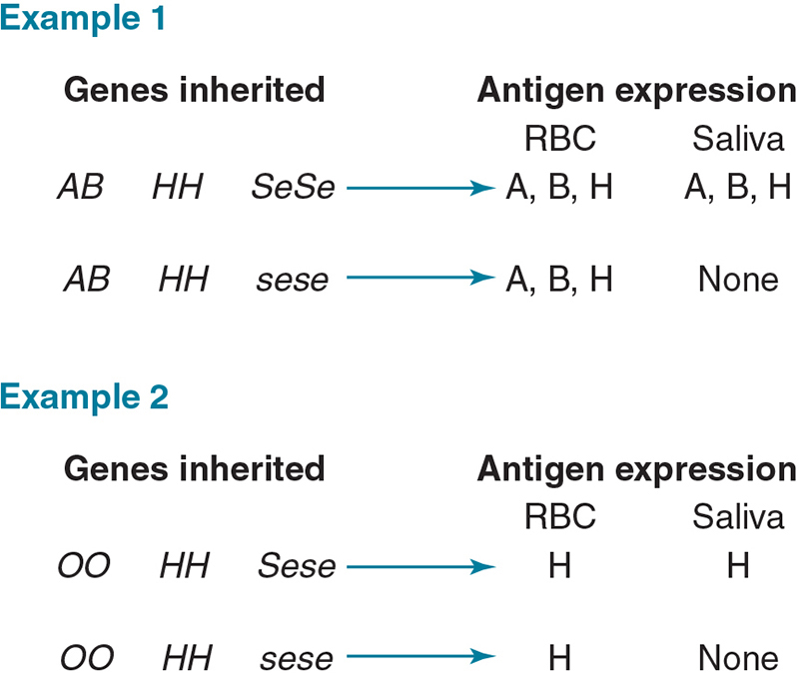
Special Topics: Secretor Status

