Slide 1
Chapter 6
Rh Blood Group System

Slide 2
Objectives (1 of 4)
Explain how the D antigen was named Rh
Describe the current genetic theory of the inheritance of Rh system antigens
Discuss the biochemistry of the Rh system, including the gene products and antigen structures
Compare and contrast the genetic theories behind the Fisher-Race and Wiener terminologies and translate from one to the other

Slide 3
Objectives (2 of 4)
Compare the Rosenfield and International Society of Blood Transfusion (ISBT) terminologies with the Fisher-Race and Wiener terminologies, and discuss their uses
Predict the Rh genotype given a phenotype
Define weak D, and list the genetic circumstances that cause this phenotype
Explain the test for the weak D antigen and the importance of an appropriate control

Slide 4
Objectives (3 of 4)
Discuss the significance of testing for weak D antigen
Define cis-product antigens, and give two examples of this phenotype
Describe the inheritance and significance of the G antigen
Explain the significance of Rh_{null}, Rh_{mod}, and deletion phenotypes

Slide 5
Objectives (4 of 4)
Describe the characteristics of the Rh system antibodies and their clinical significance with regard to transfusion and hemolytic disease of the fetus and newborn (HDFN)
Compare and contrast the LW blood group system with the Rh system
Describe anti-LW in terms of recognition and clinical significance

Slide 6
History (1 of 2)
In 1940, Levine and Stetson linked the Rh system to HDFN
Landsteiner and Wiener found that “anti-Rh”:
Agglutinated 85% of human red blood cells (RBCs)
15% of RBCs did not agglutinate

Slide 7
History (2 of 2)
The human anti-Rh was similar to guinea pig and rabbit antibodies produced when stimulated with Rhesus monkey RBCs
Both antibodies were later shown to be different, but the “Rh” name remained
The rhesus antibody produced by guinea pigs and rabbits was actually directed toward the LW antigen

Slide 8
Genetics and Biochemistry (1 of 2)
Current theory: two closely linked genes control the expression of all Rh antigens (codominant alleles)
RHD gene: determines the expression of the D antigen
RHCE gene: determines the expression of the C, c, E, and e antigens

Slide 9
Genetics and Biochemistry (2 of 2)
Other genetic theories were postulated by:
Fisher-Race
Rh antigens are controlled by 3 closely linked loci (D/d, C/c, E/e)
Wiener
Rh antigens are controlled by alleles at one gene locus

Slide 10
Common Rh Antigens
Table 6.1 Common Antigens in the Rh Blood Group System: Equivalent Notations
Numeric | Fisher-Race | Other names | ISBT NO.
Rh1 | D | Rh + | 004001
Rh2 | C |  | 004002
Rh3 | E |  | 004003
Rh4 | c |  | 004004
Rh5 | e |  | 004005
Rh6 | ce | cis-ce or f | 004006
Rh7 | Ce | cis-Ce | 004007
Rh8 | C^{w} |  | 004008
Rh9 | C^{x} |  | 004009
Rh10 | ce^{s} | V | 004010
Rh12 | G |  | 004012
ISBT, International Society of Blood Transfusion.

Slide 11
Fisher-Race Terminology
Each gene expresses an antigen that is given the same letter as the italicized letter of the gene name (e.g., the C gene produces the C antigen)
Absence of the D antigen is written as “d”
The order of the genes is usually DCE, but they are sometimes ordered alphabetically as CDE

Slide 12
Wiener Terminology (1 of 2)
According to Wiener, 8 alleles exist at the single Rh gene locus
R⁰, R¹, R², R^{z}, r, r′, r″, r^{y}
Each gene encodes an agglutinogen (made of factors) that correlates with Rh antigens
Example 1: R¹ → Rh₁(Rh₀, rh′, hr″) → D, C, e
Note: Long hand notation is outdated and rarely used.
Long hand notation
Notes:
An agglutinogen is a group of antigens or factors.

Slide 13
Wiener Terminology (2 of 2)
To convert Wiener terminology to Fisher-Race terminology:
R  D
r  no D
₁ and ′ C
₂ and ″ E
₀  ce
_{Z} or ^{y}  CE Example: R₂ → DcE
Table 6.2 Wiener Theory: Genes and Antigens
Gene (Wiener) | Antigens (Fisher-Race)
R⁰ | cDe
R¹ | CDe
R² | cDE
R^{z} | CDE
r | ce
r′ | Ce
r″ | cE
r^{y} | CE
Note: Factors in the Wiener terminology arc easily translated to the Fisher-Race terminology, which defines the antigens more clearly.

Slide 14
Rosenfield Terminology
Indicates phenotype information more suited for computerized data entry
Antigens are designated by number
Rh1:D
Rh2:C
Rh3:E
Rh4:c
Rh5:e Example:
D+, C+, E–, c+, e+ is written as Rh:1,2,–3,4,5

Slide 15
ISBT Terminology
International Society of Blood Transfusion
Attempts to standardize nomenclature
Six-digit numbers are assigned to each blood group specificity
The numbers 004 refer to the Rh system
The other numbers refer to the Rosenfield system (e.g., C antigen is RH2) Example: ISBT number for the C antigen is 004002

Slide 16
Genotype (1 of 2)
The phenotype is the result of the reaction between the RBCs and the antisera
The genotype is the genetic makeup and can be predicted by using the phenotype and by considering the race of an individual
Only family studies or molecular testing can determine the true genotype

Slide 17
Genotype (2 of 2)
Genotypes can be predicted by knowing the race of an individual
Common genotypes
Caucasians: R¹, r, R², R⁰
Blacks: R⁰, r, R¹, R²
r′, r″, R^{z}, and r^{y} are rarely encountered
Table 6.4 Order of Frequency of the Common Rh Blood Group System Haplotypes
White |  | Black | Rare (both races)
CDe (R₁) | Highest | cDe (R₀) | Ce (r′)
ce (r) | ↓ | ce (r) | cE(r″)
cDE (R₂) |  | CDe (R₁) | CE (r_{y})
cDe (R₀) |  | cDE (R₂) | CDE (R_{Z})
 | Lowest
Note: The information in this table is useful when predicting the most probable genotype after the phenotype or antigen typing determination. Knowing that a cDe/cDe or R⁰/R⁰ genotype is more common in blacks would be important if D-positive, C-negative units were requested.

Slide 18
Rh Genotypes and Phenotypes
Table 6.5 Rh Phenotypes and Genotypes
Results with antisera |  |  |  |  |  | Genotype |  | Genotype frequency
Anti-D | Anti-C | Anti-E | Anti-c | Anti-e | Phenotype | CDE | Rh-hr | White | Black
+ | + | – | + | + | CcDe | CDe/ce | R¹r | 31 | 9
 |  |  |  |  |  | CDe/cDe | R¹R⁰ | 3 | 15
 |  |  |  |  |  | Ce/cDe | r′R⁰ | <1 | 2
+ | + | – | – | + | CDe | CDe/CDe | R¹R¹ | 18 | 3
 |  |  |  |  |  | CDe/Ce | R¹r′ | 2 | <1
+ | – | + | + | + | cDEe | cDE/ce | R²r | 10 | 6
 |  |  |  |  |  | cDE/cDe | R²R⁰ | 1 | 10
+ | – | + | + | – | cDE | cDE/cDE | R²R² | 2 | 1
 |  |  |  |  |  | cDE/cE | R²r″ | <1 | <1
+ | + | + | + | + | CcDEe | CDe/cDE | R¹R² | 12 | 4
 |  |  |  |  |  | CDe/cE | R¹r″ | 1 | <1
 |  |  |  |  |  | Ce/cDE | r′R² | 1 | <1
+ | – | – | + | + | cDe | cDe/ce | R⁰r | 3 | 23
 |  |  |  |  |  | cDe/cDe | R⁰R⁰ | <1 | 19
– | – | – | + | + | ce | ce/ce | rr | 15 | 7
– | + | – | + | + | Cce | Ce/ce | r′r | <1 | <1
– | – | + | + | + | cEe | cE/ce | r″r | <1 | <1
– | + | + | + | + | CcEe | Ce/cE | r′r″ | <1 | <1
Note: The more common genotypes and genotype frequencies are shown in bold. This information shows the more probable genotypes given Rh antigen phenotype determinations. Depending on the race of the individual, a different genotype of the red cells might be predicted.

Slide 19
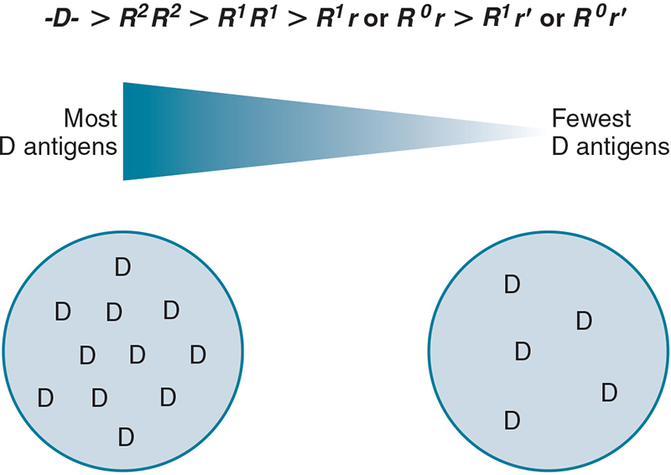
D Antigen
The D antigen is the most immunogenic in the Rh system
D-negative individuals should receive D-negative blood
D-negative individuals receiving D-positive blood may produce anti-D in response

Slide 20
Weak D Antigens
RBCs that test positive only by the indirect antiglobulin test (IAT) are called weak D antigens
Newer monoclonal reagents have enhanced the detection of weak D antigens without the IAT
Table 6.6 Weak D Test: Interpretation with Control Results
Reaction with
Sample no. | Anti-D | Control | Interpretation
1 | + | 0 | D-positive
2 | 0 | 0 | D-negative
3 | + | + | Unable to interpret
Note: The weak D test is an antiglobulin test used to detect the D antigen on the cell. Because the test uses anti-IgG to demonstrate the presence of the D antigen, preexisting IgG on the cell would cause a “false-positive” result, as in sample no. 3. The control must be negative for the presence of IgG for the weak D test to be valid as in samples 1 and 2.

Slide 21
Genetics of Weak D Antigens
More common in the black population
Due to inheritance of a weaker form of the D antigen, often the cDe haplotype
IAT is usually required to detect the weak antigen
Patients are considered weak D positive and are able to receive D-positive blood

Slide 22
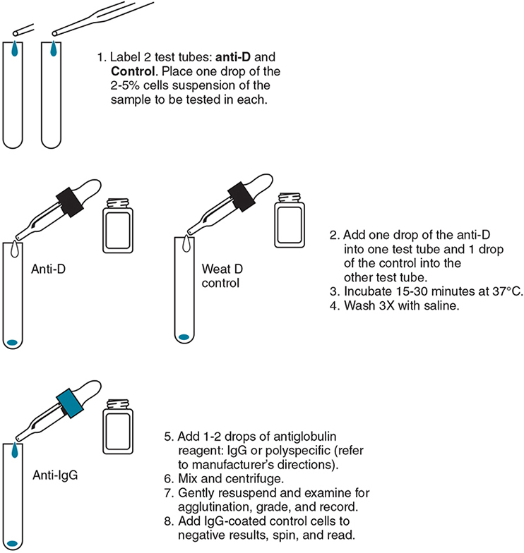
Position Effect of Weak D Antigens
The D antigen may appear weak when the C antigen is inherited trans to D
Ce (r′) gene is paired with either Cde (R¹) or cDe (R⁰)
Patients are considered weak D positive and are able to receive D-positive blood

Slide 23
Weak D: Partial D Antigens
Individuals are D positive but are missing parts of the D antigen (partial D antigen)
When exposed to the “whole D antigen,” individuals may produce anti-D toward the missing part
Partial D antigen reacts strongly with monoclonal reagents
Suspect partial D antigen when a D-positive individual makes anti-D and it does not react with his or her own RBCs

Slide 24
Significance
AABB requires that all donor cells be tested for weak D antigen if they are initially nonreactive
Testing for weak D antigen on recipient samples is not required
Patients are classified as D-negative and transfused with D-negative blood

Slide 25
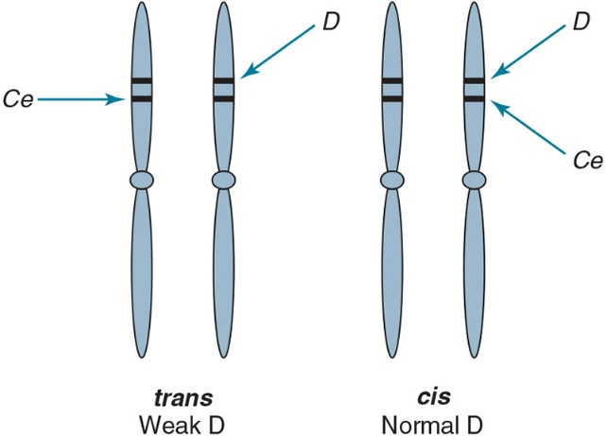
Compound Antigens
Also called cis-product antigens
Two genes inherited on the same chromosome may form additional antigen products
Example: c and e antigens cause “f” to be inherited

Slide 26
G Antigens
Almost all genes that code for the C or D antigen will code for the G antigen
Anti-G antibody will mimic anti-D and anti-C antibodies
If an individual is negative for D and/or C and receives D-positive and/or C-positive blood, he or she may produce anti-G antibody (appears as anti-D or anti-C antibody)
If anti-G antibody is present, give D-negative and C-negative blood

Slide 27
Unusual Phenotypes
D-deletion
Rh_{null}
Rh_{mod}
No reactions with anti-E, anti-e, anti-C, or anti-c
Stronger D antigen activity
Transfuse only D-deleted cells
No Rh antigens
Two possible genetic mechanisms
Regulator gene: RHAG
-D- or D--
Similar to Rh_{null}
Most Rh antigen expression is missing; the RHAG gene also controls this phenotype
Amorph (r⁼)

Slide 28
Rh Antibody Facts (1 of 2)
Usually RBC stimulated
Most are immunoglobulin G (IgG₁)
Agglutination is best observed by the IAT
Potentiators are useful for identification
Antibodies to C, c, E, and e react stronger to homozygous antigens (dosage)

Slide 29
Rh Antibody Facts (2 of 2)
Do not activate complement
E-negative and c-negative blood is sometimes given when anti-E antibody is identified (weak anti-c antibody is often seen with anti-E antibody)

Slide 30
Clinical Considerations
Transfusion reactions
Rh antibody levels may be undetectable for years but produce a rapid response upon exposure to the antigen
Antigen-negative RBCs should be transfused if Rh antibodies are identified
Hemolytic disease of the fetus and newborn
HDFN may occur when a woman is Rh negative and the fetus/infant is Rh positive
Antibodies may form during the first pregnancy
Maternal antibody may destroy fetal RBCs in subsequent pregnancies
Rh immune globulin will protect the mother from forming anti-D antibody

Slide 31
LW Blood Group System
LW antigens and antibodies are similar to Rh antigens but are not genetically related
Anti-LW antibody will react with D-positive (strong) and D-negative (weak) cells
Alleles include Lwª, LW^{b}, and LW
The most common phenotype is LW(a+b–)

