Slide 1
Chapter 7
Other Blood Group Systems, Human Leukocyte Antigens, and Platelet Antigens

Slide 2
Objectives (1 of 2)
Identify the major antigens within the other blood group systems
List the frequencies of the observed phenotypes and the association of phenotypes with ethnic group diversity
Describe the biochemical characteristics of antigens within each blood group system

Slide 3
Objectives (2 of 2)
Describe the genetic mechanisms for antigens within each blood group system
Compare and contrast the serologic characteristics and clinical relevance of the antibodies associated with each blood group system
Identify unique characteristics of selected blood group systems regarding disease association and biologic functions

Slide 4
Kell Blood Group System
Similar to the Rh system
2 major antigens
K (K1): less than 9% of the population
k (K2/cellano): more than 90% of the population
The K and k antigens are antithetical
Well developed at birth
The K (K1) antigen is very immunogenic (second to the D antigen) in stimulating antibody production

Slide 5
Other Kell Antigens
Other antithetical antigens also exist in the Kell system
Analogous to the Rh system: C/c and E/e
Kp antigens
Kpª is a low-frequency antigen (only 2%)
Kp^{b} is a high-frequency antigen (99.9%)
Js antigens
Jsª (20% in blacks, 0.1% in Caucasians)
Js^{b} is a high-frequency antigen (80% to 100%)
Notes:
Kpa = Penney
Kpb = Rautenberg
Jsa = Sutter
Jsb = Matthews

Slide 6
Kell Antigens
Kell antigens have disulfide-bonded regions on the glycoproteins
This makes them sensitive to sulfhydryl reagents
2-mercaptoethanol (2-ME)
Dithiothreitol (DTT)
2-aminoethylisothiouronium bromide (AET)

Slide 7
K₀ or Kell_{null} Phenotype
Lacks all Kell system antigens (K₀K₀)
Expresses related Kx antigen
As a result of red blood cell (RBC) immune stimulation, K₀ individuals can develop anti-Ku (Ku is on RBCs that have Kell antigens)

Slide 8
Kell Genetics
Sets of alleles include
K and k
Kpª and Kp^{b}
Jsª and Js^{b}
KEL11 and KEL17 (Wkª)
High-incidence alleles
k, Kp^{b}, Js^{b}, and KEL11
Low-incidence alleles
K, Kpª, Jsª, KEL17
Table 7.3 Common Phenotypes and Frequencies in the Kell Blood Group System
 | Frequency (%)
Phenotype | White | Black
K–k+ | 91 | 98
K+k– | 0.2 | Rare
K+k+ | 8.8 | 2
Kp(a+b–) | Rare | 0
Kp(a–b+) | 97.7 | 100
Kp(a+b+) | 2.3 | Rare
Js(a+b–) | 0 | 1
Js(a–b+) | 100 | 80
Js(a+b+) | Rare | 19
From Reid ME, Lomas-Francis C, Olsson Ml: The blood group antigen facts book, ed 3, San Diego, CA, 2012, Academic Press.

Slide 9
Kell Antibodies
Immunoglobulin G (IgG)
RBC stimulated (transfusion or pregnancy)
Agglutinate best in the indirect antiglobulin test (IAT)
Usually do not bind complement
Associated with hemolytic transfusion reactions (HTRs) and hemolytic disease of the fetus and newborn (HDFN)
No effect when treated with enzymes
Anti-K (K1) is the most common

Slide 10
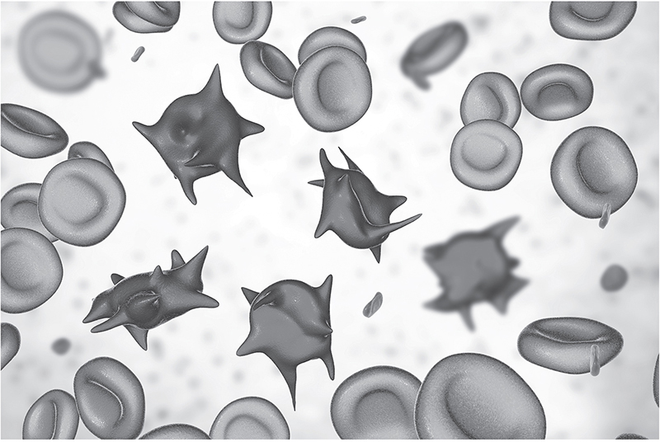
Kx Blood Group System
Kx antigen is phenotypically related to the Kell system but is not genetically similar
Individuals who lack Kx antigen may demonstrate RBC abnormalities (McLeod phenotype)
Seen in males because it is inherited on the X chromosome

Slide 11
McLeod Syndrome
McLeod phenotype is attributed to McLeod syndrome
McLeod syndrome symptoms
RBC abnormalities
Muscular and neurologic defects
Increased creatine kinase
Associated with chronic granulomatous disease
Impaired phagocytosis (white blood cells [WBCs] engulf but cannot kill)

Slide 12
Duffy Blood Group System
Antigens are well developed at birth
Destroyed by enzymes
Fyª and Fy^{b}
Codominant alleles
Most important for transfusion purposes

Slide 13
Duffy Antibodies
Anti-Fyª and anti-Fy^{b} antibodies
IgG
Do not bind complement
Stimulated by transfusion or pregnancy (not a common cause of HDFN)
Do not react with enzyme-treated RBCs

Slide 14
Duffy System and Malaria
Most African Americans are Fy(a–b–)
Certain malarial parasites (Plasmodium knowlesi and Plasmodium vivax) will not invade Fy(a–) and Fy(b–) negative cells
Fyª or Fy^{b} acts as a receptor for the merozoite to attach to the RBC
The Fy(a–b–) phenotype is found frequently in people from west and central Africa, supporting the theory of selective evolution

Slide 15
Kidd Blood Group System (1 of 2)
3 antigens: Jkª, Jk^{b}, and Jk3
In the United States, most blacks (51.1%) are Jk(a+b–)
In the United States, most Caucasians (50.3%) are Jk(a+b+)
Jk3 is present whenever Jkª and Jk^{b} are present
Kidd null phenotypes: Jk(a–b–)
Usually seen in individuals from the Far East or Pacific Islands (rare)
May produce anti-Jk3 antibody
RBCs are resistant to 2M urea

Slide 16
Kidd Blood Group System (2 of 2)
Show dosage
Enhanced by enzymes

Slide 17
Kidd Antibodies
Anti-Jkª and anti-Jk^{b} antibodies
IgG
Clinically significant
May bind complement
Implicated in HTRs and HDFN
Common cause of delayed HTRs
Usually appear with other antibodies when detected
Detection is aided by enzymes, low-ionic-strength solution (LISS), and polyethylene glycol (PEG)

Slide 18
Lutheran Blood Group System
19 antigens exist (chromosome 19)
Weakly expressed on cord blood cells
Most are high-incidence antigens; antibodies are rare
Primary antigens include Luª and Lu^{b}
92.4% Lu(a–b+)
7.4% Lu(a+b+)
0.2% Lu(a+b–)
Lu_{null} phenotype is rare, inherited recessively
Not affected by enzymes

Slide 19
Lutheran Antibodies
Anti-Luª
May occur without RBC stimulation
Immunoglobulin M (IgM) and IgG
Reacts best at room temperature
Shows mixed-field pattern
Not clinically significant
Anti-Lu^{b}
Rare due to high incidence of antigen
IgG
Reacts best at antihuman globulin (AHG)
Shows mixed-field pattern
Associated with transfusion reactions (clinically significant)

Slide 20
Lewis Blood Group System
Lewis antigens are found in secretions (glycoproteins) and plasma (glycolipids)
The glycolipids adsorb onto the RBC membrane
Table 7.10 Lewis System Phenotypes and Frequencies
Phenotype |  |  | Frequency (%)
Reactions with anti-Leª | Reactions with anti-Le^{b} | Interpretation | Whites | Blacks
+ | 0 | Le(a+b–) | 22 | 23
0 | + | Le(a–b+) | 72 | 55
0 | 0 | Le(a–b–) | 6 | 22
+ | + | Le(a+b+) | Rare | Rare
From Fung MK: Technical manual, ed 18, Bethesda, MD, 2014, AABB.

Slide 21
Lewis Antigens
Leª and Le^{b} are not alleles
Lewis system depends on Hh, Se, and Le genes
le, h, and se do not produce products
If the Le gene is inherited, Leª substance is produced
Le, H, and Se genes must all be inherited to convert Leª to Le^{b}
Le(a+b+) RBCs are rare

Slide 22
Lewis Genes
Table 7.12 Lewis Genes and Red Cell Phenotypes
Genes present | Antigens in secretions | Red cell phenotype
Le sese H | Leª | Le(a+b–)
Le Se H | Leª Le^{b} H | Le(a–b+)
lele sese H | None | Le(a–b–)
lele Se H | H | Le(a–b–)
Le sese hh | Leª | Le(a+b–)
Le Se hh | Leª | Le(a+b–)
lele sese hh | None | Le(a–b–)
lele Se hh | None | Le(a–b–)

Slide 23
Lewis Antibodies
Lewis antibodies are produced by Le(a–b–)
IgM
Not clinically significant
Agglutination can occur at immediate-spin (IS), 37°C, and AHG
Enzymes enhance anti-Le^{b} reactivity
Anti-Leª binds complement; may cause hemolysis in vitro
Neutralization can confirm the presence or eliminate reactions with Lewis antibody

Slide 24
I Blood Group System i Antigen
I and i antigens are not antithetical antigens
They form on the precursor A, B, and H chains of RBCs
Newborns have i antigen
Adults have I antigen
i antigen (linear) converts to I antigen (branched) as a child matures (about 2 years of age)

Slide 25
I Antibodies
Cold-reacting, IgM, bind complement
Not clinically significant
Usually autoantibody (autoanti-I)
Alloanti-I is rare
Reactions are avoided by prewarming
Reacts as compound antibody
Often found as an anti-IH
Stronger agglutination with RBCs having many H sites (O and A₂)

Slide 26
Disease Association
Autoanti-I
Mycoplasma pneumoniae
Cold hemagglutinin disease
Anti-i
Infectious mononucleosis
Lymphoproliferative disease
Cold hemagglutinin disease (occasionally)

Slide 27
P1PK Blood Group System
P1PK blood group system: P1 and P^{k}
P1 antigen is detected in plasma and hydatid cyst fluid
Globoside blood group system: P antigen
Globoside blood group collection: Luke (LKE) and PX2 antigens
P, P^{k}, and LKE antigens are high-frequency antigens

Slide 28
P Antigens and Antibodies
Table 7.14 P1PK and GLOB Blood Group Systems Antigen and Antibody Characteristics
Phenotype | Antigen characteristics | Possible antibodies | Alloantibody Characteristics
P₁ | Red cells express P, P1, and P^{k} antigens P1 antigen is not well developed at birth Most common phenotype | None | Not applicable
P₂ | Lacks P1 antigen but expresses P and P^{k} antigens Second most common phenotype | Anti-P1 | IgM; room temperature; not clinically significant
 |  |  | Variable reactions with adult cells
P₁^{k} | Red cells express P1 and P^{k} antigens | Anti-P | Clinically significant; associated with spontaneous abortions (rare)
 | Very rare phenotype
P₂^{k} | Red cells express only P^{k} antigens Very rare phenotype | Anti-P and anti-P1 | Anti-P and anti-P1 characteristics
p | Null phenotype of system Negative for P, P1, and P^{k} antigens Very rare phenotype | Anti-PP1P^{k} (Tjª) | Hemolytic; clinically significant; can be separated into three specificities

Slide 29
P Antibodies
Anti-P1
Found in P₂ individuals
IgM; enhanced by enzymes
Autoanti-P
Associated with cold paroxysmal hemoglobinuria
Anti-PP1P^{k}
Occurs in individuals with the null phenotype
Causes hemolysis in vitro
Non-RBC stimulated
Can be neutralized by P1 substance
IgG (Donath-Landsteiner antibody); a biphasic hemolysin that binds with P₁ or P₂ cells at low temperatures before the complement is activated
May appear in children after viral infection
Clinically significant

Slide 30
MNS Blood Group System
M and N
Coded by glycophorin A
Membrane structure is called sialoglycophorin A
Consists of 131 amino acids
M and N differ at positions 1 and 5 on glycophorin A (GPA)
Show dosage
Homozygous inheritance enhances agglutination [(M+N–) or (M–N+)]
S, s, and U
Coded by glycophorin B
Membrane structure is called sialoglycophorin B
Consists of 72 amino acids
S and s differ at position 29
S has methionine; s has threonine
U antigen
Located near membrane
Present when S or s is inherited
Absence of glycophorin B (GPB) would result in S–s–U–

Slide 31
MNS Antibodies
IgM and IgG
Rarely encountered in HDFN
Variable reactions depend on reagent pH
Rare IgM
N-like antibodies found in dialysis patients from formaldehyde-sterilized instruments
Anti-M
Anti-S, anti-s, and anti-U
Anti-N
Clinically significant IgG
Anti-U is rare but can be found in S–s– persons (black population)

Slide 32
MNS System Frequencies
Table 7.16 Phenotype Frequencies in MNS System
Antigen | Phenotype frequencies (%)
 | Whites | Blacks
M+ | 78 | 74
N+ | 72 | 75
S+ | 55 | 31
s+ | 89 | 93
U+ | 99.9 | 99
From Reid ME, Lomas-Francis C, Olsson ML: The blood group antigen facts book, ed 3, San Diego, CA, 2012, Academic Press.

Slide 33
Miscellaneous Systems
Table 7.17 Miscellaneous Blood Groups and Antigens
Name | Antigen Symbol | ISBT NO. | Antigens | Characteristics
Diego | Di. Wr | 010 | Diª Di^{b} Wrª Wr^{b} | Diª is more common in South American Indians anti-Wrª is commonly found with other antibodies
Cartwright | Yt | 011 | Ytª Yt^{b} | Variably sensitive to enzymes; sensitive to DTT
Xg | Xg | 012 | Xgª | Inherited on X chromosome; frequency varies with sex
Scianna | SC | 013 | SC:1 SC:2 SC:3
Dombrock | Do | 014 | Doª Do^{b} Gyª Hy Joª | Hy phenotype is found only in blacks; anti-Doª and anti-Do^{b} antibodies are rarely found as a single specificity
Colton | Co | 015 | Coª Co^{b} Co3 | Anti-Co^{b} is rarely found as a single specificity
Chido/Rodgers | Ch/Rg | 017 | Ch Rg | Antigens are sensitive to enzymes and found in plasma; antibodies have HTLA characteristics
Gerbich | Ge | 020 | Ge2 Ge3 Ge4 Wb Lsª Anª Dah | All antigens except for Ge4 are sensitive to enzymes
Cromer | Cr | 021 | Crª Tcª Tc^{b} Tc^{c} Drª Esª IFC WESª WES^{b} UMC | Antigen is also found in plasma; located on decay-accelerating factor
Knops | Kn | 022 | Knª Kn^{b} McCª SIª Ykª | Antigen depression in SLE, PNH, and AIDS; antigens are weakened by ficin treatment; antibodies have HTLA characteristics
Cost | Cs | 205 | Csª Cs^{b} | Part of a blood group collection rather than a system
VEL | Vel | 034 | Vel | Variable antigen expression on red cells both IgG and IgM antibodies are associated with hemolytic reactions; antibodies react best with enzyme-treated red cells
JMH | JMH | 026 | JMH | Autoanti-JMH is often found in elderly patients with absent or weak antigen expression; antibodies have HTLA characteristics; antigens are sensitive to enzymes and DTT
Sdª | Sdª | 901.012 | Sdª | Antigen found in guinea pig and human urine; antibodies are typically weak and agglutination is mixed field; reduction of Sdª expression during pregnancy
Note: Items in boldface indicate antigens of high incidence. AIDS, Acquired immunodeficiency syndrome; DTT, dithiothreitol; HTLA, high-titer, low-avidity; PNH, paroxysmal nocturnal hemoglobinuria; SLE, systemic lupus erythematosus.

Slide 34
HLAs
HLAs are found on leukocytes and tissue cells
HLA antibodies are produced as a result of transfusion and/or pregnancy
Antibodies have been associated with refractoriness and transfusion reactions
HLA testing is used to assess risk factors for disease susceptibility
Matching for organ and HPC transplants

Slide 35
Inheritance of HLAs
Genes that code for HLA are part of the MHC
MHC genes are divided into 3 classes
Class I: platelets, leukocytes, nucleated cells
Class II: macrophages, dendritic cells, B cells
Class III: code for complement and cytokines
Individuals inherit one haplotype (closely linked genes) from each parent
Antigens are named with a letter followed by a number (e.g., A2)

Slide 36
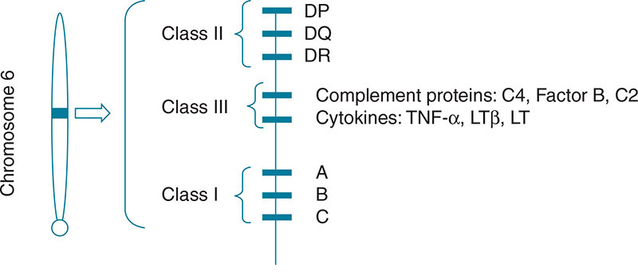
MHCs

Slide 37
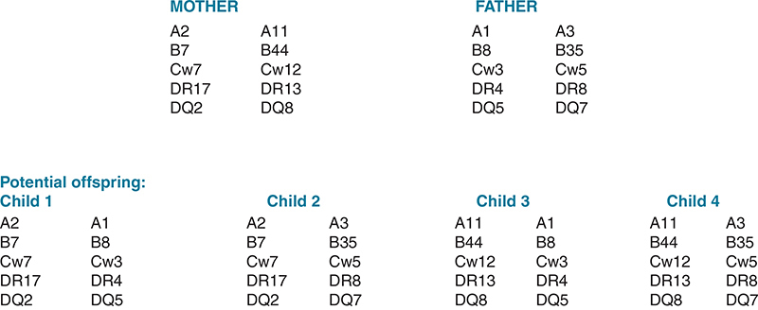
Class I and II HLA Inheritance: Example

Slide 38
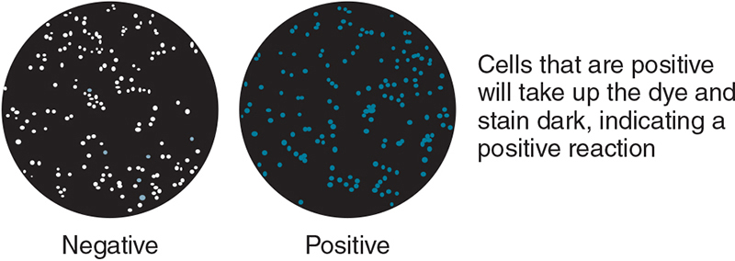
HLA Testing
Serologic identification requires the lymphocytotoxicity test method
Complement and dye are used to determine whether there is antigen–antibody recognition

Slide 39
Antibody Detection and Identification
Matching HLAs in patients with existing antibodies is important for graft survival
Patients may become sensitized to HLAs by the following exposures:
Pregnancy
Blood transfusions
Previous transplant

Slide 40
HPC Transplants
HPCs can be obtained from bone marrow, peripheral blood, and cord blood
HPCs can be used to treat diseases such as aplastic anemia, leukemia, lymphoma, and Hodgkin’s disease
HLA matching at the allelic level is important to avoid rejection and GVH disease

Slide 41
Platelet Antigens
Platelet proteins can elicit immune responses
Antibodies to platelets may cause
Neonatal alloimmune thrombocytopenia (NAIT): destruction of newborn platelets by maternal antibody
Posttransfusion purpura (PTP): destruction of platelets after transfusion
The most common platelet antibody is directed against HPA-1a (or P1^{A1})

