Slide 1
Chapter 8
Antibody Detection and
Identification

Slide 2
Objectives (1 of 5)
Define atypical or unexpected antibodies, and explain how they are formed
Discuss the purpose of the antibody screen and how positive results contribute to the identification process
Compare and contrast the autocontrol and direct antiglobulin test (DAT)

Slide 3
Objectives (2 of 5)
Explain why patient information regarding transfusion or pregnancy history, age, race, and diagnosis helps in the process of antibody identification
Describe the reagent red blood cell (RBC) panel and antigram with regard to antigen configuration and ABO type
Define phase of reactions and its significance

Slide 4
Objectives (3 of 5)
Discuss how the reaction strength contributes to antibody resolution
Describe the process of ruling out antibodies on a panel
Explain the rule of three with regard to antibody identification
List methods that can be used when working with a multiple-frequency or high-frequency antibody or antibodies

Slide 5
Objectives (4 of 5)
Describe the properties of a high-titer, low-avidity antibody and techniques for identifying or avoiding reactivity
Explain the importance of a control when performing antibody neutralization
Discuss the use of and potential problems with the prewarming procedure
List methods of enhancing weak immunoglobulin G (IgG) antibodies

Slide 6
Objectives (5 of 5)
Explain the process of identifying the specificity of a cold autoantibody and techniques to avoid cold autoantibody reactivity
Describe the process and limitations of adsorption techniques as they apply to warm and cold autoantibodies
Define the elution procedure, and list the methods and purposes of this test

Slide 7
Antibody Detection

Slide 8
Antibody Screen (1 of 2)
The test used to detect antibodies is called an antibody screen
Antibody screens are used for
Patients needing a transfusion
Pregnant women
Patients who have had transfusion reactions
Blood and plasma donors

Slide 9
Antibody Screen (2 of 2)
Uses the patient’s plasma or serum against reagent RBCs to detect unexpected antibodies
Unexpected antibodies are found in addition to the expected anti-A or anti-B antibodies
Unexpected antibodies are a result of RBC stimulation (transfusion, hemolytic disease of the fetus and newborn [HDFN])
Unexpected antibodies may be
Clinically significant (IgG)
Not clinically significant (immunoglobulin M [IgM])

Slide 10
Clinically Significant Antibodies
Usually IgG
React best at 37° C and during the antihuman globulin (AHG) phase (indirect antiglobulin test [IAT])
Clinically significant antibodies are associated with hemolytic transfusion reactions (HTRs) and HDFN

Slide 11
Performing an Antibody Screen
Patient’s plasma or serum is incubated with screening cells
After incubation, an IAT is performed using AHG reagent
Want to detect any IgG antibodies

Slide 12
Screening Cells (1 of 2)
Screening cells are single or pooled donor group O cells; however, single-donor vials offer increased sensitivity
Group O cells are used so that anti-A and anti-B antibodies will not react
Screening cells come in sets of 2 or 3 vials each
Each vial (donor) has been phenotyped for each antigen
18 antigens are required on at least one of the vials: D, C, E, c, e, M, N, S, s, P₁, Leª, Le^{b}, K, k, Jkª, Jk^{b}, Fyª, Fy^{b}

Slide 13
Screening Cells (2 of 2)
Screening cells come with a sheet of paper called an antigram
An antigram (2 or 3 cells) will list the antigens present in each vial
A reaction to one or more cells indicates the presence of an atypical antibody

Slide 14
Antigram

Slide 15
Autocontrol
Tests a patient’s serum with his or her own RBCs
Autocontrol is incubated with the antibody screen (or antibody panel)
If a laboratory technician uses an autocontrol with a screen and it is positive, the technician may run a DAT (patient cells plus AHG) to detect in vivo coating
The AC and DAT can help in determine if the antibodies are directed against the patient’s cells or transfused cells (allo- or autoantibody)

Slide 16
Potentiators (1 of 2)
Used in antibody detection and identification to enhance an antigen–antibody reaction
Saline (may only enhance if incubated for a long time)
Low-ionic-strength solution (LISS): common
Bovine serum albumin (BSA)
Polyethylene glycol (PEG)
Proteolytic enzymes (can destroy some antigens)

Slide 17
Potentiators (2 of 2)
Table 8.1 Comparison of Potentiators and Methods
Potentiator | Use | Limitations
Low-ionic-strength saline (LISS) | Sensitive. economical,. and allows for shorter incubation time | Enhances cold autoantibodies Some weak anti-K antibodies may be missed Equal pans of plasma/serum and LISS are important If the ionic strength of a LISS procedure is altered, there is a decreasing sensitivity of the test system.
Bovine serum albumin (BSA) | Affects second stage of agglutination Reduces the repulsion between red cells but does not shorten the incubation time Does not enhance warm autoantibodies | Needs longer incubation time Not sensitive for most antibodies except in Rh blood group system
Polyethylene glycol (PEG) | Shows increased sensitivity Often detects the presence of antibodies not found with BSA or LISS | Enhances warm autoantibodies IgM antibodies do not react well or at all with this potentiator Recommend using anti-IgG AHG, not anti-IgG, -C3d AHG No 37° C readings May require extra wash
Enzymes: ficin, papain | Eliminates presence of Fyª, Fy^{b,} M, and N antigens; S and s antigens are variably affected Loss of reactivity in the panel for any antibodies present to the antigens stated earlier Enhances Rh, JK, LE, P1 antibodies | Enhance cold and warm autoantibodies Can be used as additional tools for investigating complex antibody problems but should not be used as the only method
Gel technology | Avoids cold reactive antibodies Shows increased sensitivity Can be automated | Enhances warm autoantibodies Weak anti-K and some anti-E may be missed due to LISS-suspended red cells
Solid phase (SPRCA) | Avoids cold reactive antibodies Shows increased sensitivity Can be automated | Enhances warm autoantibodies Weak anti-K may be missed due to LISS potentiators Manual method may be difficult to read
AHG, Antihuman globulin.

Slide 18
Patient History
GET THE HISTORY!
Mixed RBC populations from a previous transfusion can remain for up to 3 months
Patient may have come from another hospital
Some diseases are associated with antibodies
Some antibodies occur at a higher frequency in some races
Learn about the diagnosis, age, and race of the patient

Slide 19
Antibody Identification

Slide 20
Initial Panel
An antibody panel is just an extended version of an antibody screen (10 to 20 cells)
Group O cells
Each panel cell is antigen typed
The antigram lists the phenotypes of each panel cell and is used to record and interpret results

Slide 21
Interpretation Guidelines
Autocontrol
Positive autocontrol or DAT indicates that autoantibody or alloantibody is present to recently transfused cells
Negative autocontrol indicates alloantibody
Positive autocontrol plus negative DAT indicates that the test is false positive
Phases
IgM antibodies react at room temperature or during immediate-spin (IS) crossmatching; anti-Leª, anti-Le^{b}, anti-M, anti-N, anti-I, anti-P1 antibodies
IgG antibodies usually react at 37° C or with AHG
Reactions at different phases may indicate IgM and IgG

Slide 22
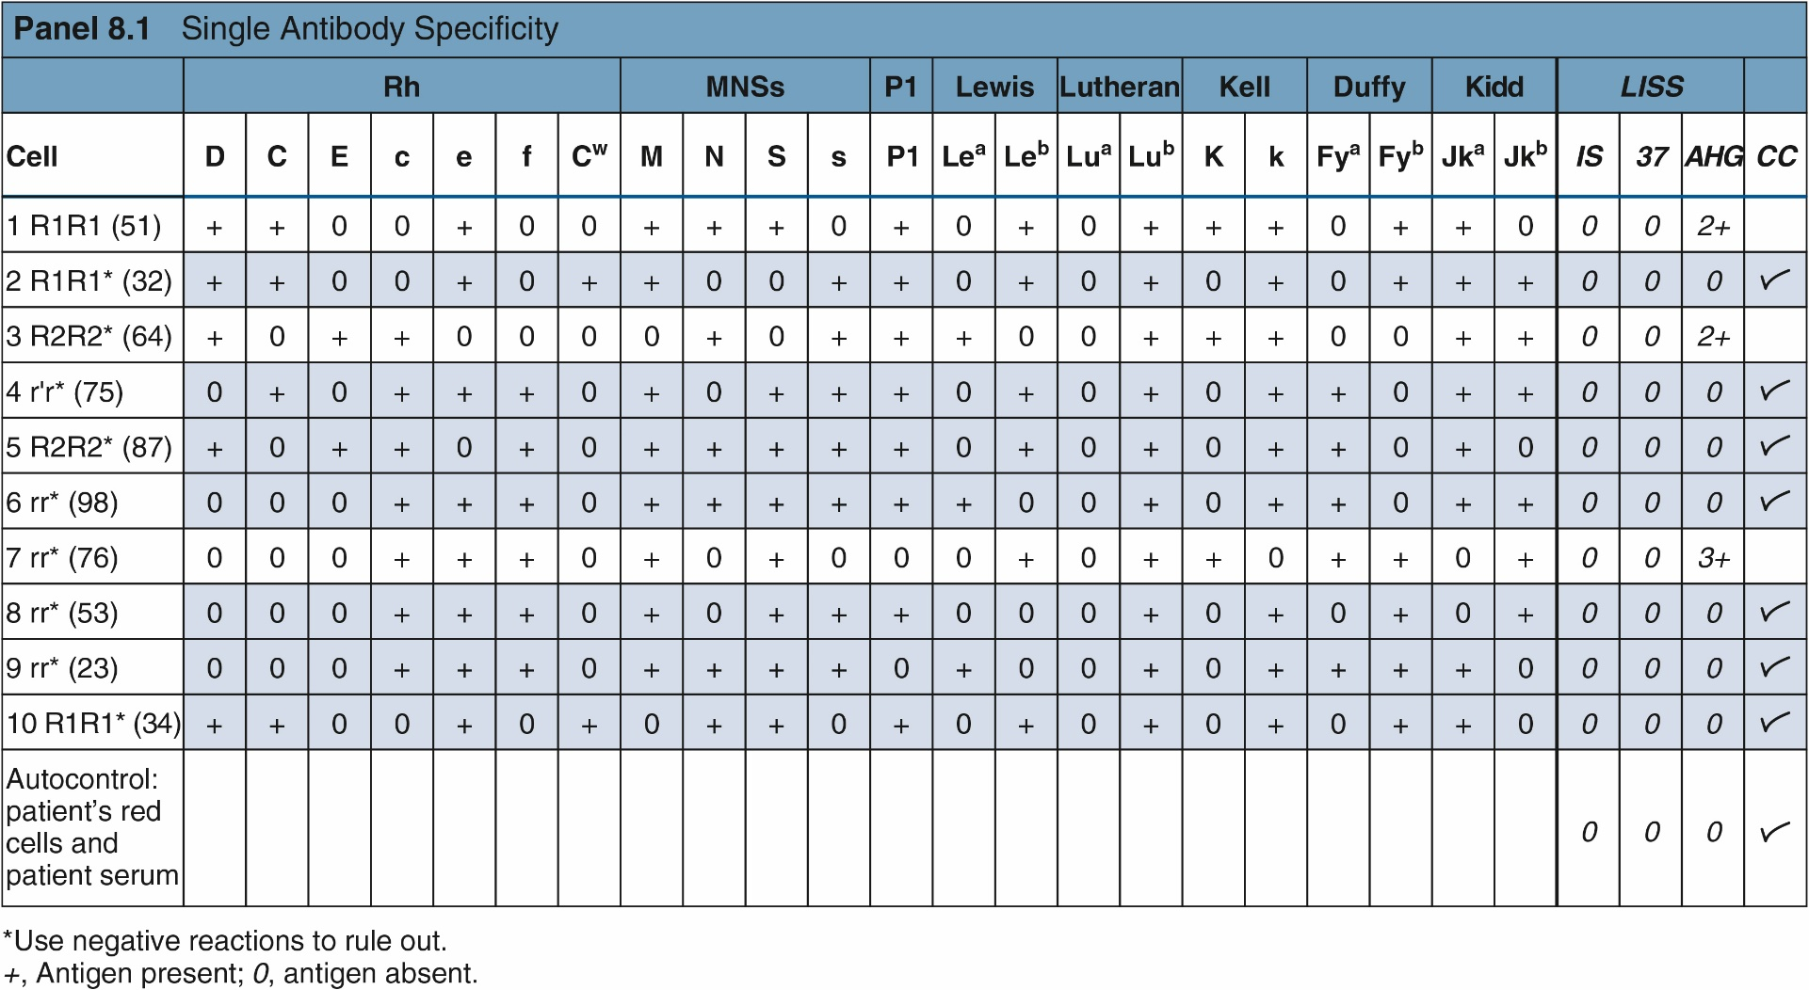
Example with Negative Autocontrol and IgG Antibody

Slide 23
Interpretation Guidelines (1 of 2)
Reaction strength
Reactions with varying strengths indicate multiple antibodies
Strength is also affected by dosage
Ruling out antibodies
Panel cells that are negative in all phases can be used to rule out antibodies
Begin with the first panel cell that is negative in all phases and cross out any antigens present
Panel cells that are heterozygous should not be crossed out, because the antibody may be too weak to react

Slide 24
Interpretation Guidelines (2 of 2)
Matching the pattern
The pattern of reactions matches one of the antigen columns when a single antibody is present
Multiple antibodies show varying patterns
Rule of three
To ensure valid results, 3 antigen-positive cells must react and 3 antigen-negative cells must not react with the patient’s serum or plasma
If this does not occur, additional panel cells (selected cells) are used

Slide 25
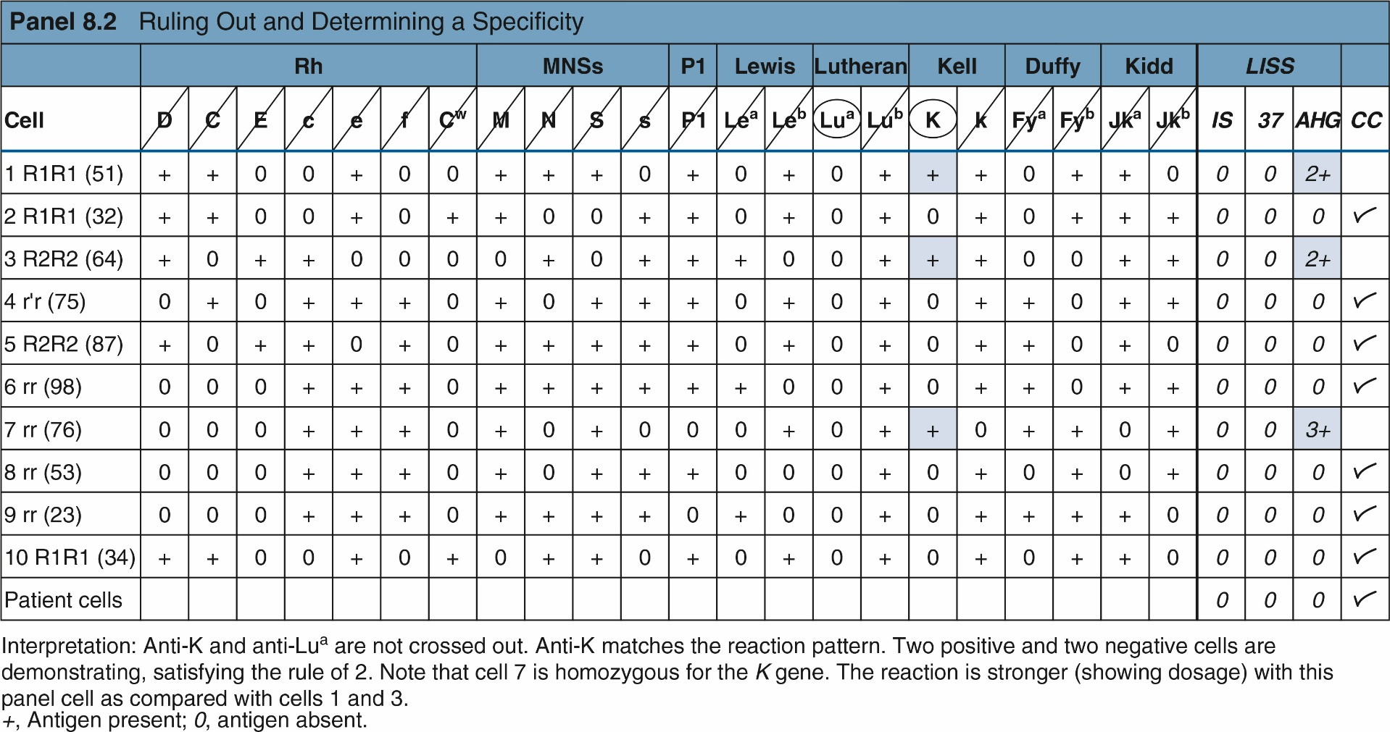
Example of Ruling Out and Matching the Pattern

Slide 26
Interpretation Guidelines
Phenotyping the patient
Another way to confirm the presence of antibody is to determine the patient’s phenotype for antigen
Individuals do not make alloantibodies toward antigens on their own RBCs
If the patient has recently been transfused, RBC separation techniques should be used before phenotyping is done

Slide 27
Multiple Antibodies
Matching the pattern is more difficult when multiple antibodies are present
Varying reactions may also be observed
Special techniques can be used to help identify multiple antibodies
Selected cells
Proteolytic enzymes
Other chemicals (e.g., dithiothreitol)
Dithiothreitol is often used to denature Kell antigens

Slide 28
Proteolytic Enzymes
Enzymes are used to eliminate or enhance antibody activity
Duffy and MNS antigens are destroyed
Rh, Kidd, and Lewis antigens are enhanced
One-stage test
Enzymes, RBCs, and serum are simultaneously incubated
Two-stage test
Panel cells are pretreated with enzymes, washed, and then used as usual

Slide 29
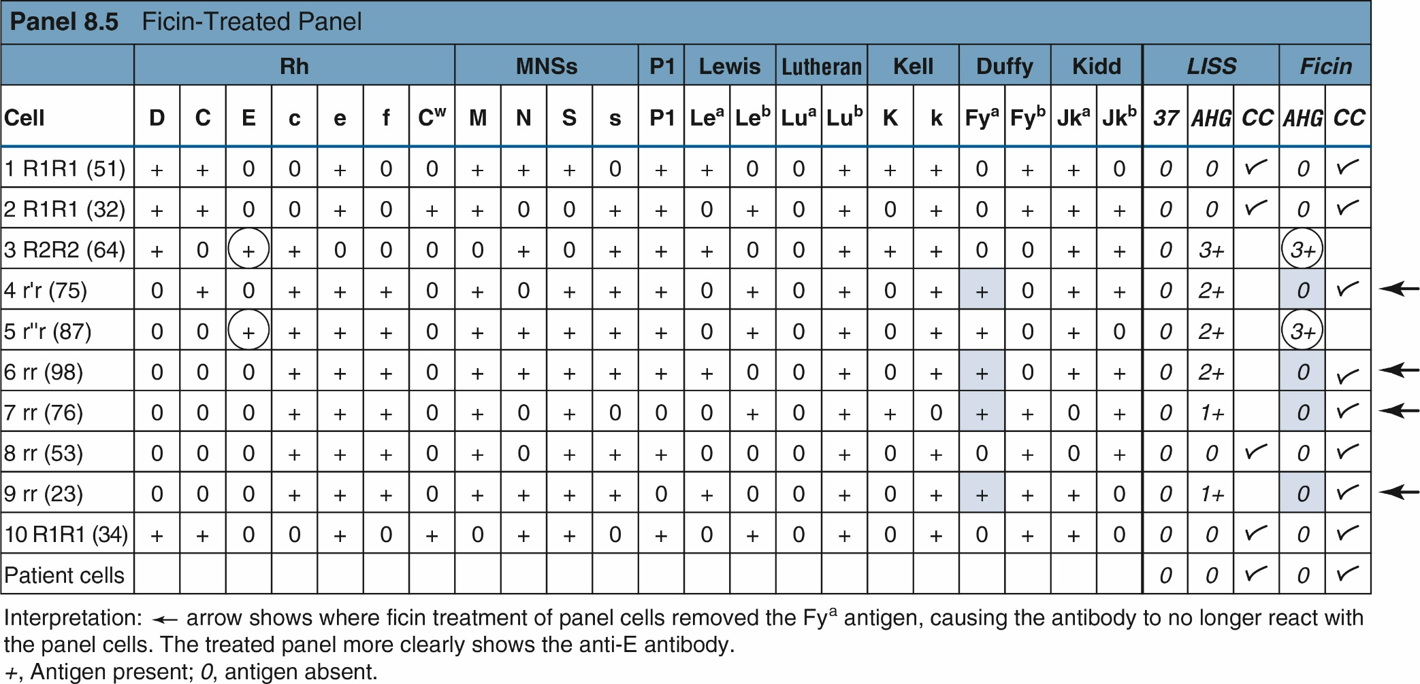
Example

Slide 30
Antibodies to High-Frequency Antigens
High-frequency antigens occur in the population at a frequency of 98% or higher
Suspect an alloantibody to a high-frequency antigen if most panel cells are positive
Additional testing may be needed to confirm the presence of the antibody
Enzymes to enhance or destroy antigens
Dithiothreitol to destroy Kell antigens

Slide 31
High-Frequency Antibodies
Table 8.5 Clues for Identifying High-Frequency Antibodies
Clue | Antibodies affected
Room temperature reactions | I, H, P, P1,PP1P^{k}
Negative with ficin-treated cells | Ch, Rg, JMH
Negative with DTT-treated cells | JMH, Ytª, Js^{b}, Kp^{b}, k, LW
Weakened with DTT-treated cells | Lu^{b}, Do^{b}, Knª
Weak reactions at AHG | Lu^{b}, Ch, Rg, Csª, Knª, McCª, Slª, JMH, Sdª
Negative or weak on cord blood cells | Sdª, Ch, Rg, Lu^{b}, I, Vel, Leª, Le^{b}
Stronger on cord blood cells | i, LW
Variable expression on RBCs | Lu^{b}, Knª, Slª, I, P1, Sdª, Ch, Rg, McCª, JMH, Vel
Race association: black | U, Js^{b}, Slª, Atª, Hy, Tcª, Crª
Race association: white | Kp^{b}, Lan
Mixed field and refractile microscopically | Sdª
High-titer, low-avidity antibodies | Ch, Rg, Ykª, Csª, JMH,* Knª, McCª
DTT, Dithiothreitol; AHG, antihuman globulin; RBCs, red blood cells.
*JMH can be an autoantibody; occurs in older patients.

Slide 32
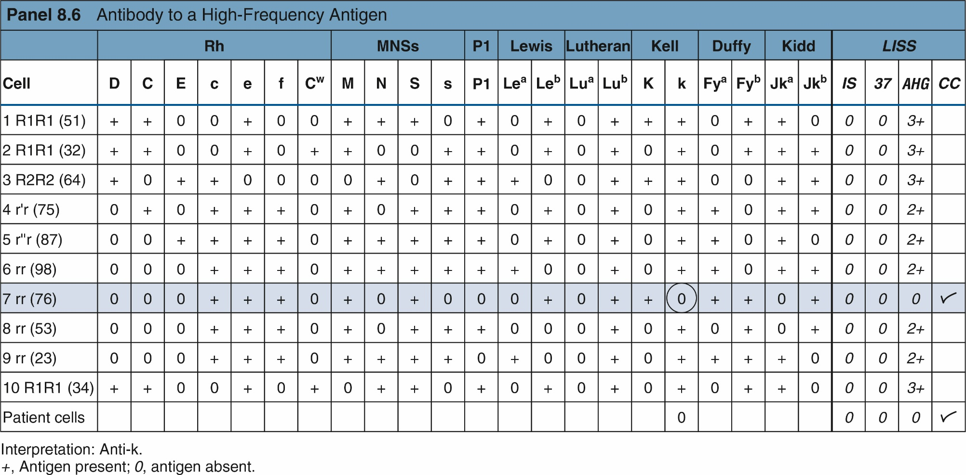
Example

Slide 33
High-Titer, Low-Avidity Antibodies
Antibodies to high-frequency antigens that react weakly
React at AHG phase
Not implicated in transfusion reactions or HDFN
Table 8.6 Characteristics of High-Titer, Low-Avidity Antibodies
Inconsistent reactions that arc sometimes not reproducible Usually not clinically significant Often found with other antibodies Variable reactions among panel cells Not usually enhanced with polyethylene glycol, low-ionic-strength saline, or enzymes Nonreactive with autologous cells Weak reactions at antiglobulin phase often only microscopic Reactions may be weaker on older red cells Titration and inhibition may be useful techniques in classification and identification of these antibodies

Slide 34
Antibodies to Low-Frequency Antigens
May occur alone or are suspected when the screen is negative and crossmatching is positive
Only one reactive cell suggests this type of antibody
Common antibodies include
Anti-C^{w}, anti-Wrª, anti-V, anti-Co^{b}, anti-Bgª, anti-Kpª, and anti-Luª antibodies

Slide 35
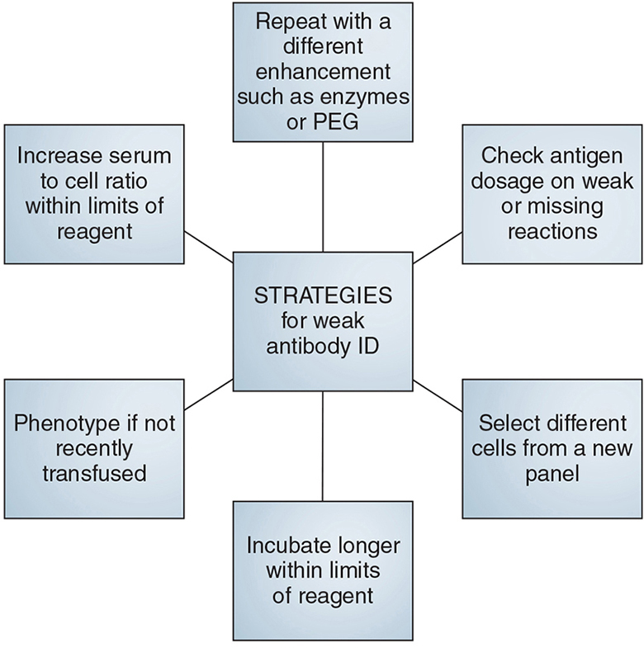
Enhancing Weak IgG Antibodies

Slide 36
Cold Alloantibodies
IgM antibodies that react during IS crossmatching and sometimes at 37° C
Not clinically significant
Anti-P1, anti-M, and anti-N antibodies have variable reactions
To enhance reactions, incubate below room temperature
To avoid reactions, neutralization can be performed so that clinically significant antibodies may be detected

Slide 37
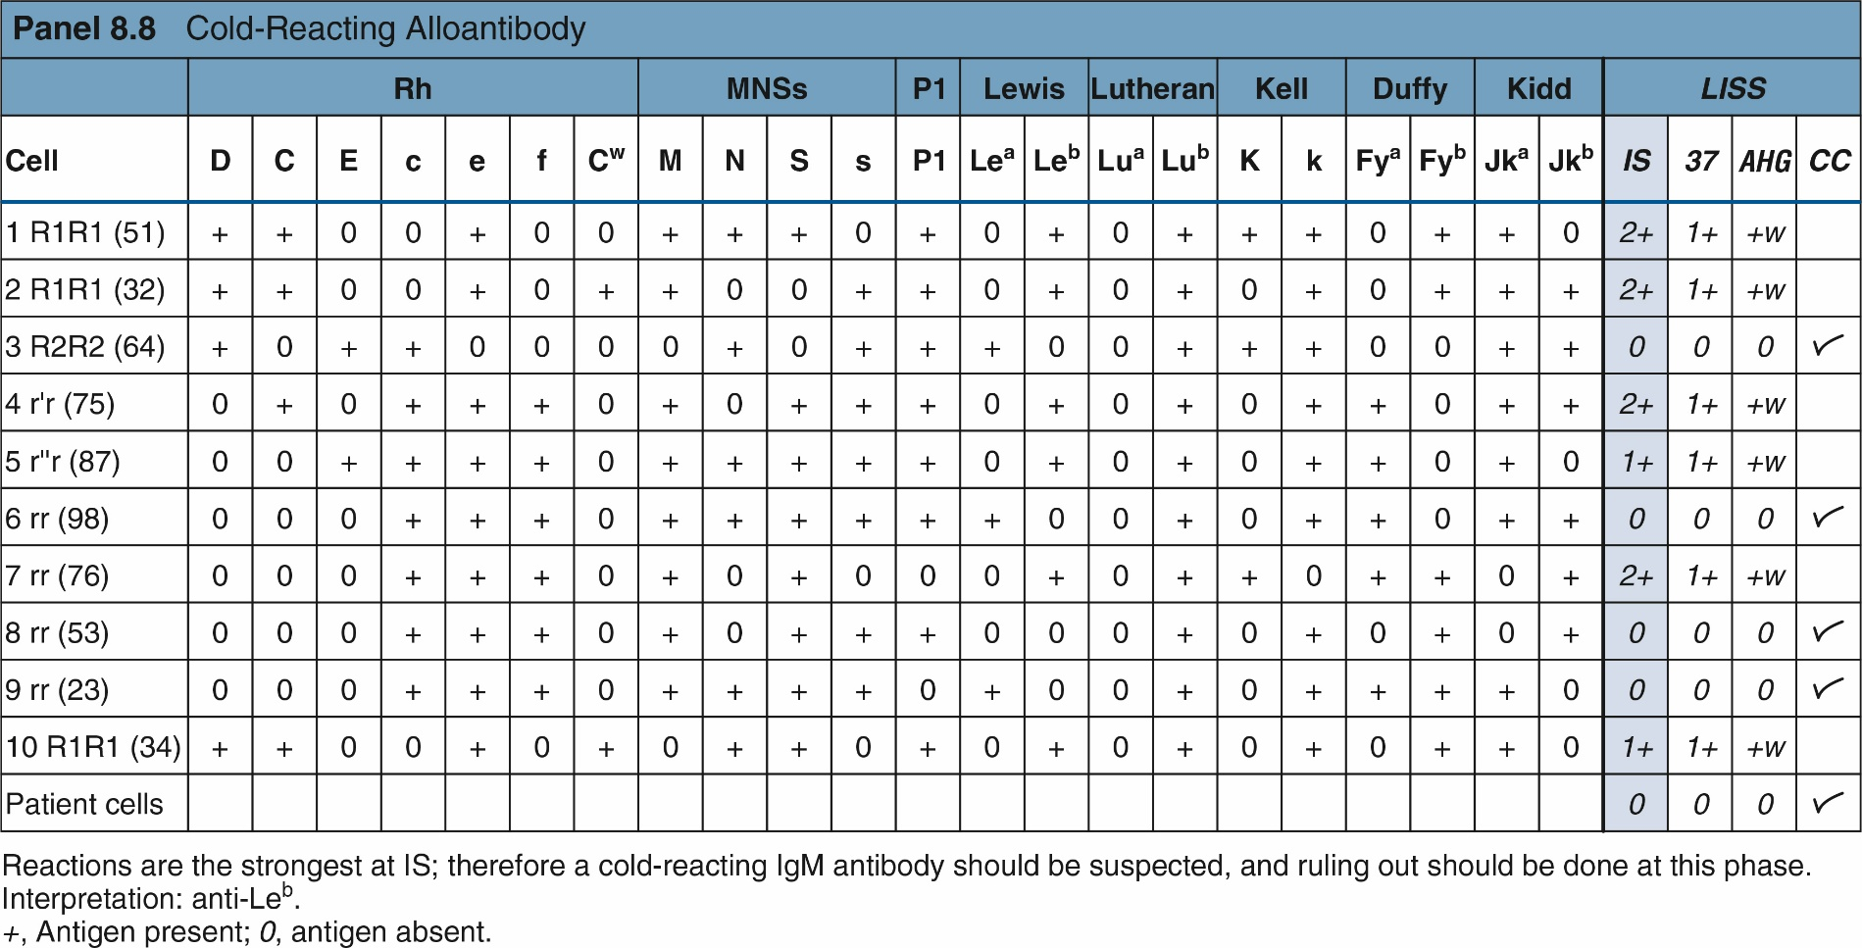
Example

Slide 38
Autoantibodies
Autoantibodies usually react with all reagents and self and donor RBCs, regardless of the antigens present
The autocontrol and DAT are also positive
It is important to identify underlying alloantibodies when an autoantibody is encountered
Adsorption techniques are usually performed to remove autoantibodies

Slide 39
Cold Autoantibodies
Typical cold autoantibodies react during IS crossmatching and have a positive autocontrol and DAT (to C3)
Cold autoantibodies may occur in individuals with a history of mild anemia, Mycoplasma pneumoniae infection, or infectious mononucleosis
Most cold autoantibodies are anti-I, anti-H, and anti-IH; “cold panels” can aid in identifying them

Slide 40
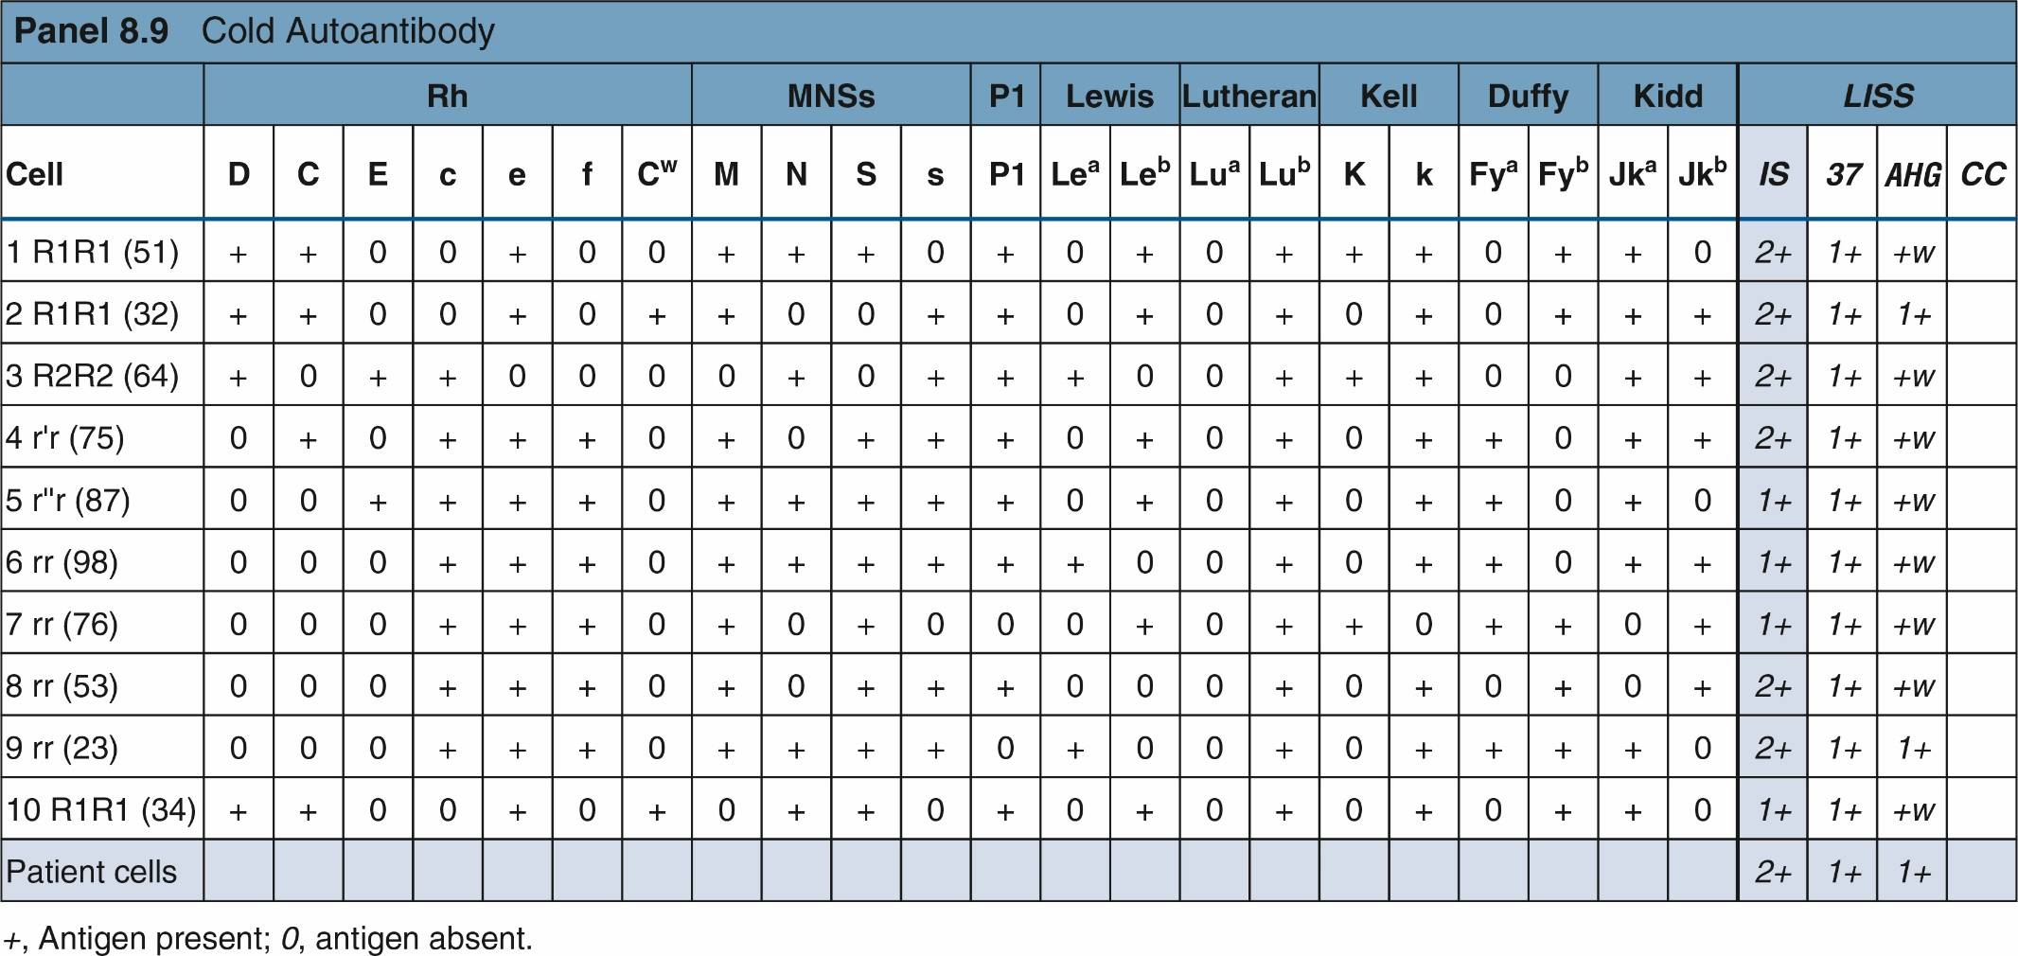
Example

Slide 41
Avoiding Cold Autoantibody Reactions
Use a monospecific IgG AHG reagent rather than a polyspecific reagent
Skip IS crossmatching and testing at 37° C
Use 22% bovine serum albumin instead of LISS
Prewarming all tubes to 37° C will avoid reactivity
Note: washing with warm saline is not advised when prewarming the tubes
Use adsorption techniques if all else fails

Slide 42
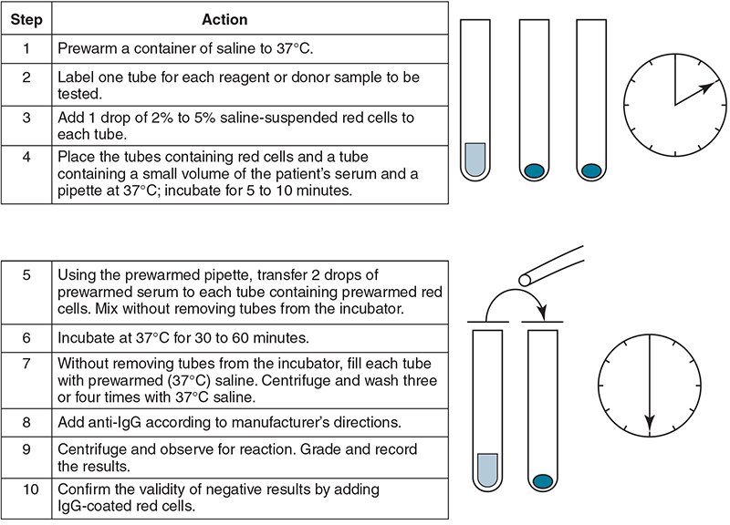
Prewarming

Slide 43
Adsorption
Table 8.9 Adsorption Techniques
Adsorption technique | Description | Limitations
Rabbit erythrocyte stroma (RESt) | Removes cold (IgM) antibodies, particularly anti-I specificities | May adsorb anti-B and other IgM antibodies¹⁵
Cold autoadsorption | Patient red cells are used to remove cold autoantibodies to determine whether alloantibodies are present | Do not use if recently transfused
Warm autoadsorption | Patient red cells are used to remove warm autoantibodies to determine whether alloantibodies are present | Do not use if recently transfused
Differential (allogeneic) adsorption | Uses known phenotyped red cells to separate specificities: ● Warm autoantibodies from alloantibodies ● Alloantibodies with several specificities | May adsorb alloantibody to a high-frequency antigen

Slide 44
Warm Autoantibodies
More common than cold autoantibodies
Warm autoimmune hemolytic anemia may be idiopathic or the result of a disease or drug
Most panel cells and the autocontrol are positive
Using 22% albumin decreases reactivity
It is important to determine if underlying alloantibodies exist in these cases

Slide 45
Specificity
Most warm autoantibodies are directed to the Rh system, especially the e antigen
Patient will have anti-e antibody and the e antigen
Positive DAT
Providing e-negative blood may increase RBC survival in chronic hemolytic situations
Medications can also cause formation of warm autoantibodies

Slide 46
Drug Mechanisms
Table 8.12 Drug Mechanisms Associated with a Positive Direct Antiglobulin Test
Category | Mechanism | Description | Associated drugs
Drug-independent | Unknown | Drug causes autoimmune process that resolves itself when the drug is discontinued Appears serologically like a warm autoantibody | Fludarabine, methyldopa
Drug-dependent | Nonimmune protein adsorption | Drug causes modification of red cell membrane, causing proteins to attach Demonstrated by antibodies that react in the presence of the drug | Cephalosporin, cefotetan, ceftriaxone, nonsteroidal antiinflammatory drugs
 | Covalently binds to RBC membrane proteins | Drug attaches to red cell membrane; antibody to the drug causes red cell clearance by macrophages Demonstrated by treating cells with drug in vitro | Penicillin, cefotetan
RBC, Red blood cell.

Slide 47
Elution (1 of 2)
To identify antibodies when the DAT is positive, the IgG must be detached by using the elution technique
The recovered antibody is called the eluate
Eluate is used in an antibody panel to identify antibody
Elution is performed in suspected cases of HDFN and may not be reactive in all cases of warm autoantibodies

Slide 48
Elution (2 of 2)
Table 8.11 Elution Methods
Method | Antibody removal | Benefits | Limitations
Glycine acid | Lower pH | Rapid and sensitive; commercially available
Heat Freeze-thaw | Physical | Rapid; effective for ABO antibodies; inexpensive | Not sensitive for antibodies other than ABO
Ether Methylene chloride Chloroform | Organic solvent | Sensitive; inexpensive | Hazardous, carcinogenic, or flammable

Slide 49
Adsorption (1 of 2)
Warm autoantibodies may need to be removed to test for underlying alloantibodies
Cells can be pretreated with dithiothreitol or a combination of enzymes and dithiothreitol (ZZAP) to remove any in vivo attached antibodies

Slide 50
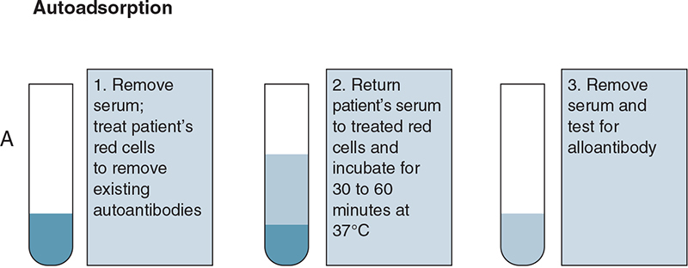
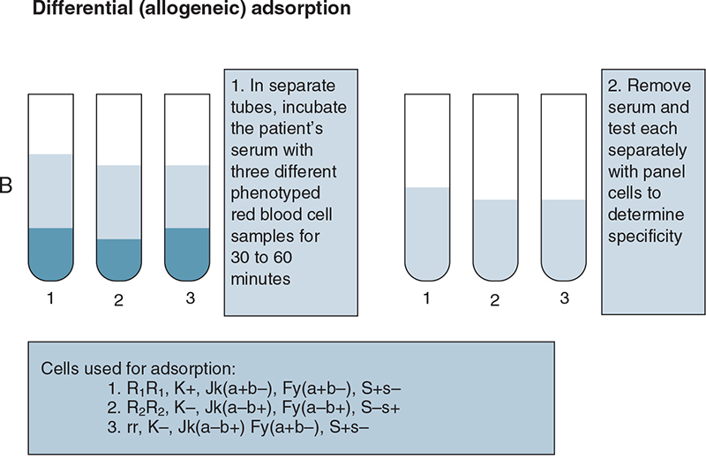
Adsorption (2 of 2)

Slide 51
Other Problems
Phenotyping RBCs coated with IgG can be a challenge
Treating cells with chloroquine diphosphate will disassociate the IgG from the RBCs without harming the antigens

