Slide 1
Chapter 9
Compatibility Testing

Slide 2
Objectives (1 of 4)
Define compatibility testing and crossmatching
List the procedures included in the routine compatibility test, and explain their purpose
Explain the AABB’s Standards for Blood Banks and Transfusion Services as related to compatibility testing
Discuss the selection of crossmatch-compatible whole blood, red blood cells (RBCs), plasma, platelets, and cryoprecipitate for transfusion

Slide 3
Objectives (2 of 4)
Discuss strategies for transfusion when compatible blood cannot be located
Discuss limitations of crossmatching
Describe how crossmatching is handled in the massive transfusion situation
Discuss the advantages and issues related to computer crossmatching

Slide 4
Objectives (3 of 4)
Explain how immediate-spin (IS) crossmatching and antiglobulin crossmatching are performed and when they would be performed
Explain the elements of patient identification and their importance in compatibility testing
Explain the use of a typing and screening protocol and a maximum surgical blood order schedule

Slide 5
Objectives (4 of 4)
Explain how compatibility testing is carried out for an infant younger than 4 months of age
Discuss the principles of autologous blood crossmatching

Slide 6
Compatibility Testing
Compatibility testing involves all the steps in the identification and testing of a donor unit and a proposed recipient’s blood
Crossmatching is part of compatibility testing
Involves mixing donor RBCs and recipient serum or plasma
No agglutination or hemolysis indicates compatibility
Agglutination or hemolysis indicates incompatibility

Slide 7
Purpose
Crossmatching
Serves as a double check of ABO errors
Provides a second means of detecting antibodies
According to the AABB Standards, crossmatching:
“shall use methods that demonstrate ABO incompatibility and clinically significant antibodies to red cell antigens and shall include an antiglobulin phase”

Slide 8
Serologic Crossmatching
IS CROSSMATCHING
IS crossmatching is performed when the recipient has no evidence of an antibody
In the current sample OR
In the historical record
Recipient serum and donor RBC suspension are mixed and immediately centrifuged
Fulfills AABB standards for detecting ABO incompatibility
ANTIGLOBULIN TEST
All phases (IS, 37° C, antihuman globulin [AHG]) are performed if the patient demonstrates a clinically significant antibody
In the current sample OR
In the historical record
If the patient has autoantibody, autoadsorbed serum may be used

Slide 9
Computer Crossmatching
Makes a final check of the ABO compatibility in the selection of units instead of a serologic IS procedure
The recipient must not have an antibody (or antibodies) in the current sample or have a history of antibodies
Bar codes are used to provide another measure of safety

Slide 10
Limitations
An acceptable crossmatch does not guarantee a successful transfusion
Adverse transfusion reactions may still occur
A negative antibody screen does not guarantee that the recipient does not have significant antibodies
A compatible crossmatch does not guarantee survival of RBCs

Slide 11
Recipient Blood Sample
Patient identification and sample labeling
Patient and sample information should have two
independent identifiers (AABB Standards)
Sample collection tubes
Samples may be plasma or serum
Age of sample
The limit is 3 days if the patient has been recently
transfused or is pregnant
Sample collection and appearance
Hemolyzed samples or samples contaminated with
intravenous fluids must be re-collected

Slide 12
Previous Records
Current blood ABO and D typing must be compared with results performed over the past 12 months
Previous records must also be consulted for any significant event related to testing or transfusion

Slide 13
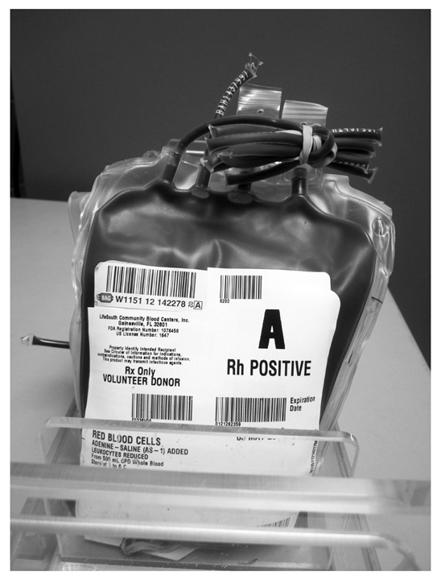
Repeat Testing of Donor Blood
Whole blood and RBCs must be re-typed to confirm the correct ABO labeling
ABO testing is performed on all units
D testing is performed only on D-negative units
Weak D testing is not required
Records are kept for 5 years

Slide 14
Pretransfusion Testing
ABO and D typing
Discrepancies should be resolved before transfusion
Antibody detection
Unpooled reagent RBCs should be used
Crossmatching
Demonstrates ABO incompatibility and clinically significant antibodies to RBC antigens

Slide 15
Selection of ABO Donor Units
Table 9.4 ABO Compatibility for Whole Blood, Red Blood Cells, and Plasma Transfusions
Recipient | Donor
ABO phenotype | Whole blood | Red blood cells | Plasma
A | A | A, O | A, AB
B | B | B, O | B, AB
AB | AB | AB, A, B, O | AB
O | O | O | O, A, B, AB

Slide 16
Selection of Donor Units
D Antigen
D-negative units should be given to D-negative recipients, especially women of child-bearing age
Antigen-negative blood should be given if anti-D antibody is formed
Recipients with Antibodies
Antigen-negative units are recommended for the following antibodies:
ABO
Rh
Kell
Duffy
Kidd

Slide 17
Tagging Blood Products
Requirements for the tag on a crossmatched donor unit:
Patient’s full name and two independent identifiers
Name of blood product
Unique donor unit number or pool number
Unit’s expiration date and ABO and D typing
Interpretation of crossmatching
Technologist’s identification

Slide 18
Issuing Blood Products
Requirements for the issue of donor units:
Physician’s order
Intended recipient’s two independent identifiers, ABO group, and D type
Requisition form: patient name and blood product
Compare requisition form with donor unit tag
Compare donor unit tag with blood product label
Check blood product’s expiration date
Visual check of unit: discoloration? clot? abnormal appearance?
Documentation of person issuing and person receiving donor unit
Special transfusion requirements
Date and time of issue, unit destination

Slide 19
Unused Blood Products
Blood products may be reissued if the closure has not been entered and
If the unit has been kept between the upper and lower temperature conditions (1° to 10° C for RBCs)
If the unit was stored at room temperature, it should be returned within 30 minutes or within a time determined by the facility

Slide 20
Emergency Release
Release must be signed by physician
Tag on donor unit indicating emergency release: compatibility and/or infectious disease
Patient name and identifiers
Donor unit number(s), ABO and D typing, expiration date
Retain segments from units for crossmatching
Name of person issuing units

Slide 21
Massive Transfusion
A massive transfusion is a total volume exchange of blood within 24 hours
Group O, D-negative unit is given in an emergency
If a D-negative unit is unavailable, group O, D-positive blood can be given to D-negative individuals who are not of child-bearing age
ABO-identical unit is given once the blood group is established in the recipient

Slide 22
Maximum Surgical Blood Order Schedule
Average number of blood units used for surgical procedures is determined in a facility
This number is used as the standard blood order for surgical procedures
It may also be used as a guide for the number of autologous units that can be donated

Slide 23
Typing and Screening Procedure
A typing and screening (T/S) procedure includes ABO, Rh, and antibody screening
A T/S is ordered when a surgical procedure uses less than 1 unit of RBCs
Crossmatching is performed on the sample if blood is needed
The goal of a T/S is to conserve the blood inventory

Slide 24
Crossmatching
Autologous Blood
Procedures must be in place to ensure that units are located and transfused to the recipient
The process is monitored manually or through computerized tracking methods
Infants Younger Than
4 Months of Age
ABO and D typing must be performed
Serum testing is not necessary
Antibody screening is performed on the infant’s or mother’s sample
If antibody is present, antigen-negative units are given

Slide 25
Non-RBC Products
Frozen plasma, platelet concentrates, and cryoprecipitate do not need to be crossmatched
Plasma products should be ABO serum compatible
Cryoprecipitate and platelet concentrates may not need to be ABO compatible
Apheresis platelets and granulocyte concentrates may need to be crossmatched if they contain more than 2 mL of RBCs

