Slide 1
Chapter 11
Adverse Complications of Transfusions

Slide 2
Objectives (1 of 4)
Describe the hemovigilance model and its role in improving transfusion safety
List common signs and symptoms of adverse transfusion reactions
Distinguish between acute and delayed transfusion reactions, and give examples of each
Discuss the mechanisms that can cause immune- and nonimmune-mediated red blood cell (RBC) destruction

Slide 3
Objectives (2 of 4)
Compare and contrast the distinguishing features of the following transfusion reactions: febrile, urticarial, and anaphylactic reactions; transfusion-related acute lung injury; and transfusion-associated graft-versus-host (GVH) disease
Discuss the causes and clinical features of the bacterial contamination of blood products
Describe the clinical features and patients at risk for a transfusion reaction caused by circulatory overload

Slide 4
Objectives (3 of 4)
Describe the mechanisms and prevention of transfusion hemosiderosis, citrate toxicity, and posttransfusion purpura
Provide direction to medical personnel performing the transfusion in the event of a reported adverse reaction
List the initial tests performed in the transfusion service on receipt of a patient’s sample after a reaction

Slide 5
Objectives (4 of 4)
Identify additional tests that might be required in the investigation of transfusion reactions, and state the rationale for selecting these tests
Describe the required documentation and reporting in the investigation of a transfusion reaction
Evaluate data from a transfusion reaction

Slide 6
Adverse Transfusion Reaction
“An undesirable response or effect in a patient temporarily associated with the administration of blood or blood component”

Slide 7
Hemovigilance Model
The hemovigilance model tracks and analyzes adverse transfusion reactions

Slide 8
Recognizing a Transfusion Reaction
Fever
Chills or rigors
Respiratory distress
Hyper-tension or hypo-tension
Pain
Skin rash, flushing, edema
Oliguria
Jaundice
Nausea
Abnormal bleeding

Slide 9
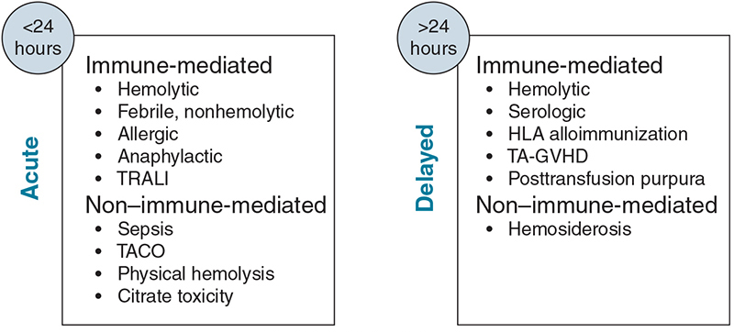
Transfusion Reactions

Slide 10
Acute Hemolytic Transfusion Reactions (AHTRs)
Rapid destruction of RBCs within 24 hours of transfusion
Signs range in severity from fever to death
Usually due to ABO incompatibility
As little as 10 mL of incompatible blood can produce symptoms

Slide 11
Pathophysiology of AHTRs
Antibody binds to incompatible RBC antigens
Complement is activated (mostly by immunoglobulin M [IgM]), which causes intravascular hemolysis
Phagocytes are activated and release cytokines
Coagulation is activated (e.g., disseminated intravascular coagulation [DIC])
Shock and renal failure occur

Slide 12
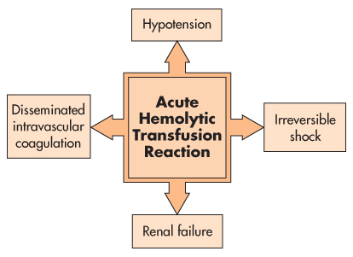
Clinical Consequences of AHTRs

Slide 13
Factors That Lead to AHTRs
Table 11.3 Errors Contributing to Acute Hemolytic Transfusion Reactions
Errors known to cause AHTR | Contributing factors causing errors
● Collection of blood from the incorrect patient | ● Insufficient segregation of units ● Preprinted sample labels
● Incorrect labeling of blood samples | ● Patients with similar or identical names
● Misidentification of sample at blood bank | ● Sequential patient identifiers
● Issuance of wrong unit from blood bank | ● Verbal and STAT orders
● Transfusion of blood to incorrect patient | ● Manual issuance of blood
● Aliquoting a patient sample to improperly labeled test tube | ● Simultaneous processing of specimens from multiple patients ● Tested the correct sample but recorded results on the wrong patient record ● Overriding computer error messages
Data from Sazama K: Reports of 355 transfusion-associated deaths: 1976 through 1985, Transfusion 30:583–590, 1990.

Slide 14
Delayed Hemolytic Reactions
Symptoms usually appear after 24 hours from the time of transfusion
Less severe than acute hemolytic reactions
Usually due to immunoglobulin G (IgG) antibodies formed from prior exposure to RBCs through previous transfusion or pregnancy
Antibodies may be undetected during pretransfusion testing due to low titers
Common antibodies: Rh, Kidd, Duffy, Kell, MNS

Slide 15
Acute and Delayed HTRs
Table 11.4 Acute Versus Delayed Hemolytic Transfusion Reactions
 | Acute hemolytic | Delayed hemolytic
Clinical Signs and Symptoms | ● Immediate or within 24 hours posttransfusion ● Fever, chills, flushing, pain at site of infusion, tachycardia, tachypnea, lower back pain ● Hemoglohinemia, hemoglobinuria, hypotension | ● >24 hours to 28 days posttransfusion ● Fever: temperature increase ≥1° C (or 2° F) with or without chills ● Unexplainable decrease in hemoglobin and hematocrit ● Jaundice and hemoglobinuria
Major Complications | ● DIC, renal failure, shock, mortality | ● Anemia
Causes | ● ABO incompatibility ● Complement activation | ● Anamnestic response to red cell antigen ● Alloantibody not demonstrating or missed pretransfusion
Clinical Laboratory Tests | ● Clerical check and visual inspection of posttransfusion sample ● DAT: positive or negative ● Repeat ABO testing ● Tests for hemolysis: ● ↑ Plasma-free hemoglobin ● ↑ Serum bilirubin ● ↓ Haptoglobin ● Hemoglobinuria | ● DAT: positive ● Posttransfusion antibody screen: positive ● ↓ Hemoglobin and hematocrit ● Tests for hemolysis: ● ↑ Plasma-free hemoglobin ● ↑ Serum bilirubin ● ↓ Haptoglobin ● Hemoglobinuria
Management | ● Treat hypotension and DIC ● Maintain renal blood flow | ● Identify antibody(ies) ● Provide antigen-negative donor units
Prevention | ● Avoid clerical and misidentification errors ● Design systems to decrease chances of technical error | ● Check of patient records ● Recently transfused or pregnant have sample drawn within 3 days of transfusion
DIC, Disseminated intravascular coagulation; DAT. direst antiglobulin test; ↑, increased levels; ↓, decreased levels.

Slide 16
Nonimmune Hemolytic Anemia
RBC destruction when antibodies are not implicated
Exposure of RBCs to extreme temperature
Improper deglycerolization
Mechanical destruction of RBCs
Incompatible solutions: use only physiologic saline
Bacterially contaminated blood products
Intrinsic RBC defects (e.g., sickle cell)

Slide 17
Febrile, Nonhemolytic Reactions
Table 11.5 Febrile Nonhemolytic Transfusion Reactions
Clinical Signs and Symptoms | ● Fever: temperature increase ≥1° C (or 2° F) above 37° C ● Other symptoms: chills, rigors, headache and vomiting
Major Complications | ● Nonthreatening ● Significant discomfort to the recipient
Causes | ● Antibody to donor WBCs ● Cytokines released by WBCs during blood product storage
Clinical Laboratory Tests | ● DAT: negative ● No visible hemolysis
Management | ● Antipyretics: acetaminophen
Prevention | ● Prestorage leukocyte reduction of blood products
WBC, white blood cell; DAT, direct antiglobulin test.

Slide 18
Allergic Reactions (1 of 2)
Caused by soluble allergens in donor plasma
Allergic reaction: immunoglobulin E (IgE) reacts with plasma proteins
Anaphylactic reaction: recipient forms antibodies to immunoglobulin A (anti-IgA antibodies)
Symptoms usually occur within seconds to minutes of being transfused

Slide 19
Allergic Reactions (2 of 2)
Table 11.6 Allergic Transfusion Reactions
 | Urticarial | Anaphylactic
Clinical Signs and Symptoms | ● Hives and itching within 15–20 min of transfusion | ● Rapid onset and severe wheezing, coughing, dyspnea, bronchospasm, respiratory distress, vascular instability ● No fever
Major Complications | ● None | ● Shock ● Loss of consciousness ● Mortality
Causes | ● Recipient antibodies to foreign plasma proteins or other substances such as drugs or food consumed by blood donor | ● Associated with genetic IgA deficiency in recipient who possesses IgG complement-binding anti-IgA antibodies
Clinical Laboratory Tests | ● DAT: negative ● No visible hemolysis | ● DAT: negative ● No visible hemolysis ● Perform IgA antigen anti-IgA tests
Management | ● Transfusion interrupted ● Antihistamine administered | ● Transfusion terminated ● Epinephrine and similar drugs administered ● Oxygen administered and open airways maintained
Prevention | ● Premedication with antihistamine, if patient history reveals repetitive reactions ● May necessitate washed cellular products | ● Plasma-containing products from IgA-deficient donors ● Washed red cell and platelet products
DAT, Direct antiglobulin test.

Slide 20
Transfusion-Related Acute Lung Injury
Table 11.7 Transfusion-Related Acute Lung Injury
Clinical Signs and Symptoms⁴ | ● Fever (1–2° C increase) ● Chills ● Hypoxia ● Dyspnea (shortness of breath) ● Cyanosis (bluish discoloration of skin) ● Nonproductive cough ● New onset bilateral pulmonary edema ● Hypotension ● Acute onset within 6 hr of blood transfusion
Major Complications | ● Severe and dramatic presentation ● Can be fatal
Causes | ● Interaction of recipient-related risks and transfusion event ● Donor with pregnancy history, anti-HLA, anti-HNA
Clinical Laboratory Tests | ● DAT: negative ● No visible hemolysis ● WBC antibody screen in donor and recipient ● Chest x-ray
Management | ● Respiratory support
Prevention | ● Avoid use of plasma components from multiparous women who have HLA antibodies
HLA, Human leukocyte antigen; DAT, direct antiglobulin test; WBC, white blood cell.

Slide 21
Graft-Versus-Host Disease
Table 11.9 Transfusion-Associated Graft-Versus-Host Disease
Clinical Signs and Symptoms | ● Onset 3–30 days posttransfusion ● Fever, erythematous maculopapular rash, abnormal liver function, diarrhea, pancytopenia
Major Complications | ● Marrow aplasia and hemorrhage ● 90% mortality rate
Cause | ● Transfused immunocompetent T lymphocytes mount immunologic response against recipient
Clinical Laboratory Tests | ● Confirmation by HLA typing to demonstrate a disparity between donor lymphocytes and recipient tissues
Management | ● Unresponsive to medical intervention
Prevention | ● Irradiation of blood products before transfusion in at-risk recipients ● Gamma irradiation (25 Gy) to prevent blast transformation of donor lymphocytes¹¹
HLA, Human leukocyte antigen.

Slide 22
Irradiation
Irradiation eliminates the ability of leukocytes to replicate and mount an immune response
Table 11.8 Indications for Irradiated Components
Indicated | Not indicated
Intrauterine transfusions | Patients with HIV
Premature, low-birth-weight infants | Full-term infants
Congenital immunedeficiencies | Nonimmunosuppressed patients
Hematologic malignancies
HLA-matched components
Directed donations from related donors
Granulocyte components
Newborns with erythroblastosis fetalis
HIV, Human immunodeficiency virus. Data from Fung MK, editor: Technical manual, ed 18, Bethesda, MD, 2014, AABB.

Slide 23
Bacterial Contamination
Major sources include:
Transient bacteremia in the donor
Improper cleansing of the donor’s skin during collection
Some organisms can grow upon storage
Yersinia enterocolitica (4° C)
Serratia liquefaciens (4° C)
Pseudomonas fluorescens (4° C)
Staphylococcus (platelets, 20° to 24° C)
Bacillus cereus (platelets, 20° to 24° C)
Apheresis platelets and platelet concentrates must be tested for bacteria

Slide 24
Transfusion-Associated Circulatory Overload (TACO)
Patient’s cardiopulmonary system exceeds its volume capacity
Symptoms (signs of congestive heart failure):
Dyspnea
Severe headache
Peripheral edema
Treated with oxygen therapy and diuretics
Candidates susceptible to circulatory overload should receive RBC units

Slide 25
Hemosiderosis
Accumulation of excess iron in macrophages in tissues
Usually occurs in patients undergoing long-term transfusions (e.g., thalassemia)
Iron intake exceeds daily iron excretion
Prevention involves iron chelation
Deferiprone
Deferoxamine

Slide 26
Citrate Toxicity
Occurs when large quantities of citrated blood are transfused
May have adverse effects in:
Those receiving large volumes of blood
Patients with impaired liver function
Preterm infants with hepatic or renal insufficiency
Prevention
Remove plasma that may contain citrate
Inject calcium chloride or calcium gluconate

Slide 27
Post-transfusion Purpura
Women negative for platelet antigen P1A1 are sensitized through multiple pregnancies (produce anti-P1A1 antibody)
Platelet count decreases 5 to 12 days after transfusion
Purpura and bleeding follow
Treatment: plasmapheresis, exchange transfusion, and intravenous IgG

Slide 28
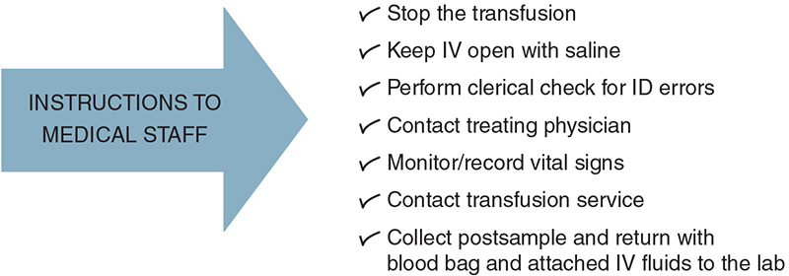
Procedure for Adverse Reactions

Slide 29
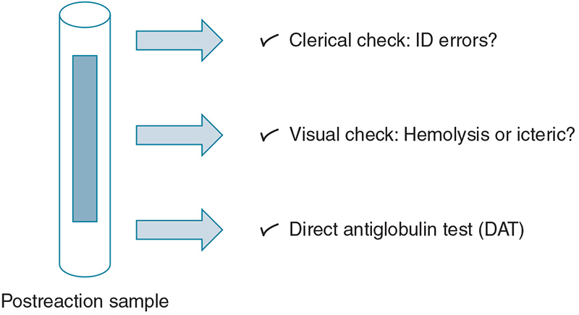
Postreaction Workup

Slide 30
Additional Testing
Table 11.8 Additional Testing in a Transfusion Reaction Investigation
Test | Reason
ABO/D phenotyping | Errors in patient or sample identification
Antibody screen | Newly detected antibodies
Crossmatch | Serologic compatibility
Hemoglobin/hematocrit | Therapeutic effectiveness
Haptoglobin | Hemolytic process
Bilirubin | Hemolytic process
Urine hemoglobin | Hemolytic process
Inspection of donor unit | Nonimmune hemolysis or bacterial contamination
Gram stain and blood culture | Bacterial contamination

Slide 31
Hemovigilance
Table 11.12 Case Definition Criteria for Hemovigilance Reporting
Criteria | Definitions
Signs and symptoms | Definitive: Conclusive Probable: Evidence in favor Possible: Evidence indeterminate
Laboratory/radiology | Definitive: Conclusive Probable: Evidence in favor Possible: Evidence indeterminate
Severity (graded) | Grade 1: Nonsevere Grade 2: Severe—requires medical intervention or prolongation of hospitalization or both Grade 3: Life-threatening; major intervention needed to prevent death Grade 4: Death as a result of adverse transfusion reaction
Relationship to transfusion (imputability) | Definitive: Conclusive Probable: Evidence in favor Possible: Evidence indeterminate
Data from NHSN manual: biovigilance component protocol hemovigilance module, August 2014. Guidelines and procedures for monitoring hemovigilance. http://www.cdc.gov/nhsn/bio.html. October 2015

Slide 32
Records and Reports
Records of patients experiencing adverse reactions remain indefinitely in transfusion services
Cases of transfusion-related disease or bacterial contamination are reported to the donation facility
Fatalities are reported as soon as possible to the director of the Food and Drug Administration (FDA) Office of Compliance, Center for Biologics Evaluation and Research

