Slide 1
Chapter 12
Hemolytic Disease of the
Fetus and Newborn

Slide 2
Objectives (1 of 5)
Discuss the cause of hemolytic disease of the fetus and newborn (HDFN)
Contrast the metabolism of bilirubin in the fetus and the newborn
Correlate the tests included in an initial prenatal workup with their significance in predicting HDFN
Distinguish clinically significant and insignificant antibodies in terms of causing HDFN

Slide 3
Objectives (2 of 5)
Explain the primary value of performing antibody titration, and state what results are considered significant
Outline the intervention procedures used in the diagnosis and management of HDFN
List the tests routinely performed on cord blood cells when HDFN is suspected, and discuss possible sources of error when performing each test

Slide 4
Objectives (3 of 5)
Compare and contrast the clinical and laboratory findings in ABO HDFN versus HDFN caused by anti-D antibody
Discuss the composition, eligibility criteria, and principle of Rh immune globulin (RhIG)
Explain the principle, interpretation, and significance of a positive rosette test for fetomaternal hemorrhage

Slide 5
Objectives (4 of 5)
Outline the principle, interpretation, and significance of Kleihauer-Betke acid elution
Evaluate laboratory test results for postpartum samples, and determine if RhIG should be administered
Calculate the dose of RhIG, given the fetomaternal hemorrhage results

Slide 6
Objectives (5 of 5)
Explain the selection of blood for an intrauterine exchange transfusion with regard to ABO and D phenotype
List the special considerations that must be met when selecting blood for exchange transfusion, and explain the purpose of each requirement

Slide 7
Hemolytic Disease of the Newborn and Fetus (HDFN)
Also known as erythroblastosis fetalis
Fetal or newborn red blood cells (RBCs) are destroyed by maternal immunoglobulin G (IgG)
Maternal antibodies:
Cross the placenta
Sensitize fetal RBCs
Shorten RBC survival

Slide 8
Etiology (1 of 3)
HDFN may occur when fetal cells escape into the maternal circulation as a result of a fetomaternal hemorrhage
Delivery
Amniocentesis
Abortion
Cordocentesis
Ectopic pregnancy
Abdominal trauma

Slide 9
Etiology (2 of 3)
Fetal RBC antigens that the mother does not have stimulate the mother to produce antibodies
Antibodies bind to fetal antigens and cause RBC destruction in the fetal liver and spleen

Slide 10
Etiology (3 of 3)
BEFORE BIRTH
Indirect bilirubin is conjugated by the maternal liver
As RBC destruction continues, fetal erythropoiesis increases
Erythroblasts are released (erythroblastosis fetalis)
Edema occurs in the peritoneal and pleural cavities (hydrops fetalis)
Cardiac failure may result
AFTER BIRTH
Newborn cannot conjugate bilirubin
Unconjugated bilirubin binds to albumin and then to tissues (jaundice)
Permanent brain damage (kernicterus) may result if bilirubin binds to tissues of the central nervous system

Slide 11
Overview of HDFN
Three important factors must occur:
RBC antibody must be IgG
Only IgG crosses the placenta
Fetus must possess an antigen that the mother lacks
The gene is inherited from the father
Antigen must be well developed at birth

Slide 12
Types of HDFN
Rh (D antigen)
ABO
Other antibodies

Slide 13
Rh HDFN
Most severe
D-negative women are sensitized during the first pregnancy with
a D-positive baby
Subsequent pregnancies are affected
Positive direct antiglobulin test (DAT)
Jaundice and/or anemia may occur
Exchange transfusion may be necessary
Rh immune globulin (RhIG) is given to prevent Rh HDFN

Slide 14
ABO HDFN
Most common type of HDFN (1 in 150 births)
Mother has group O blood; baby has group A or B blood
First pregnancy may be affected
Production of mild symptoms is possibly due to
A or B substances in tissue that may neutralize antibodies
Fetal/infant RBCs may be poorly developed
Fetal/infant RBC sites may be reduced
Some jaundice may occur
Phototherapy can be used to treat jaundice

Slide 15
Other Types of HDFN
Any IgG can cause HDFN
Anti-c and anti-K antibodies are common causes
Other Kell antibodies and antibodies to Kidd, Duffy, S, and U antigens are less common
Agglutination with paternal cells and maternal serum is a clue to a low-frequency antigen

Slide 16
Prenatal Testing (1 of 2)
Testing serves two purposes:
Identifies D-negative women who are candidates for RhIG
Identifies women with antibodies capable of causing HDFN

Slide 17
Prenatal Testing (2 of 2)
Table 12.2 Prenatal Testing: Recommended Tests to Identify Women at Risk of Hemolytic Disease of the Fetus and Newborn
Initial Prenatal Visit | ABO/D (weak D test is optional) Antibody screen for IgG antibodies If antibody screen is positive, identify antibody Antibody titration for IgG antibodies to establish baseline
Follow-up Visits (if IgG antibody was identified) | Selected reagent red cell panel should be run to exclude other clinically significant antibodies Perform antibody titration in parallel with initial sample at 2- to 4-week intervals
26–28 Weeks’ Gestation | Confirm D typing Repeat antibody screen¹⁵: ● Before RhIG therapy in D-negative ● In third trimester if patient was transfused or has a history of unexpected antibodies
RhIG, Rh immune globulin. From Judd WJ: Practice guidelines for prenatal and perinatal immunohematology, revisited, Transfusion 41:1445, 2001.

Slide 18
Antibody Titration
Titration helps determine whether certain procedures should be performed
Baseline titer is determined in the first trimester and repeated at 4- to 6-week intervals (sample is frozen for future testing)
A titer that rises by 2 dilutions (compared to baseline) is significant
A titer of 16 or 32 is usually critical for anti-D and other Rh antibodies

Slide 19
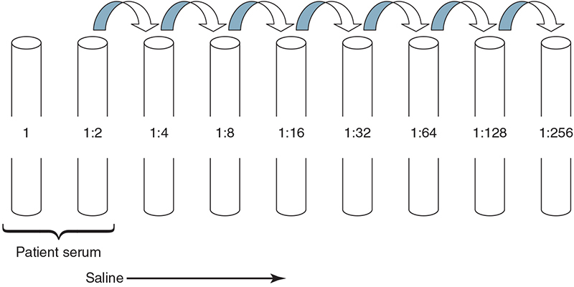
Titration

Slide 20
Ultrasound
Color Doppler ultrasonography can detect fetal anemia
Increased cardiac output and low blood viscosity
Severity of anemia is determined by evaluating the peak systolic velocity in the middle cerebral artery

Slide 21
Amniocentesis
Amniotic fluid is scanned spectrophotometrically for 350 to 700 nm
A change in optical density (ΔOD) above baseline (450 nm) is a measure of bilirubin
The ΔOD is plotted on a Liley graph (using gestational age)
Upper zone (zone 3): severe HDFN
Middle zone (zone 2): moderate disease
Lower zone (zone 1): mild disease

Slide 22
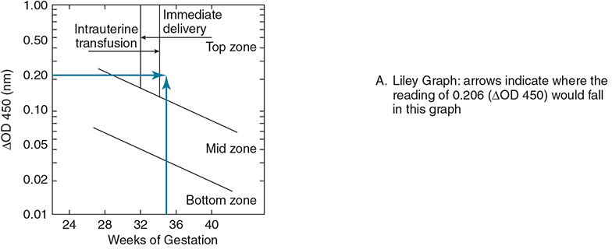
Liley Graph

Slide 23
Amniocentesis
Three alternatives exist based on results:
Pregnancy continues to term
Intrauterine transfusion is performed
Early labor is induced
Fetal lung maturity must be determined (lecithin-sphingomyelin [L:S] ratio should be greater than 2:1)

Slide 24
Cordocentesis
Fetal blood sample is taken for:
Hemoglobin and hematocrit testing
Bilirubin testing
RBC genotyping
Mortality rate is low (1% to 2%)
Cordocentesis can be used for intravascular transfusions in cases of severe HDFN

Slide 25
Fetal Genotyping
Fetal DNA can be typed using maternal plasma during the second trimester
Predicting the fetal genotype could avoid amniocentesis or cordocentesis if the fetus lacks the antigen

Slide 26
Postpartum Testing (1 of 3)
D testing
All infants born to D-negative mothers are tested, including for weak D antigen
False-negative results
D-antigen sites are blocked by antibody (blocking phenomenon)
Perform elution (will demonstrate anti-D antibody)
False-positive results
Weak D test is performed on RBCs coated with antibodies
Rh control will be positive at antihuman globulin (AHG) phase

Slide 27
Postpartum Testing (2 of 3)
Table 12.3 Testing at Delivery (Postpartum Testing)
Blood sample | Test | Indication
Maternal | ABO/D typing | To determine whether RhIG is needed For pretransfusion testing or suspected ABO HDFN Weak D test is not required if test for D is negative
 | Antibody screen | If transfusion is necessary or HDFN is suspected
 | Antibody ID | If screen is positive
 | Fetal screen (rosette) | If mother is D-negative and baby is D-positive
 | Kleihauer-Betke | If fetal screen (rosette) is positive, to determine dosage of RhIG
Cord or Infant | ABO/D typing | To determine whether RhIG is needed for the mother or if ABO HDFN is suspected Weak D test is required if test for D is negative
 | DAT | Performed routinely or in suspected cases of HDFN
 | Elution | If DAT is positive; test eluate against A cells, B cells, panel cells, or paternal cells, as indicated if HDFN is suspected
RhIG, Rh immune globulin; HDFN, Hemolytic disease of the fetus and newborn; DAT, direct antiglobulin test.

Slide 28
Postpartum Testing (3 of 3)
ABO testing
Only the forward grouping is performed
ABO antibodies are not yet produced
Cord blood is washed to remove Wharton’s jelly
DAT
Elution may be necessary if the test is positive and if the mother’s antibody has not been identified or the maternal serum sample is unavailable
If the eluate is negative, an antibody to low-frequency antigen is suspected
If the eluate is positive with A or B cells and negative with screening cells, ABO HDFN is indicated

Slide 29
Intrauterine Transfusions
ABO/Rh and DAT results should be interpreted with caution in newborns who have had intrauterine transfusions
Cord blood may phenotype as group O, D-negative blood because group O, D-negative unit is given
DAT may be falsely negative or weakly positive

Slide 30
Prevention of HDFN
RhIG prevents alloimmunization in D-negative mothers
RhIG only prevents formation of anti-D antibody
Antepartum administration
Initial dose (300 μg) is given at 28 weeks’ gestation
Postpartum administration
Nonimmunized women receive one full dose of RhIG within 72 hours of delivery
More than one dose may be necessary if the mother has fetomaternal hemorrhage of more than 30 mL

Slide 31
Screening for Fetomaternal Hemorrhage
RhIG candidates are screened for fetomaternal hemorrhage
Most common screening method is the rosette test
Uses postpartum maternal specimen
Maternal RBCs are incubated with anti-D antibody
D-positive indicator cells are added
Rosettes are observed under the microscope
Less than 1 rosette per 3 low-power fields: one dose of RhIG
More than 1 rosette per 3 low-power fields: bleed must be quantitated

Slide 32
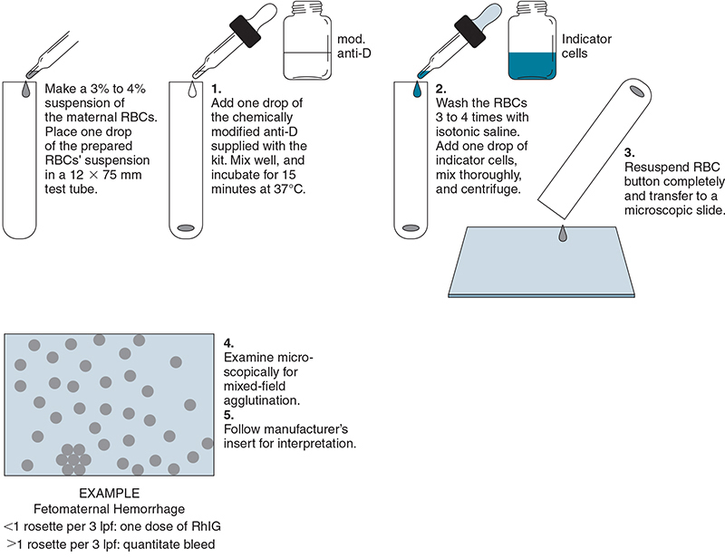
Rosette Test

Slide 33
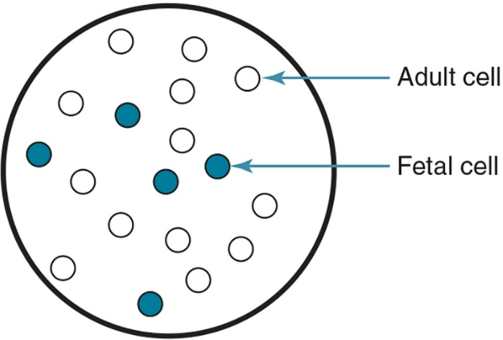
Quantifying Fetomaternal Hemorrhage
To calculate the additional doses of RhIG, flow cytometry or the Kleihauer-Betke test is performed
Kleihauer-Betke test is based on the following facts
Fetal hemoglobin is resistant to acid (retains dye)
Adult hemoglobin is not resistant to acid (ghost-like)

Slide 34
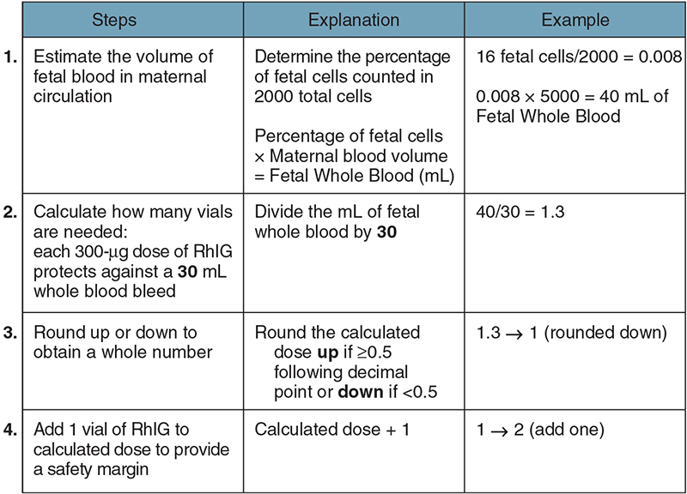
Kleihauer-Betke Calculation

Slide 35
Intrauterine Transfusion
Corrects anemia and prevents heart failure
Blood for intrauterine transfusion
Group O, D-negative RBCs
RBCs collected within 7 days (fresh)
Irradiated to prevent graft-versus-host disease
Negative for cytomegalovirus and/or leukocyte reduced
Negative for hemoglobin S

Slide 36
Phototherapy
Initial treatment for hyperbilirubinemia
Mild cases of HDFN, such as ABO HDFN
Uses fluorescent blue light (420 to 475 nm)
Light converts bilirubin to isomers that are excreted in the bile
If patient is unresponsive, exchange transfusion may be necessary

Slide 37
Exchange Transfusion (1 of 2)
Replacement of 1 to 2 whole blood volumes
Exchange transfusion
Corrects anemia without expanding the blood volume
Removes newborn’s RBCs and replaces them with antigen-negative cells
Reduces bilirubin (prevents kernicterus)
Reduces maternal antibody

Slide 38
Exchange Transfusion (2 of 2)
ABO and D typing is determined in the infant
Maternal or infant serum or plasma is used for antibody screening
Antigen-negative units are given if antibody is present
Table 12.5 Selection of Blood for Exchange Transfusion
● Group O (or ABO-compatible) D-negative blood ● RBCs <7 days old, resuspended in group AB FFP ● CMV-reduced-risk components: CMV-seronegative donors or leukocyte reduced ● Irradiated blood ● Hemoglobin S–negative blood ● Blood lacks antigen corresponding to maternal antibody ● Compatible crossmatch with maternal scrum or eluate prepared from newborn’s red cells
RBCs, Red blood cells; FFP, fresh frozen plasma; CMV, cytomegalovirus.

