Slide 1
Chapter 14
Testing of Donor Blood

Slide 2
Objectives (1 of 3)
List the required tests performed on allogeneic and autologous donor blood
Describe the enzyme-linked immunosorbent assay (EIA), and differentiate among sandwich, indirect, and competitive EIA techniques
Describe the principle of nucleic acid testing for donor blood samples
Compare and contrast internal and external controls in EIA testing

Slide 3
Objectives (2 of 3)
Compare and contrast test sensitivity with test specificity
Describe when cytomegalovirus (CMV) screening is performed
State the frequency of positive tests on blood donated for allogeneic transfusion

Slide 4
Objectives (3 of 3)
Define look-back investigation and the Food and Drug Administration (FDA) requirements with regard to hepatitis C virus (HCV) and human immunodeficiency virus (HIV) testing on blood donors
State the reason for performing bacterial detection tests on plateletpheresis products

Slide 5
Types of Testing
Donor tests can be divided into 2 categories:
Immunohematologic testing (ABO and D testing and antibody screen)
Infectious disease screening

Slide 6
Required Tests
Table 14.1 Required Donor Blood Tests
Testing for | Testing performed
RBC antigens | ABO and D phenotype
Clinically significant RBC antibodies | Antibody screen
Hepatitis | HBsAg Anti-HCV Anti-HBc HCV NAT HBV DNA
HIV-1/2 | Anti-HIV-1/2 HIV-1 RNA
HTLV-I/II | Anti-HTLV-I/II
Syphilis | Nontreponemal serologic test for syphilis (eg, rapid plasma reagin) or IgG or IgG + IgM antibody to Treponema pallidum antigens
WNV | WNV RNA
Trypanosoma cruzi (Chagas disease) | IgG antibody to T. cruzi (one-time testing for donor screening)
RBC, Red blood cell; HBsAg, hepatitis B surface antigen; anti-HBc, antibody to hepatitis B core; anti-HCV, antibody to hepatitis C virus; HCV, hepatitis C virus; HIV, human immunodeficiency virus; HTLV, human T-cell lymphotropic viruses; WNV, West Nile virus.

Slide 7
Immunohematologic Tests
ABO and D testing
Forward and reverse testing is performed
Weak D testing is performed on all negative donors
Antibody screen
Screening cells can be separated or pooled
If significant antibodies are present, plasma and platelets cannot be used
RBCs can be used, but the antibody interpretation should be on the label

Slide 8
Syphilis Testing
Syphilis is caused by Treponema pallidum
Rapid plasma reagin (RPR)
Screening test that detects reagin in serum
Hemagglutination for T. pallidum
Fixed chicken RBCs sensitized with the organism react with patient antibodies to T. pallidum
Confirmatory testing
Tests for specific antibody if the RPR or hemagglutination test is positive
Fluorescent treponemal antibody adsorption

Slide 9
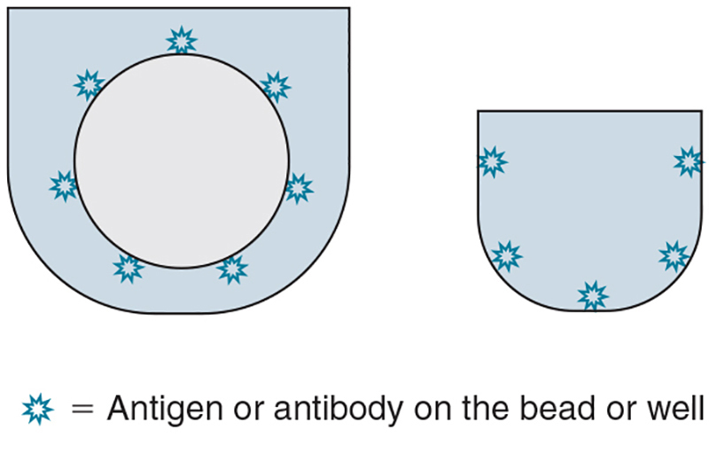
Enzyme-Linked Immunosorbent Assay
EIA detects antigens or antibodies using a solid object (e.g., plastic bead) coated with antigen or antibody
Indirect EIA
Detects antibodies
Sandwich EIA
Detects antigen

Slide 10
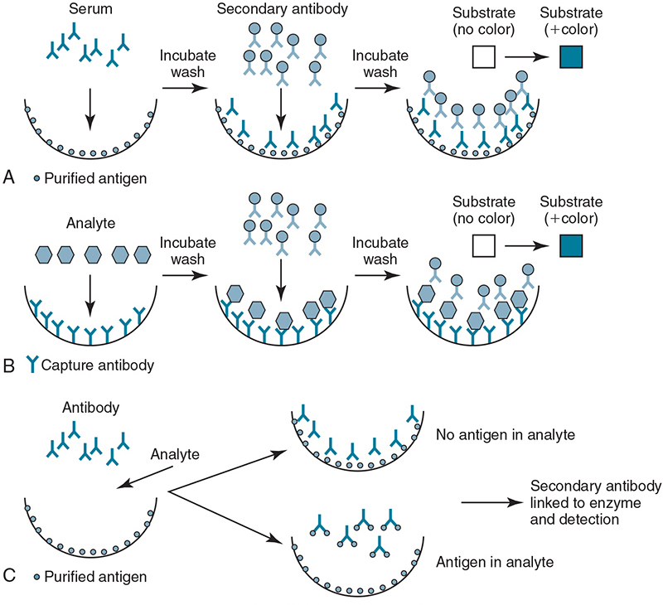
EIA Technique

Slide 11
EIA Terms
Table 14.2 Enzyme-Linked Immunosorbent Assay Test Terms and Definitions
Term | Definition
Internal controls | Validation materials provided with assay kit
External controls | Reagents or materials that are not part of test kit used for surveillance of test performance
Cutoff value | Absorbance value unique to each test run that determines a positive or negative result; calculated from internal controls
Conjugate | Enzyme, usually horseradish peroxidase, labeled antibody or antigen
Substrate | Color developer, usually o-phenylenediamine

Slide 12
Nucleic Acid Testing (NAT)
NAT amplifies nucleic acids of infectious agents and identifies viral RNA
NAT can detect very low numbers of viral copies in plasma before antibodies appear
RNA and DNA viruses routinely tested using NAT:
HIV
HCV
West Nile virus (WNV)
HBV

Slide 13
Chemiluminescence
Chemiluminescence is the emission of light from a chemical reaction
Chemiluminescent labels are attached to an antigen or antibody where the highest light intensity emitted is measured
Advantages
Stable
Less reagent is needed
Relatively nontoxic
Quick reagents
Very sensitive
Fast turnaround time

Slide 14
Sensitivity and Specificity
Sensitivity
Ability of assay to identify samples from infected individuals as positive
Sensitivity percentage
⇩
100 × No. of positive individuals
Total No. of infected individuals
Specificity
Ability of assay to identify samples from noninfected individuals as negative
Specificity percentage
⇩
100 × No. of negative individuals
Total No. of infected individuals

Slide 15
Viral Hepatitis
Table 14.3 Hepatitis Viruses
 | A | B | C | D | E
Transmission | Enteric; oral and fecal | Parenteral; sexual; perinatal | Parenteral; sexual; perinatal | Parenteral; sexual; perinatal | Enteric; oral and fecal
Incubation (days) | 15–50 | 60–150 | 14–300 | 30–50 | 21–42
Classification | Picornavirus | Hepadnavirus | Flavivirus | Satellite | Calicivirus
Nucleic acid | RNA | DNA | RNA | RNA | RNA
Donor Testing | No | Yes | Yes | No | No
RNA, Ribonucleic acid; DNA, deoxyribonucleic acid.

Slide 16
Hepatitis Testing on Donors
Hepatitis B surface antigen (HBsAg)
HBsAG is a protein on the viral surface; it indicates that the individual is infectious
Antibody to hepatitis B core antibody (anti-HBc)
Antibody appears after HBsAG but before symptoms
Antibody to HCV
Anti-HCV antibody is detectable 10 weeks after infection
NAT to detect RNA of HCV
NAT to detect DNA of HBV

Slide 17
Human Retroviruses
A retrovirus contains reverse transcriptase, which allows the virus to convert RNA to DNA and then integrate the DNA into the cell
Three subfamilies exist:
Lentivirus (HIV types 1 and 2)
Oncornavirus (human T-cell lymphotropic virus [HTLV] types I, II, and V)
Spumavirus (no human disease)

Slide 18
HIV Types 1 and 2
HIV types 1 and 2 cause acquired immunodeficiency syndrome (AIDS)
Infects CD4⁺ T lymphocytes (helper T cells)
Donor testing requires:
Antibody to HIV 1 and 2 develops 22 to 25 days after infection
HIV-1 NAT

Slide 19
HTLV Types I and II
HTLV-I is associated with adult T-cell leukemia
HTLV-II is associated with large granular lymphocyte leukemia
It is a requirement that all donor blood be tested for antibody to HTLV types I and II

Slide 20
West Nile Virus
Mosquito-borne flavivirus
Clinical manifestations range from mild fever to encephalitis, coma, and death
Individual donors are screened for West Nile virus using NAT

Slide 21
Look-Back Investigation
A look-back investigation involves actions taken when donor test results are positive for the hepatitis virus, HIV, HTLV, or WNV
Quarantine prior to donations from the donor
Notify facilities that received products
Donor is further tested
Destroy (or relabel) prior collections
Notify transfusion recipients

Slide 22
Additional Tests
Cytomegalovirus
Mononucleosis-like virus that is found in white blood cells
CMV-negative blood is given to infants or anyone who is immunocompromised
Chagas disease
Caused by Trypanosoma cruzi; transmitted by reduviid bug
Blood collection facilities in areas with many Latino immigrants perform an EIA test
In 2010, the FDA recommended one-time donor screening
Bacterial contamination
Apheresis platelets and platelet concentrates must be tested

