Slide 1
Chapter 15
Blood Component Preparation and Therapy

Slide 2
Objectives (1 of 3)
Explain the benefits of component separation
Define storage lesion, and list the elements that change during blood storage
Compare the anticoagulant and preservative solutions with regard to expiration and content
Illustrate the steps in blood component preparation

Slide 3
Objectives (2 of 3)
Given certain patient clinical conditions, state the blood component most appropriate for their transfusion needs
State the storage temperature and storage limits for each blood component
Given laboratory quality control test measurements, determine which component products meet acceptable AABB standards and Food and Drug Administration (FDA) guidelines

Slide 4
Objectives (3 of 3)
Explain the intent and activities of the FDA in regulating blood component preparation, storage, and distribution
List the labeling requirements common to all blood components and the International Society of Blood Transfusion (ISBT)128 advantages
Discuss the importance of monitored storage equipment for blood components and the alarm requirements
Describe essential aspects of safe blood administration

Slide 5
Blood Collection and Storage
Blood is collected in a primary bag containing anticoagulants and preservatives
The blood collection set is sterile and considered a closed system
If ports or other areas are exposed to air, the system becomes an open system

Slide 6
Anticoagulant–Preservative Composition
Table 15.1 Anticoagulant-Preservative Composition: Purpose and Storage Limits
Chemical | Purpose
Dextrose | Supports ATP generation by glycolytic pathway
Adenine | Acts as substrate for red cell ATP synthesis
Citrate | Prevents coagulation by chelating calcium, also protects red cell membrane
Sodium biphosphate | Prevents excessive decrease in pH
Mannitol | Osmotic diuretic acts as membrane stabilizer
Red cell anticoagulant/preservative | Storage limit (days)
CPD/citrate-phosphate-dextrose | 21
CP2D/citrate-phosphate-2-dextrose | 21
CPDA-1/citrate-phosphate-dextrose-adenine | 35
AS-1 (Adsol); AS-5 (Nutricel)/dextrose, adenine, mannitol, saline | 42
AS-3 (Optisol)/dextrose, adenine, saline, citrate | 42
AS-7 (SLOX)/dextrose, adenine, mannitol, saline, citrate, sodium bicarbonate | 42
ATP, Adenosine triphosphate.

Slide 7
Anticoagulant-Preservatives
CPD
Citrate-phosphate-dextrose; 21-day expiration time
CP2D
Citrate-phosphate-2-dextrose; 21-day expiration time
CPDA-1
Citrate-phosphate-dextrose-adenine; 35-day expiration time
Additive solutions: AS-1, AS-2, AS-5
Must be added within 72 hours of whole blood collection
Extend storage time to 42 days

Slide 8
Component Preparation
Whole blood is centrifuged at a LIGHT spin
Platelet-rich plasma (PRP) is expelled into a satellite bag
Additive solution is added to red blood cells (RBCs), followed by leukoreduction (optional)
PRP is centrifuged at a HEAVY spin
Platelets are separated from plasma (pH 6.2)
Plasma can be further processed as fresh frozen plasma (FFP)
FFP can be processed into cryoprecipitate

Slide 9
Component Storage
Table 15.2 Storage Temperature, Expiration Limits, and Quality Control Requirements of Selected Blood Components
Component | Storage temperature | Expiration limits | Quality control: minimum requirements⁴
Whole Blood | Storage: 1–6° C; Shipping: 1–10° C | CPD, CP2D: 21 days CPDA-1: 35 days
RBCs | Storage: 1–6° C; Shipping: 1–10° C | CPD, CP2D: 21 days CPDA-1: 35 days AS-1, AS-3, AS-5, AS-7: 42 days | Hematocrit: ≤80% in CPDA-1 units
Frozen RBCs | ≤–65° C | CPD, CPDA-1: 10 yr | None
RBCs, Deglycerolized or Washed (open system) | 1–6° C | 24 hr | Visual hemoglobin check; Method known to provide a ≥80% RBC recovery
Irradiated RBCs | 1–6° C | 28 days from irradiation or original outdate, whichever is first | Irradiator QC applied 2500 cGy/rad in center of unit
RBCs Leukocytes Reduced | 1–6° C | Depends on anticoagulant/preservative | <5.0 × 10⁶ residual leukocytes and 85% of original red cells retained
Plasma, Frozen Within 24 Hours After Phlebotomy (PF24) | ≤–18° C | 1 yr | None
Fresh Frozen Plasma | ≤–18° C ≤–65° C | 1 yr 7 yr | None
FFP, PF24, thawed | 1–6° C | 24 hr | None
Thawed Plasma | 1-6° C | 5 days from thawing | Not FDA-licensed product
Cryoprecipitated AHF | ≤–18° C | 1 yr | Factor VIII: ≥80 IU and ≥150 mg fibrinogen
Pooled Cryoprecipitated AHF (after thawing) | 20–24° C | 4 hr | Factor VIII: ≥80 IU and ≥150 mg fibrinogen times number in pool
Platelets | 20–24° C with continuous agitation | 5 days | ≥5.5 × 10¹⁰ platelets in 90% of units tested; pH ≥6.2
Pooled Platelets (open system) | 20–24° C with continuous agitation | 4 hr | None
Apheresis Platelets Leukocytes Reduced | 20–24° C with continuous agitation | Open system: within 4 hr Closed system: 5 days | <5.0 × 10⁶ residual leukocytes in 95% of units; ≥3.0 × 10¹¹ platelets in 90% of units tested; pH ≥6.2
Apheresis Granulocytes | 20–24° C | 24 hr | ≥ 1.0 × 10¹⁰ granulocytes in 75% of units tested
CPD, Citrate-phosphate-dextrose; CP2D, citrate-phosphate-2-dextrose; CPDA-1, citrate-phosphate-dextrose-adenine; RBCs, red blood cells; As, additive solution; FFP, fresh frozen plasma; CRYO, cryoprecipitated antihemophilic factor; PF24, plasma frozen within 24 hours of phlebotomy; QC, quality control. Source: Fung MK, editor: Technical manual, ed 18, Bethesda, MD, 2014, AABB.

Slide 10
Whole Blood
Consists of all components
Indicated for patients who are:
Actively bleeding
Undergoing exchange transfusion
Increases hemoglobin by 1 g/dL
Increases hematocrit by 3%
Must be ABO identical and crossmatched

Slide 11
RBC Components
One unit of RBCs increases the hemoglobin by 1 g/dL and the hematocrit by 3%
Indicated for:
Patients undergoing chemotherapy or irradiation
Trauma victims
Patients undergoing cardiac, orthopedic, or other surgeries
End-stage renal disease
Premature infants
Sickle cell patients

Slide 12
Leukocyte-Reduced RBCs (1 of 2)
Reactions to leukocytes can cause fever, shaking, and chills
Cytokines produced by leukocytes can cause febrile reactions
An in-line filter is used to remove leukocytes before storage

Slide 13
Leukocyte-Reduced RBCs (2 of 2)
Leukoreduction also removes cytomegalovirus (CMV), which resides in white blood cells (WBCs)
Removing leukocytes does not prevent graft-versus-host (GVH) disease
Final unit must contain less than 5 x 10⁶ WBCs

Slide 14
Apheresis RBCs
Automated collection allows:
1 unit every 8 weeks
2 units every 16 weeks (double RBCs)
Saline replaces the lost fluid in the donor
Final component must have:
Hemoglobin of at least 51 g
Minimum volume of 153 mL
Double units are separated into 2 units

Slide 15
Frozen RBCs (1 of 2)
High-glycerol method
Glycerol concentration is 40%
Initial freezing is at –80° C or –65° C
Storage is at –65° C for up to 10 years
More common method used
Low-glycerol method
Glycerol concentration is 20%
Initial freezing is at –196° C
Maximum storage of –120° C for 10 years

Slide 16
Frozen RBCs (2 of 2)
Deglycerolization
After thawing, the unit is washed with a series of saline solutions to remove glycerol
Considered “open system”; expiration time is 24 hours

Slide 17
Washed RBCs
Washing with normal saline may remove plasma proteins that cause allergic, febrile, or anaphylactic reactions
Unit has a 24-hour outdate

Slide 18
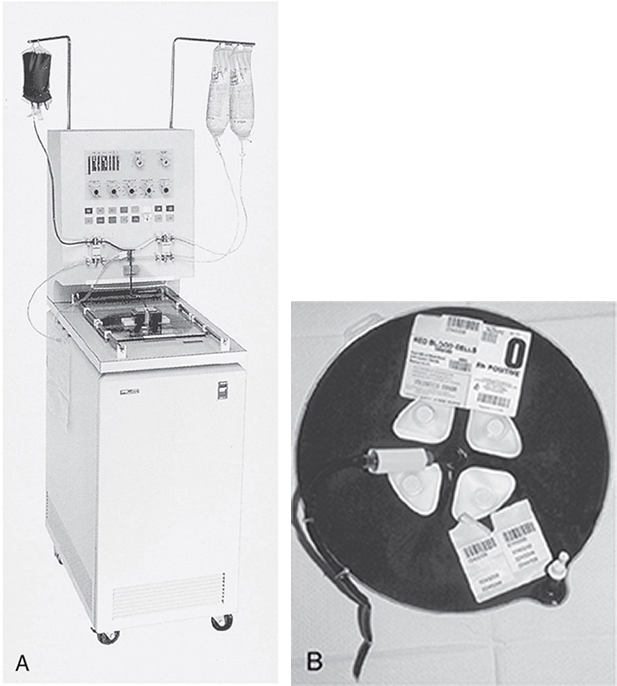
Deglycerolization

Slide 19
Irradiated RBCs
Irradiation prevents transfusion-related (GVH) disease
GVH disease is a reaction toward human leukocyte antigens (HLAs) on T cells
RBCs and platelets must be irradiated if the unit is from a blood relative, if the unit is HLA matched, or if the patient is immunocompromised
Dose
Middle of canister: 2500 cGy or 25 Gy
Lowest dose is 1500 cGy
Irradiated RBCs have an expiration time of 28 days

Slide 20
Platelets (1 of 2)
Platelets
Maintain vascular integrity
Initiate formation of the platelet plug
Stabilize the platelet plug by contributing to fibrin formation
Indications for use
Chemotherapy or irradiation
Posthematopoietic progenitor cell transplant
Postoperative bleeding

Slide 21
Platelets (2 of 2)
Platelet concentrate should contain at least 5.5 x 10¹⁰ platelets
One unit increases the platelet count by 5,000 to 10,000/μL
Pooled platelets
Considered an “open system”; expires in 4 hours
Apheresis platelets
Each unit must contain at least 3 × 10¹¹ platelets
Leukoreduced platelets
Prevent febrile reactions and HLA alloimmunization

Slide 22
FFP
FFP and PF24 contain all coagulation factors (PF24 may have less factor VIII)
Indicated for:
Patients needing factor II, V, X, or XI, when concentrates are not available
Abnormal coagulation assays from mass transfusion
Patients taking warfarin who are bleeding
Replacement solution for therapeutic plasmapheresis
Patients with liver disease with factor deficiencies
Disseminated intravascular coagulation when fibrinogen is low (<100 mg/dL)

Slide 23
FFP and PF24
Thaws in 30 to 45 minutes
Stored at 1° to 6° C
Transfuse within 24 hours
If not transfused within 24 hours, relabel as “thawed plasma” and store at 1° to 6° C for up to 5 days
Thawed plasma cannot be used to replace factor VIII
Should be ABO compatible
10 to 20 mL/kg is given for factor replacement

Slide 24
Cryoprecipitated Antihemophilic Factor (CRYO) (1 of 3)
CRYO is the cold precipitate that forms when FFP is thawed at between 1° and 6° C
CRYO is refrozen within 1 hour of preparation and stored at –18° C for up to 1 year
Must demonstrate 150 mg of fibrinogen and 80 international units of factor VIII per unit

Slide 25
Cryoprecipitated Antihemophilic Factor (CRYO) (2 of 3)
CRYO contains:
von Willebrand factor
Fibrinogen
Factor VIII
Fibronectin (for wound healing)
Factor XIII
CRYO is a secondary treatment for hemophilia A and von Willebrand’s disease
CRYO-reduced plasma
Plasma left over after removing CRYO
Can be refrozen within 24 hours of removing CRYO
Treatment for thrombotic thrombocytopenic purpura
Once thawed, store at 1° to 6° C for up to 5 days

Slide 26
Cryoprecipitated Antihemophilic Factor (CRYO) (3 of 3)
Pooled cryoprecipitated AHF
Pooled CRYO is kept at room temperature and administered within 4 hours (or within 6 hours if pooled by a “closed system”)
Fibrin sealant from CRYO
CRYO is mixed with thrombin to control surface bleeding during surgery

Slide 27
Apheresis Granulocytes
Contain leukocytes and platelets (some RBCs)
Each unit contains 1.0 x 10¹⁰ or more granulocytes
Kept at 20° to 24° C (without agitation) for up to 24 hours
Should be crossmatched because of RBC content
Must be irradiated
The use of apheresis granulocytes is rare

Slide 28
Labeling
AABB Standards required each facility to convert to ISBT 128 by May 1, 2008
In addition to standard labeling:
Irradiated components must have the name of the facility performing irradiation
Pooled components must have the final volume listed and the name of the facility preparing the pool
Autologous units must be labeled “For Autologous Use Only”

Slide 29
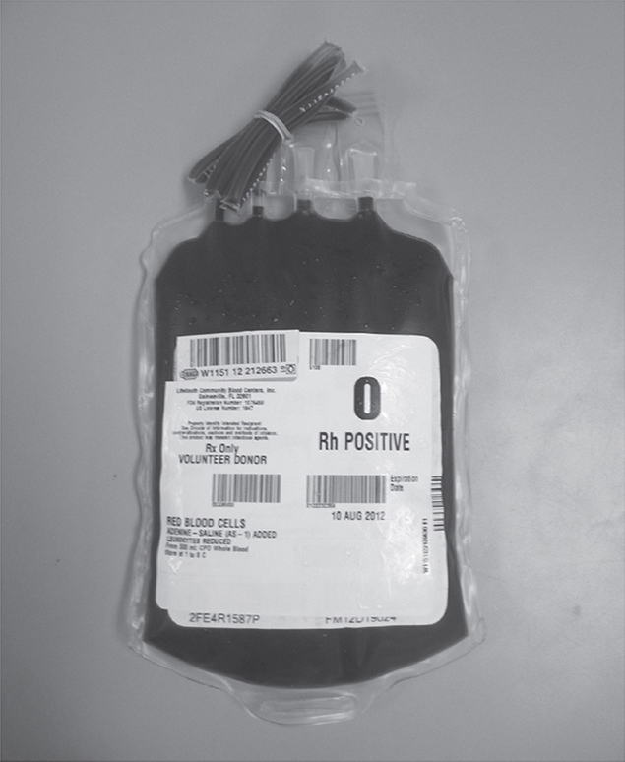
Standard Labeling Requirements

Slide 30
Storage
Refrigerators, freezers, and platelet incubators should have:
Recording devices
Audible alarms
Alarm checks
Emergency backup procedures
Calibrated thermometers
Stored blood should be examined for hemolysis and abnormal color or clots

Slide 31
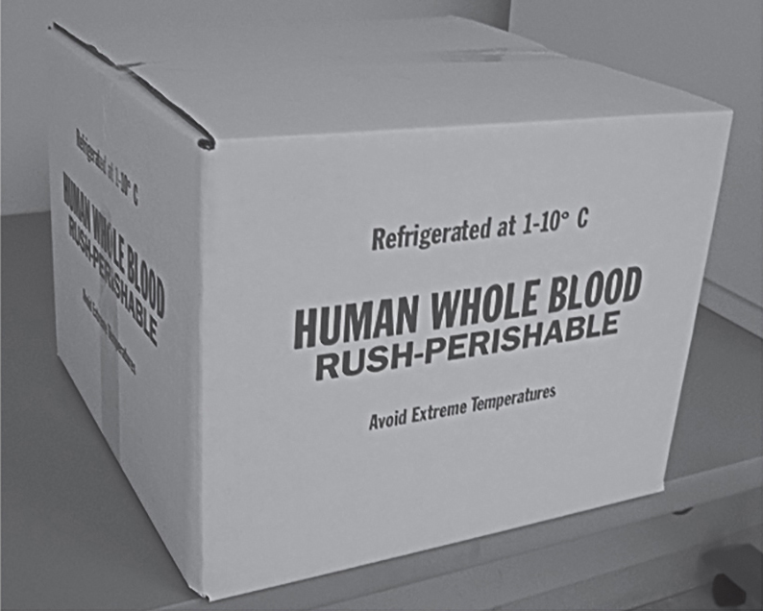
Transportation
Whole blood or RBCs should be kept at 1°C to 10° C
Frozen units are shipped on dry ice
Platelets are maintained at 20°C to 24° C
Containers should be validated periodically

