Slide 1
Chapter 10
Blood Bank Automation for Transfusion Services

Slide 2
Objectives (1 of 2)
Compare and contrast the forces driving the move to automation in the transfusion service
Identify the potential benefits and challenges associated with a change to automation
Define the characteristics of an ideal instrument for blood bank testing
Evaluate a vendor, base technology, and instrument for desired features

Slide 3
Objectives (2 of 2)
Compare and contrast gel technology and solid-phase red cell adherence (SPRCA) assays
Compare and contrast the automated platforms available for a transfusion service
Select an automated platform for a transfusion service

Slide 4
Benefits of Automation
Potential opportunities:
Reduction in operating costs
Redesign of work processes and support systems
Increased productivity
Enhanced total quality

Slide 5
Challenges of Automation
Concerns among staff
Job replacement
Involvement in decision making
Cost justification issues
Capital investment plan should be developed
Automation implementation issues
Time investment
Training and validation may require extra staff

Slide 6
Important Criteria
Automation should meet the criteria for testing, sample handling, and data handling
Testing
Random-access mode
Simultaneous multiple analyses
Sample Handling
Clot detection
Bar code reader
Data Handling
Flexible software
Laboratory information system interface
Liquid detection
Closed tube sampling
Precise sampling
Extensive test menu
Automated reader
Accepts multiple samples
Precise pipetting
Flags discrepancies
Automatic patient updates to laboratory information system

Slide 7
Selection of Automation
Vendor assessment
Determine vendor’s experience with customer support, training, and service
Base technology assessment
Investigate the reliability and accuracy of technology
Instrument assessment
Consider the adaptability, availability, and cost-effectiveness of the automation to assess the instrument’s performance

Slide 8
Automated Systems
Automated systems have been developed for:
SPRCA assays
Gel technology
Microtiter plates
Instruments can perform:
ABO and Rh testing
Antibody detection and identification
Crossmatching

Slide 9
Hemagglutination Assays
Assays are performed on microplates using the same principles as in tube agglutination
Bar-coded samples and reagents are used
Plates are automatically read using a camera reader

Slide 10
SPRCA Assays (1 of 2)
SPRCA assays are used for both indirect antiglobulin tests (IATs) and direct antiglobulin tests (DATs)
Microtiter wells have RBC membranes bound to the surface
Patient antibodies (if present) will attach to the corresponding antigen covering the well
Negative results form a button at the bottom of the well
Capture-R Select® assay system immobilizes RBCs other than screen or panel cells

Slide 11
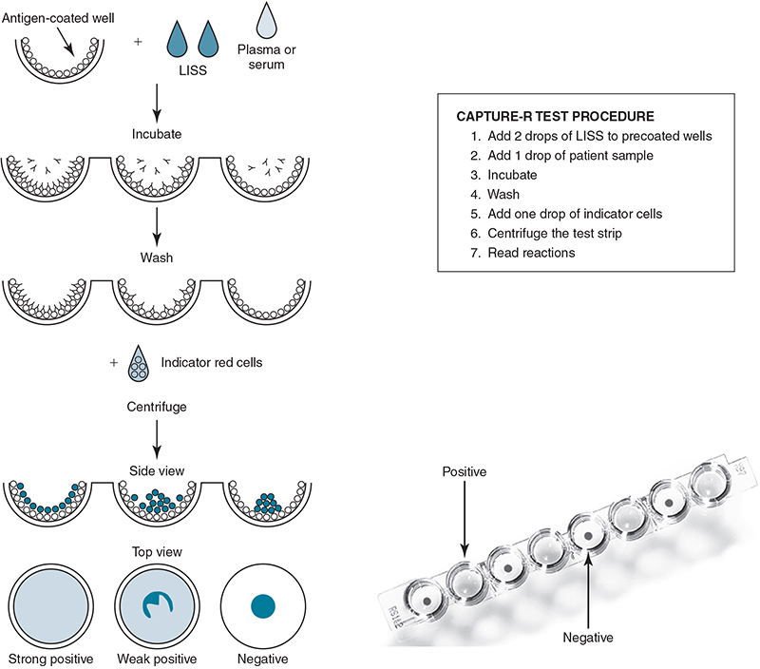
SPRCA Assays (2 of 2)

Slide 12
Solidscreen II (1 of 2)
Solid-phase assay that detects RBC antibodies in serum or plasma
Wells are precoated with protein A, which has a high affinity for the Fc portion of immunoglobulins
Positive test: RBCs and antibody to immunoglobulin G (anti-IgG antibody) bind with protein A, forming a smooth monolayer
Negative test: RBCs form a button at the bottom of the well

Slide 13
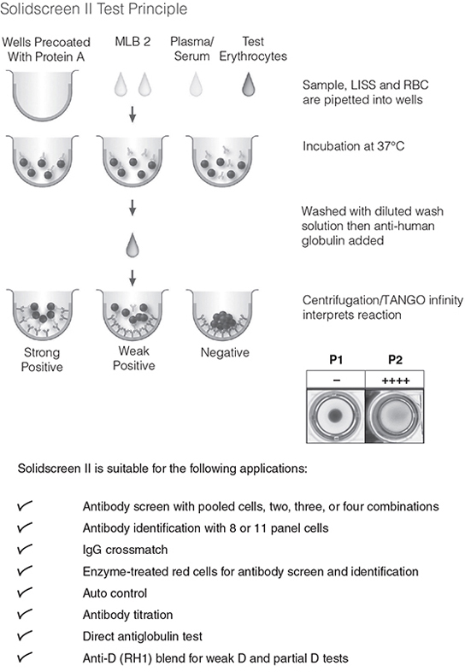
Solidscreen II (2 of 2)

Slide 14
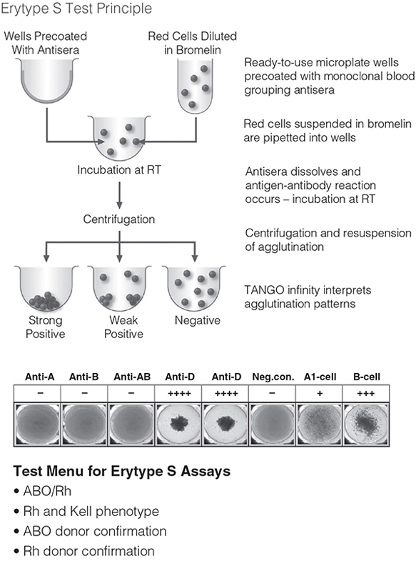
Erytype S
Hemagglutination assay
ABO, D, and other RBC antigen testing
Monoclonal antisera are dried in microwells

Slide 15
Automated SPRCA Systems
TANGO™ Infinity (Bio-Rad)
Combines Erytype® S and Solidscreen® II
Capture™ system (Immucor)
Microtiter plates accommodate SPRCA or hemagglutination testing

Slide 16
Automated Gel Systems
ID-MTS™ Gel Test (Ortho Clinical Diagnostics)
Automated instrument is ORTHO Vision®
Microprocessor controlled unit
Stand-alone or interfaced unit
Uses gel cards and digital image processing

Slide 17
ORTHO Vision® (1 of 3)
Components: computer, software, instrument, bar-code scanner, printer
Tests
Agglutination: ABO and D, Rh phenotyping, IS crossmatching
DAT: anti-IgG, anti-IgG-C3d antibodies
IAT: antibody screening and identification, IAT crossmatching
Benefits
Eliminates time-consuming processes
Increases productivity
Enhances process control

Slide 18
ORTHO Vision® (2 of 3)
Carousel holds
48 patient samples-outer ring
Up to 18-33 reagents vials ( 3 mL vs 10mL vials)-inner ring
2 diluents
Utilizes a high-resolution imaging system
Reads both sides of the cassette
36-position-capacity card block
24 positions at Room temp
12 positions at 37˚C
Probe performs dilutions
Gel card gripper transports cards to centrifuge, imaging system, or service rack

Slide 19
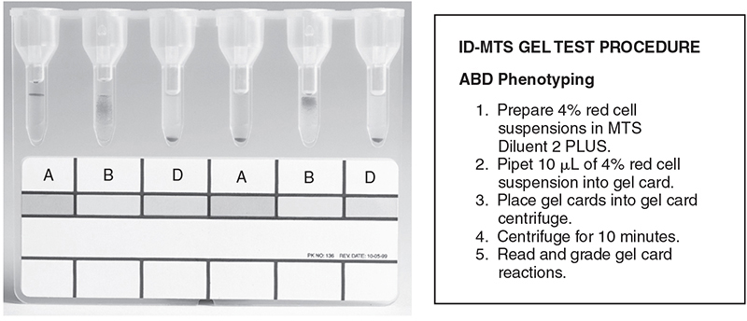
ORTHO Vision® (3 of 3)

