Slide 1
Chapter 26
Mycobacterium tuberculosis (MTB) and Nontuberculous Mycobacteria (NTM)

Slide 2
Introduction
CHAPTER TWENTY-SIX

Slide 3
Classification
The genus Mycobacterium is composed of approximately 170 recognized and proposed species.
Most familiar species
M. tuberculosis (MTB), causative agent of tuberculosis (TB)
M. leprae, causative agent of Hansen disease (leprosy)
Other species
Nontuberculosis Mycobacteria (NTM)
Sometimes these species are referred to as atypical mycobacteria or mycobacteria other than the tubercle bacillus (MOTT)

Slide 4
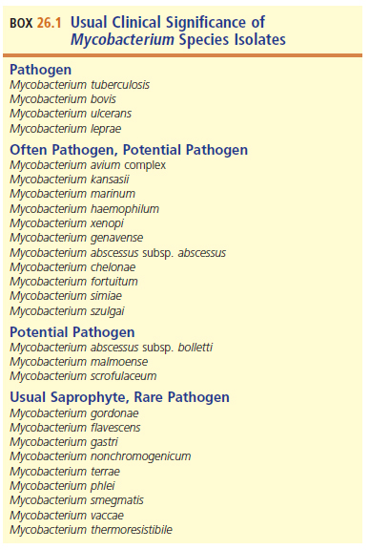
Usual Clinical Significance of Mycobacterium Species Isolates

Slide 5
Clinical Mycobacteriology Advances
Historically, epidemiologic changes led to challenges in the mycobacteriology laboratory.
New developments in the field of clinical mycobacteriology are helping to meet the challenges and have resulted in
Rapid identification (ID) of all clinically significant mycobacteria
NAATs
matrix-assisted laser desorption ionization–time-of-flight (MALDI-TOF) spectrometry

Slide 6
What’s Ahead?
The clinical significance of the Mycobacterium tuberculosis complex
Clinical significance of the nontuberculous mycobacteria
A discussion of Mycobacterium leprae
Isolation and Identification of mycobacteria
Susceptibility testing of Mycobacterium tuberculosis

Slide 7
General characteristics
CHAPTER TWENTY-SIX

Slide 8
Microscopic Morphology and Cell Wall Characteristics
Slender, slightly curved or straight, rod-shaped organisms
Cell wall has high lipid (mycolic acid) content.
Organisms resist staining with basic aniline dyes, such as Gram stain, at room temperature.
Mycobacteria take up the dye with increased staining time or application of heat but resist decolorization with acid–ethanol, a characteristic known as “acid fastness.”
Distinguishing characteristic
Organisms known as AFB (acid-fast bacilli)

Slide 9
Growth Characteristics
Nonmotile and do not form spores
Strictly aerobic
Slow growers; those associated with disease take 2 to 6 weeks to produce growth
M. tuberculosis is enhanced by increased carbon dioxide (CO₂), often requires complex media.
M. leprae fails to grow in vitro.

Slide 10
Clinical SIGNIFICANCE OF THE MYCOBACTERIUM TUBERCULOSIS COMPLEX (MTBC)
CHAPTER TWENTY-SIX

Slide 11
MYCOBACTERIUM TUBERCULOSIS COMPLEX (MTBC)
Member | Description
M. tuberculosis | Causative agent of tuberculosis (TB)
M. bovis | Found mainly in cattle but can infect other mammals as well (including humans) Includes vaccination strain bacillis Calmette-Guérin (BCG)
M. africanum | Human cases of TB in tropical Africa
M. microti | Linked to TB in immunocompromised and immunocompetent individuals
M. canetti | Children and patients with HIV in Africa
M. caprae | Infrequently associated with human infections
M. pinnipedii | Infrequently associated with human infections
M. mungi | Infrequently associated with human infections
M. orygis | Infrequently associated with human infections

Slide 12
Mycobacterium tuberculosis (MTB)

Slide 13
MTB-By the Numbers
One of the oldest documented communicable diseases and remains leading cause of morbidity and mortality
1882- TB first described by Robert Koch
A disease of poverty, it is estimated that as many as 25% of the world’s population might be infected.
Approximately 71% of cases in the United States today, associated with foreign-born individuals from endemic areas

Slide 14
Primary Tuberculosis (TB)
After exposure to M. tuberculosis, whether or not a person develops TB is determined by his or her
cellular immune response
the infective dose, and
the virulence of the strain.

Slide 15
Primary TB (Cont.)
Typical signs and symptoms include
malaise,
weight loss,
night sweats, and
cough that can be nonproductive or productive (with sputum) with or without blood.
TB is usually a disease of the lower respiratory tract.

Slide 16
Primary TB (Cont.)
TB is acquired from persons with active disease who are excreting viable bacilli by
coughing,
sneezing, or
talking.
Infected airborne droplets enter the respiratory tract of the exposed person and reach the lung alveoli.

Slide 17
Primary TB (Cont.)
M. tuberculosis cells are phagocytized by alveolar macrophages but can prevent fusion of phagosomes containing bacteria with lysosomes. This permits intracellular multiplication of the bacteria.

Slide 18
Primary TB (Cont.)
In a person with adequate cellular immunity,
Macrophages secrete interleukin 12 and tumor necrosis factor alpha, which recruit T cells and natural killer cells and enhance the inflammatory reaction.
Some of the T cells differentiate into T-helper cells type-1 (Th1) releasing lymphokines, such as interferon-γ (IFN-γ). IFN-γ stimulates macrophages in the infection site to destroy intracellular mycobacteria.
This is followed by regression and healing of the primary lesion.

Slide 19
Primary TB (Cont.)
In many exposed individuals, the immune system does not initially eliminate the bacteria, and this can result in lifelong or latent infections.
The pathologic features of TB are the result of a hypersensitivity reaction to mycobacterial antigen.
If there is little antigen and a strong hypersensitivity reaction, a small, hard tubercle, or granuloma, may be formed.

Slide 20
Primary TB (Cont.)
The granuloma is an organization of lymphocytes, macrophages, fibroblasts, and capillaries, along with fibrosis encapsulation.
With granuloma formation, the bacteria are contained and can ultimately be killed, and healing occurs along with calcification and scar formation as a reminder of the past infection.

Slide 21
Primary TB (Cont.)
If the antigen load and hypersensitivity reaction are both high, tissue necrosis from the enzymes of degenerating macrophages can occur
The tissue response is less organized, and granulomas are surrounded by fibrin that protects the bacteria from phagocytosis by macrophages.
Necrotic or caseous material can be present at the site of the primary lesion.

Slide 22
Primary TB (Cont.)
After healing of the primary infection, the bacilli are not totally eradicated but can remain viable, but dormant, in granulomas for months or years.
Reactivation of TB can happen when the bacteria are released from the granulomas.
Due to immunosuppression from old age or other causes

Slide 23
Primary TB (Cont.)
A small percentage of individuals who are infected with TB develop progressive (active) pulmonary disease, usually from a failed cellular immune response and, hence, a failure to stop multiplication of the bacilli.
In young children or older adults with primary infection and in people with an underlying immunodeficiency, massive lymphohematogenous dissemination may occur and lead to meningeal or miliary (disseminated) TB.

Slide 24
Primary MTB (Cont.)
10% of young adults may progress to active disease from their primary infection.
This will resemble reactivation TB in older adults; the only way to differentiate it is a positive purified protein derivative (PPD) skin test result in a previously negative individual.

Slide 25
Reactivation TB
Cause
An alteration or suppression of the cellular immune system in infected host resulting in replication of the bacilli and progression of the disease
Risk factors for the progression of infection to active disease
Malnutrition with or without:
Advanced age
Immunocompromised
HIV infection
Immunosuppression
Alcoholism
Homelessness
Incarceration

Slide 26
Reactivation TB (Cont.)
Symptoms are slow to develop (insidious).
Fever
Shortness of breath
Night sweats and chills
Fatigue
Anorexia
Weight loss
About 20% of individuals may have no symptoms.
Most eventually have productive cough, chest pain, and, and fever.

Slide 27
Reactivation TB (Cont.)
Manifestations in chronic disease
Fibrosis
Loss of lung volume
Calcifications
PPD test may be negative in up to 25% of cases.
Diagnosis
Stained smear and culture of
Sputum, gastric aspirates, bronchoscopy specimens
Fiberoptic bronchoscopy has been found to yield 95% recovery of the bacteria

Slide 28
Reactive TB (Cont.)
Potential complications in any case of pulmonary TB if diagnosis and treatment are delayed.
Empyema
Pleural fibrosis
Massive hemoptysis
Adrenal insufficiency (rare)
Hypercalcemia (up to 25% of cases)
Other considerations
Patients with AIDS and TB drug-resistant bacilli
Increased risk of progression from infection to disease

Slide 29
Extrapulmonary TB (EPTB)
Also known as disseminated TB
Infection outside of the lungs
Populations at risk
People with human immunodeficiency virus (HIV) infection
Foreign-born status
Individuals of advanced age
Risk factors are not clear, studies have indicated that besides HIV positivity, patients with liver cirrhosis and diabetes are also at increased risk.

Slide 30
Miliary TB
Seeding of many organs outside the pulmonary tree with AFB through hematogenous spread
Usually occurs shortly after primary pulmonary disease
Common sites of spread of MTB
Lymph nodes, spleen, liver, lungs, bone marrow, kidney
Other forms of EPTB include pleuritis, lymphadenitis, meningitis, peritonitis, and gastrointestinal and skeletal infections

Slide 31
Miliary TB (Cont.)
Almost any organ of the body can be infected by M. tuberculosis
Diagnosing EPTB is challenging because
clinical samples must be obtained from relatively inaccessible sites, and
often only a few bacteria are present, thus decreasing the sensitivity of diagnostic tests.
Overall, children account for most cases
Common form of TB in individuals with HIV infection

Slide 32
Military TB (Cont.)
Meningeal
Meningitis from rupture of tubercle into the subarachnoid space
Mass-like lesions at base of the brain
Genitourinary TB
Kidneys and genital organ involvement
Urinary tract infection (UTI)–like symptoms with sterile pyuria
Male scrotal mass accompanied by renal TB
Skeletal TB of the spine, also known as Pott Disease
Back pain, hip and knee site often involved

Slide 33
Diagnosis of MTB Infection
Diagnosis of primary TB is usually limited to signs and symptoms, chest roentograph, and a positive PPD skin test result.
Cultures are confirmatory, but because of the slow-growing nature of M. tuberculosis, a culture result can take up to 8 weeks.
Infected children may demonstrate
Nonproductive cough and fever, with or without shortness of breath

Slide 34
Diagnosis of MTB Infection (Cont.)
Along with these limited clinical findings, patients with primary TB can have a paucity of bacteriologic findings.
If sputum or bronchial washings are cultured during the primary infection, the positivity rate is only 25% to 30%.
The tuberculin (TB) skin test has been used for many years to determine an individual’s exposure to M. tuberculosis.

Slide 35
Diagnosis of MTB Infection (Cont.)
The skin test detects a patient’s cell-mediated immune (CMI) response to the bacterial antigens in a type IV hypersensitivity reaction.
Protein extracted and purified from the cell wall of culture-grown M. tuberculosis is used as the antigen (i.e., PPD).
PPD test procedure
A standardized amount of antigen is injected intradermally into the patient’s forearm.

Slide 36
Diagnosis of MTB Infection (Cont.)
PPD test procedure
A standardized amount of antigen is injected intradermally into the patient’s forearm.
The skin test detects a patient’s cell-mediated immune (CMI) response to the bacterial antigens in a type IV hypersensitivity reaction.
Reactivity is read at 48 hours.
PPD test results
In immunocompetent individuals, the presence of a raised firm area (induration) 10mm or larger is considered reactive.

Slide 37
Diagnosis of MTB Infection (Cont.)
A reactive tuberculin skin test only indicates past exposure to M. tuberculosis.
Other Mycobacterium spp. generally result in an induration smaller than 10mm.
Immunocompromised patients with previous M. tuberculosis infection may also produce induration less than 10mm.

Slide 38
Diagnosis of MTB Infection (Cont.)
Because some people with latent TB infection have a negative reaction when tested years after being infected, the two-step PPD skin test is often recommended.
First, a routine PPD skin test is administered. If the result is reactive, no additional skin testing is needed.
If the result is nonreactive, a second PPD skin test is administered in 1 to 3 weeks.

Slide 39
Diagnosis of MTB Infections (Cont.)
Two-step PPD skin test
If the second test is also nonreactive, the individual is considered not infected.
A reactive test indicates a boosted response for an infection many years ago. The individual should be evaluated to determine if treatment is necessary.

Slide 40
Diagnosis of MTB Infections (Cont.)
Alternative to PPD skin testing
Interferon-gamma release assays (IGRAs)
Greater specificity and as much or more sensitivity than the PPD skin test
Results in about 24 hours
More expensive than the PPD skin test
Reference method-cultures
Time-consuming

Slide 41
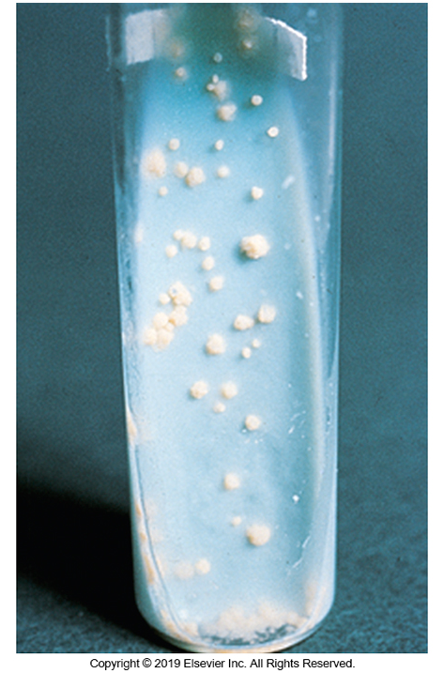
Diagnosis of MTB (Cont.)
Colonies
Slow growing
Raised, with a dry, rough appearance
Nonpigmented
Buff colored
Cord factor
Cording of bacteria
Optimal growth
35 to 37° C

Slide 42
MTB Identifying Characteristics
Biochemical test | Result
Niacin accumulation | Positive
Reduction of nitrate to nitrite | Positive
Catalase | Generally Positive Note: isoniazid-resistant strains may not produce catalase at all
Catalase after heating | Negative (heat-stable, catalase negative)

Slide 43
Diagnosis of MTB (Cont.)
Inhibited by nitroimidazopyran or p-nitroacetylamino-β-hydroxpropiophenone (NAP).
Distinguished from M. bovis
Inhibition of M. bovis by thiophene-2-carboxylic acid hydrazide (T2H) and pyrazinamidase activity

Slide 44
Treatment of MTB Infections
The treatment of TB involves the use of more than one antimycobacterial agent in two phases for 6 to 9 months.
Phase one- eight weeks of therapy with isoniazid, rifampin, pyrazinamide, and ethambutol
Phase two- isoniazid and rifampin for an additional 18 weeks

Slide 45
Treatment of MTB Infections (Cont.)
Although people with latent TB infection are asymptomatic and cannot spread TB, the bacteria can reactivate and progress to active TB disease.
Therefore, not only should people with TB disease be treated but also those individuals with latent TB infection.
Several regimens are used to treat latent TB infection. Short-course, rifamycin-based, 3- or 4-month regimens are recommended.

Slide 46
Multidrug-Resistant (MDR) MTB
Definition
Resistance to at least isoniazid and rifampin, drugs recognized as the primary treatments for drug-susceptible M. tuberculosis
\Within any population of M. tuberculosis, resistance to a single agent can develop at a fairly well-defined rate.

Slide 47
MDR-MTB (Cont.)
Random drug resistance has a good likelihood of development
when only one antimycobacterial agent is used or
if the patient is receiving multidrug therapy and fails to complete the course of medication.
Therefore, combination therapy (i.e., two or more drugs) to treat mycobacterial infections is recommended.

Slide 48
MDR-MTB (Cont.)
Risk factors for drug resistance may include
Treatment for TB
Residence in an area endemic for drug resistance
Close contact with an individual who has MDR-MTB
Second-line anti-TB drugs may include a regimen of four or five drugs that include
An aminoglycoside, fluoroquinolone, pyrazinamide, and cycloserine/terizidone, among others

Slide 49
MDR-MTB (Cont.)
In 2016, the World Health Organization estimated that 6.2% of MDR-TB cases were extensively drug-resistant tuberculosis (XDR-TB).
New definition of XDR-TB
“TB caused by Mycobacterium tuberculosis (M. tuberculosis) strains that fulfil the definition of MDR/RR-TB and which are also resistant to any fluoroquinolone and at least one additional Group A.

Slide 50
Vaccine-MTB (Cont.)
The BCG vaccine, an attenuated M. bovis, is used in many countries with endemic TB. The vaccine is more efficacious in preventing infection when administered to children compared with adults.
However, the vaccine cannot be given to immunocompromised individuals, such as those with HIV infection.

Slide 51
Vaccine-MTB (Cont.)
It is therefore unlikely to be useful in countries with a high prevalence of HIV infection.
Individuals who have received the vaccine will have a positive tuberculin (PPD) skin test result.

Slide 52
Mycobacterium bovis

Slide 53
M. bovis
Produces TB primarily in cattle
Also dogs, cats, swine, parrots, and humans
Similar symptoms and treatment as that of M. tuberculosis
Isolation
Grows very slowly on egg-based media
Small, granular, rounded, white (nonpigmented) colonies with irregular margins
After 21 days incubation at 37° C
Middlebrook 7H10 medium
Similar to M. tuberculosis but slower to mature

Slide 54
M. bovis Identifying Characteristics
Biochemical test | Reaction
Nitrate reduction | Negative
Niacin | Negative
Growth in the presence of T2H | None

Slide 55
CLINICAL SIGNIFICANCE OF NONTUBERCULOUS MYCOBACTERIA
CHAPTER TWENTY-SIX

Slide 56
General Characteristics
Found in soil and water
Opportunistic pathogens
Patients with underlying lung disease, immunosuppression, or percutaneous trauma
Chronic pulmonary disease resembling TB
Few species more commonly associated with cutaneous infections.
Some species can be commensal inhabitants of humans; therefore, their isolation must be evaluated with clinical history and presentation
Not considered transmissible person to person

Slide 57
Mycobacterium avium Complex (MAC)
Slowly Growing Species

Slide 58
Epidemiology
M. avium and M. intracellulare
Most common species isolated from humans
Commonly found in the environment, soil, water, house dust, other environmental sources
Coastal marshes have higher concentrations of organism
Environmental sources, especially natural waters seem to be the reservoir for most human infection

Slide 59
Epidemiology
M. avium
Causes disease in swine, cattle, and poultry
Animal to human transmission not shown to be important transmission factor
Large increase in number of isolates occurred in the past due to HIV-positive patients developing AIDS.
Although not a reportable disease, recently MAC infections have been decreasing among persons with HIV infection.

Slide 60
Clinical Infections
Pulmonary disease resembles TB
Most common form is in middle-aged men with a history of smoking and other underlying pulmonary disease.
Cough, fatigue, weight loss, low-grade fever, and night sweats
Cavitary disease in most patients on radiographs
Other presentations include lymphadenitis and tenosynovitis
May develop into disseminated disease
Common isolate in AIDS patients and in patients with hematologic abnormalities

Slide 61
Treatment
Clinical outcome is unpredictable
Combination of surgical excision and chemotherapy is the usual treatment for adults with localized nonpulmonary disease.
Somewhat resistant to TB drugs, so use higher concentrations and combinations

Slide 62
Laboratory Diagnosis and Morphology
Laboratory diagnosis
Most laboratories do not distinguish species of M. avium complex.
Colonies, optimal growth temperature 37°C
Grow slowly, producing thin, transparent or opaque, homogeneous, smooth colonies, nonpigmented
Some may be rough colonies and also may yellow with age.
Microscopic
Short and coccobacillary and uniformly stained without beading or banding

Slide 63
Identifying Characteristics
MAC species are inactive in most physiologic tests used to identify the mycobacteria. Exceptions are below.
Biochemical test | Results
Production of heat-stable catalase | Yes
Grow in media containing 2 µg/mL of T2H | Yes
Specific nucleic probes | Available
Molecular methods are now the reference method.

Slide 64
Other Mycobacterium Species
Slowly Growing Species

Slide 65
M. avium subsp. paratuberculosis (MAP)
Johne disease—intestinal infection
Chronic diarrhea in cattle, sheep, goats, and other ruminants; recovered in resected patients with Crohn disease
Found in potable water, pasteurized milk, other foods
Difficult to cultivate because of very slow growth rate (3–4 months).
Mycobactin-supplemented medium necessary for primary isolation
Mycobactin is an iron-binding compound produced by other mycobacterial species.

Slide 66
M. Kansasii Epidemiology
Second most common cause of NTM lung disease in the United States (MAC is #1)
Tap water seems to be the most significant reservoir.
The natural source of human infection is unclear but is likely by aerosol.
As with other NTM, infections are not normally considered contagious from person to person.

Slide 67
M. Kansasii Clinical Infections
Chronic pulmonary disease of upper lobes with cavitation and scarring
Most patients with pulmonary disease have underlying conditions including
chronic obstructive pulmonary disease, bronchiectasis, pneumoconiosis, alcohol abuse, malignancies, and HIV infection.

Slide 68
M. Kansasii Clinical Infections
Extrapulmonary infections, such as lymphadenitis, skin and soft tissue infections, and joint infection, have been reported occasionally.
Disseminated M. kansasii infection rarely occurs in immunocompetent individuals but has been reported in severely immunocompromised patients, particularly those with AIDS.
In fact, infections are more common in HIV-infected individuals compared with those who are HIV negative.

Slide 69
M. kansasii Laboratory Diagnosis
Slow growth with colonies that are smooth to rough with wavy edges and dark centers
When grown on Middlebrook 7H10 agar
Microscopically long rods with distinct cross-banding
Some cording can usually be seen on low-power

Slide 70
M. kansasii Laboratory Diagnosis
Colonies are photochromogenic
Pigment when exposed to light, nonpigmented in the dark
With prolonged exposure to light most strains form dark red crystals of β-carotene on the surface of and inside the colony, producing reddish-orange colonies.
Scotochromogenic, rarely isolated
Produce pigments in light and dark
Nonchromogenic, rare isolated

Slide 71
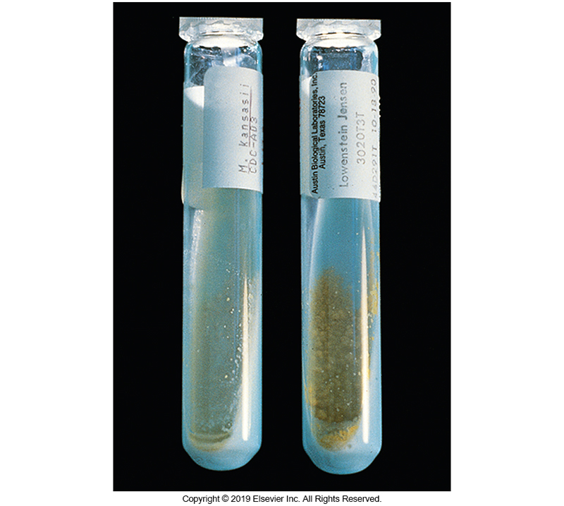
M. kansasii Showing Photoreactivity

Slide 72
M. kansasii Identifying Characteristics
Biochemical test | Reaction
Catalase | Positive
Tween 80 hydrolysis in 3 days | Yes
Nitrite reduction | Strong positive
Specific nucleic acid probe | Commercially available
Molecular analysis | Five subtypes identified; Subtype 1 most commonly found

Slide 73
M. genavense
Disseminated infections in AIDS
Enteritis, genital, and soft tissue in various immunocompromised patients
Grows in BACTEC blood culture medium but not on subculture to routine solid media
Needs mycobactin to grow on Middlebrook 7H11 solid agar
Positive semi-quantitative and heat-stable catalase
Positive pyrazinamidase and urease

Slide 74
M. haemophilum
Rare occurrence typically found in immunocompromised patients
Submandibular lymphadenitis, subcutaneous nodules, painful swellings, ulcers progressing to abscesses, draining fistulas
Requires hemoglobin or hemin, growth at 28 to 32° C
Morphology
Microscopic
Strongly acid fast, short, occasionally curved
No banding or beading, arranged in tight clusters or cords
Macroscopic
Colonies rough to smooth and nonpigmented

Slide 75
M. marinum
Cutaneous infections due to contact with saltwater or inadequately chlorinated freshwater
“Swimming pool granuloma”
Typical presentation
Tender red or blue-red subcutaneous nodule usually on the elbow, knee, toe, or finger 2 to 3 weeks after exposure
In some cases, an ulcer develops at primary site of inoculation
With secondary spread along the ascending lymphatics

Slide 76
M. marinum (Cont.)
Optimal incubation temperature
28°C to 30°C
Colony morphology
Smooth to rough and wrinkled on inspissated egg medium
May be smooth on Middlebrook 7H10 or 7H11 agar
Photochromogenic, young colonies grown in the dark may be nonpigmented or buff. Colonies exposed to light develop deep yellow color.
Microscopic morphology
Moderately long to long rods with cross-barring

Slide 77
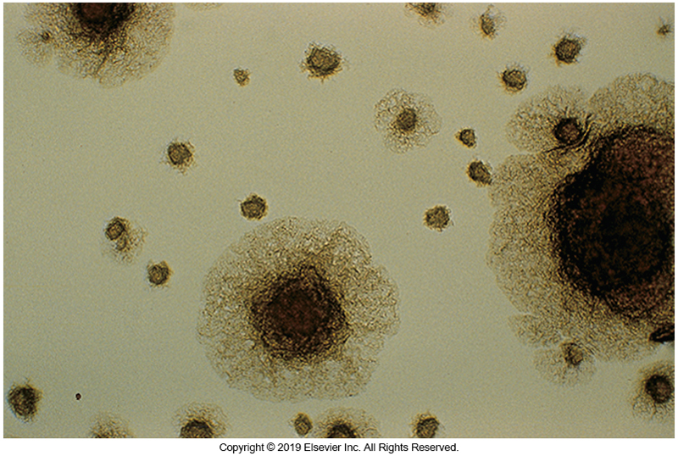
M. marinum on Middlebrook 7H10 Medium Producing Rough Colonies

Slide 78
M. marinum Identifying Characteristics
Biochemical test | Result
Niacin production | Negative
Nitrite reduction | Negative
Production of heat-stable catalase | Negative
Hydrolysis of Tween 80 | Positive
Urease and pyrazinamidase | Positive

Slide 79
M. scrofulaceum
Rare in the United States
Most common form
Cervical lymphadenitis in children
Disease progression
One or more enlarged nodes, often adjacent to the mandible and high in the neck with little or no pain

Slide 80
M. Scrofulaceum (Cont.)
Pulmonary infections typically appear with chronic structural lung disease or an immunomodulatory condition.
Treatment
Surgical incision and drainage
Anti-TB drugs are generally not necessary
Often resistant to isoniazid, streptomycin, ethambutol, and p-aminosalicylic acid.

Slide 81
S. scrofulaceum (Cont.)
Scotochromogenic
Smooth with dense centers and pigmentation from light yellow to deep orange

Slide 82
M. scrofulaceum Identifying Characteristics
Biochemical test | Result
Nitrite reduction | Negative
Production of heat-stable catalase | Positive
Hydrolysis of Tween 80 | Negative
Urease | Positive

Slide 83
M. simiae
Has been recovered in tap water
Significant geographic variation in incidence
Typically manifests as pulmonary disease
Lymphadenitis, skin lesions, and other presentation have been reported
Many isolates are resistant to most anti-TB drugs
Associated with significant morbidity and mortality

Slide 84
M. simiae (Cont.)
Microscopic morphology
Short coccobacilli
Culture morphology
On inspissated egg agar at 37° C
Smooth in 10 to 21 days
On Middlebrook 7H10 agar
Thin, transparent or tiny, and filamentous
Usually photochromogenic
Development of yellow pigment may require prolonged incubation
Some strains are never produce pigment on exposure to light

Slide 85
M. simiae Biochemical Reactions
Biochemical test | Reaction
Niacin accumulation | Positive
Nitrate reduction | Negative
High-level, heat-stable catalase | Positive

Slide 86
M. szulgai
Causes pulmonary disease similar to TB
Extrapulmonary infections, including lymphadenitis and bursitis, osteomyelitis, keratitis, cervical lymphadenitis, and renal or cutaneous infection, have also been reported.
Organism has been isolated from environmental sources such as
Snails, tropical fish, aquarium water, swimming pools, and hospital water supplies
Person-to-person transmission has not been documented
Susceptible to most anti-TB drugs in vitro
Combination treatment is generally successful

Slide 87
M. szulgai (Cont.)
Cells are medium to long rods with some cross-barring
Colonies are grown at 22°C
Nonpigmented or buff in the absence of light
Yellow to orange pigment with light exposure
Produces smooth and rough colonies on egg-based medium incubated at 37°C
Yellow-to-orange pigment in absence of light
Pigment intensifies with exposure to light

Slide 88
M. szulgai Biochemical Reactions
Biochemical Test | Reaction
Hydrolysis of Tween 80 | Slow positive
Nitrite Reduction | Positive
Growth in the presence of 5% NaCl | Negative (no growth)

Slide 89
M. ulcerans
Rare occurrence in the United States
Possibly underreported because of isolation difficulty
Worldwide, third most common behind MTB and M. leprae
Disease manifestations
Painless nodule under the skin following trauma
Shallow ulcer, known as Buruli ulcer, develops that can be quite severe
Widespread ulcerative necrosis, osteomyelitis, and disfigurement can result.
Patients rarely develop fever or systemic symptoms

Slide 90
M. ulcerans (Cont.)
Cells are moderately long, without beading or cross-banding
Fastidious and difficult to grow
Optimal growth is 28°C to 30°C
Little growth at 25°C
Usually, no growth at 37°C
Often required 6 to 12 weeks of incubation before colonies are evident

Slide 91
M. ulcerans (Cont.)
Colonies are
smooth or rough
Nonpigmented or lightly buff
No pigment with light exposure
Produces heat-stable catalase but is inert in most other conventional biochemical tests
Molecular techniques are available that may improve detection.

Slide 92
M. xenopi
Recovered from hot- and cold-water taps and birds
Including water storage tanks of hospitals
Uncommon in the United States
Slow, progressive pulmonary infection in individuals with predisposing conditions such as obstructive pulmonary disease

Slide 93
M. xenopi (Cont.)
The pulmonary infections present a clinical picture resembling that seen in patients with M. tuberculosis, M. kansasii, or MAC infection.
Disseminated and extrapulmonary infections have also been reported, primarily in patients who are immunocompromised
Susceptible to the quinolones
Some susceptible to vancomycin, erythromycin, or cefuroxime
Resistant to ethambutol, variable resistance to other anti-TB drugs

Slide 94
M. xenopi (Cont.)
On acid-fast-stained smears
Long filamentous rods
On Middlebrook 7H10
Colonies are small with dense centers and filamentous edges.
Microscopic magnification observation of colonies on cornmeal-glycerol agar
Distinctive round colonies with branching and filamentous extensions
Aerial hyphae-like elements are usually seen in rough colonies.
Young colonies grown on cornmeal agar have a “bird’s nest” appearance, with characteristic sticklike projections.

Slide 95
M. xenopi (Cont.)
Optimal growth temperature is (42°C to) 45°C
Grows more rapidly at this temperature than at 37°C
Fails to grow at 25°C
C. M. xenopi has been classified with the nonphotochromogenic group;
however, colonies are frequently bright yellow on primary isolation when incubated in the absence of light and when exposed to light (scotochromogenic pigment).

Slide 96
M. xenopi Identification
Biochemical test/characteristic | Reaction
Optimal growth | 42° C - 45°C
Frequent bright yellow pigment on primary isolation when incubated in absence of light and when exposed to light | Yes
Niacin accumulation | Negative
Nitrite reduction | Negative
Heat-stable catalase | Positive
Arylsulfatase | Positive
Pyrazinamidase | Positive

Slide 97
Mycobacterium Species
Rapidly Growing

Slide 98
M. chelonae/M. abscessus Group (MCMAG)
Opportunistic infections
M. chelonae is related closely to M. abscessus subsp. abscessus and is a commonly isolated rapidly growing mycobacterium
It has caused sporadic cases of localized wound infections following medical or surgical procedures, including needle injections.

Slide 99
MCMAG (Cont.)
Is most likely among the rapidly growing mycobacteria to be isolated from disseminated cutaneous infections in immunocompromised patients.
M. chelonae has been associated with a variety of infections of the
skin, lungs, bone, central nervous system, and prosthetic heart valves.

Slide 100
MCMAG (Cont.)
Approximately 80% of the cases of pulmonary disease resulting from rapidly growing mycobacteria are caused by M. abscessus.
Infections by this organism have also been seen in patients with cystic fibrosis.
Unlike with M. chelonae, tap water is an important reservoir for M. abscessus.

Slide 101
MCMAG (Cont.)
Microscopically, young cultures of M. chelonae are strongly acid fast, with pleomorphism ranging from long and tapered to short and thick rods.
This rapidly growing mycobacterium produces rough or smooth, nonpigmented to buff colonies within 3 to 5 days of incubation at 28° to 30° C.

Slide 102
MCMAG (Cont.)
Biochemical Test | Reaction
3-day arylsulfatase test | Positive
Nitrate reduction | Negative
Growth on MacConkey agar without Crystal Violet | Positive

Slide 103
M. fortuitum Group (MFG)
10 species-isolated from water, soil, and dust
Clinical manifestations
Localized cutaneous infections
Bone and joint infections
Abscesses at the site of puncture wounds
Long-term use of intravenous and peritoneal catheters, injection sites, surgical wounds following mammoplasty
Cardiac bypass procedures

Slide 104
MFG (Cont.)
There are differences in susceptibility to antimicrobial agents
In vitro susceptibility testing recommended for clinically significant isolates
Rough or smooth and nonpigmented, creamy, white, or buff colonies

Slide 105
MFG (Cont.)
Microscopic examination of growth on cornmeal-glycerol and Middlebrook 7H11 agars after 1 to 2 days incubation reveals
colonies with branching filamentous extensions and rough colonies with short aerial elements.
Cells are pleomorphic, ranging from long and tapered to short and thick rods.

Slide 106
MFG (Cont.)
From most cultures, especially older ones, cells tend to decolorize and appear partially acid fast with any of the acid-fast staining techniques.
Additional characteristics that distinguish M. fortuitum from other rapidly growing mycobacteria are
Positive 3-day arylsulfatase test result
Positive reduction of nitrate.

Slide 107
M. segmatis Group (MSG)
There are two species
M. smegmatis
M. goodii
M. smegmatis commonly considered saprophytic
Implicated in rare cases of pulmonary, skin, soft tissue, and bone infections
Appearance upon acid-fast staining
Cells appear long and tapered or as short rods with irregular acid fastness

Slide 108
MSG (Cont.)
Appearance upon acid-fast staining
Occasionally, rods are curved with branching or Y-shaped forms; swollen, with deeper staining, beaded, or ovoid forms are sometimes seen.
Colonies appearing on egg medium after 2 to 4 days are usually
rough, wrinkled, or coarsely folded;
smooth, glistening, butyrous colonies may also be seen.

Slide 109
MSG (Cont.)
Colonies on Middlebrook 7H10 agar are heaped and smooth or rough with dense centers.
Pigmentation is rare or late; colonies appear nonpigmented, creamy white, or buff-to-pink in older cultures.

Slide 110
MSG (Cont.)
Biochemical Test | Reaction
Arylsulfatase reaction | Negative
Iron uptake | Positive
Nitrate reduction | Positive
Growth in the presence of 5% NaCl | Positive (growth)
Growth on MacConkey agar without crystal violet | Positive (growth)

Slide 111
MYCOBACTERIUM leprae
CHAPTER TWENTY-SIX

Slide 112
M. leprae
Causative agent of Hansen disease (leprosy)
Disease of the skin, mucous membranes, and peripheral nerves
Despite its historical reputation, not highly contagious
The most important mode of transmission is not known
The disease can be transmitted by direct contact and inhalation of aerosols from skin lesions.
Shedding from the nasal passage is another transmission route.

Slide 113
M. leprae (Cont.)
Bacteria multiply slowly, producing a lengthy incubation period up to 20 years
Tuberculoid leprosy (paucibacillary Hansen disease)
Hypopigmented or hyperpigmented skin macules and nerve involvement that can produce areas with loss of sensation (anesthesia)
Patients eventually exhibit an effective CMI (cell-mediated immune) response

Slide 114
M. leprae (Cont.)
Tuberculoid leprosy (paucibacillary Hansen disease)
The optimal growth temperature for M. leprae is approximately 30° C, and because the patient mounts an adequate CMI response, the bacteria tend to remain in the extremities.
Spontaneous recovery often occurs with tuberculoid leprosy.

Slide 115
M. leprae (Cont.)
Lepromatous leprosy (multibacillary Hansen disease)
Patients have a strong humoral-mediated immune response, but it is not an effective CMI response.
Skin lesions and progressive, symmetric nerve damage
Lesions of the mucous membranes of the nose can lead to destruction of the cartilaginous septum, resulting in nasal and facial deformities.
Slowly progressing and can be life threatening

Slide 116
M. leprae (Cont.)
Lepromatous leprosy (multibacillary Hansen disease)
The current recommended therapy for lepromatous leprosy consists of a combination of diaminodiphenylsulfone (dapsone) and rifampin for a minimum of 6 months.
For tuberculoid leprosy, clofazimine is added to “the mix” above, and treatment should be continued for 12 months.

Slide 117
M. leprae (Cont.)
Borderline or dimorphous Hansen disease
Most common form
Presents as intermediate in severity
Skin lesions resemble those found in the tuberculoid form, but they are more numerous and can be found anywhere on the body.
Peripheral nerves are affected, resulting in anesthesia and weakness.

Slide 118
M. leprae (Cont.)
The lepromin skin test utilizes a standardized suspension of inactivated M. leprae. Like the PPD test for TB, a small volume is injected just under the skin and examined at 48 hours.
Although it is not recommended for primary diagnosis, it can help differentiate between tuberculoid and lepromatous leprosy.
Uninfected patients and those with lepromatous leprosy will be nonreactive, indicating a weak or negative CMI response.
Individuals who were previously exposed and have a CMI response will have a reactive response, suggesting tuberculoid leprosy.

Slide 119
M. leprae (Cont.)
Depends on demonstration of AFB from skin biopsy specimens
Has not been grown on artificial media
In patients with tuberculoid leprosy, organisms are extremely rare and may not be detected in skin scrapings or biopsy specimens.
In patients with lepromatous leprosy
AFB abundant in samples

Slide 120
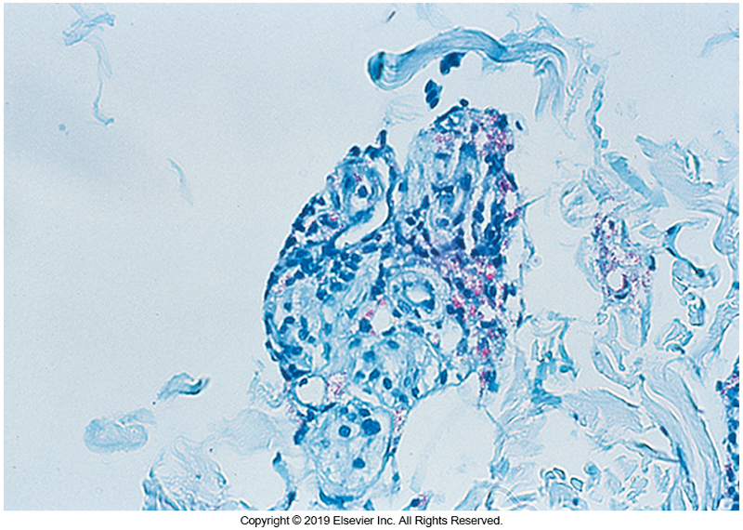
Skin biopsy for M. leprae Ziehl— Neelsen Stain

Slide 121
M. leprae (Cont.)
Not as acid or alcohol fast as other mycobacteria
A weaker decolorized consisting of 10% sulfuric acid recommended over the standard acid–ethanol decolorizer
The bacteria are rod-shaped.
The entire smear should be examined under oil immersion field (×1000) for the presence of the microorganisms.
Polymerase chain reaction (PCR) assays are also available to definitively detect the bacteria.

Slide 122
ISOLATION AND IDENTIFICATION OF MYCOBACTERIA
CHAPTER TWENTY-SIX

Slide 123
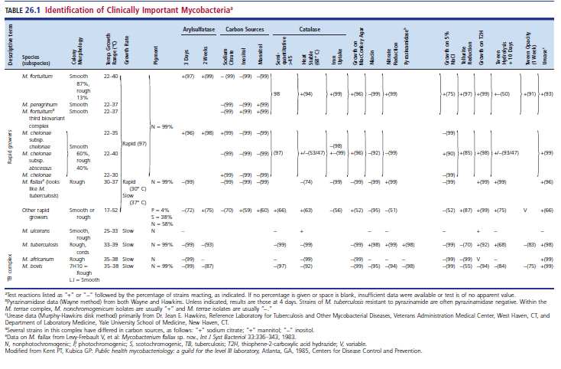
Isolation and ID of Mycobacteria

Slide 124
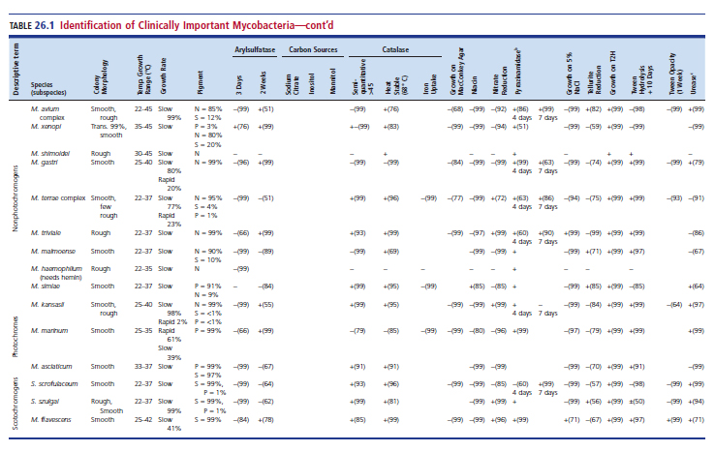
Isolation and ID of Mycobacteria (cont.)

Slide 125
Identification Techniques
Rapid techniques include broth-based culture systems, including some that monitor cultures continuously during the incubation period.
However, because phenotypic identification of the slowly growing mycobacteria is not sufficient for accurate species identification, molecular-based assays are the reference method.
A limited number of species-specific nucleic acid probes offer rapid identification of culture isolates.

Slide 126
Identification Techniques (Cont.)
Researchers have developed PCR assays that have increased the sensitivity of nucleic acid probes.
Other techniques, such as high-pressure liquid chromatography (HPLC) and MALDI-TOF mass spectrometry, have been used recently to distinguish mycobacterial species and have become routine in many laboratories.

Slide 127
Laboratory Safety Considerations

Slide 128
Introduction
The serious nature of TB and the usual airborne route of infection require that special safety precautions be used by anyone handling mycobacterial specimen.
The incidence of positive TB skin test positivity is at least 3X higher among mycobacteriology laboratory workers than those who work elsewhere in the laboratory.

Slide 129
Personnel Safety
Each employee must have/be provided
adequate safety equipment
trained in safe laboratory procedures
informed of hazards associated with procedures
prepared for action following an unexpected accident
monitored regularly by medical personnel with skin test
Appropriate personal protective equipment (PPE)

Slide 130
Ventilation
Microbiology laboratory should be physically separated from the rest of the laboratory.
Equipped with negative air pressure in relation to other areas of the laboratory
Noncirculating ventilation system
6 to 12 room-air changes per hour to effectively remove 99% or more of airborne particles within 30 to 45 minutes

Slide 131
Biological Safety Cabinet
Purpose
Prevents aerosols and inhalation
Proper installation of maintenance
Testing for performance at least yearly be trained personnel
Processing clinical specimens or transferring viable cultures outside a safety cabinet should not be permitted
Disinfectant cleaning and use of ultraviolet (UV) light required

Slide 132
Use of Proper Disinfectant
Cover surface in towel or absorbent pad soaked in disinfectant.
Reduces the accidental creation of infectious aerosols
Selection of a disinfectant—criteria
Must be bactericidal for mycobacteria.
Sodium hypochlorite is effective at a concentration of 0.05% to 0.5% (e.g., a 1:50 to 1:10 dilution of most household bleaches).
The solution should be made fresh daily and contact time should be 10 to 30 minutes.

Slide 133
Specimen Collection

Slide 134
Specimen Collection
General guidelines
Each specimen should be confined to a single collection in an individual collection container.
Sterile, wide-mouth cup with a tightly fitted lid preferred
Special sterile receptacles containing a 50-mL centrifuge tube for sputum collection are also available commercially.
As with all specimens for microbiological examination, aseptic collection is important.

Slide 135
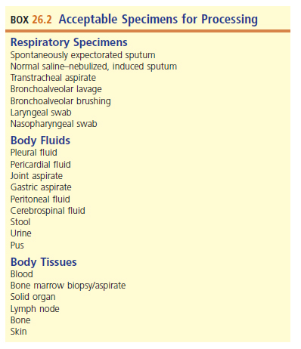
Acceptable Specimens for Processing

Slide 136
Sputum and Other Respiratory Secretions
An early-morning sputum specimen should be collected on 3 consecutive days, although studies have suggested that the addition of a third specimen does not significantly increase the sensitivity of detecting mycobacteria.
If at least two of the first three sputum direct smears are positive, then three specimens are often sufficient to confirm a diagnosis.
When none or only one of the first three sputum smears is positive, additional specimens are needed for culture confirmation.

Slide 137
Sputum and Other Respiratory Secretions (Cont.)
A volume of 5 to 10mL of sputum produced by deep coughing and expectoration of sputum or induced by inhalation of an aerosol of hypertonic saline should be used.
Induced sputum specimens increase the chances of detection and yield of mycobacteria.
When sputum is not obtainable, bronchoscopy may be performed to obtain samples, such as bronchial washing, bronchoalveolar lavage (BAL), or transbronchial biopsy specimen.

Slide 138
Sputum and Other Respiratory Secretions (Cont.)
Brushings appear to be more commonly diagnostic compared with washing or biopsy specimens, possibly caused by inhibitory effect of the lidocaine used during bronchoscopy or because of dilution of the specimen with saline.
Often patients can produce sputum for several days after bronchoscopy;
these samples should be collected and examined.

Slide 139
Gastric Aspirates and Washings
Gastric aspirates are used to recover mycobacteria that may have been swallowed during the night.
Use of this type of specimen should be only for patients who do not produce sputum by aerosol induction, for children younger than 12 years of age, and for nonambulatory individual.

Slide 140
Gastric Aspirates and Washings (Cont.)
Gastric lavage may offer a diagnostic alternative only for those unable to expectorate sputum and in whom BAL might be contraindicated.
Gastric aspirates should be obtained in the morning after overnight fasting.
Three specimens should be collected within 3 days.
Sterile water, 30 to 60mL, is instilled orally or via nasogastric tube aspiration.

Slide 141
Gastric Aspirates and Washings (Cont.)
Prolonged exposure to gastric acid kills mycobacteria and diminishes culture yield.
Specimen processing should be done expeditiously, or the specimen should be neutralized with sodium carbonate or another buffer to pH 7.0 as soon as possible after specimen collection.

Slide 142
Urine
For examination of urine, first-morning midstream specimens collected on 3 successive days are preferred.
The entire volume of voided urine, or a minimum of 15mL, is collected in a sterile container.
Specimens collected from an indwelling catheter with a sterile needle and syringe are acceptable.

Slide 143
Urine (Cont.)
Urine specimens should be refrigerated during the interval between collection and processing; specimens should be processed promptly.
As a rule, pooled specimens collected over 12 to 24 hours are not recommended.
Such specimens are more subject to contamination and may contain fewer viable tubercle bacilli.

Slide 144
Stool
Examination of stool specimens for the presence of AFB can be useful in identifying patients, such as those with AIDS, who may be at risk for developing disseminated mycobacterial disease resulting from MAC.
Frequently, the number of organisms found in the bowel in these patients is quite high, although it has been reported that 68% of MAC culture–positive stool specimens are acid-fast–smear negative.

Slide 145
Stool (Cont.)
Stool specimens should be collected in clean containers without any preservative and sent directly to the laboratory for processing.
If processing within a few hours is not possible, the specimen should be frozen at −20° C until it is processed.
Culture of feces for mycobacteria from patients other than those with or at risk for AIDS is usually not warranted.

Slide 146
Blood
Mycobacteremia, once considered rare, is now often seen in patients with AIDS but is seen less frequently in other immunocompromised hosts.
Most infections are caused by MAC.
Recovery of the organism from blood is associated with clinical disease
The Isolator lysis-centrifugation system has been reliable and recommended for blood sample for many years.

Slide 147
Blood (Cont.)
Alternative recovery systems
Direct inoculation of blood into a MYCO/F bottle or
The BacT/Alert MB blood medium
The collection systems are considered equivalent, although the Isolator system allows quantitative analysis, which may be used to monitor therapy and evaluate prognosis.

Slide 148
Tissues and other Body Fluids
General guidelines for body fluids
Larger volume increases yield.
2 mL for cerebrospinal fluid (CSF)
3 to 5 mL for exudates and pericardial and synovial fluids
10 to 15 mL for abdominal and chest fluids
Tissue or fluid
Collected aseptically and placed in 10 to 15 mL of sterile saline to prevent dehydration

Slide 149
Digestion and Decontamination of Specimens

Slide 150
Digestion and Decontamination Process
Performed to ensure optimal recovery of mycobacteria in clinical specimens from body sites that may contain commensal bacteria
Purpose
To liquefy the sample through digestion of the proteinaceous material
To allow the chemical decontaminating agent to contact and kill nonmycobacterial organisms that may be in the sample

Slide 151
Digestion and Decontamination Agents
Sodium hydroxide (NaOH) 2%, 3%, 4%
Serves as decontaminating agent and digestant
N-acetyl-l-cysteine (NALC)
Serves as a liquefying or mucolytic agent
Others used
Benzalkonium chloride
Liquefies sputum to help digest and decontaminate
Oxalic acid
Used to decontaminate P. aeruginosa from cystic fibrosis (CF) patients

Slide 152
Concentration Procedures

Slide 153
Concentration Procedures
Mycobacteria
Treatment of sample with mucolytic agents
splits mucoprotein, allowing greater sedimentation of AFB
Low specific gravity
Need at least 3000 ×g centrifugation to concentrate
Slow speeds take longer and expose bacteria to toxic chemicals longer
Particularly important with large-volume specimens

Slide 154
Staining for Acid-Fast Bacilli

Slide 155
Staining Requirements
Increased lipid content of cell wall results in irregular uptake of Gram stain.
Appear as lightly stained gram-positive bacilli if at all with beaded appearance
Conventional acid-fast staining
Ziehl–Neelsen
Carbolfuchsin (primary stain) while heating
Acid alcohol (decolorizer)
Methylene blue (counterstain)
Kinyoun
Similar except no heating

Slide 156
Staining Requirements (Cont.)
Auramine or auramine-rhodamine fluorochrome stain
More sensitive than the carbolfuchsin stains
Smear is examined under mercury vapor lamp with a strong blue-filtered light
Positive stains reveal bright, yellow-orange bacilli against a dark background.

Slide 157
Acid-Fast Smear Interpretation

Slide 158
Culture Media and Isolation Methods

Slide 159
Culture Media and Isolation Methods
Generation time of mycobacteria is longer than 12 hours.
M. tuberculosis has longest time at 20 to 22 hours.
Most pathogenic mycobacteria require 2 to 6 weeks of incubation.
MTB is enhanced in 5% to 10% CO₂ atmosphere.
Culture requirements for best growth
Strict aerobe
pH of growth media between 6.5 to 6.8
Humidity

Slide 160
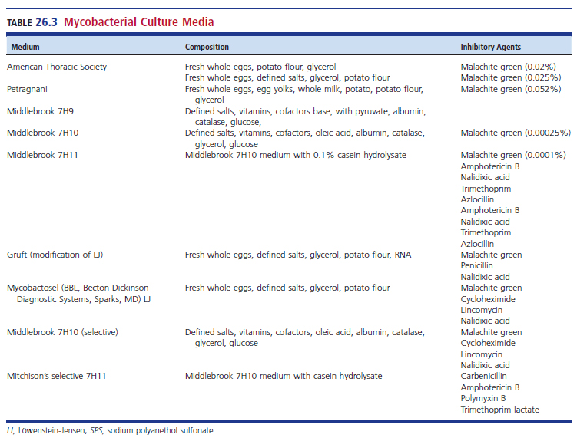
Mycobacterial Culture Media

Slide 161
Egg-Based Culture Media
All egg-based media contain malachite green.
Suppress growth of gram-positive organisms
Examples
Lowenstein-Jensen (LJ) media, American Thoracic Society (ATS) media, and Petragnani’s
Typical ingredients
Whole eggs, potato flour, and glycerol with slight variations in defined salts, milk, and potato flour
Each media contains malachite green to suppress the growth of gram-positive bacteria

Slide 162
Egg-Based Culture Media (Cont.)
Gruft modification of LJ medium and Mycobactosel (BD Diagnostic Systems) contain antimicrobial agents (selective) are used in combination with nonselective media to increase the isolation of mycobacteria from contaminated specimens.
The nonselective egg-based media have a long shelf life up to 1 year, but distinguishing early growth from debris is sometimes difficult.

Slide 163
Agar-Based Media
Better chemically defined than egg-based media
Do not readily support growth of contaminants
Examples: Middlebrook 7H10 and 7H11
Basal medium of defined salts, vitamins, cofactors, glycerol, malachite green and agar combined with enrichment consisting of Oleic acid, bovine albumin, glucose, beef catalase

Slide 164
Other Agar-Based Media
Opaque egg-based media, clear agar-based media
Can be examined using a dissecting microscope for early detection of growth and colony morphology
Drug susceptibility tests may be performed without altering drug concentrations.
CHOC agar
For primary isolation for skin and other body surface specimens for M. haemophilum
Requires ferric ammonium or hemin for growth

Slide 165
Other Agar-Based Media (Cont.)
Alternatively, a Middlebrook 7H10 agar plate supplemented with hemolyzed sheep red blood cells or another source of hemin may be used.
The plate should be incubated at 30° C, the optimal temperature for recovery of M. haemophilum.

Slide 166
Liquid Media
Mycobacterium spp. grow more rapidly in liquid medium, and it can be used for both primary isolation and subculturing.
Examples of nonselective liquid media used for subculturing stock strains, picking single colonies, and preparing an inoculum for in vitro testing.
Middlebrook 7H9 broth
Dubos Tween albumin broth

Slide 167
Liquid Media (Cont.)
The mycobacterial growth indicator tube (MGIT) system (BD Diagnostic Systems) uses modified Middlebrook 7H9 broth with a fluorescence quenching-based oxygen sensor for detecting mycobacterial growth.
Oxygen present in the sterile medium quenches the fluorescence. Bacterial growth consumes the oxygen, allowing fluorescence when the tube is exposed to UV light.

Slide 168
Liquid Media (Cont.)
In the manual system, a Wood lamp or s0405 p1245 p1250 transilluminator can be used. Before use, oleic acid–albumin– dextrose is added to stimulate growth of mycobacteria.
To inhibit growth of nonmycobacteria, the antimicrobial agents polymyxin B, amphotericin B, nalidixic acid, trimethoprim, and azlocillin (PANTA) are added.

Slide 169
Liquid Media (Cont.)
Broth media is used in continuous monitoring systems
MGIT 960 system
MB/BacT Alert 3D system
VersaTREK culture system
A disadvantage of the liquid systems is that
no colony morphology or pigmentation is available to suggest that the growth is of a mycobacterial species and not that of a contaminant or commensal organism.

Slide 170
Liquid Media (Cont.)
Another disadvantage of the liquid systems is that cultures with mycobacteria with a lower optimal temperature may not be detected
M. haemophilum
M. marinum
M. ulcerans
M. chelonae may not be detected

Slide 171
Isolator lysis-Centrifuge System (ILCS)
IsolatorTM is a blood collection system that contains saponin to liberate intracellular organisms.
After saponin treatment and centrifugation, the sample is inoculated onto mycobacteria agar plates or tubes.
Advantages
Yielding of isolated colonies and the ability to quantify mycobacteremia

Slide 172
ILCS (Cont.)
For maximal recovery of mycobacteria, laboratories should use a battery of media that includes a liquid medium and at least one solid medium—egg-based or agar-based— for primary isolation.
An additional selective medium is often reserved for specimens in which heavy contamination is anticipated

Slide 173
Laboratory Identification

Slide 174
Laboratory Levels or Extents of Service
Laboratories must decide which level of mycobacterial services to offer.
The College of American Pathologists (CAP) levels of service
Level 1- specimen collection only
Level 2- perform microscopy and isolate and identify and sometime perform susceptibility tests for MTB
Level 3- perform microscopy, isolate and identify, and perform susceptibility tests for all Mycobacterium spp.

Slide 175
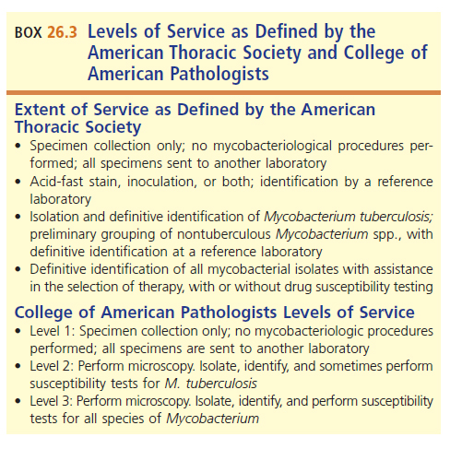
Levels of Laboratory Services

Slide 176
Preliminary ID of Mycobacteria
Perform acid-fast stain on recovered isolate
Examine phenotypic characteristics to help in the selection of more definitive tests.
Colony morphology
Growth rate
Optimal growth temperature
Photoreactivity

Slide 177
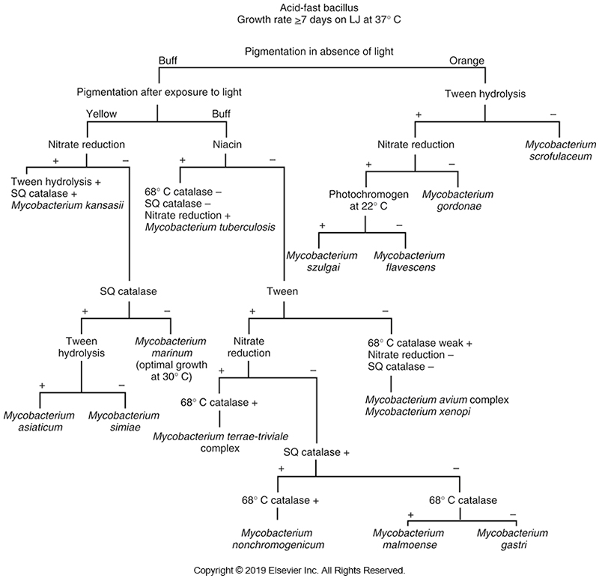
Schematic Diagram for Slow-Growing Mycobacterium

Slide 178
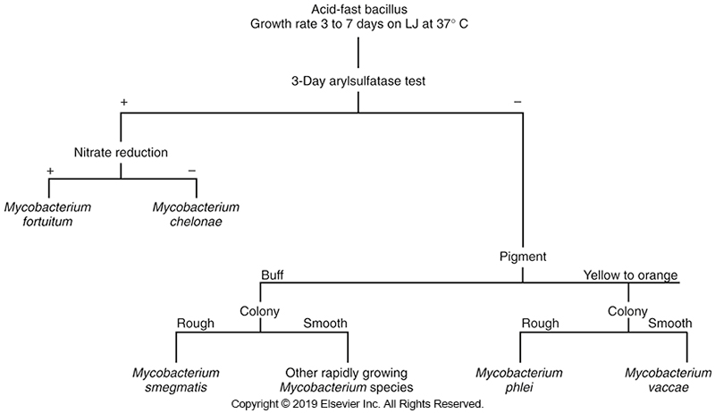
Schematic Diagram for Rapidly-Growing Mycobacterium

Slide 179
Colony Morphology
Two general types
Smooth and soft
Rough and “friable” (with a fried egg appearance with dense center)
M. tuberculosis
Cording: rough colonies that exhibit a prominent patterned texture (curved strands of bacilli)
Mycobacterium avium–intracellulare complex
Glossy, whitish colonies often occurring with smaller translucent colonies

Slide 180
Growth Rate
Growth rate and recovery time depend on the species of mycobacteria but are also influenced by the media, incubation temperature, and initial inoculum size.
The range in recovery time is wide, from 3 to 60 days.
Mycobacteria are generally categorized as rapid growers, having visible growth in fewer than 7 days
For slow growers, producing colonies in more than 7 days

Slide 181
Temperature
Temperature
The optimal temperature and range at which a mycobacterial species can grow may be extremely narrow, especially at the time of initial incubation. M. haemophilum, M. marinum, M. ulcerans, and M. chelonae grow best at 25° to 33° C and poorly, if at all, at 35° to 37° C. At the other extreme, M. xenopi grows best at 42°C (to 45°C).

Slide 182
Photoreactivity
Nonchromogen
Nonphotoreactive in light or dark conditions
Photochromogen
Nonpigmented until addition of light
Photoreactive
Carotene pigment upon exposure to light
Pale yellow to orange
Scotochromogen
Produce pigment in light or dark conditions
Produce a pale yellow to orange color

Slide 183
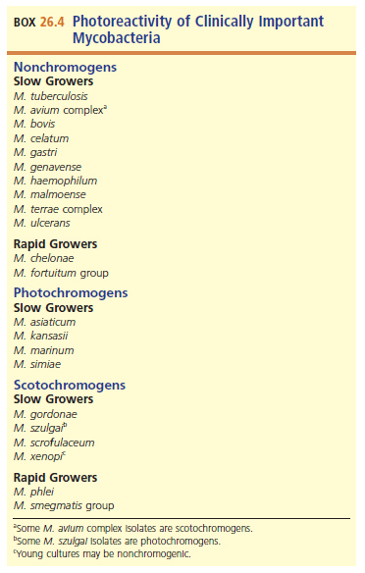
Photoreactivity of Clinically Important Mycobacteria

Slide 184
Biochemical Identification
Niacin accumulation
Most mycobacteria possess the enzyme that converts free niacin to niacin ribonucleotide.
However, 95% of M. tuberculosis isolates produce free niacin (nicotinic acid) because this species lacks the niacin-connecting enzyme.
Accumulation of niacin, detected as nicotinic acid, was the most used biochemical test for the identification of M. tuberculosis

Slide 185
Biochemical Identification (Cont.)
Niacin accumulation
Nicotinic acid reacts with cyanogen bromide in the presence of an amine to form a yellow-pigmented compound.
Reagent-impregnated strips eliminated the need to handle and dispose of cyanogen bromide, which is caustic and toxic.
Because of molecular assays, this test is rarely used today.

Slide 186
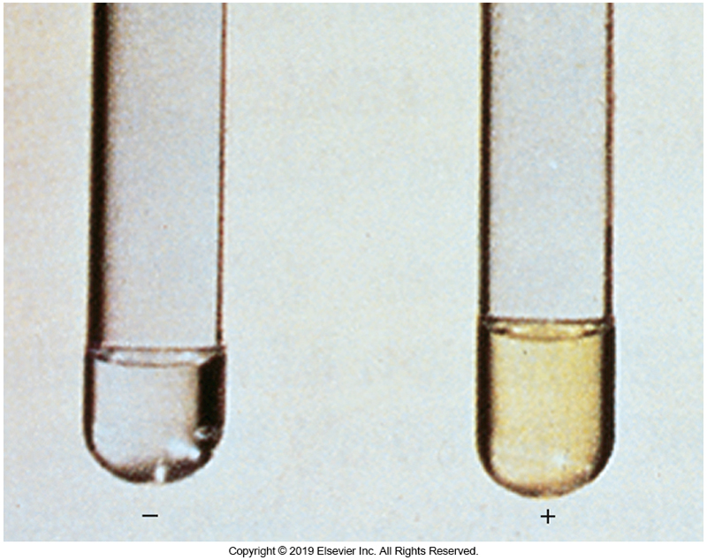
Example of Niacin Test

Slide 187
Biochemical Identification (Cont.)
Niacin accumulation
The niacin test may be negative when performed on young cultures with few colonies. It is recommended that the test be done on egg agar cultures 3 to 4 weeks old (results are most consistent when the test is performed on egg-based media) and with at least 50 colonies.
Tests that yield negative results may need to be repeated in several weeks. The test should not be performed on scotochromogenic or rapidly growing species because M. simiae, the BCG strain of M. bovis, M. africanum, M. marinum, M. chelonae, and M. bovis, may be positive, although this rarely occurs.

Slide 188
Biochemical ID
Nitrate reduction test
Production of nitroreductase
Catalyzes the reduction of nitrate to nitrite
Bacteria are incubated in 2 mL of sodium nitrate at 37° C for 2 hours.
Hydrochloric acid, sulfonamide, and N-napthylenediamine dihydrochloride added
Red color indicates reduction and positive test.
Negative tests must be confirmed by the addition of zinc.
If test is a true-negative, a pink color results.

Slide 189
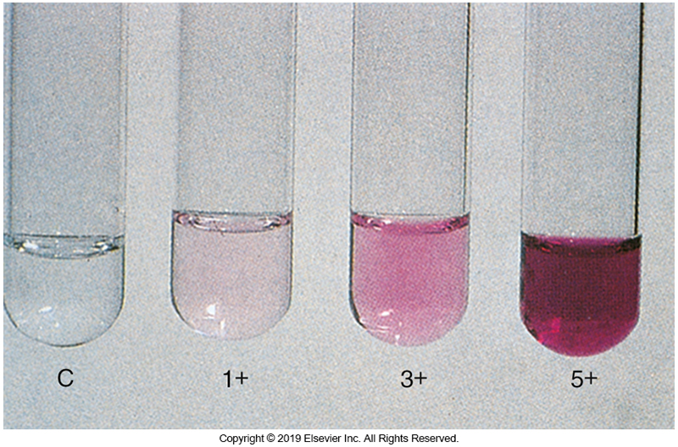
Example of Nitrate Reduction Test

Slide 190
Biochemical ID (Cont.)
Catalase
Enzyme splits hydrogen peroxide into water and oxygen.
Mycobacteria are catalase-positive.
Not all strains produce a positive reaction after the culture is headed to 68° C for 20 minutes.
Isolates positive after incubation have a heat-stable catalase.
Most MTBC organisms do not produce heat-stable catalase; exceptions are strains resistant to isoniazid.

Slide 191
Biochemical ID (Cont.)
Semi-quantitation of catalase production
Based on addition of Tween 80 (a detergent) and hydrogen peroxide to a 2-week-old culture grown in an agar deep
Reaction is read after 5 minutes.
Measure column of bubbles
Record less than or greater than 45 mm

Slide 192
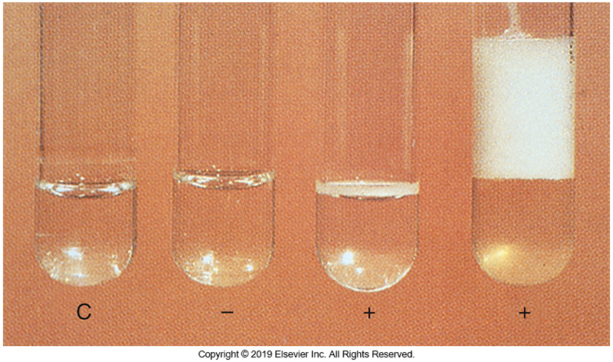
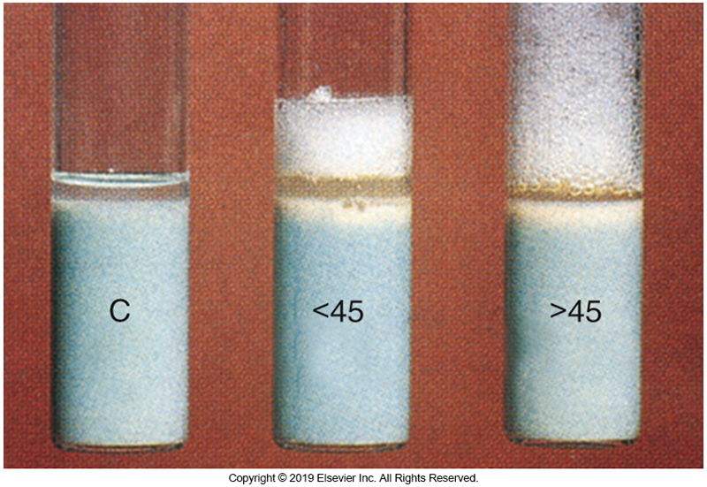
Examples of Semi-quantitative Catalase Test
Catalase test
Semi-quantitative catalase test

Slide 193
Biochemical ID (Cont.)
Hydrolysis of Tween 80 detergent
Lipases split detergent into oleic acid and polyoxyethylated alcohol sorbitol.
pH indicator is neutral red; positive test pink.
Results are recorded as positive after 24 hours, 5 days, or 10 days. This test is helpful in distinguishing between scotochromogenic and nonphotochromogenic mycobacteria.

Slide 194
Biochemical ID (Cont.)
Iron uptake
Convert ferric ammonium citrate to iron oxide
After growth of the isolate appears on an egg-based medium slant, rusty brown colonies appear in a positive reaction on the addition of 20% aqueous solution of ferric ammonium citrate; coloration is the result of iron uptake.
Most useful in distinguishing M. chelonae, which is generally negative for iron uptake, from other rapid growers, which are positive

Slide 195
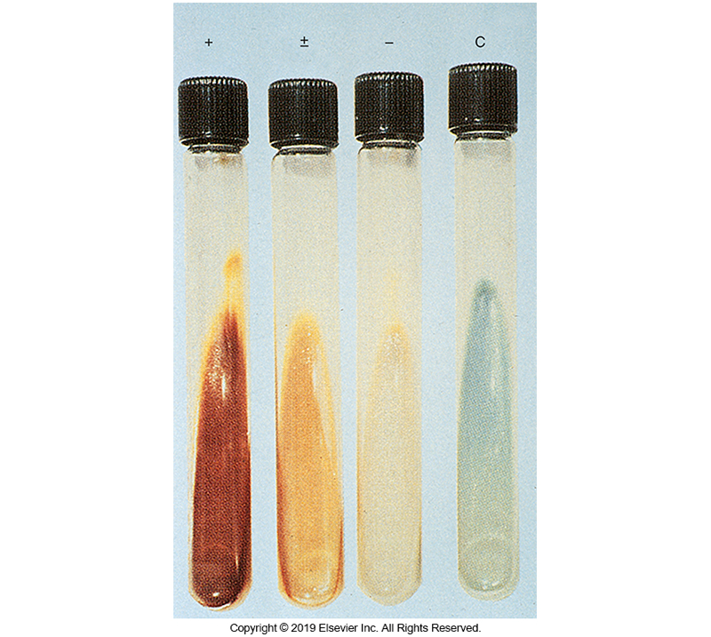
Examples of the Iron Uptake Test

Slide 196
Biochemical ID (Cont.)
Arylsulfatase
Hydrolyzes the bond between sulfate group and aromatic ring structure in compounds with the formula R–OSO3 H
Tripotassium phenolphthalein sulfate is such a molecule, from which phenolphthalein is liberated with exposure to arylsulfatase.
The liberation of phenolphthalein causes a pH change in the presence of sodium bicarbonate, indicated by the change to a pink coloration.

Slide 197
Biochemical ID (Cont.)
Arylsulfatase
The M. fortuitum complex, M. chelonae, M. xenopi, and M. triviale, have rapid arylsulfatase activity that can be detected in 3 days.
M. marinum and M. szulgai exhibit activity with 14 days of incubation.

Slide 198
Biochemical ID (Cont.)
Pyrazinamidase
Hydrolyzes PZA to pyrazinole acid and ammonia in 4 days
Ferrous ammonium sulfate combines with pyrazinoic acid producing red pigment.
Characteristic of MTB
This reaction occurs in about 4 days and may be useful in distinguishing M. marinum (positive) from M. kansasii (negative) and M. bovis (negative) from M. tuberculosis (positive)

Slide 199
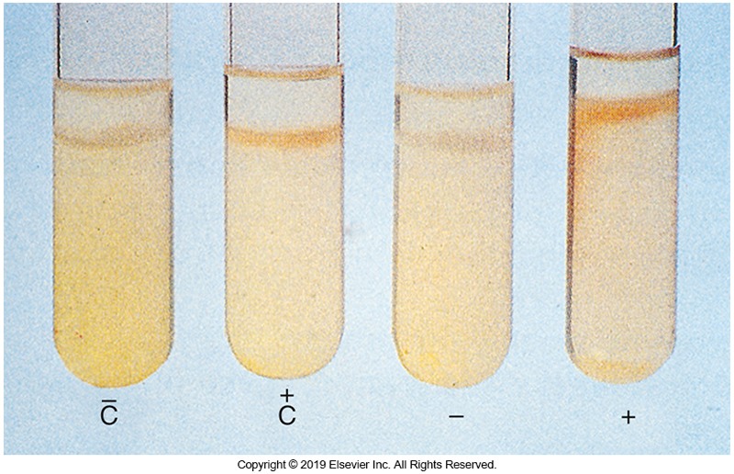
Example of Pyrazinamidase Test

Slide 200
Biochemical ID (Cont.)
Tellurite reduction
Reduce potassium tellurite to black tellurium in 3 to 4 days—characteristic and distinguishing characteristic of MAC vs. the other nonchromogenic species
All rapid growers can reduce tellurite in 3 days.
Urease
Loopful of test organism is grown in 4 mL of urea broth at 37° C for 3 days.
Pink to red color is indicative of positive reaction.
M. scrofulaceum (positive), M. gordonae (negative)

Slide 201
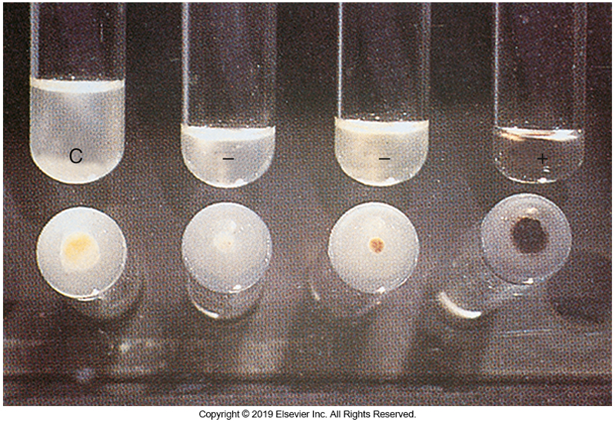
Example of Tellurite Reduction Test

Slide 202
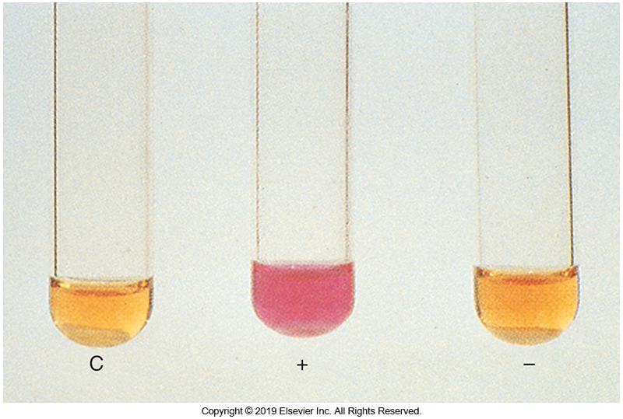
Example of Urease Test

Slide 203
Inhibitory Tests
Thiophene-2-caroboxylic acid hydrazide (T2H)
Distinguishes M. bovis from M. tuberculosis
M. bovis is susceptible to lower concentrations of T2H than MTB.
Variability in inhibition exists, depending on the concentration of the inhibitory agent and the temperature of incubation.

Slide 204
Inhibitory Tests (Cont.)
NaCl tolerance (5%)
In egg-based media, inhibits most mycobacteria
M. flavescens and M. triviale and most rapid growers do grow in this medium.
Growth on MAC agar
M. fortuitum–chelonae complex can grow on MAC agar without crystal violet.
Most other mycobacteria cannot grow on this medium.

Slide 205
Chromatography
Chromatography
Mycobacterium spp. contain mycolic acids which may be detected by chromatography.
Long-chain fatty acids
Need to extract mycolic acids but not too difficult
A basic saponification followed by acidification and chloroform extraction allows accurate identification of most mycobacterial species using chromatograms.
Species identifications made with HPLC have been shown to agree well with biochemical and nucleic acid probe identifications.
This method has been replaced by
Molecular assays and MALDI-TOF mass spectrometry.

Slide 206
Hybridization and Nucleic Acid Amplification Tests (NAAT) for MTB
Commercial probes
Probes are specific and need to use several probes to detect species.
Automated DNA sequencing
Commonly used target for gene coding is16S rRNA.
Identification is achieved via PCR amplification of DNA, followed by sequencing of the amplicons.
The organism is identified by comparison of the nucleotide sequence with reference sequences in a quality database.

Slide 207
Hybridization and NAATS for MTB (Cont.)
Direct nucleic acid amplification tests
Detect MTB complex bacilli directly from patient specimens in 6 to 8 hours on processed specimens.
Mass spectrometry
MALDI-TOF mass spectrometry is becoming more commonly used in microbiology laboratories.

Slide 208
SUSCEPTIBILITY TESTING OF MYCOBACTERIUM TUBERCULOSIS
CHAPTER TWENTY-SIX

Slide 209
Protocols
M. tuberculosis should be tested for susceptibility to isoniazid, rifampin, ethambutol, and streptomycin.
Requires experienced and trained staff
Two methods used
Culture-based drug susceptibility testing
Molecular based drug susceptibility testing

Slide 210
Other Susceptibility Methods
Agar proportion method
For all antimycobacterial drugs except PZA
Two FDA-approved liquid methods to determine the susceptibility of MTB
MGIT 960
VersaTREK
Molecular assays for drug-resistant mycobacteria
Susceptibility testing for NTB is not routinely performed
An exception- the rapidly growing mycobacteria
Broth dilution is the recommended reference method

Slide 211
LET’S REVISIT THE CASE IN POINT
CHAPTER TWENTY-SIX

Slide 212
Highlights
The Patient | 56-year-old male
Symptoms Upon Arrival to the ED | Fatigue Weight loss (10 lb) over the past 12 months Cough for three months that produced red-tinged sputum
Patient History | Night fever and chills without dyspnea or chest pain Patient moved to the U.S. from Mexico Family history of pulmonary tuberculosis His last purified protein derivative (PPD) skin test performed five years ago was non-reactive

Slide 213
Highlights (Cont.)
Patient Vial Signs | Temperature of 36.5° C (97.7° F) Pulse of 63 beats per minute Respirations of 15 breaths per minute Blood pressure of 96/56 mm Hg
Chest Xray Results | An infiltrate in the upper lobe of the right lung
Computed Tomography of the Chest Results | A nodular patchy opacity in the upper lobe of the right lung.
PPD Test Result After Patient Admission to the Hospital | 10-mm by 7-mm induration

Slide 214
Highlights (Cont.)
Specimens for Culture | Three sputum samples obtained over a 3-day period for acid fast bacilli (AFB) smear and culture
Direct Smear Results | All three sputum samples were reported as no organisms seen
Media Inoculated with Processed Sputum Samples | Löwenstein-Jensen (LJ) medium and into BACTEC 12B bottles
After 12-14 Days Incubation | The BACTEC bottles from all three specimens were positive

Slide 215
Highlights (Cont.)
Kinyoun Stain Results from Positive BACTEC Bottles | Acid-fast bacilli (AFB) present
PCR DNA Amplification Results | Positive for Mycobacterium tuberculosis
Treatment Plan | A four-drug antituberculosis regimen comprising isoniazid, rifampin, pyrazinamide (PZA), and ethambutol was recommended.

Slide 216
Issues to Consider
After reading this patient’s case history, consider:
Significant aspects of this patient’s family history
The characteristic symptoms of tuberculosis
The typical length of time for a culture to yield pathogenic Mycobacterium

Slide 217
POINTS TO REMEMBER
CHAPTER TWENTY-SIX

Slide 218
Points to Remember
Mycobacteria are important causes of human diseases, such as TB and Hansen disease.
Mycobacteria have a unique cell wall, and special stains are required to visualize the microorganisms.
Many Mycobacterium spp. are environmental microorganisms infrequently isolated from clinical specimens.

Slide 219
Points to Remember (Cont.)
Isolation of mycobacteria requires specific safety precautions, including laboratories with negative air pressure, biological safety cabinets, the use of respirators and other PPE, and electric incinerators instead of flame incinerators.
Most pathogenic mycobacteria are slow growers, taking up to several weeks for isolation on artificial media.

Slide 220
Points to Remember (Cont.)
(Other) tests for identification of mycobacteria include rate of growth, nitrate reduction, niacin production, presence of heat-stable catalase, and sensitivity to T2H.
However, phenotypic identification is being replaced by molecular methods such nucleic acid amplification.

Slide 221
Points to Remember (Cont.)
Some Mycobacterium spp. produce a pigment, which can be a helpful feature in their identification.
Antimicrobial susceptibility testing of the mycobacteria, while important, is technically demanding and should be performed only by experienced personnel

