Slide 1
Chapter 3
The Laboratory Role in Infection Control

Slide 2
INTRODUCTION
CHAPTER THREE

Slide 3
The Facts
It is estimated that 722,000 health care-associated infections (HAIs) occur every year.
  Resulting in 75,000 deaths
Health care-acquired infections (HAIs) are infections that originate in health care facilities.
HAIs carry a huge financial cost.
It is imperative that an effective infection control program be established in health care settings to Recognize and prevent HAIs.

Slide 4
The Facts
The microbiology laboratory is an integral part of infection control programs. Here’s why:
  Advent of terrorist activities
  Emerging diseases (examples)
    Zika virus-2016
    SARS-CoV-2 in 2020
  Reemerging diseases (example)
    Rocky Mountain spotted fever

Slide 5
The Facts

Slide 6
Role of the Laboratory Scientists
Rapidly identify emerging and reemerging pathogens in human infections
Collaborate with the infection preventionist (IP) in dealing with these agents in the human population

Slide 7
Role of the Laboratory
Questions that the laboratory must answer:
  How are these infectious agents spread/transmitted?
  What are the reservoirs?
  What is their incubation period?
  What antimicrobial agents can successfully treat them?
  How can the environment be disinfected?

Slide 8
Role of the Laboratory Scientists
Provide a microbiology laboratory scientist to serve as a member of the infection prevention and control (IPC) team
  Other members as it relates to the case-in-point
    ICU nurse manager
    Physician in charge of the ICU
    IPC practitioner
  Members of the team must combine their knowledge to address the issues.

Slide 9
Role of the Laboratory Scientists
Educational Role Teaching Proper:
  Specimen collection
  Specimen transport
  Disinfection procedures
  Safety protocols
Learn current information on:
  Media selection
  Identification techniques
  Safety precautions

Slide 10
What’s Ahead?
Components of implementing an effective infection control program from the laboratory scientist’s perspective:
  Settings
  Activites
  Analytic practices

Slide 11
General Concepts in Infection Prevention and Control Practice
CHAPTER THREE

Slide 12
General Concepts
Laboratory role in infection prevention and control varies
  May provide supportive data
  May assume a role as part-time infection preventionist (IP) and part-time laboratorian
Infection prevention and control
  Goal is to reduce the dissemination of infections of persons in broad and varied settings.
  Microbiology laboratory scientists must be poised to participate in infection control activities.

Slide 13
General Concepts
Infection prevention and control
  Highly interdisciplinary by definition
    Incorporates many departments and services in health care facilities
  Range of activities
    Surveillance
    Outbreak investigation
    Data management
    Education
  Requires inquisitive and analytic mind

Slide 14
Infection and Control in
Health Care Settings
The Goal
  To prevent spread of infectious agents and reduce dissemination of infections
Involves assessment, planning, implementation, education, and evaluation of national infection control practices
In Public health or community settings
  Transmission of microorganisms through daily living

Slide 15
Infection and Control in
Health Care Settings
Infections occur as
  Community-acquired
  Health care-associated (HAIs)
  Iatrogenic
Causes of HAIs and iatrogenic infections
  instrumentation
  increased use of antimicrobial agents
  breaks in aseptic technique
  lack of hand hygiene

Slide 16
Infection and Control in
Health Care Settings
Health care-associated infections occur as
  Surgical site infections (SSIs)
  Central line-associated bloodstream infections (CLABSIs)
  Catheter-associated urinary tract infections (CUTIs)
  Ventilator-associated pneumonia (VAP)
  Others
Ambulatory care settings include
  Outpatient surgery, chronic dialysis, infusion centers
  Physician or therapeutic practices
  Emergency care facilities (ECFs)
    Skilled nursing facilities, nursing homes, hospice care settings

Slide 17
Infection and Control in
Health Care Settings
The microbiology laboratory may receive samples from these additional settings:
  Home care
    Intravascular-related or device-related care
  Communal living
    Prisons
    Behavioral health facilities

Slide 18
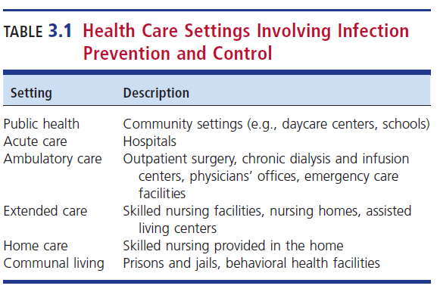
Health Care Settings Involving Infection Prevention and Control

Slide 19
Infection Prevention and Control (IPC) During a Pandemic
Additional IPC practices are recommended by the CDC for all patients due to the high transmissibility of SARS-Co-V-2.
Key points in the IPC guidelines
  Visitation and physical distance measures
  ICP guidance on the proper use and handling of personal protective equipment (PPE)
  Guidelines for “sheltering-in-place”
  Recommendations and management of individuals in quarantine

Slide 20
Infection Control Surveillance
Involves
  Collecting data on existing infections
  Comparing baseline figures with periodic numbers data
Outbreak
  Sudden increase in the occurrence of a disease
Surveillance
  Ongoing, systematic collection of infection data with analysis and interpretation of the details surrounding a disease/event

Slide 21
Infection Control Surveillance
Key considerations for and objectives of surveillance include the ability to:
  Perform rapid detection
  Isolation
  Identification
  Manage suspected cases
  Guide implementation of control measures

Slide 22
Surveillance Definitions
Infections are defined by:
  Site
  Risk factors
  Procedures
Most IPs are concerned about infections that are acquired in a health care facility (i.e., HAIs).
  HAIs are infections that occur 48 hours after patient arrival.

Slide 23
Surveillance Definitions (Cont.)

Slide 24
General or Targeted Surveillance
Total surveillance
  All infections are recorded and analyzed to determine whether the infections are health care-associated.
Risk assessments
  Determine whether the situation is high or low risk, and whether the infections are occurring in an unanticipated number

Slide 25
General or Targeted Surveillance
Infection rate
  The speed of spread or frequency of an infectious disease within a population, is determined and analyzed to determine if infection numbers are going up or down.
Targeted surveillance
  Close watch of specific, high-risk, high-volume procedures
Baseline Data
  Previously ascertained data on infection rates

Slide 26
Baseline Data
Baseline data are typically collected within the specific health care setting as they accurately reflect the events that occur there.
The baseline data are collected and analyzed by
  Numbers,
  Percentages, or
  Rates per 1000 device days

Slide 27
Data Gathering: Culture Review
Culture review
  Increased isolation of a specific genus and species of bacteria
  Increased number of antibiotic-resistant bacteria
  Increased isolation of identical bacteria in numerous specimens collected from the same body site in different patients
Formal data analysis involves daily review of culture results reported by the laboratory or IP.

Slide 28
Data Mining
Using a database to statistically analyze infections
  A multitude of events from a database are searched and analyzed then reported to the IP.
  Removes much of the daily details of the culture result review
  Adds other health care parameters to the analysis that may not be otherwise be available without detailed examination

Slide 29
Cases
The laboratory must be attuned to what is happening in the community and in various community settings regarding infection control issues.
Examples:
  There may be an increase in number of Bordetella pertussis isolates in the surrounding counties.
    The laboratory must be aware of these cases.
  Anticipated appearance of influenza cases

Slide 30
Cases
Potential infection control issues that might become apparent within a setting can drive activities in the microbiology laboratory.
  E.g., product recall because of suspected bacterial contamination

Slide 31
Cases
Best Practices
  Effective communication between the infection control program and the microbiology laboratory
  Laboratory scientists must increase their knowledge of:
    Specific products and recalls, e.g., contaminated antiseptics
    Types of specimens to anticipate and expected isolates
  Collaboration among the microbiology laboratory, IPC program, and the health care customer
  Reporting community-acquired cases to and by the laboratory to the infection control team

Slide 32
Laboratory Support and
Data Gathering
The laboratory may provide the following information to the IP to aid in an investigation:
  Identity of isolates
  Specimen contamination rates
  Number of isolates per site
  Number of isolates per hospital unit
  Knowledge of specimen contamination
  Interpretation of culture results

Slide 33
Laboratory Support and
Data Gathering
Prevalence
  The number of cases of a disease that occur in a given moment in time or specified period in a given population
Being able to recognize which pathogens are isolated from patients in an ICU may provide the opportunity for the IP to inform health care providers about the effects of antimicrobial pressure.
  May result in physicians limiting the use of certain antimicrobial agents

Slide 34
Common Microbes of Infection
Control Significance

Slide 35
Frequently Identified Microbes
Varies among settings
Common pathogens encountered
Most frequent HAIs
  Pneumonia
  SSIs
  Gastrointestinal illness
  UTIs
  Primary bloodstream infections

Slide 36
Frequently Identified Microbes
Public health and community setting
  Organisms associated with water or food-borne community outbreaks
    Epidemics
    Agents of bioterror
Acute care setting
  Methicillin-resistant S. aureus (MRSA)
  E.coli, Klebsiella pneumoniae, others
Ambulatory care setting
  Chronic illness or immunosuppressed-related pathogens
    Opportunistic, community-acquired (e.g., hepatitis B)

Slide 37
Frequently Identified Microbes
Extended care facility (ECF) and home care settings
  Immunosuppressed- or device-related infections
    Opportunistic infections (e.g., P. aeruginosa, MRSA)
Communal living
  Close contact
  Shared equipment and facilities
    Antimicrobial-resistant bacteria, hepatitis, lice, etc.

Slide 38
Outbreak Investigation
CHAPTER THREE

Slide 39
Definitions
Epidemic
  Suspected when a sudden increased frequency of a disease above the usual rate or what is expected in a given population or geographic area occurs over a period (of time)
  Most cases have a common cause or source (index case) or be related to each other in some way.

Slide 40
Definitions
Outbreak
  Occurs when the incidence of disease is limited in a particular setting
  May be localized or widespread
Cluster
  An aggregate of cases in a given area over a particular period regardless of the number of cases

Slide 41
Definitions
Pandemic
  An epidemic that has spread over several countries or continents and usually affects many people

Slide 42
Reasons for Initiating and Conducting an Outbreak Investigation
To identify the source so preventative and control measures will prevent future episodes of the diseases are established and instituted
Provides the opportunity to learn more about
  The disease and its severity
  Mechanisms for transmission
  Potential for further spread

Slide 43
Local Outbreaks
May be suspected when an unanticipated increase in infection occurs
Example
  Catheter-Related Bloodstream Infections in a medical intensive care unit setting
    The next slide shows the baseline infection rate is seen for January to August.
    In September, the infection rate rose above the baseline.
    This might indicate that an outbreak occurred or that a change int the rate of infections may have other causes.
    Detailed investigation is needed to reveal further information.

Slide 44
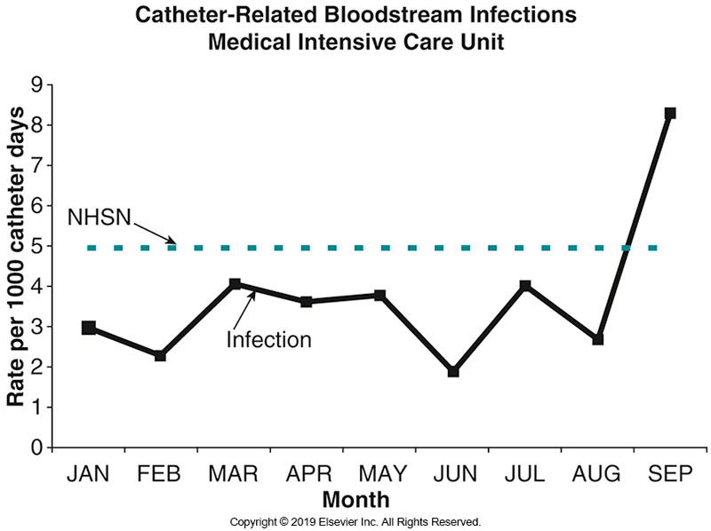
Catheter-Related Bloodstream Infections

Slide 45
Widespread Outbreaks and
Epidemiologic Curve
Widespread outbreaks
  Occur outside of a given health care setting
  Can be worldwide (epidemic) as a result of modern travel
Index case
  The first case described
Epidemiologic curve
  Data on the number of cases from the index case through intervention

Slide 46
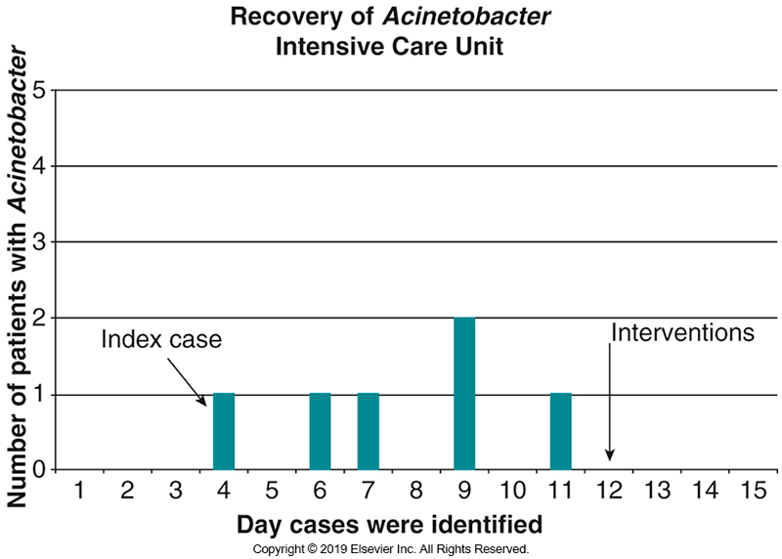
Chapter Case-in-Point:
Epidemiologic Curve

Slide 47
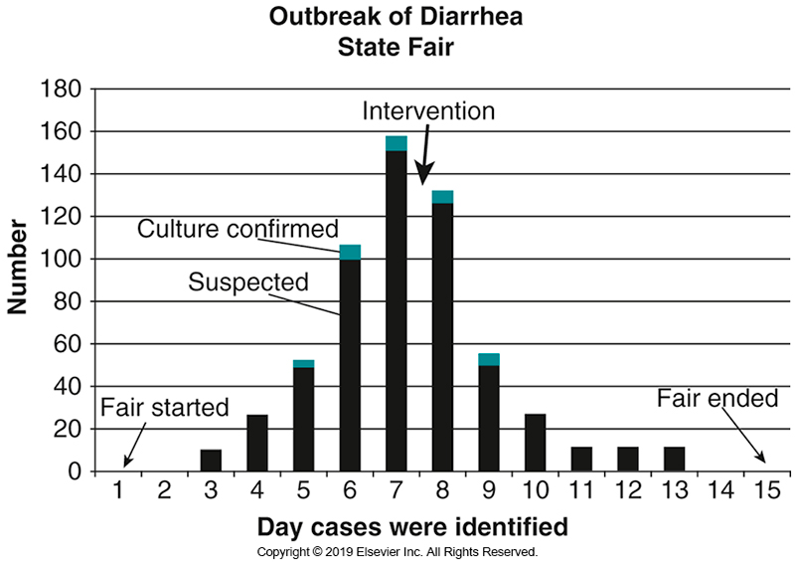
Example Epidemiologic Curve-Outbreak Investigation

Slide 48
Pandemic
COVID-19 caused by SARS-CoV-2
  First identified in December 2019 in Wuhan, China
  New human pathogen
  Respiratory illness spread person to person
  Cases spread quickly around the world
  March 11, 2020
    The world health organization (WHO) declared the COVID-19 outbreak as a pandemic

Slide 49
Pandemic
COVID-19 caused by SARS-CoV-2
  As of December 20, 2022
    Over 658 million cases
    Nearly 6.7 million deaths
First case of COVID-19 in the US
  A resident of Washington state who traveled to Wuhan
  Cases in Seattle emerged primarily in older adults in congregant settings.

Slide 50
Pandemic
COVID-19: Affect on US health care system
  Overwhelmed
Cases in the US as of October 2022
  Over 99 million
  Over 1 million deaths

Slide 51
Investigation Support from the Laboratory
First step: establish a case definition to ensure that a single definition is universally used.
The laboratory plays a crucial role in providing investigative support in an outbreak investigation via:
  The availability of culture reviews
  Other types of support

Slide 52
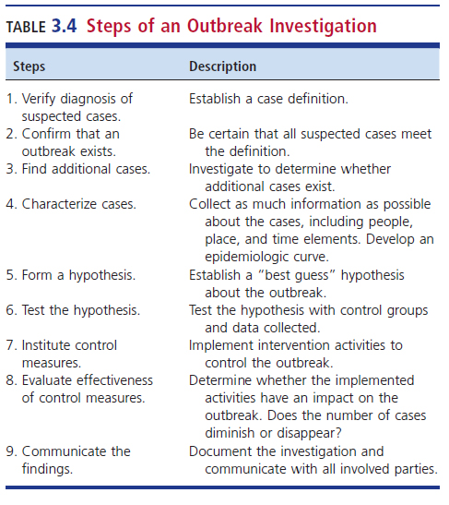

Slide 53
Cultures and Serology
Patient cultures
Cultures from other sites
  E.g., well water, food, etc.
Barriers in the event of a large outbreak
  Reduce ability to collect & transport specimens from the immediate area
    Difficult to track and retrieve
Isolate identification
Serologic relatedness, when appropriate

Slide 54
Support from the
Laboratory: Antibiograms
Antibiograms
  Patterns of sensitivity and resistance to antimicrobial agents in bacteria
    Provide some guidance to relatedness of microorganisms
    Provide treatment data

Slide 55
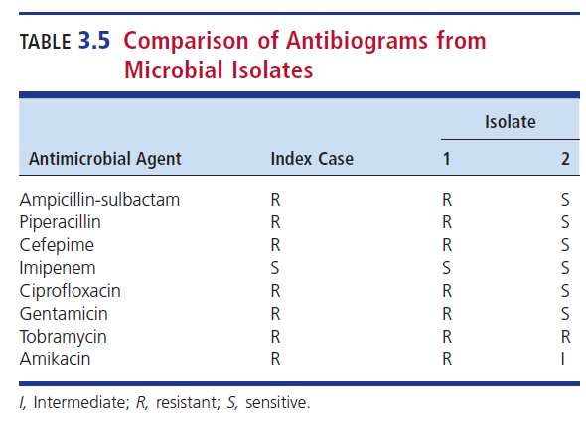
Comparison of Antibiograms from Microbial Isolates

Slide 56
Support from the Laboratory
Molecular epidemiology
  Analysis of molecules, such as proteins and nucleic acids, for microorganism detection, identification, and characterization
  Used to assess epidemiologic relatedness
Pulsed-field gel electrophoresis (PFGE)
  Strain typing technique
  Enzyme-digested chromosomal fragments of bacteria for fragment comparison
    Similar patterns indicate possibly related bacteria.
    Dissimilar patterns indicate no related bacteria.

Slide 57
Environmental Culturing: Air
Often traced back to construction activities in a health care setting
Cultures of air can be a component of air quality investigations.
First step: an infection control risk assessment should be conducted to see if the air is the likely source of infectious particles.

Slide 58
Environmental Culturing: Water
Outbreaks associated with water may occur in:
  Contaminated drinking water
  Recreational water
Possible locations of water outbreaks
  Homes
  Aboard ships or planes
  City or state
  Foreign country

Slide 59
Environmental Culturing:
Water
Outbreaks associated with water may cause
  Diarrheal illnesses
  Respiratory illnesses via inhalation of aerosols
  Skin infections
  Central nervous system infections
When the microbiology laboratory is asked to perform environment culturing of water:
  The specific pathogens being sought need to be identified so the appropriate techniques can be done

Slide 60
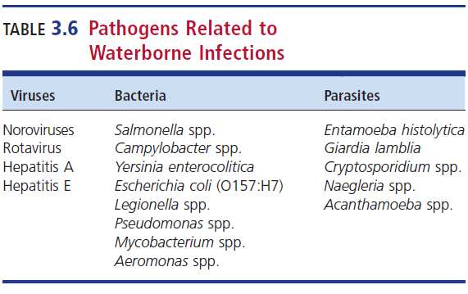
Pathogens Related to
Water-borne Infections

Slide 61
Environmental Culturing: Surfaces
Should be performed only under the direction of the laboratory and the IP
Should not routinely be obtained in an outbreak investigation
Proper procedures and media must be used when culturing is deemed appropriate after laboratory consult.
The laboratory scientist should be instrumental in the interpretation of results.

Slide 62
Reporting
The laboratory role does not stop with providing culture reports.
The laboratory may be responsible for reporting certain infectious diseases to local public health department.
Reporting may be expected by committees, persons managing specific program, and the news media.

Slide 63
Reporting to Public Health, Committees and Programs
Reporting to local public health department
  Infections required to be reported to the local, state, or federal public health entities
    Established by federal and state guidelines
    Class A1 diseases must be reported ASAP
      Considered as public health concerns
Reporting to committees and programs
  Balance need of confidentiality and health needs
    IPC committees, physicians, schools, businesses

Slide 64
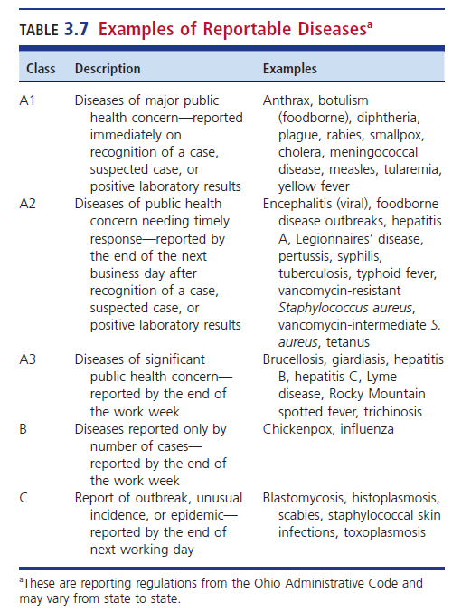
Examples of Reportable Diseases

Slide 65
Reporting to the Media
Reporting to the media
  Television, radio, newspapers
  Educational opportunities
  Balance informational needs with confidentiality

Slide 66
Education
CHAPTER THREE

Slide 67
Laboratory Scientists and Infection Prevention and Control Practitioners
Laboratory scientists must
  Remain educated in their specialty to contribute to the infection control team
  Keep the infection control personnel educated regarding the laboratory’s contribution to the team
Example of education strategies
  Seminars, scientific articles and books, computer-based learning, discussion with infection control personnel

Slide 68
Laboratory Scientists and Infection Prevention and Control Practitioners
Laboratory scientists should
  Continuously educate the IP regarding the abilities of the laboratory in contributing meaningful information to the IPC committee
  Educate others in the health care setting including but not limited to
    Nursing personnel
    Housekeeping personnel
    Maintenance personnel

Slide 69
Education: Safety
The microbiology laboratory scientists must adhere to basic safety standard precautions including but not limited to:
  Hand hygiene
  Wearing gloves
  Proper disposal of microbiologic waste
Laboratory personnel should receive available vaccines and be tested for diseases such as tuberculosis, hepatitis B, influenza, and meningococcus.

Slide 70
RESPONSE PLANS
CHAPTER THREE

Slide 71
Response Plans
Emergency response plans
  Planned response to biological agents
    Laboratory input
      Safety
      Specimen collection
      Agent identification
      Agent control

Slide 72
Points to Remember
The microbiology laboratory interacts with the infection preventionist and infection prevention and control committee in many different health care settings.
Surveillance is important to establish baseline data and recognize the need to investigate potential outbreaks.

Slide 73
Points to Remember
The microbiology laboratory supports outbreak investigations by providing consultative services including epidemiologic correlation of isolates.
Although infrequently performed, environmental cultures may play a role in outbreak investigation.

Slide 74
Points to Remember
Microbiology laboratory scientists must recognize their role in providing reports to health departments, committees, the infection control program, and on occasion, the public.
The microbiology laboratory must maintain competencies in new techniques and the identification of reemerging and emerging infectious diseases.

Slide 75
Points to Remember
In anticipation of potential bioterrorism events and pandemics, the microbiology laboratory must be equipped to participate in emergency preparedness programs.

