Slide 1
Chapter 4
Control of Microorganisms

Slide 2
What’s Ahead?
Disinfection and/versus sterilization
Factors that influence the degree of microbial killing
Methods of disinfection and sterilization
Disinfectants versus antiseptics
EPA regulations on chemical surface disinfectants

Slide 3
What’s Ahead
FDA administration regulations on chemical skin antiseptics
Microbiology laboratory safety
General safety
Bioterrorism and the clinical microbiology laboratory

Slide 4
DISINFECTION AND Sterilization
CHAPTER FOUR: SECTION A

Slide 5
General Comments
Safety in the clinical laboratory cannot be overemphasized.
Each laboratory must develop, institute, and adhere to a plan that effectively minimizes exposure to infectious agents.

Slide 6
What’s Ahead?
Sterilization and disinfection
Chemical and physical methods of disinfection and sterilization
Principles and application of each method
Common disinfectants and antiseptics used in health care settings

Slide 7
What’s Ahead? (Cont.)
Principles and applications of disinfectants and antiseptics
Regulatory process of disinfectants and antiseptics
Laboratory safety guidelines

Slide 8
STERILIZATION VERSUS DISINFECTION
CHAPTER FOUR

Slide 9
Definitions
Sterilization
  Sterilization is the destruction of all forms of life including bacterial spores
    All or nothing process
  Accomplished by chemical or physical methods
Sterile
  Relevant to the method used
  There may still be infectious particles (e.g., viruses) even though a solution, for example, is considered sterile

Slide 10
Definitions
Disinfection
  A process that eliminates, a defined scope of microorganisms, including some spores
  Physical or chemical methods can be used
Disinfectant
  Chemical agents applied to inanimate objects
Antiseptic
  A substance applied to the living tissue (e.g., skin) to eliminate or reduce the number of bacteria present

Slide 11
FACTORS THAT INFLUENCE THE DEGREE OF KILLING
CHAPTER FOUR

Slide 12
Factors that Influence the Degree of Killing
Types of organisms | Contact time
Numbers of organisms | Temperature
Concentration of disinfecting agent | pH
Presence of organic material (e.g., blood, serum) | Biofilms
Nature of surface to be disinfected | Compatibility of disinfectants and sterilant

Slide 13
Types of Organisms
Organisms vary in their ability to withstand chemical and physical treatment
  Endospores
    Coats rich in proteins, lipids, and carbohydrates with cores containing dipicolinic acid and calcium
      Protects the spores
  Mycobacterial cell walls
    Lipid rich that may account for resistance to chemical and environmental stresses, particularly desiccation

Slide 14
Types of Organisms
Organisms vary in their ability to withstand chemical and physical treatment.
  Enveloped viruses
    Lipid envelope makes viruses more susceptible to detergents and wetting agents.
  Biofilms
    Protection by microbes living in communities
    Protects against chemical and physical means of destruction

Slide 15
Types of Organisms
Prions
  Most resistant infectious agent
  Small, naked infectious proteins
  Transmitted through contaminated products
    Medical products
    Therapeutic devices
    Body fluids
    Food products
Special methods for sterilization
  Routine methods may not be sufficient.

Slide 16
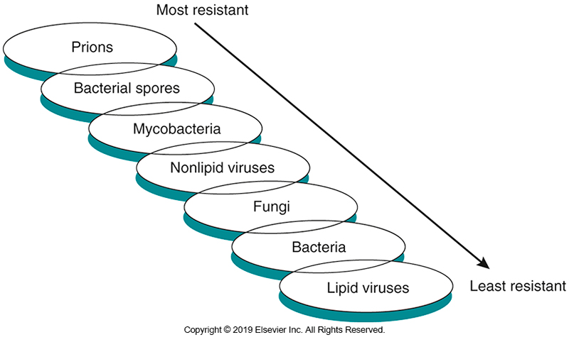
Types of Microorganisms and
Resistance to Killing

Slide 17
Number of Organisms
Microbial load (bioburden)
  Total number of organisms present
If the number of organisms (log) is plotted against the time they are exposed to the killing agent (exposure time) logarithmically, it results in a straight line.
  Higher numbers of organisms require longer exposure times to effectively eliminate 99.9% of the organisms present.

Slide 18
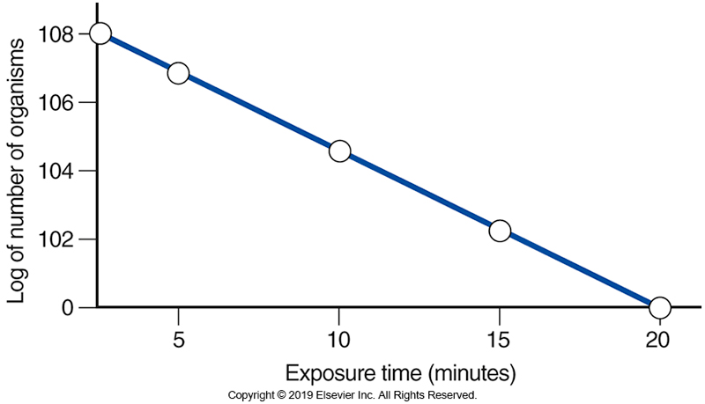
Number of Organisms

Slide 19
Concentration of Disinfecting Agent/ Presence of Organic Material
Concentration of disinfecting agents
  Following manufacturer’s directions is important.
Presence of organic material
  Affects killing activity by inactivating the disinfecting agent
Nature of surface being disinfected
  Must consider possible damage to instruments

Slide 20
Nature of the Surface to be Disinfected
Certain medical instruments are manufactured of biomaterials that exclude the use of certain disinfection or sterilization methods because of possible damage to the instruments.
Example
  Endoscope instruments are readily damaged by the head generated in an autoclave.
Alternative methods must be used for this class of instruments.

Slide 21
Contact Time/Temperature/pH
Contact time
  Length of exposure of agent to object
  Nature of microorganism can affect time required.
Temperature
  Disinfectants are generally used at room temperature.
  Activity increases as temperature increases, up to a point.
pH
  Critical to make sure at what pH the agent is active & the pH of the target material.

Slide 22
Biofilms/Compatibility of Disinfectants
Biofilms
  Communities of bacteria can have resistant protective layers that functions as a shield.
Compatibility of disinfectants
  Common mistake: two disinfectants are better than one
  Some disinfectants inactivate others.
  Care should be taken in determining compatibility of disinfectants.

Slide 23
METHODS OF DISINFECTION AND STERILIZATION
CHAPTER FOUR

Slide 24
E.H. Spaulding Categories of Medical Materials
There are three device classifications that determine which disinfection and sterilization method is used.
1. Critical materials
  Those that penetrate sterile tissues or enter the vascular system
  Produce infection if contaminated
  Require sterilization

Slide 25
E.H. Spaulding Categories of Medical Materials
2. Semicritical materials
  Contact with mucous membranes
    Require high level disinfection
3. Noncritical materials
  Contact with intact skin
    Requires intermediate- to low-level disinfection before contact

Slide 26
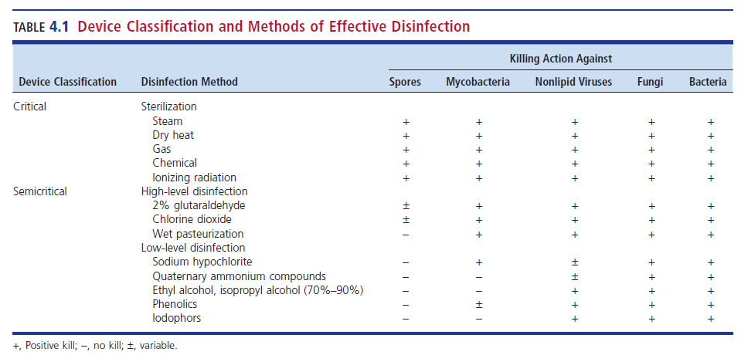
Classification and Methods of Effective Disinfection

Slide 27
Physical Methods: Heat and Filtration
Heat
  Moist heat (heat under pressure)
    Principle of autoclaves
    1 atmosphere (atm) at 121° C for 15 minutes destroys endospores.
  Dry heat
    Requires longer exposure and higher temperatures
  Boiling & pasteurization achieve disinfection but not sterilization.

Slide 28
Physical Methods: Heat and Filtration
Filtration
  Can be used with both liquid and air
  Liquid filtration
    Accomplished through use of thin membrane filters
      Plastic polymers or cellulose esters
    Liquid is pulled (vacuum) or pushed (pressure) through a filter matrix.
    Common applications: parenteral solutions, vaccines, antimicrobial solutions

Slide 29
Physical Methods: Heat and Filtration
Filtration
  Air filtration
    Accomplished with the use of high-efficiency particulate air (HEPA) filters
    Used in laboratory hoods and rooms of immunocompromised patients

Slide 30
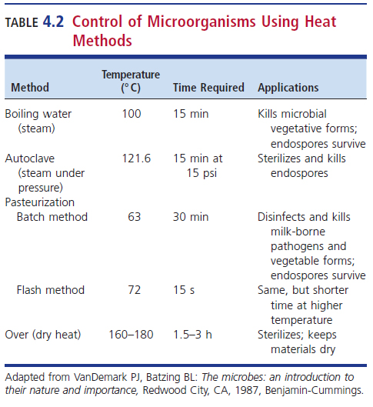

Slide 31
Radiation
Two forms:
  Ionizing in the form of gamma rays or electron beams
    Short wavelength and high energy
    Breaks chemical bonds and forms ions damaging and inactivating vital molecules
    Used for sterilization of heat-sensitive disposable supplies
      Syringes
      Catheters
      Gloves

Slide 32
Radiation
Two forms:
  Nonionizing in the form of ultraviolet rays
  Long wavelengths and low energy
  Damages deoxyribonucleic acid (DNA) by forming thymine & cytosine dimers
  Usefulness is limited due to poor penetrability
  Can be used to disinfect surfaces

Slide 33
Chemical Methods
Chemical methods used for sterilization—Chemosterilizers
  These substances exert their killing effect by:
    Reacting with components of the cytoplasmic membrane
      Leakage and death
    Denaturing of cellular proteins
      Disrupt metabolism
    Reacting with thiol groups of enzymes
      Inactivation
    Damaging RNA and DNA
      Inhibit replication

Slide 34
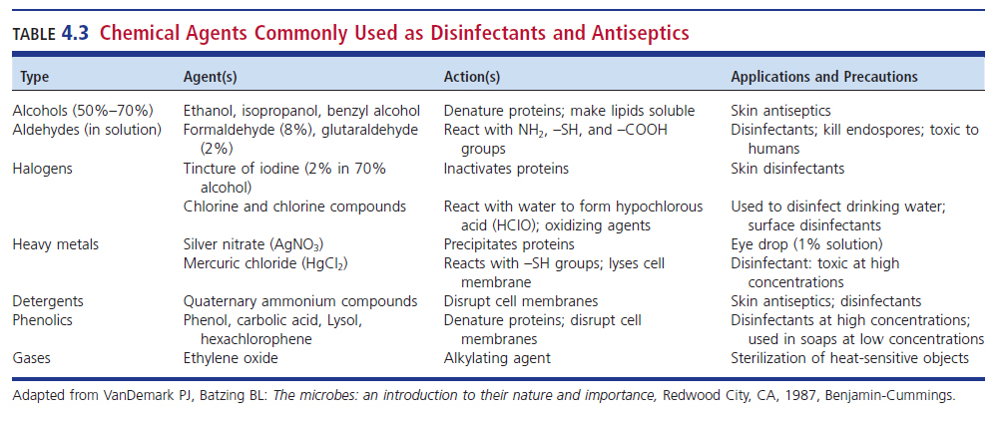
Chemical Agents Commonly Used as Disinfectants and Antiseptics

Slide 35
DISINFECTANTS VERSUS ANTISEPTICS
CHAPTER FOUR

Slide 36
Historical Background
Germ theory of disease
  Important contribution
    Awareness of nosocomial infections
    Practice sepsis to prevent contamination of wound, dressing, surgical instruments
    Development of antimicrobial chemotherapeutics
  Need to practice asepsis to prevent contamination

Slide 37
Historical Background
Semmelweis (1816 to 1865)
  Handwashing can prevent disease.
Lister (1827 to 1912)
  Benefited by reading Pasteur’s works about bacteria as causes of infection
  Introduced handwashing and the of phenol to sterilize wound dressings

Slide 38
Alcohols
Ethyl alcohol and Isopropyl alcohol
  Excellent invitro bactericidal activity against most gram-positive and gram-negative bacteria
  Effective against Mycobacterium tuberculosis, various fungi, and enveloped viruses
  Poor activity against nonenveloped viruses
  Not sporicidal

Slide 39
Alcohols
Ethyl alcohol and Isopropyl alcohol
  Inactivated by presence of organic materials
  Must be given time
  Inactivate microorganisms by:
    Denaturing proteins
    Dehydrating cells
    Dissolving lipids

Slide 40
Alcohols
Ethyl alcohol and Isopropyl alcohol
  Uses
    Antiseptics
    Disinfectants
    Disinfect laboratory surfaces and gloved hands
    Disinfect skin surface before venipuncture, injection or inserting intravenous needle
    Housekeeping disinfectant
  Alcohols are flammable
    Not to be used in the presence of ignition sources

Slide 41
Aldehydes
Formaldehyde
  37% aqueous solution or as a gas
    Can be used as a chemosterilizer in high concentrations
    Usefulness limited by irritability factor and potential carcinogenicity
    Exposure limits in place for workers who use formaldehyde
    Mycobacteria tuberculosis has been known to survive for many years in tissue fixed in formaldehyde
    Not recommended on a routine basis

Slide 42
Aldehydes
Glutaraldehyde
  Classified as a high-level disinfectant
  Broad spectrum activity and rapid killing action
  Remains active in the presence of organic matter
  Extremely susceptible to pH changes
  Only active in alkaline environment
  2% solution
    Germicidal in approximately 10 minutes
    Sporicidal in 3 to 10 hours

Slide 43
Aldehydes
Glutaraldehyde
  Killing activity is caused by inactivation of DNA, RNA, and proteins through alkylation of sulfhydryl and amino groups
  Is inactivated by organic material
  Does not penetrate organic material well
  Solutions can be reused
    Decrease in activity may be seen
  Does not corrode lenses, metal, or rubber
  Sterilizer of choice for medical equipment that is not heat-stable; can’t be autoclaved.
  Bactericidal, pseudomoniacidal, fungicidal, virucidal

Slide 44
Halogens: Iodophors
Two Forms
  Tincture
    Alcohol and iodine solutions used mainly as antiseptics
  Iodophor
    Combination of iodine and a neutral polymer carrier that increases the solubility of the agent
      Allows for slow release of iodine
    Must be diluted properly to be effective
    Less irritating, nonstaining, more stable than iodine in its pure form

Slide 45
Halogens: Iodaphors
May be used as antiseptics or disinfectants
Best known iodophor: providone-iodine (Betadine)
  Mainly used as an antiseptic
  Provides slow, continuous release of free iodine
    Degrades microbial cell walls and cytoplasm, denatures enzymes, and coagulates chromosomal material
Commonly used as skin preparation agents before blood draw, handwash, surgical hand scrub, patient pre-operative skin preparation

Slide 46
Chlorine and Chlorine Compounds
Hypochlorite
  Sodium hypochlorite (bleach)
    Pros
      Inexpensive and broad-spectrum activity
    Cons
      Requires long exposure time for sterility
      Corrosive and pH sensitive
      Inactivation by organic matter
      Rapidly degrades (30 days max)
Generally used for surface decontamination
  0.5% to 1% solution for surfaces with greater than 3-minute exposure
    Longer if organic material present
  1:10 solution of 5.25% sodium hypochlorite for blood spills

Slide 47
Detergents: Quaternary
Ammonium Compounds
Cationic, surface-active agents
  Surfactant: reduce surface tension
    Disrupt cell membranes, causing leakage
  Reduced effectiveness in hard water and soap
    Inactivated by excess organic material
Some gram-negative organisms resistant
  Pseudomonas spp.
Generally used on noncritical surfaces
  Bench tops and floors

Slide 48
Phenolics
Molecules of phenol (carbolic acid)
  Substituted with halogens, alkyl, phenyl, or benzyl groups which reduces toxicity and increases its effectiveness.
  Broad-spectrum activity but not sporicidal
    Addition of detergents = products that clean and disinfect
  Stable and biodegradable
  Active in the presence of organic matter
  Disrupt cell walls and precipitate proteins
  Used in disinfection of hospital, institutional, and household environments

Slide 49
Chlorohexidine Gluconate
Topical antiseptic
High level of antimicrobial activity
Low toxicity
Strong affinity for binding to the skin and mucous membranes
Broad spectrum
  Gram-positive and gram-negative bacteria
  Less activity against fungi and tubercle bacteria

Slide 50
Chlorohexidine Gluconate
Bacteriostatic (inhibits bacterial growth) at low concentration
Bactericidal (kills bacteria) at high concentration
Inactive against
  Bacteria with spores except at elevated temperatures
  Nonenveloped viruses

Slide 51
Chlorohexidine Gluconate
Disrupts cell membrane
Precipitates cell contents
Sensitive to pH
  Optimal range is pH 5.5 to 7.0
Uses
  Disinfection of the surgical personnel hands
  Whole-body disinfection of patients undergoing surgery
Can be paired with alcohol-based preparations

Slide 52
Hexachlorophene
Primarily effective against gram-positive bacteria
Interrupts bacterial electron transport
Low concentration; inhibits membrane-bound enzymes
High concentration; ruptures bacterial membrane
3% solution=quick effectiveness (15 to 30 sec)
  Longer for gram-negative organisms when effective
  Available only by prescription

Slide 53
Chloroxylenol
Chloroxylenol (0.5% to 4%)
  Used primarily against gram-positive bacteria
  Microbial cell wall disruption and enzyme inactivation
  Intermediate-acting to slow-acting
    Minimal persistent effect of more than a few hours
  Low microbial efficacy compared with other options
  Unaffected by organics
  Neutralized by nonionic surfactants and polyethylene glycol

Slide 54
Triclosan
Disrupts cell wall
Reaction time-intermediate
  Persistence is excellent
Good activity against
  Gram-positive and gram-negative bacteria
  Viruses
Fair activity against M. tuberculosis
Poor activity against fungi

Slide 55
Triclosan
Not affected by organics
Affected by surfactants, emollients, and pH
FDA does not have enough information to assess the level of risk that triclosan poses for the development of antimicrobial resistance.
  Ruled that products containing triclosan and triclocarban will no longer be marketed
  There is no proof that triclosan is safe for daily use of a long period of time

Slide 56
Heavy Metals
Rarely used as there are safer options now
Slowly bactericidal
  Action is bacteriostatic
Not used as disinfectants because
  Toxic effects of mercuric chloride/other mercury compounds

Slide 57
Heavy Metals
Mainly used as preservatives for paint
Silver nitrate
  Historically used prophylactically for gonococcal conjunctivitis in newborns
    Erythromycin drops are now used
Being evaluated for use lining rails and door handles in health care facilities to mitigate the spread of microorganisms

Slide 58
Gases
Ethylene oxide—used for sterilization
  Best for plastics and heat sensitive materials
    Explosive hazard in pure form
      Mixed with nitrogen or carbon dioxide before use
    Recommended concentration: 450 to 700 mg/L at 55° C to 60° C for 2 hours
    30% Humidity best
  Kills through alkylation of nucleic acids in the spore and vegetative cell
  Historical use: hospital materials that cannot withstand steam

Slide 59
Gases
Combination of hydrogen peroxide and peracetic acid vapors
  Used in combination with each other
  Used in the pharmaceutical and medical device manufacturing industries
  Using combination results in shorter contact time
  Active against all vegetative form of microorganisms and bacterial and fungal spores

Slide 60
ENIVIRONMENTAL PROTECTION AGENCY REGULATIONS ON CHEMICAL SURFACT DISINFECTANTS
CHAPTER FOUR

Slide 61
EPA Regulations on Chemical Surface Disinfectants
The Environmental Protection Agency (EPA) regulates use, sale, and distribution of antimicrobial pesticide products in certain situations.
  Certain inanimate, nonporous surfaces
  Incorporation of antimicrobial pesticide products
  Federal Insecticide, Fungicide, and Rodenticide Act (FIFRA)
    Require appropriate labels based on laboratory test data

Slide 62
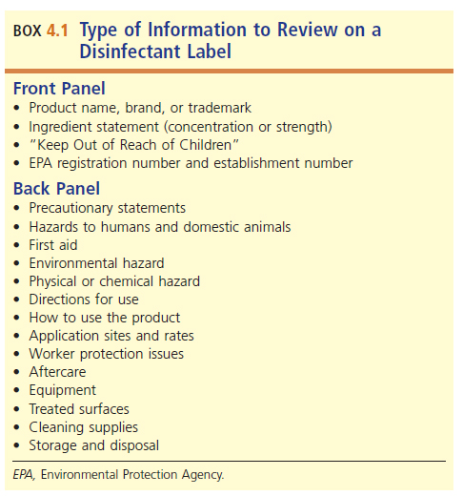
Information on Disinfectant Labels

Slide 63
Food and drug administration [fda] REGULATIONS ON CHEMICAL SKIN ANTISEPTICS
CHAPTER FOUR

Slide 64
FDA Regulations on Chemical Skin Antiseptics
Antiseptic development: two options a manufacturer can pursue
  New drug application (NDA)
    Recognized as being safe and effective (RASE)
  Over-the-counter (OTC) drugs
    Also known as the monograph system
    Generally recognized as safe and effective (GRASE)
    Examples- health care personnel handwash, surgical hand scrub, patient preoperative skin preparation

Slide 65
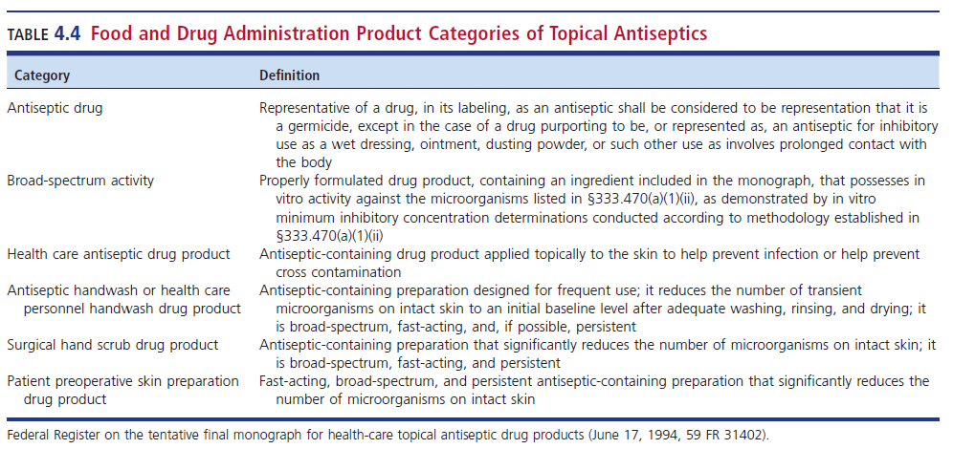
FDA Product Categories of Topical Antiseptics

Slide 66
Hygienic Handwashing/Waterless
Hand Rubs
Goal is to eliminate transient biota (contracted from the environment or other people).
  To protect against resident skin biota
Handwashing
  Physically remove dirt
  Before and after patient contact or objects
When there is no visible soiling
  Use waterless liquid or gel.
    Fast-acting antiseptic
      Small volume, quick acting

Slide 67
Surgical Hand Scrub/Waterless Surgical Hand rubs
Goal is to eliminate transient biota and most resident biota.
  Prevent surgical infections
Broad spectrum, fast acting, persistent
FDA guidelines
  The product must reduce on the first wash/rub the number of bacteria by a superiority margin (compared with a negative control) of 0.5 log₁₀ for hand scrub and 1.5 log₁₀ for hand rub on each hand within 1 minute after application and that the count on each hand does not subsequently exceed the baseline within 6 hours after product use.

Slide 68
Presurgical Skin Disinfection
Goal is to degerm an intended surgical site rapidly and provide a high level of inactivation for up to 6 hours after skin preparation.
Fast acting, broad spectrum, and persistent
FDA requirements
  Reduce bacteria by 1.2 log₁₀ per sq. cm on abdomen & groin
    Must work within 30 sec and last for 6 hours
  Reduce bacteria by 1.2 log₁₀ per sq. cm within 30 sec at dry skin test sites

Slide 69
Microbiology laboratory safety
CHAPTER FOUR: SECTION B

Slide 70
GENERAL LABORATORY SAFETY
CHAPTER FOUR

Slide 71
General Laboratory Safety
Safety in the clinical laboratory is the responsibility of the
  Institution
  Laboratory directors
  Laboratory managers
  Laboratory employees

Slide 72
Key Components of a Safety Program for the Clinical Laboratory
Address biological hazards
Describe safe handling, storage, and disposal of chemicals and radioactive substances
Clearly outline laboratory or hospital policies in the event of emergencies
Perform initial safety training for all employees and update annually
Teach correct techniques for lifting and moving heavy objects

Slide 73
Key Components of a Safety Program for the Clinical Laboratory
Plan must be
  Ongoing
  Consistent with federal and state regulations
  Presented in a way that encourages employees to incorporate the safety practices into their daily routines and take responsibility for keeping the work environment safe

Slide 74
Occupational Safety and Health Administration (OSHA)
Safety hazards are classified as
  Biological
  Chemical
  Radiologic
  Physical
Safety training should be available for potentially exposed employees

Slide 75
Occupational Safety and Health Administration (OSHA)
The mission of OSHA is to protect workers.
The clinical laboratory falls under these regulations:
  1991 Blood-borne Pathogen Final Standard
    Revised in 2001 in conformance with the Needlestick Safety and Prevention Act

Slide 76
Exposure Control Plan
Designed to protect employees from bloodborne pathogens
  Employers are responsible for having this implemented plan on file
  Must be reviewed and updated annually

Slide 77
Exposure Control Plan Components
Determination of tasks/procedures that may result in occupational hazards
A plan to investigate exposure and prevent reoccurrences
Methods of compliance with universal precautions

Slide 78
Exposure Control Plan Components
Engineering and work practice controls
Personal protective equipment (PPE)
Guidelines for maintaining worksite in clean and sanitary manner
Guidelines for handling and disposal of regulated waste
A training program for all employees

Slide 79
Standard Precautions
Developed in 1985 under the name of universal precautions
Revised in 1996 with a new name of standard precautions
All blood and body fluids are treated as infectious.
  Includes nonintact skin and mucous membranes
  The lone exception is sweat

Slide 80
Standard Precautions
Precautions address
  Handwashing
  Gloves, mask, eye protection, face shield
  Laboratory coats
  Appropriate sharps disposal
  Environmental controls
    Provide procedures for care, cleaning, and disinfection of environmental surfaces

Slide 81
Transmission-Based Precautions
Added precautions that are used when the patient is known to be or suspected of being infected or colonized with an infectious agent that requires extra measures to prevent spread or transmission of the agent
  Categories
    Contact precautions
      Examples: methicillin-resistant S. aureus (MRSA), Clostridioides difficile
    Droplet precautions
      Examples: Neisseria meningitidis, Bordetella pertussis
    Airborne precautions
      Example: Mycobacterium tuberculosis

Slide 82
Engineering Controls
Controls designed to isolate or remove hazards from the workplace
  Some examples are eye wash stations, safety showers, eye shields.
Laboratories
  Negative air pressure
  Limited access
  Insect infestation prevention

Slide 83
Work Practice Controls
No mouth pipetting
No eating, drinking, smoking, or applying cosmetics in the laboratory
Disinfecting workstations at the end of each shift and after any spill of infectious material
No recapping or breaking of contaminated needles

Slide 84
Work Practice Controls
Disposal of needles in puncture-resistant containers
Procedures minimize splashing and the generation of air droplets.
Specimens transported in containers with secure lids
  Prevent leakage of infectious materials
Frequent handwashing

Slide 85
Personal Protective Equipment (PPE)
Gloves, laboratory coats, masks, respirators, face shields, safety glasses
  Must be accessible and worn when potential for exposure exists
  Must be removed before leaving the work area
  Must fit properly
    Examples: N95 mask, respirator

Slide 86
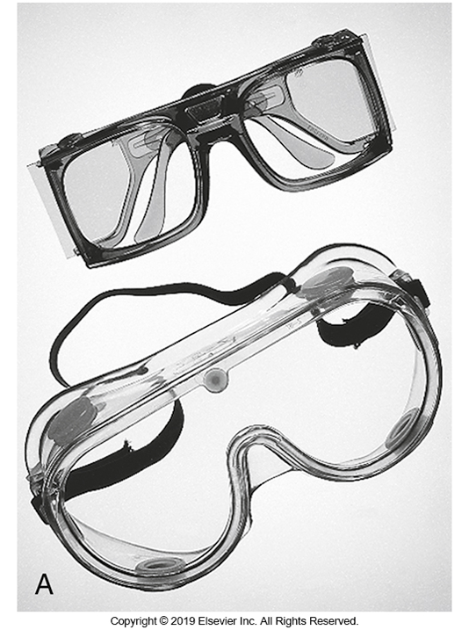
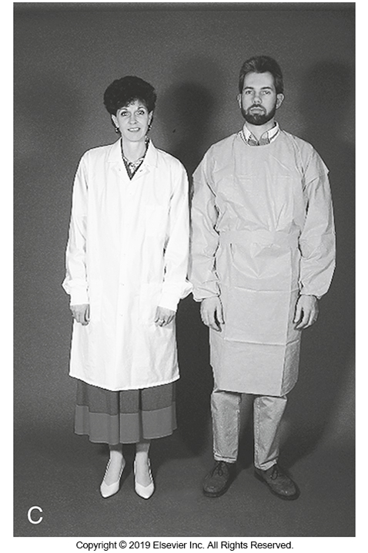
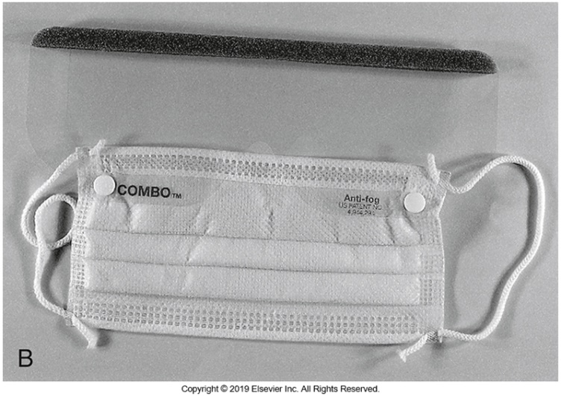
PPE

Slide 87
Biological Risk Assessment
Hazards
  Two major sources
    Processing of patient specimens
    Handling active cultures
  Modes of infection
    Direct contact
    Inhalation
    Ingestion
    Needle stick
    Spill/splash

Slide 88
Recommendations for laboratory safety improvements
Laboratorians and students should know that bacteria handled in the laboratory can make people (workers, students, family members) ill.
  Leave important items outside of the laboratory
Students should have dedicated writing utensils and supplies at their workstations, and these should not leave the laboratory.
Laboratorians and students should be aware of the organisms and their affects on humans.

Slide 89
Recommendations for Laboratory Safety Improvements
Laboratorians and students must be trained and proficient in biosafety practices and techniques.
Laboratory coats should always be worn over personal clothing (appropriate PPE should be worn). Individuals should not leave the laboratory with PPE on, PPE always be properly disposed
Handwashing sinks and supplies must be provided; individuals should always wash their hands before leaving the laboratory.

Slide 90
Biological Risk Assessment
A process used to recognize the hazardous characteristics of infectious agents that may be encountered in the clinical microbiology laboratory.
Hazard risk characteristics of an agent are determined by:
  The agent’s ability to infect and case disease
  Virulence
  Ability to treat for the disease
  Whether there are any preventive measures

Slide 91
Biological Risk Assessment
Recognition of the hazardous characteristics of an infectious agent(s)
  Based on ability of agent to infect and cause disease
    Includes virulence and availability of treatment
World Health Organization (WHO) classification
  Four risk groups
    Correlate to biosafety levels (BSLs) (see Box 4-2)

Slide 92
Biological Risk Assessment
World Health Organization (WHO)
  Defined four risk groups for infectious agents based on the hazard characteristics
  Risk groups correlate with the biosafety levels (BLSs).
    Criteria to select the appropriate BLS
      The mode of transmission
      The microbiological procedures that will be performed
      Experience of staff members

Slide 93
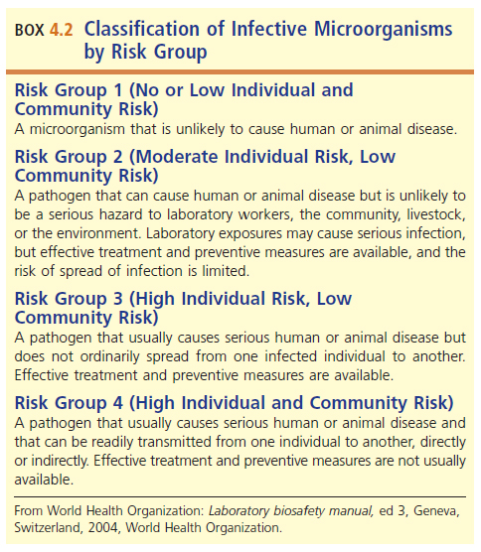
Biological Risk Assessment

Slide 94
Centers for Disease Control and Prevention (CDC) Guidelines for Safe Work Practices
  Identify the hazards associated with an infectious agent or material.
  Identify the activities that might cause exposures to the agent or material.
  Consider the competencies and experience of laboratory personnel.
  Evaluate and prioritize risks (evaluate the likelihood that an exposure would cause a laboratory-acquired infection [LAI] and the severity of consequences if such an infection occurs).
  Develop, implement, and evaluate controls to minimize the risk for exposure.

Slide 95
Processing of Patient Specimens
Standard precautions should be used when handling all patient samples
Assume that all patient sample contain agents that correlate with at least a Biosafety Level (BLS) of at least a 2 (BLS-2)
Perform all specimen processing in a biological safety cabinet (BSC)

Slide 96
Working with Actively
Growing Cultures
Frequently wash hands to avoid exposure.
Wear appropriate PPE.
Cover wounds, cuts, hangnails, and bandage small finger cuts.
Prevent exposure when determining microbial odor.

Slide 97
Working with Actively
Growing Cultures
Wear face shield (splash guard) when appropriate.
Avoid open flames in the laboratory
Seal plates growing fungus—only work with them in a biosafety cabinet (BSC)
Work with cultures that have suspicious growth only in a BSC.

Slide 98
Biological Safety Cabinets (BSCs)
A form of engineering control
Also known a biosafety hoods
Serves as a containment barrier that protects workers from the aerosolized transmission of infectious agents

Slide 99
Biological Safety Cabinets (BSC)
Three types
  Class I
  Class II—most commonly class used in microbiology laboratories
  Class III
BSCs must be maintained, inspected, and used properly

Slide 100
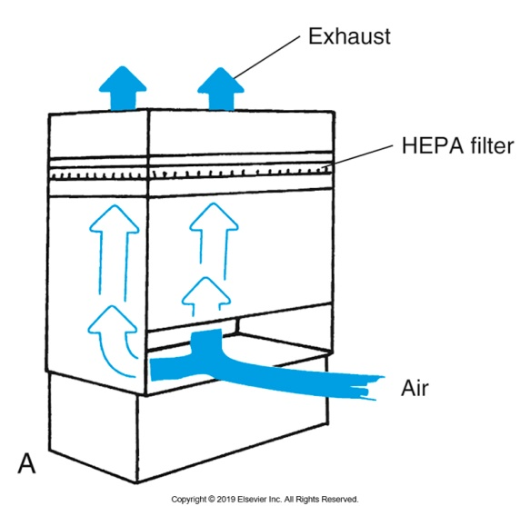
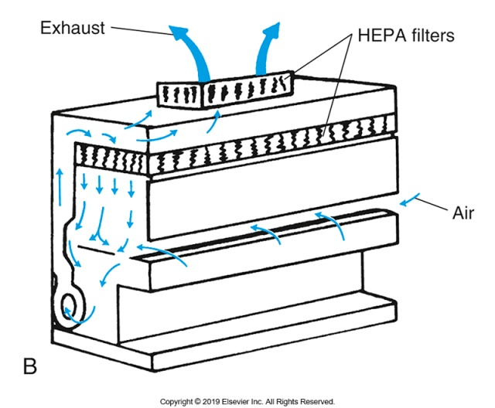
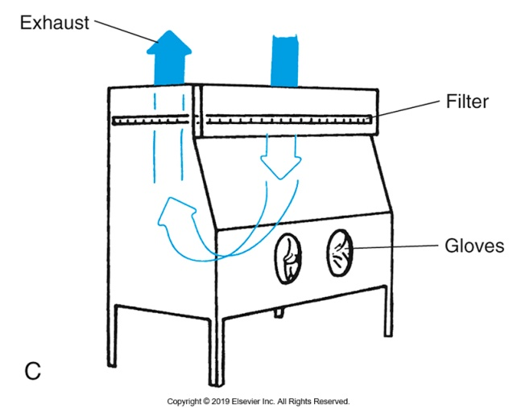
Biological Safety Hoods

Slide 101
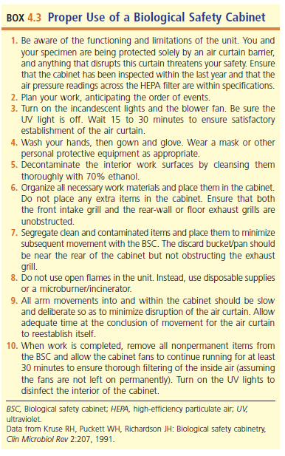
Proper Use of a BSC

Slide 102
Biosafety Levels (BSLs)
BSL-1
  Well classified and not known to consistently cause disease
  Standard PPE
  See text for guidelines list.
BSL-2
  Moderate potential hazard for employees and the environment
  See text for guidelines list.

Slide 103
BSLs
BSL-3
  Agents have potential aerosol transmission
  Agents may have serious lethal consequences.
  See text for guidelines list.
BSL-4
  Agents have high risk of causing life-threatening infections
  Agents can spread by aerosols or other measures
  See text for guidelines list.

Slide 104
Hazardous Waste
The clinical laboratory is responsible for the proper handling and disposal of all the waste it generates.
The Clinical Laboratory Standards Institute (CLSI), Clinical Laboratory Waste Management Approved Guideline, 3rd edition, addresses
  Chemical, infectious, radioactive, sharps, multihazardous, and nonhazardous waste
  Emphasizes methods to reduction of waste generation, volume, and toxicity of unavoidable wastes

Slide 105
Disposal of Infectious Waste
Must follow local and state regulations on the safe disposal of infectious waste.
  Usually autoclaving or incineration
Place in appropriate containers labeled with biohazard symbol.

Slide 106
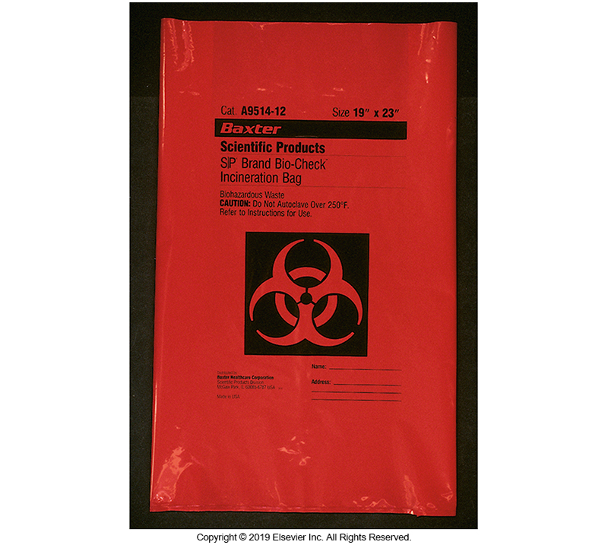
Examples of Biohazard
Containers

Slide 107
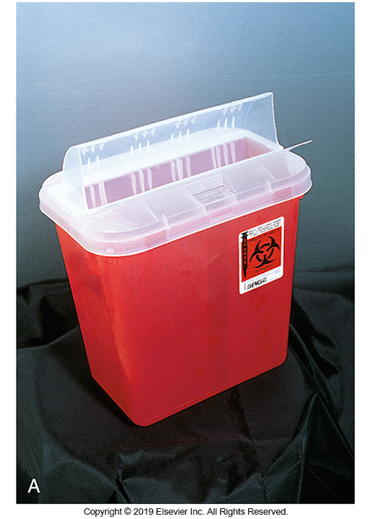
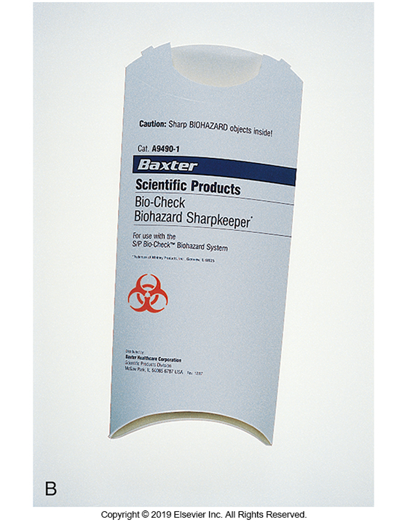
Examples of Biohazard
Containers

Slide 108
Hazardous Waste Reduction
Substitute less hazardous chemicals when possible.
Develop procedures that use less of a hazardous chemical.
Recycle chemicals when possible.
Segregate infectious wastes from uncontaminated trash.
Substitute micromethodology to reduce volume of chemical reagents as well as infectious waste.

Slide 109
Chemical Safety: Employee
Right-to-Know
Provides for a chemical hygiene plan
Employees should have a thorough working knowledge of the hazards of the chemicals used.
All hazardous chemicals must be labeled with National Fire Protection Association (NFPA) hazard rating diamond.
  States risk for flammability, reactivity, and health

Slide 110
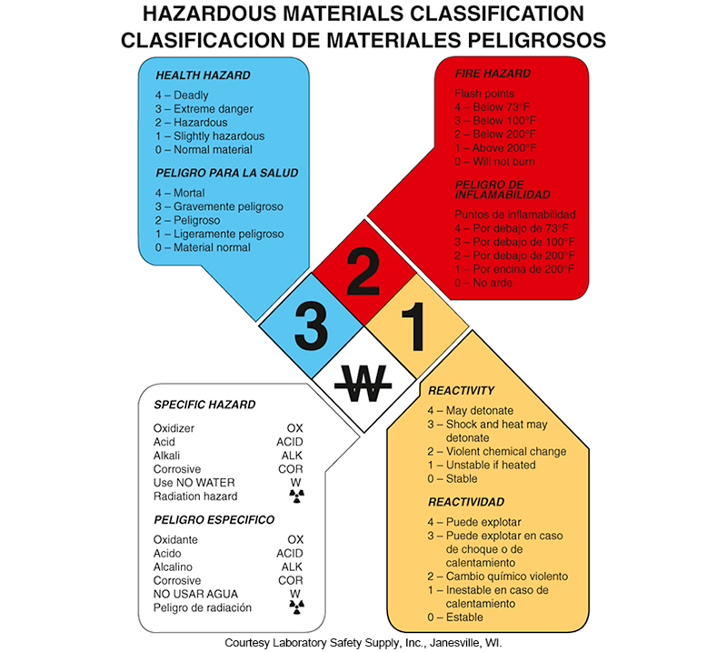
Hazardous Materials Classification

Slide 111
Safety Data Sheets (SDS)
Sheets provided by manufacturer
  Name, address, telephone of manufacturer
  Chemical and synonym names, and a list of hazardous ingredients
  Chemical characteristics such as vapor pressure and physical characteristics like potential for fire
  Health hazards of the hazardous chemical
  Emergency and first aid procedures
  Primary routes of entry and the target organs
  Disposal recommendations

Slide 112
Safety Data Sheets (SDS)
  Primary routes of entry and the target organs
  Precautions for safe handling and use, including appropriate hygienic practices
  Applicable control measures such as PPE
  Emergency and first aid procedures
  Spill cleanup procedure
  Disposal recommendations

Slide 113
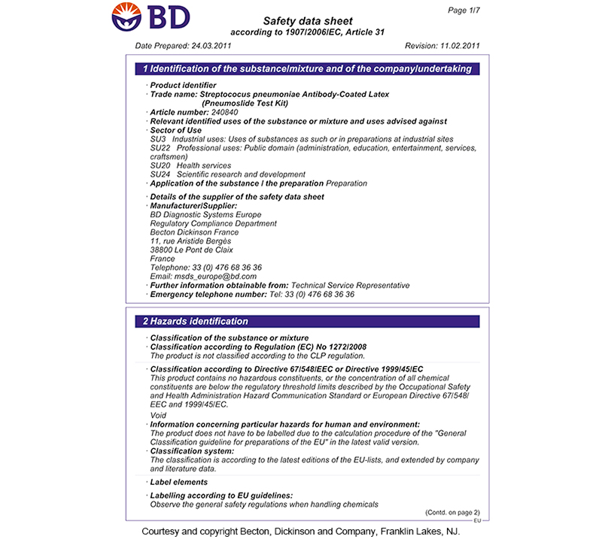
Example of SDS

Slide 114
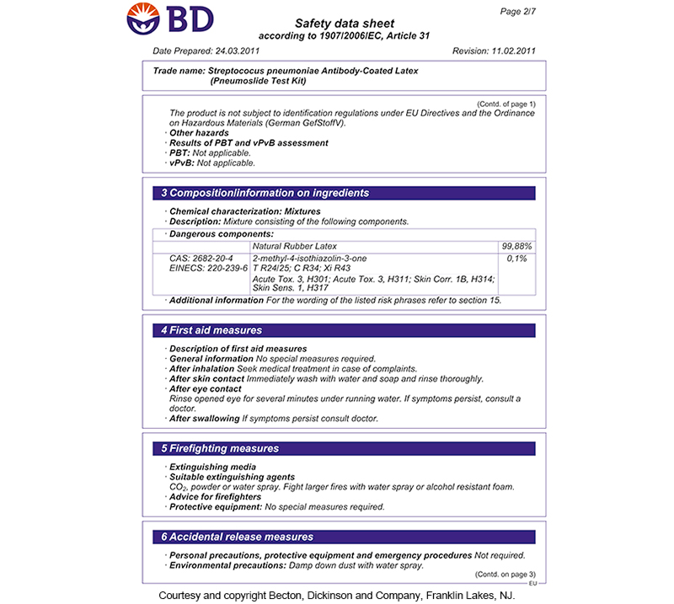
Example of SDS

Slide 115
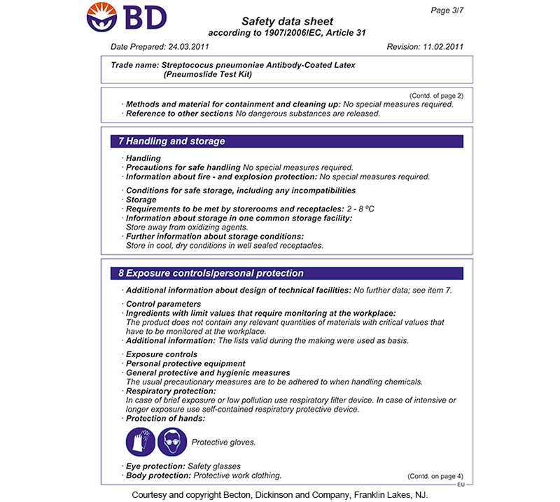
Example of SDS

Slide 116
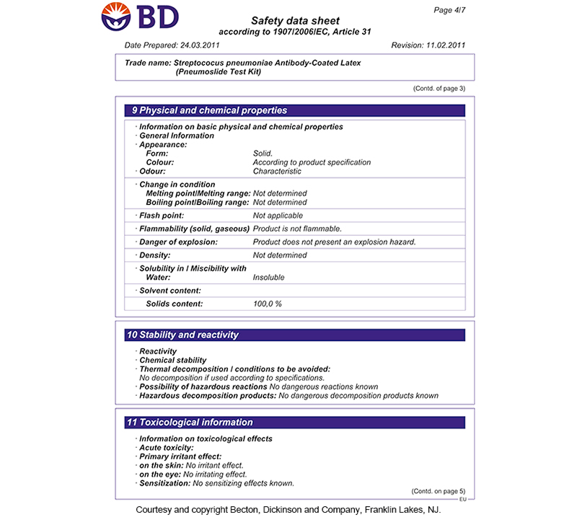
Example of SDS

Slide 117
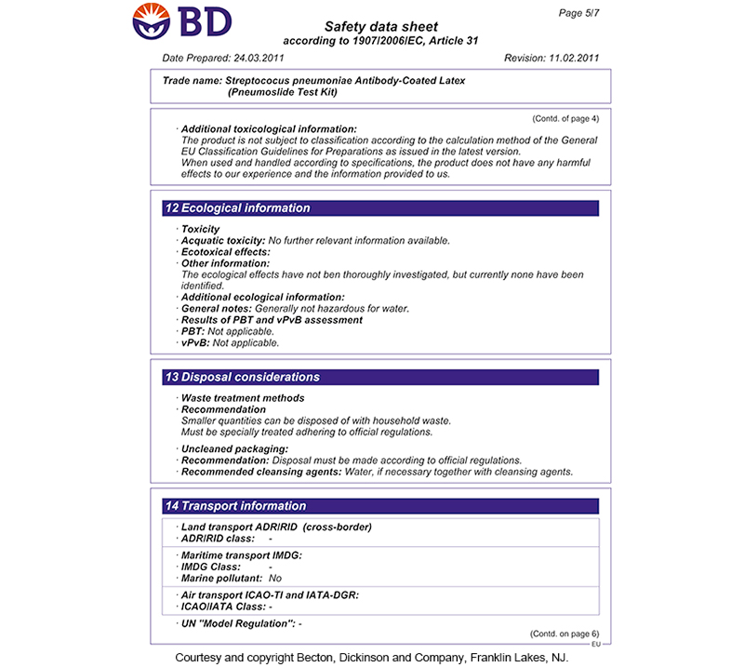
Example of SDS

Slide 118
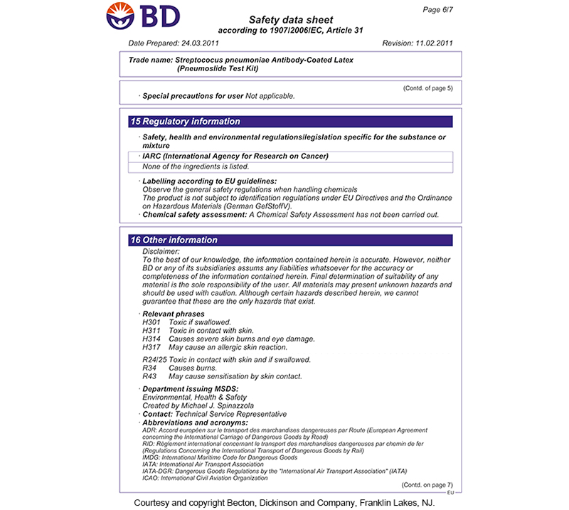
Example of SDS

Slide 119
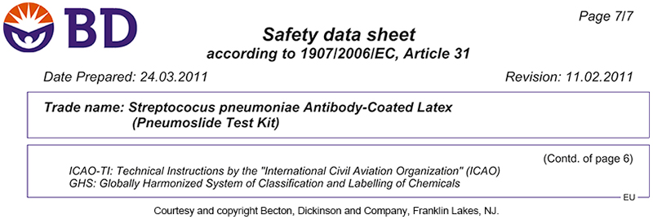
Example of SDS

Slide 120
Hazardous Chemicals Commonly
Used in the Microbiology Laboratory

Slide 121
Chemicals Inventory
Current inventory of hazardous chemicals
  Must be updated annually
Corresponding MSDS all present and updated
Sources to consult in preparing inventory:
  29 CFR Part 1910, Subpart Z, Toxic and Hazardous substances, OSHA
  National Toxicology Program Annual Report on Carcinogens
  International Agency for Cancer Research Monographs
  Manufacturers’ SDSs

Slide 122
Chemical Storage
Never store chemicals alphabetically.
Store according to compatibility.
  Do not store alkali metals (sodium [Na], potassium [K], etc.) with carbon dioxide, chlorinated hydrocarbons, or water.
  Do not store acids and bases together.
  Do not store certain acids with oxidizing agents.
  Halogens are incompatible with ammonia, acetylene, and hydrocarbons.
  Flammable chemicals should be stored in a flammable cabinet.

Slide 123
Hazardous Chemical Classification
Classification is determined by OSHA standards.
Placement of chemicals into the correct classification is done by chemical manufacturers and importers using said standards.

Slide 124
Laboratory Safety for Hazardous Chemicals: Fume Hoods
Prevent inhalation of fumes
Evaluate annually for face velocity and operation
Should be vented
PPE required
Use dedicated equipment.

Slide 125
Chemical Spills and Signage
Chemical spills
  Acid/base spill kits
  Flammable spill kits
  PPE stored in a designated area for spills
  Environmental Health and Safety Department should be called in the event of large spills
Signage
  Warning signs and symbols must be in place.

Slide 126
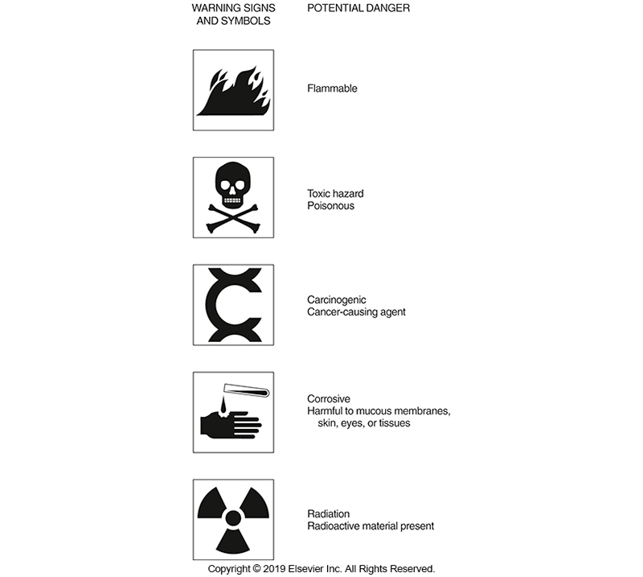
Signage Warning Signs and Symbols

Slide 127
Fire Safety
R—Rescue: remove anyone from danger
  Handicapped personnel should be a priority
A—Alarm: pull fire alarm, call to report fire
C—Contain: close doors to contain fire
E—Extinguish: use proper fire extinguisher to extinguish small fires
Fire evacuation plan must be posted.
Appropriate drills should be conducted.

Slide 128
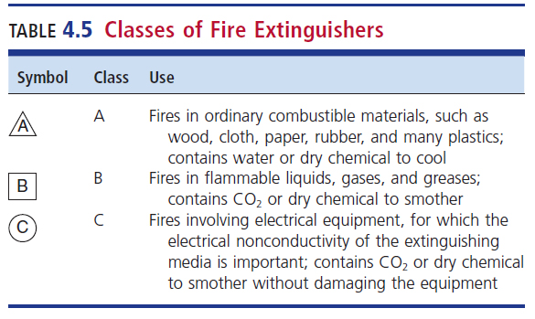
Classes of Fire Extinguishers

Slide 129
Thermal Injuries
Use thermal gloves up to shoulder for reaching into autoclaves.
Warning signs for hot liquids/instruments
Freezer burns
  Liquid nitrogen or ultra-low-temperature freezers
    Wear thermal gloves for handling materials.

Slide 130
Storage of Compressed Gases
Flammable and nonflammable gases
  Secure and store in vented areas
  Locate away from open flames and heat sources.
  Use metal cap to prevent breakage of pressure valve when not in use.
  Proper transportation equipment used when moved between locations.

Slide 131
Electrical Safety
All equipment must conform to national electrical safety standards and codes.
Preventive maintenance should be performed.
  Check cords for fraying
  Check for electrical grounding and leakage
Electrical equipment should not be placed near safety showers.
  Risk of electrocution

Slide 132
Miscellaneous Safety Considerations
Back safety
  Use legs to lift, not back.
  Keep loads close to the body during transport
  Ask for help or use a cart when load is too heavy.
  Use good posture.
  Stay physically fit.
First aid training
  All personnel should be trained in cardiopulmonary resuscitation (CPR) and other lifesaving first aid.
Immunizations
  Hepatitis B vaccination
  Tuberculosis (TB) screening annually

Slide 133
Safety Training
All clinical laboratories should offer annual documented safety training. Key issues include:
  Fire
    How and when to report
    Location of alarm box and fire extinguishers
    Use of extinguishers and blocking of fire doors
  Hazardous materials management
    How to use MSDS
  Proper storage of gases
  Blood-borne pathogens program

Slide 134
BIOTERRORISM AND THE CLINICAL MICOBIOLOGY LABORATORY
CHAPTER FOUR

Slide 135
Laboratory Response Network
Respond quickly and effectively to a bioterrorism event.
Three levels of laboratories:
  Sentinel laboratories
  Reference laboratories
  National laboratories

Slide 136
Laboratory Response Network
Sentinel laboratories—category of most hospital-based microbiology laboratories
  Divided into two levels:
    Advanced Sentinel laboratories: front line with highest capability
      Role: Recognize possible bioterrorism agents and perform basic testing to rule out these agents or refer them to a LRN reference laboratory

Slide 137
Laboratory Response Network
Sentinel laboratories—category of most hospital-based microbiology laboratories
  Divided into two levels
    Basic Sentinel laboratories: fewer analytical capabilities but may handle suspect samples and refer them an LRN reference laboratory
Reference Laboratory
  Role to perform confirmatory identification testing

Slide 138
Safety During a Possible Bioterrorism Event
Biggest threats with handling possible bioterrorism agents
  Not recognizing the risk associated with these infectious agents
  Not following the safety procedures instituted in the laboratory for protection
Specimen Processing of samples should occur within a class II BSC

Slide 139
Safety During a Possible
Bioterrorism Event
Until the agent is identified, cultures of infected patients could cause the greatest risk to laboratorians.
Agents transmitted by aerosols are those that cause great risk.
When bioterrorism agent is suspected, all manipulations of the culture should be performed using BSL3-guidelines.

Slide 140
Packaging and Shipping of
Infectious Substances
Laboratory personnel must be trained and certified in the packing and shipping of infectious materials.
Laboratory personnel must undergo regular retraining.

Slide 141
Points to Remember
Physical and chemical methods may be used in the process of sterilization to remove all forms of life.
Disinfection involves removal of pathogenic organisms but may not include removal of bacterial or other spores; most disinfectants are chemical agents.

Slide 142
Points to Remember
Factors that influence the degree of killing include types of organisms and number of organisms present, concentration of disinfecting agent, amount of soil present, and nature of the surface to be disinfected.
Antiseptics are designed to reduce the bacterial load of living tissues.

Slide 143
Points to Remember
Disinfectants are designed to be used on inanimate objects to kill or destroy disease-producing microorganisms.
There are two options a manufacturer can pursue in seeking approval for a disinfectant product: submission of an NDA or OTC drug review known as the monograph system

Slide 144
Points to Remember
Antimicrobial agents for health care personnel use must meet certain standards that demonstrate the product’s safety and efficacy.
Major sources of biological hazards come from patient samples during processing and handling of actively growing culture materials.
Protective equipment should be used appropriately.

Slide 145
Points to Remember
Safety policies and procedures should be reviewed annually and always followed.
The microbiology safety program includes proper and safe disposal of infectious waste material.
OSHA regulations for bloodborne pathogen protection should be followed.

Slide 146
Points to Remember
Chemical and fire safety hazards must be identified, and measures to prevent chemical spills should be employed.
Continuing education programs to train laboratory personnel in all aspects of laboratory safety and exposure control should be in place

