Slide 1
Chapter 29
Clinical Virology
Part One

Slide 2
CASE IN POINT
CHAPTER TWENTY-NINE

Slide 3
Highlights
March 02, 2020
The Patient | 65-year-old male
Medical History | 14-year history of chronic lymphocytic leukemia along with hypogammaglobulinemia, chronic leukocytosis, and severe anemia presented to the emergency department of a local community hospital with lower back, lower hip, and lower extremity pain
Symptoms When Patient was seen in the ED | Lower back, lower hip, and lower extremity pain
March 05, 2020 | Hip fracture surgery related to the patient’s cancer
Post-Surgery | Patient was transferred to a rehabilitation facility.

Slide 4
Highlights (Cont.)
Two Weeks Later | Patient was Readmitted to the Hospital
Reason for Readmission | Anemia; no other respiratory or systematic symptoms
Test Results | Chest Radiograph-normal Chest computed tomography (CT) scan negative Other tests-unremarkable
Reason Patient was Not Allowed to Return to the Rehabilitation Facility | Confirmed outbreak of severe acute respiratory syndrome coronavirus-2 (SARS-CoV-2) infection, the cause of coronavirus disease 2019 (COVID-19)
March 25, 2022 | SARS-CoV-2 test results release positive

Slide 5
Highlights (Cont.)
s
Precautions Instituted | Patient was kept in an isolation unit in a single room with negative air pressure.
Part of Treatment Regimen | Intravenous (IV) immunoglobulin every 4 weeks because of the patient’s acquired hypogammaglobulinemia caused by the patient’s cancer
Early May 2022 | Patient was transfused with 200 mL of SARS-Co-V-2 convalescent plasma.
One Week Later | Patient received another 200-mL dose of convalescent plasma from a different donor.
On Days 35 and 72 | Infectious SARS-CoV-2 was successfully cultured from nasopharyngeal swabs.

Slide 6
Highlights (Cont.)
Over the next 18 weeks | Patient was tested for SARS-CoV-2 another 20 times using real-time reverse transcription-polymerase chain reaction (RT-PCR) test, and he remained positive through July 16, 2020 (113 days after the initial positive RT-PCR test).
From July 22 to August 10, 2022 | The patient tested negative on 6 consecutive swabs, indicating that the infection had finally cleared.
On Days 25, 60, and 80 of Hospital Admission | Culturable virus was obtained on each noted day. The patient remained asymptomatic for the entire duration of his hospitalization.

Slide 7
Issues to Consider
After reading the patient’s case history, consider:
How the patient’s medical history affected his viral infection
What information is obtained from the laboratory, radiograph, and CT results
Could this patient have been returned to the rehabilitation sooner? If yes, why? If no, why not?
Other testing for SARS-CoV-2 includes antigen testing and testing for IgG and IgM antibodies. Would the patient’s diagnosis or treatment have improved with any of these assays?

Slide 8
Introductory Remarks
Significant advances in diagnostic methods have transformed the field of virology.
Newer methods provide quicker turn-around times.
Test results are now more clinically useful.
Molecular diagnostic testing results in earlier intervention, earlier treatment, and better outcomes.

Slide 9
What’s Ahead?
Basic virology
Advances and challenges in clinical virology in the modern clinical laboratory
How the laboratory helps diagnose viral infections

Slide 10
CHARACTERISTICS OF VIRUSES
CHAPTER TWENTY-NINE

Slide 11
Structure

Slide 12
Structure
All viruses contain nucleic acid and a protein capsid, with some viruses having up to 90% of their mass from the protein component.
Viruses contain a viral genome of RNA or DNA and a protein coat that together are known as a nucleocapsid.
Entire virus particle = virion

Slide 13
Structure
Some viruses have a phospholipid, labile envelope surrounding the virion.
Enveloped viruses are usually more susceptible to inactivation by high temperature, extreme pH and chemicals.
Non-enveloped viruses are referred to as “naked”.

Slide 14
Structure (Cont.)
Morphologic types of virions
Helical
Polyhedral (e.g., icosahedral, a geometric shape with 20 triangular sides)
Complex
When present, the envelope masks the shape of the virion.
Size extremes of human viruses
Poxviruses are the largest, poliovirus is the smallest.

Slide 15
Taxonomy

Slide 16
Viral Taxonomy
Viruses are classified in
Orders,
Families,
Genera
Species
based on genotype (RNA or DNA), and presence or absence of an envelope.
Nucleotide sequence is also a valuable tool for the taxonomic placement of viruses.

Slide 17
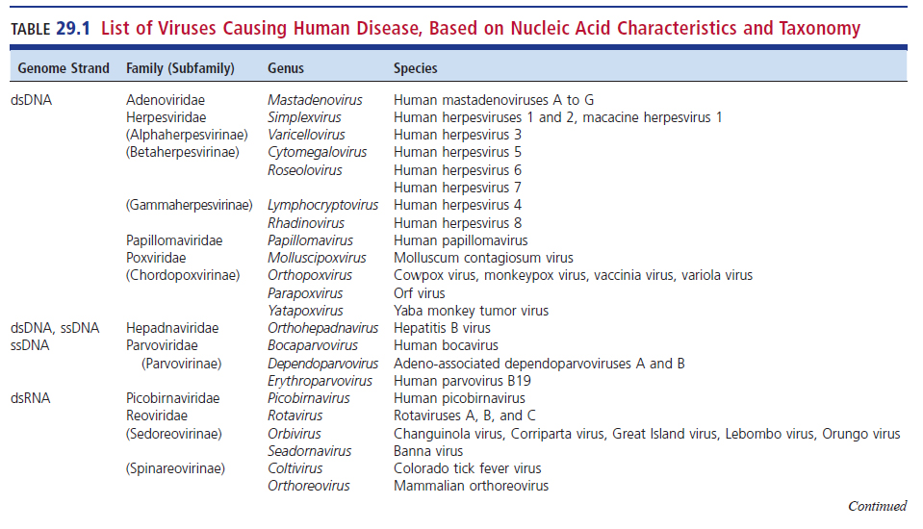
List of Viruses Causing Human Disease

Slide 18
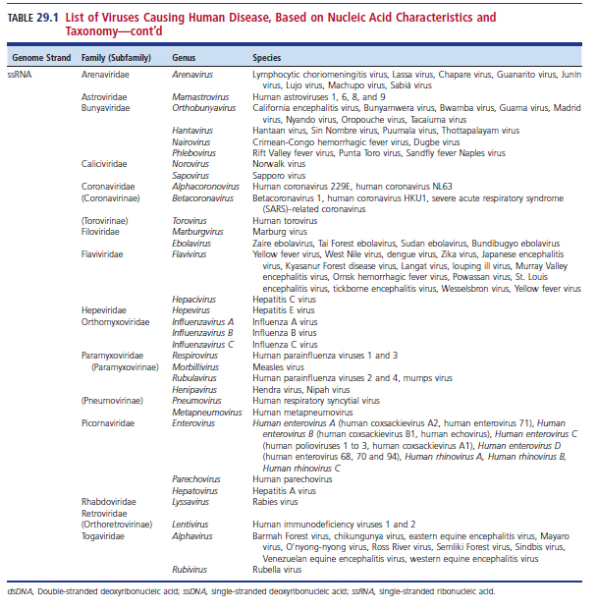
List of Viruses Causing Human Disease (Cont.)

Slide 19
Viral Replication

Slide 20
Viral Replication
Viruses are obligate intracellular parasites.
Virus must be inside a living cell and the use the host machinery to replicate.
Steps of infection
Step 1–Absorption or attachment to the cell surface
Specific for certain cell receptors via viral adhesion molecules.
Receptor distribution often determines entry point into the host.
Most host cell receptors are glycoproteins.
The adhesion molecule receptor interaction determines the viral tissue tropism in the host.

Slide 21
Viral Replication (Cont.)
Steps of infection
Step 2–Penetration
Naked virions
Direct penetration through the cell membrane
Enveloped virions
Fusion with cell membrane or
Endocytosis (enters cell in a cytoplasmic vacuole)

Slide 22
Viral Replication (Cont.)
Steps of infecting a cell
Step 2–Penetration
Uncoating
Virus loses its protein coat, releasing the genome.
RNA viruses release their genome into the cytoplasm.
DNA viruses release their genome into the host nucleus.
Replication and translation
Viral genome then directs the host cell to make viral proteins and replicate the viral genome.
Metabolism of host cell may be completely stopped or continue at a reduced scale.

Slide 23
Viral Replication (Cont.)
Steps of infecting a cell
Step 3–Assembly or maturation of the virus particles
Capsid protein subunits aggregate to form capsomers and then capsomers combine to form the capsid.
The capsid and genome associate to form the nucleocapsid.
Step 4–Virion release
Naked virions are released by cell lysis.
Enveloped viruses are released by budding.
During budding, part of the host cell plasma membrane surrounds the viral capsid and becomes the viral envelope.

Slide 24
LABORATORY DIAGNOSIS OF VIRAL INFECTIONS
CHAPTER TWENTY-NINE

Slide 25
Examples of Available Viral Testing Methods
Laboratory diagnosis of viral infections
Varying levels of viral testing are available.
Examples of viral testing methods
Rapid tests
Viral antigen tests, i.e., IF or enzyme immunoassay (EIA)
Detection of RNA or DNA using PCR assays
Cell cultures, available only in full-service virology labs

Slide 26
Specimen Selection, Collection, and Transport

Slide 27
Specimen Selection
Clinical signs and symptoms of diseases often point to the target organ(s) involved,
Which can help determine the most appropriate specimen(s) to collect.
This, combined with a basic understanding of viral pathogenesis, can help in specimen selection for each specific virus.
It is important to ensure, however, that the specimen collected can be used to isolate a wide range of viral pathogens because different viruses can have overlapping clinical symptoms.

Slide 28
Specimen Collection
The best specimens are those collected as early as possible, which, in many infections, is even before symptoms occur.
The sensitivity of viral culture can decrease rapidly 3 days after the acute onset of symptoms.
Care must be taken to collect specimens appropriately to maximize detection and identification.
Specimens should be collected aseptically.

Slide 29
Specimen Collection (Cont.)
Depending on anatomic sites, the method of collection can be sterile or nonsterile.
Example of nonsterile–contamination with bacteria and/or fungi
Non–culture-based test methods are typically not affected by contamination, but this varies with the system.

Slide 30
Specimen Collection (Cont.)
In a normally sterile specimen, such as blood, CSF, or tissue, identification of a virus without bacterial isolates usually means that the virus is the cause of the disease.
Nonsterile specimens are obtained from sites that contain normal biota.
Such as the respiratory tract, genital tract, skin, or stool.
These specimens may require processing to reduce contaminants and promote viral growth.

Slide 31
Specimen Collection (Cont.)
Aspirated secretions are often preferable, but swabs are easier to use for collection.
Swabs must be made of Dacron or rayon.
Calcium alginate swabs inhibit the replication of some viruses and can interfere with nucleic acid amplification tests (NAATs).
FLOQSwab® (flocked swab) is recommended.
Tissue samples must be kept moist and must not be placed in transport media unless it is specifically designed for viral preservation.
Often it is preferred for tissue specimens to be sent to the laboratory in a sterile container.

Slide 32
Specimen Transport Media
Substances that can be added to sterile containers to keep tissues from drying out include
Viral transport medium–often consist of a buffered isotonic solution with a protein, gelatin, or serum
Saline
Trypticase soy broth
Antibacterial and antifungal agents can also be added to these samples
Respiratory, swab, and tissue

Slide 33
Specimen Transport Media
Samples that should be collected without viral transport media include
Blood, bone marrow, CSF, amniotic fluid, urine, pericardial fluid, and pleural fluid.
The transport container should be unbreakable and able to withstand freezing and thawing.

Slide 34
Specimen Transport
Specimens
Samples are best cultured immediately.
Refrigerate if necessary, at 4° C.
Freeze only if longer than 4 days and only at −70° C.
Never freeze specimens at −20° C because this temperature facilitates the formation of ice crystals that will disrupt the host cells and result in loss of viral viability.
Repeated freeze thawing cycles is not recommended since it too can result in loss of viral viability.

Slide 35
Appropriate Specimens for Maximum Recovery of Viruses

Slide 36
Appropriate Specimens for Maximum Recovery
Best if collected from affected site
Examples of specimen types
Respiratory specimen
Lesion aspirates or surface swabs (for lesions)
Stool
Urine
Blood
Tissue biopsy
CSF

Slide 37
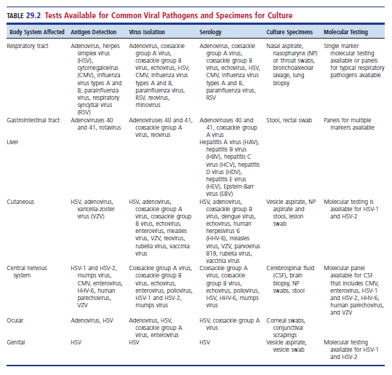
Tests Available for Common Viral Pathogens and Specimens for Culture

Slide 38
Methods in Diagnostic Virology

Slide 39
Methods in Diagnostic Virology
Diagnostic categories
Direct viral detection in clinical specimens
Isolation of viruses in cell cultures
Serologic assays to detect antibodies to virus
Major methods for direct viral detection in clinical specimens
Microscopy to detect cytopathic effect (CPE)
Detection of viral antigens
Nucleic acid detection

Slide 40
Direct Detection Methods
Not usually as sensitive as culture methods
Can offer quick results to allow rapid therapy
Many tests can be performed in a matter of a few minutes.
Viral detection allows clinicians to make relevant decisions about
Therapy, infection control measures, and hospitalization.
In many cases, virology results may be available before routine bacteriology culture results.

Slide 41
Microscopy
Bright-field light microscopy is not useful for visualizing viruses.
Viruses are extremely small.
Exception–the largest human viruses (poxviruses) can be seen
Electron microscopy has a greater magnification
Can be used to visualize virions, and it is useful to detect nonculturable viruses, such as Norwalk virus, in stool filtrates.

Slide 42
Microscopy (Cont.)
Electron microscopy
Expensive, labor-intensive, and not a very sensitive method of detecting viruses.
Therefore, electron microscopy is rarely used in clinical laboratories and is more suited for large teaching or research institutions.
Cytopathic effect (CPE)
Distinctive visual changes in infected cells.
CPE can be viewed using brightfield microscopy

Slide 43
Microscopy (Cont.)
CPE
Tzanck smear common method used
Scraping of an ulcer base to look for Tzanck cells, large round keratinocytes that are degenerated as a result of viral infection.
Can detect Cowdry type A bodies from herpes simplex virus (HSV) and varicella-zoster virus (VZV) lesions.
Papanicolaou (Pap) smears can reveal human papillomavirus (HPV)-associated koilocytes–squamous epithelial cells with an enlarged nucleus surrounded by a nonstaining halo.

Slide 44
Antigen Detection
Available methods
Direct fluorescence antibody (DFA) assay
Cells from a patient are fixed to a microscope slide, and fluorescence-labeled antibodies are added. If viral antigens are present in the sample, the labeled antibody will bind, and fluorescence will be seen using fluorescent microscopy.
EIA
Most laboratories use multi-well microtiter plate formats, which offer variable testing capacity to meet the needs of small or large laboratories.

Slide 45
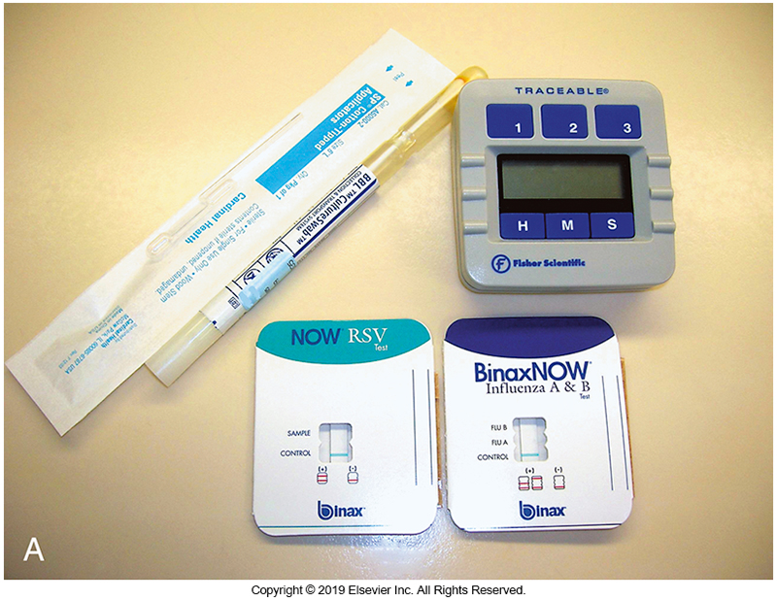
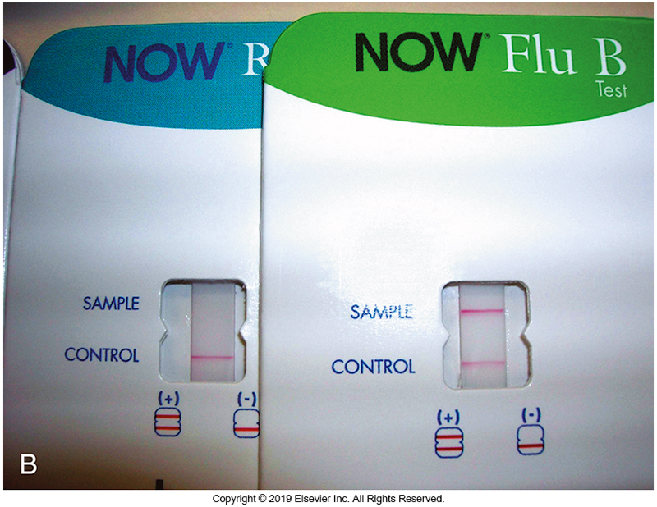
Antigen Detection
Card format rapid immunochromatographic membrane assay
Positive specimens detected by colorimetric or optical density changes on membrane or silicon surfaces.

Slide 46
Nucleic Acid-Based Detection
Shifted the focus of clinical virology
Not only can the presence or absence of a virus be determined with nucleic acid–based analysis, but depending on the assay used, a quantitative result can also be obtained.
There are many advantages including a much faster turnaround time (TAT).
Molecular assays lead to faster treatment and more favorable patient outcomes.

Slide 47
Nucleic Acid-Based Detection (Cont.)
Disadvantages to molecular assays
Detection of both active and inactivated virus
Higher cost, need for specialized training and more complex facilities
Lack of assays approved by the FDA
Smaller clinical laboratories often rely on sending these tests to reference laboratories at a higher cost and longer TAT.

Slide 48
Nucleic Acid-Based Detection (Cont.)
Examples of nucleic acid-based assays
PCR
Reverse transcription-PCR (RT-PCR)
Branched DNA
Nucleic acid sequence-based amplification (NASBA)
Combination of PCR and flow cytometry
Gene amplification
Primarily for bloodborne pathogens

Slide 49
Viral Isolation
Isolating viruses is still the gold standard against which all other methods are compared.
Three methods are used for viral isolation
Cell culture (most commonly used)
Animal inoculation
Embryonated eggs

Slide 50
Cell Culture
Terminology
The term cell culture is used to indicate culture of cells in vitro, the cells are not organized into a tissue.
The term tissue culture or organ culture is used to denote the growth of tissues or an organ so that the architecture or function of the tissue or organ is preserved.

Slide 51
Cell Culture (Cont.)
Cell viability is maintained by periodically removing cells from the surface, diluting them, and placing them into a new container.
This process is referred to as splitting or passaging.
Some cell lines can only be passaged a few times before new cells must be obtained.
Some viruses produce a characteristic CPE that can provide a presumptive identification of a virus isolated from a clinical specimen.

Slide 52
Cell Culture
Primary cell cultures
The tissue is finely minced and then treated with an enzyme, such as trypsin, to disperse individual cells.
The cells are then seeded onto a surface, such as in a flask or a test tube, to form a monolayer.
With primary cell lines, only minimal cell division occurs.
Primary cell monolayers can only be passaged a few times.

Slide 53
Cell Culture
Finite cell cultures
Can divide but passage is limited to about 50 generations
Finite cell lines, like primary cell lines, are diploid, that is, they contain two copies of each chromosome.
Diploid is the normal genetic makeup for eukaryotic cells.
As the number of passages increases, these cells become more insensitive to viral infection.
E.g., human neonatal lung cells

Slide 54
Cell Culture
Continuous cell cultures
Capable of infinite passage and are heteroploid
They have an abnormal and variable number of chromosomes.
Sometimes the number is not a multiple of the normal haploid number–referred to as aneuploid
E.g., HEp2 (derived from a human laryngeal epidermoid carcinoma), A549 (derived from a human lung carcinoma), and Vero (derived from monkey kidneys)

Slide 55
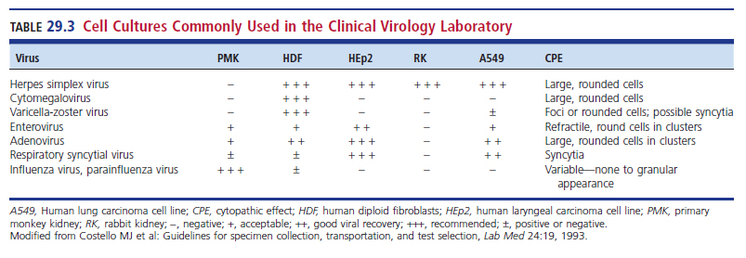
Cell Cultures Commonly Used in the Clinical Virology Laboratory

Slide 56
Cell Culture
Mixed or Engineered Cell Cultures
Cell lines that contain a mixture of two different cell types or are made up of cells genetically modified to make identification of viral infection easier
Mixed cell lines have been developed by combining two cell lines susceptible to certain types of viruses, such as respiratory or enteric viruses.
Greater sensitivity to a wider range of viruses
Useful for fastidious viruses

Slide 57
Cell Culture
Screening cell cultures for viruses
Some viruses produce characteristic or suggestive CPE.
Fluorescent antibody stains that detect viral antigen, such as those used directly on clinical specimens, can also be used to screen cell cultures before a final negative result is reported.
IF, EIA, and NAATs can also be used to detect and identify viruses in cell cultures to ensure that true positives are not missed.

Slide 58
Centrifugation-Enhanced Shell Vial Culture
Cells grown on a round cover slip in a shell vial covered in culture media
A shell vial is a small, round, flat-bottomed tube, generally with a screw cap.
Sample is added to the shell vial and centrifugation is used to promote viral absorption to cells.

Slide 59
Centrifugation-Enhanced Shell Vial Culture (Cont.)
The coverslip is removed, and an IF assay is performed on the slide.
Based on the type of clinical specimen and suspected viruses, a variety of fluorescent-labeled antibodies can be used.
Modification of this procedure
Use flat-bottomed microtiter wells
Although this is better than looking for CPE, in many cases it can be labor-intensive, and often cultures are done in duplicate, which results in reading at 24 hours then again at 48 hours, thus increasing the TAT.

Slide 60
Serologic Assays to Detect Antibodies to Viruses
Viral serology detects circulating antibodies to viruses after exposure.
This method provides limited information and has certain inherent problems.
First, serologic assays measure the host response rather than directly detecting the virus.
Second, the antibody-producing capabilities of human hosts differ widely from person to person.

Slide 61
Serologic Assays to Detect Antibodies to Viruses
With few exceptions, paired sera (acute and convalescent) demonstrating seroconversion or a fourfold rise in titer are required to establish a diagnosis of recent infection.
Serologic assays are usually retrospective.
Some assays can
Distinguish IgM between IgG
The presence of IgM indicates an acute (recent) infection.

Slide 62
Serologic Assays to Detect Antibodies to Viruses
Indications for serologic testing
Diagnosis of infections with nonculturable agents, such as hepatitis viruses
Distinguishing between a past (IgG) or acute (IgM) viral infection
Determination of immune status regarding rubella virus, measles virus, VZV, hepatitis A virus (HAV), and HBV

Slide 63
Serologic Assays to Detect Antibodies to Viruses
Indications for Serologic Testing
Monitoring patients who are immunosuppressed or have had transplantations
Epidemiologic or prevalence studies that are critical during outbreaks to assess overall spreading and herd immunity status

Slide 64
Serologic Assays to Detect Antibodies to Viruses
Disadvantages
Lack of paired sera
Antibodies are not always diagnostic.
Does not work well in patients who are severely immunocompromised.
Reactivating viruses have previously induced antibody formation.
Infants with maternal antibody
Cross-reactivity with other antibodies

Slide 65
DOUBLE-STRANDED DNA (dsDNA) VIRUSES
CHAPTER TWENTY-NINE

Slide 66
Group Members Presented Here
Adenoviridae
Adenovirus
Herpesviridae
HSV type 1 (HSV-1) and HSV type 2 (HSV-2)
CMV
Epstein-Barr virus (EBV)
Varicella-zoster virus (VZV)
Human herpes virus 6, 7, & 8
Papillomaviridae
Human papillomavirus (HPV)
Poxviridae
Smallpox (veriola)
Monkeypox (Mpox)

Slide 67
Adenoviridae
Naked icosahedral viruses with dsDNA
Common serotypes
1 to 8, 11, 21, 35, 37, 40
Clinical presentations
Asymptomatic ~50% of infections
Pneumonia ~10%
Gastroenteritis ~5% to 15% (in children)
Type 40 and 41
Responsible for epidemic
Keratoconjunctivitis
Acute hemorrhagic cystitis
Pharyngoconjunctival fever

Slide 68
Adenoviridae
Identification Methods
Enteric adenoviruses can be identified but not serotyped by EIA.
Commercial antigen detection kits are available
Lack sensitivity
Inexpensive
Fluorescent antibody methods
Nucleic acid tests
Serotyping via serum neutralization or hemagglutination inhibition

Slide 69
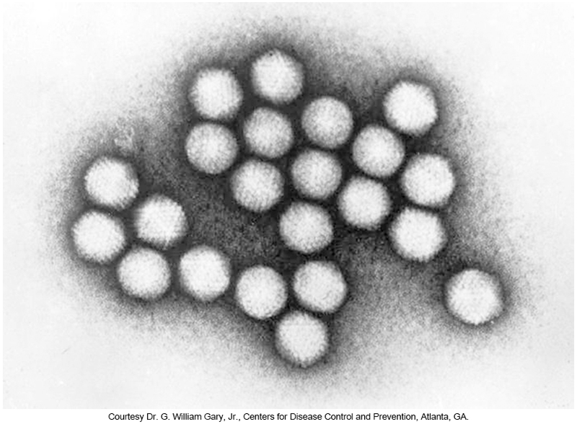
Transmission Electron Micrograph of Adenovirus

Slide 70
Bronchoalveolar Lavage, Cytospin Preparation, Immunofluorescent Antigen Adenovirus Stain

Slide 71
Herpesviridae
Genome of linear dsDNA
Icosahedral capsid
Amorphous integument surrounding the capsid
Envelope

Slide 72
Herpesviridae
Eight species of human herpes viruses (HHV)
HSV-1 (HHV-1)
HSV-2 (HHV-2)
VZV (HHV-3)
EBV (HHV-4)
Human CMV (HHV-5)
Human herpesvirus-6 (HHV-6)
Human herpesvirus-7 (HHV-7)
Human herpesvirus-8 (HHV-8)
Aka, Kaposi’s sarcoma herpes virus (KSHV)

Slide 73
Herpes Simplex Virus (HSV)
HSV-1 (HHV-1) and HSV-2 (HHV-2) belong to the genus Simplex virus.
HSV infections are very common.
By adulthood, about 80% of Americans have been infected with HSV-1.
Approximately 20% of Americans have had HSV-2 infections.
These figures indicate that about one in six persons in the United States has had HSV infection, and most infections are asymptomatic.

Slide 74
Herpes Simplex Virus
Types of Infections
HSV infections occur worldwide, and infections can cause a wide spectrum of clinical manifestations. HSV-1 and HSV-2 cause the same diseases.
Skin vesicles are filled with clear fluid and have a red base.
The vesicles progress to pustular lesions, ulcerate, and then finally crust over.

Slide 75
Herpes Simplex Virus
Oral herpes
Most oral herpes infections, herpes labialis, are caused by HSV1, but many cases are caused by HSV-2.
Incubation 2 days to 2 weeks
Primary infections are usually asymptomatic.
When apparent, they commonly manifest as mucosal fluid-filled vesicles inside the mouth or as ulceration (gingivostomatis)
Recurrent of reactivation of HSV- border of the lips
Junction of oral mucosa and skin

Slide 76
Herpes Simplex Virus
Oral Herpes
An early symptom of burning or pain followed by vesicles, ulcers, and crusted lesions is the typical pattern.
These eruptions can result from stress or sunlight exposure and are often quite painful.

Slide 77
Herpes Simplex Virus
Genital Herpes
Aka herpes genitalis infections are usually caused by HSV-2, although HSV-1 can cause as many as one third of the infections
Many individuals with antibodies to HSV-2 have not been diagnosed with genital herpes.
In women vesicles on the
Labia, vagina, or both
Involvement of cervix and vulva possible

Slide 78
Herpes Simplex Virus
Genital Herpes
In men–affected sites
Penis shaft, glans, and prepuce of the penis
In women and men
Urethra involvement
Recurrent herpes infections involve the same sites as primary infections
However, the urethra is less commonly involved with fewer symptoms and shorter duration.
Herpes genitalis can as much as double the risk of sexual transmission of HIV.

Slide 79
Herpes Simplex Virus
Neonatal Herpes
HSV-2 is more severe than HSV-1 in neonates.
Acquired in utero, during birth, or after birth
Most commonly during vaginal delivery: 50% chance of transmission when mother has a primary infection.

Slide 80
Herpes Simplex Virus
Neonatal Herpes
The risk of transmission is very low when the mother has recurrent herpes.
Cesarean delivery or suppressive antiviral therapy at delivery significantly reduces the risk of transmission.
Mortality associated with disseminated neonatal disease is about 60% in treated neonates and exceeds 70% in untreated neonates.

Slide 81
Herpes Simplex Virus
HSV Encephalitis
Devastating disease with a mortality rate of 70%
Accounts for 20% of all cases in the U.S.
Encephalitis is usually caused by HSV-2 in neonates and HSV-1 in older children and adults.
HSV encephalitis is also associated with an immunocompromised status.
Survival rates and clinical outcomes are greatly improved with IV antiviral treatment.

Slide 82
Herpes Simplex Virus
Ocular Herpes
Infection of the conjunctiva
Swelling of the eyelids
Associated with fluid-filled vesicles
Corneal involvement, herpes keratitis, can result in destructive ulceration and perforation of the cornea, leading to blindness.
Fortunately, most infections involve only the superficial epithelial layer and heal completely with treatment

Slide 83
Herpes Simplex Virus
Diagnosis of HSV
Best made by antigen detection or viral isolation in culture
Smaller laboratories
Tzanck smear from suspicious lesion and look for CPE typical of HSV
If present, specific fluorescent antibodies to HSV-1 or HSV-2
Other specimen types
Stained and observed for CPE consistent with HIV infection

Slide 84
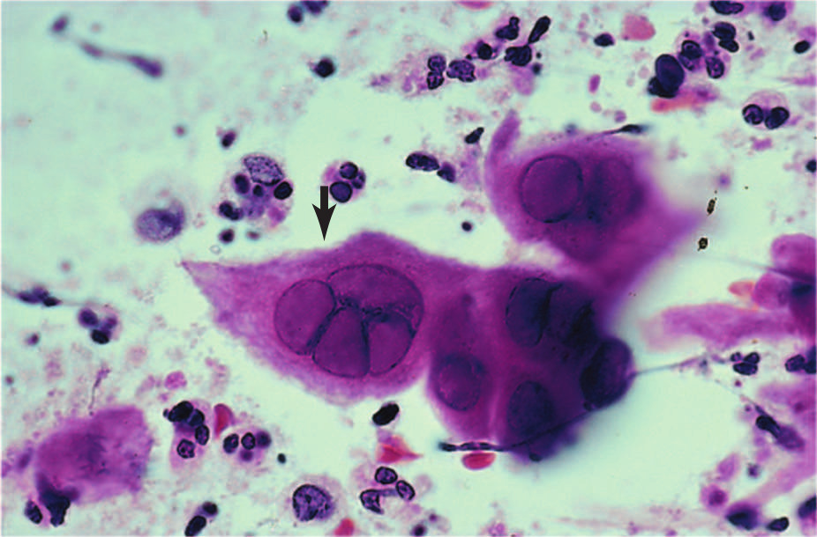
Skin Vesicle Fluid, Tzanck Prep, Hematoxylin and Eosin Stain
Intranuclear inclusions present, morphology consistent with HSV inclusions

Slide 85
Skin Vesicle Fluid, Tzanck Prep, Fluorescent Antibody Stain for HSV

Slide 86
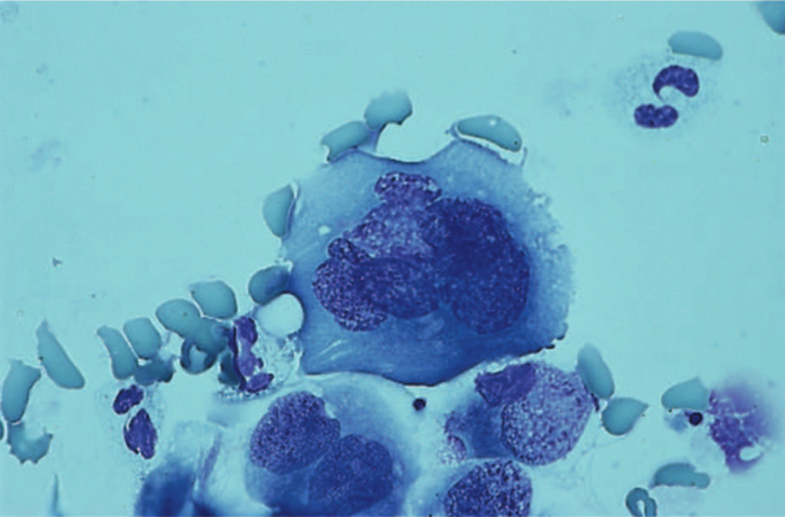
Bronchoalveolar Lavage, Centrifuge Prep, Rapid Wright-Giemsa Stain
Multinucleated epithelial cells and intranuclear inclusions present. Morphology consistent with herpes simplex virus infection.

Slide 87
Herpes Simplex Virus
HSV Diagnosis
Culture is still considered the gold standard.
The best specimens for culture are
Aspirates from vesicles, open lesions, or host cells collected from infected sites.
Culture of CSF is usually not productive.
To make a culture-confirmed diagnosis of encephalitis, brain biopsy material is required.

Slide 88
Herpes Simplex Virus
HSV Diagnosis
Preferred diagnostic method in CSF is PCR
In many studies, gene amplification for HSV in CSF approaches 100% sensitivity with almost the same specificity.
There are other newer nucleic acid assays
A diagnostic panel is available for the detection of HSV-1, HSV-2, and several other viruses and bacteria that cause meningitis
Frequently performed to reduce the need for antiviral therapy
Especially in infants

Slide 89
Herpes Simplex Virus
HSV Diagnosis
Culture
HSV replicates rapidly
CPE can be seen within 24 hours
Diagnosis in cell cultures is quicker than for many other viruses, but it is not as rapid as molecular assays.
HSV can be isolated in numerous cell lines, including human embryonic lung, rabbit kidney, MRC-5, HEp2, and A549 cells.
Commercially available engineered cell lines

Slide 90
Herpes Simplex Virus
HSV Diagnosis
Tests that differentiate antibody response to HSV
EIA
Strip immunoblot
“Simple” membrane-based, point-of-care assays
Serologic assays can be of value in diagnosing new infections in patients without a history of infection, particularly women who are pregnant.

Slide 91
Overview of the Remaining Members of the Herpesviridae
The discussion of each of the remaining members of the family Herpesviridae highlights
Epidemiology
Modes of virus transmission
Diseases and symptoms-note, latent infections can occur with these viruses
Complications
The focus, however, is on the diagnosis of each virus.

Slide 92
Cytomegalovirus (CMV)
CMV also known as HHV-5
The name originates from the enlargement of infected cells
Cyto is Latin for cell and mega means large
Spread by close contact with an infected person via
Tears, saliva, urine, stool, breast mix, semen, vaginal and cervical secretions, blood and blood products

Slide 93
Cytomegalovirus
CMV infection is the most common congenital infection in the United States.
Most infections are asymptomatic in the immunocompetent host.
Can be a self-limiting, mononucleosis-like illness with fever and hepatitis
In immunocompromised host, such as transplant recipients and patients with HIV
Can become a significant, life-threatening, systematic disease involving almost any organ

Slide 94
Cytomegalovirus
Congenital infections
Often asymptomatic
Can present with serious manifestations If mom acquires the primary infection during pregnancy
Unlikely to occur if mom was seropositive at the time of conception
Symptoms
Petechiae, hepatosplenomegaly, microecephaly, chorioretinitis, reduced birth weight, CNS involvement, mental impairment, deafness and death
One of the leading causes of deafness and intellectual impairment

Slide 95
Cytomegalovirus
Detection
CMV is best confirmed by isolation of the virus from normally sterile body fluids, such as
The buffy coat of blood or other internal fluids or tissues.
Can be cultured from urine or respiratory sections
Must be interpreted with care since shedding of CMV from these sites is common in normal hosts
Typically, this is done using standard stains on respiratory specimens looking for inclusions typical of CMV infection

Slide 96
Cytomegalovirus
Detection
CMV is a typical herpesvirus, but it replicates only in human cells and more slowly compared with HSV or VZV.
CMV can be isolated in cell culture only by using human diploid fibroblast cell
E.g., human embryonic lung or human foreskin fibroblasts.
May take up to 3 weeks for CPE to appear
Shell vials can reduce the time to as little as 1 day
Serology is not helpful.

Slide 97
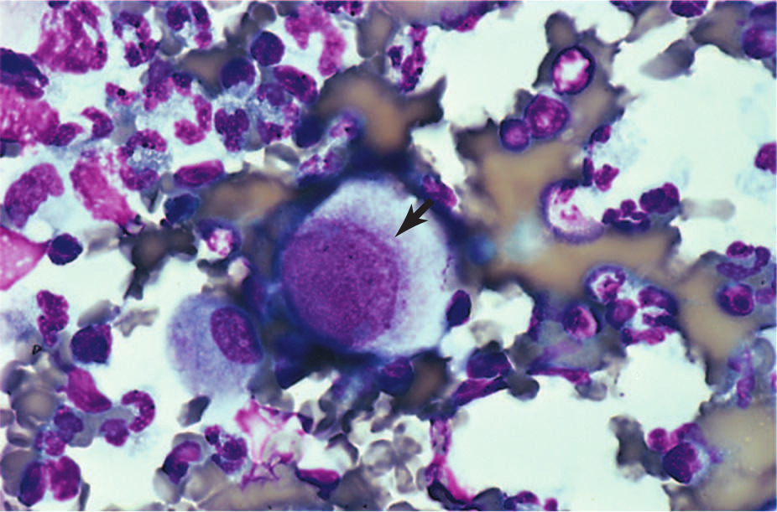
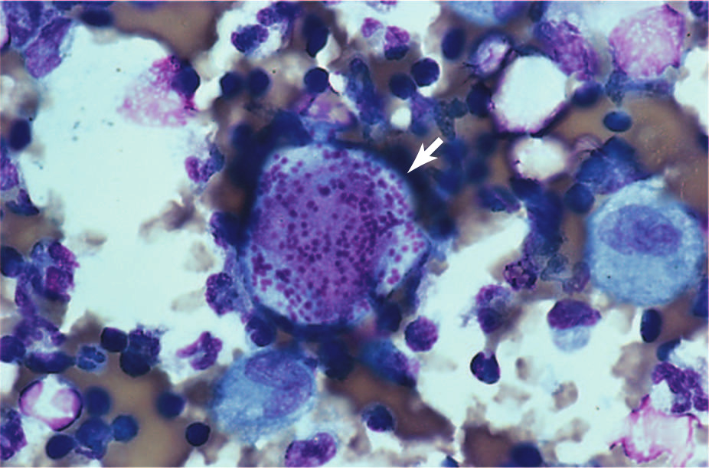
Cytomegalovirus
Detection
Direct light microscopy can provide an indication of CMV infection if typical CPE is noted.
Bronchoalveolar Lavage, Centrifuge Preparation, Rapid Wright-Giemsa Stain Enlarged Pneumocyte Consistent with CMV
Bronchoalveolar Lavage, Centrifuge Preparation, Rapid Wright-Giemsa Stain

Slide 98
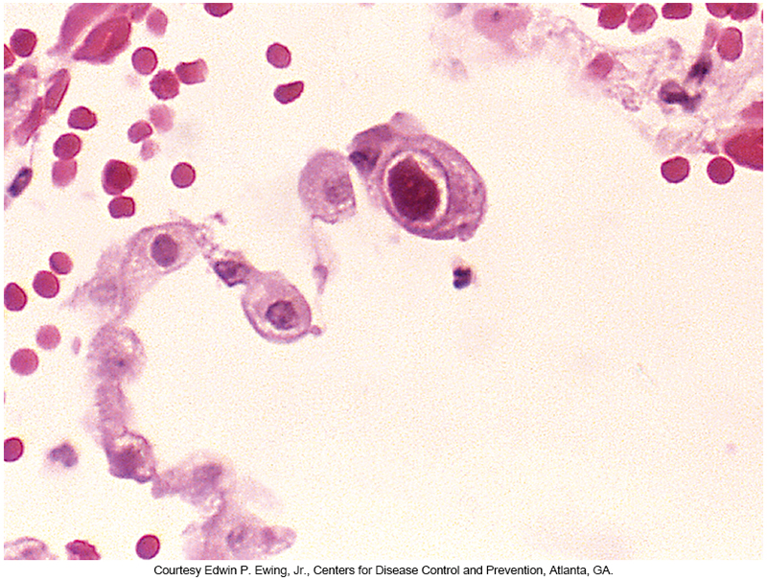
Cytomegalovirus
Active CMV Lung Infection in AIDS Patient

Slide 99
Cytomegalovirus
Detection
Viral antigenemia test
Specific, sensitive, rapid, and relatively easy to perform
Based on the immunocytochemical detection of the 65-kilodalton (kDa), lower-matrix phosphoprotein (pp65) in the nuclei of infected peripheral WBCs
The antigenemia test is more sensitive and rapid than cell culture, and it can prove helpful in assessing the efficacy of antiviral therapy.
However, several newer NAATs may replace this test.

Slide 100
Cytomegalovirus
Detection
Molecular-based testing is widely used to detect virus particles in clinical samples.
PCR, branched DNA, and hybridization assays are all used for diagnostic applications and blood donor screening.
Meningitis panels that include CMV are available and are suitable for use in pediatric populations.
NAATs are the preferred method for determining viral load.

Slide 101
Epstein-Barr Virus (EBV)
Also known as HHV-4
Causes infectious mononucleosis
Up to 95% of adults between the ages 35 and 40 have been infected.
Children can become infected with few signs of infection.

Slide 102
Epstein-Barr Virus
Signs and symptoms of infection
Sore throat
Fever
Lymphadenopathy
Hepatomegaly
Splenomegaly
General malaise
Symptoms usually resolve within a few weeks
Malaise can last longer

Slide 103
Epstein-Barr Virus
Complications of EBV infection
Splenic hemorrhage and rupture
Hepatitis
Thrombocytopenia purpura with hemolytic anemia
Reye syndrome
Encephalitis
Other neurologic syndromes

Slide 104
Epstein-Barr Virus
Some cancers have been associated with EBV
Burkitt lymphoma
Hodgkin disease
Nasopharyngeal carcinoma (NPC)
EBV has been increasing recognized as an important infectious agent in transplant patients
Most significant clinical effect of EBV in these patients is the development of B-cell lymphoproliferative disorder or lymphoma

Slide 105
Epstein-Barr Virus
EBV infection incubation period
Ranges from 2 days to 2 weeks
Most adults demonstrate EBV antibodies
Children almost always asymptomatic
As the age at the time of infection increases to young adulthood, a corresponding increase occurs in the ratio of symptomatic to asymptomatic infections.

Slide 106
Epstein-Barr Virus
Diagnosis
Viral culture for EBV requires human B lymphocytes and is beyond the capabilities of most clinical virology laboratories.
Laboratory diagnosis of EBV infection is often accomplished with serologic tests.

Slide 107
Epstein-Barr Virus
Diagnosis
EBV infects circulating B lymphocytes and stimulates them to produce multiple heterophile antibodies, including antibodies to sheep and horse RBCs.
The Paul-Bunnell heterophile antibody test is a rapid screening test for these antibodies, although some false-positive reactions do occur.

Slide 108
Epstein-Barr Virus
Diagnosis
Rapid test kits for detecting heterophile antibodies
Generally based on EIA or latex agglutination
These tests are 80% to 85% effective. Some false-positive test results represent patients who have had an EBV infection and still have low antibody levels.
Young children can have false-negative results with the heterophile test
Performing EBV-specific antibody test is appropriate

Slide 109
Epstein-Barr Virus
Diagnosis
EBV-specific serologic tests
Anti-VCA: antibodies to the viral capsid antigen
Anti-EA IgG: IgG antibody to early antigen
Anti-EA/D: antibody to early antigen, diffuse
Anti-EA/R: antibody to early antigen, restricted
Anti-EBNA: antibody to the EBV nuclear antigen

Slide 110
Interpretation of EBV Serologic Markers

Slide 111
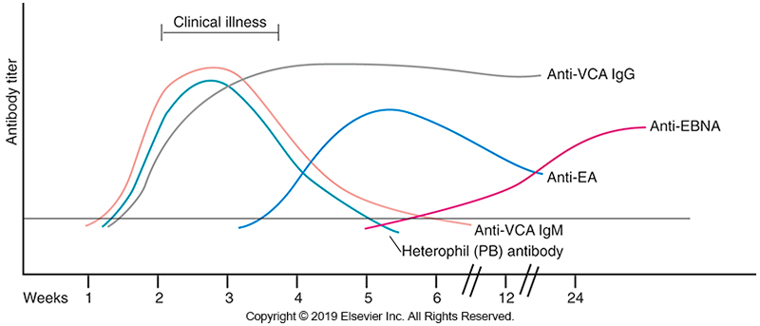
Serologic Evaluation of EBV Infection

Slide 112
Varicella-Zoster virus (VZV)
VZV also known as HHV-3
Spreads by droplet inhalation or direct contact with infectious lesions
Cell-free virus is produced at very high levels in skin vesicles
Vesicle fluid is highly infectious.
Two clinical manifestations
Varicella (chickenpox)
Zoster (shingles)

Slide 113
Varicella-Zoster virus
In the United States, more than 90% of adults have antibodies to VZV.
Varicella is the primary infection and is highly contagious.
Infections are generally clinically apparent.
Varicella symptoms
Mild febrile illness
Rash
Vesicular lesions
First on head and trunk, then spreads to limbs

Slide 114
Varicella-Zoster virus
Varicella symptoms
Vesicular lesion progression
Fluid in lesions dries
Lesions crust over
Heal in 1 to 2 weeks
Painful oral mucosal lesions may develop, particularly in adults

Slide 115
Varicella-Zoster virus
Diagnosis
Based on characteristic clinical findings
Some smaller labs use smears made with standard stains from lesion specimens to detect cellular inclusions (CPE) typical of VSV.
In atypical cases such as immunosuppressed patients, the diagnosis may be difficult or questionable.
Confirmation of diagnosis–DFA (fluorescent-labeled monoclonal antibodies against VZV) or culture of fresh lesions

Slide 116
Varicella-Zoster virus
Diagnosis
VZV can be cultured on human embryonic lung or Vero cells.
Cytopathic changes may not be evident for 3 to 7 days.
NAATs, such as PCR assays, have become the standard for the diagnosis of VZV disease of the CNS and disseminated infection.
Especially in immunocompromised patients and in patients who do not develop the typical VZV rash

Slide 117
Varicella-Zoster virus
Vaccines available for chickenpox and zoster
First vaccine for chickenpox approved in 1995
Expected to give life-long immunity
Shingrix (GlaxoSmithKline, Philadelphia, PA), a recombinant subunit adjuvanted vaccine approved 2017, is the only vaccine available in the U.S. for shingles
Recommended for adults 50 years old and older

Slide 118
Varicella-Zoster virus
Treatment
Antiviral treatment of VZV infection and reactivation is available and is quite effective in reducing the infection time for patients, especially if coupled with more rapid molecular diagnostics.

Slide 119
HHV-6
In the genus Roseolvirus
Two variants: A and B
Indistinguishable serologically
Variant B seems to be the cause of disease
Common pathogen
About 95% of young adults are seropositive

Slide 120
HHV-6 (Cont.)
Virus persists in the salivary glands and has been isolated from stool specimens, but most evidence indicates that saliva is the most likely route of transmission.
Inhalation of respiratory droplets and close contact with infected individuals is the primary portal of entry.

Slide 121
HHV-6 (Cont.)
Associated with the childhood disease
Roseola, also known as roseola infantum, exanthem subitem, sixth disease
Children are protected by maternal antibodies until approximately 6 months of age. Seroconversion occurs in 90% of children between 6 months and 2 years o age.

Slide 122
HHV-6 (Cont.)
In immunocompetent individuals, most infections are mild or asymptomatic.
When symptoms occur, the disease is acute and febrile; a maculopapular rash appears as the fever resolves.
30% to 40% of infected children with symptoms experience seizures.
There may be a connection to the development of progressive multifocal leukoencephalopathy and multiple sclerosis

Slide 123
HHV-6
Diagnosis
Usually made clinically
Isolation of the virus
Most sensitive with lymphocyte cell culture, but not practical for routine diagnosis
Serology if paired sera are available.
Patients do not usually have a positive IgM result until about 5 days after infection; IgG appears several days later.
PCR and viral load testing offer the most sensitive and specific means of diagnosing primary HHV-6 infection.

Slide 124
HHV-7
HHV-7 is in the genus Roseolovirus with HHV-6.
The CD4 molecule serves as a receptor for HHV-7 to infect T lymphocytes.
It also uses other receptors and has a broad range of host cells.
Extremely common
Shed in the saliva of 75% of adults
Causes roseola
Clinically identical to that caused by HHV-6

Slide 125
HHV-7 (Cont.)
Causes latent infections in T lymphocytes
The antigen diversity of HHV-6 and HHV-7 is such that antibodies to one virus do not protect against infection from the other.
Exposure to HHV-7 seems to occur later in life than exposure to HHV-6.
Most 2-year-olds are seronegative for HHV-7.
Most children are seropositive by age 6.

Slide 126
HHV-7
Diagnosis
Specimens for isolation in culture
Peripheral blood lymphocytes
Cord blood lymphocytes
Can be isolated from saliva of healthy individuals
Rarely isolated from peripheral blood mononuclear cells
PCR assays can detect the virus but interpreting the results can be problematic.
Serologic tests susceptible to cross-reactions.

Slide 127
HHV-8
In the genus Rhadinovirus
Can be detected in all forms of Kaposi sarcoma (KS)
Common name for virus, Kaposi sarcoma-associated herpesvirus
Has been shown to play a role in the development of primary effusion lymphomas and multicentric Castleman disease.

Slide 128
HHV-8 (Cont.)
In North America and much of Europe
Appears to be transmitted primarily through sexual contact
In Africa and some Mediterranean populations
Transmission by more casual means likely
Pattern of infection is like that of HSV-2.
Although, men who have sex with men (MSM) seem to be more susceptible than heterosexuals.

Slide 129
HHV-8
Diagnosis
Cannot be recovered in cell culture
PCR
Shown to be less sensitive than some immunoassays
PCR assay has been used to detect the virus in various specimens, including tissue, blood, bone marrow, saliva, and semen.
In situ hybridization can detect HHV-8–affected tissue.

Slide 130
HHV-8 (Cont.)
Diagnosis
Commercial monoclonal antibodies
Identification of HHV-8-infected cells in various types of lesions by immunohistochemistry more common
Serologic tests being evaluated and may soon be available

