Slide 1
Chapter 29
Clinical Virology
Part Two

Slide 2
Papillomaviridae
Human papillomaviruses (HPVs)
Cause of warts
Clustered into five genera
Alphapapillomavirus, Betapapillomavirus, Gammapapillomavirus, Mupapillomavirus, and Nupapillomavirus.
Most clinically significant HPVs are in this genera

Slide 3
Papillomaviridae
Alphapapillomavirus includes types infecting the
Genital and nongenital mucosa
Genital cutaneous surfaces
Types most often seen in human cancers
Cervical cancer
More than 100 types of these small dsDNA viruses
More than 40 types are sexually transmitted, known as the genital types.

Slide 4
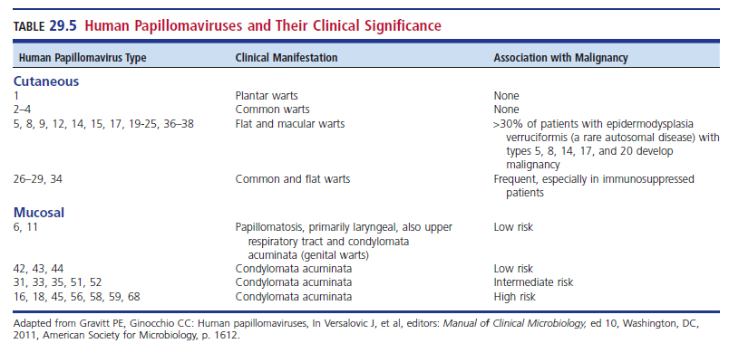
HPVs and Their Clinical Significance

Slide 5
Papillomaviridae
Cervical HPV lesions
Flat areas of dysplasia
Often difficult to see
Wart formations (condylomata acuminata)
Easily identified
Removal of lesions–surgery, cryotherapy, laser

Slide 6
Papillomaviridae
Diagnosis
HPVs cannot be grown in cell cultures.
Laboratory diagnosis often involves cytology sections.
Smears are examined by cytotechnologists and cytopathologists.
Other testing
Nucleic acid probe tests
PCR

Slide 7
Papillomaviridae
Diagnosis
As many as one third of all college-age women are infected with HPV, and most develop only subclinical infections.
Because finding HPV in cervical tissue is not the sole predictor of invasive disease, there is some debate about whether it is useful to look routinely for the virus in cervical specimens.

Slide 8
Papillomaviridae
Vaccines
Quadrivalent (Gardisil)–HPV types 6, 11, 16, and 18 to prevent cervical cancer, approved by the U.S. Food and Drug Administration (FDA)
For females ages 9 to 26 in 2006
For males in 2009
Second vaccine against HPV types 16 and 18 (Ceravix)
Approved for use in women in 2009

Slide 9
Papillomaviridae
Vaccines
HPV types 16 and 18 are linked to most cervical cancers and other HPV-associated cancers.
Controversy exists about the use of these vaccines because it is recommended that they be administered at a young age, preferably before sexual activity.

Slide 10
Poxviridae
Poxviruses are among the largest of all viruses.
Possess characteristics brick shape and contain a dsDNA genome

Slide 11
Variola Virus
Causative agent of smallpox
Infects humans only
Bioterrorism agent
Eradicated
Extinct in nature
After decades of aggressive efforts toward vaccination, education, and eradication, the WHO officially declared the world smallpox free in May 1980.
One culture is kept at the U.S. CDC, and one remains in Russia.

Slide 12
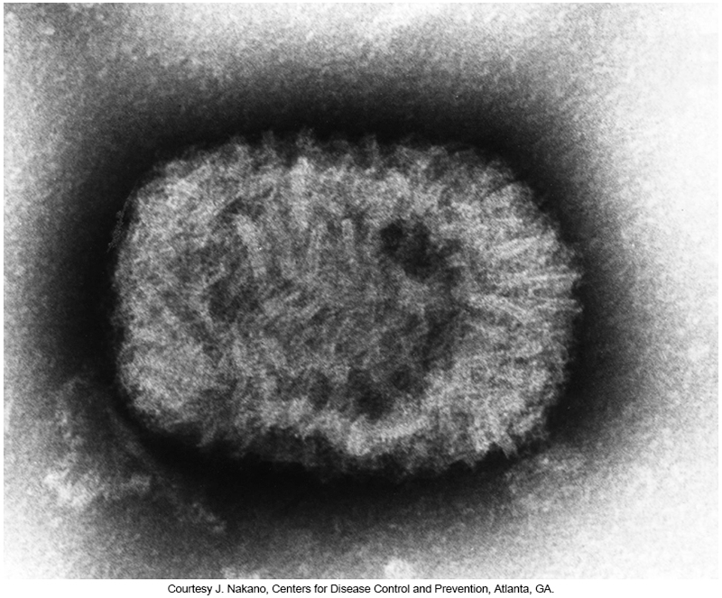
Negatively Stained Transmission Electron Micrograph of Smallpox

Slide 13
Variola Virus
Smallpox
Characterized as a synchronous progressive rash accompanied by fever
10-to-17-day incubation period
Disease progression
Fever and oral lesions can appear
Patient is infectious
Faint macular rash develops on all parts of the body.
Within 24 to 48 hours
Centrifugal distribution–lesions are in greater concentration on the head and limbs.
Include palms and soles

Slide 14
Variola Virus
Disease progression
Macular rash progresses into papules, then vesicles, and finally to pustules.
Pustules are deeply embedded into tissues.
All lesion changes occur at the same time–hence the term synchronous.
Mortality rate was on average 30%.
Other forms of smallpox
Flat and hemorrhagic occurred rarely and were almost always fatal

Slide 15
Variola Virus
Vaccinations
Routine vaccination ended in the U.S. in 1972.
Two vaccines are approved for use in the U.S.
Although smallpox was eradicated with the use of a relatively safe vaccine, most of today’s population is now susceptible to infection because vaccination is thought to offer protection for only up to 10 years.

Slide 16
Variola Virus
Vaccinations
Because most humans are now susceptible to variola virus, it remains a threat as a bioterrorism weapon.
Most military personnel moving into areas of conflict receive the vaccine.
If an outbreak of smallpox were to occur, there is sufficient stock of smallpox vaccine to mount an effective vaccination program in the United States.
The antiviral compounds cidofovir and brincidofovir have been shown to be effective in combating disease in humans.

Slide 17
Monkeypox (Mpox)
First described in primates in 1958
1970–first case of human monkeypox
2003–multistate outbreak occurred in the U.S.
It is thought that monkeypox traveled from Africa to the U.S. by imported rodents.
Human infections are rare.
Vesicular, pustular febrile illness like that of smallpox
Less severe, significantly lower mortality rates

Slide 18
Monkeypox (Mpox)
In 2022, an outbreak of monkeypox occurred in 50 countries.
The WHO reported 3413 laboratory confirmed cases and one death between January 1 and June 22, 2022.
86% of cases were reported in the European region.
460 cases were reported in the U.S.
One theory–The virus might have been circulating below detectable levels and maintained human-to-human transmission for a period of time.

Slide 19
Monkeypox (Mpox)
It is unknown how people in this outbreak were exposed.
Data suggest it is transmitted by close personal contact, and several cases have been found in gay, bisexual, and other men who have sex with men.

Slide 20
Monkeypox (Mpox)
Vaccination
Provides some degree of protection
There has been a concerning rise in the number of cases of monkeypox infection in nonendemic countries in recent years.
indicates a weakening of protective immunity or emergence of mutant strains that are not protected by the smallpox vaccination.

Slide 21
SINGLE-STRANDED DNA (ssDNA) VIRUSES
CHAPTER TWENTY-NINE

Slide 22
Parvoviridae
Smallest of the DNA viruses
Principle human pathogen–parvovirus B19
Classified in the genus Erythovirus
Virus named after the serum sample (number 19 of panel B) in which the initial viral isolate was observed

Slide 23
Parvovirus B19 (Cont.)
Infections range from asymptomatic to potentially fatal.
The most recognized syndrome is erythema infectiosum, more commonly referred to as fifth disease.
Symptoms of fifth disease
Prodrome of fever, headache, malaise, myalgia followed by
Respiratory and GI symptoms (nausea and vomiting)

Slide 24
Parvovirus B19
The prodromal phase lasts a few days, after which a rash often appears.
The rash gives a “slapped cheek” appearance and then spreads to the trunk and limbs.
The rash occurs more commonly in children than in adults, lasts up to 2 weeks, and can recur after exposure to heat and sunlight.
Other symptoms
Arthralgia, arthritis or both

Slide 25
Parvovirus B19
Most infections occur in children and adolescents.
80% of adults are seropositive by age 65.
Virus can cause transient aplastic crisis.
Self-limiting erythropoietic arrest
Decrease in RBC production in the bone marrow
Complications
Viremia, thrombocytopenia, granulocytopenia, pancytopenia, flulike symptoms, and congestive heart failure

Slide 26
Parvovirus B19
Within about 1 week, reticulocytosis occurs, and the patient recovers.
Persons with weakened immune systems caused by HIV infection, organ transplantation, cancer, or leukemia are at risk for serious complications from fifth disease.
Creates risk for fetuses and blood transmission in blood products

Slide 27
Human bocavirus (HBoV)
A novel parvovirus described in 2005
Clinical Symptoms
Cough, rhinorrhea, fever, difficulty breathing, diarrhea, conjunctivitis, and rash
Primarily in winter months
Detection of HBoV has improved with the development of sensitive and specific RT-PCR assays.

Slide 28
double-STRANDED rNA (dsRNA) VIRUSES
CHAPTER TWENTY-NINE

Slide 29
Reoviridae

Slide 30
Rotaviruses
Naked dsRNA virus
Two protein layers surrounding the capsid.
Most common cause of gastroenteritis in infants and children.
Gastroenteritis
Major cause of infant death and failure to thrive
Most outbreaks occur in
Winter months in temperate zones and
Year-round in subtropical and tropical regions.

Slide 31
Rotaviruses
Route of transmission
Fecal-oral route with 1 to 4 days incubation period
Symptoms typically occur suddenly.
Vomiting, diarrhea, fever, and often abdominal pain and respiratory symptoms
Can lead to fatal dehydration

Slide 32
Rotaviruses
Virus multiplies in the epithelial cells in the tips of the small intestine microvilli.
Microvilli are stunted and adsorption is reduced.
The virus is shed in large quantities in the stool and can cause healthcare-associated outbreaks in the absence of good hygiene.

Slide 33
Rotaviruses
Diagnosis
Although the rotavirus is present in large numbers in feces, it can be isolated only with special procedures.
Enzyme-linked immunosorbent assay (ELISA) and latex agglutination tests detect the viral antigens in fecal material.
Rapid membrane-bound colorimetric tests are also available.
Electron microscopy examination of stool samples can be used; however, this method is not very sensitive and is usually restricted to large reference or research laboratories.

Slide 34
Rotaviruses
Vaccine
Introduced in 2006–RotaTeq
Human-bovine rotavirus vaccine delayed the onset of virus season from Mid-November to late February.
Protects against five strains of RSV and is a series of three oral vaccines administered beginning at age 6 to 12 weeks
A second vaccine, Rotarix, was approved in June 2008.
Both vaccines were shown to be safe and effective.

Slide 35
Colorado Tick Fever Virus
Member of the genus Coltivirus in the family Reoviridae
Spherical particle with two outer shells containing 12 RNA segments
Causes a dengue-like infection
Western U.S. and Canada
Colorado tick fever is not reportable, actual numbers of cases are unknown.
Viruses transmitted by arthropods are referred to as arboviruses.

Slide 36
Colorado Tick Fever Virus
Transmission is by ticks (Dermacentor).
Has many hosts in nature
Hosts are rodents bitten by ticks.
Symptoms
Dengue-like infection
Fever, photophobia, myalgia, arthralgia, and chills
May have biphasic fever with a rash
Children may have hemorrhagic fever.

Slide 37
Colorado Tick Fever Virus
Diagnosis
No commercially produced tests available
Recombinant immunoassays to detect Colorado tick fever IgG have been developed.
Some nucleic acid-based assays using RT-PCR in research laboratories are becoming available and may be helpful in the future.
Many clinicians rely on ruling out other tickborne diseases to diagnose Colorado tick fever.

Slide 38
SINGLE-STRANDED RNA (ssRNA) VIRUSES
CHAPTER TWENTY-NINE

Slide 39
Arenaviridae

Slide 40
Arenaviridae
Name is from the Latin arena, meaning “sand”
Under an electron microscope, virus appears sandy and granular.
Members of the arenaviruses are commonly divided into two groups: Old World and New World complexes.
Mode of transmission
Via contact with aerosolized virus or fomite contact with infected rodents

Slide 41
Arenaviridae
Most well-known member–Lassa Virus
Associated with lymphocytic choriomeningitis (LCM)
Symptoms
Most exposed individuals develop asymptomatic infection.
Some develop fever, headache, pharyngitis, myalgia, diarrhea, and vomiting
Severe symptoms may occur.
Pleural effusions, hypotension, and hemorrhaging
CNS involvement- seizures, encephalopathy

Slide 42
Arenaviridae
Transmission
Community
Contact with excretions of rodents
Person-to-person spread—Humans inhale the aerosolized virus or contract the virus directly through breaks in skin (e.g., sexual contact)
Hospital acquired
Airline travel by people from endemic areas
A resurgence of the infection in Nigeria prompted vaccine development efforts.

Slide 43
Arenaviridae
Diagnosis
Serologic diagnosis recommended—ELISA to detect IgM and IgG antibodies
RT-PCR
Lassa virus is present in throat secretions
Treatment
If therapy begins within the first 6 days of exposure, Lassa virus infection can be effectively treated with the antiviral drug ribavirin

Slide 44
Bunyaviridae

Slide 45
Bunyaviridae
Member of the group arboviruses
Viruses replicate initially in the gut of the arthropod vector when feeding.
Mode of transmission
Arthropod transmits virus when feeding on blood of vertebrate hosts including humans

Slide 46
Bunyaviridae
Symptoms
Asymptomatic viremia develops after a few days.
While much less common, some hosts become febrile.
Most virus members can cause a febrile illness, hemorrhagic fever or encephalitis.

Slide 47
Bunyaviridae
La Crosse virus (LACV)
Reportable disease
Can present as encephalitis
Incidence is underestimated because the disease manifests itself as a
nonspecific fever, headache, nausea, vomiting, and lethargy.
Commonly occurs in children, in the summer
Called summer flu or summer cold
Diagnosis
Serologic tests are not offered + disease has very low mortality (about 1%)
Definitive diagnosis is not often made

Slide 48
Bunyaviridae
Hantaviruses
Also known as New World hantavirus
Genus Hantavirus
Hantaan virus, Seoul virus, Puumala virus, and Dobrava virus
Do not infect arthropod hosts
Rodent-borne viruses

Slide 49
Bunyaviridae
Hantaviruses
Transmission
Inhalation of contaminated aerosolized infected rodent urine, saliva, and droppings
Causative agent of hemorrhagic fever with renal syndrome (HFRS)
Distribution varies by specific virus
Disease targets the kidneys

Slide 50
Bunyaviridae
Hantaviruses
Clinical manifestations
Affect peritoneal cavity, thoracic cavity, kidneys, or lungs
3-to-5-day febrile prodrome with fever, chills, and myalgia
Patients enter a phase of fever and shock, accompanied by oliguria.
As the patient recovers, the kidneys gradually regain function.
The mortality rate for HFRS is 1% to 15%.

Slide 51
Bunyaviridae
Sin nombre virus
First described in 1993
The disease caused by this virus was named hantavirus pulmonary syndrome (HPS).
Virus is transmitted through inhalation of contaminated aerosolized mouse urine, saliva, and feces; not known to transmit via person-to-person.

Slide 52
Bunyaviridae
Sin nombre virus
Clinical manifestations Hantavirus pulmonary syndrome (HPS)
a 3- to 5-day febrile prodrome, with fever, chills, and myalgia
Patients then enter a phase of hypotensive shock and pulmonary edema.
The patient develops tachycardia, hypoxia, and hypotension.
In severe cases
DIC can develop. Mortality rate is about 50%
Treatment is primarily supportive.

Slide 53
Hantaviruses That Cause HPS

Slide 54
Bunyaviridae
Diagnosis of Hantavirus infection
No FDA-approved laboratory tests
Some European tests are being evaluated.
State health labs and the CDC
Perform EIAs to detect the anti-SNV IgM and IgG antibodies
Immunohistochemistry is a sensitive method used to detect hantavirus antigens in the capillary endothelium.
A high concentration of antigens is found in capillary tissue specimens from the lung.

Slide 55
Bunyaviridae
Crimean-Congo hemorrhagic fever (CCHF) virus
Infects the vascular endothelium and liver
Infection begins with fever, myalgia, arthralgia, and photophobia.
Patients exhibit mental status changes, ranging from confusion and agitation to depression and drowsiness.
Petechiae and ecchymoses can form on mucosal surfaces and the skin.
Bleeding can occur from the bowel, nose, and gums.

Slide 56
Bunyaviridae
Crimean-Congo hemorrhagic fever (CCHF)
About 30% of patients die.
Others begin recovering after about 10 days of illness.
Healthcare-associated transmission of CCHF virus has been reported.

Slide 57
Caliciviridae

Slide 58
Caliciviridae
Noroviruses (NoVs)
Most common cause of infectious gastroenteritis in the U.S.
Causes 19 to 21 million cases a year with 900 deaths
Most deaths are in patients aged 65 or older.
They cause outbreaks of acute gastroenteritis in
schools, colleges, nursing homes, and families as well as on cruise ships and in resort areas
Virus can be found in drinking water swimming areas, and contaminated food.

Slide 59
Caliciviridae
Transmission is most commonly foodborne, although waterborne and person-to-person transmission can be significant.
Disease progression
Incubation period—24 to 48 hours
The onset of severe nausea, vomiting, diarrhea, and low-grade fever is abrupt.
Infection rate can be as high as 50%.
Illness usually subsides within 72 hours.
Immunity likely short-lived, multiple infections possible.

Slide 60
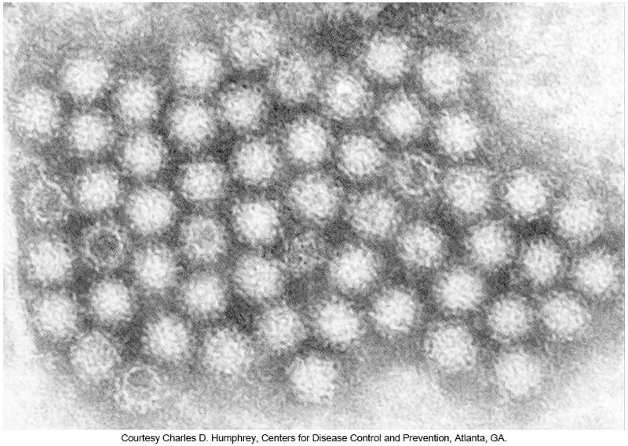
Transmission Electron Micrograph of Norovirus Virions

Slide 61
Caliciviridae
Diagnosis
Cannot be grown in culture
RT-PCR is now the most used diagnostic assay for detecting NoV (viral RNA).
Specimens—stool, vomitus, environmental samples
Several EIAs for detecting NoV in stool samples are available.
The FDA has approved an EIA for detecting NoV during outbreaks.
However, at this time, EIAs are not sensitive enough for diagnosing individuals suspected of being infect

Slide 62
Caliciviridae
Sapoviruses (SaVs)
SaVs are small (30–35 nm in diameter) diarrheagenic viruses distinguished by a cup-shaped morphology.
They usually cause diarrhea and vomiting in infants, young children, and older adults.
Originally discovered in Sapporo, Japan, in 1977, these viruses are detected by electron microscopy, molecular methods (e.g., RT-PCR), and/or immunologic methods (e.g., ELISA).

Slide 63
Caliciviridae
Sapoviruses
Causes diarrhea and vomiting in infants, young children, and older patients
Detection
Electron microscopy
Molecular methods (e.g., RT-PCR)
Immunologic methods (e.g., ELISA)

Slide 64
Cornaviridae

Slide 65
Cornaviridae
30 recognized species of Coronaviruses (CoVs)
6 found in humans
4 strains considered endemic in the U.S.
Associated with upper respiratory tract infections
Some can infect more than one related species
1 strain has been linked to croup in children
Responsible for 15% of cold-like infections seen in adults
Higher conversion rates are seen in children.
A few CoVs are responsible for a small percentage of pediatric diarrhea cases. In general, the illness lasts about 1 week, and blood may appear in the stool.

Slide 66
Cornaviridae
CoVs have large, linear, positive-stranded RNA genomes, ranging from approximately 25 to 32 kilobases (kb) in size, and they are enveloped, helical viruses.
They were first identified by electron microscopy and were named because the distinctive club-shaped projections on their surface resemble a crown.

Slide 67
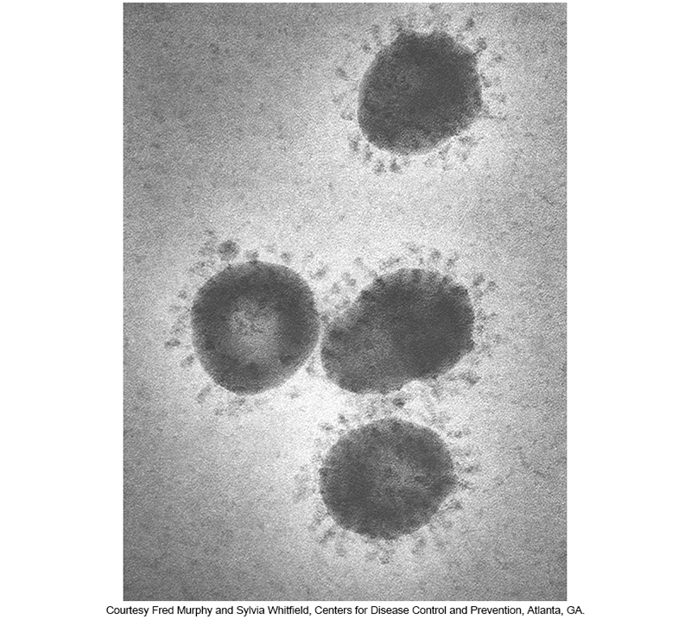
Electron Micrograph of Coronavirus

Slide 68
Cornaviridae
A novel CoV was the causative agent of a pandemic respiratory disease that emerged from Hong Kong in late 2002.
Symptoms—high-grade fever, pneumonia and in some patients, acute respiratory distress syndrome (SARS)
Causative agent—SARS-associated CoV (SARS-CoV)

Slide 69
Cornaviridae
Other outbreaks associated with CoVs
2012—Middle East respiratory syndrome (MERS-CoV)
2002—SARS outbreak
Sparked much interest in understanding the epidemiology, reservoir-host relationship, and vaccination possibilities associated with CoV
2019 (December 31) pneumonia with unknown etiology
Reported to the WHO by national authorities in China. It was first seen in Wuhan, China, and was thought to have emerged in a food market
This virus was officially identified by the coronavirus study group as SARS coronavirus 2 (SARS-CoV-2); the disease as coronavirus disease 2019 (COVID-19).

Slide 70
Cornaviridae
Clinical Manifestation of SARS-CoV-2
Highly infectious, and although most individuals are asymptomatic or have mild symptoms, those with certain medical conditions often progress to severe, life-threatening, illness.
Risk factors include diabetes, overweight or obesity, history of smoking or cancer, and heart and kidney disease.
Severe illness is linked to two primary causes: secondary pneumonia and an overexuberant proinflammatory cytokine response.

Slide 71
Cornaviridae
Clinical Manifestation of SARS-CoV-2
The cytokine response is referred to as cytokine storm or hyperinflammation.
Cytokine storm syndrome is an uncontrolled activation and amplification of the host immune response.
Results in the release of several cytokines
Appears to be related to the severity of ARDS—widespread inflammation in the lungs

Slide 72
Cornaviridae
Clinical Manifestation of SARS-CoV-2
Targets the epithelial cells of the respiratory tract
Transmitted from person-to-person via direct contact or airborne routes.
Other affected organ systems
Spleen, lymph nodes, digestive tract, urogenital tract, CNS, bone marrow, and heart
Virus can be isolated from urine and feces
Suggests other routes of transmission

Slide 73
Cornaviridae
Diagnosis
Coronaviruses are extremely fragile and difficult to culture.
Direct specimen testing by IF and EIA methods is possible to detect viral antigens.
Preferred detection method—RT-PCR
Antibodies can be detected through Western blot analysis and ELISA.
Serologic assays have a role in epidemiologic studies.

Slide 74
Cornaviridae
COVID-19 Treatment
Basic life support
Mitigating the effects on the respiratory system caused by ARDS, the leading cause of mortality
Modulating cytokine levels is key in preventing widespread organ damage, respiratory failure, and death.
Drugs with anti-inflammatory activity
Interferon, steroids, atazanavir, others

Slide 75
Cornaviridae
Vaccines
Multiple COVID-19 vaccines were developed, and two successful vaccines were approved for EUO authorization in December 2020.
These vaccines are unique in that they use messenger RNA (mRNA) coding for a viral protein.
After injection, the cells in the recipient use the mRNA to express the viral spike protein, which initiates the immune response to the virus.
Although these vaccines are new, mRNA vaccine technology began in the 1980s

Slide 76
Flioviridae

Slide 77
Flioviridae
There are several viruses in the family Filoviridae
Only two discussed here
Lake Victoria Marburg Virus (MARV)
Ebola Virus (EBOV)
These viruses share common morphology, and similar genome and structural proteins.

Slide 78
Flioviridae
These viruses have many similarities;
They rarely cause human infections,
They cause infections with high mortality rates, and
They have unknown reservoirs in nature,
Although human infection can result from contact with infected monkeys

Slide 79
Flioviridae
Clinical manifestations of MARV and EBOV
Produces hemorrhage fever
Incubation period 4 to 16 days
Sudden onset of fever, chills, myalgia, and anorexia
Symptoms
Sore throat, abdominal pain, diarrhea, vomiting, and maculopapular rash.
Bleeding from injection sites and the GI tract
Hemorrhaging in the skin and internal organs may also occur.

Slide 80
Flioviridae
Diagnosis
EBOV and MARV
Because of the risk of laboratory infection, biosafety level 3 laboratories are required.
Sometimes electron microscopy of clinical samples will yield the characteristic long, rodlike virions.
Newer molecular testing is being developed to detect EBOV in serum; this will likely obtain rapid FDA review and approval.

Slide 81
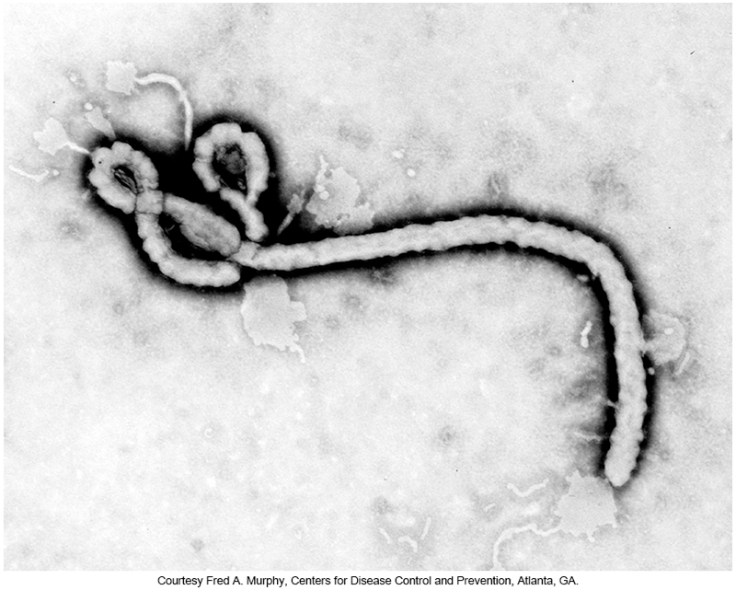
Transmission Electron Micrograph of the Ebola Virus

Slide 82
Flavivirdae

Slide 83
Flavivirdae
Japanese encephalitis (JE) virus
Major cause of encephalitis in Asia
The most common cause of arboviral encephalitis in the world
Most patients are asymptomatic, cases are likely under-reported.
Children are mostly affected by this infection, with mortality as high as 30%; mortality in adults is much lower.

Slide 84
Flavivirdae
Dengue virus
Responsible for two distinct diseases
Classic dengue fever (DF)
Dengue hemorrhagic fever (DHF)—more serious
Deaths occur in children younger than 5 years in association with DHF.
Transmitted by Aedes mosquitoes

Slide 85
Flavivirdae
Clinical Manifestations
Dengue fever (DF)
Fever, headache, myalgia, and bone pain (resulting in the nickname “breakbone fever”)
Some patients develop a rash.
Self-limiting, often resolves in 1 to 2 weeks

Slide 86
Flavivirdae
Clinical Manifestations
Dengue hemorrhagic fever (DHF)
Patients develop DHF after previous exposure to one serotype of dengue virus and are then exposed to one of the other three serotypes.
Exposure to two different serotypes of dengue virus appears to be necessary for development of DHF.
Patients with DHF develop the symptoms of classic DF, along with thrombocytopenia, hemorrhage, shock, and sometimes death.

Slide 87
Flavivirdae
Yellow fever
Caused by yellow fever virus
Considered an emerging pathogen, even though a vaccine has been available for decades.
The actual incidence may be underreported.
Still endemic in parts of Africa and South America
80% of these populations must be vaccinated to reduce the impact of disease.

Slide 88
Flavivirdae
Yellow fever
Symptoms
Asymptomatic
Acute infection
Fever, myalgia, backache, headache, anorexia, nausea, and vomiting
Self-limiting, nonfatal, most recover
Systemic toxic phase (15%)
Fever, jaundice, hemorrhaging from mouth, eyes, nose, stomach, and other areas
Kidney failure causing 50% mortality

Slide 89
Flavivirdae
Yellow fever
Three different transition cycles
Sylvatic—virus is maintained in monkey populations and transmitted by mosquitoes
Humans are not the usual hosts.
Urban—occurs in larger towns and cities
Mosquito transmits infection to humans.
Large outbreaks can occur from a single case.
Intermediate—humans and monkeys are the reservoirs; mosquitoes serve as reservoirs and vectors
High-morbidity, low-mortality outbreaks

Slide 90
Flavivirdae
St. Louis encephalitis (SLE)
Symptoms
Usually, asymptomatic
Fever only
Some patients develop meningoencephalitis
Milder in children than adults
Mortality 3% to 20% in symptomatic patients
Transmitted to humans by the bird biting Culex mosquitoes. Most infections occur in the summer months.

Slide 91
Flavivirdae
West Nile Virus (WNV)
Birds are natural hosts
Transmission
Mosquitoes
Humans are dead-end hosts.
Symptoms
Usually asymptomatic
West Nile fever if symptomatic
Fever, headache, fatigue, occasional skin rash on the trunk, swollen lymph glands, and/or eye pain
Some patients develop meningitis or encephalitis
Adults over age 50 years

Slide 92
Flavivirdae
Diagnosis West Nile virus (WNV)
Rapid WNV ELISA assay
Cross-reaction with other flaviviruses can occur.
Confirm results with antibody neutralization.
Indirect IF assay for antibodies
IgM antibody does not cross the blood-brain barrier; therefore, the presence of IgM in CSF strongly suggests CNS infection.

Slide 93
Flavivirdae
Diagnosis of West Nile Virus (WNV) infection
Several RT-PCR, TaqMan, and nucleic acid sequence–based amplification assays have been used.
No specific treatment for the infection
In severe cases requiring hospitalization, supportive care, including
IV fluids, respiratory support and prevention of secondary infection, may be warranted.

Slide 94
Flavivirdae
Zika virus
Mosquito-transmitted disease that can also be transmitted via infected blood or sexual contact
Less common—mother to child
Endemic in areas of Africa and Asia
Significant number of cases reported across South, Central, and North Americas
Symptoms
Fever, headache, fatigue,
Microcephaly in newborns during an epidemic in Brazil between 2014-2016.

Slide 95
Orthomyxoviridae

Slide 96
Orthomyxoviridae
Influenza viruses
Enveloped
Members can be distinguished using two major structural proteins.
Matrix (M) protein and nucleoprotein (NP)
Worldwide distribution
Originate as zoonotic infections
Carried by different species of birds and mammals
Influenza season
Southern hemisphere—May to October
Northern hemisphere—November to April

Slide 97
Orthomyxoviridae
Segmented genome
Types A & B have 8 segments of ssRNA
Types C & D have 7 segments of ssRNA
Influenza A virus
Remains one of the most crucial health problems worldwide
Classified into subtypes using the two major surface glycoproteins: hemagglutinin (H) and neuraminidase (N).
H antigen is used to bind host cells, and
N antigen cleaves budding viruses from infected cells

Slide 98
Orthomyxoviridae
Key to persistence of influenza virus is its antigenic variation.
Each year, antigenic drifts occur, caused by RNA replication errors of the virus.
Antigenic variation drifts occur with all four types of influenza: A, B, C, and D.
When the surface antigens change drastically, an antigenic shift occurs resulting in a new antigen (either H or N).
Antigenic shift is only associated with influenza A.

Slide 99
Orthomyxoviridae
Notable influenza A antigenic shifts
H1N1
1918-1919 Spanish flu
H2N2
1957-1958 Asian flu
H3N2
1968 Hong Kong flu
H1N1 and H3N2 since 1977

Slide 100
Orthomyxoviridae
Notable influenza A antigenic shifts
H5N1
1998 Avian flu
H3N2v
2011; mixture of avian, swine, and human viruses
H1N1 Swine flu
2009

Slide 101
Orthomyxoviridae
Clinical Manifestations
Influenza viruses are spread through aerosol inhalation.
Incubation period is 1 to 4 days
Influenza A and B
Prodrome of runny or stuffy nose, sore throat, low grade fever, and headache
Followed by cough, elevated fever, chills, muscle and & body aches, fatigue
Infected patients ill up to 7 days, and convalescence may require more than 2 weeks.
Complications: secondary bacterial pneumonia and fatal viral pneumonia
Influenza B virus infections, which also can occur seasonally, are usually less common than influenza A virus infections.

Slide 102
Orthomyxoviridae
Clinical Manifestations
Influenza C
Can cause mild upper respiratory tract illness in humans indistinguishable from the common cold.
Its genome consists of seven ssRNA segments, lacking the gene coding for neuraminidase, as in influenza A and B viruses.
Influenza C virus appears to be more stable genetically than influenza A virus.

Slide 103
Orthomyxoviridae
Clinical Manifestations
Influenza D
Isolated from a pig in Oklahoma in 2011. Subsequently, it has been isolated from other animals. Little is known about its likelihood to cause human infections.

Slide 104
Orthomyxoviridae
Diagnosis
Specimens
Nasopharyngeal swabs, washes, or aspirates collected early in infection
Flocked swabs are better at collecting epithelial cells.
Do not freeze specimens.
Rapid kits
Can detect and distinguish between influenza A and B viruses
Cannot distinguish between them or detect only influenza A virus

Slide 105
Orthomyxoviridae
Diagnosis
DFA, EIA, and immunochromatographic assays
In respiratory secretions
Nucleic acid-based assays
RT-PCR

Slide 106
Orthomyxoviridae
Vaccines
It is highly recommended that persons with reduced immune status be vaccinated annually to prevent infection, because it can be rapidly fatal in these populations.

Slide 107
Orthomyxoviridae
Treatment
The antiviral drugs amantadine and rimantadine can prevent infection or reduce the severity of symptoms if administered within 48 hours of onset of infection.
Only work against influenza A virus
A newer class of antivirals, termed neuraminidase inhibitors, is available.
These agents, such as zanamivir (Relenza) and oseltamivir (Tamiflu), are more expensive compared with amantadine but provide coverage against infections by influenza A virus and influenza B virus.

Slide 108
Orthomyxoviridae
Current CDC guidelines highly recommend both zanamivir and oseltamivir as primary treatments in confirmed cases of influenza.
There has been significant resistance to amantadine by influenza A virus (H3N2), so it is not recommended for treatment of infection by this virus.
There have been some reports of resistance to oseltamivir by influenza A virus (H1N1), but use of this agent is still recommended as a primary treatment.

Slide 109
Paramyxoviridae

Slide 110
Paramyxoviridae
Parainfluenza Viruses (PIVs)
Four types of PIVs can cause human disease, noted as PIV-1 through PIV-4.
Paramyxovirus
Parainfluenza 1 and 3
Rubulavirus
Parainfluenza 2 and 4

Slide 111
Paramyxoviridae
PIV characteristics
Enveloped helical RNA viruses
Two distinct surface receptors
HN: hemagglutinin-neuraminidase
Viral adhesion molecule
F: fusion antigen
Fusion of virus to the cells and of one infected cell to another

Slide 112
Paramyxoviridae
The viruses are spread through respiratory secretions, aerosol inhalation, and direct contact.
Clinical manifestations
Primary cause of respiratory disease in young children
Ages 2 to 4 years
Parainfluenza 1 and 2 (PIV-1 and PIV-2)
Croup—laryngotracheobronchitis

Slide 113
Paramyxoviridae
Clinical manifestations
Ages less than 2 years
Parainfluenza 3 (PIV-3)
Bronchiolitis and pneumonia
Second in importance only to RSV
Parainfluenza 4 (PIV-4)
Mild upper respiratory infections

Slide 114
Paramyxoviridae
Clinical manifestations
Infection of the cells in the respiratory tract leads to cell death and an inflammatory reaction in the upper and lower portions of the respiratory tract.
Rhinitis, pharyngitis, laryngotracheitis, tracheobronchitis, bronchiolitis, and pneumonia can result.

Slide 115
Paramyxoviridae
Diagnosis
Direct examination of nasopharyngeal secretions by IF can give rapid results.
Nucleic acid assay panels
Some with other respiratory pathogens
Serologic methods- epidemiological studies
Best specimens
Aspirated secretions
Nasopharyngeal washes

Slide 116
Paramyxoviridae
Mumps Virus
Enveloped ssRNA virus
Possesses HN and F surface antigens
Transmission
Droplets of infected saliva
Primarily infects children and adolescents’
Usually results in long-lasting immunity

Slide 117
Paramyxoviridae
Mumps Virus
Clinical Manifestation
The primary infection of the ductal epithelial cells in the glands results in cell death and inflammation.
It causes an acute illness producing unilateral or bilateral swelling of the parotid glands, although other sites, such as the testes, ovaries, and pancreas, can be infected.

Slide 118
Paramyxoviridae
Mumps Virus
Vaccine
A vaccine effective in controlling the disease is available. Two doses are recommended for better immunity—the first at 12 to 15 months and the second at 4, 6, 11, or 13 years of age.

Slide 119
Paramyxoviridae
Mumps Virus
Diagnosis
Physicians rarely have trouble recognizing mumps clinically.
Specimens
Swabs of the Stensen duct or saliva
Collected from 9 days before until 8 days after parotitis appears
Urine and CSF
Identification methods
CSF. Specimens may be examined directly by using IF and EIA methods.

Slide 120
Paramyxoviridae
Mumps Virus
Diagnosis
Paired sera can be tested for mumps antibody by EIA, IF, and hemagglutination inhibition tests.
Paired sera taken at as small an interval as 4 to 5 days can demonstrate a diagnostic or fourfold increase in titer.
Cross-reactions between soluble and viral antigens can confuse the interpretation of serologic results.

Slide 121
Paramyxoviridae
Measles Virus
Belongs to the genus Morbillivirus
Also known as rubeola
Highly contagious
Spreads by aerosol
Initial viral replication takes place in the mucosal cells of the respiratory tract.
Then replicates in the local lymph nodes and spreads systematically

Slide 122
Paramyxoviridae
Measles Virus
Clinical manifestation of measles virus
The virus circulates in T and B cells and monocytes until eventually the lungs, gut, bile duct, bladder, skin, and lymphatic organs are involved.
After an incubation period of 7 to 10 days, there is an abrupt onset, with symptoms of
sneezing, runny nose and cough, red eyes, and rapidly increasing temperature.

Slide 123
Paramyxoviridae
Measles Virus
Clinical manifestation
2 to 3 days later, maculopapular rash on head and trunk with fever
Koplik spots, lesions on the oral mucosa consisting of irregular red spots with a bluish-white speck in the center
Appear 2 to 3 days before rash and are diagnostic
Complications: otitis, pneumonia, encephalitis
Resolution of symptoms provides lifelong immunity.
An effective attenuated vaccine is available and recommended for all children.

Slide 124
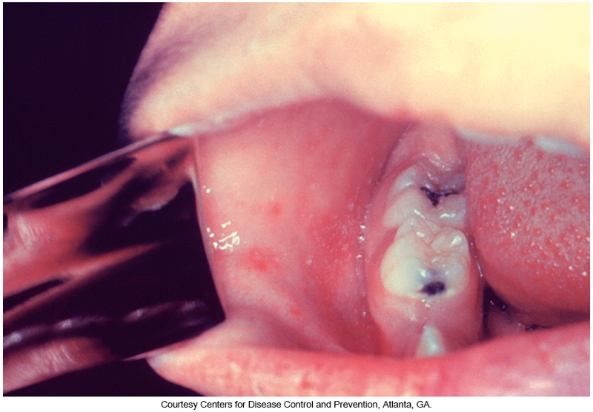
Koplik’s Spots

Slide 125
Paramyxoviridae
Measles Virus
Diagnosis
Measles is easily diagnosed clinically
Few requests for laboratory identification are made.
Virus is fragile; handle carefully
Specimens of choice
Nasopharynx and urine, collected only in early stages of infection

Slide 126
Paramyxoviridae
Diagnosis
Serologic diagnosis of measles is accomplished by demonstrating measles-specific IgM in the specimens collected during the acute phase of the disease.
Nucleic acid testing should be considered for diagnostic use if
IgM testing is compromised by the recent use of measles virus–containing vaccine as part of a routine vaccination or in response to a suspected outbreak.

Slide 127
Paramyxoviridae
Respiratory Syncytial Virus (RSV)
Member of the genus Pneumovirus
A causative agent of
Croup, bronchitis, bronchiolitis, interstitial pneumonia
Most common cause of lower respiratory tract disease among infants and young children worldwide
Nosocomial infections in hospitals and clinics
Can cause morbidity and mortality in older adult patients
Often results in pneumonia in adults

Slide 128
Paramyxoviridae
Respiratory Syncytial Virus (RSV)
Spreads mostly through large-particle droplets and contact with fomites rather than through inhalation of small aerosols
The virus may be carried in the nares of asymptomatic adults.
RSV infections occur in yearly outbreaks that last 2 to 5 months and usually appear during winter or early spring in temperate zones.

Slide 129
Paramyxoviridae
Respiratory Syncytial Virus (RSV)
Diagnosis
Specimens of choice
Nasopharyngeal swabs and washes
Direct testing from specimen
Using DFA or EIA
Rapid detection kits
Relatively low sensitivity
NAATs
Normally part of a multiplex assay for other pathogens

Slide 130
Paramyxoviridae
Diagnosis
Because the virus is extremely fragile, recovering it from cultures is difficult, but culture remains the gold standard.
Do not freeze specimens for culture
Specimens must be collected within the first few days of illness.
Once the CPE is detected, RSV can be identified by using IF, EIA, and serum neutralization tests.

Slide 131
Paramyxoviridae
Treatment
The antiviral compound ribavirin is approved for treatment of RSV infection.
However, some controversy regarding the efficacy of ribavirin therapy still exists.
A monoclonal antibody, palivizumab (PVZ), which blocks RSV entry into the host cell, is also approved for RSV treatment and prophylaxis in high-risk children.
Often, ribavirin is recommended to be used in combination with PVZ.
No vaccine for RSV infection is available

Slide 132
Paramyxoviridae
Human metapneumovirus (HMPV)
First described in children with previously virus-negative cultures in 2001
Infected children display many clinical symptoms that mimic infections with RSV, influenza virus, and PIV.
Often, these diseases are ruled out early in diagnosis, which leads to a presumptive identification of HMPV. Serologic and RNA sequence studies have shown that the virus is found worldwide in all age groups.
Most children have been exposed by age 5 years of age.

Slide 133
Paramyxoviridae
Human metapneumovirus (HMPV)
Clinical symptoms mimic those seen in cases of
RSV, influenza virus, and PIV.
Clinical disease ranges from mild upper respiratory tract infection to acute lower respiratory tract infection and includes
Fever, nonproductive cough, sore throat, wheezing, congestion, shortness of breath, and lethargy.
HMPV infections usually occur in the winter months, but outbreaks have been documented during summer.

Slide 134
Paramyxoviridae
Human metapneumovirus (HMPV)
Diagnosis
Specimen of choice—nasopharynx using flocked swabs placed in transport media and sent to the laboratory for culture or molecular analysis
Specimens should be processed immediately but can be stored at 4°C for up to 72 hours.
DFA and RT-PCR assays are used for identification, although DFA has lower sensitivity.
Respiratory viral panel assay from Luminex

