Slide 1
Chapter 29
Clinical Virology
Part Three

Slide 2
Picornaviridae
One of the largest families of viruses
  More than 280 members
Important for human clinical signifance
  Enterovirus
  Hepatovirus
    Includes HAV
  Rhinovirus
  Parechovirus

Slide 3
The Enteroviruses, Rhinoviruses, and Parechoviruses Affecting Humans

Slide 4
Enteroviruses
Enteroviruses
  Small naked viruses
Causes various conditions including
Fever of unknown origin | Mycopericarditis
Aseptic meningitis | Pleurodynia
Paralysis | Conjunctivitis
Sepsis-like illness | Exanthemas
Pharyngitis | Pneumonia

Slide 5
Enteroviruses
(Cont.)
Enteroviruses have also been implicated in
  early-onset diabetes, cardiomyopathy, and fetal malformations.
Most serotypes are distributed worldwide.
  Occur mostly in summer and early fall
Infections are more prevalent in areas with
  poverty, overcrowding, poor hygiene, and poor sanitation

Slide 6
Enteroviruses
(Cont.)
Modes of transmission
  Aerosol inhalation, fecal-oral, and fomites
    Port of entry is alimentary canal via the mouth.
Viruses replicate in lymphoid tissue of pharynx and gut.
  May result in viremia and virus spread to spinal cord, heart, or skin

Slide 7
Enteroviruses
Enteroviruses clinical manifestations
  Neurologic, respiratory, or cardiac symptoms
    Depends on viral spreading and the immune state of the patient
Enterovirus infections most often cause mild nausea and diarrhea in adults.
However, disease can be much more severe in neonates because of the immaturity of their immune system.

Slide 8
Enteroviruses
Polioviruses clinical manifestations
  Polioviruses tend to infect the CNS and cause paralysis in a small percentage of infected individuals.
  The viruses destroy their host cells. In the intestines, damage is temporary because the cells lining the gut are rapidly replaced.
  In contrast, neurons are not replaced, which results in neuron death and permanent paralysis.

Slide 9
Enteroviruses
No vaccines are available for enteroviruses other than poliovirus.
  Good personal and health care facility hygiene and proper sanitation can reduce the incidence of enterovirus infections.
  Poliovirus vaccines of attenuated or inactivated viruses are available.

Slide 10
Enteroviruses
Diagnosis
  Specimens of choice, collect early in course of infection whenever possible
    Pharyngeal (before onset of symptoms and for 1 to 2 weeks afterward)
    Throat
    Feces
    Rectum
    CSF
    Conjunctiva

Slide 11
Coxsakievirus A
Hand, foot, and mouth disease (HFMD)
Primarily types A5, A10, and A16 (occasionally type 71)
Transmission by fecal-oral route or fomites
Symptoms
  Malaise, headache, abdominal pain
  Small painful sores on tongue, buccal mucosa, and soft palate
  Maculopapular rash on hands, feet, and buttocks
  Bullae on hands and soles of feet

Slide 12
Enteroviruses
Diagnosis of polioviruses, type B coxsackieviruses, and echoviruses
  Grow readily in several cell lines
  The CPE appears quickly and is readily identifiable.
  Enteroviruses have no group antigen, so they must be identified individually by a serum neutralization test.

Slide 13
Coxsakievirus A
Diagnosis
  The virus can be isolated from specimens from swabs of the mouth and bullae.
  Coxsackievirus A16 grows in PMK and human diploid fibroblast cells and can be identified by serum neutralization tests.

Slide 14
Rhinoviruses
Infect the nasal epithelial cells and
  Activate the mediators of inflammation
Transmission mainly via aerosols
  Contact with secretions and fomites is possible
Causative agent of the common cold
  Nasal congestion, runny nose, sneezing, headache, sore throat, cough, sometimes bronchitis, rarely fever
  Severe cases- bronchitis and asthma possib;
    Generally increased incidence during winter and spring

Slide 15
Rhinoviruses
Unfortunately, no cure for the common cold is available.
Treating symptoms and reducing the spread of the virus in the household is the typical response.
Both natural and recombinant interferons have been shown to be effective in preventing infection and illness when given intranasally over short periods.
  However, prolonged administration has resulted in adverse effects, such as nasal irritation, ulceration, and bleeding.

Slide 16
Retroviridae
Members of this group, known as retroviruses, have a unique mode of replication.
  They require an RNA-dependent DNA polymerase (reverse transcriptase) to synthesize DNA from the RNA genome.
These viruses are not cytolytic but are associated with several leukemias, sarcomas, and lymphomas.

Slide 17
Retroviridae
Classification
  Oncovirinae
    Human T-lymphotropic virus 1, 2, 5 (HTLV-1, HTLV-2, HTLV-5)
      Cause leukemias, sarcomas, and lymphomas
  Lentivirinae
    Human immunodeficiency virus 1 (HIV-1)
    HIV-2

Slide 18
HIV
The virus is transmitted via blood and exchange of other body fluids.
HIV is cell associated, so fewer viruses are found in
  Cell-free plasma than in whole blood, and even fewer viruses are found in saliva, tears, urine, or breast milk.
HIV is not highly contagious, and normal, social, nonsexual contact poses no threat to individuals.

Slide 19
HIV (Cont.)
High risk for contracting the virus includes
  Unprotected sex with multiple partners
  IV drug abuse
  Infusion of blood and blood products
  Presence of the virus in pregnant women who pass it to the fetus during pregnancy
Individuals with ulcerative sexually transmitted infections (STIs),
  E.g., syphilis, genital herpes, chancroid
Donor blood and blood products are screened for HIV, which substantially reduces the risk.

Slide 20
HIV
Spherical virus with a three-layer structure
  Enveloped ssRNA
  Nucleocapsid
    Enclosed by matrix shell to which an envelope of the host cell origin is attached
    Two identical copies of ssRNA and reverse transcriptase surrounded by an icosahedral capsid
  Inserted into viral envelope
    Viral glycoprotein (gp) trimmers or spikes
    Diagnostically important structural proteins
      P24, gp41, gp120, gp160

Slide 21
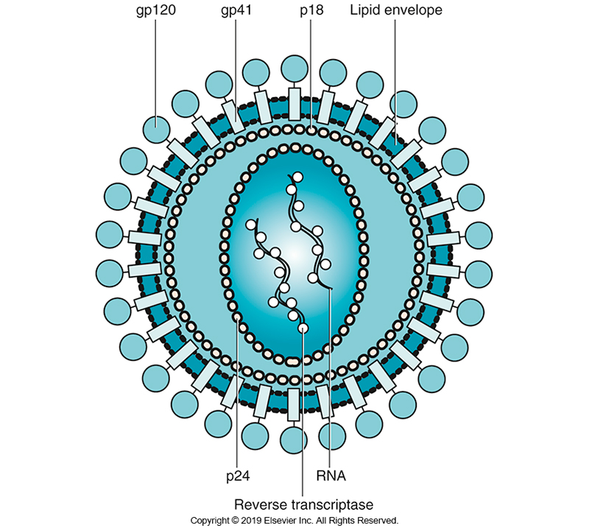
Diagram of HIV

Slide 22
HIV
Clinical Manifestations
Once HIV enters the body, primary target cells
  CD4+ T cells
  Monocytes
  Macrophages
Acute infections generally mild and can resemble infectious mononucleosis
Patient will enter clinical latency.
  Virus in the background rapidly replicating in lymphoid tissue, not detectable in bloodstream
  Patient remains asymptomatic

Slide 23
HIV
Clinical Manifestations (Cont.)
Eventually lymphopenia results, with the greatest loss in the CD4+ T-cell population.
Healthy individuals have CD4+ counts of at least 1000/mm³, whereas patients with HIV/AIDS can have counts lower than 200/mm³.
Lymph nodes become enlarged and hyperplastic.

Slide 24
HIV
Clinical Manifestations (Cont.)
Virus destroys T-helper cells that are critical in the immune response to infectious agents.
  Patient begins experiencing several chronic and recurrent infections.
  With time, the CD4+ cell count drops and opportunistic infections become more severe.
  Patient can also develop virus-induced cancers.
    Kaposi sarcoma
  Death usually occurs from the resulting opportunistic infections.
  HIV-1 can directly cause encephalitis and dementia.

Slide 25
Opportunistic Infections and Cancers Commonly Seen in Patients with AIDS

Slide 26
HIV
Clinical Manifestations (Cont.)
Clinical manifestations in adult patients living in developed countries
  The average length of time from HIV infection to development of AIDS is about 10 years.
  About 20% develop AIDS within 5 years, and fewer than 5% have an asymptomatic HIV infection for periods longer than 10 years.
  The rate at which the virus multiplies in the host is related to the onset of AIDS.

Slide 27
HIV
Diagnosis
Generally based on demonstration of anti-HIV antibodies and, in some cases, detection of viral antigens and RNA.
HIV viral load assay
  A quantitative gene amplification technique that measures the amount of HIV-1 RNA in the plasma of the patient.
Serologic tests suffer from the disadvantage of the window period, the time between infection and the ability to detect antibodies (seroconversion).
  HIV antibodies are normally produced within a few weeks after infection.

Slide 28
HIV
Diagnosis
Several assays are commercially available as screening tests using different methods, including EIA and IF.
The early diagnostic kits, referred to as first-generation screening tests, used purified viral lysate as antigens.
The second-generation tests used recombinant viral proteins, thus improving performance.
The third-generation tests relied on the double-antigen sandwich assay.
Fourth-generation kits detect antibody and HIV-1 p24 antigen.

Slide 29
HIV
Diagnosis (Cont.)
The first fifth-generation assay is a multiplexed screening test that detects and differentiates three HIV analyte markers: antiHIV-1 antibodies, anti-HIV-2 antibodies, and the p24 antigen.
The immunoassays are generally based on EIA or chemiluminescent immunoassay methods. By detecting antigen, early infections could be identified before antibody is produced.
These newest assays are considered the standard of care for diagnosis of HIV infection.

Slide 30
HIV
Diagnosis (Cont.)
Several rapid assays screen for HIV infection by using serum, plasma, and saliva.
Current CDC guidelines (published in 2014 and revised in 2018) recommend using a screening test that detects HIV-1 and HIV-2 antibodies and p24 antigen.
  No further testing is required if the test result is negative.

Slide 31
HIV
Diagnosis (Cont.)
Any reactive result on a screening test should be confirmed with a supplemental antibody immunoassay that differentiates HIV-1 antibodies from HIV-2 antibodies.
If both tests are reactive, the specimen should be interpreted as positive for HIV.
A specimen positive in the initial screening test and negative in the supplemental test should be tested with a NAAT.
  A positive NAAT indicates an acute HIV infection.

Slide 32
HIV
Diagnosis (Cont.)
A positive NAAT indicates an acute HIV infection.
A specimen with a negative NAAT should be referred for testing with a different validated supplemental HIV-2 test (antibody test or NAAT) or repeat testing in 2 to 4 weeks.

Slide 33
Important Immunologic Markers for AIDS

Slide 34
HIV
Diagnosis (Cont.)
Western blot
  Reference method for HIV diagnosis for years.
  Viruses grown in cell cultures are lysed, and the proteins are separated by electrophoresis and transferred to nitrocellulose.
  Antibodies to several HIV proteins and glycoproteins can be detected.
  For a positive result, CDC guidelines require detection of at least two antibodies to the three proteins p24, gp41, and gp120/160.
  Western blot results should also be followed by tests for anti-HIV-2 antibodies.

Slide 35
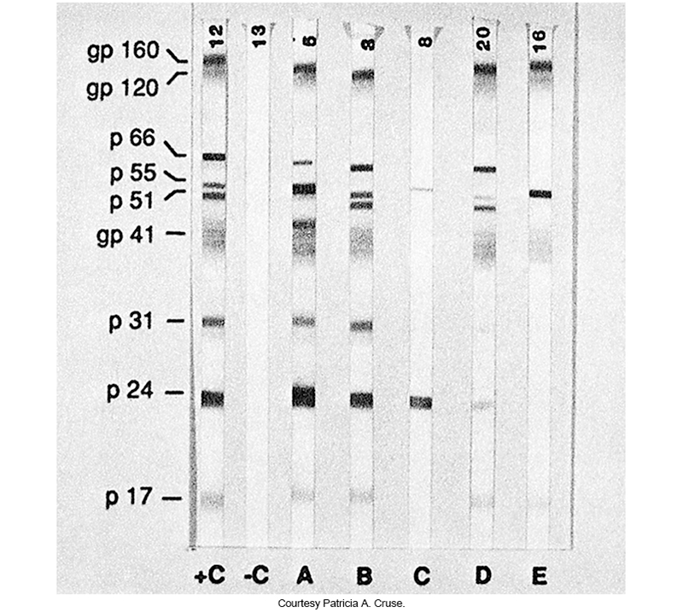
HIV Immunoblot

Slide 36
HIV
Treatment
Because these viruses readily develop resistance to drugs, HIV infection is often treated with combination therapy.
  Highly active antiretroviral therapy (HAART) involves aggressive combination therapy soon after HIV infection is diagnosed, ideally within 7 days.
Despite aggressive therapy, a cure is not achieved.
There are several classes of antiviral drugs approved for treatment.

Slide 37
HIV
Treatment (Cont.)
HIV viral load assays can predict therapeutic efficacy.
  In different studies, suppression of HIV RNA levels to less than 5000 copies of RNA/mL for up to 2 years was correlated with an increase in CD4+ cell counts, up to 90/mm³.
  In contrast, patients with HIV RNA loads of more than 5000 copies of RNA/mL generally showed a decrease in CD4+ cell counts.
  Usually, these assays are performed monthly so therapy can be adjusted on an individual basis.

Slide 38
Rhabdovirus
Belongs to the family Rhabdoviridae in the genus Lyssavirus
Causes rabies—cases of rabies are rare in the US.
  Worldwide, dogs are implicated in 99% of rabies deaths among humans.
Rabies is an emerging infection in animals.
Transmission to humans
  Bite or scratch by animals with rabies

Slide 39
Rhabdovirus
Symptoms
  Brief prodromal pain in exposure site
  Vague flulike symptoms and personality changes
  Mental status changes, such as anxiety, irritability, and depression, can also occur.
  After prodromal period
    CNS changes involving hallucinations, paralysis, excessive salivation, hydrophobia, bouts of terror, seizures, respiratory and cardiac problems; leads to coma and death
    These symptoms are followed ultimately by coma and death.

Slide 40
Rhabdovirus
Diagnosis involves determining whether an animal that has bitten a human has rabies.
  The animal is killed, and its head is removed and sent to a reference laboratory.
  The fastest and most sensitive method of identifying rabies virus in a specimen is by using a direct IF technique.
  Impression smears should be made from various areas of the brain: primarily the hippocampus, pons, cerebellum, and medulla oblongata.

Slide 41
Rhabdovirus
  In living patients suspected of having rabies, skin biopsy, especially at the hairline at the back of the neck, and an impression of the cornea may be performed.
  The presence of rabies virus in these specimens is diagnostic, but its absence merely means that no virus is present in those specific specimens, not that the patient does not have rabies.
  EIAs are currently the most sensitive assays to used for serologic tests.

Slide 42
Rhabdovirus
Treatment
  Must occur prior to symptoms, cannot be treated successfully once symptoms appear
  Postexposure prophylaxis is 100% effective.
    Vigorous cleaning of the wound
    Providing human rabies immunoglobulin
    Administering a 3-injection series of rabes vaccine
Vaccine can be given to those at risk for exposure
  E.g., veterinarians and laboratory personnel.

Slide 43
Togaviridae
Members in the family Togaviridae
  Alphavirus
    Eastern equine encephalitis (EEE) virus
    Western equine encephalitis (WEE) virus
    Venezuelan equine encephalitis (VEE) virus
  Rubivirus
    Rubella virus

Slide 44
Eastern Equine Encephalitis (EEE)
Natural reservoirs-birds
Mode of transmission
  Mosquito bite
  Occurs primarily in the eastern half of the U.S.
Causes disease in horses and humans
  Dead-end hosts
  EEE in horses can be a predictor of human EEE cases.
Range of symptoms
  Mild flulike to encephalitis

Slide 45
Western Equine Encephalitis (WEE)
Causes disease in humans and horses
Causes milder disease than EEE
  Asymptomatic or mild infection
    Fever, headache, nausea, mental status changes
Of young children and infants who survive, 5% to 30% will suffer permanent CNS damage. Mortality is about 3%.

Slide 46
Venezuelan Equine Encephalitis (VEE)
Has caused large outbreaks of human and horse encephalitis in the Americas
Death is much more common that in EEE or WEE
Between 4% and 14% of infected individuals will develop neurologic disease.
Infected adults often develop a flulike illness, whereas encephalitis is more commonly seen in children with VEE.

Slide 47
Rubella Virus
Enveloped virus belonging to the genus Rubivirus
Causative agent of rubella, or German measles
  Mild febrile illness
Transmitted by respiratory droplets
Virus is present in nasopharyngeal secretions or any secretions of infected infants.

Slide 48
Rubella Virus
Clinical Manifestations
  Rash starts on the face and spreads to the trunk and limbs.
  No rash appears on the palms and soles.
  Transient polyarthralgia and polyarthritis can occur in children and are common in adults.
  About 50% of those infected with rubella virus are asymptomatic.

Slide 49
Rubella Virus
(Cont.)
Rubella would be of little concern if it did not cross the placenta and spread to the fetus, which results in congenital rubella syndrome.
  The syndrome can cause effects ranging from birth of a normal infant to birth of a severely impaired infant, fetal death, or spontaneous abortion.
  Virus halts or slows cell growth
    Impact on the embryo is worse when infection develops in the earliest stages of pregnancy.

Slide 50
Rubella Virus
An effective attenuated vaccine is available and should be administered to all children and to young women before they become sexually active.
In 2004, the CDC declared the United States rubella free, meaning an absence of continuous disease transmission for 12 months or more.

Slide 51
Rubella Virus
Diagnosis
  Important to collect specimens (e.g., throat swabs) the day the rash appears
  To date, no protocol for detecting viral RNA has been established.
  Isolation procedures are difficult because of the lack of a cell line that exhibits cytopathic effect.

Slide 52
Rubella Virus
(Cont.)
  Serologic procedures are effective because any rubella antibody is presumed to be protective.
  The most sensitive serologic assays are the solid-phase and passive hemagglutination tests.
  Latex agglutination and antigen-coated RBC tests are useful but less sensitive.

Slide 53
Human Hepatitis Viruses
VIRUS | ABBREVIATION | TRANSMISSION ROUTE
Hepatitis A | HAV | Fecal–oral route
Hepatitis B | HBV* | Infected blood and blood products
Hepatitis C | HCV | Infected blood and blood products
Hepatitis D | HDV | Infected blood and blood products
Hepatitis E | HEV | Fecal–oral route
Hepatitis G | HGV | Infected blood and blood products
SEN virus | SEN virus* | Infected blood and blood products
Transfusion-transmitted virus | TTV* | Infected blood and blood products
*Possess DNA genomes, | the others possess RNA genome

Slide 54
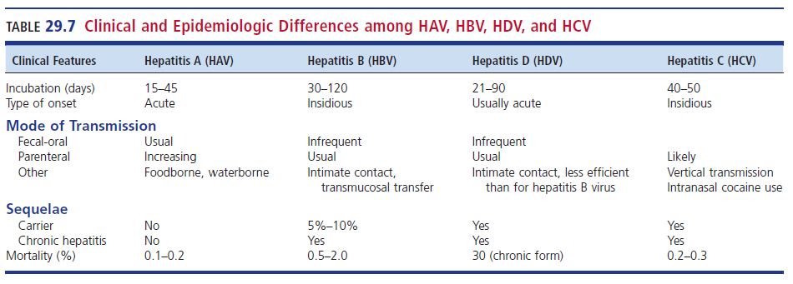
Clinical and Epidemiologic Differences Among HAV, HBV, HDV, and HCV

Slide 55
General Clinical Symptoms
Despite the biological and morphologic differences among the hepatitis viruses, many of the clinical symptoms caused by them are similar.
Therefore, differentiation based on clinical findings should not be relied on for diagnosis.
  The most common symptoms are fatigue, headache, anorexia, nausea, vomiting, abdominal pain (right upper quadrant or diffuse), jaundice, and dark-colored urine.

Slide 56
Hepatitis A Virus (HAV)
Enteric virus
  Small icosahedral, naked ssRNA virus
Transmission
  Fecal-oral route via close personal contact or contaminated food
Risk factors
  Sexual or household contact with an infected person, daycare contacts, foodborne or waterborne outbreaks, IV drug use, and international travel.
  50% of cases in the U.S have no established risk factor.

Slide 57
Hepatitis A Virus (HAV)
Symptoms
  In adults
    Mild to severe, prolonged hepatitis
      Fever, chills, fatigue, malaise, aches, pains, and sometimes jaundice
    Infection is self-limiting with convalescence possibly lasting weeks.
    Complete recovery can take months
  Low mortality rate
  No chronic liver damage

Slide 58
Hepatitis A Virus (HAV)
Diagnosis
  Demonstration of IgM to IgG most common method
Isolation of HAV is not practical
Some labs offer in-house RT-PCR
  To detect HAV before liver enzymes are elevated
Studies have shown that HAV RNA can be detected much earlier after infection.

Slide 59
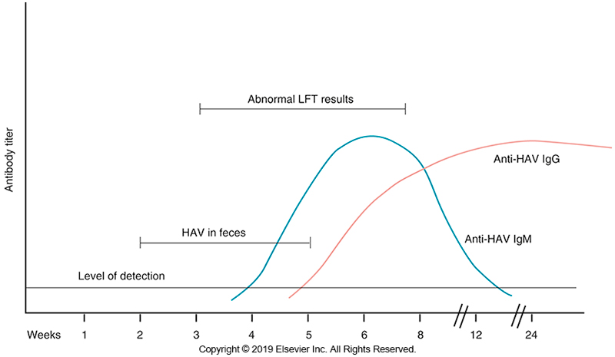
Serologic Evaluation of HAV Infection

Slide 60
Hepatitis A Virus (HAV)
Vaccination of children has the potential to reduce the incidence of HAV infection.
Other vaccination target groups include
  People who travel to countries with endemic HAV, MSM, drug abusers, and patients with chronic liver disease.
Persons who have not been vaccinated and have been exposed to HAV can receive immunoglobulin therapy,
  Which is 80% to 90% effective in preventing infection when administered soon after exposure.
Immunoglobulin therapy can also be used as preexposure prophylaxis.

Slide 61
Hepatitis B Virus (HBV)
Enveloped, partially dsDNA virus
  Contains hepatitis B surface antigen (HBsAg)
    Circulates in the bloodstream as 22-nm particles
  Virion also contains
    Hepatitis B core antigen (HBcAg)
    Hepatitis B envelope antigen (HBeAg)
  Eight genotypes of HBV have been identified (A to H), and several studies have shown a difference in clinical outcome based on the genotype.

Slide 62
Hepatitis B Virus (HBV)
Main modes of transmission
  Bloodborne pathogen
  Sexual, vaginal fluid, saliva
High risk groups
  IV-drug users
  Men who have sex with men (MSM)
  Individuals from endemic areas
  Household contacts of those with HBV
  People with tattoos and body piercings
  Health care personnel
  Infants born to HBV-positive mothers

Slide 63
Hepatitis B Virus (HBV)
Diagnosis
  Based on clinical presentation and demonstration of specific markers for HBV
  Serum aminotransferase levels also increase in infected patients.
  Presence of HBsAg in patient serum indicates patient has/is
    an active infection
    a long-term carrier
    in an incubation period

Slide 64
Serologic Markers for the Diagnosis of HBV Infection

Slide 65
Hepatitis B Virus (HBV)
Diagnosis
  IgM anti-HBc appears early in the course of the disease and indicates an acute infection.
  In patients in whom HBsAg is not detected and anti-HBs has not yet appeared,
    detection of IgM anti-HBc confirms the diagnosis of acute HBV infection.
  The period between the inability to detect HBsAg and anti-HBs antibodies is called the core window.

Slide 66
Hepatitis B Virus (HBV)
Diagnosis
  The detection of anti-HBs antibodies in serum indicates convalescence or immune status.
  When the infection resolves,
    IgG anti-HBc and anti-HBs antibodies become detectable in the patient’s serum.

Slide 67
Hepatitis B Virus (HBV)
Diagnosis
  The presence of HBsAg after 6 months of acute infection is a strong indication that
    The patient is a long-term carrier; the appearance of HBeAg in this case is indicative of a chronic infection and high infectivity

Slide 68
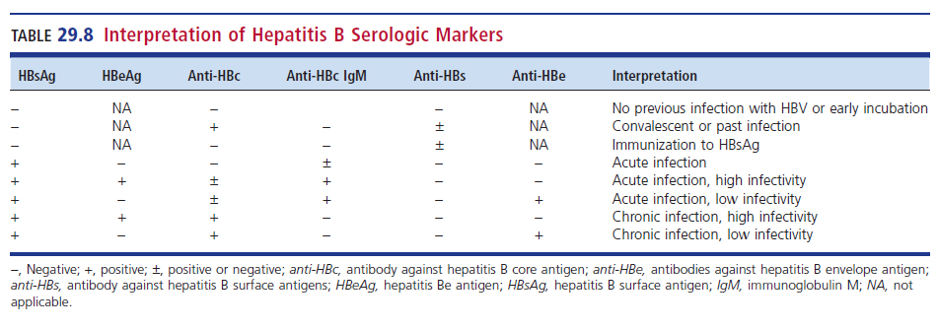
Interpretation of HBV Serologic Markers

Slide 69
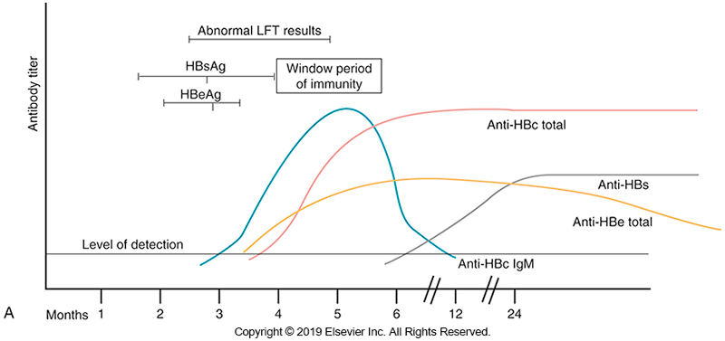
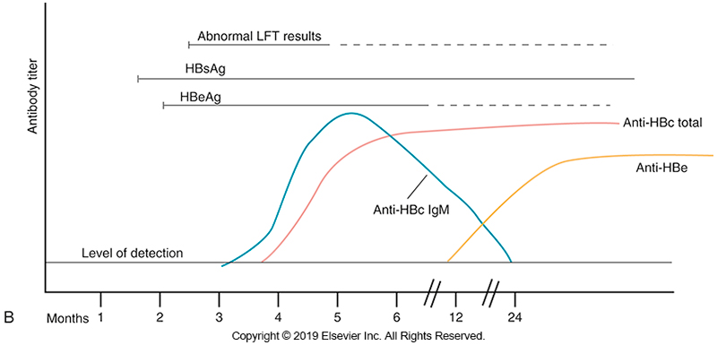
Serologic Evaluation of HBV Infection

Slide 70
Hepatitis D Virus (HDV)
A.K.A. Delta hepatitis virus
  Defective virus that requires HBV for replication
  Requires HBsAg as its envelope
Transmission
  Primarily through parenteral routes
  Mucosal contact has been implicated.
Risk factors
  IV-drug users
  Limited numbers of MSM in certain locations

Slide 71
Hepatitis D Virus (HDV)
Rare but usually severe and results in acute disease
  with a fatality rate of 5%, or chronic symptoms progressing to cirrhosis in two thirds of those infected.
Two clinical forms:
  Co-infection, simultaneous infection with HBV and HDV
  Superinfection, infection develops in a patient with chronic HBV infection.

Slide 72
Hepatitis D Virus (HDV)
Patients with superinfection
  Have a more severe acute infection and have a higher risk of fulminant hepatitis compared with patients with co-infection.
Long-term carriers of HBV who become superinfected with HDV
  Also develop chronic HDV infection, which increases their chance of developing cirrhosis.

Slide 73
Hepatitis D Virus (HDV)
Diagnosis of HDV infection requires serologic testing for specific HDV antibody.
Commercial tests are available for HDV IgG.
Reference laboratories may offer IgM anti-HDV antibody testing and PCR assay for HDV.

Slide 74
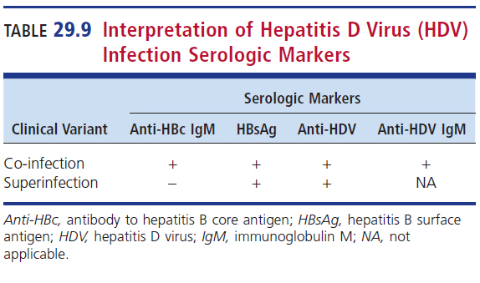
Interpretation of HDV Infection Serologic Markers

Slide 75
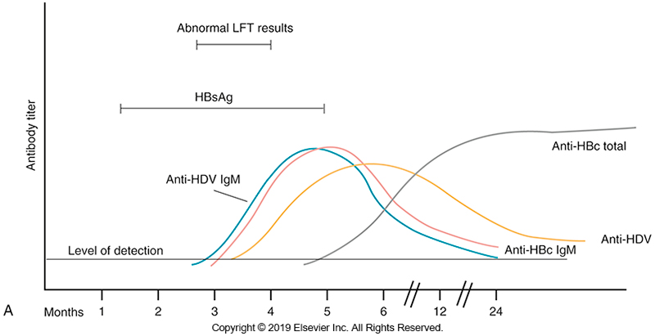
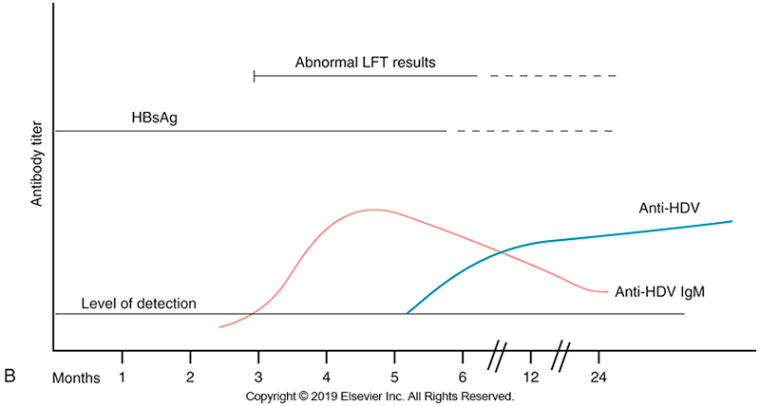
Serologic Evaluation of HDV Infection

Slide 76
Hepatitis C Virus (HCV)
ssRNA virus, accounts for about 90% of all previous cases that were not HAV or HBV (NANB)
Bloodborne pathogen
Transmission
  Perinatal
  Sexual transmission
  Parental transmission-the major route

Slide 77
Hepatitis C Virus (HCV)
Risk factors
  Blood exposure, usually transfusions before routine testing of blood units
  Sometimes sexual contact
  IV-drug use

Slide 78
Hepatitis C Virus (HCV)
Symptoms
  May be subtle and take time to become apparent
About 20% to 30% of patients with chronic infections develop cirrhosis.
Major risk factor for hepatocellular carcinoma- cirrhosis
HVC has the highest mortality rate among HAV, HBV, and HCV.

Slide 79
Hepatitis C Virus (HCV)
Diagnosis
  Gene amplification tests prove that HCV RNA appears in newly infected patients in as little as 2 weeks.
  Most detection is via serologic testing.
  Anti-HCV antibodies
    Does not produce lifelong antibodies
    Persistence indicates chronic infection

Slide 80
Hepatitis C Virus (HCV)
Diagnosis
  Screening tests
    EIAs that detect serum antibodies to HCV proteins
    Low sensitivity
  Second-generation immunoblot assays use recombinant and/or synthetic proteins to detect anti-HCV antibodies.

Slide 81
Hepatitis C Virus (HCV)
Diagnosis
  Currently, third-generation tests are more sensitive and accurate and are commonly used.
    Employ recombinant proteins
  Confirmation testing relies on nucleic acid amplification testing (NAAT).

Slide 82
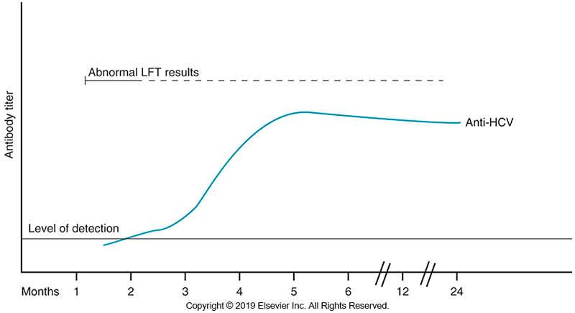
Serologic Evaluation of HCV

Slide 83
Hepatitis E Virus (HEV)
Small, naked ssRNA virus
Waterborne enteric agent, transmitted via fecal-oral route
  Fecal contamination of drinking water
Causes acute, self-limiting disease, resembling HAV
Found in developing countries
  Asia, Africa, and Central America
  No U.S. sources

Slide 84
Hepatitis E Virus (HEV)
Clinical Manifestations
  Acute, self-limiting disease
  Incubation period 2 to 9 weeks
  Signs and symptoms
    Fever, malaise, nausea, vomiting, jaundice, and dark-colored urine

Slide 85
Hepatitis E Virus (HEV)
Diagnosis
  An ELISA test has been developed to detect IgG and IgM antibodies to HEV but is not currently performed in diagnostic laboratories in the US.
Treatment
  No specific antiviral therapy is available; patients receive supportive therapy.
  Viral shedding in feces has been shown to persist for several weeks.

Slide 86
Other Hepatitis Viruses
HGV
  Not common in the US.
  Clinical significance is still under investigation.
SEN
  Bloodborne
    Circular DNA genome
    Possible link to hepatitis; not definitively linked to any human disease
    Appears to be linked to blood transfusions
TTV
  May be associated with posttransfusion hepatitis

Slide 87
Prions
Definition
  Not viruses
  Prions are proteinaceous infectious particles that cause a group of diseases in mammals called Transmissible spongiform encephalopathies (TSEs)
Clinical forms
  Kuru and Creutzfeldt-Jakob disease (CJD) in humans
  Scapie in sheep
  Bovine spongiform encephalopathy (BSE) in cattle
    Also known as mad cow disease
  Chronic wasting diseases in deer and elk

Slide 88
Prions
Increase in variant form of CJD (vCJD) was noted at about the same time as the surge in BSE
It appears that the agent of scrapie crossed species and infected cows and that it is the causative agent in BSE-infected humans, causing vCJD.
TSEs—acquired via ingestion
  Some prions may also enter the body via other routes.

Slide 89
Prions
Clinical Manifestations
  Progressive, relentless degeneration of the CNS that is ultimately fatal.
Diagnosis
  Often based on clinical findings
  Histopathology staining and PrPSc immunostaining is the most specific diagnostic method.
  Other tests
    Antigen testing, serologic testing and nucleic acid sequencing

Slide 90
Prions
Handling of suspected prion materials
  Caution should be used when handling suspected materials because prions are highly resistant to inactivation
  Exposure to household bleach with more than 20,000 parts per million available chlorine or 1 M sodium hydroxide is recommended.

Slide 91
Prions
It is not recommended to test any specimens from a suspected case of prion disease until it is ruled out since
  Instrumentation cannot be sufficiently decontaminated, and it presents a risk of infection to staff.

Slide 92
Managing Viral Infections
Viruses have evolved to replicate inside host cells.
Since viruses use host machinery to replicate, most drugs targeting viruses have the potential to affect the host cell as well.
Viruses with very high mortality rates (e.g., Ebola virus) are often eradicated equally rapidly as the survival of virus relies on effective transmission to new hosts.

Slide 93
Managing Viral Infections
Most pathogenic viruses eventually mutate to milder infections and become more contagious.
This trend is being observed in the ongoing COVID-19 pandemic.
Most mild viral illnesses are not treated
  Instead, supportive care is provided
  Quarantine of infected individuals is recommended to break the transmission cycle.

Slide 94
Managing Viral Infections
Antiviral Therapy
  Some viral infections are treatable, especially if a laboratory can rapidly identify the pathogen.
  Antiviral compounds must
    Target essential viral replicative mechanism without destroying or damaging uninfected host cells.
  Use of antiviral compounds
    increases the risk of drug resistance and thus antiviral susceptibility testing will become increasingly important.

Slide 95
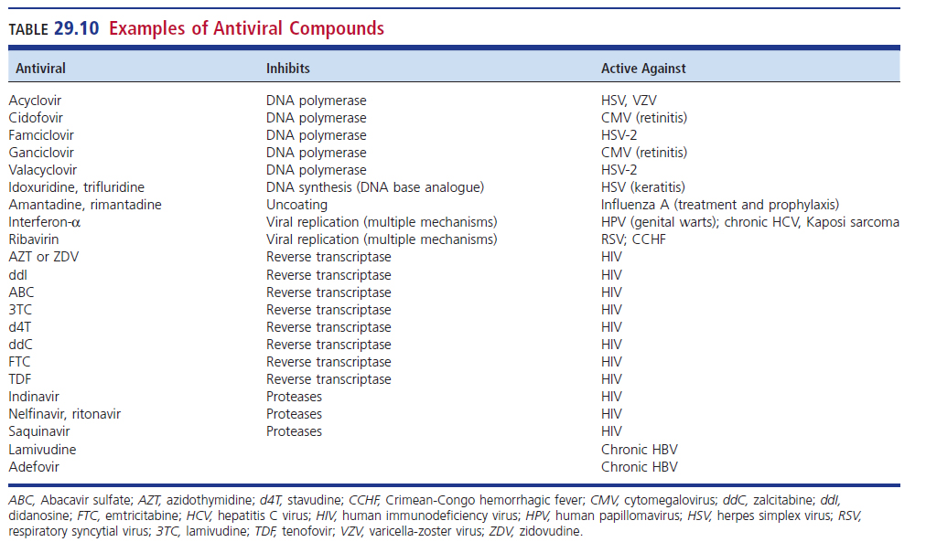
Examples of Antiviral Compounds

Slide 96
Managing Viral Infections
Vaccines
  Development of vaccines for highly contagious viruses is a top priority in the management of clinically relevant viral infection.
  Composition of a vaccine
    A highly weaken attenuated virus or viral component that can trigger an immune response
  Vaccines prevent disease, not the infection.

Slide 97
Managing Viral Infections
  Global efforts to invest in research and development of effective vaccines as well as increasing awareness to the public about the safety and efficacy of vaccinations is a key step to prevent future pandemics.

Slide 98
LET’S REVISIT THE CASE IN POINT
CHAPTER TWENTY-NINE

Slide 99
Highlights
March 02, 2020
The Patient | 65-year-old male
Medical History | 14-year history of chronic lymphocytic leukemia along with hypogammaglobulinemia, chronic leukocytosis, and severe anemia presented to the emergency department of a local community hospital with lower back, lower hip, and lower extremity pain
Symptoms When Patient was seen in the ED | Lower back, lower hip, and lower extremity pain
March 05, 2020 | Hip fracture surgery related to the patient’s cancer
Post-Surgery | Patient was transferred to a rehabilitation facility.

Slide 100
Highlights (Cont.)
Two Weeks Later | Patient was Readmitted to the Hospital
Reason for Readmission | Anemia; no other respiratory or systematic symptoms
Test Results | Chest Radiograph-normal Chest computed tomography (CT) scan negative Other tests-unremarkable
Reason Patient was Not Allowed to Return to the Rehabilitation Facility | Confirmed outbreak of severe acute respiratory syndrome coronavirus-2 (SARS-CoV-2) infection, the cause of coronavirus disease 2019 (COVID-19)
March 25, 2022 | SARS-CoV-2 test results released positive

Slide 101
Highlights (Cont.)
s
Precautions Instituted | Patient was kept in an isolation unit in a single room with negative air pressure.
Part of Treatment Regimen | Intravenous (IV) immunoglobulin every 4 weeks because of the patient’s acquired hypogammaglobulinemia caused by the patient’s cancer
Early May 2022 | Patient was transfused with 200 mL of SARS-Co-V-2 convalescent plasma.
One Week Later | Patient received another 200 mL dose of convalescent plasma from a different donor.
On Days 35 and 72 | Infectious SARS-CoV-2 was successfully cultured from nasopharyngeal swabs.

Slide 102
Highlights (Cont.)
Over the next 18 weeks | Patient was tested for SARS-CoV-2 another 20 times using real-time reverse transcription-polymerase chain reaction (RT-PCR) test, and he remained positive through July 16, 2020 (113 days after the initial positive RT-PCR test).
From July 22 to August 10, 2022 | The patient tested negative on 6 consecutive swabs, indicating that the infection had finally cleared.
On Days 25, 60, and 80 of Hospital Admission | Culturable virus was obtained on each noted day. The patient remained asymptomatic for the entire duration of his hospitalization.

Slide 103
Issues to Consider
After reading the patient’s case history, consider:
How the patient’s medical history affected his viral infection
What information is obtained from the laboratory, radiograph, and CT results
Could this patient have been returned to the rehabilitation sooner? If yes, why? If no, why not?
Other testing for SARS-CoV-2 includes antigen testing and testing for IgG and IgM antibodies. Would the patient’s diagnosis or treatment have improved with any of these assays?

Slide 104
POINTS TO REMEMBER
CHAPTER TWENTY-NINE

Slide 105
Points to Remember
Several viruses have been responsible for several pandemics including influenza viruses and coronaviruses.
Clinical virology services can consist of rapid antigen detection, NAATs, antibody detection, or cell cultures.

Slide 106
Points to Remember (Cont.)
Clinically significant viruses can be isolated from patients with signs and symptoms commonly thought to be associated with
  Bacterial infections, including pneumonia, GI disorders, cutaneous lesions, sexually transmitted infections, and sepsis.
Members of the family Herpesviridae produce life-long, latent infections.

Slide 107
Points to Remember (Cont.)
Most cases of cervical cancer are linked to HPV, the causative agent of genital warts.
Some viruses mutate rapidly, resulting in new strains, which can be challenging to contain or treat.
Retroviruses (e.g., HIV) replicate with reverse transcriptase, which uses viral RNA as a template to make a complementary DNA strand.

Slide 108
Points to Remember (Cont.)
Arboviruses are those viruses transmitted by the bite of arthropods, such as mosquitoes.
Many emerging infections are caused by viral agents that are unexpectedly transmitted into a susceptible human population.
The hepatitis viruses are a diverse collection of viruses grouped together because they all infect primarily the liver.
  Laboratory diagnosis is based on serologic markers.

Slide 109
Points to Remember (Cont.)
Antiviral compounds can treat numerous viral infections, but resistance has been seen.
Vaccines against viruses is an effective way to manage viral infections.

