Slide 1
Chapter 27
Medically Significant Fungi
PART ONE

Slide 2
Overview of Fungi
Diverse group of organisms
Classified as molds and yeasts
Categories
Classic pathogens
Environmental saprobes
Living on nonliving material
May cause a range of signs and symptoms
Mild to life-threatening
Significant in the immunocompromised patient

Slide 3
What’s Ahead?
General characteristics
Taxonomy
Mycoses
Clinically Significant Species
Laboratory Diagnosis of Fungi
Immunodiagnosis of fungal disease
Antifungal Susceptibility

Slide 4
GENERAL CHARACTERISTICS
CHAPTER TWENTY-SEVEN

Slide 5
General Characteristics
Eukaryotic
Possess a true nucleus, with a nuclear membrane and mitochondria
Lack chlorophyll
Must absorb nutrients from the environment

Slide 6
General Characteristics
Thick cell walls
Made of chitin
Prefer neutral pH
Moisture is necessary for growth but
Spores and conidia survive in dry conditions for extended lengths of time.

Slide 7
Yeasts versus Molds

Slide 8
Yeasts
Single vegetative cells
Form a smooth, creamy, bacterial-like colony without aerial hyphae
ID is primarily based on biochemical testing and molecular diagnostic methods.
Reproduction via budding or fission

Slide 9
Formation of Blastoconidia in Yeast

Slide 10
Molds
Fuzzy or woolly appearance because of the formation of mycelia
Mycelia support the reproductive structures that produce conidia.
Conidia are used to identify different fungal genera
Aerial mycelia
Extend above the surface of the colony
Responsible for the fuzzy appearance
Vegetative mycelia
Extend downward into the medium to absorb nutrients.
Microscopic appearance
Often aids in the identification of molds.

Slide 11
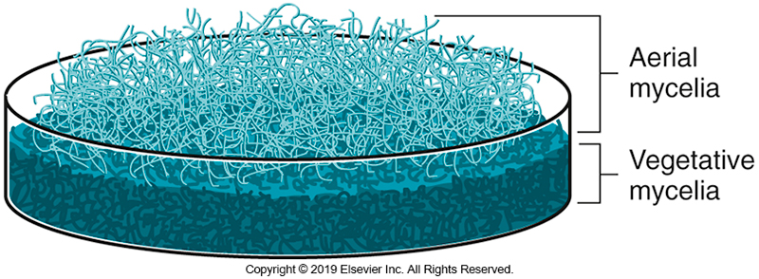
Visual Representation of Aerial and Vegetative Mycelia

Slide 12
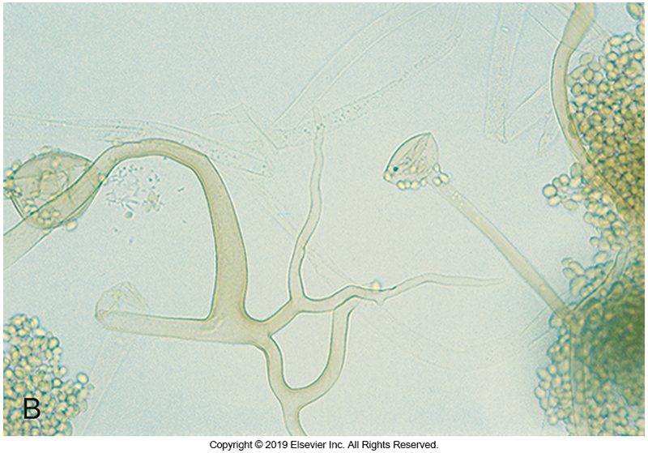
Mold Morphology
Hyphae
Shape
Antler
Racquet
Spiral
Rhizoids
Septate
Frequent perpendicular cross-walls
Sparsely septate
Frequent perpendicular cross-walls

Slide 13
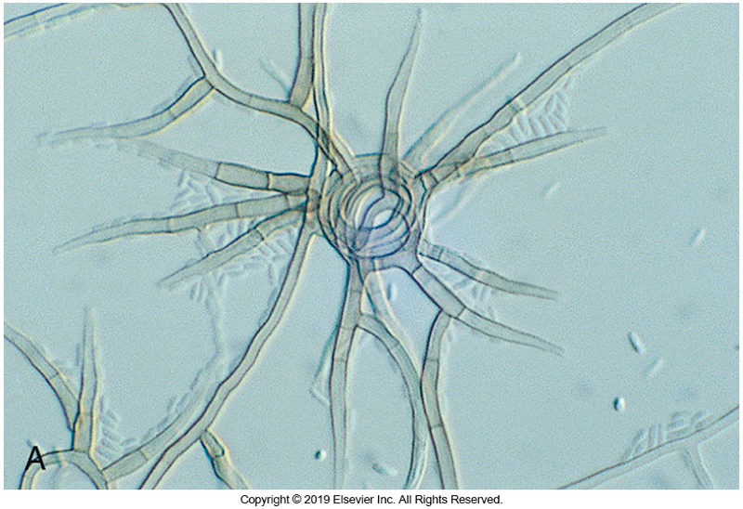
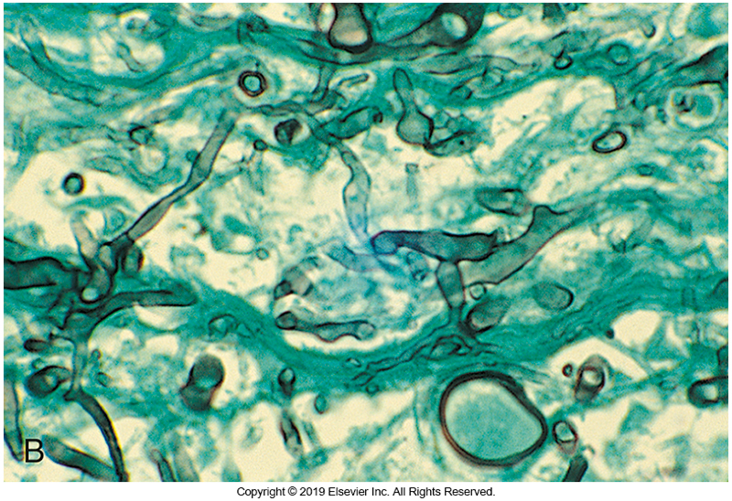
Septate Versus Sparsely Septate

Slide 14
Hyaline versus Phaeoid

Slide 15
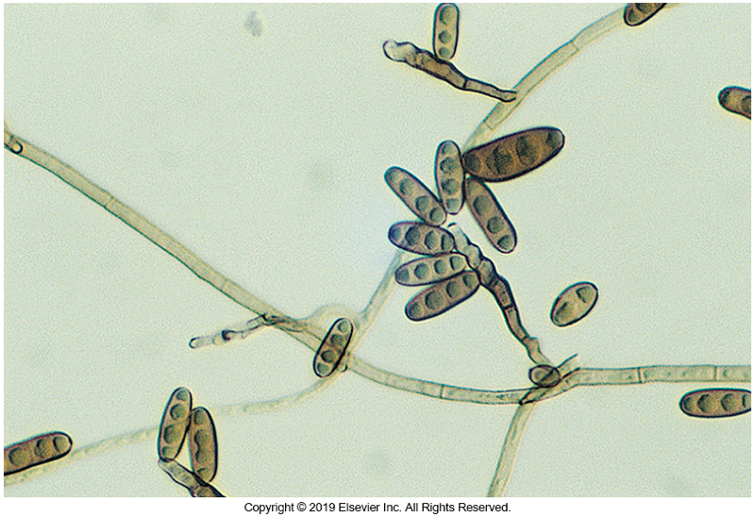
Hyaline Versus Phaeoid
Hyaline
Nonpigmented
Lightly pigmented
Phaeoid (Dematiaceous)
Darkly pigmented
Melanin production in cell wall

Slide 16
Dimorphism and Polymorphism

Slide 17
Dimorphism and Polymorphism
Dimorphism
Ability to exist in two forms based on growth conditions
Mold phase
22 to 25° C (room temperature in ambient air)
Yeast phase
37° C with increased carbon dioxide (CO₂)
Polymorphism
The ability to form yeast and mold in same culture
Generally, yeast first moving to mold as culture ages
Ex. Exophiala spp.

Slide 18
Reproduction

Slide 19
Reproduction
Asexual reproduction
Conidia (conidium) following mitosis
Fruiting structures
Conidiogenous cells
Annellide ring structures
Phialides
Vase-like structures that produce phialoconidia
Annellides
Ringed structures that produce annelloconidia

Slide 20
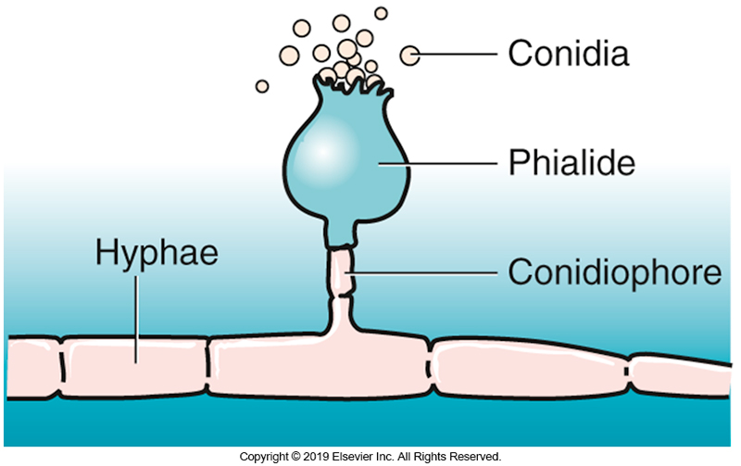
Asexual Reproduction Producing Phialoconidia

Slide 21
Reproduction (Cont.)
Another type of conidia is the arthroconidia (singular, arthroconidium).
These conidia are formed by fragmentation of fertile hyphae as opposed to being formed by conidiogenous cells.
In the clinical laboratory, mold identifications may be based on the structures formed as a result of asexual reproduction.

Slide 22
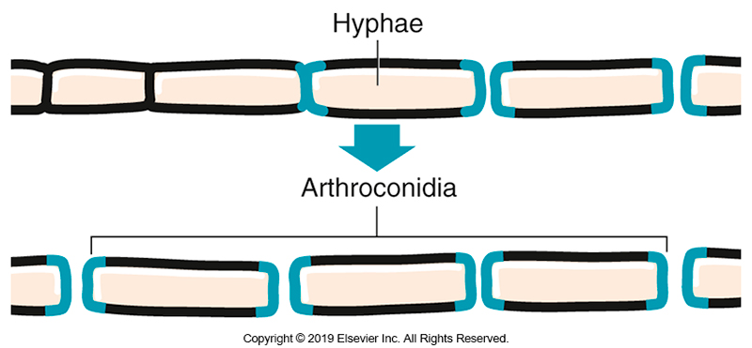
Formation of Arthroconidia

Slide 23
Reproduction (Cont.)
Sexual reproduction requires the joining of two compatible nuclei, followed by meiosis.
Teleomorph- a fungus that reproduces sexually
Occasionally these fungi will reproduce asexually. The asexual form is called that anamorph.
Synanamorphs
Name for amorphic strains when more than one anamorph is present for the same teleomorph

Slide 24
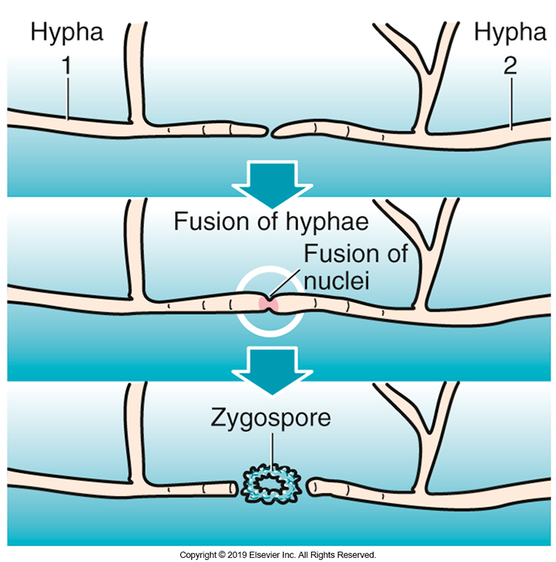
Zygospore Formation

Slide 25
TAXONOMY
CHAPTER TWENTY-SEVEN

Slide 26
Taxonomy of Clinically Significant Fungi
The causative agents of clinical infections are found in four groups of fungi
Phylum Ascomycota
Phylum Basidiomycota
Subphylum Mucoromycotina
Form division fungi Imperfecti (Deuteromycota)

Slide 27
Ascomycota

Slide 28
Ascomycota
Approximately 50% of all named fungi are classified in the phylum Ascomycota.
Sexual spores
Ascospores that are formed in a saclike structure known as an ascus.
Representative species
Microsporum spp.
Trichophyton spp.
Scedosporium spp.

Slide 29
Basiodiomycota

Slide 30
Basidiomycota
Major pathogens are members of the
Cryptococcus neoformans and C. gattii species complexes
Members of these genera are associated with human infections
Malassezia
Trichosporon
Rhodotorula

Slide 31
Basidiomycota (Cont.)
Basidiomycetous molds are being recovered in increasing numbers in the laboratory, but their clinical significance is not clearly understood.
Close communication between the physician and the laboratory would help determine whether the isolate is an environmental contaminant or an agent of disease.

Slide 32
Basidiomycota (Cont.)
When basidiomycetous molds are recovered in the laboratory, they typically remain sterile, complicating the identification process.
One clue that a mold is a basidiomycete is the presence of clamp connections.
Occur at the septations in the vegetative hyphae and are easily visible under a light microscope
A portion of the hypha on one side of the septation grows out and connects to the hypha on the other side of the septation, thereby bypassing the septation.
Clamp connections are not always present.
Staining with diazonium blue B or growing on culture medium supplemented with benomyl can assist in the identification of a putative basidiomycete isolate.

Slide 33
Mucorales

Slide 34
Mucorales
The most significant order
Rapid growers
Rapidly growing organisms normally found in soil
Produce gray to white aerial mycelium with hyaline, sparsely septate hyphae
Opportunistic pathogen in the immunocompromised
Clinical infection is referred to as mucormycosis.

Slide 35
Mucorales
Reproduction
Asexual reproduction
Sporangiospores (asexual spores) are produced in a structure known as a sporangium, which develops from a supporting structure known as a sporangiophore.
Although some Mucorales are capable of sexual reproduction resulting in the production of zygospores, these structures are not routinely seen in clinical laboratories.
Examples of clinically significant genera
Actinomucor, Mucor, Rhizopus

Slide 36
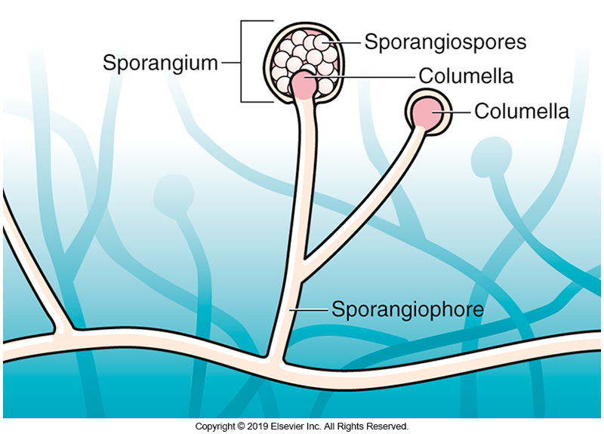
Asexual Reproduction by Mucorales

Slide 37
Fungi Imperfecti

Slide 38
Fungi Imperfecti
Contains the largest number of causative agents of mycoses including
Cutaneous, subcutaneous, and systemic diseases
Organisms are placed in this group when no mode of sexual reproduction has been identified.
These organisms are identified on the basis of characteristic asexual reproductive structures.

Slide 39
MYCOSES
CHAPTER TWENTY-SEVEN

Slide 40
Mycoses
Diseases caused by fungi (singular mycosis)
Disease categories
Superficial, cutaneous, subcutaneous, systemic
Systemic
Infections not involving the skin or deeper tissues just under the skin
Superficial and cutaneous mycoses are caused by
Fungi that can degrade keratin (dermatophytes) and
Fungi that cannot degrade keratin (nondermatophytes).

Slide 41
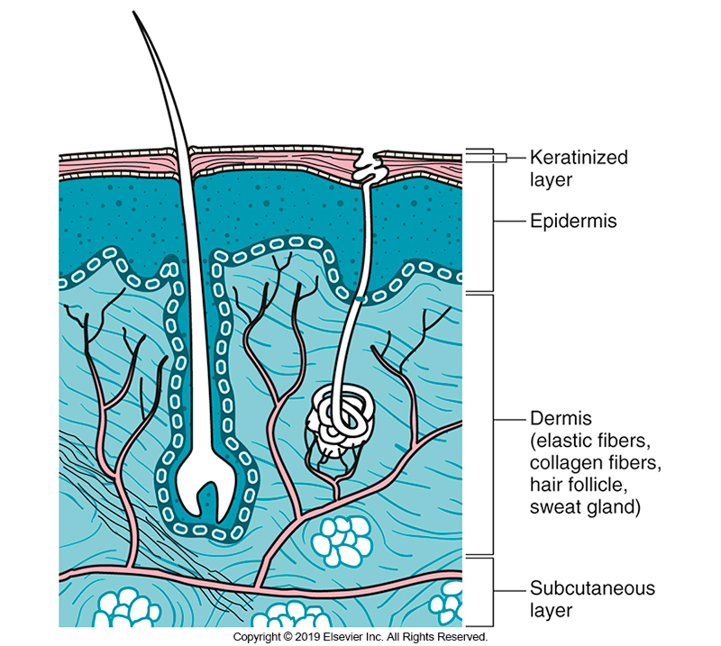
Diagram of Skin and Tissue Layers in Which Fungal Infections Can Occur

Slide 42
Superficial Mycoses

Slide 43
Superficial Mycoses
Superficial mycoses are infections confined to the outermost layer of skin or hair.
Because infections of skin, hair, and nails were at one time believed to be the result of burrowing worms that formed ring-shaped patterns in the skin, the term tinea (Latin, meaning “worm”) was applied to each disease, along with the Latin term for the body site.
Common terminology: ringworm

Slide 44
Superficial Mycoses
Tinea or dermatophytosis (Ringworm)
Tinea versicolor (pityriasis versicolor)
Discoloration or depigmentation and scaling of the skin
Caused by Malassezia furfur complex
Tinea nigra-nondermatophytic
Almost always caused by Hortea werneckii and is characterized by brown or black macular patches, primarily on the palms.
Biopsy and culture of the site are important to distinguish this infection from melanoma, a much more serious nonfungal disease.

Slide 45
Superficial Mycoses (Cont.)
Another superficial infection, piedra, is confined to the hair shaft and is characterized by nodules composed of hyphae and a cementlike substance that attaches it to the hair shaft.
Black piedra is caused by Piedraia hortae
White piedra is caused by Trichosporon ovoides and T. inkin.
Onychomycosis, caused by Onychocola canadensis and O. kanei, is also a nondermatophytic superficial mycosis characterized by white superficial and distal lateral subungual infections of the great toenail.

Slide 46
Cutaneous Mycoses

Slide 47
Cutaneous Mycoses
Dermatomycoses are defined as fungal diseases of the keratinized tissues of humans and other animals. Although nondermatophyte species are capable of causing similar infections, this syndrome is usually a result of infection with a dermatophyte—hence the term dermatophytosis.
This term should not be used until the causative agent has been identified as a dermatophyte.

Slide 48
Cutaneous Mycoses (Cont.)
Dermatophytic infections usually involve a restricted region of the host; traditionally, these diseases are named with respect to the portion of the body affected.

Slide 49
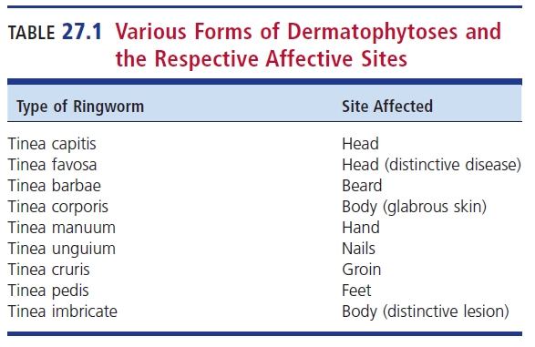
Various Forms of Dermatophytoses and the Respective Affected Sites

Slide 50
Cutaneous Mycoses (Cont.)
Each ringworm lesion is the result of local inoculation of skin with the causative agent.
Lesions enlarge with time, usually with most inflammation occurring at the advancing edge of the lesion.
Some cases of ringworm are subclinical, exhibiting only a dry, scaly lesion without inflammation.

Slide 51
Cutaneous Mycoses (Cont.)
Symptoms of cutaneous mycoses
Itching, scaling, ringlike patches of skin
Thick, discolored nails
Brittle, broken hairs
Example members
Trichophyton, Epidermophyton, Microsporum

Slide 52
Subcutaneous Mycoses

Slide 53
Subcutaneous Mycoses
Involve deeper skin layers
Muscle, connective tissue, bone
Generally, dissemination through the blood does not occur.
Clinical features
Progressive, nonhealing ulcers
Presence of draining sinus tracts
Verricous nodules that often become ulcerated and crusted

Slide 54
Subcutaneous Mycoses
Chromobastomycosis
is diagnosed by the presence of characteristic lesions accompanied by microscopic sclerotic bodies, often referred to as “copper pennies” because of their shape and staining properties in tissue sections.
Eumycotic mycetoma
Caused by fungi and results in draining sinus tracts and tissue destruction
Grains (granules), which are tightly bound hyphae, can be collected from the fluids that drain from the sinus tracks and are useful in identifying the causative agent.

Slide 55
Subcutaneous Mycoses
Sporotrichosis, caused by the Sporothrix schenckii species complex
Commonly presents as a progressive lymphocutaneous infection
Begins with a single draining lesion
Progress along the limbs via the lymphatic system
Forms multiple draining lesions
Granules are not formed, thus not qualifying this infection as a mycetoma.
Dissemination of these species causing systemic sporotrichosis is much more common
Has been implicated in pneumonia that is refractory to antifungal therapy.

Slide 56
Systemic Mycoses

Slide 57
Systemic Mycoses
Infections that affect internal organs or deep tissues of the body
Frequently enter via the lungs, then spread
Generalized symptoms
Fever, fatigue, sometimes chronic cough and chest pain

Slide 58
Systemic Mycoses (Cont.)
Historically, the term systemic mycoses was used to describe diseases caused by thermally dimorphic fungi
Histoplasma, Coccidioides, and Blastomyces spp.
However, other fungal agents are also capable of causing systemic disease, including but not limited to
Aspergillus, Fusarium, Scedosporium, and Curvularia spp. as well as some yeasts, such as Candida and Cryptococcus spp.
It is important to note that any fungus is capable of disseminating from the primary site of infection in the immunocompromised host.

Slide 59
CLINICALLY SIGNIFICANT SPECIES
CHAPTER TWENTY-SEVEN

Slide 60
Agents of Superficial Mycoses

Slide 61
Agents of Superficial Mycoses General Characteristics
Affect only the cornified layers (stratum corneum) of the epidermis
Affected patients do not show any overt symptoms.
Fungal agents do not activate any tissue response of inflammatory reaction.
Medical attention usually sought to address cosmetic rather than medical concerns caused by these fungi.

Slide 62
Malassezia furfur Clinical Manifestations
The Malassezia furfur complex causes tinea versicolor, a disease characterized by patchy lesions or scaling of varied pigmentation.
It is also thought to be a cause of dandruff.
Lesions appear as pale patches in individuals with darkly pigmented skin, but they can also be described as fawn-colored liver spots in individuals with a fair complexion.
Prevalent body sites for infections
Face, trunk, chest, abdomen

Slide 63
Malassezia furfur Clinical Manifestations
Antifungal therapy is not typically indicated, but the appearance of lesions may be diminished by treatment with antidandruff shampoos.
Interestingly, M. furfur complex has also been implicated in disseminated infections in patients receiving lipid replacement therapy (total parenteral nutrition), particularly in infants
Removal of indwelling feeding lines is usually sufficient to clear infections without using antifungal therapy.

Slide 64
Malassezia furfur Laboratory Diagnosis (Cont.)
M. furfur can be identified by visualizing skin scrapings from characteristic lesions in a potassium hydroxide (KOH) preparation or by observing yellow fluorescence with a Wood lamp on examination of the infected body site.
Microscopic examination of the direct smear in KOH preparations reveals budding yeasts, approximately 4 to 8µm, along with septate, sometimes branched, hyphal elements.
This microscopic appearance has gained M. furfur the nickname the “spaghetti-and-meatballs” fungus.

Slide 65
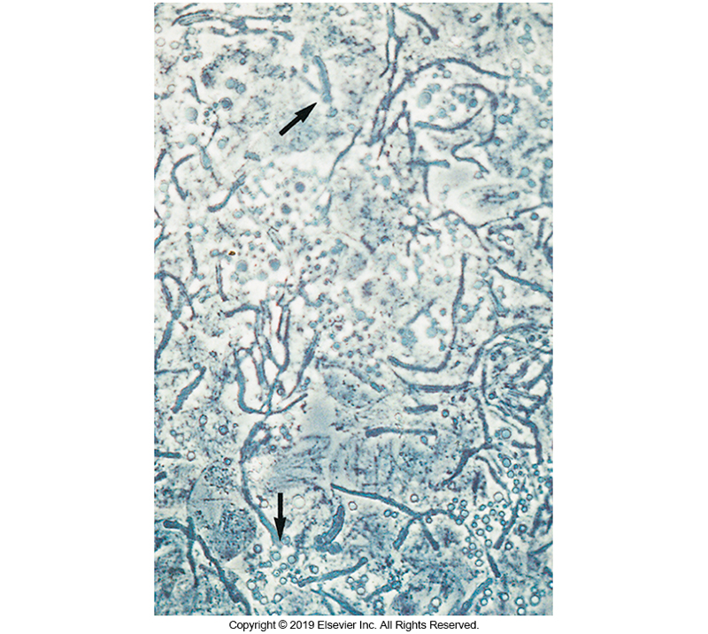
Photograph of “Spaghetti and Meatballs”

Slide 66
Malassezia furfur Laboratory Diagnosis
M. furfur requires lipids for growth and will not grow on routine fungal media that have not been supplemented with a lipid source.
Because of its special nutritional requirements, routine fungal cultures are negative for growth. Typical yeastlike colonies may be observed only after the culture medium has been overlaid with olive oil.
Colonies are cream colored, moist, and smooth.

Slide 67
Piedraia hortae
Causative agent of black piedra
Infection that occurs in the hairs of the scalp
Black gritty nodules
Endemic in tropical Africa, Asia, and Latin America
Examine infected hairs are removed and placed in 10% to 20% KOH.
Nodules may be crushed to reveal asci.
Thick-walled rhomboid cells containing ascospores are seen.
P. hortae grows slowly on Sabouraud dextrose agar at room temperature.
It forms brown, restricted colonies that remain sterile.

Slide 68
Trichosporon spp. Clinical Manifestations
More than 30 distinct species exist
The most commonly seen species are
Trichosporon ovoides, T. asteroides, T. inkin, and Cutaneotrichosporon (previously Trichosporon) cutaneum
T. asahii is implicated in severe and frequently fatal disease in immunocompromised hosts.
T. mucoides also causes systemic disease (meningitis).

Slide 69
Trichosporon spp. Clinical Manifestations (Cont.)
T. muciodes
The colony resembles young colonies of Cryptococcus neoformans but is easily differentiated on the basis of physiologic and morphologic characteristics.
Apiotrichum (formerly Trichosporon) mycotoxinovorans is associated with pulmonary colonization and disease in patients with cystic fibrosis

Slide 70
Trichosporon spp. Clinical Manifestations (Cont.)
Can be part of normal skin flora
Can also be isolated from animals and soil
White piedra on hair shaft
Surrounding hair of scalp, face, and pubic region
Opportunistic systemic pathogens
Although rare, systemic diseases caused by these fungi are frequently fatal and occur most often in immunocompromised hosts, commonly those who have hematologic disorders or malignancies or are undergoing chemotherapy.

Slide 71
Trichosporon spp. Laboratory Diagnosis (Cont.)
Trichosporon spp. grow rapidly on primary fungal media and produce arthroconidia, hyphae, and blastoconidia.
Colonies are straw- to cream-colored and yeastlike.
Colonies are varied and can be
Smooth or wrinkled
Dry or moist
Creamy of velvety in appearance

Slide 72
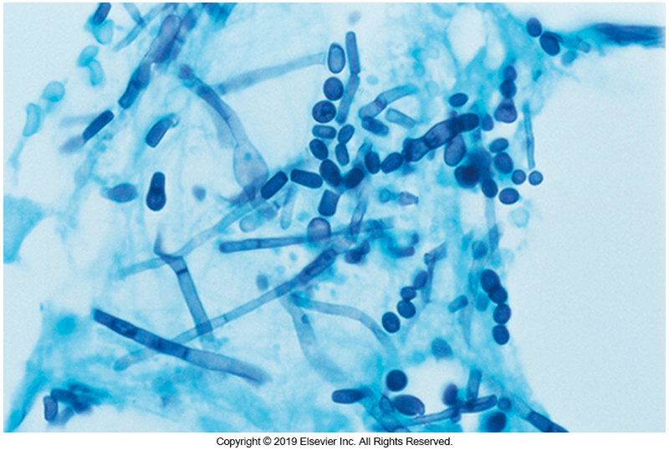
Lactophenol Cotton Blue (LPCB) Preparation Showing Blastoconidia and Arthroconidia

Slide 73
Trichosporon spp. Laboratory Diagnosis (Cont.)
Identification to the species level confirmed by
Biochemical reactions
Absence of carbohydrate fermentation
Use of potassium nitrate (KNO₃ )
Assimilation of sugars
Urease positivity
Numerous molecular and proteomic approaches in conjunction with biochemical reactions,
Deoxyribonucleic acid (DNA) sequence analysis
Matrix-assisted laser desorption/ionization–time-of-flight (MALDI-TOF)

Slide 74
Hortaea werneckii Clinical Manifestations
Causative agent of Tinea nigra
Brown to black nonscaly macules
Palms of hands and soles of feet
No inflammation or reaction to fungus
The clinical presentation is so similar to that of other conditions that misdiagnosis could occur.
Endemic in tropical areas
Central and South America, Africa, and Asia

Slide 75
Hortaea werneckii Laboratory Diagnosis
Laboratory diagnosis
Direct examination of skin scrapings placed in 10% to 20% KOH showing septate hyphal elements and budding cells
Younger cultures are primarily composed of budding blastoconidia, whereas the older mycelial portion of the colony shows wide, profusely septate hyphae with blastoconidia in clusters.
Culture
Shiny, moist, yeastlike colonies, brown to olive or greenish-black

Slide 76
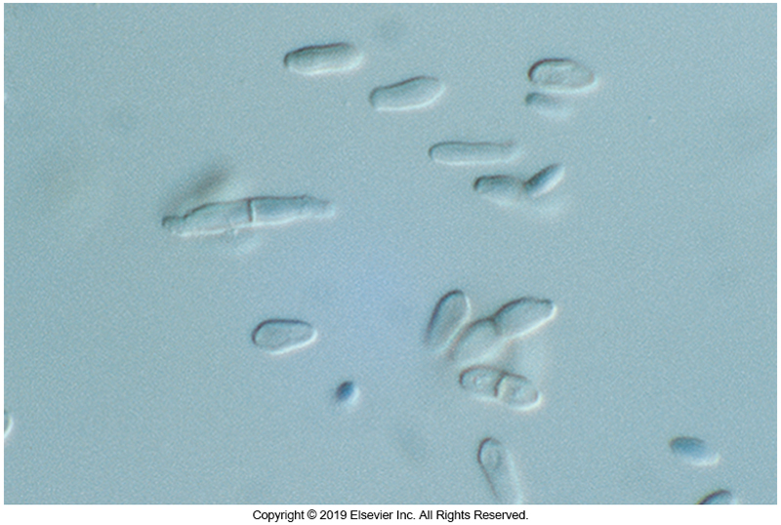
Microscopic Structures of H. werneckii

Slide 77
Agents of Cutaneous Mycoses

Slide 78
General Characteristics
Causative agents of dermatophytoses
Trichophyton, Microsporum, and Epidermophyton—are
Species within these genera, referred to as dermatophytes, are keratinophilic; that is, they are adapted to grow on hair, nails, and cutaneous layers of skin that contain the scleroprotein keratin.
Infection of deep tissue by these fungi is rare, but occasionally extensive inflammation and nail bed involvement or disseminated disease may result.

Slide 79
General Characteristics (Cont.)
Agents of dermatophytoses
Most live freely in the environment (geophilic),
few have adapted almost exclusively to living on animals (zoophilic)
human tissues (anthropophilic) rarely recovered from any other source.
Distribution is generally worldwide, although a few are found only in restricted geographic regions.

Slide 80
General Characteristics (Cont.)
Two sizes of reproductive cells—important in species identification
Macroconidium and microconidium
Bothe are anamorphic or asexual conidia
Structures for species identification
Distinctive size
Shape
Surface features

Slide 81
General Characteristics (Cont.)
Some members also have teleomorphic stages in which ascospores are the reproductive cells.
Teleomorphs in this group of organisms are not observed in routine laboratory studies of patient isolates because dermatophytes are heterothallic, requiring the combination of two distinct mating types.
Although a few reference laboratories perform mating tests with known tester strains, this procedure is not regularly performed in clinical laboratories.

Slide 82
General Characteristics (Cont.)
Most geophilic fungi produce large numbers of conidia and therefore are among the most readily identified species.
Zoophilic dermatophytes are not commonly found living freely in soil or on dead organic substrates.
They often cause infections in animals and can be spread as agents of disease in humans.
Fewer conidia are produced by zoophilic fungi than by geophilic species.

Slide 83
General Characteristics
Although the anthropophilic species are almost always encountered as agents of human disease, the infections are seldom inflammatory.
Species identification may be difficult because most anthropophilic species produce few conidia.
Symptoms of dermatophyte infections range from slight to moderate and occasionally severe.

Slide 84
Infections Involving Hair
Infections of the scalp, in which hair follicles are the initiation sites, can be among the most severe and disfiguring forms of mycoses.
Tinea favosa, or favus caused by Trichophyton schoenleinii
Begins as an infection of the hair follicle
Progresses to a crusty lesion made up of dead epithelial cells and fungal mycelia.
Forms crusty, cup-shaped flakes, called scutula
Hair loss and scar tissue formation commonly follow.

Slide 85
Infections Involving Hair (Cont.)
Two distinct forms of tinea capitis
Gray patch ringworm
Black dot ringworm
Gray patch ringworm
The fungus colonizes primarily the outer portion of hair shafts, the so-called ectothrix hair involvement.
The lesions are seldom inflamed, but luster and color of the hair shaft may be lost.
Causative agents
Microsporum audouinii
Microsporum ferrugineum

Slide 86
Infections Involving Hair (Cont.)
Black dot ringworm consists of endothrix hair involvement.
The hair follicle is the initial site of infection, and fungal growth continues within the hair shaft, causing it to weaken.
The brittle, infected hair shafts break off at the scalp, leaving the black dot stubs.
Causative agents
Trichophyton tonsurans
Trichophyton violaceum

Slide 87
Infections Involving the Nails
Onychomycosis, which is infection of the nails, is most often caused by dermatophytes but also may be the result of infection by other fungi.
These nail and nail bed infections may be among the most difficult dermatomycoses to treat.
Long-term, costly therapy with terbinafine or itraconazole has been considered the best treatment, but results are often unsatisfactory.

Slide 88
Infections Involving the Nails (Cont.)
There is a direct association between dermatophytic infections of the feet or hands and infections of the nails.
Some common agents that infect the nails
Trichophyton rubrum,
T. mentagrophytes
T. tonsurans
Epidermophyton floccosum.

Slide 89
Tinea pedis
Also known as athlete’s foot
Infection arises from infected skin scales coming into contact with exposed skin via a carpet, shower floors, or other shared walking/standing surfaces where shoes are not always worn.
Infections within a family are common.
Various sites on the foot may be involved, but tinea pedis usually affects the soles and toe webs.

Slide 90
Tinea pedis (Cont.)
In more severe cases, the sole may develop extensive scaling, with fissuring and erythema.
The disease may progress around the sides of the foot from the sole, giving rise to use of the term moccasin foot, descriptive of the appearance of the infected area.
Infections of the glabrous skin range from mild, with only minimal scaling and erythema, to severely inflamed lesions.

Slide 91
Systemic Dermatophyte Infections
Occur in immunocompromised individuals
In disseminated disease, nodules with varying size to granulomas possible
Primarily in kidney transplant patients and is thought to have spread from athlete’s foot or onychomycosis.

Slide 92
Epidermophyton floccosum
Produces one size of conidia described as macroconidia (because of their size)
Macroconidia appearance
Smooth, thin-walled
Produced in clusters or singly
Distal end is broad or spatulate and reminiscent of a beaver’s tail
Usually, separated into two to five cells by perpendicular cross-walls.

Slide 93
Epidermophyton floccosum (Cont.)
Colony morphology
Yellow to yellow tan with feathered edges; small in diameter
E. floccosum isolates are notorious for developing pleomorphic tufts of sterile hyphae in older cultures.
E. floccosum is distributed worldwide.

Slide 94
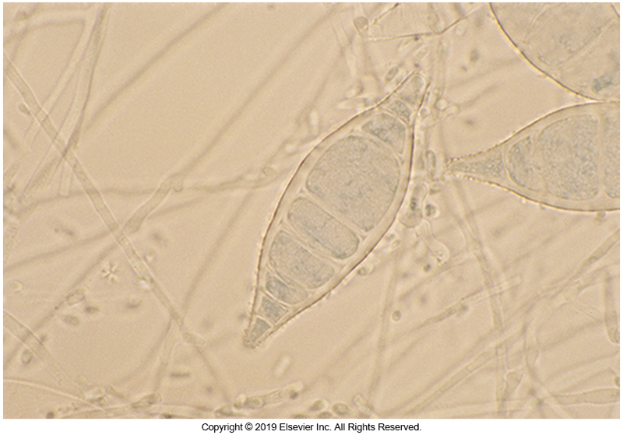
Microsporum canis
Macroconidia
Spindle shaped, with echinulate, thick walls.
Tapered, sometimes elongated, spiny distal ends of the macroconidia are key features that distinguish this species.
Microconidia are abundantly formed by most isolates, and these may be the only conidia maintained in cultures that have been serially transferred.

Slide 95
Microsporum canis
Colony Morphology
Initially white and silky
Reverse side of colony is usually developing a lemon-yellow pigment, especially on potato dextrose agar
Worldwide distribution

Slide 96
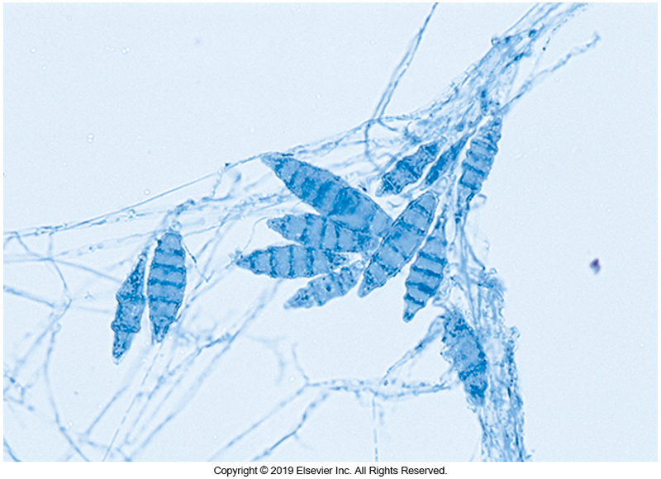
Nannizzia gypseum
Macroconidia
Fusiform
Moderately thick-walled
May contain as many as six cells
In some isolates the distal end of the macroconidium might bear a thin, filamentous tail.

Slide 97
Nannizzia gypseum (Cont.)
Abundant macroconidia and microconidia produced by most isolates of this species result in a powdery, granular appearance on colony surfaces.
Colonies that form tan to buff conidial masses are typical of fresh isolates, but this species tends to develop pleomorphic tufts of white sterile hyphae in aging cultures and after serial transfers.
Abundant brown-to-red pigment can form beneath some strains, but others remain colorless.
N. gypseum is a rapidly growing geophilic species found in soils worldwide

Slide 98
Microsporum audouinii
Slow-growing anthropomorphic dermatophyte
Used to be leading cause of tinea capitis of children
Rare conidia
Some isolates produce terminal chlamydoconidium-like swellings terminally on hyphae.
Colonies
Cottony and white with little to no pigment on reverse

Slide 99
Trichophyton mentagrophytes
Microconidia are
Primarily globose but may appear tear shaped.
Found in clusters described as grapelike (“en grappe”).
Macroconidia
Smooth.
Cigar shaped, with four to five cells separated by parallel cross-walls.
Produced singly on undifferentiated hyphae.

Slide 100
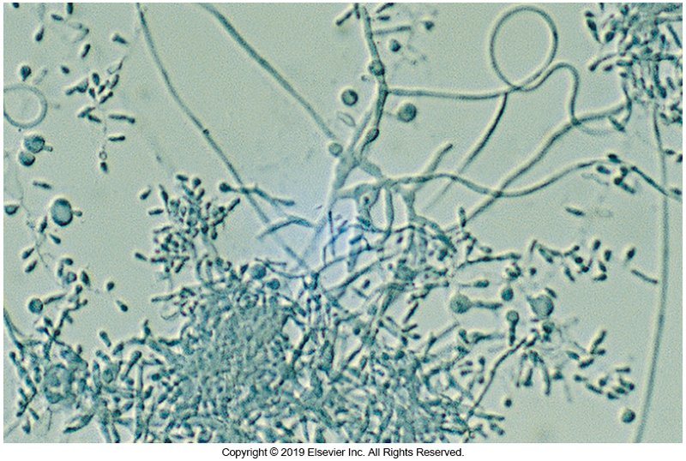
Trichophyton mentagrophytes Microconidia

Slide 101
Trichophyton mentagrophytes (Cont.)
Colony morphology varies with the extent of conidia production.
Granular colonies are noted when abundant microconidia are formed.
In the downy form, conidia are less abundant.
Compared with other dermatophytes, T. mentagrophytes is a relatively rapidly growing fungus.
This species is distributed worldwide

Slide 102
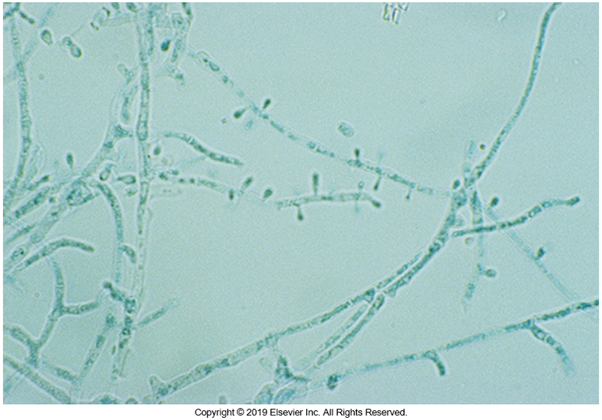
Trichophyton rubrum Microconidia
Microconidia
Clavate- or peg-shaped formed along undifferentiated hyphae
Macroconidia are seldom seen in clinical isolates

Slide 103
Trichophyton rubrum (Cont.)
Colonies usually remain white on the surface but may be yellow to red.
Most strains develop a red to deep burgundy wine–colored pigment on the reverse that diffuses into the agar.
This species has a worldwide distribution.

Slide 104
Trichophyton tonsurans
Colony morphology
Rust-colored pigment on colony’s reverse when grown on Sabrouad dextrose agar
Microscopic
Microconidia extremely variable in shape
Ranges from round to peg shapes
Leading cause of tinea capitis in children in many parts of the world (including the United States)
Infects hair, skin, and nails

Slide 105
Agents of Subcutaneous Mycoses

Slide 106
General Characteristics
Affect subcutaneous tissue
Usually result of traumatic implantation of foreign objects into the deep layers of the skin, permitting fungus to gain entry into the host
Causative agents—organisms typically found in soil or decaying vegetation
Infections may be grouped by either the
disease processes they cause.
causative agents involved.

Slide 107
Chromoblastomycosis
Also known as verrucous dermatitis and chromomycosis
Chromoblastomycosis occurs worldwide but is most common in tropical and subtropical regions of the Americas and Africa.
In the United States, most cases occur in Texas and Louisiana.
Agents that cause chromoblastomycosis
Fonsecaea pedrosoi
Phialophora verrucosa
Cladophialophora carrionii
Rhinocladiella aquaspersa

Slide 108
Chromoblastomycosis (Cont.)
Clinical Manifestations
Common subcutaneous mycosis
Chronic infection of skin and subcutaneous tissue and develops over a period of months or, more commonly, years.
It is mostly asymptomatic in the absence of secondary complications, such as bacterial infections, carcinomatous degeneration, and elephantiasis.

Slide 109
Chromoblastomycosis (Cont.)
Lesions are usually confined to the extremities, often the feet and lower legs, and are a result of trauma to these areas.
Lesions frequently appear as verrucous nodules that may become ulcerated and crusted.
Longstanding lesions have a cauliflower-like surface.
Brown, round sclerotic bodies, which are nonbudding structures occurring singly or in clusters, are seen in tissues.

Slide 110
Chromoblastomycosis (Cont.)
These sclerotic bodies reproduce by dividing in various planes, resulting in multicellular forms.
Occasionally, short hyphal elements are also seen. The presence of sclerotic bodies is diagnostic for this disease.
Males are predominately infected, possibly indicating a role of sex hormones in disease development.
Fonsecaea, Cladophialophora carrionii, and Phialophora verrucosa cause most cases of chromoblastomycosis.

Slide 111
Chromoblastomycosis (Cont.)
Laboratory diagnosis
Isolates are identified on the basis of characteristic structures, such as arrangement of conidia and the manner in which conidia are borne. (see next slide)
Organisms causing chromoblastomycosis are darkly pigmented.
Growth is moderate to slow, and colonies are velvety to woolly and gray-brown to olivaceous black.

Slide 112
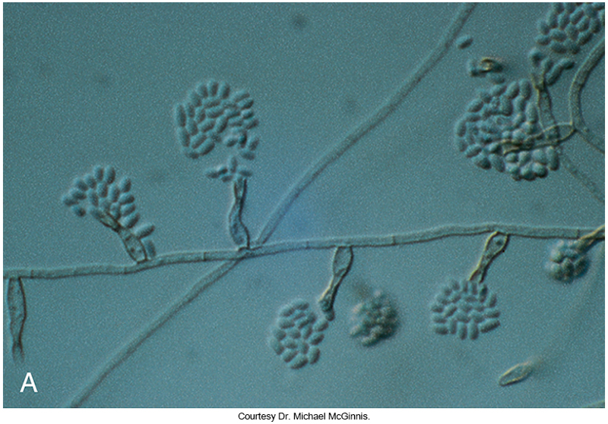
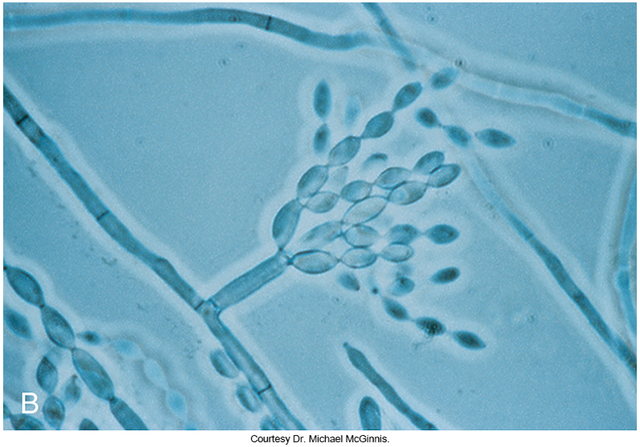
Conidia of Phialophora Versus Cladophialophora
Phialophora verrucosa
Cladophialophora carronnii

Slide 113
Chromoblastomycosis (Cont.)
Laboratory diagnosis
Species are not differentiated by colony morphologies because they all produce similar characteristics.
Molecular approaches, such as ribosomal gene sequencing, provide accurate identification to the species level.

Slide 114
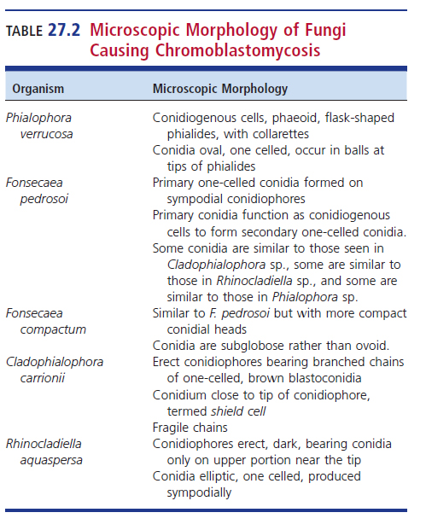
Microscopic Morphology of Fungi Causing Chromoblastomycosis

Slide 115
Eumycotic Mycetomas
Subcutaneous and cutaneous tissue infection at inoculation site
Swelling and exudates draining to skin surface
Can be caused by fungi or bacteria
Actinomycotic mycetomas if caused by bacteria infection
Although clinical manifestations are similar for both types, the cause must be determined because the therapy for each is different.

Slide 116
Eumycotic Mycetomas (Cont.)
Mycetomas occur primarily in tropical and subtropical areas but are also seen in temperate zones.
The disease is endemic in India, Africa, and South America.
Although mycetoma is an uncommon mycosis in the United States, the following species (in order of occurrence) are the most commonly incriminated agents:
Scedosporium boydii, Fusarium falciforme, Madurella mycetomatis, Trematosphaeria grisea (formerly Madurella grisea), and Exophiala spp.

Slide 117
Eumycotic Mycetomas (Cont.)
Direct microscopic examination of the granules collected from the draining lesion immediately differentiates eumycotic from actinomycotic mycetomas.
Actinomycetes has branching filamentous rods.
Eumycotic infections have hyphal elements.

Slide 118
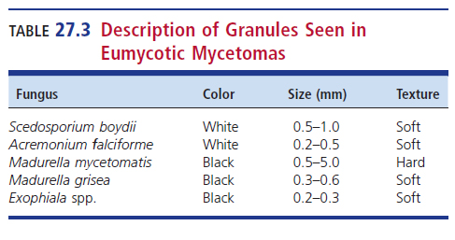
Description of Granules

Slide 119
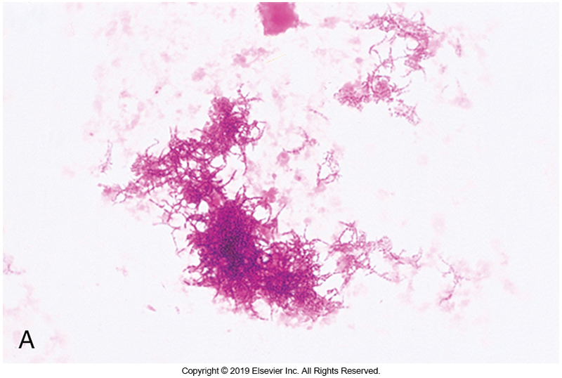
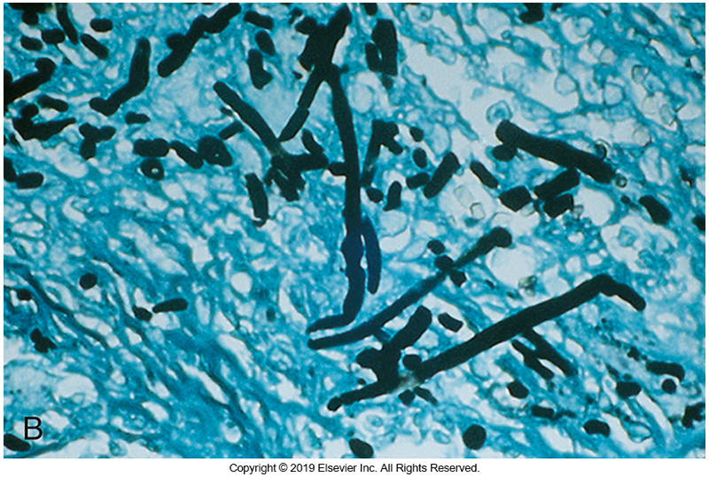
Actinomyotic mycetoma (Left) Eumycotic Hyphal Elements (Right)

Slide 120
Scedosporium apiospermum
Previously, it was thought that Scedosporium apiospermum was the anamorphic state of S. boydii, but molecular characterization has revealed that S. boydii and S. apiospermum are different species.
Pseudoallescheria boydii, the teleomorph, and the anamorph, S boydii, are the same species.

Slide 121
Scedosporium apiospermum (Cont.)
S boydii produces oval conidia singly at the tips of conidiogenous cells (cells that make conidia) known as annellides.
The teleomorph form is noted by the formation of cleistothecia containing ascospores.
This phenomenon occurs in fungi that are homothallic (ability of a single organism to undergo sexual reproduction without a mate).

Slide 122
Scedosporium apiospermum (Cont.)
This isolate grows rapidly and produces colonies that are white to dark gray on potato dextrose agar at 22° and 35°C. Opinions regarding this fungus differ in relation to it being hyaline or phaeoid.

Slide 123
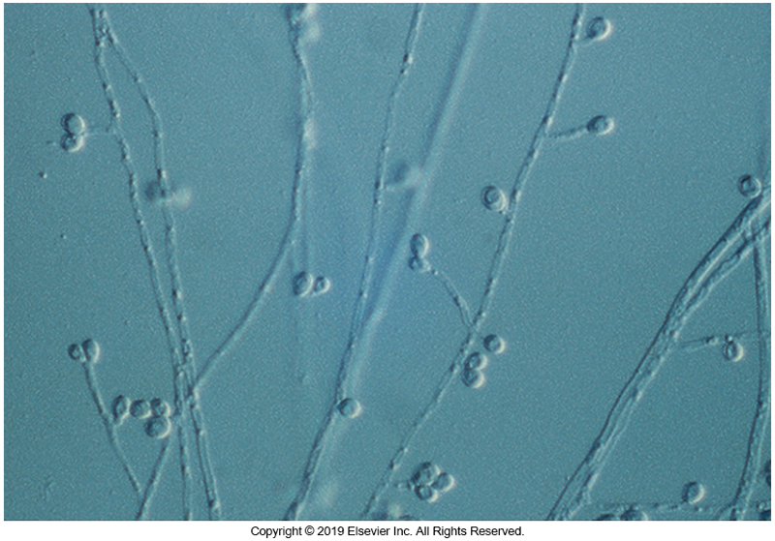
Scedosporium boydii

Slide 124
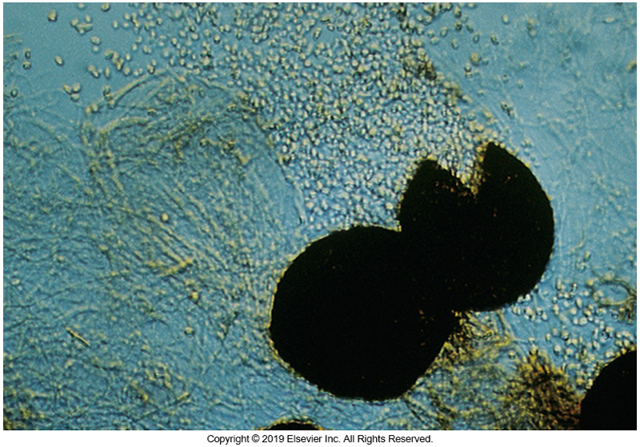
Cleistothecia Containing Ascospores

Slide 125
Fusarium falciforme
This organism produces mucoid clusters of single- or two-celled, slightly curved conidia borne from phialides at the tips of long, unbranched, multiseptate conidiophores.
Conidia are held together in mucoid clusters at the apices of the phialides.
This isolate is a hyaline, septate, filamentous mold. Colonies grow slowly and are grayish brown, becoming grayish violet.

Slide 126
Madurella
Madurella mycetomatis causes most cases of eumycotic mycetoma.
Madurella spp. are phaeoid, septate fungi.
Approximately 50% of the isolates of M. mycetomatis produce conidia from the tips of phialides, but many remain sterile.

Slide 127
Madurella (Cont.)
This species grows very slowly but is initially white, and becomes yellow, olivaceous, or brown, with a characteristic diffusible brown pigment with age.
It grows best at 37°C, with slower growth at 40°C.
DNA analysis led to the description of a new species formerly named M. grisea.

Slide 128
Subcutaneous phaeohyphomycosis
A mycotic disease caused by darkly pigmented (phaeoid or dematiaceous) fungi or fungi that have melanin in their cell walls.
Phaeohyphomycosis was coined to distinguish several clinical infections caused by phaeoid fungi from those distinct clinical entities known as chromoblastomycosis.
In tissue, these fungi may form yeastlike cells that are solitary or in short chains or hyphae that are septate, branched, or unbranched and often swollen to toruloid (irregular or beaded).

Slide 129
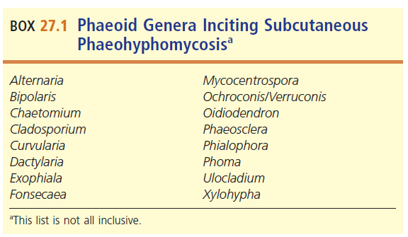
Phaeoid Genera Inciting Subcutaneous Phaeohyphomycosis

Slide 130
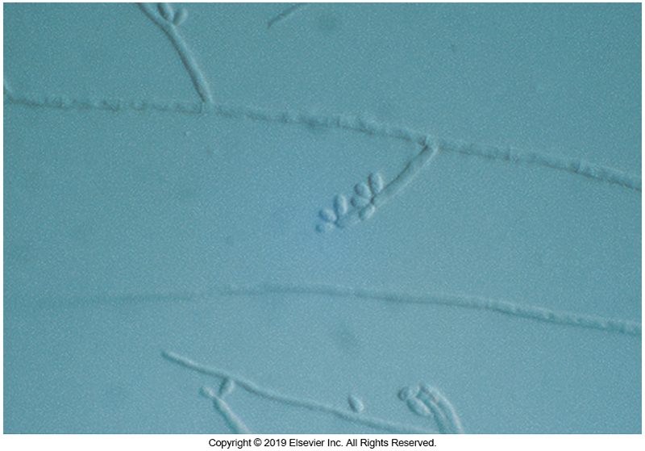
Conidia of Exophiala sp.

Slide 131
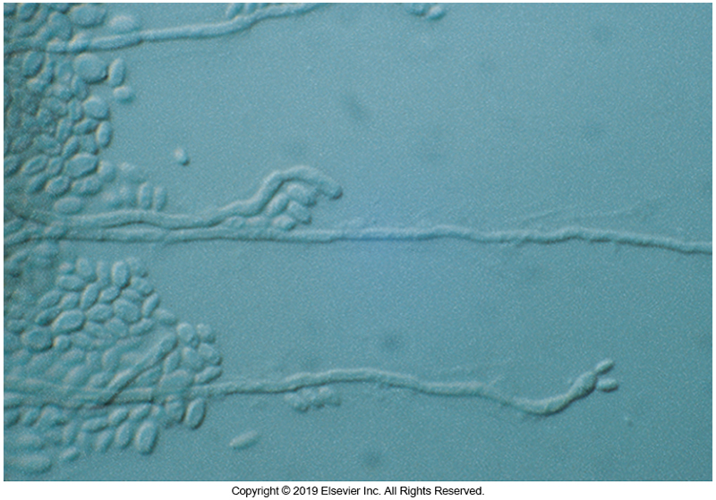
Conidia of Exophiala dermatitidis

Slide 132
Sporothrix schenckii Species Complex
Clinical manifestations
Most common presentation
Lymphocutaneous sporotrichosis
Nodular and ulcerative lesions
Worldwide distribution
Found in soil and decaying vegetative matter
Associated with gardening, rosebush thorns

Slide 133
Sporothrix schenckii Species Complex
Laboratory diagnosis
Direct examination of tissue might reveal members of the S. schenckii species complex as small, cigar-shaped yeasts.
Microscopic examination from culture reveals thin, delicate hyphae bearing conidia developing in a rosette pattern at the ends of delicate conidiophores.
Dark-walled conidia are also produced along the sides of the hyphae and may be more readily viewable than the rosettes in mature cultures.

Slide 134
Sporothrix schenckii Species Complex
Laboratory diagnosis
Because members of this complex are dimorphic, cultures are examined at 22° and 37°C.
These fungi grow well on most culture media, including those containing cycloheximide.
The colony morphology at 22°C can be variable.
At this temperature, colonies are often initially white, glabrous, and yeastlike, turning darker and more mycelial as they mature.

Slide 135
Sporothrix schenckii Species Complex
Laboratory diagnosis
Demonstration of dimorphism is important for the identification of these species.
To induce mycelia conversion to yeast, the fungus is inoculated onto brain-heart infusion (BHI) agar supplemented with sheep red blood cells and incubated at 37°C in a CO2 incubator.
The formation of yeast colonies may require several subcultures.
Complete conversion seldom occurs, but a portion of the colony will develop yeastlike cells.

Slide 136
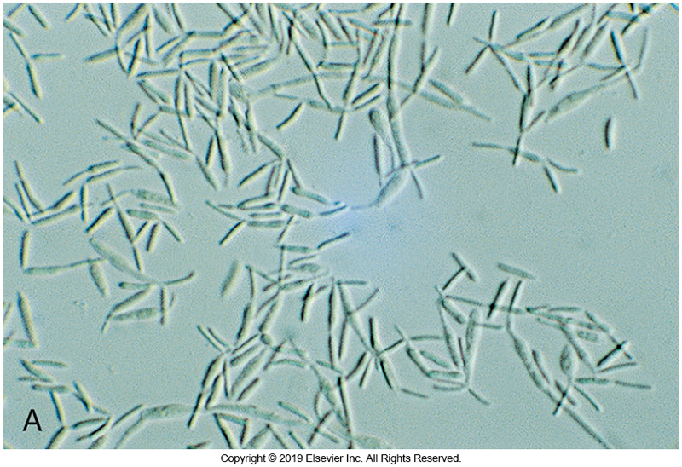
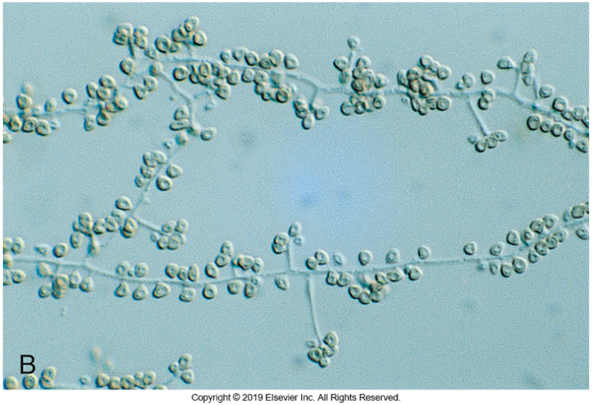
Yeast and Mold Phases of S. schenckii
Yeast phase
Mold phase

