Slide 1
Chapter 27
Medically Significant Fungi
PART TWO

Slide 2
Agents of Systemic Mycoses

Slide 3
Clarification of the Term Systemic
Although the term systemic generally refers to the organisms described here,
it must be understood that any fungus, in an immunocompromised host,
has the potential to become invasive and disseminate to sites far removed from the portal of entry.

Slide 4
General Characteristics
Morphology of the system dimorphic
Conversion to the yeast or spherule form occurs when it is incubated at 35° to 37°C on enriched media with increased concentration of CO₂.
Each agent has a fairly well-defined endemic area.
The diseases are contracted generally by the inhalation of infectious conidia.
All laboratory procedures to recover and identify these agents must be performed in a biological safety cabinet.

Slide 5
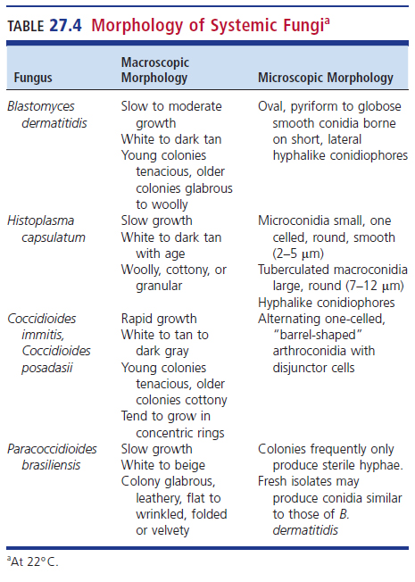
Morphology of Systemic Fungi at 22° C

Slide 6
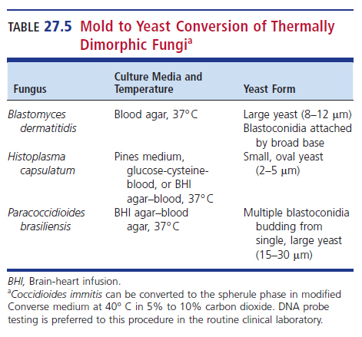
Mold to Yeast Conversion of Thermally Dimorphic Fungi

Slide 7
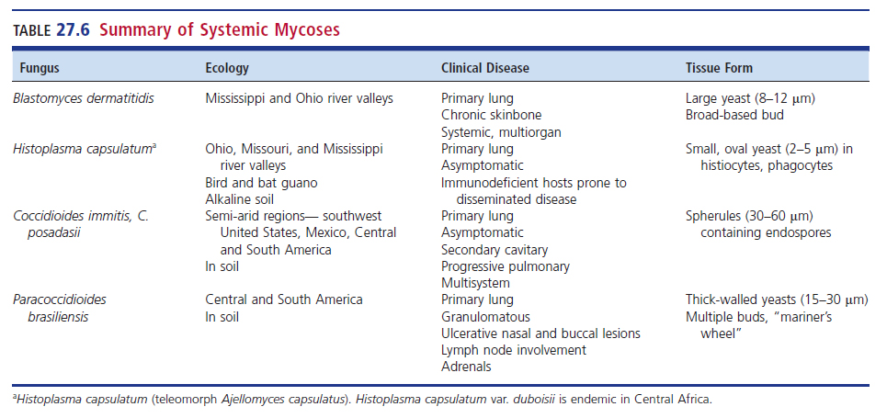
Summary of Systemic Mycoses

Slide 8
Blastomyces Clinical Manifestations
Most prevalent in middle-aged men
Presumably of occupational and recreational exposure to the soil
Patients with primary infection
Flu-like symptoms, most are asymptomatic
When primary disease fails to resolve, pulmonary disease may ensue.
Cough, weight loss, chest pain, and fever

Slide 9
Blastomyces Clinical Manifestations (Cont.)
Progressive pulmonary or invasive disease may follow.
Results in ulcerative lesions of the skin and bone
In immunocompromised patients may experience
Multiple organ systems involvement
Rapid death possible

Slide 10
Blastomyces Clinical Manifestations (Cont.)
Causes blastomycosis
a.k.a. Gilchrist disease, North American blastomycosis, Chicago disease
Occurs primarily in North America and parts of Africa
B. dermatitidis is endemic in the Mississippi and Ohio river basins.
B. helicus is found primarily in the west.

Slide 11
Blastomyces Clinical Manifestations (Cont.)
Several species of Blastomyces are now recognized, including
B. dermatitidis
B. gilchristii
B. helicus, among others.
Morphologically, B. dermatitidis and B. gilchristii are indistinguishable.
B. gilchristii can be identified by using the sequences of the internal transcribed spacer 2 of the nuclear ribosomal ribonucleic acid (RNA) gene.

Slide 12
Blastomyces Laboratory Diagnosis
Specimens of choice
Tissue or purulent material in cutaneous skin lesions
Direct microscopic examination
Large, spherical, refractile yeasts 8 to 15 μm in diameter with double-contoured wall and buds connected by a broad base
KOH (10%) or calcofluor white may be used to enhance yeast cell detection.

Slide 13
Blastomyces Laboratory Diagnosis (Cont.)
Mold phase
Conidia are borne on short lateral branches that are ovoid to dumbbell-shaped and vary in diameter from 2 to 10 μm.
Microconidia resemble other fungi and are thus not diagnostic.

Slide 14
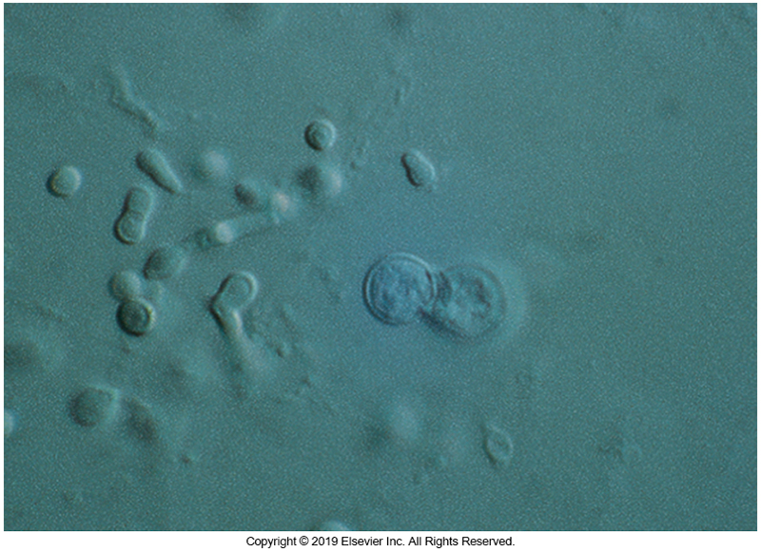
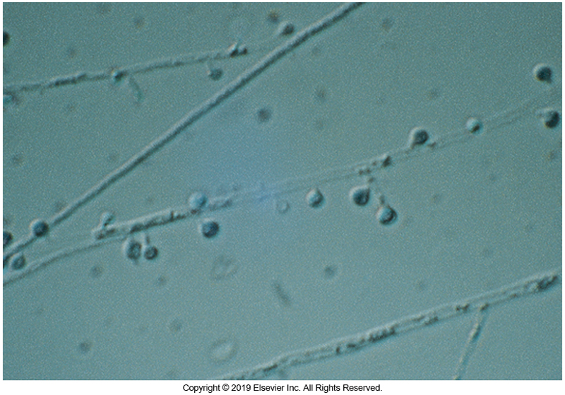
Yeast (Left) and Mold Phase (Right) of B. dermatitidis

Slide 15
Blastomyces Laboratory Diagnosis (Cont.)
Culture characteristics at 22° C
Variety of colony morphologies: white, tan, or brown and may be fluffy to glabrous
Frequently, raised areas known as spicules are seen in the centers of the colonies.
When grown at 37°C on suitable media,
B. dermatitidis and B. gilchristii produce characteristic, broad-based, budding yeast cells.

Slide 16
Blastomyces Laboratory Diagnosis (Cont.)
The mycelial phase of these fungi require confirmatory ID, typically by DNA probe or sequencing.
Because of low sensitivity and specificity, antigen detection methods are generally not used.

Slide 17
Coccidioides species Clinical Manifestations
Considered as the probable most virulent of all human mycotic agents
Two very similar species infect humans
C. immitis and C. posadasii
Mode of transmission
Inhalation of only a few arthroconidia produces primary coccidioidomycosis
Types clinical infections
Asymptomatic pulmonary disease and allergic manifestations

Slide 18
Coccidioides species Allergic Manifestations
Toxic erythema
Erythema nodosum (desert bumps)
Erythema multiforme (valley fever)
Arthritis (desert rheumatism)
Primary disease in these cases usually resolve without therapy.
Confers a strong, specific immunity to reinfection

Slide 19
Coccidioides species Symptomatic Disease
Primary disease symptoms
Fever, respiratory distress, cough, anorexia, headache, malaise, myalgia
Disease might progress to secondary coccidioidomycosis.
Nodules, cavitary lung disease, and/or progressive pulmonary disease
In about 1% of this population, single or multisystem dissemination follows.

Slide 20
Coccidioides species Epidemiology
Reside in a narrow ecologic niche
The Lower Sonoran life zone
Areas of low rainfall and semi-arid conditions
Highly endemic areas
San Joaquin Valley of California
The Maricopa and Pima counties of Arizona
Southwest Texas
Endemic areas outside of the United States
Northern Mexico, Guatemala, Honduras, and parts of South America
Geographic locations
C. immitis—San Joaquin Valley of California
C. posadasii—desert southwest, Mexico, South America

Slide 21
Coccidiodes species Laboratory Diagnosis
After inhalation, the barrel-shaped arthroconidia, which measure 2.5 to 4 µm × 3 to 6µm, round up as they convert to spherules.
At maturity, the spherules (30 to 60µm) produce endospores by a process known as progressive cleavage
Rupture of the spherule wall releases the endospores into the bloodstream and surrounding tissues.
These endospores, in turn, form new spherules.

Slide 22
Coccidiodes species Laboratory Diagnosis (Cont.)
Direct smear examination of secretions may reveal the spherules containing the endospores.
Caution must be exercised when diagnosis is made by histopathologic means only.
Small, empty spherules may resemble the yeast cells of B. dermatitidis, and the endospores can be confused with the cells of Cryptococcus, Histoplasma, and Paracoccidioides.
Direct antigen detection methods are limited.

Slide 23
Coccidioides species Microscopic Examination of Culture
Fertile hyphae arising at right angles to the vegetative hyphae produces alternating hyaline arthroconidia separated by a disjunctor cell
When released, conidia have an annular frill at both ends.
As culture ages, vegetative hyphae also fragment into arthroconidia.
Variety of mold morphology produced at 22° C

Slide 24
Coccidioides species Microscopic Examination of Culture (Cont.)
Initial growth, which occurs within 3 to 4 days, is white to gray, moist, and glabrous.
Colonies rapidly develop abundant aerial mycelia, and the colony appears to enlarge in a circular bloom.
Mature colonies usually turn tan to brown to lavender in color.

Slide 25
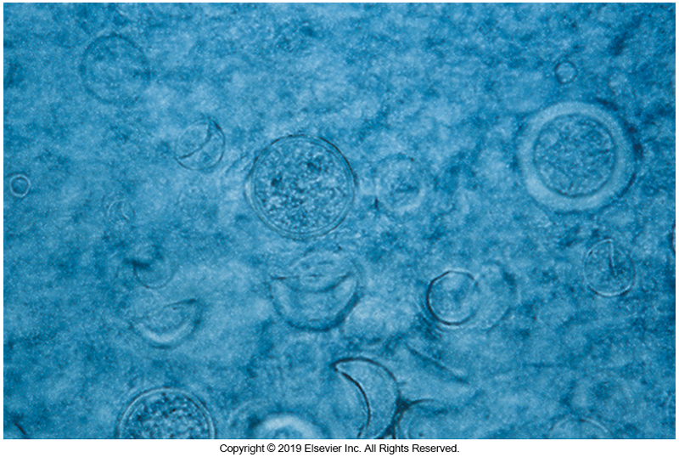
Spherules of C. immitis

Slide 26
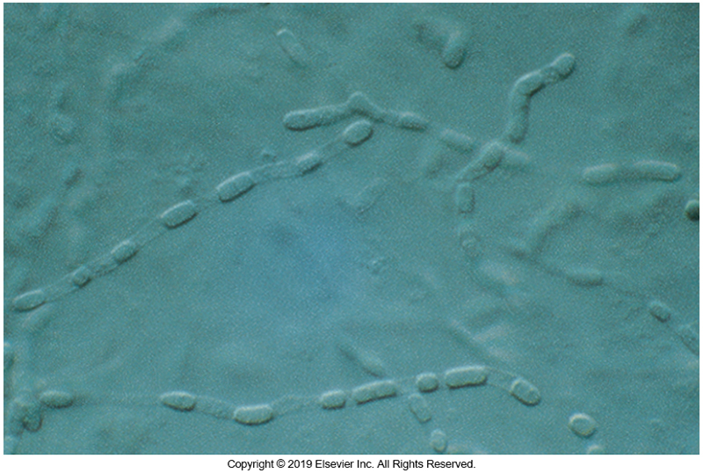
Arthroconidia of C. immitis

Slide 27
Histoplasma Clinical Manifestations
Histoplasmosis is also known as
Reticuloendothelial cytomycosis
Cave disease
Spelunker’s disease
Darling disease
Histoplasmosis infection is acquired by inhalation of the microconidia of Histoplasma species.
The microconidia are phagocytized by macrophages in the pulmonary parenchyma.

Slide 28
Histoplasma Clinical Manifestations
In the host with intact immune defenses, the infection is limited and is usually asymptomatic, with the only sequelae being areas of calcification in the lungs, liver, and spleen
Heavy exposure may result in acute pulmonary disease.
In immunocompromised patients
Progressive and potentially fatal disseminated disease possible
Other manifestations
Mediastinitis, pericarditis, mucocutaneous lesions

Slide 29
Histoplasma Clinical Manifestations (Cont.)
Worldwide distribution
Highest endemicity—Ohio, Missouri, Mississippi river deltas
Organisms reside in soil with a high nitrogen content particularly in areas heavily contaminated with bat and bird guano (accumulated excrement).

Slide 30
Histoplasma Laboratory Diagnosis
Careful examination of direct smear preparations of specimens for histoplasmosis frequently reveals the small yeast cells of H. capsulatum and similar Histoplasma species, particularly in infections seen in immunodeficient hosts.
When smears are stained with Giemsa or Wright stain, the yeast cells are commonly seen within monocytes and macrophages, occurring in significant numbers.

Slide 31
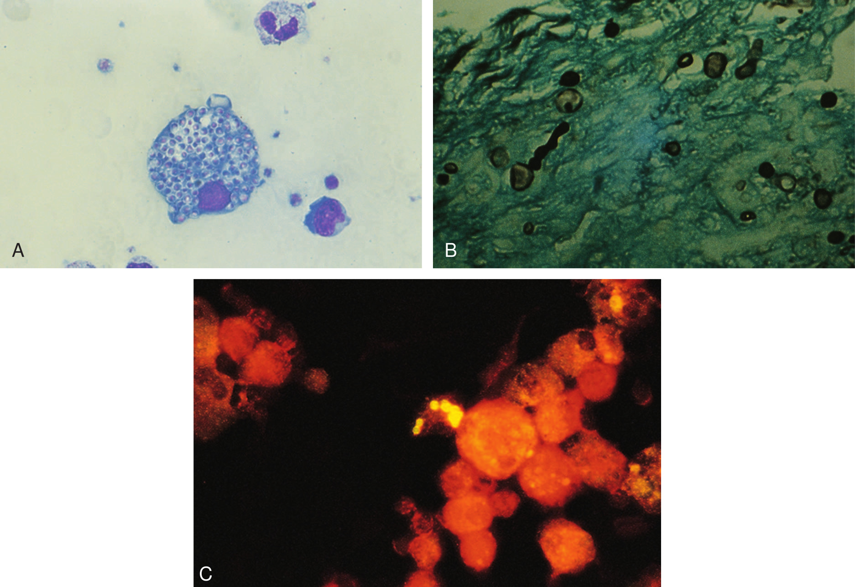
A. H. capsulatum in Monocytes B. Tissue C. Bronchoalveolar lavage

Slide 32
Histoplasma Laboratory Diagnosis (Cont.)
The small cells, when found in tissue resemble the blastoconidia of Candida glabrata, but they can be differentiated by fluorescent antibody techniques or culture.
Conversion of the mold form to the yeast form, using BHI agar incubated at 37°C, is confirmatory for H. capsulatum.

Slide 33
Histoplasma Laboratory Diagnosis (Cont.)
H. capsulatum
Mycelium grows as white-to-brownish
Young cultures produce round to pyriform microconidia.
As colony matures, large echinulate or tuberculate macroconidia emerge.
Examples of other available ID methods
Direct antigen detection, serologic procedures
Most useful test for rapid diagnosis
Combination of DNA hybridization system and DNA sequencing

Slide 34
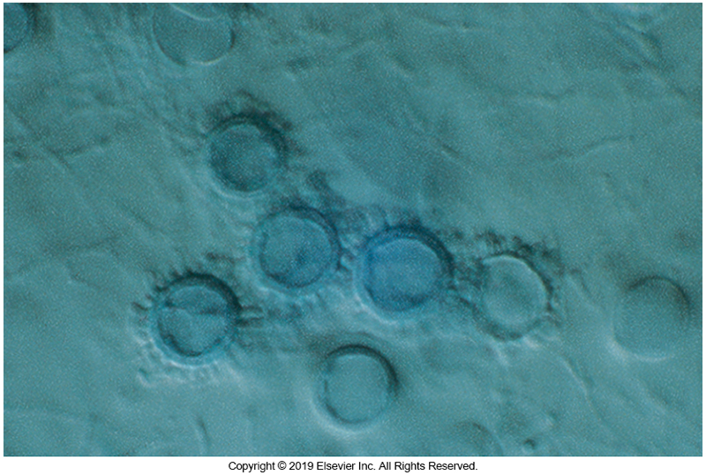
Large Tuberculate Macroconidia

Slide 35
Paracoccidioides Clinical Manifestations
Causative agent of paracoccidioidomycosis
A chronic, progressive fungal disease
Pulmonary in nature
Infection is usually unapparent and asymptomatic.
Subsequent dissemination leads to ulcerative granulomatous lesions of the buccal, nasal, and occasionally gastrointestinal mucosa.
Concomitant striking lymph node involvement is evident.
Dissemination to other organs, particularly the adrenals, occurs with compromised host defenses.

Slide 36
Paracoccidioides Clinical Manifestations (Cont.)
Endemic to Central America and South America
Highest incidents are in areas that are typically humid and experience high-rainfall, with acidic soil conditions.

Slide 37
Paracoccidioides Laboratory Diagnosis
Direct microscopic examination of cutaneous and mucosal lesions
Budding yeast cells 15 to 30 μm in diameter
Multipolar budding at the periphery resembling a “mariner’s wheel”
Daughter cells are 2 to 5 μm in size are connected by narrow base.
Buds of various sizes can occur.
Some strains may resemble a Mickey Mouse cap in appearance.

Slide 38
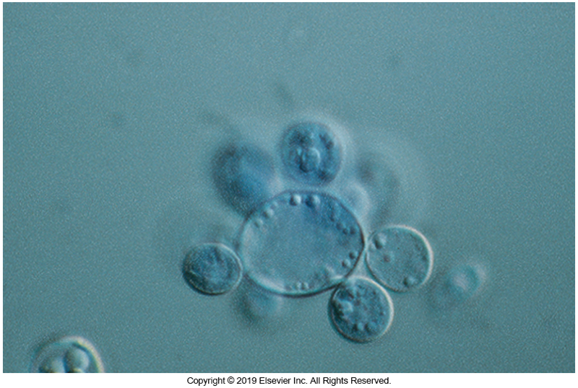
P. brasiliensis Budding Yeast Resembling a Mariner’s Wheel

Slide 39
Paracoccidioides Laboratory Diagnosis (Cont.)
Mold morphology
Vary when grown at 22° C
Flat colonies are glabrous to leathery, wrinkled to folded, floccose to velvety, pink to beige to brown with yellowish brown reverse.
Microscopically mold form produces
2 to 10 μm in diameter one-celled conidia
On BHI-blood agar, at 37°C, the mycelial phase rapidly converts to the yeast phase.

Slide 40
Talaromyces marneffei Clinical Manifestations
Formerly known as Penicillium marneffei
Common cause of systemic infections in immunocompromised patients who have visited the endemic region of Southeast Asia
Includes patients with AIDS, hematologic malignancies, or autoimmune disease and patients undergoing organ transplantations
Infections are usually disseminated with multiple organ involvement and is typically fatal.

Slide 41
Talaromyces marneffei Laboratory Diagnosis
Specimen for fungus isolation
Skin lesions or biopsy specimens
Yeast cells present resembling those of Histoplasma
Oval to cylindric, measuring 3 to 6 μm long, and may have a cross-wall
Mold form
Sparse green aerial and reddish-brown vegetative hyphae and production of a red diffusible pigment
Polymerase chain reaction (PCR) tests have been described for identification confirmation.
Serologic assays have been shown to be important in early diagnosis; however, they are not commercially available.

Slide 42
Agents of Opportunistic Mycoses

Slide 43
General Characteristics
Saprobe and saprophyte
Terms that describe free-living microorganisms in the environment that are typically not of concern in humans
The line between these two terms has been increasingly blurred due to the growing number of persons with defects in their immune systems.
Ideal points of saprophyte inoculation
Surgical wounds, skin and nail bed infections, severe respiratory infections
Members of this group of fungi are found worldwide, often associated with decaying vegetation.

Slide 44
Mucorales

Slide 45
Mucorales General Characteristics
Common environmental isolates associated with soil and plants
They contaminate grains, breads, and fruits
Most often associated with infections of the sinuses, lungs, and skin of immunocompromised
Diabetics is a significant risk factor for these infections.

Slide 46
Cunninghamella
During disseminated disease can be recovered from sinuses or affected organs
Sporangiophores are erect, branching into several vesicles that bear sporangioles, and may be covered with long, fine spines.
Colony morphology
Cottony, initially white, becoming gray with age

Slide 47
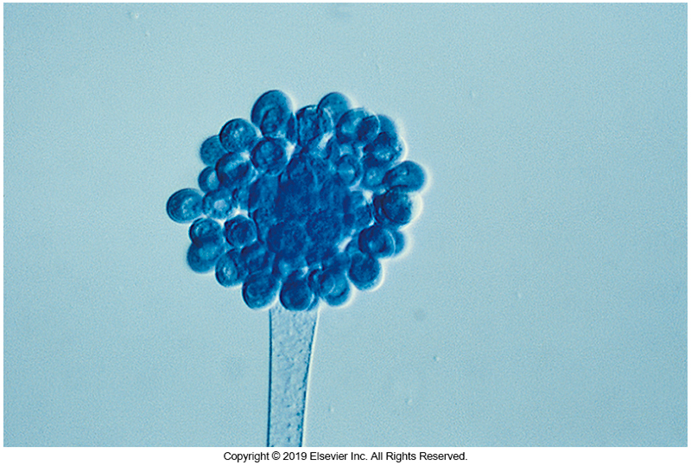
Cunninghamella LPCB Prep

Slide 48
Lichtheimia
Clinical significance
Causes vascular invasion, causing thrombosis and necrosis of the tissues
Usually found in patients with poorly controlled diabetes
Infection usually begins in the sinuses.
Rapidly spreads to orbits, face, palate, brain- a presentation known as rhinocerebral mucormycosis
Found worldwide
Soil of decomposing organic matter

Slide 49
Lichtheimia (Cont.)
Hyphae are broad and ribbon-like, with few septations
Erect sporangiophores, solitary or in groups (slightly branched), terminate in an apophysis surrounded by a sporangium.
Sporangiospores are smooth and ovoid.

Slide 50
Lichtheimia (Cont.)
Internodal rhizoids (short, thin projections that anchor the growing cells to substratum) are present.
Colonies are woolly and grow rapidly, completely covering the culture medium.
Colony color is initially white, becoming gray to gray-brown with age.

Slide 51
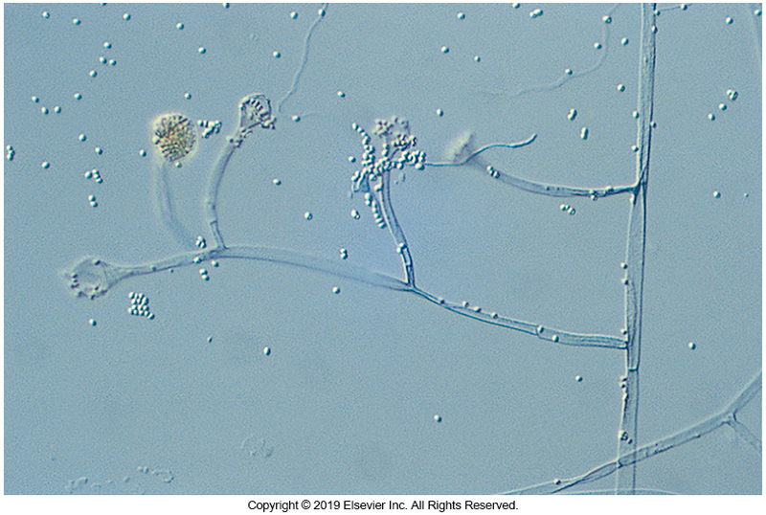
Lichtheimia

Slide 52
Mucor
Clinical significance
Rhinocerebral zygomycosis
Disseminated disease
Isolated from the environment worldwide

Slide 53
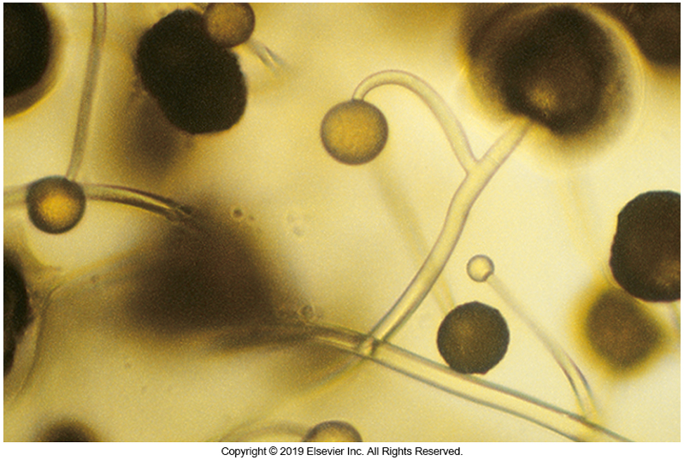
Mucor (Cont.)
Rhizoids are absent in most species.
The sporangia frequently remain intact, as opposed to Rhizopus spp., in which the sporangia typically collapse.
Mucor spp. grow rapidly and form cottony, dirty white colonies that become mousy brown to gray with age.

Slide 54
Rhizopus
Most common zygomycete that causes human disease
Typically involved in diabetic patients with ketoacidosis presenting as rhinocerebral mucormycosis
May be refractory to treatment
May be recovered from almost any source
Worldwide distribution
Isolate easily recovered from the environment in decaying vegetation

Slide 55
Rhizopus
Rhizopus spp. are rapidly growing and have erect sporangiophores terminating in dark sporangia and sporangiospores.
At the base of the sporangiophores are brown rhizoids.
Separate clusters of sporangiophores are joined by stolons, arching filaments that terminate at the rhizoids.

Slide 56
Rhizopus (Cont.)
The sporangia are typically fragile and are not easily retained when making slide culture preparations, resulting in an umbrella-shaped structure at the end of the conidiophores.
Rhizopus spp. produce rapidly growing, woolly colonies that cover the entire surface of the culture medium.
Colonies are initially white but become gray to brown with age

Slide 57
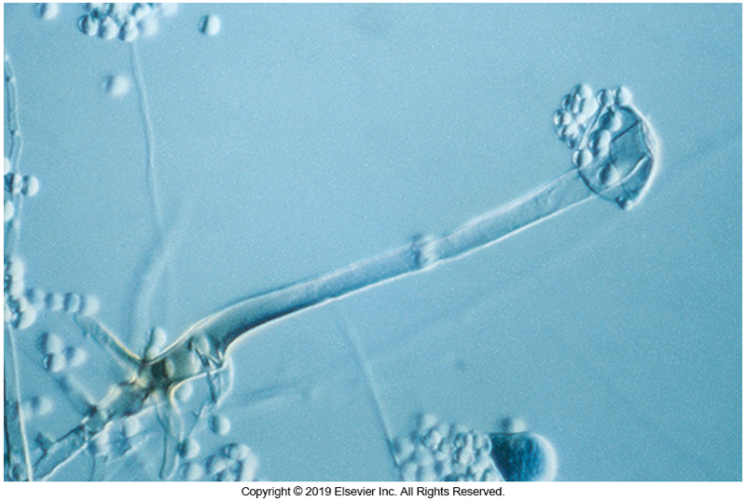
Rhizopus

Slide 58
Syncephalastrum
Rarely implicated in human disease but has been documented in cutaneous infections
Found in soil and decaying vegetation
Microscopically, erect sporangiophores
Each sporangiophore has a large columella on which merosporangia, containing stacks of sporangiospores, are formed.

Slide 59
Syncephalastrum (Cont.)
Isolates are sometimes confused with Aspergillus on initial examination.
Colonies are rapidly growing and are initially white and become gray with age.
The growth rate is rapid, with colonies covering the entire surface of the agar.

Slide 60
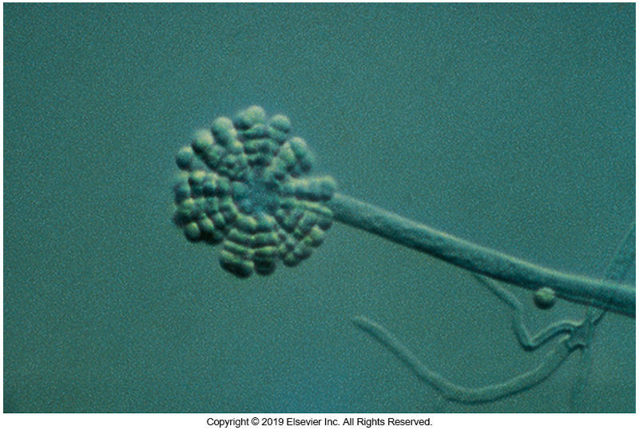
Syncephalastrum

Slide 61
Septate and Hyaline Saprobes

Slide 62
Aspergillus
Ubiquitous environmental saprobes and can frequently be isolated from a number of hospital sites, including ventilation systems and food.
Pathogenic species of Interest
A. fumigatus—species most often seen
A. flavus
A. terreus
A. niger

Slide 63
Aspergillus (Cont.)
Route of transmission
Conidia are constantly inhaled.
Readily cleared in healthy, immunocompetent individuals
Mortality from infections remains high, in the immunocompromised host particularly in neutropenic individuals
The most frequent cause of disease in bone marrow transplant recipients, in addition to other transplant recipients and those with cancer.

Slide 64
Aspergillus (Cont.)
Infection is initiated following inhalation of conidia.
In the lung air spaces, conidia germinate into hyphae, which invade the tissue, including blood vessels.
Pneumonia-like symptoms are common.
The infection easily spreads hematogenously, and it is not uncommon to find multiorgan system involvement, including the brain, liver, heart, and bone.

Slide 65
Aspergillus (Cont.)
Aspergillus spp. also trigger allergic reactions and are a common cause of sensitivities to molds.
Another frequent presentation is that of so-called “fungus balls” in the lungs of agricultural workers who routinely are in contact with fungal conidia from environmental sources.
Chronic pulmonary aspergillosis may occur in patients with structural damage to their lungs caused by other diseases, including tuberculosis and sarcoidosis.

Slide 66
Aspergillus (Cont.)
Appearance
Uniseriate or biseriate
Uniseriate species have phialides attached directly to the vesicle at the end of the conidiophore.
Biseriate species possess a supporting structure—metula that attach directly to the vesicle with phialides attached to each metula.
Conidia are produced from the phialides.

Slide 67
Aspergillus (Cont.)
Appearance
An erect conidiophore arising from a foot cell within the vegetative hyphae
It is also important to note whether or not phialoconidia remain in long chains or are easily disturbed into individual phialoconidia.
Chains of conidia may be
Aligned in very straight columns or
In a radiating pattern around the vesicle.
The conidia may be rough or smooth.

Slide 68
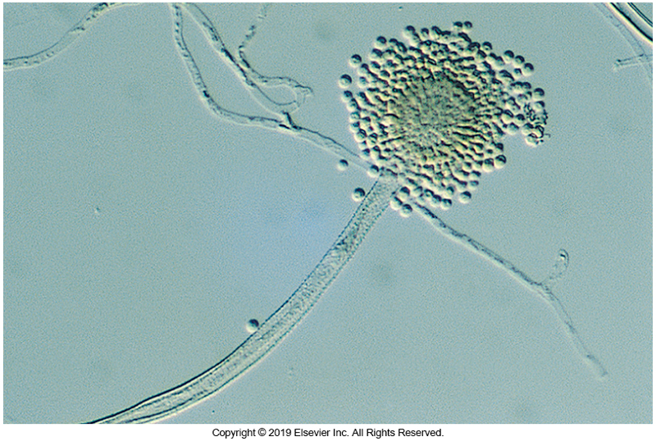
Aspergillus

Slide 69
Aspergillus (Cont.)
Colony appearance
Color is derived from the conidia and range from black to white and include yellow, brown, green, gray, pink, beige, tan.
Some species have diffusible subsurface pigments on a variety of media.
Most known pathogens form green- to tan-colored colonies.
Although some are easily distinguished from others, molecular and proteomic tests aid in definitive identification at the species level.

Slide 70
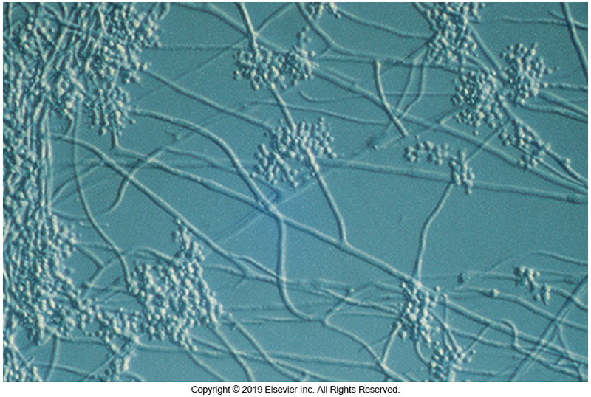
Other Saprobes Beauveria
Beauveria
Rare isolate
Causes keratitis

Slide 71
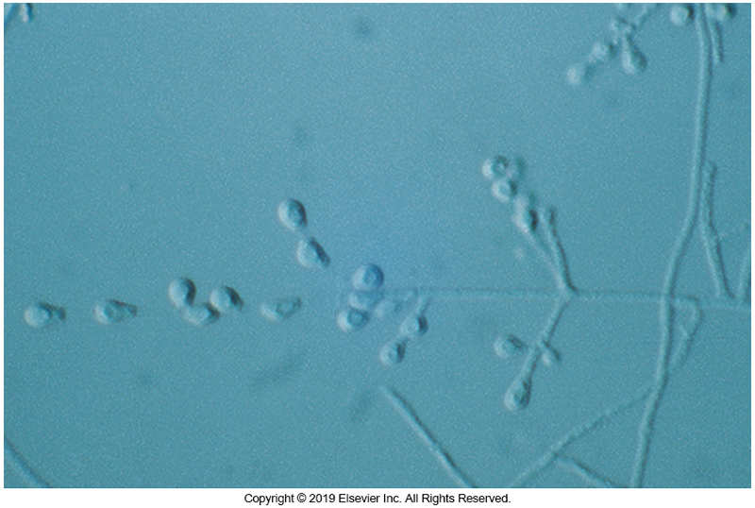
Other Saprobes Chrysosporium sp.
Chrysosporium
Rare isolate
Causes skin and nail infections

Slide 72
Fusarium
Frequently seen in mycotic keratitis
2006 Outbreak in the U.S.
More than 100 individuals wearing soft contact lenses
Specific contact lens solution
Occurred typically in patients who wore contacts continuously without removal for several days at a time
In bone marrow transplant recipients with infections caused by fusaria, the mortality rate approaches 100%.

Slide 73
Fusarium (Cont.)
Unless a patient regains some cell-mediated immunity, mortality is certain because of the ability of these fungi to grow and continue to invade despite antifungal therapy.
Patients present with high fever, possibly disseminated skin lesions, and in some patients, fungemia.
Fusarium spp. can be recovered in blood culture systems.
Care should be taken when reviewing positive blood cultures because isolates typically appear yeastlike on initial recovery.

Slide 74
Fusarium (Cont.)
Abundant macroconidia with fewer microconidia are produced on vegetative hyphae.
Macroconidia
Banana or canoe shaped
Typically are multicelled
Appear singly, in small clusters, or clustered together in mats termed sporodochia.
Rapid grower that can develop various colors with age, ranging from rose to mauve to purple to yellow.

Slide 75
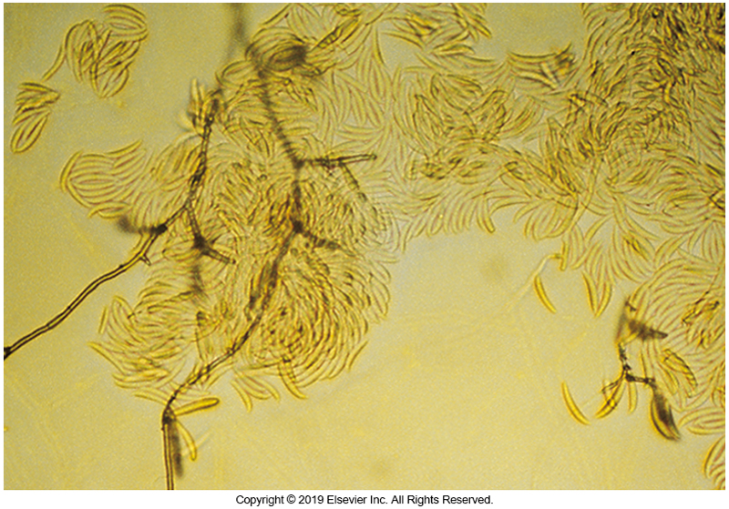
Fusarium sp.

Slide 76
Geotrichum
Pulmonary disease in immunocompromised
Microscopic evaluation reveals abundant arthroconidia formed from vegetative hyphae that occur singly or may be branched
Colonies appear white to cream and yeastlike and can be confused with Trichosporon spp.
Occasionally, aerial mycelium forms, producing colonies that resemble those of Coccidioides spp.

Slide 77
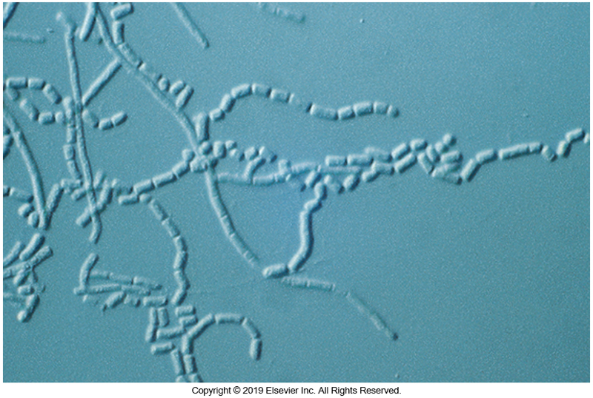
Geotrichum sp.

Slide 78
Purpureocillium
Associated with
cutaneous and subcutaneous infections
pyelonephritis, endocarditis, and pulmonary infections in immunocompromised and immunocompetent patients.
Evaluate carefully to avoid confusion with Penicillium spp.

Slide 79
Purpureocillium
Appearance of phialides
Long and obviously tapered
Arranged singly or arranged in a verticillate pattern on which long chains of spindle-shaped or somewhat cylindric conidia are formed
Flat, granular to velvety, tan, brownish gold, or mauve colonies
Molecular testing is recommended to get a definitive species identification.
Infections are potentially serious and difficult to treat.

Slide 80
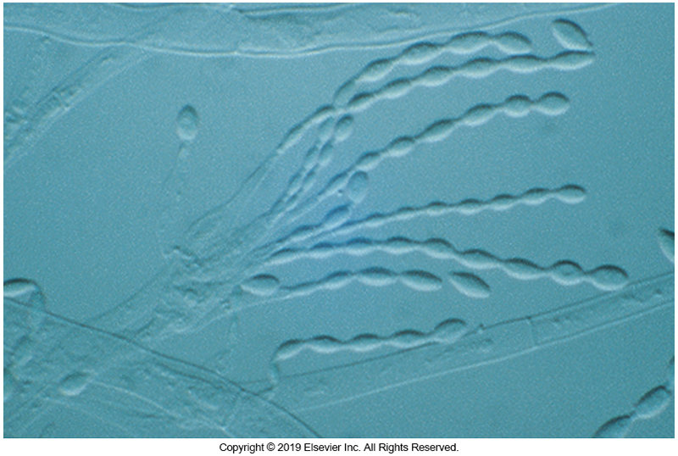
Purpureocillium sp.

Slide 81
Penicillium
Because many Penicillium spp. are inhibited at 37°C, they do not frequently cause infections.
Most reports of disease involve chronic fungal sinusitis.
Ubiquitous in nature
Worldwide distribution

Slide 82
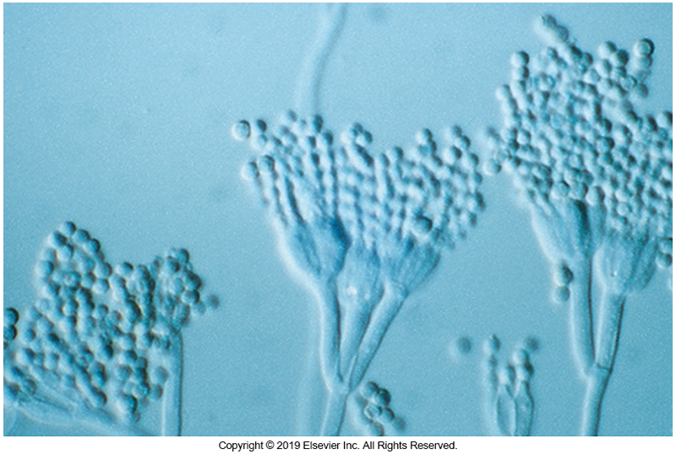
Penicillium (Cont.)
Conidiophores are erect, sometimes branched, with metulae bearing one or several phialides on which oval to ovoid conidia are produced in long, loose chains).
A rapid grower, colonies usually in shades of green or blue-green

Slide 83
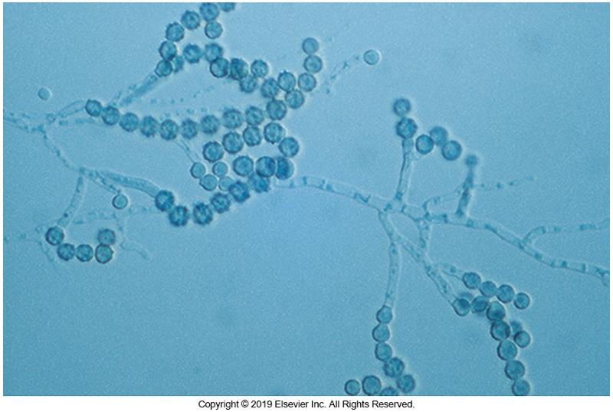
Other Saprobes Scopulariopsis sp. (Cont.)
Nail specimens
Implicated in pulmonary disease in immunocompromised
Tan to buff conidia

Slide 84
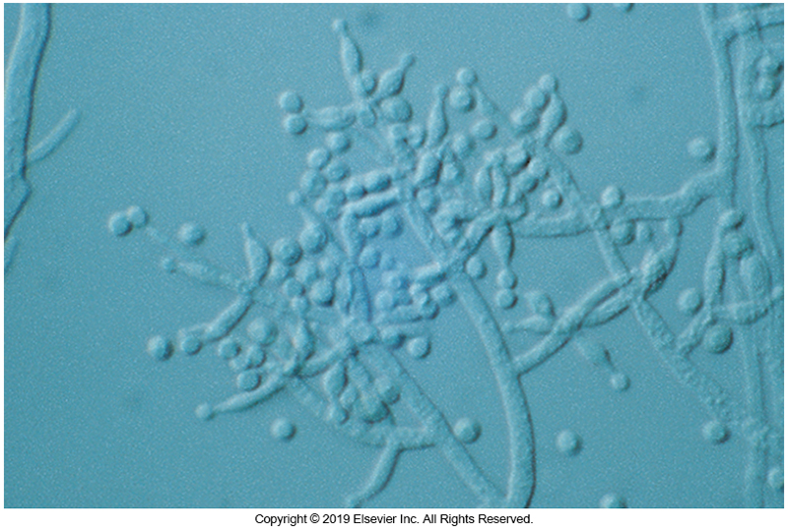
Other Saprobes Trichoderma sp.
Emerging pathogen in immunocompromised
Pulmonary and skin infections
Rapid growth, yellow-green to green conidia

Slide 85
Septate And Phaeoid Saprobes

Slide 86
Alternaria
Primarily implicated in chronic fungal sinusitis. Often misdiagnosed and patients are treated for bacterial sinusitis
Found worldwide on grasses and leaves
Implicated in tomato rot

Slide 87
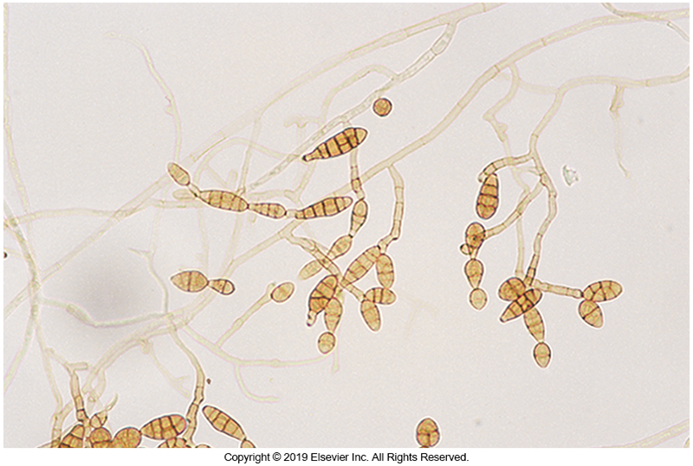
Alternaria (Cont.)
Short conidiophores with conidia that lengthen in acropetal fashion
Angular cross-walls and taper toward distal end
Phaeoid
Rapid grower
colonies ranging from shades of gray to brown to black

Slide 88
Aureobasidium
Rare but found in contaminated dialysis lines, catheters, and similar devices
Recovered from blood, tissues, abscesses
Worldwide distribution in wet environments
Hyaline hyphae gives rise to hyaline conidia directly from the vegetative hyphae.

Slide 89
Aureobasidium (Cont.)
With age, phaeoid hyphae develop and break up into arthroconidia, which do not bear hyaline conidia.
Arthroconidia are responsible for the darkening colony morphology.
Grow moderately rapidly to significantly rapidly and have a yeastlike consistency.
Young cultures are off-white to pink, but they become black with age, with the production of darkly pigmented arthroconidia.

Slide 90
Chaetomium
Infections of the brain of patients with central nervous system (CNS) disease
Pineapple-shaped peritheca
Curled or straight curled hairs or setae
Colonies are moderately rapid to rapidly growing and begin dirty gray and become phaeoid with age.
Some species produce a diffusible pigment that turns the agar completely red.

Slide 91
Cladosporium
Infrequent cause of disease
Primarily recovered as laboratory contaminants
Infections are typically confined to the sinuses or following traumatic inoculation.
Ubiquitous in nature, this isolate can be recovered from almost any location in the world.

Slide 92
Cladosporium (Cont.)
Cladosporium spp. form brown to olive to black hyphae and conidia.
Conidiophores are erect and can branch into several conidiogenous cells.
Spherical to ovoid conidia form blastically on the end of each previously formed conidium.
Branched conidium-bearing cells may dislodge, and the three scars on each of these cells give them the appearance of a shield.

Slide 93
Cladosporium (Cont.)
Generally, conidial chains of the saprobic species break up easily, whereas those of pathogenic species remain connected.
These organisms are slowly to moderately growing phaeoid fungi, with granular velvety to fluffy colonies, ranging in color from olive to brown or black.

Slide 94
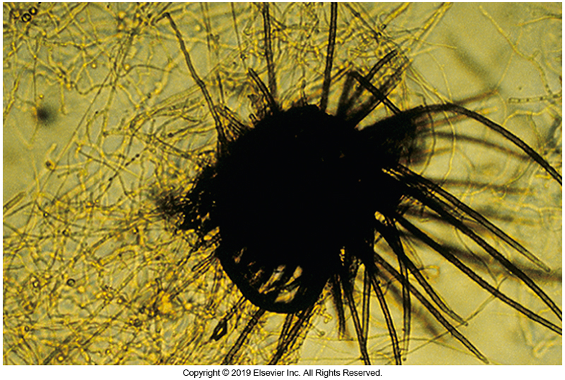
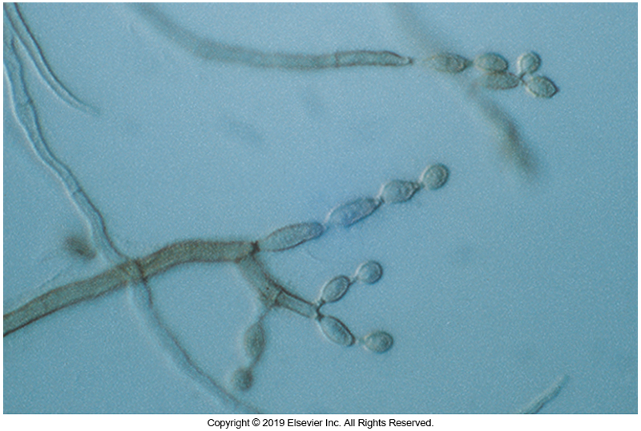
Chaetomium sp. (Left) Cladosporium sp. (Right)

Slide 95
Curvularia
Chronic sinusitis in immunocompromised patients
Recovered from leaves, grass, decaying vegetation
Multicelled conidia produced on sympodial conidiophores
Frequently seen crescent-shaped conidia with three to five cells of unequal size and enlarged central cell
Rapidly growing phaeoid colony that is cottony and dirty gray to black.

Slide 96
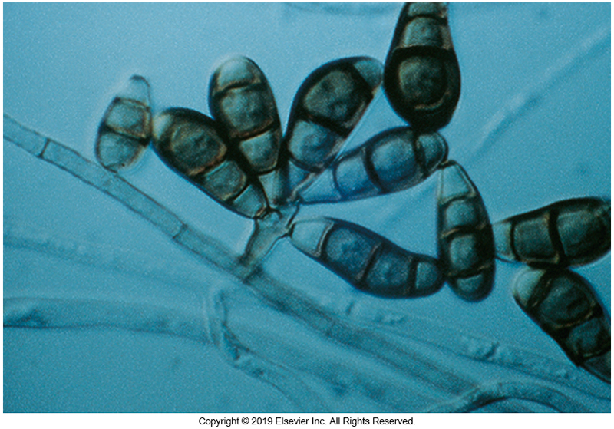
Curvularia sp.

Slide 97
Phoma and Pithomyces
Phoma
Pycnidia appearing as black fruiting bodies that globose and lined inside with short conidiophores
Moderately rapid growing gray to brown colonies
Pithomyces
Barrel shaped singly on short conidiophores
Transverse and longitudinal cross-walls and often echinulate
Rapidly growing phaeoid colonies

Slide 98
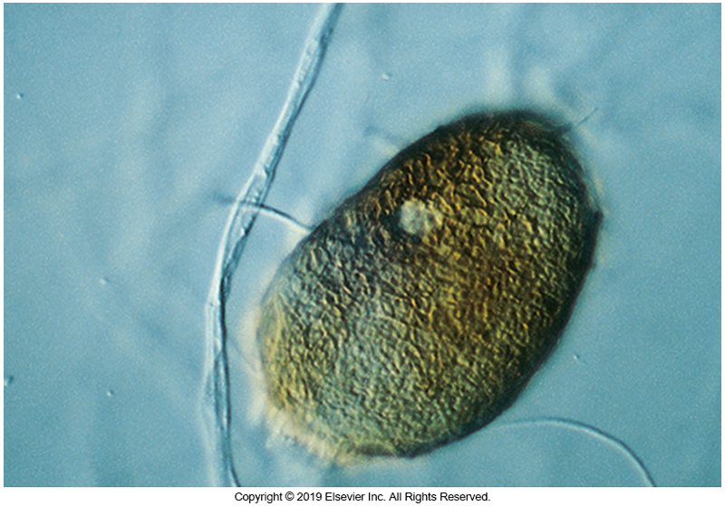
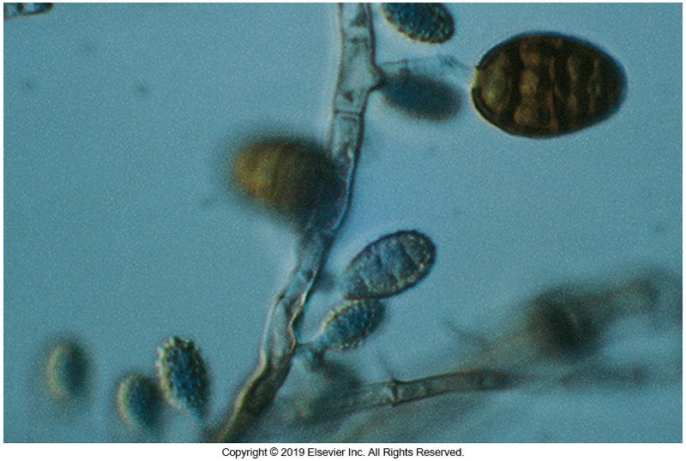
Phoma sp. (Left) Pithomyces sp. (Right)

Slide 99
Ulocladium
Occasional subcutaneous infections
Usually following traumatic inoculation
Dark multicelled conidia on sympodial conidiophores
Conidia have angular cross-walls echinulate surfaces, in some species
Colonies are brown to olivaceous to black
Rapidly growing

Slide 100
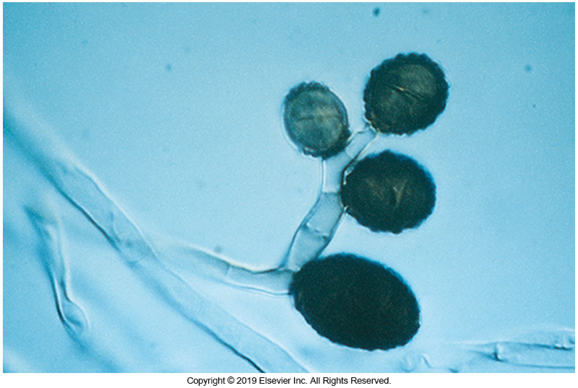
Ulocladium sp.

