Slide 1
Chapter 27
Medically Significant Fungi
PART THREE

Slide 2
Agents of Yeast Infections

Slide 3
Incidence and Classification
Escalating incidence
Provides evidence for identifying yeasts a species level
Classified into two groups based on reproduction characteristics
Those who reproduce sexually by forming ascospores or basidiospores are truly yeasts.
Isolates not capable of sexual reproduction are termed yeastlike fungi.
All organisms are referred to here as yeasts.

Slide 4
General Characteristics
Colony characteristics
Colony color
Ranges from white to cream or tan, with some species forming a pink- to salmon-color
Some yeasts are referred to as phaeoid yeasts, are darkly pigmented because of melanin in their cell walls.
Colony texture
Mucoid and flowing across the culture plate
Butter-like
Velvety to wrinkled
Strain-to-strain variation in texture may be noted within a species

Slide 5
Candida Characteristics
Disease ranges from superficial skin infections to systemic disease.
Candida albicans
Premier cause of yeast infection in the world
May be opportunists in immunocompromised people
Recovered as normal biota from multiple sites
Skin, oral, mucosa, digestive tract, vagina
When host conditions are altered, disease may ensue

Slide 6
Candida Species
Candida albicans
Thrush
Recognized as in indicator of immunosuppression
Can evolve into serious infection in patients receiving long-term antibiotics or other chemotherapeutic agents
Serious infection capable of dissemination
Candida glabrata
May account for 21% of all urinary yeast isolates
Tend to be aggressive and difficult to treat with traditional antifungal therapy in patients with multiple comorbidities

Slide 7
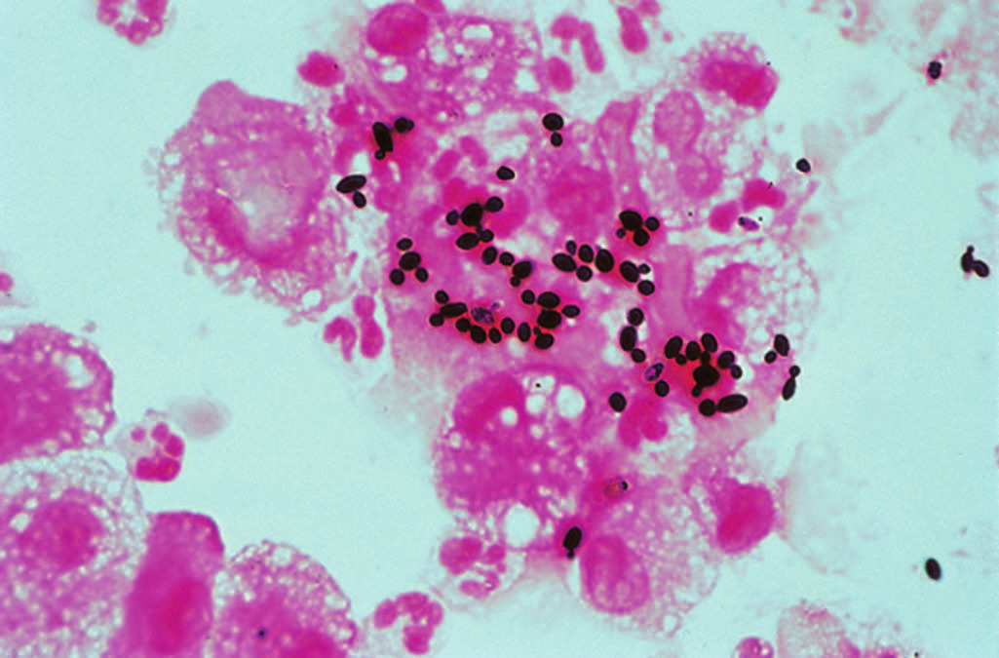
Bronchoalveloar lavage. Gram-positive yeasts with buds, morphology consistent with Candida spp.

Slide 8
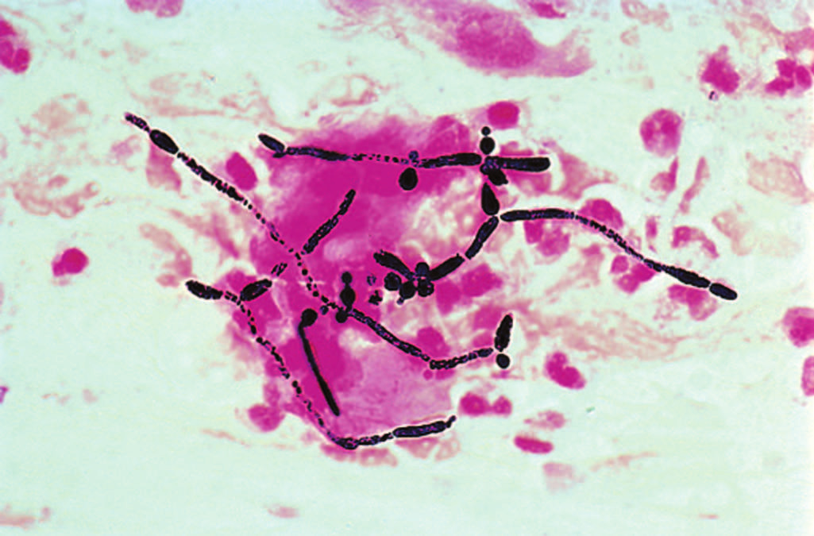
Expectorated sputum. Gram-positive pseudohyphae morphology consistent with Candida spp.

Slide 9
Candida Species (Cont.)
Candida auris
An emerging multidrug-resistant yeast linked to high mortality rates in hospital-acquired infections worldwide
In hospital setting, likely transmitted patient to patient
Colonized patients should be placed on contact precautions (recommendation of the CDC).
MALDI-TOF mass spectrometry can identify this species.

Slide 10
Candida Species (Cont.)
Other notable species
Candida krusei
Candida tropicalis
Candida parapsilosis
Becoming major cause of outbreaks of nosocomial infections
Species can be distinguished by differences in their carbohydrate assimilation patterns and other secondary procedures.

Slide 11
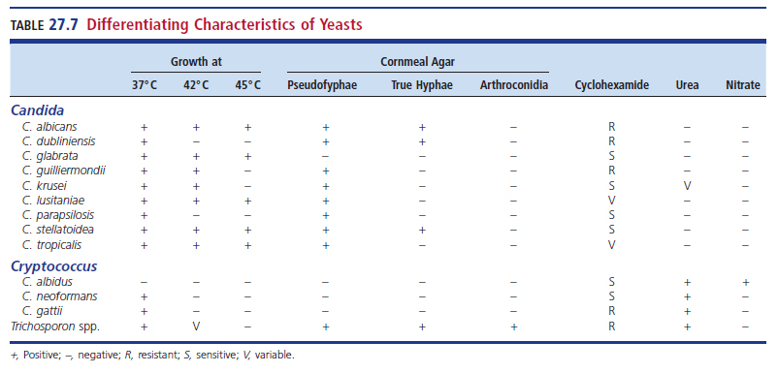
Differentiating Characteristics of Yeast

Slide 12
Cryptococcus
Important cause of meningitis, pneumonia, and septicemia
Most notable species
C. neoformans species complex
C. neoformans and C. deneoformans
Major cause of opportunistic infection in patients with AIDS
Organisms are commonly found in soil contaminated with pigeon droppings
Most likely mode of transmission- inhalation

Slide 13
Cryptococcus
Emerging pathogens, particularly in the Pacific Northwest of the U.S. and Canada
Members of the C. gattii species complex (C. gattii, C. bacillisporus, C. deuterogattii, C. tetragattii, and C. decagattii)
C. gattii can also cause disease in immunocompromised patient immunocompetent hosts

Slide 14
Cryptococcus (Cont.)
Cryptococcus spp. express a capsule (Fig. 27.61) that produces the characteristic mucoid colony.
The capsule can be detected surrounding the budding yeast in CSF with the aid of India ink or nigrosin.
The background fluid is black, and clear unstained halos are seen around individual yeast cells.
Because of its low sensitivity, the use of India ink preparation is being replaced by cryptococcal antigen tests.

Slide 15
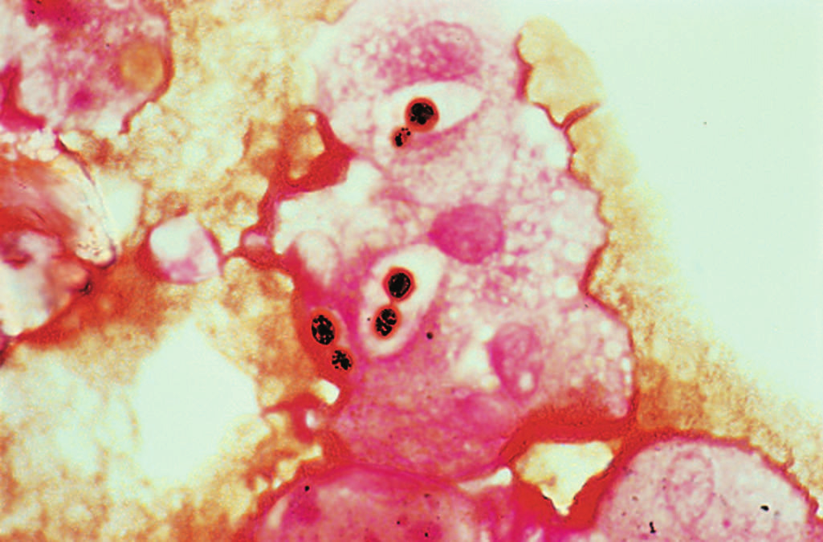
Bronchoalveolar lavage Gram-variable yeast with capsules morphology suggests Cryptococcus spp.

Slide 16
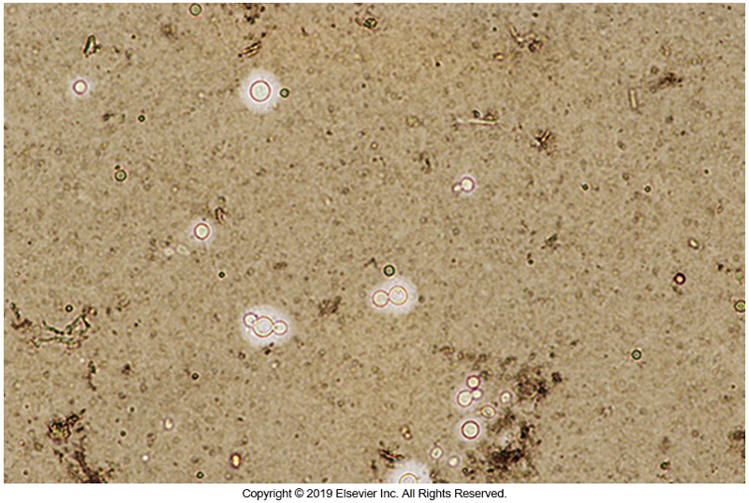
India Ink Preparation Showing Cryptococcus

Slide 17
Cryptococcus (Cont.)
The cryptococcal antigen assays and an easy-to-use lateral-flow assay are recommended for routine use in clinical microbiology laboratories.
The antigen assays detect both C. neoformans and C. gattii species complexes in CSF and serum.

Slide 18
Cryptococcus (Cont.)
Cryptococcus spp. are noted for producing blastoconidia only, without producing true hyphae or pseudohyphae on cornmeal agar.
It is extremely difficult to distinguish members of the C. neoformans and C. gattii species complexes from each other.

Slide 19
Cryptococcus (Cont.)
A key laboratory characteristic is that members of the C. gattii species complex use glycine as a sole carbon and nitrogen source in the presence of canavanine, whereas C. neoformans does not.
Canavanine glycine bromothymol blue agar is commercially available for this purpose and can be used to help differentiate between these species complexes

Slide 20
Rhodotorula
Noted for bright salmon-pink color
Resemble Cryptococci
Possess a capsule and are urea-positive
Some species also nitrate-positive
Not common agents of disease
Known to cause opportunistic infections

Slide 21
Pneumocystis

Slide 22
Pneumocystis
Pneumocystis can inhabit the lungs of many mammals.
Pneumocystis carinii was originally classified with the protozoa, but nucleic acid sequencing showed conclusively that the organism is a fungus.
It is apparent from nucleic acid studies that P. carinii is not a single species.
P. carinii is the species most commonly found in rats
P. jirovecii is the species most often recovered from humans.

Slide 23
Pneumocystis (Cont.)
Pneumocystis infection is acquired early in life
Serologic studies have found that most humans have antibodies or antigens by 2 to 4 years of age.
In immunocompetent individuals, infection is asymptomatic
However, in immunocompromised patients, serious life-threatening pneumonia can develop.

Slide 24
Pneumocystis (Cont.)
Pneumocystis initially was identified as the causative agent in interstitial plasma cell pneumonia seen in malnourished or premature infants.
Since the early 1980s, it has remained one of the primary opportunistic infections found in patients with AIDS.
A high incidence of disease also results from the use of immunosuppressive drugs in patients with malignancies and in organ transplant recipients.

Slide 25
Pneumocystis (Cont.)
Patients infected with Pneumocystis may have
Nonproductive cough
Difficulty breathing
Low-grade fever
Chest radiographs can be normal or show a diffuse interstitial infiltrate.

Slide 26
Pneumocystis (Cont.)
Life cycle
Transmission
Respiratory route
Three stages
Trophozoite
Multiply by binary fission
Precyst
Cyst
Infective stage

Slide 27
Pneumocystis (Cont.)
Life cycle
Transmission of the organism is known to occur through the respiratory route, with the cyst being the infective stage.
The spores or intracystic bodies are released from the cyst in the lung, and these trophic forms multiply asexually by binary fission on the surface of the epithelial cells (pneumocyte) lining the lung.
Sexual reproduction by trophozoites also occurs, first producing a precyst and then the cyst containing spores or intracystic bodies.

Slide 28
Pneumocystis (Cont.)
Laboratory Diagnosis
Appropriate specimens
Bronchoalveolar lavage (BAL) fluid
Transbronchial biopsy specimens
Tracheal aspirate, pleural fluid
Induced sputum
Sputum is the least productive.
Lavage and sputum specimens are often prepared using a cytocentrifuge.

Slide 29
Pneumocystis (Cont.)
Laboratory Diagnosis
Histologic stains, such as Giemsa and GMS stains, are used.
With the methenamine silver stain, the cyst wall stains black.
Cysts often have a punched-out ping-pong ball appearance.
With the Giemsa stain, the organism appears round, and the cyst wall is barely visible.
Intracystic bodies are seen around the interior of the organism.

Slide 30
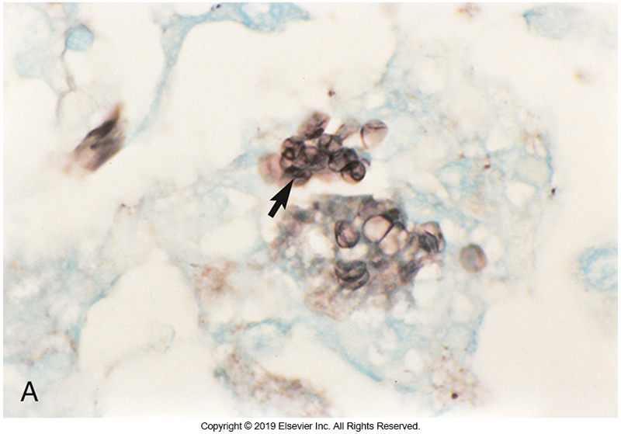
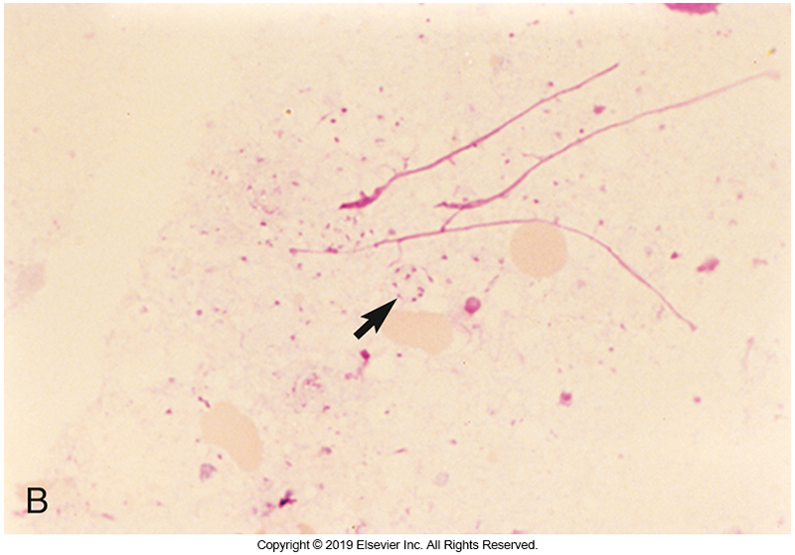
Stains of Pneumocystis
A. Cysts in silver stain; B. Giemsa stain

Slide 31
Pneumocystis (Cont.)
Laboratory Diagnosis
Calcofluor white can be used to screen specimens for Pneumocystis and other fungi.
This stain detects any organism that contains chitin in its cell wall. Fungi, yeasts, and Pneumocystis will fluoresce with a blue-white color when stained and viewed microscopically with ultraviolet light.
Immunofluorescent monoclonal antibody stains are commercially available and are widely used.

Slide 32
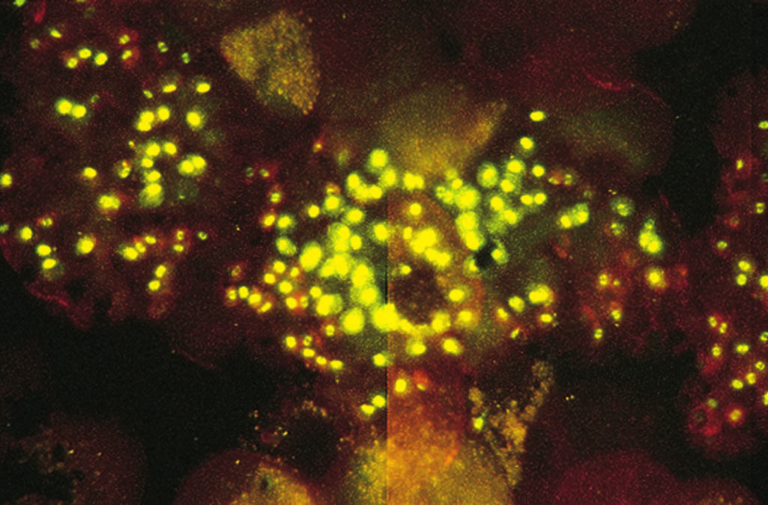
Pneumocystis jiroveci Calcoflour white stain, fluorescence microscopy

Slide 33
LABORATORY DIAGNOSIS OF FUNGI
CHAPTER TWENTY-SEVEN

Slide 34
Safety Issues

Slide 35
Safety Issues
Class II (2) biosafety cabinet
Reduces personal exposure
Enclosed electric incinerator
Eliminates the hazards of open gas flames
Use of Petri dishes is hazardous; screw-top tubes (slants) are recommended to prevent aerosols.

Slide 36
Specimen Collection, Handling,
and Transport

Slide 37
Specimen Collection, Handling, and Transport
All specimens should be transported and processed as soon as possible.
All laboratories should maintain a protocol for specimen rejection of unsatisfactory or improperly labeled specimen.
Common specimen types
Respiratory secretions, hair, skin, nails, tissue, blood, bone marrow, CSF

Slide 38
Predominant Culture Sites for Recovery of Etiologic Agents

Slide 39
Specimen Collection
Hair, skin, or nails submitted for dermatophyte culture are generally contaminated with bacteria, rapidly growing fungi, or both.
With these types of specimens, primary isolation medium should contain antimicrobial agents.

Slide 40
Specimen Types
Hair
A Wood lamp emits UV light >365 nm and can be useful in identifying infected hairs.
The Wood light can be shown on the scalp.
Sterile forceps should be used to pull affected hair.
Hairs are placed directly into a sterile Petri Dish then inoculated onto fungal medium and incubated at 22 to 30° C.

Slide 41
Specimen Types (Cont.)
Skin
Area is cleaned with 70% alcohol before sampling.
Outer edge of a surface legion is scraped.
A KOH wet mount is prepared with some of the sample collected.
KOH breaks down tissue making it easier to view fungal hyphae.
Sample material is inoculated directly onto the agar.

Slide 42
Specimen Types (Cont.)
Nails
Area is cleaned with 70% alcohol before sampling.
Nail scraping or cuttings or a complete nail may be submitted for testing.
A KOH wet mount is prepared with some of the sample collected.
Sterile scissors are used to cut complete nails into thin strips, which are used to inoculate the media.

Slide 43
Specimen Types (Cont.)
Blood and bone marrow
Lysis centrifugation system release organisms from cells
CSF (and other sterile fluids)
Concentrate via centrifugation before inoculation.
One drop for India ink or cryptococcal antigen test for C. neoformans
Directly inoculate media

Slide 44
Specimen Types (Cont.)
Abscess, wound, or tissue
Mince and grind tissue
Plate directly or perform other tests
Respiratory specimens
Plated directly or digested with mucolytic prior to plating
Urogenital or fecal specimens
Culture (yeast will grow on routine culture media)
If urine, first voided morning urine is preferred
Centrifuge to sediment

Slide 45
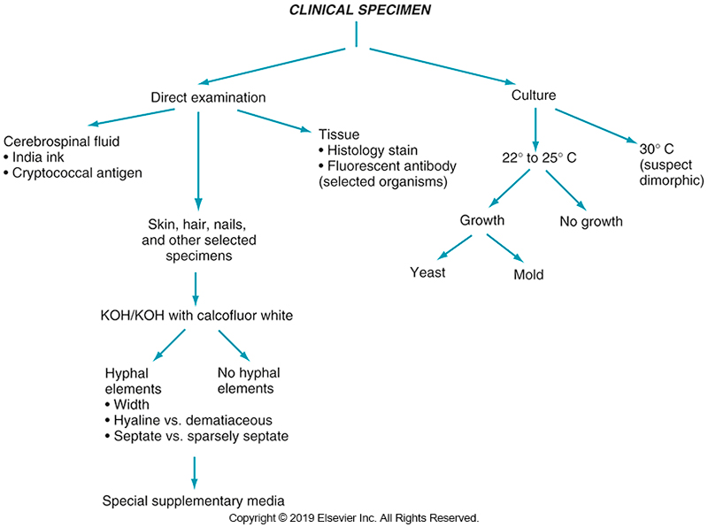
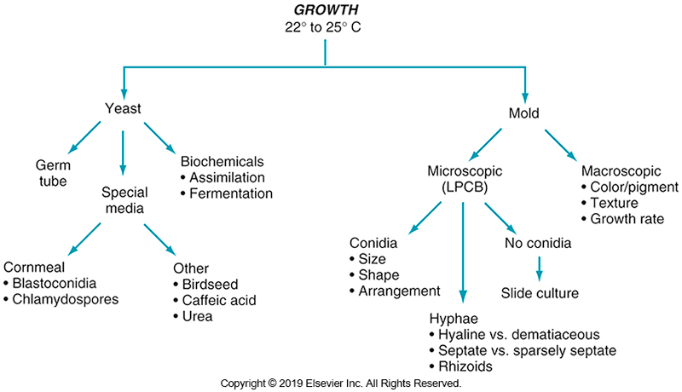
Guideline for the Identification of Fungal Isolates

Slide 46
Direct Microscopic Examination of Specimens

Slide 47
Direct Examinations of Specimens
KOH preparation
10% to 20% solution of KOH
Some may contain dimethyl sulfoxide (DMSO) and a stain
Equal parts sample to KOH
Coversliped and heated gently then cooled for 15 minutes
Purpose of KOH
Breaks down keratin and skin layers to see fungi better
KOH with calcofluor white
Dye binds to cellulose or polysaccharides present in chitin.
Apple-green or blue-white in UV light

Slide 48
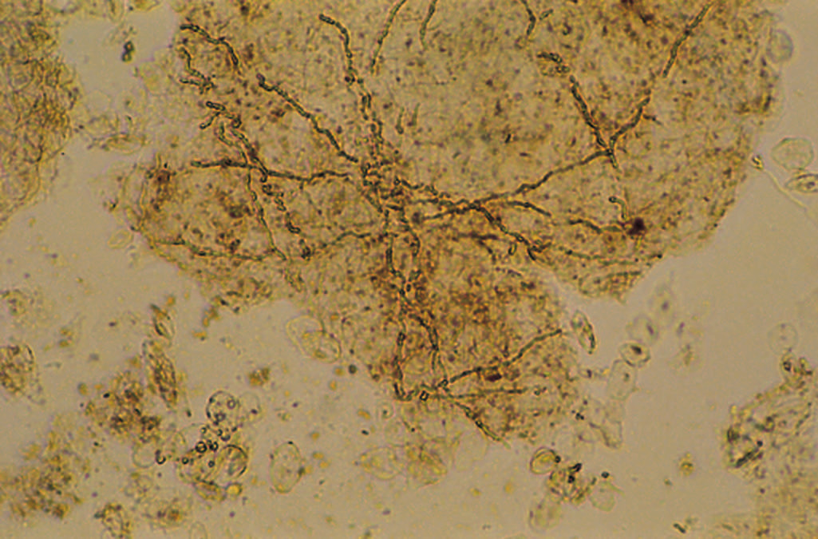
Skin scales scrapings, KOH preparation. Hyphae present.

Slide 49
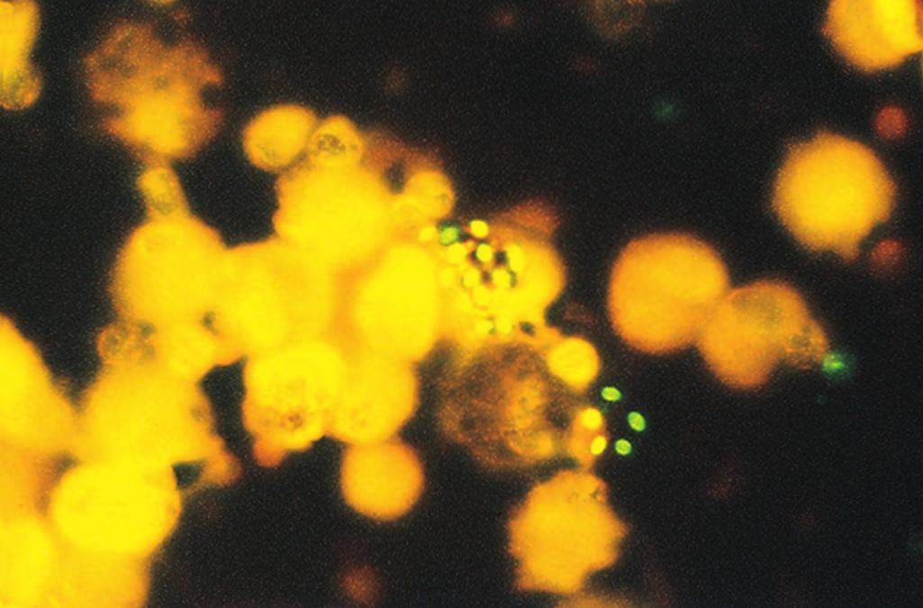
Bronchoalveolar lavage Calcofluor white stain, fluorescence microscopy. Morphology suggests Cryptococcus neoformans

Slide 50
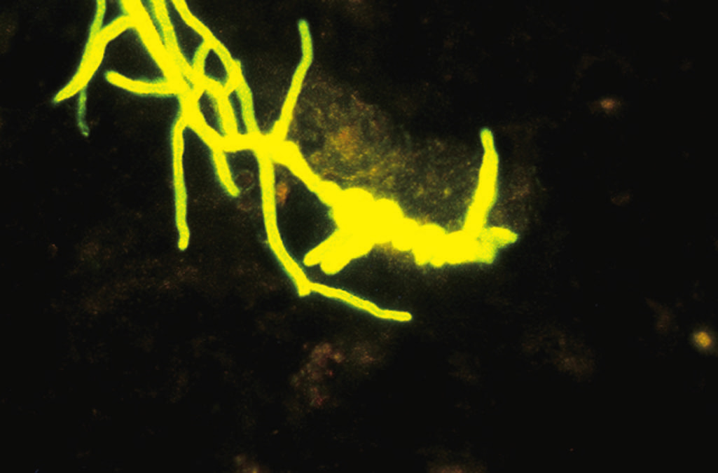
Soft tissue abscess. Calcofluor r white stain, fluorescence microscopy. Fungal hyphae

Slide 51
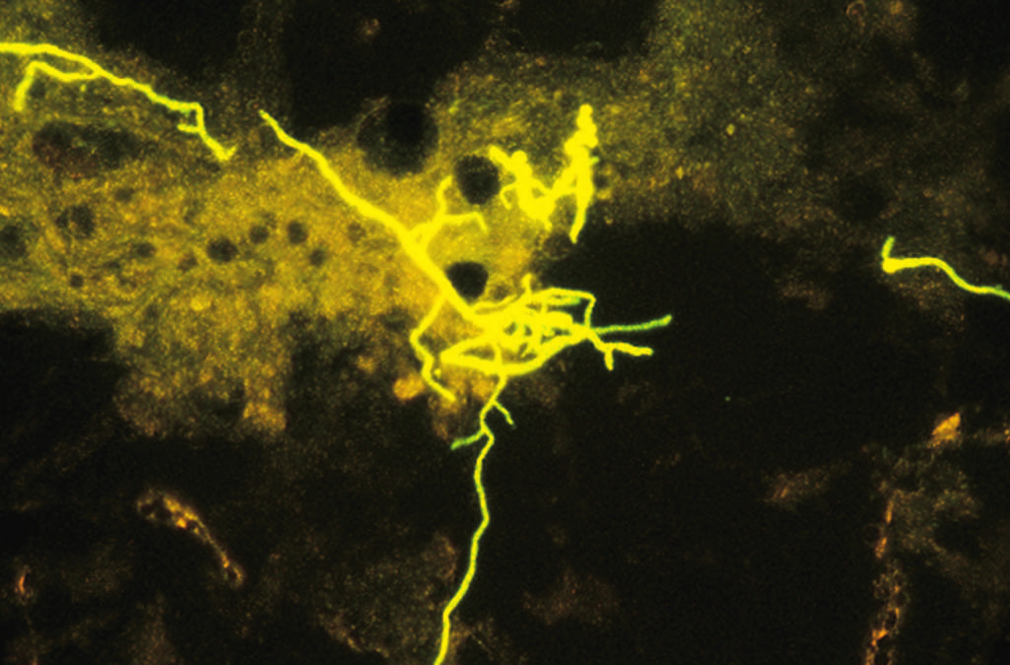
Skin scales scrapings. Calcofluor white stain, fluorescence microscopy. Fungal hyphae, thin. Suggests dermatophyte.

Slide 52
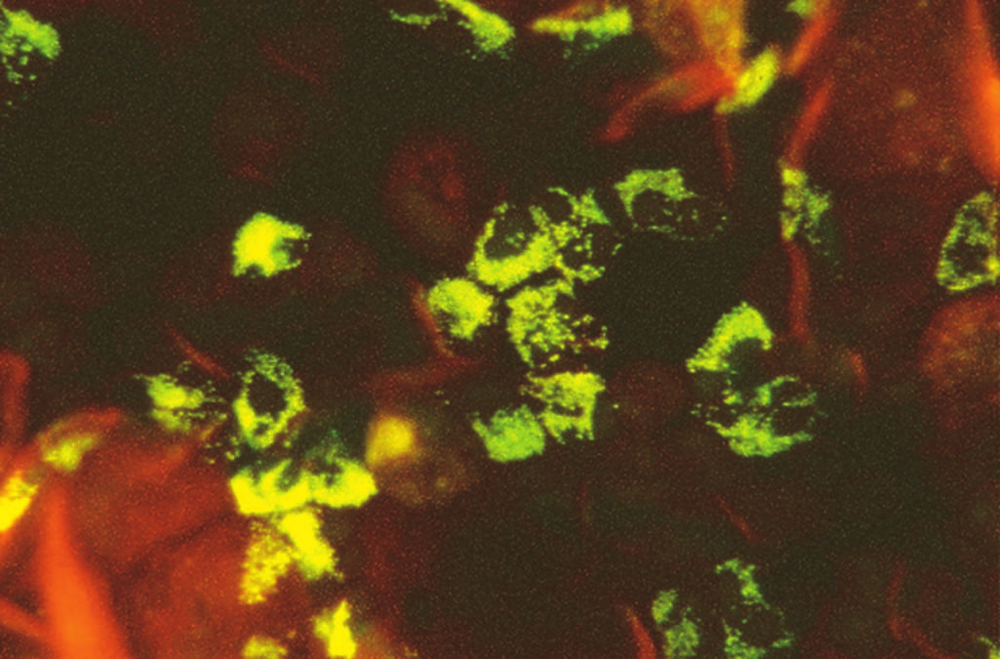
Expectorated sputum. Calcofluor white stain, fluorescence microscopy. Eosinophils

Slide 53
Direct Examinations of Specimens (Cont.)
1 drop India ink + 1 drop of CSF sediment
Black background stain
Visualize capsules of yeast or bacteria
Tissue stains
Periodic acid–Schiff (PAS)
Gomori methenamine-silver (GMS)
Hematoxylin and eosin (H&E)
Giemsa
Fontana-Masson

Slide 54
India Ink Preparation Showing Cryptococcus

Slide 55
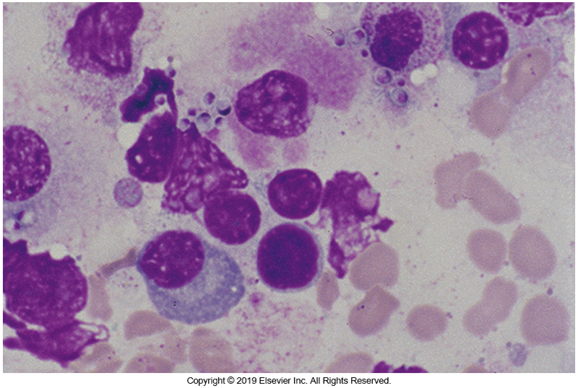
Bone Marrow stained with Giemsa Stain

Slide 56
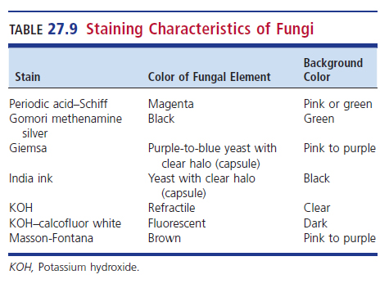
Staining Characteristics of Fungi

Slide 57
Isolation Methods

Slide 58
Isolation Methods
Culture media
Sabouraud dextrose agar (SDA) (with or without antimicrobials)
Potato dextrose agar (PDA)
Brain–heart infusion (BHI) agar enriched with blood and antimicrobials
Plates or tube media
Tubes safer to handle and less susceptible to drying

Slide 59
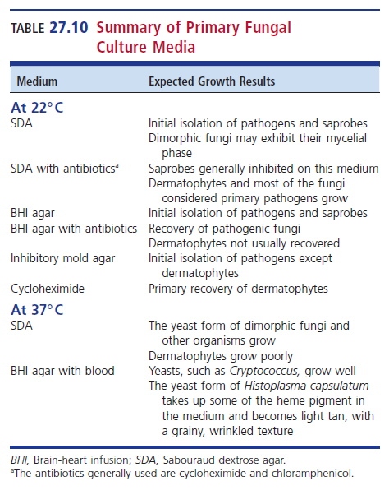
Summary of Primary Fungal Culture Media

Slide 60
Isolation Methods (Cont.)
Incubation
Room temperature or 30° C
Dimorphic at 37° C
Maintain 4 to 6 weeks.
Examine twice a week for growth.
Incubation characteristics should be recorded.

Slide 61
Fungi Identification

Slide 62
Fungal Identification
It typically takes a group of tests to sufficiently identify fungi
Typically start by determining if the isolate is a yeast or a mold.
Molds do not always produce structures to facilitate ID.
Molecular and proteomic tests can be used with traditional procedures.
DNA hybridization, DNA sequencing, MALDI-TOF, PCR

Slide 63
Macroscopic Examination

Slide 64
Macroscopic Examination
Macroscopic
Colony growth rate
Color
Texture
Pigment on reverse of colony
Microscopic
Septate versus sparsely septate hyphae
Hyaline or dematiaceous hyphae
Reproductive (fruiting) structures
Types, size, shape, and arrangement of conidia/ascospores

Slide 65
Microscopic Examination

Slide 66
Macroscopic Examination
Microscopic
Septate versus sparsely septate hyphae
Hyaline or dematiaceous hyphae
Reproductive (fruiting) structures
Types, size, shape, and arrangement of conidia/ascospores

Slide 67
Tease Mount
Tease mount
Use teasing needles or sterile applicator sticks are used to remove a portion of the mycelium from the middle third of the colony.
Mount in drop of lactophenol aniline (cotton) blue
Gently tease apart the colony and overlay with cover slip to disperse
Examine at ×100 or ×400

Slide 68
Modified Tease Mount
Modified tease mount
More practical and permits retention of more of the fruiting structure.
The mycelia are placed into a drop of LPCB on a slide but not teased apart, a coverslip is added, and the slide is examined microscopically at low and high magnifications.

Slide 69
Cellophane Tape Preparation
Cellophane tape preparation
Press cellophane tape gently but firmly to surface of the colony.
Press one side of tape to slide with drop of LPCB.
Stretch tape across slide, lowering it into the stain.
Pull taught and affix other side of tape, avoiding air bubbles.

Slide 70
Slide Culture
Slide cultures
Useful for demonstrating the natural morphology of fungal structures
Encourage conidiation in some poorly fruiting fungi.
The slide culture can be preserved for a prolong period, making those of known isolates useful for future comparison against isolates awaiting identification.
There are several methods available.

Slide 71
Miscellaneous Tests for the Identification Of Molds

Slide 72
Miscellaneous Tests for Molds
Hair perforation test
Urease test
Thiamine requirement
Trichophyton agars
Growth on rice grains

Slide 73
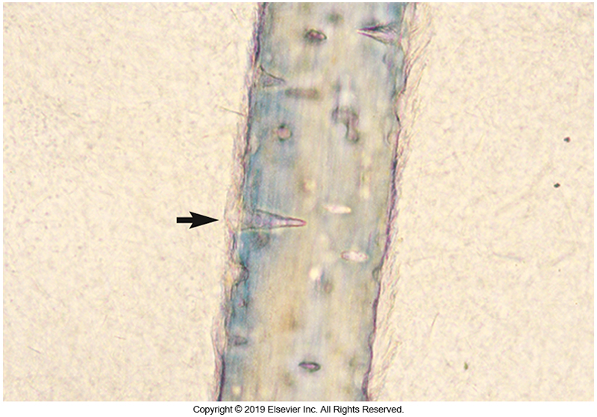
Hair Perforation Test

Slide 74
Miscellaneous Tests for the Identification of Yeasts

Slide 75
Miscellaneous Tests for Yeasts
Germ tube production
Easiest test to perform
Carbohydrate assimilation
Identifies which carbohydrates a yeast can use aerobically as a sole carbon source creating an assimilation pattern
Chromogenic substrates
Based on different colors
Cornmeal agar
For recognition of blastoconidia, chlamydoconidia, pseudohyphae, arthroconidia

Slide 76
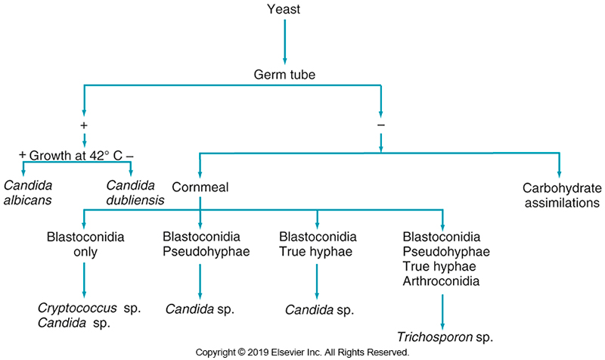
Schematic Diagram Showing Germ Tube Test to Presumptively Identify Yeasts

Slide 77
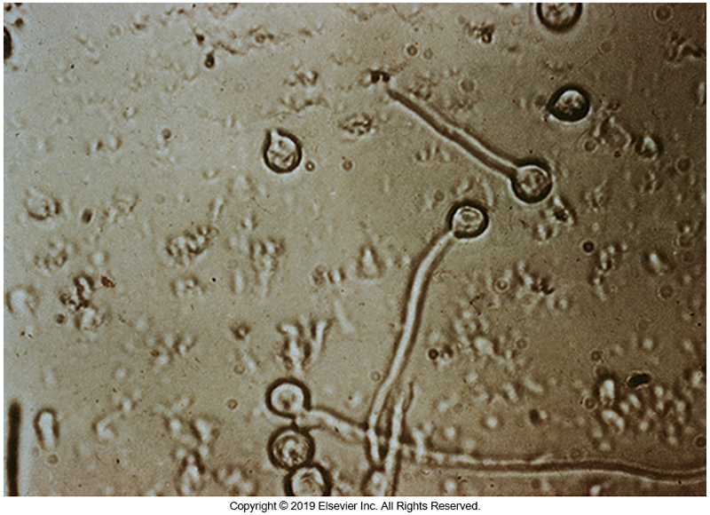
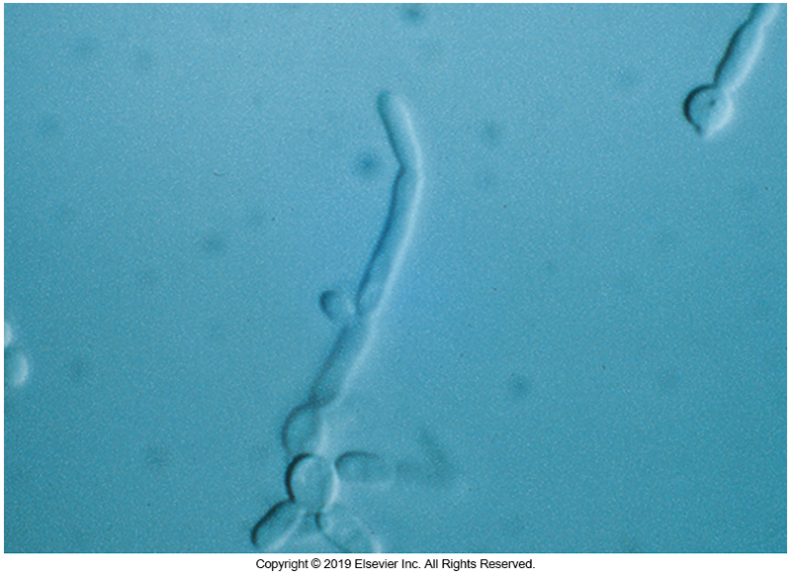
Germ Tube and Pseudogerm Tube Production

Slide 78
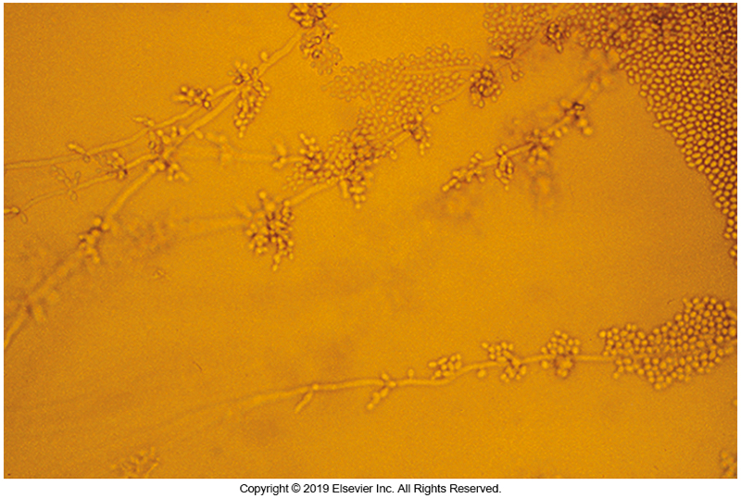
C. albicans on Cornmeal Agar

Slide 79
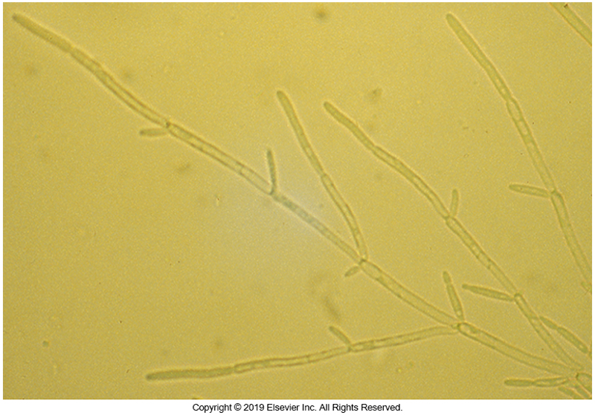
Pseudohyphae

Slide 80
Miscellaneous Tests for Yeasts (Cont.)
Potassium nitrate assimilation
Positive turns the medium blue.
Negative result turns the medium yellow.
Temperature studies
Urease
Christensen urea agar

Slide 81
Diagnosis Using Clinical Specimens and Surrogate Markers

Slide 82
(1,3)-β-D-Glucan
Important component of the cell wall of various fungi
Pathogenic yeasts
Pathogenic molds
This assay is a chromogenic test based on activation of the horseshoe crab coagulation cascade by (1,3)-β-d-glucan and uses amebocyte enzymes from Limulus polyphemus.

Slide 83
(1,3)-β-D-Glucan (Cont.)
Clinical studies have demonstrated the utility of this assay for the diagnosis of invasive fungal infections.
However, various substances as well as some bacteria can lead to false-positive results.
The cryptococci lack (1,3)-β-d-glucan, so they are negative.
In addition, this is a panfungal assay, so a positive result does not provide information on the species that may be causing infection

Slide 84
Galactomannan
A component of the Aspergillus cell wall within plasma or BAL fluid that can often be used used in the diagnosis of invasive infections caused by Aspergillus species
Is now part of the diagnostic criteria for probable invasive aspergillosis
Can be done using ELISA methods

Slide 85
T2 magnetic resonance assay
A relatively new assay for the diagnosis of invasive candidiasis combines nuclear magnetic resonance spectroscopy with PCR to detect Candida cells directly in blood samples.
This assay has excellent analytical sensitivity, being able to detect one to three colony-forming units of Candida per milliliter of blood.
The results are rapidly available, usually within 4 hours in one study.

Slide 86
Cryptococcal antigen
Can be performed on CSF or serum
Several available assays detect the glucuronoxylomannan component of the Cryptococcus antigen.
Types of assays available
Latex agglutination
EIA
Lateral flow

Slide 87
IMMUNODIAGNOSIS OF FUNGAL DISEASE
CHAPTER TWENTY-SEVEN

Slide 88
Immunodiagnosis
Skin test reactivity to fungal antigens
Uses antigen extract
Only valuable if patient has a history of a nonreactive skin test
Antibody detection assays
Most common is probably double-immunodiffusion
Individuals can have detectable antibodies but not active infection.
Interlaboratory discrepancies have been reported.

Slide 89
ANTIFUNGAL SUSCEPTIBILITY
CHAPTER TWENTY-SEVEN

Slide 90
Antifungal Agents

Slide 91
Antifungal Agents
Current options for treating fungal infection include drugs primarily from four classes
polyene, azole, echinocandin, and allylamine.
For many years, the primary antifungal agent was amphotericin B, a polyene.
This agent has a broad spectrum of activity in addition to fungicidal activity.
Not only is this agent lethal to fungi, but it is also toxic to patients.

Slide 92
Antifungal Agents (Cont.)
The class with the largest number of agents is the azoles.
The most noteworthy compounds in this class include fluconazole, itraconazole, isavuconazole, posaconazole, and voriconazole.
The azoles are important because they exhibit reasonable activity against fungi while causing fewer side effects.
Fluconazole is the leading agent for treating yeast infections but has limited to no activity against molds.

Slide 93
Antifungal Agents (Cont.)
Other agents worth noting
Caspofungin, a member of the echinocandins group
The CDC recommends an echinocandin for the treatment of invasive C. auris infections.
Two FDA-approved allylamines are terbinafine and naftifine.
Terbinafine may be given orally or applied topically and is active against several groups of fungi, including the dermatophytes.
Naftifine is used only topically.

Slide 94
Antifungal Susceptibility Testing

Slide 95
Antifungal Susceptibility Testing
Clinical and Laboratory Standards Institute (CLSI) standards
M27 for yeast testing, M38 for mold testing, M44 for disk diffusion testing for yeasts, and M51 for disk diffusion testing for molds.
Fungal susceptibility testing is gaining popularity.

Slide 96
Antifungal Susceptibility Testing (Cont.)
The largest barrier to widespread antifungal testing is the lack of established breakpoints for most of the agents.
Breakpoints are now species specific by drug, with results placing the organism categorically in the same manner as bacteria.
The specifics vary by antifungal agent type.
Until other drugs are studied, and breakpoints are established, the usefulness of antifungal susceptibility testing will most likely remain limited.

Slide 97
POINTS TO REMEMBER
Yeasts typically reproduce by budding, whereas molds often reproduce by forming conidia/spores.
A large array of fungi are capable of causing human infections.
Fungi can be isolated from almost any type of clinical specimen

Slide 98
POINTS TO REMEMBER
Fungal identification is based on a variety of characteristics
Macroscopic appearance
Microscopic appearance
Ability to grow at various temperatures
Biochemical reactions
Molecular and proteomic assays are now commonly used for fungal identification.
Phaeoid (dematiaceous) fungi produce dark pigments.
Dermatophytoses are caused by
Trichophyton, Microsporum, and Epidermophyton species.
macroscopic appearance, microscopic appearance, ability to grow at various temperatures, and biochemical reactions. Molecular and proteomic assays are now commonly used for fungal identification.

Slide 99
Points to Remember (Cont.)
The thermally dimorphic fungi
Blastomyces spp.
Coccidioides immitis
Coccidioides posadasii
Histoplasma spp.
Paracoccidioides spp.
Sporothrix schenckii species complex
Talaromyces (Penicillium) marneffei are often associated with systemic mycoses

Slide 100
Points to Remember (Cont.)
Clinically important Mucorales include
Rhizopus
Mucor
Lichtheimia
Cunninghamella
Syncephalastrum
Apophysomyces
Saksenaea
Geotrichum is a mold that is often initially mistaken for a yeast

Slide 101
Points to Remember (Cont.)
Saprobic fungi are most problematic in the immunocompromised host.
Candida albicans is the most commonly isolated yeast.
Pneumocystis jirovecii is an important pathogen in patients with AIDS.

Slide 102
Points to Remember (Cont.)
Extreme care should be taken when working with dimorphic fungi n the laboratory. Cultures for all molds should be processed in a biological safety cabinet.
Antifungal therapy is frequently ineffective when diagnosis is delayed.

