Slide 1
Chapter 28
Diagnostic Parasitology
PART ONE

Slide 2
Overview
Parasites are an important cause of human morbidity and mortality in many parts of the world.
Parasites are often associated with gastrointestinal (GI) infection or, in the case of malaria, a blood infection.
Other human organs and systems may also be infected

Slide 3
Factors Contributing to Parasite Significance
Rising number of immunocompromised patients susceptible to infections by known pathogens and opportunistic organisms
The increasing number of people who travel to countries with marginal sanitation and a large number of endemic parasites
Growing population of immigrants from areas with endemic parasites
Climate changes that might affect parasite transmission

Slide 4
Important Considerations
Important and significant information when a patient presents with an infection that may be caused by a parasite
Patient symptoms
Clinical history including travel history

Slide 5
Important Considerations (Cont.)
The primary care provider and the laboratory scientist should collaborate to ensure
the appropriate specimen is collected.
proper specimen collection, handling, and examination occur.
Parasite recovery is only as good as the adequacy of the specimen submitted and following established laboratory procedures.

Slide 6
What’s Ahead?
A discussion of the major medically important parasites, their epidemiology and life cycle, and the clinical infections they cause
The diagnostic features that characterize parasitic agents

Slide 7
General concepts in parasitology laboratory methods
CHAPTER TWENTY-EIGHT

Slide 8
Fecal Specimens Collection, Handling, and Transport

Slide 9
Fecal Specimens
Collection, Handling and Transport
Stool specimens
Deliver to the lab as soon as possible after collection or a portion should be placed immediately in a preservative
Traditional process for optimal detection of parasites
Series of 3 stool specimens collected a day or two apart within a 10-day period
Time consuming and labor intensive

Slide 10
Fecal Specimens Collection, Handling and Transport
Pooling of three formalin-preserved specimens yields the same parasite recovery rate
Saves time
Risk that if parasites are in small numbers, they will be missed upon microscopic examination-dilution effect
Another option
Examination of a second or third specimen only if the first test is negative and the patient remains symptomatic

Slide 11
Fecal Specimens Collection, Handling and Transport
It has been recommended that permanently stained smears be made and examined for each specimen individually. In addition, whether the patient is an inpatient or outpatient, the presence of symptoms should dictate whether three specimens are needed.

Slide 12
Fecal Specimens Collection, Handling and Transport
Collection container
Clean, dry, sealed tightly, and waterproof
Plastic container with lid
Commercial systems that incorporate collection container and preservatives are also available.
Specimens should never be collected from bedpans or toilet bowls.
Risk of contaminating sample with free-living protozoa, urine or water

Slide 13
Fecal Specimens Collection, Handling and Transport
Alternative specimen collection procedures
Place specimen on waxed paper or newspaper and transferred to the container
Use a disposable collection container (often called a “hat”) that can be fitted under the toilet bowl rim
Specimens should be submitted as soon as possible after passage.

Slide 14
Fecal Specimens Collection, Handling and Transport
Collect samples for parasites before
a barium enema,
certain procedures using dyes, or
the start of antimicrobial therapy.
If the patient has undergone a barium enema
Stool examination should be delayed for 7 to 10 days
Barium obscures organisms present
For purged samples
Recommended that a saline or phosphosoda purgative be used rather than oil droplets

Slide 15
Preservation

Slide 16
Fecal Specimens Preservation
Several methods are available for stool preservation if the specimen will not be delivered immediately to the laboratory.
The preservative used is determined by the procedure to be performed on the fecal sample.
Regardless of the preservative used, the ratio of three parts preservative to one part feces should be maintained for optimal fixation.

Slide 17
Preservatives Commonly Used for Fecal Samples

Slide 18
Macroscopic Examination

Slide 19
Fecal specimens Macroscopic Examination
The examination of an unpreserved stool specimen should include
macroscopic (gross) and microscopic procedures.
Initial procedure-macroscopic examination
Specimen macroscopic exam has 3 purposes
1-Examine for intact worms or proglottids (tapeworm segments) can be seen on the surface of the stool.
2-Specimen consistency-liquid, soft, formed
Helps with preservative determination, possible parasite forms present and immediacy of examination

Slide 20
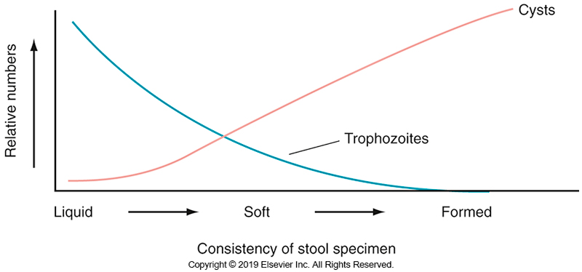
Relationship of Stool Consistency and Protozoan Stage

Slide 21
Fecal specimens Macroscopic Examination
Specimen macroscopic exam has 3 purposes
Color- normal is brown
Other colors may indicate processes going on in the body (i.e., bleeding)
Any portion of the stool that contains blood or blood-tinged mucus should be selected for wet mount preparations and adding to preservative.

Slide 22
Fecal specimens Macroscopic Examination
Liquid stool- examine within 30 minutes of passage to detect motile trophozoites morphologic forms of some parasites
Formed stool-examine within 2 to 3 hours of passaged if held at room temperature
If held at 4°C, examination can be held for 24 hours

Slide 23
Fecal specimens Macroscopic Examination
The specimen should not be placed in a 37° C incubator, which increases the rate of disintegration of any organisms present and enhances overgrowth by bacteria.
Following macroscopic examination, the specimen should be placed into the appropriate fixative(s) for concentration and preparation of permanently stained smear.

Slide 24
Microscopic Examination

Slide 25
Fecal specimens Microscopic Examination
Several diagnostic methods can be used in the microscopic examination of a fecal specimen:
Direct wet mount examination (iodine-stained and unstained) of fresh stool specimens
Concentration procedures with wet mount examination of the concentrate
Permanently stained smears
In general, concentration and permanent staining procedures should be performed on all specimens.

Slide 26
Wet Mount Preparations

Slide 27
Fecal specimens Microscopic Examination
Direct wet mount preparations (preps)
Performed to detect presence of motile protozoan trophozoites in a fresh liquid stool or from sigmoidoscopy material
Detects protozoan cysts, helminth eggs, and helminth larvae
Uses a glass slide on which a drop of physiologic saline (0.85%) has been place on 1 end and a drop of iodine at the other end
A small drop (2 mg) of feces is added to each drop and mixed well.
Each preparation is covered with a No. 1, 22 mm square coverslip.

Slide 28
Fecal specimens Microscopic Examination
Direct wet mount preparations
Preparation should be thin enough so newsprint can be read through it.
It should not overflow beyond the edges of the coverslip.
In unfixed stool specimens
Saline prep is useful for the detection of helminth eggs or larvae, motile protozoa, and refractile protozoan cysts
Iodine prep shows nuclear detail and glycogen masses but kills trophozoites

Slide 29
Fecal specimens Microscopic Examination
Examination of wet mount preps
Thorough examination of each coverslipped prep at low power in a systematic fashion
Start at one corner and foll0ow a systematic vertical or horizontal pattern until the entire prep has been examined.
A high-power objective is used to identify any suspicious structures.
Oil immersion should not be used on a wet preparation unless the preparation has been sealed.

Slide 30
Concentration Techniques

Slide 31
Fecal Specimens Concentration Techniques
Purpose of concentration techniques
To concentrate the parasites, present into a small volume of fluid and remove as much debris as possible
Fresh or stool specimens in an acceptable preservative may be used.
The concentrate sediment may then be examined by making wet mount preparations
unstained or stained with iodine

Slide 32
Fecal Specimens Concentration Techniques
Protozoan trophozoites do not survive the concentration procedure.
Protozoan cysts, helminth larvae, and helminth eggs, however, can be detected using this method.
Two concentration methods are available, both of which are based on differences in specific gravity between the parasites and concentrating solution.
Sedimentation
Flotation

Slide 33
Fecal Specimens Concentration Techniques
In sedimentation method, the organisms are concentrated in sediment at the bottom of the centrifuge tube.
In flotation method, the organisms are suspended at the top of a high-density fluid.
Overall, the sedimentation method concentrates a greater diversity of organisms, including cysts, larvae, and eggs.

Slide 34
Fecal Specimens Concentration Techniques
The traditional standard sedimentation method
Formalin-ethyl acetate sedimentation (FES)
A number of manufacturers now market self-contained fecal concentration kits that do not use the solvent ethyl acetate.
Some kits incorporating collection and concentration in a single tube may not require centrifugation, making them useful in rural areas and developing countries

Slide 35
Fecal Specimens Concentration Techniques
Although these kits offer easier disposability and a cleaner preparation because of the filtration method used, studies indicate that their use is more expensive than that of the traditional FES method.

Slide 36
Fecal Specimens Concentration Techniques
The zinc sulfate method is the usual flotation procedure, although other methods such as zinc chloride are also available.
While the flotation methods yield less fecal debris in the finished preparation compared with the FES method,
the flotation liquids can cause operculated eggs to open or collapse.
Tends to distort protozoan cysts

Slide 37
Fecal Specimens Concentration Techniques
When a flotation method is used
infertile Ascaris lumbricoides eggs and Schistosoma spp. eggs may be missed.
Because of their high density, these eggs sink to the bottom of the test tube.
Most organisms tend to settle after about 30 minutes. Therefore, the examination should be performed as soon as possible after the procedure has been completed to ensure optimal recovery of organisms.

Slide 38
Permanently Stained Smears

Slide 39
Fecal Specimens Permanently Stained Smears
Permanently stained smear preparations of all stool specimens should be made to detect and identify protozoan trophozoites and cysts.
If the smear is stained properly, nuclear detail, size, and internal structures should be visible as they are needed for identification.

Slide 40
Fecal Specimens Permanently Stained Smears
The permanent stains commonly used include iron hematoxylin and trichrome (Wheatley modification of the Gomori stain).
The stain of choice in most laboratories is the trichrome stain because results are somewhat less dependent on the technique, and the procedure is less time-consuming.

Slide 41
Fecal Specimens Permanently Stained Smears
Some labs prepare the stain in-house, manufacturers provide prepared stains and reagents
Trichrome staining can be performed on a smear made from a fresh stool specimen fixed in Schaudinn fixative or from one that has been preserved in PVA.
Specimens preserved in SAF do not stain well with trichrome and should be stained with iron hematoxylin

Slide 42
Fecal Specimens Permanently Stained Smears
Parasite features seen on a well-stained trichrome smear:
The cytoplasm of protozoan cysts and trophozoites stains blue-green, although Entamoeba coli often stains purple.
Nuclear peripheral chromatin (deoxyribonucleic acid [DNA] and proteins on the edge of the nucleus), karyosome (mass of chromatin in the nucleus), chromatoidal bars (dark-staining cytoplasmic inclusions of chromatin), and RBCs stain dark red to purple.

Slide 43
Fecal Specimens Permanently Stained Smears
Parasite features seen on a well-stained trichrome smear:
Eggs and larvae stain red; however, they are often distorted or destroyed in the staining process.
Background debris and yeasts stain green.
With an iron hematoxylin stain, the parasites stain gray to black, nuclear material stains black, and background material stains light blue to gray.

Slide 44
Fecal Specimens Permanently Stained Smears
All permanently stained smears should be examined by first scanning for thick and thin areas using lower-power magnification (×10 or ×40 objective).
Thin areas should be selected and examined under oil immersion (×100 objective) for identification of organisms.

Slide 45
Fecal Specimens Permanently Stained Smears
Organisms that stain lightly and may be difficult to identify in either the cyst or the trophozoite stage include
Entamoeba hartmanni,
Dientamoeba fragilis,
Endolimax nana,
Chilomastix mesnili, and
Giardia duodenalis.

Slide 46
Fecal Specimens Permanently Stained Smears
Modified acid-fast stain
The Kinyoun modified acid-fast stain is used to detect oocysts of Cryptosporidium spp., Cystoisospora belli (formerly Isospora belli), and Cyclospora cayetanensis.
With this procedure, the oocysts appear as magenta-stained organisms against a blue background

Slide 47
Other Specimens Examined for Intestinal and Urogenital Parasites

Slide 48
Cellophane Tape Preparation For Pinworm

Slide 49
Cellophane Tape Test for Pinworm
Enterobius vermicularis (pinworm)
Female worms migrate from the anus at night to lay eggs in the perianal region
Specimen collection procedure
This procedure involves swabbing the person’s perianal area with a tongue blade covered with cellophane tape (sticky side out).
Collection should take place first thing in the morning before individual uses the bathroom or has bathed.

Slide 50
Cellophane Tape Test for Pinworm (Cont.)
Specimen collection procedure
After the sample has been taken, the sticky side of the tape is placed on a microscope slide and scanned at low- and high-power magnification for the characteristically shaped eggs.
Adaptations of this procedure using paddles with a sticky surface are commercially available

Slide 51
Duodenal Aspirates and Sigmoidoscopy Specimens

Slide 52
Duodenal Aspirates
Material obtained from duodenal aspirate or from the duodenal capsule Entero-Test
may be collected in cases of suspected giardiasis or strongyloidiasis when clinical symptoms are suggestive of infection, but repeated stool examination results are negative
Entero-Test
Patient swallows a gelatin capsule containing a weighted string
One end is taped to the side of a patient’s mouth

Slide 53
Duodenal Aspirates (Cont.)
Entero-Test
The weighted end is carried into the upper small intestine.
After about 4 hours, the string is brought up, and part of the mucus adhering to the surface is stripped off and examined on a wet mount for motile trophozoites.
The remainder of the specimen is placed in a fixative for a permanently stained smear.
Eggs of Fasciola hepatica and Clonorchis sinensis as well as oocysts of Cryptosporidium and C. belli can also be recovered.

Slide 54
Sigmoidoscopy Specimens
Scrapings or aspirates obtained by sigmoidoscopy may be used to diagnose amebiasis or cryptosporidiosis.
Examine immediately for motile trophozoites
Place a portion of the sample in fixative for permanently stained smears
If cryptosporidiosis is suspected, a smear for staining with a modified acid-fast stain or by a fluorescent procedure should be prepared.

Slide 55
Urine, Vaginal, And Urethral Specimens

Slide 56
Urine, Vaginal, And Urethral Specimens
Urine sediment can be screened for these parasites
Schistosoma haematobium eggs
E. vermicularis eggs
Trichomonas vaginalis trophozoites
T. vaginalis can also be detected in a wet mount of vaginal or urethral discharge.
Envelope culture methods for T. vaginalis, are available
Specimen is added to the medium and incubated; macroscopic growth can be seen n macroscopically through the bag
Rapid antigen tests and molecular assays are available too.

Slide 57
Sputum

Slide 58
Sputum
In cases of Strongyloides stercoralis hyperinfection, filariform larvae may be seen in a direct wet mount of sputum and bronchoalveolar lavage and washings.
Larval forms of other migrating helminths, such as A. lumbricoides and hookworm, can also be detected.
Eggs of the lung fluke Paragonimus westermani can be identified in a wet mount.

Slide 59
Sputum
Entamoeba histolytica, Cryptosporidium oocysts, and microsporidia can be found in lower respiratory tract specimens.
If the patient is suspected of having a pulmonary infection caused by these agents, the specimen should be examined as a permanently stained smear.

Slide 60
EXAMINATION OF SPECIMENS FOR BLOOD AND TISSUE PARASITES
CHAPTER TWENTY-EIGHT

Slide 61
Blood Smears

Slide 62
Blood Smears
Depending on the blood parasite, whole blood or buffy coat preparations can be used.
Examination of a whole blood smear stained with the Giemsa or Wright stain is the most common method of detecting Plasmodium, Babesia, Trypanosoma, and some species of microfilaria.

Slide 63
Blood Smears
Although motile organisms, such as Trypanosoma trypomastigotes and microfilariae (larval form of filarial worms), can be detected on a wet preparation of a fresh blood specimen under low and high-power magnification, identification is made on the basis of characteristics seen on a permanently stained smear.
Stained smears from buffy coats are helpful in finding Leishmania spp. and Toxoplasma gondii in the cytoplasm of mononuclear cells.

Slide 64
Blood Smears
Concentration methods using membrane filters can be used to detect Trypanosoma spp. or microfilariae, but these methods are rarely used in the clinical laboratory.

Slide 65
Collection and Preparation

Slide 66
Collection and Preparation
Blood taken directly from a finger stick is the ideal specimen for a malarial smear because it tends to give the best staining characteristics.
Blood collected in ethylenediamine tetraacetic acid (EDTA) gives adequate staining if processed within 1 hour.
Distortion of the organism may occur if the time to preparation of the slide is longer than 1 hour, and organisms maybe lost.

Slide 67
Collection and Preparation
Giemsa staining blood samples gives the best morphologic detail but is a time-consuming procedure.
Wright stain has a shorter staining period, but the color intensity for the differentiation of parasites is not as good as that with Giemsa stain.

Slide 68
Identification Procedure

Slide 69
Identification Procedure
For suspected cases of blood parasites, a thick film and a thin film should be made. Both preparations can be made on the same slide or on separate slides. The use of two slides is more convenient.
The Giemsa stain provides the best staining of the organisms and should be used on thick and thin films.

Slide 70
Identification Procedure
Thin smears must first be fixed in methanol before staining with the Giemsa stain.
RBCs in the unfixed thick smear will lyse during the staining procedure.
Unless the RBCs on the slide are first lysed in distilled water, Wright stain cannot be used for a thick film because the stain contains methanol, which will fix RBCs.

Slide 71
Identification Procedure Thick Film
A thick film (slide) is best for the detection of parasites (high sensitivity) because of the larger volume of blood and the fact that organisms are concentrated in a relatively small area.
The thick film is made by pooling several drops of blood on the slide and then spread into a circular area with a diameter approximately equal to 1.5 cm.

Slide 72
Identification Procedure Thick Film
A film that is too thick peels from the slide; thickness is optimal when newsprint is barely visible through the drop of blood before it dries.
The blood should be allowed to dry for at least 6 hours before staining.
Smears should not be fixed with methanol before staining
Fixing prevents lysis of the RBCs
The Giemsa stain releases hemoglobin by lysing unfixed RBCs.

Slide 73
Identification Procedure Thick Film
The thick blood smear is examined at x100 for microfilaria and at ×1000 magnification for the presence of malarial organisms.
In the thick film, the RBCs are destroyed, so only WBCs, platelets, and parasites are visible.
In a thick film, the organisms may be difficult to identify, and there is no way to compare the size of infected and noninfected erythrocytes.

Slide 74
Identification Procedure Thin Film
Therefore, species identification should be made from a thin film because the characteristics of the parasite and the RBCs can be seen.
The thin film is made in the same way as that for a differential cell count.
Thin films should be fixed in methanol for 1 minute and air-dried before staining with Giemsa stain.

Slide 75
Identification Procedure Thin Film
The entire smear should be scanned at low-power (×100 magnification) for detection of large organisms such as microfilariae; then at least 100 oil immersion fields (×1000 magnification) must be examined for the presence of organisms such as Trypanosoma or intracellular organisms such as Plasmodium or Babesia.

Slide 76
Identification Procedure Thin Film
Because the RBCs are intact, the thin smear has a higher specificity compared with a thick smear.
For a symptomatic patient, several blood smears from samples collected at approximately 6-hour intervals over 36 to 48 hours should be examined before a final negative diagnosis is made.

Slide 77
Identification Procedure Thin Film
Parasitemia (percentage of erythrocytes parasitized) can be calculated from the thin blood smear. It is recommended that a minimum of 500 RBCs be counted.
The calculation is as follows:
(Number of infected RBCs / Total number of RBCs counted) × 100 ≡ Percent infected RBCs

Slide 78
Biopsy Specimens

Slide 79
Biopsy Specimens
Biopsy specimens are typically examined using stained tissue sections processed in the histology section of a clinical laboratory.
Tissues that might yield parasites include skin, muscle, cornea, intestine, liver, lung, and brain.
Depending on the species present, the amastigote (obligate intracellular form) can be detected in tissues, such as skin, liver, spleen, and bone marrow.

Slide 80
Biopsy Specimens
Cutaneous lesions should be sampled below the edges of the ulcer; surface samples do not yield infected cells.
Biopsy of striated muscle may also be performed for the diagnosis of Trichinella spiralis.
T. gondii can also be identified by examination of tissue biopsy specimens

Slide 81
Cerebrospinal Fluid (CSF)

Slide 82
Cerebrospinal Fluid (CSF)
Viable organisms in suspected cases of amebic meningitis or sleeping sickness can occasionally be seen in a cerebrospinal fluid (CSF) specimen.
The trypomastigote, an extracellular nonreplicating form, is readily visible because of the motion of the flagellum and undulating membrane.

Slide 83
Cerebrospinal Fluid (CSF)
If amebic meningoencephalitis caused by Naegleria fowleri is suspected, CSF can be cultured.
Nonnutrient agar is seeded with an Escherichia coli overlay, and the CSF sediment is inoculated onto the medium.
The specimen is sealed and incubated at 35° C.
The medium is microscopically examined daily for thin tracks made by the amebae as they feed on the bacteria

Slide 84
Immunologic Diagnosis

Slide 85
Immunologic Diagnosis
Parasites that invade tissues (e.g., E. histolytica, Trypanosoma cruzi, or T. gondii) are the primary organisms that stimulate antibody production.
Serologic tests are sometimes useful if invasive methods cannot be used for identification.
In most cases, however, tests for antibody serve only as epidemiologic markers, especially in endemic areas.

Slide 86
Immunologic Diagnosis
The parameters that should be considered in selecting a method to be used should therefore include not only cost but also diagnostic yield, patient population, relative incidence of the parasite in the area, and number of specimens to be processed.

Slide 87
Immunologic Diagnosis
Classically, such methods as hemagglutination or complement fixation were used to detect antibodies to parasitic organisms. Newer tests use fluorescent or enzyme immunoassay (EIA) techniques.
Immunoassay tests for antibodies to T. gondii or E. histolytica (extraintestinal infections) are available for use in clinical laboratories.

Slide 88
Enzyme Immunoassays (EIAs)

Slide 89
Enzyme Immunoassays (EIAs)
Enzyme immunoassays (EIAs) provide information about current infection in contrast with antibody tests
Several EIAs are available to detect the presence of Giardia duodenalis, Cryptosporidium spp., E. histolytica, and Entamoeba dispar.
Antigen detection kits have replaced microscopic examination in some hospital laboratories.

Slide 90
Enzyme Immunoassays (EIAs)
A growing area of EIA application testing is in the diagnosis of malaria
These tests are based on the principle of immunochromatographic antigen capture and use whole blood to detect malarial protein.
The patient’s blood is reacted with monoclonal antibody labeled with dye or gold particles.

Slide 91
Enzyme Immunoassays (EIAs)
Some tests are relatively non–species specific and detect a protein, such as parasite lactate dehydrogenase or aldolase, that is common to all four human Plasmodium spp.
Some tests detect both types of protein to provide a more complete picture of the infective agent.

Slide 92
Fluorescent Antibody Techniques

Slide 93
Fluorescent Antibody Techniques
Direct fluorescent antibody (DFA) techniques using monoclonal antibodies have been developed to detect Cryptosporidium oocysts in fecal specimens.
Fecal material is placed and spread on a slide
Reagent containing the antibody is added
Specimen is examined under a fluorescent microscope for a characteristic apple-green structure

Slide 94
Fluorescent Antibody Techniques
A DFA combination reagent for G. duodenalis and Cryptosporidium antigens is also available. The monoclonal antibodies help avoid false-positive and false-negative results.
Such procedures are useful in screening large numbers of specimens during epidemiologic studies.
DFA assays have greater sensitivity and specificity compared with routine stains.

Slide 95
Fluorescent Antibody Techniques
The quantitative buffy coat procedure uses the fluorescent dye acridine orange to stain nuclear material for detecting malarial organisms in blood.
A microhematocrit tube is coated with the fluorescent dye.
After centrifugation, the parasites can be viewed in a small area at the top of the erythrocyte column.
A thin smear still must be made for definitive identification.

Slide 96
Molecular Methods

Slide 97
Molecular Methods
Molecular methods for parasite identification are rapidly being adopted by clinical laboratories.
Methods can include classic and real-time polymerase chain reaction (PCR) assays.

Slide 98
Molecular Methods
Molecular methods of detection exist that identify several organisms, including malarial parasites.
Multiplex PCR panels are commercially available for GI pathogens that can detect a significant number of viruses and bacteria and a limited number of parasites (e.g., Giardia duodenalis, E. histolytica, Cryptosporidium spp., and in some cases Cyclospora cayetanensis).
Dientamoeba fragilis, Blastocystis spp., and microsporidia do not yet have a rapid identification procedure.

Slide 99
Molecular Methods
Several of the current procedures are rapid and do not require specimen processing.
Although these newer methods have eliminated the need for routine concentration for selected organisms, the downside is that if the test result is negative and the patient remains symptomatic, routine procedures then should be instituted.

Slide 100
Quality Assurance in the Parasitology Laboratory

Slide 101
Quality Assurance in the Parasitology Laboratory
Quality assurance procedures in the parasitology laboratory are like those in other laboratory sections
Updated procedure manual
Controls for staining procedures
Records of centrifuge calibration
Ocular micrometer calibration
Refrigerator and incubator temperatures

Slide 102
Quality Assurance in the Parasitology Laboratory
Reagents, solutions, and kits must be properly labeled.
Other important items that should be available
Reference book collection, including texts and atlases
A set of digital images of common parasites; many are available online
A set of clinical reference specimens including permanently stained smears and formalin-preserved feces

Slide 103
Quality Assurance in the Parasitology Laboratory
The department should also be enrolled in an external proficiency testing program.
An ongoing internal proficiency testing program can be used to enhance the identification skills of the clinical laboratory scientists, especially if a fulltime parasitologist is not employed.

Slide 104
Quality Assurance in the Parasitology Laboratory
Size is an important diagnostic criterion for parasites, and use of a properly calibrated ocular micrometer ensures accurate measurement of organisms.
The micrometer should be calibrated for each objective on the microscope.

Slide 105
Quality Assurance in the Parasitology Laboratory
Micrometer calibration requires two parts:
(1) the stage micrometer, a 0.1-mm line that is ruled in 0.01-mm units, and
(2) the ocular micrometer, which is ruled in 100 units but has no value assigned to the units.
Values for each ocular unit can be calculated by using the stage micrometer.

Slide 106
MEDICALLY IMPORTANT PARASITIC AGENTS
CHAPTER TWENTY-EIGHT

Slide 107
MEDICALLY IMPORTANT PARASITIC AGENTS: An Overview
Historically, the human medically important eucaryotic parasites were classified as protozoan, helminth, and arthropod.
More recently the microsporidia, which belong to the kingdom of fungi, were recognized as human pathogens
Due to their morphology and pathogenesis, the microsporidia are often considered with the parasites.

Slide 108
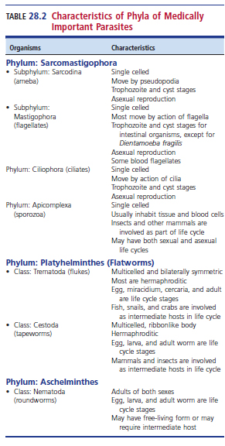
Characteristics of Phyla of Medically Important Parasites

Slide 109
MEDICALLY IMPORTANT PARASITIC AGENTS: An Overview
Medically important parasites can be found in phyla representing single-celled organisms, such as the protozoa and sporozoa, and complex, multicelled organisms, such as the helminths (worms).
The protozoan parasites are classified according to their motility organelles
The ameba move by pseudopodia, the flagellates move by flagella, and the ciliates move by cilia.
The sporozoa are nonmotile.

Slide 110
MEDICALLY IMPORTANT PARASITIC AGENTS: An Overview
Helminths are classified according to their shape and include flatworms (flukes and tapeworms) and roundworms.
Arthropods, such as Pediculosis humanus (pediculosis) and Sarcoptes scabiei (scabies), cause human infestations.
They can also sometimes be vectors for infectious pathogens.
These agents are not discussed in this textbook.

Slide 111
Protozoa

Slide 112
Protozoa
The protozoan parasites include pathogens and nonpathogens (commensals) that closely resemble pathogens
To ensure appropriate therapy when necessary and patients not being treated unnecessarily, it is important for the laboratory scientist to recognize and differentiate the pathogens from commensals
Commensal parasites must be reported in the test results.
Presence indicates contaminated food/water
Specimens should be closely examined for pathogens

Slide 113
Intestinal Amebae

Slide 114
Intestinal Amebae
Considered the most difficult to identify because of their small size
Two morphologic forms- trophozoites and cysts
Species identification is often based on
Size
Number of nuclei
Nuclear structure
Presence of specific internal structures

Slide 115
Intestinal Amebae
In a direct wet preparation, the motility of the trophozoite may aid in presumptive identification.
Overall the permanently stained smear is the best preparation to identify amebae.
Entamoeba histolytica- recognized as a true pathogen
Questionable status- Blastocystis spp.
Other amebae are considered nonpathogens.

Slide 116
Intestinal Amebae
All the amebic organisms discussed here
Live in the large intestine
Have two morphologic forms:
Trophozoite, motile and feeding stage that reproduces by binary fission
Cyst, infective, environmentally resistant stage; multiplication of nuclei serves as a reproductive function
Blastocystis hominis has more morphologic forms

Slide 117
Life Cycle

Slide 118
Life Cycle
The life cycle of amebae is relatively simple, with direct fecal-oral transmission in food or water
No intermediate hosts.
Humans ingest the infective cysts, which excyst in the intestinal tract, and the emerged trophozoites multiply by binary fission.
Trophozoites colonize the cecal area.

Slide 119
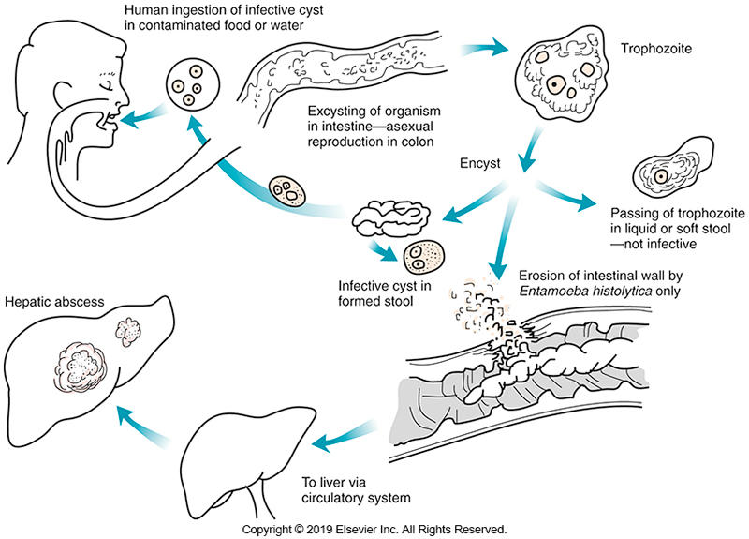
Generalized Life Cycle of Intestinal Amebae

Slide 120
Treatment

Slide 121
Treatment
Treatment is administered only for E. histolytica infections invasive amebiases are treated with systemic drugs, such as metronidazole and luminal amebicides
Treatment for nonpathogens is not indicated.
Luminal amebicides are given to carriers in nonendemic areas to prevent the invasive phase and reduce the risk of transmission.

Slide 122
Treatment
In endemic areas with a high risk of reinfection, treatment may not be indicated.
In cases of Blastocystis spp. infection, treatment may be indicated if the patient is symptomatic.

Slide 123
Entamoeba histolytica and Related Organisms

Slide 124
Entamoeba histolytica and Related Organisms
E. histolytica and E. dispar are morphologically identical organisms that differ in their effects on the host.
E. histolytica is a recognized pathogen, while E. dispar is nonpathogenic.
E. moshkovkii and E. bangladeshi are also morphologically identical to E. histolytica
It is unclear if the latter two organisms are pathogenic.
E. bangladeshi has been identified as an agent of diarrhea

Slide 125
Entamoeba histolytica and Related Organisms
The aforementioned species of Entamoeba organisms are morphologically identical and must be distinguished on the basis of identification of surface antigens.
The presence of ingested erythrocytes in the trophozoite stage will distinguish E. histolytica from the other species

Slide 126
Entamoeba histolytica Characteristics
Found worldwide, especially in the tropics and subtropics
Ranked 3rd behind malaria and schistosomiasis as a cause of death resulting from a parasitic infection
Prevalence differs according to socioeconomic levels and sanitary practices
More common in developing countries

Slide 127
Entamoeba histolytica Characteristics (Cont.)
Travelers are at increased risk of acquiring infection
Primary route of transmission-fecal-oral
Other route- sexually transmitted agent among men who have sex with men (MSM)
HIV infection does not appear to have increase the risk of invasive disease.

Slide 128
Entamoeba histolytica Clinical Infection
Subsists on intestinal bacteria and partially digested food of the host
Has the ability to cause invasive intestinal amebiasis and extraintestinal amebic infections
Presents in several ways
Asymptomatic colonization
Amebic dysentery (colitis)
Extraintestinal amebiasis

Slide 129
Entamoeba Histolytica Clinical Infection (Cont.)
Asymptomatic colonized individuals are cyst passers and therefore infective.
In symptomatic individuals, clinical infection may appear in an acute or chronic form.
Those with increased risk for severe disease include young individuals, older adults, malnourished individuals, and those receiving immunosuppression therapy

Slide 130
Entamoeba histolytica Clinical Infection (Cont.)
Symptoms in acute infections
Abdominal tenderness and cramping, fever, and up to 20 diarrheic stools per day that contain trophozoites, blood, and mucus.
Some stools contain Charcot-Leyden crystals
breakdown remnants of eosinophils; their presence in the stool is suggestive of an intestinal parasitic infection but is not specific for E. histolytica.

Slide 131
Entamoeba histolytica Clinical Infection (Cont.)
In severe E. histolytica infection, the patient may shed pieces of intestinal mucosa.
Some patients develop an ameboma (amebic granuloma), a tumorlike lesion that forms in the submucosa of the intestine
An area of chronic lysis and infiltration with neutrophils, lymphocytes, and eosinophils
In chronic infections, there may be alternating asymptomatic periods and diarrheal episodes.

Slide 132
Entamoeba histolytica Clinical Infection (Cont.)
Symptoms in patients with hepatic abscesses
Fever, chills, pain in the upper right quadrant
Weight loss, increased WBC counts, elevated liver enzyme levels. Jaundice is usually absent.
Or they can be asymptomatic.
Invasion of the lung can cause the patient to have chest pain, dyspnea, and a productive cough

Slide 133
Entamoeba histolytica Laboratory Diagnosis
Trophozoites in the stool that may be seen in direct wet mounts or trichrome-stained smear in patients with diarrhea
Sigmoid biopsies may be used to demonstrate the characteristic morphology of the intestinal ulcers or to identify trophozoites in tissue when none can be isolated from the stool specimen.

Slide 134
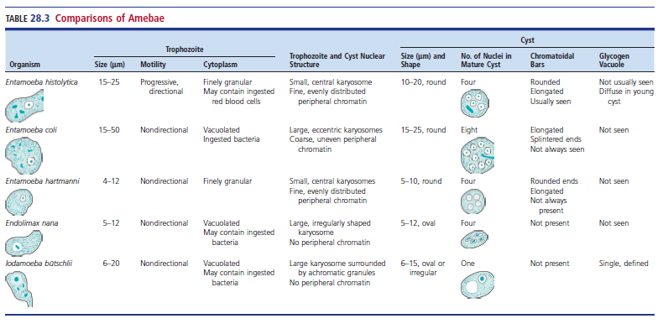
Comparison of Intestinal Amebae

Slide 135
Entamoeba histolytica Laboratory Diagnosis (Cont.)
In a direct saline wet mount of a diarrheic stool, the trophozoite of E. histolytica may exhibit
A progressive, directional motility by extending long, thin pseudopods.
The size of the organism ranges from 10 to 50 µm, averaging 15 to 25 µm.
The organism is refractile, with the characteristic “bull’s eye” nucleus, consisting of a small central karyosome.
Even, fine peripheral chromatin may be only slightly visible.

Slide 136
Entamoeba histolytica Laboratory Diagnosis (Cont.)
In a trichrome-stained smear, the cytoplasm of the trophozoite appears clean and free from ingested bacteria and vacuoles.
Finely granular nuclear chromatin is evenly distributed on the nuclear membrane, and the small central karyosome stains dark purple-red.
Ingested RBCs are diagnostic for E. histolytica trophozoites but usually are not seen.

Slide 137
Entamoeba histolytica Laboratory Diagnosis (Cont.)
If there are no ingested RBCs, the organism must be reported as E. histolytica/E. dispar. The World Health Organization (WHO) and the Pan American Health Organization recommend that E. moshkovkii also be included.
Immunoassays are necessary to differentiate these species.

Slide 138
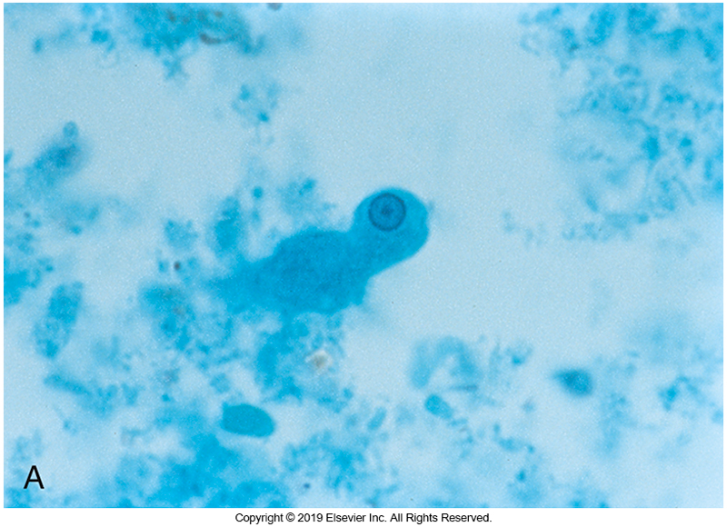
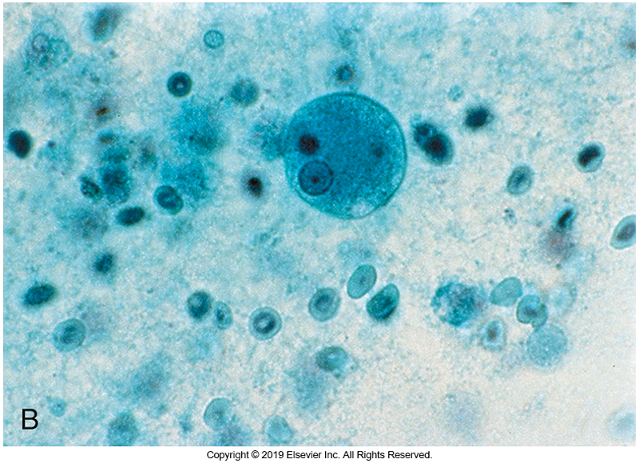
E. histolytica Trophozoites

Slide 139
Entamoeba histolytica Laboratory Diagnosis (Cont.)
Cysts of E. histolytica may have one to four nuclei, each with a small central karyosome and fine, evenly distributed peripheral chromatin.
The cytoplasm may occasionally contain chromatoidal bars composed of ribonucleic acid.
The chromatoidal bars are cigar shaped, with rounded ends. In young cysts, there are often multiple bars, and mature cysts may show only one
The average size of the cyst is 10 to 20 µm

Slide 140
Entamoeba histolytica Laboratory Diagnosis (Cont.)
In an iodine wet mount, the nuclei appear as yellowish refractile bodies within the cyst; chromatoidal bars do not take up stain and appear as colorless areas.
With trichrome stain, the cyst stains light green to gray; nuclear material and chromatoidal bars stain dark purple-red.

Slide 141
Entamoeba histolytica Laboratory Diagnosis (Cont.)
Discrete glycogen in young cysts stain light brown in an iodine wet mount, in the more mature cyst, the glycogen is diffuse.
Cysts can persist for 2 to 4 weeks in a moist environment but may be killed by drying, temperatures over 55° C, superchlorination, or addition of iodine to drinking water.

Slide 142
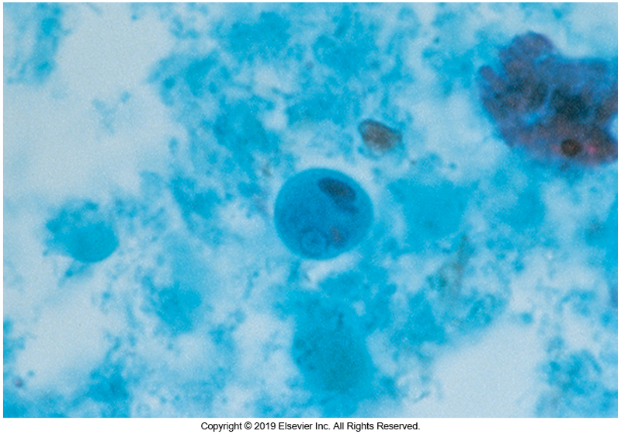
E. histolytica Cyst

Slide 143
Entamoeba histolytica Laboratory Diagnosis (Cont.)
Amebic ulcers of the liver often are detected with ultrasonography or radiography.
Subsequent aspiration of the abscess may yield motile trophozoites and necrotic material composed of lysed cells.
Serologic methods of detecting antibody to E. histolytica are available;
the results are positive in more than 90% of patients with extraintestinal disease.

Slide 144
Entamoeba histolytica Laboratory Diagnosis (Cont.)
Tests that detect E. histolytica antigen in stool provide evidence of current infection.
Some kits require a large number of organisms to be present for a positive result; however, antigen detection is still considered more sensitive than a microscopic examination of feces.
These tests use the EIA method with monoclonal antibodies to proteins (e.g., serine-rich antigen) or the galactose/N-acetylgalactose adhesion lectins.

Slide 145
Entamoeba histolytica Laboratory Diagnosis (Cont.)
Some antigen testing kits detect E. histolytica antigens without excluding E. dispar; others differentiate E. histolytica from E. dispar.
Point-of-care tests using immunochromatographic techniques assist with the rapid diagnosis of E. histolytica infection.
Antigen detection assays can be used on other specimens besides feces
Multiplex molecular assays for GI syndromic testing are available; E. histolytica is often included.

Slide 146
Entamoeba hartmanni

Slide 147
Entamoeba hartmanni Morphology
E. hartmanni, once known as small race E. histolytica, is a nonpathogen.
It generally resembles E. histolytica in a trichrome-stained smear but is more likely to have an eccentric karyosome or uneven peripheral chromatin resembling that of Entamoeba coli.

Slide 148
Entamoeba hartmanni Morphology (Cont.)
The average size of the trophozoites of E. hartmanni is 4 to 12 µm;
trophozoites with an average size larger than 12 µm are identified as E. histolytica or E. dispar.
E. hartmanni cysts measure 5 to 10 µm
those of 10 µm or larger are identified as E. histolytica, E. dispar, or E. moshkovkii.

Slide 149
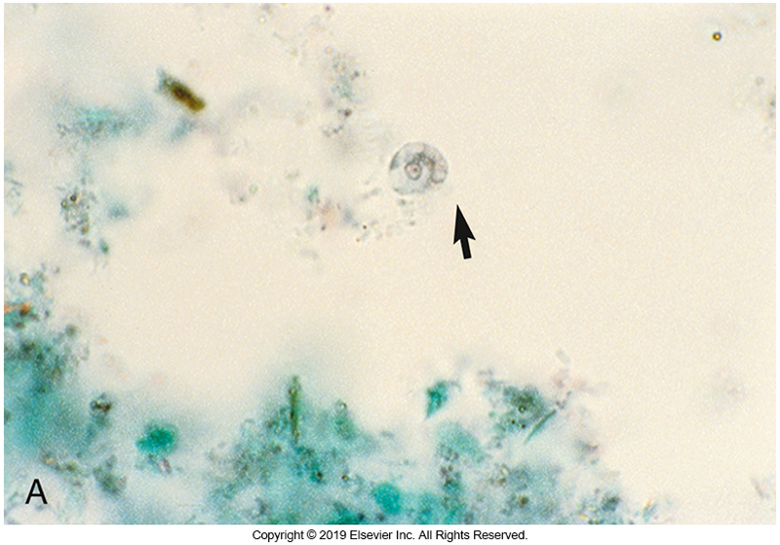
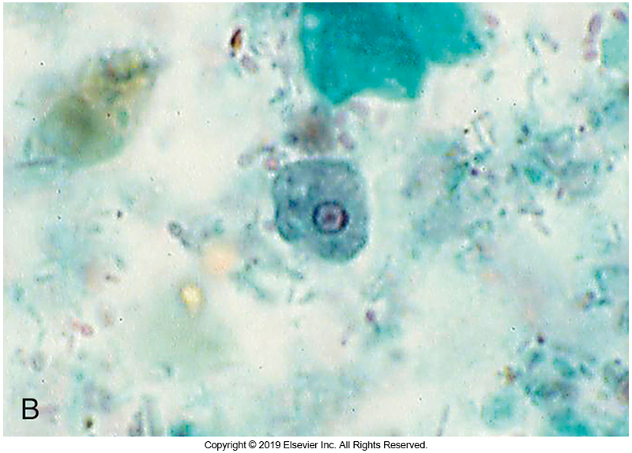
E. hartmanni

Slide 150
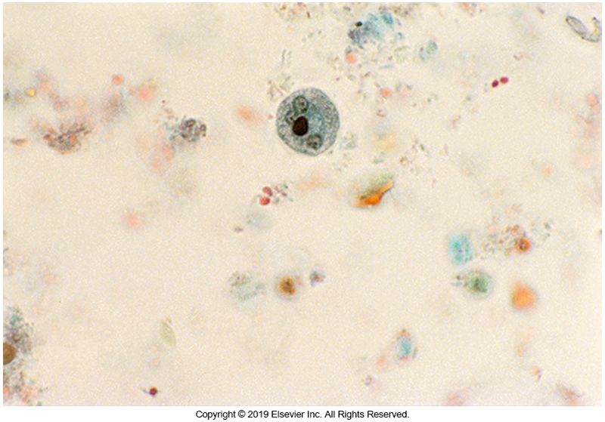
E. hartmanni Cyst

Slide 151
Entamoeba coli Morphology
Entamoeba coli is a commonly found intestinal commensal transmitted by the ingestion of cysts in fecally contaminated food or water.
The average size of the trophozoite is
15 to 50 µm, with most measuring 25 µm
The nuclear structure is characterized by
a large eccentric karyosome and coarse, uneven peripheral chromatin on the nuclear membrane.

Slide 152
Entamoeba coli Morphology (Cont.)
The motility of the trophozoite in a wet preparation is sluggish and nondirectional.
In a permanently stained preparation, the cytoplasm of the trophozoite may stain a dark purplish gray and contains vacuoles and ingested materials.

Slide 153
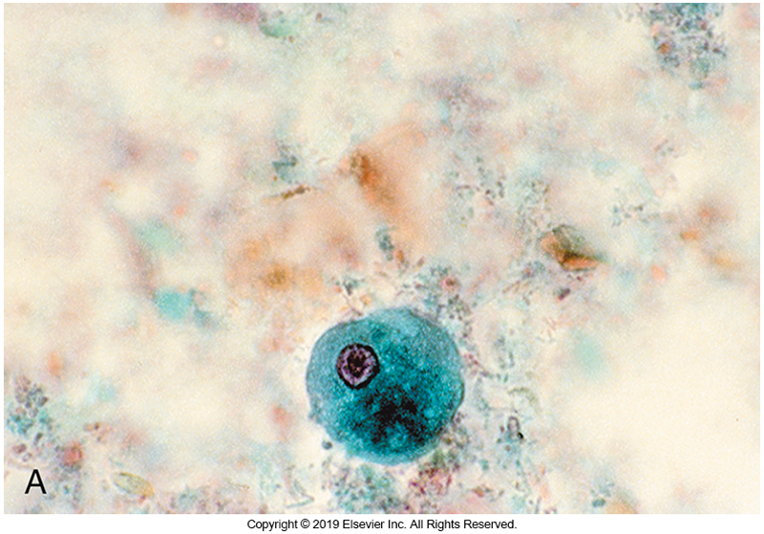
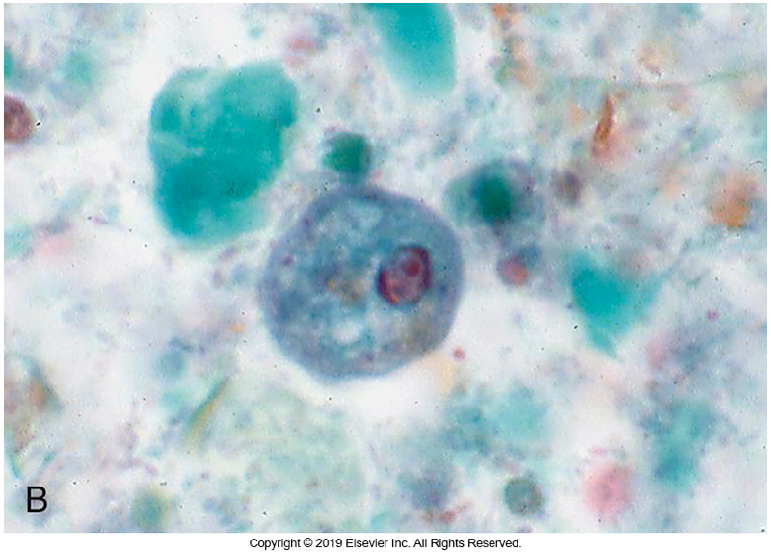
E. coli Trophozoites

Slide 154
E. coli Morphology (Cont.)
The mature cyst has eight nuclei
The immature cyst may have one or two large nuclei, with a large glycogen vacuole.
Cysts often stain darkly and unevenly, giving an irregular appearance to the cyst.
The large eccentric karyosome is visible but peripheral chromatin surrounding the entire nucleus may be difficult to see.

Slide 155
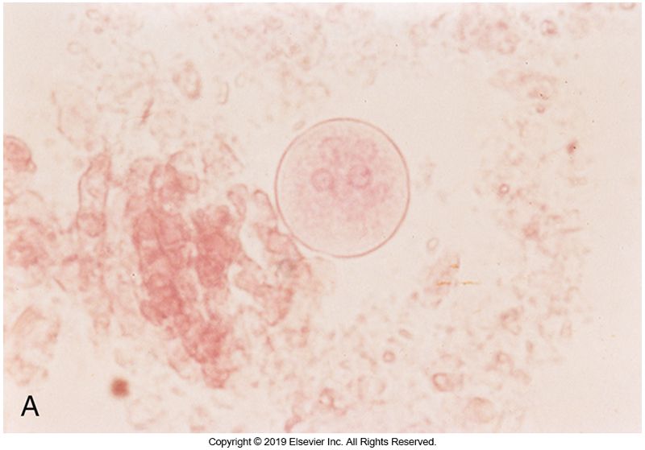
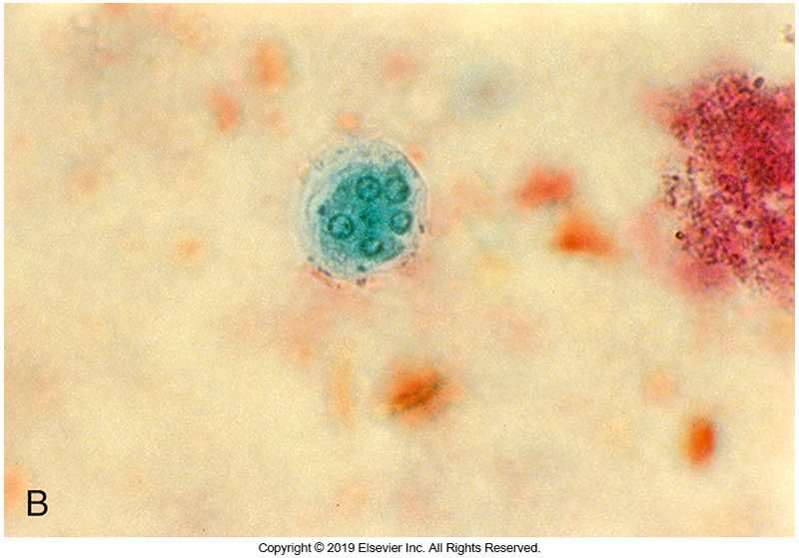
E. coli Trophozoites Cysts

Slide 156
Endolimax nana Morphology
Trophozoite
Size ranges from 5 to 12 μm
Average is less than 10µm
Single large karyosome; no peripheral chromatin
Granular and vacuolated cytoplasm
In wet mount, motility is sluggish
In a wet mount, it may be difficult to distinguish the large karyosome of E. nana from the karyosome of E. hartmanni, and the organisms may be misidentified.

Slide 157
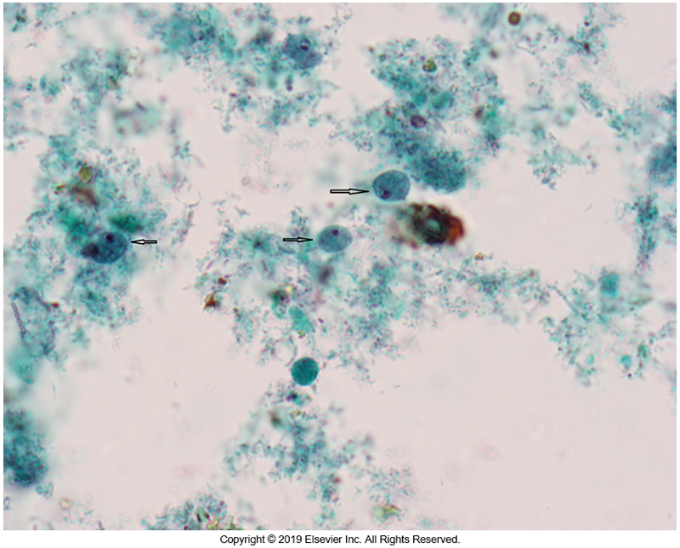
E. nana Trophozoite

Slide 158
E. nana Morphology
Cyst
Oval or spherical in shape
5 to 12 μm
Has up to four large nuclei
Characteristic nuclei resemble buttonholes

Slide 159
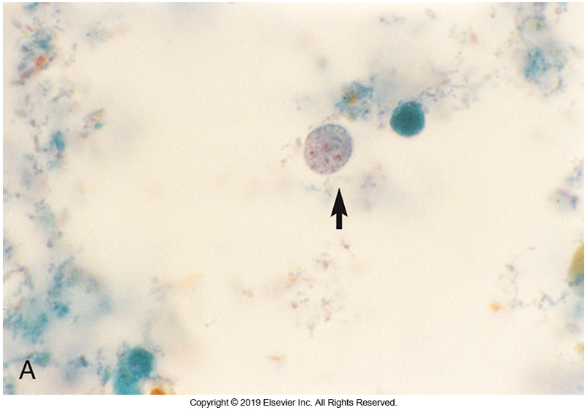
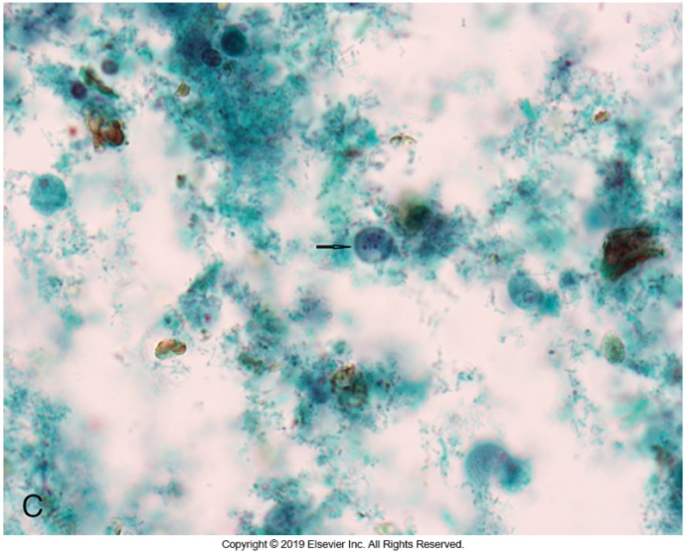
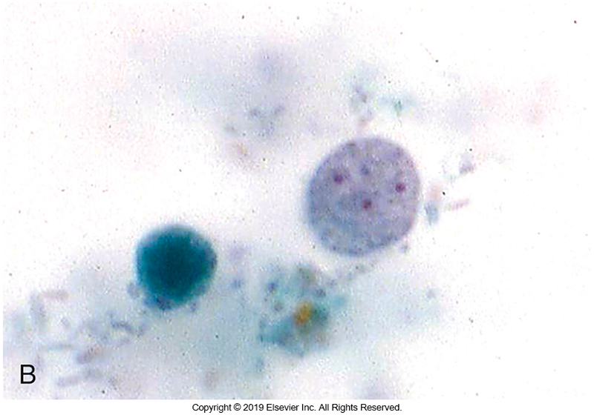
E. nana Cysts

Slide 160
Iodamoeba bütschlii Morphology
Iodamoeba bütschlii is less commonly encountered compared with other nonpathogenic amebae.
The nucleus is composed of a single, irregularly shaped karyosome surrounded by achromatic granules and a thin nuclear membrane, with no peripheral chromatin.

Slide 161
Iodamoeba bütschlii Morphology (Cont.)
The trophozoites of I. bütschlii, measure 6 to 20 µm in size and can show a vacuolated cytoplasm in a permanently stained smear.
The oval cyst is 6 to 15 µm (average, 9 to 10 µm) in size
Contains a single large karyosome and a large, well-defined glycogen vacuole
The vacuole stains dark brown in an iodine wet mount and appears empty in a permanently stained smear.

Slide 162
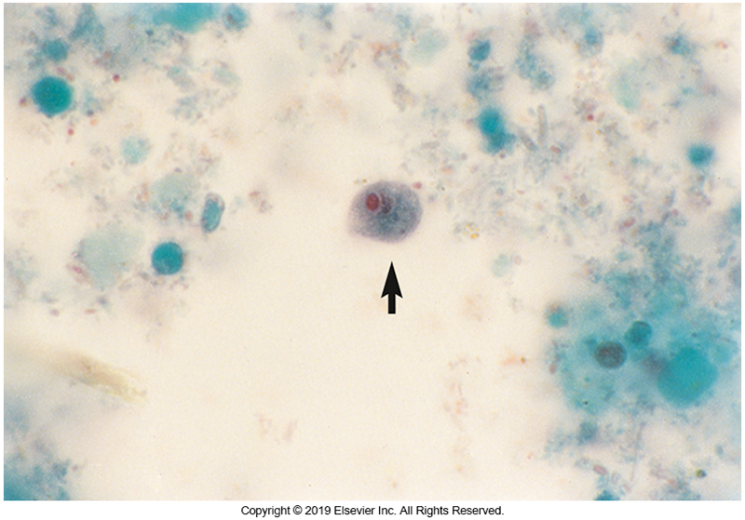
I. bütschlii Trophozoite

Slide 163
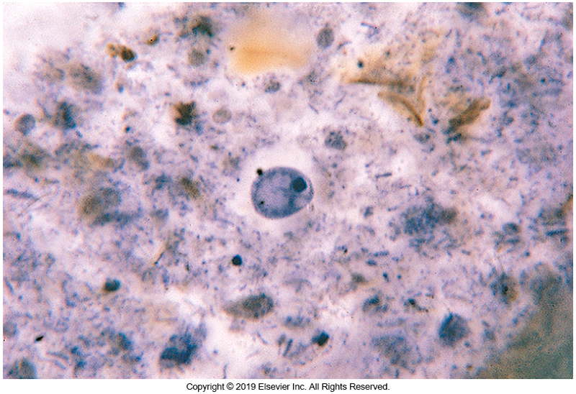
I. bütschlii Cyst

Slide 164
Blastocystis spp.
Taxonomy is unresolved
Originally considered as a yeast
Recently underwent taxonomic reclassification
Genetically, Blastocystis closely resembles Proteromonas lacerate, a flagellate.
However, Blastocystis is nonmotile and does not have flagella.
Ribosomal ribonucleic acid (rRNA) analysis indicates that it is related to the stramenopiles (brown algae and water molds)

Slide 165
Blastocystis spp. (Cont.)
Studies indicate that at least 12 different species are found in humans and other animals, and Blastocystis hominis is no longer considered a valid species name.
Clinical microbiologists should simply report isolates as Blastocystis spp.

Slide 166
Blastocystis spp. (Cont.)
Blastocystis is one of the most common intestinal protozoa and has
a prevalence rate of greater than 50% in developing countries.
Infection occurs in immunocompetent and immunocompromised individuals.
Blastocystis has come to prominence as a possible cause of diarrhea in humans,
although controversy concerning its pathogenicity persists because of conflicting results from numerous studies.

Slide 167
Blastocystis spp. (Cont.)
Although not considered a common cause of diarrheal disease,
this organism, nevertheless, has been found in patients who have abdominal pain and diarrhea but no other intestinal pathogens.
associated with chronic infection in some patients
Most frequently, patients have a history of consuming untreated water.
Some infected individuals often have a travel history abroad and have a history of handling animals.

Slide 168
Blastocystis spp. (Cont.)
Some studies linked the presence of Blastocystis spp. to colitis and irritable bowel syndrome (IBS),whereas others have not.
Others have suggested that Blastocystis spp has no role as a pathogen.
Clinical manifestations
diarrhea, abdominal pain, bloating, anorexia, and flatulence

Slide 169
Blastocystis spp. (Cont.)
Laboratories often report the presence of the organism quantitatively, with the presence of more than five organisms per high-power field and no other known enteric pathogens in symptomatic patients considered evidence of Blastocystis as the cause of GI symptoms.

Slide 170
Blastocystis spp. (Cont.)
Blastocystis spp.is a polymorphic organism that exists in four forms:
ameboid, granular, central vacuolar (central body form), and cystic.
The central body form is the most commonly identified.

Slide 171
Blastocystis spp. (Cont.)
The life cycle is not completely known, and revisions continue to occur.
The cyst is ingested and is infective
The organism excysts in the large intestine, where it transforms into the central vacuolar form.
It is not known what triggers the change into other forms.
It is known that the organism encysts as stool passes through the large intestine.

Slide 172
Blastocystis spp. (Cont.)
The average size for the vacuolar form is 5 to 15 µm, but up to 20% of organisms are smaller than 5 µm, and a few approach 100 µm.
The organism is round and has a ring of cytoplasm lining the inside of the plasma membrane, with as many as four nuclei present, which are usually pushed to the side.

Slide 173
Blastocystis spp. (Cont.)
There is a large central vacuole that occupies up to 90% of the cell volume and may play a role as a storage organelle.
The granular form is similar but possesses granules in the central vacuole and cytoplasm.
The ameboid form, which may be seen in diarrheic stools, is 3 to 8 µm and often lacks a vacuole but possesses several pseudopods

Slide 174
Blastocystis spp. (Cont.)
In an iodine mount, the cytoplasm and central area of the vacuolar form stain brown.
With the trichrome stain, the cytoplasm stains dark green and the central area may stain pale to intensely green, with the nuclei staining dark purple to black.
The cyst form can be found in stool and in culture.

Slide 175
Blastocystis spp. (Cont.)
The cyst stage is small (3 to 5 µm),
is oval to round and possesses one to four nuclei and multiple vacuoles.
Because of its small size, it may resemble fecal debris.
It is resistant to the usual chlorine levels in drinking water, and water has been implicated in transmission of the organism.

Slide 176
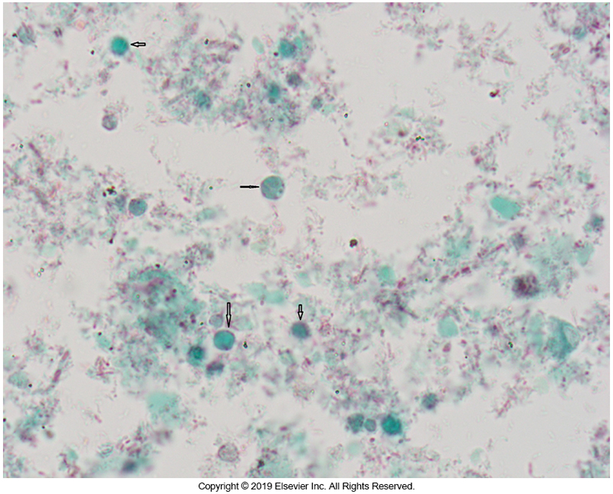
B. hominis Vacuolar Form

