Slide 1
Chapter 28
Diagnostic Parasitology
PART TWO

Slide 2
Tissue amebae

Slide 3
Tissue amebae: Overview
Free-living, thermotolerant-wide range of temperature, pH, salinity
Found in soil and water
Freshwater sources, domestic water supplies, sewage, swimming pools
Feed on bacteria in the environment
Mode of transmission to humans
Inhalation of the nasal mucosa
Travel along the olfactory nerve to the brain
Hematogenous spread from the lungs or skin lesions

Slide 4
Tissue amebae: Overview
Although the number of infections caused by these organisms is low compared with those caused by intestinal protozoans, they are very difficult to diagnose and treat and are associated with a high mortality rate.
Naegleria fowleri and Acanthamoeba spp. have been recognized for many years as the amebae
Most commonly associated with CNS invasion in humans.
Sappinia spp. and Paravahlkampfia francinae, also free-living amebae have been identified in rare cases of encephalitis and meningitis

Slide 5
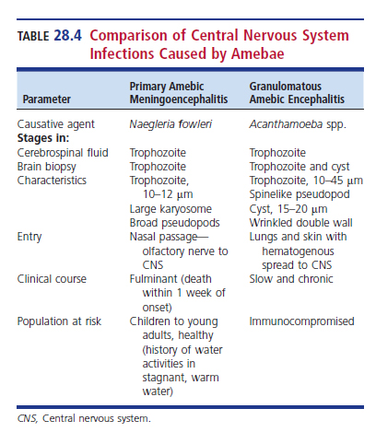
Comparison of Central Nervous System (CNS) Infections Caused by Tissue Amebae

Slide 6
Naegleria fowleri
Causative agent of primary amebic meningoencephalitis (PAM)
The press sometimes refers to N. fowleri as the “brain-eating ameba.”
A rapidly fatal condition involving the CNS
A common factor in infection is the report of recent swimming or other water-related activities in warm, artificial lakes or brackish or muddy water or exposure to bottom sediment.
Waterskiing, wakeboarding, or other activities that increase the chances of forceful entry of water into the nose may facilitate infection.

Slide 7
Naegleria fowleri Life cycle (Cont.)
Life cycle, relatively simple, consisting of 3 stages
(1) free-living amebic trophozoite
(2) transient flagellate form that appears when there is scarcity of nutrients
(3) environmentally resistant cyst

Slide 8
Naegleria fowleri Life cycle
The trophozoite enters the nasal cavity through inhalation of contaminated water or soil.
The amebic form colonizes the nasal cavity, invades the nasal mucosa
Attaches to olfactory nerves, penetrates the cribriform plate, moves along the olfactory nerve to the olfactory bulb, and moves into the arachnoid space.
Then, spreads throughout the CNS

Slide 9
Naegleria fowleri Clinical Infection (Cont.)
Thought to be related to inhalation of a large number of organisms or forceful entry of water into the nose (microtrauma) and to the virulence of the strain
Cannot be distinguished from bacterial meningitis
Incubation period- usually 2 to 3 days but may range up to 2 weeks
Initial symptoms
Severe bifrontal headache, fever (38° to 41° C), stiff neck, and nausea and vomiting

Slide 10
Naegleria fowleri Clinical Infection (Cont.)
CSF will show evidence of increased intracranial pressure, increased levels of neutrophils and protein, and decreased glucose levels.
In late stages, there may be increased numbers of RBCs in CSF
The organism multiplies in brain tissue, and within 2 to 4 days, the patient can experience drowsiness, confusion, and seizures that can progress to coma.

Slide 11
Naegleria fowleri Clinical Infection (Cont.)
Disease usually fatal within one week of clinical symptoms.
At autopsy, there will be evidence of trophozoites along with a purulent exudate, edema, and hemorrhagic and necrotic areas of infection in the brain.
N. fowleri is capable of direct cell-to-cell damage resulting in the destruction of RBCs and other cells including nerve cells.

Slide 12
Naegleria fowleri Clinical Infection
Because the symptoms resemble those of bacterial meningitis, specific treatment may be delayed, yet the possibility of cure depends on early diagnosis.
Aggressive therapy consists of
intravenous and intrathecal administration of amphotericin B
Rifampin, miconazole, or fluconazole and azithromycin have been used in addition to amphotericin B.

Slide 13
Naegleria fowleri (Cont.)
Other treatment measures
Survival in several cases has been linked to additional procedures, including use of medically induced hypothermia and the experimental drug miltefosine.
Laboratory diagnosis
Finding motile amebic trophozoites in CSF

Slide 14
Naegleria fowleri Laboratory Diagnosis
Trophozoite characteristics
10 to 35 µm and moves by explosively extending large, broad pseudopods (lobopodia).
Nucleus contains a large central karyosome that is surrounded by a halo.
In PAM, CSF contains
Many segmented neutrophils and RBCs
Demonstrates elevated protein levels and
Normal to decreased glucose levels, which are characteristics of bacterial meningitis.

Slide 15
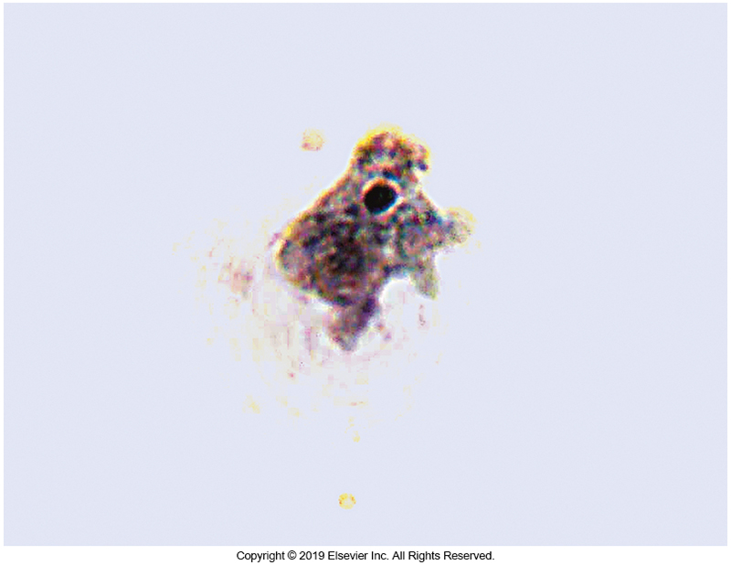
N. fowleri Trophozoite

Slide 16
Naegleria fowleri Laboratory diagnosis
N. fowleri does not stain well with Gram stain
Motile trophozoites can be seen in a wet mount of CSF. They must be carefully distinguished from leukocytes.
The trophozoite may also be seen in cytocentrifuged CSF specimens stained with Wright stain.
The ameba can be converted to the flagellate stage by adding one drop of CSF sediment to 1 mL of distilled water and incubating it at 37° C.

Slide 17
Naegleria fowleri Laboratory diagnosis
Conversion to the flagellate form occurs in 2 to 20 hours.
The organisms can be cultured by overlaying nonnutrient agar with Escherichia coli and inoculating the agar with a drop of the CSF sediment and incubating it at 37° C.
Clearing of the agar in thin tracks is evidence of the organism feeding on the bacteria.
Trophozoites may be observed microscopically.

Slide 18
Naegleria fowleri Laboratory diagnosis
Cysts
Measure approximately 10 µm in diameter and
Have a round, smooth double wall and a single pore, not seen in clinical specimens.
Immunofluorescent staining of CSF with monoclonal antibody can be done in some reference laboratories for detection of the trophozoite.
Molecular methods are used to identify strains

Slide 19
Acanthamoeba spp.
Acanthamoeba spp. have been linked to several clinical conditions, including GAE, cutaneous infections, and amebic keratitis.
Legionella spp., Vibrio cholerae, and Escherichia coli O157
The role these bacteria may play—if any—in pathogenicity is unknown.

Slide 20
Acanthamoeba spp. (Cont.)
Cutaneous acanthamebiasis
Associated with patients with AIDS whose CD4 count is less than 250/µL.
Symptoms
Chronic nonhealing lesions that may present as nodules, papules, or ulcerations, especially on the extremities and the face.
Lesions may develop at the site of inoculation or may occur as a result of hematogenous dissemination from the lungs.
Trophozoites and cysts can be seen in biopsy preparations of the lesion.

Slide 21
Acanthamoeba spp. (Cont.)
Granulomatous amebic encephalitis (GAE)
Subacute
Incubation time is unknown
May range from months to years
Symptoms
Drowsiness, lost of reflex activity, hemiparesis, headache, stiff neck, personality disorders
The trophozoite is uncommonly seen in CSF, and diagnosis is typically made by brain biopsy demonstrating cysts, trophozoites, or both.

Slide 22
Acanthamoeba spp. (Cont.)
Granulomatous amebic encephalitis (GAE)
Histologic preparations of the brain at autopsy show inflammatory lesions containing many segmented neutrophils, eosinophils, and trophozoites.
A specific therapeutic regimen has not been established because most infections have been diagnosed at autopsy.
Disseminated Acanthamoeba infections have been treated with amphotericin B, pentamidine isethionate, fluconazole, ketoconazole, and co-trimoxazole (trimethoprim-sulfamethoxazole).

Slide 23
Acanthamoeba spp. (Cont.)
Amebic keratitis
Has been identified in immunocompetent individuals since the 1980s.
Group at risk
Individuals who wear contact lenses, especially the soft and extended-wear types
This group comprises greater than 80% of identified cases
Factors in these infections
Improper storage and disinfection procedures
A history of corneal trauma or swimming with contacts in
May cause corneal trauma and subsequent colonization

Slide 24
Acanthamoeba spp. (Cont.)
Amebic keratitis
The organism binds directly to corneal epithelium via acanthapodia and produces proteases and other enzymes that cause cell lysis.
Patients experience photophobia, blurred vision, inflammation, ring infiltrates, and pain.

Slide 25
Acanthamoeba spp. Laboratory diagnosis (Cont.)
Phase-contrast microscopy of direct wet mount preparations of corneal scrapings can reveal the trophozoite or cyst.
The use of calcofluor white increases detection of the organisms.
Permanent stains, such as trichrome and Wright-Giemsa stains, may also demonstrate the trophozoite in clinical specimens.

Slide 26
Corneal Scraping, Wright-Giemsa Stain Morphology Consistent with Acanthamoeba

Slide 27
Acanthamoeba spp. (Cont.) Laboratory diagnosis
Isolation of acanthamoeba may be performed in a manner similar to that for N. fowleri.
Acanthamoeba spp. have only two stages—the resistant cyst and the motile trophozoite.
Trophozoite morphology
Size ranges from 15 to 45 µm in diameter and has a single nucleus, with a central prominent endosome.
Blunt pseudopods and characteristic spinelike projections of the cytoplasm (acanthopodia) may also be seen on a wet mount.

Slide 28
Acanthamoeba spp. (Cont.) Laboratory diagnosis
Cyst morphology
Size approximately 15 to 20 µm
Spherical, and double walled, with the walls having a wrinkled appearance
Treatment
Cutaneous infections
Topical applications of chlorhexidine gluconate and ketoconazole
Corticosteroids are used to reduce inflammation.
Despite treatment
Patients with systemic infections have a poor diagnosis.
Patients with keratitis lose their site in the affected eye.

Slide 29
Balamuthia mandrillaris
An emerging opportunistic pathogen that has been identified as a cause of skin lesions and GAE
Primarily found in soil
Since 1990, when it was first linked to human illness to 2019, this free-living ameba has caused more than 200 cases worldwide and about 100 cases in the United States.
The mortality rate is greater than 95%.

Slide 30
Balamuthia mandrillaris (Cont.)
It is unknown if there is a genetic predisposition or if the type of work in which the individuals engage increases exposure risk.
Can occur in immunocompetent and immunocompromised hosts
Humans become infected by inhaling airborne cysts of the organism or by direct inoculation through skin lesions.
There have been several reported cases of transmission via organ transplants

Slide 31
Balamuthia mandrillaris (Cont.)
No person-to-person spread has been documented.
Skin infections present as a relatively painless nodule.
Once the organism enters the body via the lungs or skin, it spreads hematogenously.
Ultimately reaches the blood-brain barrier

Slide 32
Balamuthia mandrillaris (Cont.)
In the CNS
The organism multiplies by binary fission and causes a necrotizing hemorrhagic infection similar to that caused by Acanthamoeba spp.
Symptoms
Onset is insidious
Fever, headache, stiff neck, vomiting, and photophobia
Progresses to personality changes and seizures

Slide 33
Balamuthia mandrillaris (Cont.)
Onset of symptoms can occur weeks to months after infection, but when the brain is affected, the time to death is short.
Treatment involves a multiple antimicrobial regimen, including fluconazole, clarithromycin, and sulfadiazine.
In most cases, infection is identified at autopsy by finding trophozoites and cysts in the tissue.

Slide 34
Balamuthia mandrillaris (Cont.)
Trophozoite morphology
30 to 60 µm in diameter, with broad pseudopods and a large ingle nucleus, with multiple nucleoli.
Cyst morphology
large single nucleus, with multiple nucleoli
round, 10 to 30 µm in diameter, and it has a single nucleus and is multiwalled

Slide 35
Balamuthia mandrillaris (Cont.)
The CSF will usually exhibit increased protein levels, normal or decreased glucose levels, and increased levels of lymphocytes.
The culture methods using nonnutrient agar seeded with Escherichia coli are nonproductive because this organism will not feed on gram-negative bacteria.
Immunohistochemical or nucleic acid assays are often needed to identify B. mandrillaris.

Slide 36
Ciliates

Slide 37
Neobalantidium coli
Neobalantidium coli (formerly Balantidium coli) only ciliate pathogenic for humans.
The largest protozoa
Natural host- pigs
Accidental host- humans
Lives in the large intestine
May cause mucosal lesions
No extraintestinal infections

Slide 38
Neobalantidium coli (Cont.)
Most infected individuals are asymptomatic.
Organism can cause
Self-limiting diarrhea with nausea, vomiting, and abdominal tenderness
Life cycle
Similar to that of the amebae
Infective stage- cyst

Slide 39
Neobalantidium coli (Cont.)
Trophozoite morphology
Covered with short cilia
Oval in shape
Demonstrates two size ranges:
(1) 45 to 60 µm × 30 to 40 µm
(2) 90 to 120 µm × 60 to 80 µm.
Cilia-lined cytostome is located at the slightly pointed anterior end
The cytoplasm contains food vacuoles.

Slide 40
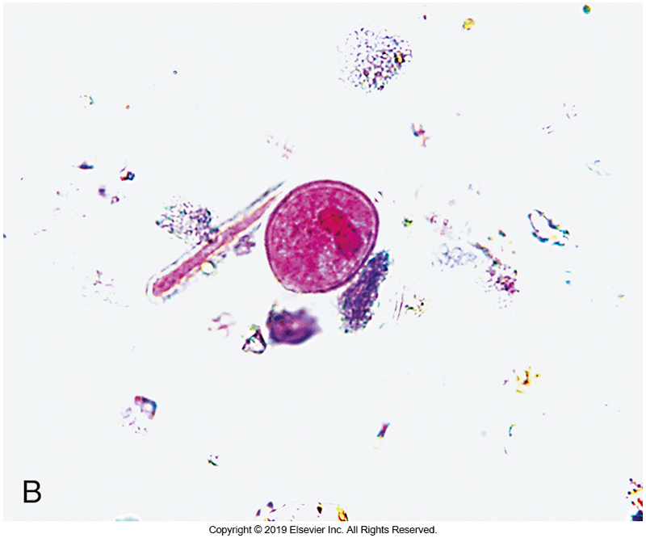
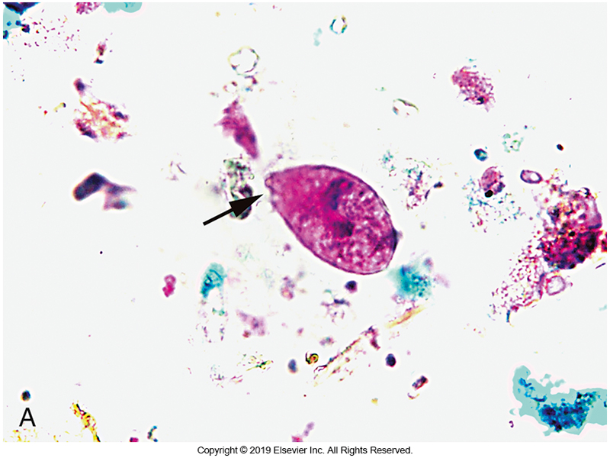
N. coli Trophozoite (A) and Cyst (B)

Slide 41
Neobalantidium coli (Cont.)
Trophozoite morphology
A small opening located at the posterior, the cytopyge is used to expel the contents of food vacuoles.
In a wet mount, the cilia are seen propelling the organism with a rotary motion.

Slide 42
Neobalantidium coli (Cont.)
Cyst morphology
Rounded and thick walled
Cilia may be seen retracted within cell wall
Trophozoite and Cyst common morphology
Two nuclei, a kidney bean– shaped macronucleus, and a small, round micronucleus that is usually situated in the small curvature of the macronucleus.
The micronucleus is rarely visible in routinely stained smears. Although this is the largest of protozoa, it can be missed during microscopic examination
Laboratory scientists are trained to search for small protozoan shapes.

Slide 43
Pathogenic Intestinal
and Urogenital Flagellates

Slide 44
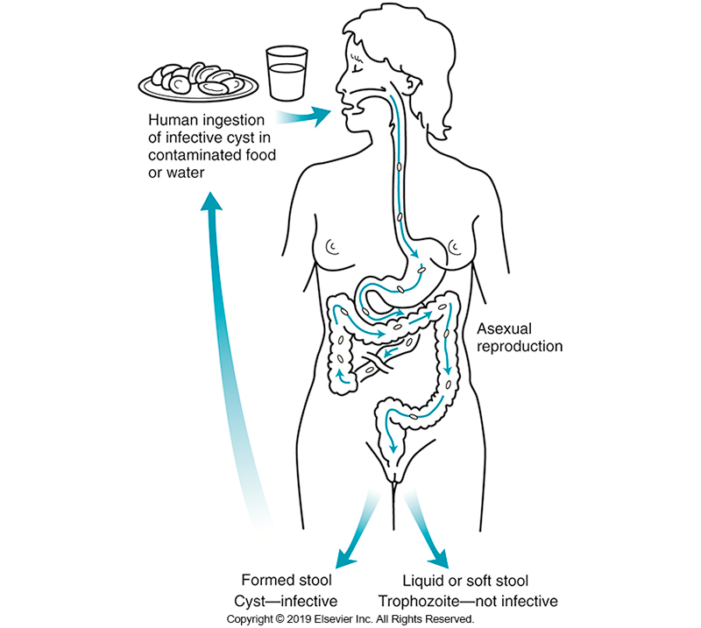
Generalized Life Cycle for Intestinal Flagellates

Slide 45
Giardia duodenalis
Formerly known as Giardia lamblia and Giardia intestinalis
Causative agent of outbreaks of gastroenteritis and traveler’s diarrhea
The most commonly reported intestinal protozoan in the U.S.

Slide 46
Giardia duodenalis (Cont.)
The main groups at risk
Travelers returning from endemic areas,
(Travelers in areas with poor sanitation are often exposed to conditions in which waterborne or foodborne (rare) cysts are ingested.)
Hikers who drink untreated water from streams, and
Children in daycare centers.
Outbreaks have been reported from swimming pools contaminated with feces.

Slide 47
Giardia duodenalis (Cont.)
Cysts may remain viable for several months in cold water.
Somewhat resistant to chlorine and iodine
Susceptible to desiccation and heating to 50° C.
Reservoirs
Animals, such as beavers
Source of infection for backpackers who drink water from streams/rivers
Condition is known as beaver fever or backpacker’s diarrhea

Slide 48
Giardia duodenalis (Cont.)
Along with E. histolytica, G. duodenalis has been identified as a sexually transmitted pathogen among those who practice oral-anal sex.
Clinical infection
A low number of cysts, as few as 10, can initiate infection with G. duodenalis.
After cyst ingestion, gastric acid in stomach triggers the beginning of excystation.

Slide 49
Giardia duodenalis (Cont.)
Clinical infection
The cyst responds to the slightly alkaline pH in the small intestine and completes the excystation process.
The presence of carbohydrates and bile stimulates growth of the trophozoite.
The trophozoite attaches to the surface of columnar epithelial cells and adheres to it via a ventral sucking disk.

Slide 50
Giardia duodenalis (Cont.)
Clinical infection
Pathologic mechanisms associated with G. duodenalis include a mix of human and organism factors.
These factors result in irritation and damage to the mucosa, as well as interference with absorption of nutrients, fats, and fat-soluble vitamins.
No toxins or virulence factors have been identified but there is evidence of inflammatory cell infiltration.

Slide 51
Giardia duodenalis (Cont.)
Clinical presentation
Ranges from asymptomatic infection to acute infection or chronic infection.
In most patients
Self-limiting diarrhea, with malaise, cramps, nausea, and abdominal tenderness after an incubation period of 12 to 14 days
Explosive, foul-smelling, nonbloody diarrhea present
No fever or evidence of inflammation
Symptoms last 1 to 4 weeks, and the patient may lose a significant amount of weight.

Slide 52
Giardia duodenalis (Cont.)
Clinical presentation
Patients with secretory IgA deficiency or achlorhydria seem not only to be more apt to acquire the infection but also to develop chronic disease.
Possible symptoms with chronic giardiasis
There may be a malabsorption-like syndrome, with up to 20% weight loss, fatigue, anorexia, and steatorrhea with large amounts of gas.
Fats and vitamin B₁₂ may be incompletely absorbed
Macrocytic anemia is not common

Slide 53
Giardia duodenalis (Cont.)
Clinical presentation
Children 6 months to 5 years of age are most susceptible to metabolic problems
Iron deficiency, protein malnutrition, and micronutrient deficiency.
Demonstrate growth and cognitive delay or general failure to thrive.
Children with preexisting malnutrition are more likely to develop long-term complications.
Treatment
Drug of choice-Metronidazole (Flagyl)
Albendazole can also be used

Slide 54
Giardia duodenalis (Cont.)
Laboratory diagnosis
Feces serve as the usual diagnostic specimen, but shedding of the cysts is irregular, and multiple stool specimens are often required for diagnosis.
Trophozoite morphology
Pear shaped or teardrop shaped, are bilaterally symmetric, and measure approximately 9 to 21 µm × 5 to 15 µm
Shows a characteristic “falling leaf” motility in a wet mount
In a permanently stained smear, the binucleate organism has been described as having an “old man appearance”

Slide 55
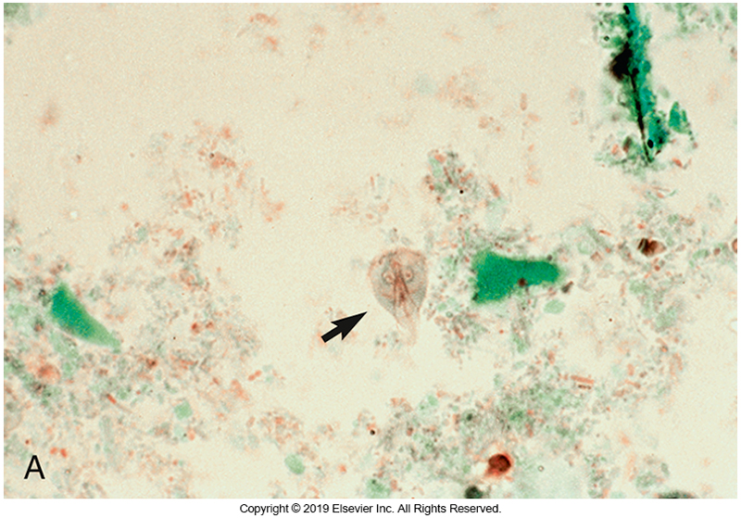
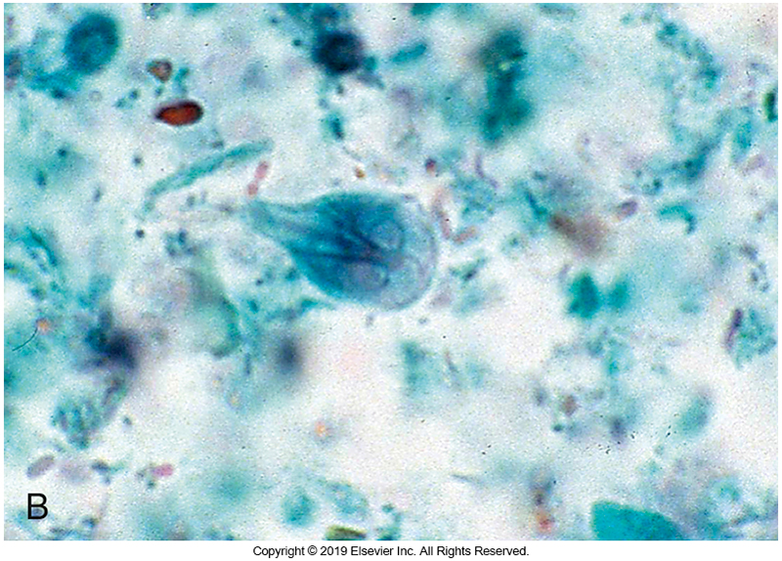
G. duodenalis Trophozoites

Slide 56
Giardia duodenalis (Cont.)
Laboratory diagnosis
Cyst morphology
Oval and measure approximately 8 to 12 µm × 7 to 10 µm.
Up to four nuclei
Cytoplasm is often pulled away from the cyst wall.
In a permanently stained smear, the retracted flagella and other internal structures give the cyst a cluttered appearance.

Slide 57
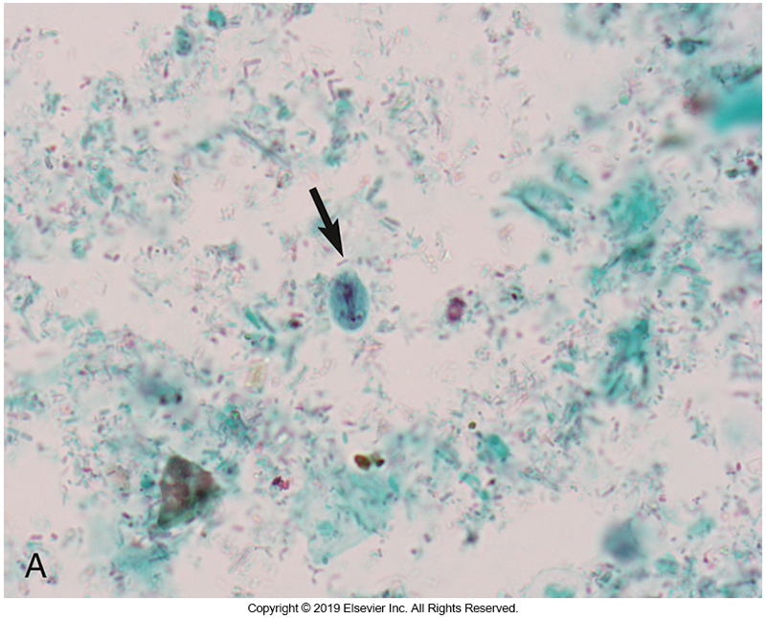
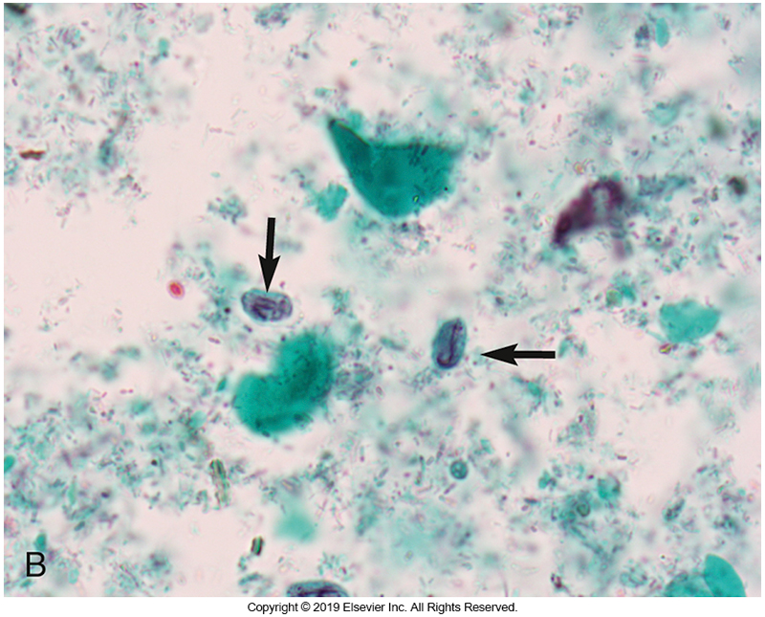
G. duodenalis Cysts

Slide 58
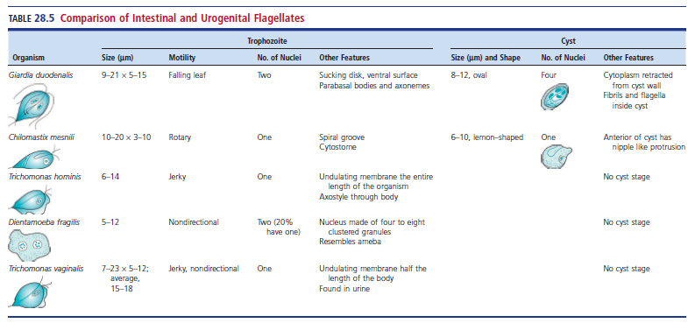
Comparison of Intestinal and Urogenital Flagellates

Slide 59
Giardia duodenalis (Cont.)
Laboratory diagnosis
EIAs using monoclonal antibodies to detect soluble antigens of G. duodenalis in stool are available.
Newer lateral flow immunochromatographic tests that may detect E. histolytica and/or Cryptosporidium spp. (as well as G. duodenalis) provide results in 15 minutes.
DFA tests can be used to identify the cyst of Giardia in a stool specimen.
Several of these DFA tests also contain a monoclonal antibody that identifies Cryptosporidium.

Slide 60
Giardia duodenalis (Cont.)
Laboratory diagnosis
When clinical symptoms persist, and the organism cannot be demonstrated in feces or when the patient does not respond to treatment, duodenal aspiration or the Entero-Test has been used to detect the organism.

Slide 61
Dientamoeba fragilis
D. fragilis has a worldwide distribution, with prevalence ranging from less than 1% to greater than 40%.
For many years, there were questions about the pathogenicity of D. fragilis.
The organism was isolated from the stools of patients who were asymptomatic and from those who had GI symptoms, such as abdominal pain or tenderness and diarrhea.

Slide 62
Dientamoeba fragilis (Cont.)
Evidence now suggests that the organism has a role as a pathogen in either acute or chronic infections.
As with Blastocystis infections, links to IBS or irritable bowel disease have been suggested.
Case reports show that treatment with metronidazole results in the clearance of the organism and alleviation of symptoms.

Slide 63
Dientamoeba fragilis (Cont.)
Molecular methods show that there are at least two genotypes.
While their significance is unknown, genotype 1 is more common.
The organism was historically described as lacking a cyst stage, but recent animal studies have identified a cyst-like structure in feces.

Slide 64
Dientamoeba fragilis (Cont.)
The life span of the trophozoite outside the body is very short, so direct transmission is unlikely.
Foodborne or waterborne outbreaks are not common, but some infections have been seen in family groups.
Controversy about transmission exits in research studies.
Some studies suggest that the trophozoite may be transmitted to humans through ingestion of helminth eggs, especially those of Enterobius vermicularis, because co-infection of D. fragilis and E. vermicularis is more common than co-infection of D. fragilis and other organisms.

Slide 65
Dientamoeba fragilis (Cont.)
Some, but not all, molecular studies have shown evidence of D. fragilis DNA within the pinworm egg.
Whether the cyst-like structure can be confirmed as the transmission stage remains to be determined.
Electron microscopy studies of ultrastructure, small-subunit rRNA gene analysis, and the lack of a cyst stage all indicate that it is closely related to the trichomonads.
D. fragilis has apparently permanently lost its flagella.

Slide 66
Dientamoeba fragilis (Cont.)
Trophozoite morphology
Resembles that of an amebae, hence the name
Binucleate (50% to 80% show this characteristic)
Delicate nuclear membrane with no peripheral chromatin
Karyosome consists of four to eight discrete granules, one of which is often larger than the others.
Size of the trophozoite ranges from 5 to 12 µm
Cytoplasm contains many food vacuoles and bacteria

Slide 67
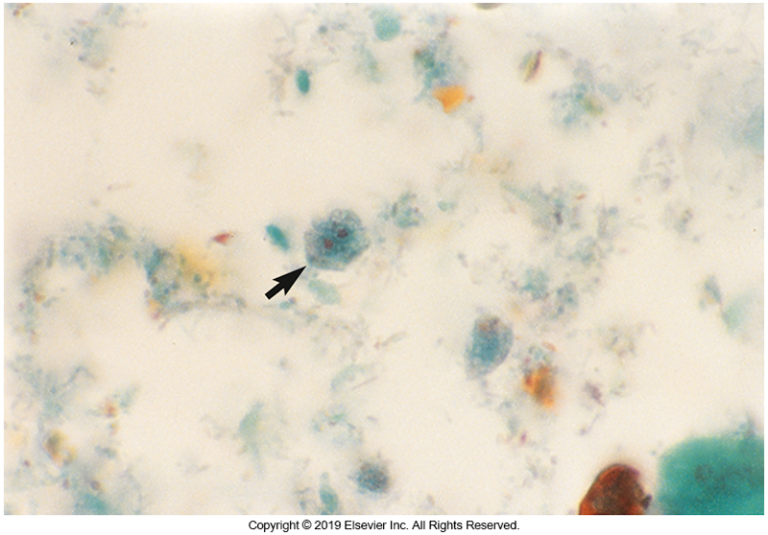
D. fragilis Trophozoite

Slide 68
Dientamoeba fragilis (Cont.)
Since trophozoites do not usually survive the concentration technique, they will only be detected on a permanent stained smear.
D. fragilis can be difficult to see on a trichrome-stained smear because its outline is often indistinct and blends into the background.
No commercial tests are available for D. fragilis antigen in stool
Microscopy remains the method of choice

Slide 69
Trichomonas vaginalis
T. vaginalis, a pathogen of the urogenital tract in men and women, causes trichomoniasis
One of the most common, nonviral, sexually transmitted diseases (STDs), with an estimate of 180 million cases worldwide.
Humans are the only host, and the presence of infection with the organism is associated with other STDs, especially gonorrhea.

Slide 70
Trichomonas vaginalis (Cont.)
Trichomoniasis has been increasingly associated with
Adverse pregnancy outcomes, including transmission of the organism to the newborn
Cervical neoplasia and pelvic inflammatory disease.
T. vaginalis lacks a cyst stage
The trophozoite stage is infective through sexual contact.

Slide 71
Trichomonas vaginalis (Cont.)
The pear-shaped trophozoite assumes an ameboid form on contact with epithelial cells of the genital tract.
Adhesion molecules, known as lipoglycans, mediate this binding.
The organism is susceptible to rapid drying in the environment, but a few cases of nonsexual transmission have been reported.

Slide 72
Trichomonas vaginalis (Cont.)
In women, the infection is primarily localized to the vagina, resulting in itching and the production of a frothy, creamy, mucopurulent vaginal discharge as well as dysuria.
About one third of infected women, however, are asymptomatic.
A chronic state can develop, with mild symptoms of pruritus and scanty discharge.

Slide 73
Trichomonas vaginalis (Cont.)
Women with chronic infection are often a major source of transmission to sexual partners.
Men infected with T. vaginalis are usually asymptomatic and serve as carriers, although they can develop nonspecific urethritis with a milky discharge that lasts up to 4 weeks.
T. vaginalis is now considered an important cause of nongonococcal urethritis.

Slide 74
Trichomonas vaginalis (Cont.)
Long-term immunity is not developed after an acute infection, and reinfection can occur.
Diagnosis
In women, typically made by finding the trophozoite in vaginal discharge or occasionally in urine
In men, the trophozoite is seen in urine or prostatic secretions

Slide 75
Trichomonas vaginalis (Cont.)
Trophozoite morphology
5 to 18 µm in diameter
Four anterior flagella
An undulating membrane that extends one half the length of the body.
In a wet mount, the trophozoite has a characteristic jerky motility, and the motion of the flagella and undulating membrane may be seen.
The preparation should be examined immediately because the organism loses viability quickly.

Slide 76
Trichomonas vaginalis (Cont.)
Diagnosis
In a Giemsa-stained preparation, the pear-shaped organism shows the presence of
an axostyle extending the length of the organism,
a single nucleus near the anterior end, and
chromatic granules extending the length of the axostyle.
Fluorescent staining of exudates using acridine orange will demonstrate a typical fluorescent morphology with a yellow to green nucleus.
Although most clinicians rely on wet mount preparations, the method has relatively low sensitivity (30% to 70%).

Slide 77
Trichomonas vaginalis (Cont.)
Diagnosis
Until the advent of molecular methods, culture of the organism from exudate was considered the most sensitive and specific method of detection, although an inoculum of 300 to 500 organisms is necessary.
Commercial systems using a plastic pouch containing culture medium are available for detection of the organisms.
Inoculate specimen into the pouch within 30 minutes of collection to ensure optimal organism viability.

Slide 78
Trichomonas vaginalis (Cont.)
Diagnosis
Culture specimens should be held for up to 5 days and then examined microscopically through the pouch.
PCR methods and antigen detection assays are also commercially available.
Useful for detecting infection in asymptomatic men
Rapid antigen detection tests are based on immunochromatographic EIA procedures using monoclonal antibodies.

Slide 79
Trichomonas vaginalis (Cont.)
Treatment
Infections are usually treated with metronidazole.
Treatment of sexual partners is suggested to obtain optimal cure and prevent reinfection.

Slide 80
Nonpathogenic Intestinal Flagellates

Slide 81
Chilomastix mesnili (Cont.)
Trophozoite morphology
Pear shaped
Approximately 10 to 20 µm long × 3 to 10 µm wide
Prominent cytostome
elongated and rounded at the anterior and posterior
Prominent nucleus
a small central karyosome and is surrounded by fibrils that curl around the cytostome to give a so-called “shepherd’s crook” appearance
Spiral groove that encircles the body of the organism

Slide 82
Chilomastix mesnili (Cont.)
Cyst morphology
Measures 6 to 10 µm
Lemon shaped
An anterior nipple
Nucleus, cytostome, and curved fibrils are visible in a stained smear

Slide 83
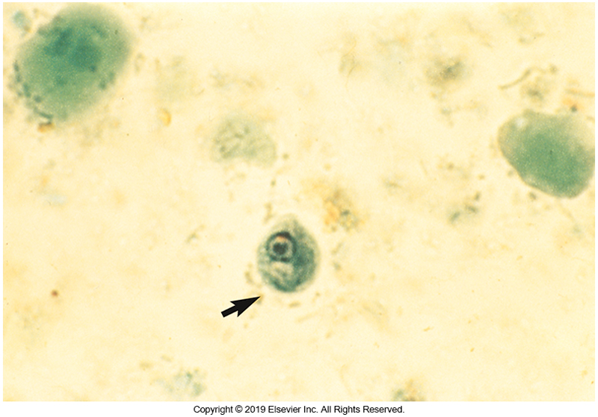
Chilomastix mesnili Cyst

Slide 84
Pentatrichomonas hominis
Formerly known as Trichomonas hominis
Trophozoite morphology
6 to 14 µm long
Prominent axostyle extending through the posterior of the organism
Four anterior flagella
An oval nucleus with a small karyosome.
The undulating membrane extends the length of the organism and is joined to the body along the costa.
Difficult to detect on stained-smears-stains weakly

Slide 85
Blood and Tissue Flagellates

Slide 86
Blood and Tissue Flagellates Overview
The hemoflagellates in the genera Leishmania and Trypanosoma differ in several ways from the intestinal flagellates.
First, they are transmitted by insect vectors, organisms that can transmit disease-causing agents.
These vectors are necessary for completion of the life cycle
Second, these organisms have different life cycle stages for diagnosis.
The trypomastigote and amastigote are the diagnostic stages found in humans.

Slide 87
Blood and Tissue Flagellates Overview
There are four morphologic forms associated with Leishmania and Trypanosoma
Amastigote
Promastigote
Epimastigote
Trypomastigote

Slide 88
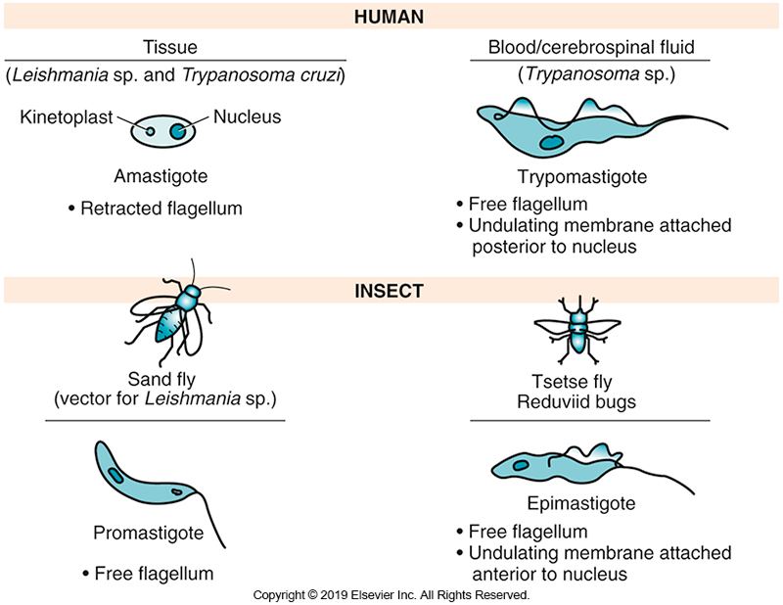
Life Cycle Stages of the Blood and Tissue Flagellates

Slide 89
Blood and Tissue Flagellates Overview
Amastigote
Amastigote is an obligate intracellular parasite.
2 to 5 μm
Found within macrophages and liver, spleen, or bone marrow cells in diseases caused by Leishmania spp.
May also be seen in cardiac or GI cells of patients infected with Trypanosoma cruzi

Slide 90
Blood and Tissue Flagellates Overview
Trypomastigote
a flagellated form
15 to 20 µm
Found in the blood, lymphatic fluid, or CSF of patients infected by Trypanosoma spp
Epimastogote and promastigote
These stages are seen in the insect vectors.

Slide 91
Leishmania
Contains several complexes of at least 20 species that cause disease in humans:
Leishmania tropica, Leishmania mexicana, Leishmania braziliensis, and Leishmania donovani complexes.
Leishmaniasis
Zoonotic infection in which dogs and rodents are the primary reservoir hosts for all species
Humans serve as an accidental host
Vector sand flies of the genera
Phlebotomus, Lutzomyia

Slide 92
Leishmania Clinical Infections
L. tropica complex
Cutaneous leishmaniasis or Oriental sore
Orient and North and Central Africa
Disease progression
Presence of a crusted circular lesion on any exposed body surface (especially the face and extremities)
Lesion begins as a small, red papule at the site of the insect bite and progresses to a lesion with an elevated indurated margin that may reach 8 cm.
Lesion resolves in several months and provides incomplete immunity against future infection.

Slide 93
Leishmania Clinical Infections
L. mexicana complex
New World cutaneous leishmaniasis
South and Central America
Another form of the disease- chiclero ulcer, also associated with L. mexicana complex.
Lesions on the ear
Self-limiting
Does not invade mucosal surfaces
Secondary bacterial infections can occur.

Slide 94
Leishmania Clinical Infections (Cont.)
L. braziliensis complex
Mucocutaneous leishmaniasis
Also known as espundia
Found in Mexico and Central and South Americas
Disease
Initial lesion that increases in size and targets oral and nasal mucosa
Gross disfigurement of the soft tissues with extensive tissue destruction

Slide 95
Leishmania Clinical Infections (Cont.)
L. donovani complex
Visceral leishmaniasis
Also known as kala-azar
Endemic to parts of South America, Africa, Southern Europe, and Asia
Disease progression
Organism spreads via lymphatics and invades the liver, spleen, lymph nodes, and bone marrow.
Symptoms
Present with headache, malaise, fever, anorexia, and weight loss
Fatal within 2 years if not treated

Slide 96
Leishmania Clinical Infections (Cont.)
L. donovani complex
Other possible symptoms
Splenomegaly and hepatomegaly with elevated liver enzyme levels
Hypogammaglobulinemia
Hypoproteinemia
Leishmania-containing macrophages invade the bone marrow.
The kidneys and heart may also be affected.

Slide 97
Leishmania Clinical Infections (Cont.)
L. donovani complex
A few patients experience a nodular or macular rash, known as post-kala-azar dermal leishmaniasis (PKDL), on the face, trunk, and limbs months to years after treatment.
If untreated, visceral leishmaniasis is often fatal within 2 years.

Slide 98
Leishmania Clinical Infections (Cont.)
Cases of cutaneous leishmaniasis and visceral leishmaniasis have been seen in several military personnel serving in Middle Eastern countries, such as Iraq and Afghanistan.
Visceral leishmaniasis has also been reported to be transmitted through solid organ transplants.

Slide 99
Leishmania Treatment
Previously, standard therapy for all leishmanial infections was pentavalent antimony compounds.
However, liposomal amphotericin B and paromomycin were used in the past few years.
A new drug, miltefosine, has been successful in treating infections

Slide 100
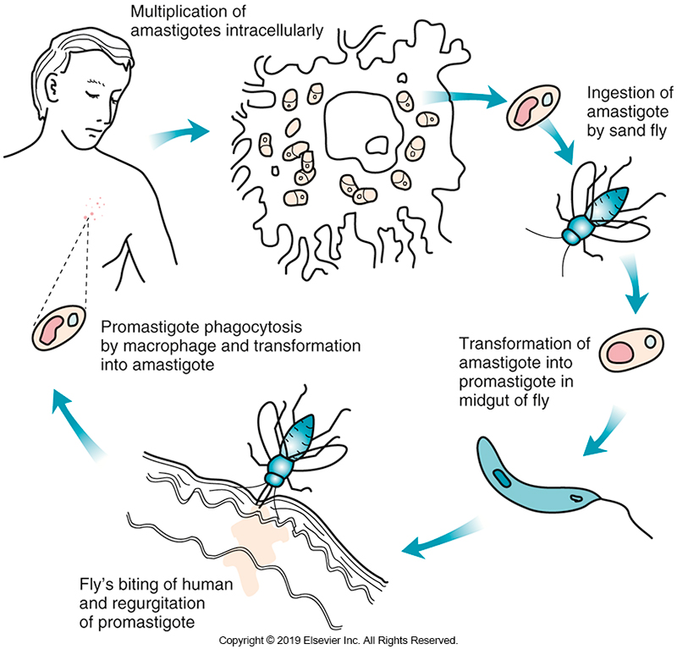
Life Cycle of Leishmania spp.

Slide 101
Leishmania Laboratory Diagnosis
Diagnostic stage in humans-amastigote
Found in macrophages or histocytes around the periphery of the skin lesions (L. tropica or L. braziliensis)
Found within cells of a bone marrow aspirate or liver or spleen biopsy specimen (L. donovani).
Wright staining of bone marrow aspirate reveals
an oval organism 2 to 5 µm in diameter
pale blue cytoplasm
a large red nucleus,
a rodlike kinetoplast (a structure rich in DNA associated with the basal body near the base of the flagellum) in cytoplasm

Slide 102
Leishmania Laboratory Diagnosis (Cont.)
The amastigote has also been reported extracellularly in cases of cutaneous leishmaniasis.
Promastigotes (the insect form of the parasite) have been identified in some patient samples.
Serologic tests, such as direct agglutination and indirect fluorescent assays, can be used to detect antibodies in individuals from nonendemic areas.

Slide 103
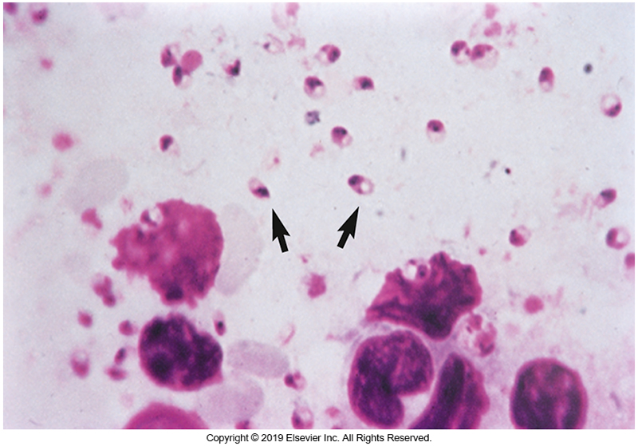
Amastigotes of Leishmania spp.

Slide 104
Trypanosoma
Trypanosomes are blood and CSF flagellates that require an insect vector.
Trypanosoma brucei rhodesiense and Trypanosoma brucei gambiense are the causative agents of human African trypanosomiasis, commonly called sleeping sickness, seen primarily in Central Africa.
Vector- tsetse fly (genus Glossina)

Slide 105
Trypanosoma (Cont.)
West African sleeping sickness
T. brucei gambiense
More common, milder, and more chronic of the two diseases
A long asymptomatic stage is followed by death years later.
Humans are the main reservoir but can sometimes be found in animals

Slide 106
Trypanosoma (Cont.)
East African sleeping sickness
T. brucei rhodesiense
A zoonosis
Game animals serve as reservoirs
Chagas’ disease or American trypanosomiasis
T. cruzi

Slide 107
Trypanosoma Clinical Infections
African sleeping sickness
Initial symptoms of African sleeping sickness include a local inflammatory reaction with tenderness, edema, and erythema at the site of the insect bite.
Occurs within 2 to 3 days and can last up to 4 weeks
During this time, the organisms are reproducing and beginning to enter the bloodstream.
First stage of disease-hemolymphatic phase
Occurs 1 to 3 weeks after infection

Slide 108
Trypanosoma Clinical Infections
African sleeping sickness
Trypomastigotes enter the blood and lymphatics
Patient experiences generalized symptoms
Fever, headache, joint and muscle pain, weakness, and lymphadenopathy
Enlargement of the lymph glands in the posterolateral triangle of the neck known as the Winterbottom sign.
Edema in the legs and arms and around the eyes is possible.

Slide 109
Trypanosoma Clinical Infections
African sleeping sickness
Second stage (meningoencephalitic)
Begins as the trypomastigotes invade the CNS
Patient develops-severe headaches, mental dullness, and apathy, and may experience-
Coordination problems, altered reflexes, and paralysis.
Eventually, the patient has convulsions, lapses into a coma, and dies.

Slide 110
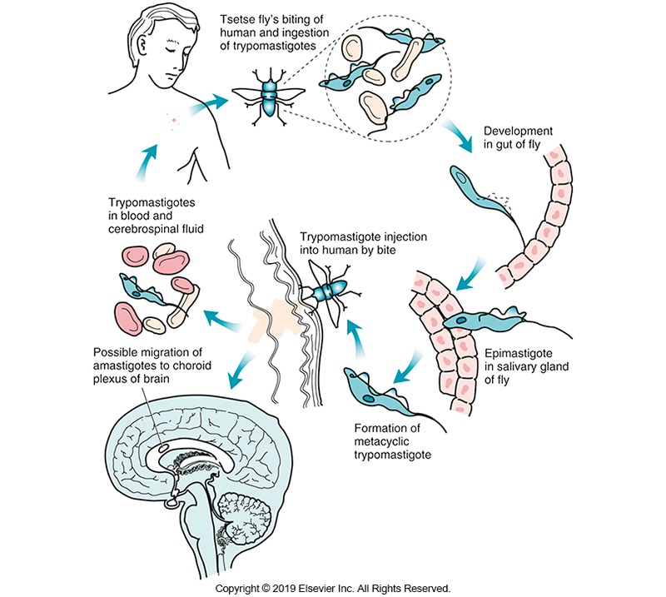
Life Cycle of the Agents of Sleeping Sickness

Slide 111
Trypanosoma Laboratory Diagnosis
Diagnostic stage-trypomastigote
Usually seen in a Wright-stained blood smear
Wet films may be used to detect motile trypomastigotes
Blood concentration methods are often needed because of the small number of organisms present

Slide 112
Trypanosoma Laboratory Diagnosis (Cont.)
Generally detected in blood
Can be found in lymphatic fluid or CSF
CSF will often show increased WBC count (primarily lymphocytes) and elevated protein levels
Trypomastigote
15 to 20 μm with a single large nucleus and posterior kinetoplast attached to the flagellum of the undulating membrane
Reported as Trypanosoma sp.
Final determination of species based on clinical symptoms and geographic area

Slide 113
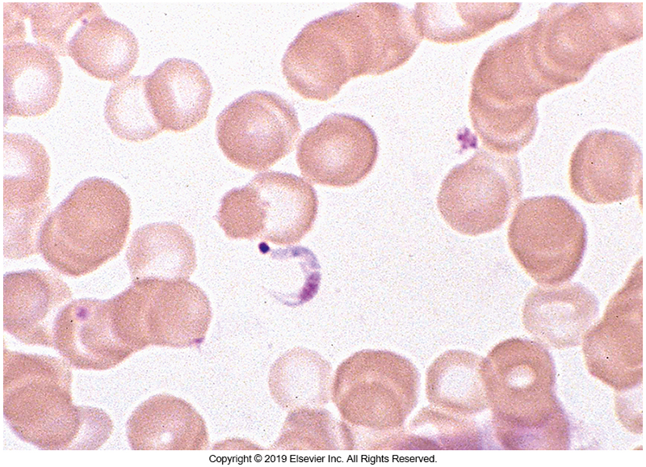
Trypanosoma Trypomastigote in a Blood Smear

Slide 114
Trypanosoma Laboratory Diagnosis (Cont.)
The QBC method, which has been used in the detection of malarial parasites, has also been adapted for the detection of trypomastigotes.
Field diagnosis of infection is important in endemic areas
A serologic method using a card agglutination test for trypanosomiasis (CATT) and a micro-CATT have been developed.
Uses lyophilized T. gambiense antigens but cannot distinguish current from past infection
Confirm with microscopy

Slide 115
Trypanosoma Laboratory Diagnosis (Cont.)
Latex agglutination test
Uses three surface antigens
Considered as more specific than CADD
There is no comparable method for T. brucei rhodesiense

Slide 116
Trypanosoma cruzi
Causative agent of Chagas disease
Transmitted via the triatomid bug
Also known as the kissing or reduviid bug
Less common transmission routes
Blood transfusion, transplanted organs, and congenital infection
Particularly hard on children
Involving multiple organ systems
Adults have milder symptoms.

Slide 117
Trypanosoma cruzi Clinical infections
Acute phase
Symptomatic or asymptomatic
After the insect bites, there is an incubation period that ranges from 2 to 4 weeks.
As the organisms enter the blood, the acute phase begins and lasts 4 to 8 weeks.
If symptomatic, local in nature
Presence of a chagoma (ulcerative skin lesion at the site of the insect bite) or
Unilaterial edema around the eye (Romaña sign) if bite is near the ocular conjunctiva

Slide 118
Trypanosoma cruzi Clinical infections
Acute phase
Systemic manifestations include fever, lymphadenitis, hepatosplenomegaly, malaise, muscular pains, and diarrhea and vomiting
If untreated during the acute phase, the patient will most likely remain chronically infected.
Latent phase
Develops as the trypomastigotes disappear from circulation and invade cells of the cardiac or GI system
Can last 10 to 40 years after infection, but only about 30% to 40% of patients develop the chronic form of Chagas disease—primarily cardiomyopathy.

Slide 119
Trypanosoma cruzi Clinical infections
Chronic phase
Chronic myocarditis develops with damage to all heart chambers and the conduction system.
May progress to tachycardia and eventually congestive heart failure.
In some patients, the chronic form may manifest itself as
megacolon, megastomach, or megaesophagus, which results in difficulty swallowing and disturbances to intestinal motility.
Damage to the organs is caused by a combination of continuous low-level parasitemia and immune-mediated tissue damage.

Slide 120
Trypanosoma cruzi Clinical infections
Chronic Phase
Polyclonal B-cell activation in the acute phase produces antibodies that have a weak affinity for the organism and may cross-react with heart tissue.
Controversy exists about the role of these autoantibodies in damage to tissue.
When the patient enters the chronic stage of the disease, there are periods of intermittent parasitemia of trypomastigotes, during which time the organism may be transmitted.

Slide 121
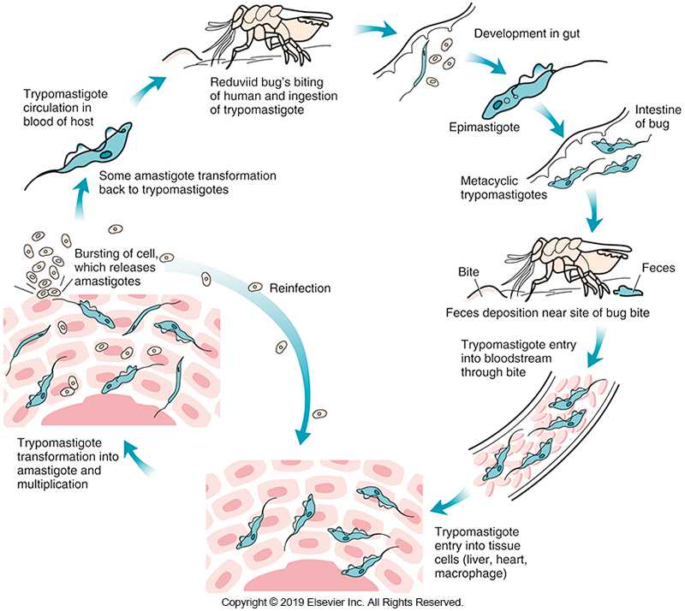
Life Cycle of T. cruzi

Slide 122
Trypanosoma cruzi Laboratory Diagnosis
Generally detected in blood
Trypomastigote 15 to 20 μm long
Crescent C or U shape
Single, large-nucleus midbody
Single anterior flagellum
In most Wright-stained smears, posterior kinetoplast attached to undulating membrane are well stained, but only the suggestion of a flagellum can be seen at the anterior end.

Slide 123
Trypanosoma cruzi Laboratory Diagnosis
In the chronic stage, the organism can be seen as an amastigote in a cardiac or other tissue biopsy specimen.
The morphology of all trypomastigotes is similar therefore the complete patient history must be obtained to determine the species present.
If the history is not available, then the organisms are reported as trypomastigotes of Trypanosoma spp.

Slide 124
Trypanosoma cruzi Laboratory Diagnosis
Chronic infection
If the history is not available, then the organisms are reported as trypomastigotes of Trypanosoma spp.
Diagnosis of chronic infection with T. cruzi is based on patient history, clinical symptoms, and presence of IgG antibodies to the organism.

Slide 125
Trypanosoma cruzi Laboratory Diagnosis
Xenodiagnosis
Used in Central and South America as a diagnostic tool
A laboratory-raised triatomid bug is allowed to feed on patients suspected of having T. cruzi infection.
The insect’s feces are examined on a regular basis for the presence of the parasite.
Presence of the parasite in the insect’s feces indicates that the patient was infected.

Slide 126
Trypanosoma cruzi Laboratory Diagnosis
Xenodiagnosis
Most helpful for diagnosing infections in the chronic stage, when fewer parasites are present.
Rapid diagnostic tests (RDTs) using whole blood are under evaluation for testing individuals in remote areas.

Slide 127
Apicomplexa

Slide 128
Apicomplexa Overview
The phylum Apicomplexa includes blood and tissue parasites.
This group of organisms shows a diversity of morphology and transmission methods and can infect many different body sites.
The life cycles are complex, characterized by sexual reproduction and asexual reproduction (reproduction when offspring arise from a single parent) phases.

Slide 129
Apicomplexa Overview
Some members of Apicomplexa may require an insect vector or intermediate host for completion of the life cycle.
Humans can serve as definitive hosts when sexual reproduction (offspring arise from the exchange of genetic material between two parents) occurs in human tissues and as intermediate hosts when asexual reproduction occurs.

Slide 130
Plasmodium Epidemiology
Causative agents of human malaria
Plasmodium vivax
Plasmodium ovale
Plasmodium malariae
Plasmodium falciparum
Plasmodium knowlesi
Originate in simian species, now associated with human malaria
Endemic throughout the world in tropical and subtropical countries

Slide 131
Plasmodium Epidemiology
Along with schistosomiasis and amebiasis, malaria is a major cause of death in people in underdeveloped countries.
Geographic distribution
P. vivax*- widest, most likely to be found in temperate climates
P. ovale- western parts of Africa
P. ovale & P. falciparum*-throughout Africa and in tropical countries
*responsible for more than 95% of infections

Slide 132
Plasmodium Routes of Transmission
Usually transmitted through the bite of an anopheline mosquito
Other routes
Blood transfusion
Infected needles
Transplacental infection has been documented.
The organism is sequestered in the placenta and can compromise fetal development because it affects transplacental transport of nutrients.

Slide 133
Plasmodium Clinical Infections
The malarial paroxysm, which begins 10 to 15 days after the bite of an infected mosquito
Associated with the growth of the parasites in RBCs and release of high levels of cytokines.
Symptoms are linked to the rupture of RBCs and release of merozoites (parasitic forms produced from multiple fission), malarial metabolites, and endotoxin-like substances into the bloodstream.

Slide 134
Plasmodium Clinical Infections (Cont.)
There are three phases to the malarial paroxysm.
The prodromal phase involves headache, bone pain, nausea, and/or flulike symptoms.
In the first phase the patient experiences a shaking chill lasting 15 to 60 minutes
The second phase is characterized by a fever up to 40º C along with headache, myalgia, and nausea lasting 2 to 4 hours.
In the third and final phase the fever finally breaks

Slide 135
Plasmodium Clinical Infections (Cont.)
Paroxysms
Over the course of 2 to 4 hours, the patient begins to sweat profusely and is left exhausted and sleepy.
This cycle repeats itself at regular intervals, depending on the species of malarial organism present, as parasites exit infected RBCs.
Anemia associated with malaria
The result of lysis of erythrocytes, removal of the infected cells by splenic macrophages, and in some cases
Immune clearance of erythrocytes coated with immune complexes of malarial antigens and antibodies.

Slide 136
Plasmodium Clinical Infections (Cont.)
Long-term infection with any malarial organism may result in damage to the liver and spleen caused by deposits of malarial pigment (hemozoin).
P. vivax and P. ovale infections generally do not have the range of complications seen with other species because the organism invades reticulocytes, there is generally low-level parasitemia (2% to 5%).

Slide 137
Plasmodium Clinical Infections (Cont.)
Long-term infection (cont.)
However, the persistence of hypnozoites that remain dormant in the liver can lead to relapses within 3 years of initial exposure.
P. malariae infections can lead to nephrotic syndrome which arises from the deposition of circulating immune complexes of malarial antigens and antibodies on the basement membrane of the glomeruli, causing an autoimmune-like reaction.
This organism has the most chronic course, and recrudescence occurs even decades after the initial infection.

Slide 138
Plasmodium Clinical Infections (Cont.)
The most severe form of malaria is caused by P. falciparum.
Up to 50% of erythrocytes may be infected, and the primary complication is development of cerebral malaria.
Between 20% and 50% of deaths caused by P. falciparum are the result of CNS complications.

Slide 139
Plasmodium Clinical Infections (Cont.)
A second but less complication of infection with P. falciparum is blackwater fever
Characterized by hemoglobinuria (hence the term blackwater)
It usually develops in patients with repeated infections and those undergoing quinine therapy.
Blackwater fever may be mediated by an antigen-antibody reaction caused by the development of an autoantibody to the RBCs.

Slide 140
Plasmodium Clinical Infections (Cont.)
Blackwater fever (cont.)
The black appearance of the urine is the result of massive intravascular hemolysis and resulting hemoglobinuria that appears black in acid urine.
The high-level parasitemia that often accompanies P. falciparum infection can lead to anemia and deposits of malarial pigment in some organs, such as the spleen
Renal complications, such as nephrotic syndrome or even renal failure, can occur with P. falciparum infection as a result of tubular necrosis brought about by tissue anoxia.

Slide 141
Plasmodium Treatment
Chloroquine remains the primary drug for prophylaxis and treatment of malaria.
It is effective against all asexual stages of malarial organisms and all gametocytes, except those of P. falciparum.
There is emerging evidence of a diminished response to chloroquine treatment in patients with P. vivax.
Chloroquine-resistant P. vivax may be treated with mefloquine or quinine sulfate with doxycycline.

Slide 142
Plasmodium Treatment
Primaquine phosphate, which is effective against hypnozoites that persist in the liver, is used to treat individuals infected with P. vivax and P. ovale to prevent relapses of these infections.
There is also evidence that some strains of P. vivax in the geographic areas of chloroquine resistance may be refractory to primaquine.

Slide 143
Plasmodium Treatment
Artemisinin-based drugs have been used in combination with classic drugs in areas in which highly resistant strains of P. falciparum have emerged.
The level of parasitemia should be calculated as a percentage before and during treatment to follow effectiveness of treatment.
In cases of high-level parasitemia, an RBC exchange may be used before treatment to decrease the level of parasitemia and increase effectiveness of the drug.

Slide 144
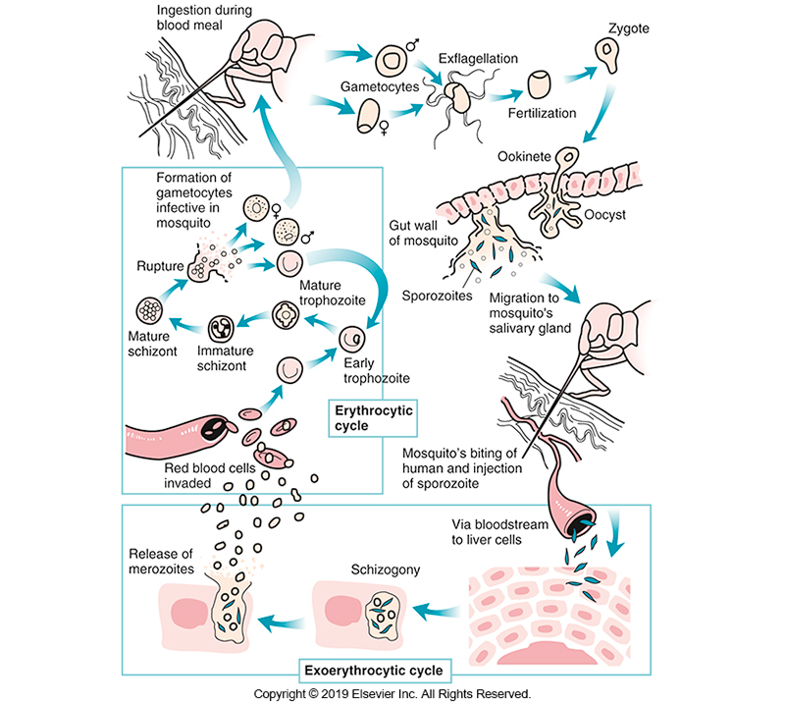
Life Cycle of Plasmodium spp.

Slide 145
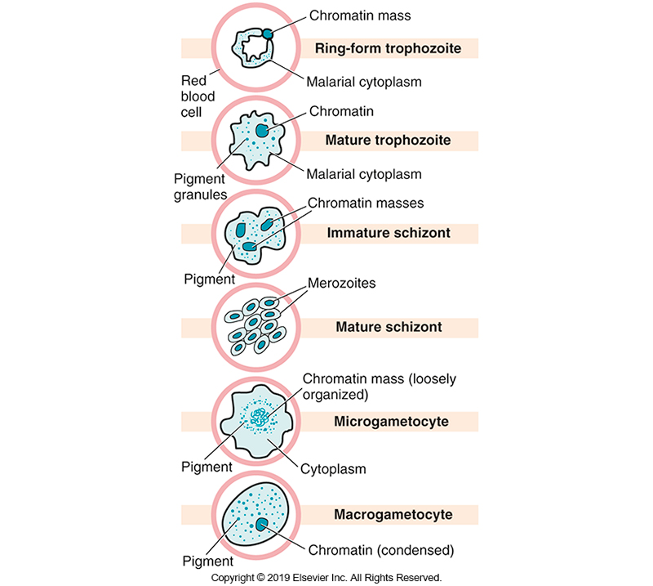
Life Cycle Stages of Malaria

Slide 146
Plasmodium Exoerythrocytic Phase
Occurs outside of the RBCs
After transmission to a human, sporozoites travel through the body to the liver and penetrate parenchymal cells.
Parasite replication in the liver (and outside of the bloodstream) that generates new merozoites is termed “exoerythrocytic.”
Some merozoites may persist in the liver in a dormant stage known as hypnozoites.
Accounts for instances of infection recurrence (relapse)
Typically, one cycle of merozoite production occurs in the liver before RBCs are invaded.

Slide 147
Plasmodium Erythrocytic Phase
When merozoites emerge from the liver, they enter the RBCs
Once inside the RBCs, the parasites feed on hemoglobin initiating the erythrocytic phase.
Malarial pigment, which is composed of iron deposits, is formed in the growing trophozoite as a result of incomplete metabolism of hemoglobin.

Slide 148
Plasmodium Erythrocytic Phase
Once the organism has reached the mature trophozoite stage, the chromatin begins to divide (developing schizont).
When the chromatin split has been completed (mature schizont), each chromatin mass is surrounded by its own small amount of malarial cytoplasm (merozoite).
Each malarial species has a typical number of merozoites, which may be used as an identifying characteristic.

Slide 149
Plasmodium Erythrocytic Phase
When the RBC ruptures, merozoites are released to invade other RBCs.
At this point, two outcomes are possible.
One is that the merozoite enters a cell and repeats development into a schizont
Or the merozoite enters a cell and develops into one of the sexual stages, the microgametocyte or macrogametocyte.

Slide 150
Plasmodium Sexual Phase
Takes place in mosquito vector
Macro and micro gametes infect a female mosquito after a blood meal.
Form ookinete that migrates through gut wall
Forming oocyst
Sporozoites are released and migrate to salivary glands.
Sporozoites are injected during blood meal.

Slide 151
Plasmodium Laboratory Diagnosis
Important patient information to aid in laboratory diagnosis
Travel history
Presence of clinical symptoms
Malarial paroxysm of fever and chills
Preparation and examination of both thick and thin Giemsa-stained slides are recommended.
Other microscopic and immunoassays are available.

Slide 152
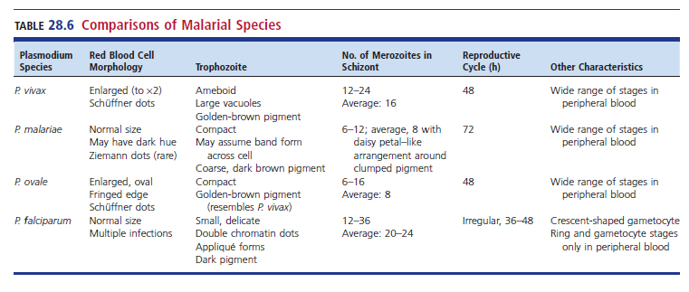
Comparison of Malarial Species

Slide 153
Plasmodium Laboratory Diagnosis
The thick smear is used to detect malarial parasites
Distortions of parasite morphology and the lack of intact RBCs require that a thin smear be examined to identify the species.
Trophozoites, schizonts, and gametocytes may be seen in the blood smear.
More than one set of smears should be made within a 36-hour period because one set is inadequate to completely rule out the presence of malarial organisms.

Slide 154
Plasmodium Laboratory Diagnosis
The QBC system using the fluorescent dye acridine orange is a sensitive method for demonstrating the presence of parasites
A thin smear must still be examined for definitive identification of Plasmodium spp.
Nucleic acid amplification tests have been proposed as another method for diagnosing malaria.
They have good sensitivity in detecting low levels of P. falciparum infection.
However, the extended time and costly equipment required do not make the procedure cost-effective or efficient, especially for field work

Slide 155
Plasmodium Laboratory Diagnosis (Cont.)
Several different immunoassays, collectively referred to as RDTs, use malarial antibody–impregnated dipsticks to detect Plasmodium infection.
These assays use an antigen capture immunochromatographic principle to detect soluble proteins from malarial organisms in blood.
Some tests use a monoclonal antibody directed against an antigen specific to P. falciparum, histidine-rich protein 2.
Other tests use an antibody that detects a protein common to all species, parasite lactate dehydrogenase or Plasmodium aldolase.

Slide 156
Plasmodium Laboratory Diagnosis (Cont.)
Serologic tests for antibody to malaria are not useful in an endemic area but may be useful for diagnosis in those who have traveled to an endemic area and have clinical symptoms of malaria.
Testing for the presence of hemozoin in blood is an emerging area of malaria diagnostics.

Slide 157
Plasmodium vivax
Tertian life cycle pattern
Life cycle takes approximately 48 hours to complete.
Invasion begins on the 3rd day.
P. vivax usually invades young RBCs (reticulocytes) and therefore is characterized by enlarged infected RBCs, often up to double the normal size.
Infected RBCs may contain pink-red staining granules
Schüffner’s stippling

Slide 158
Plasmodium vivax (Cont.)
The young trophozoite is characterized by its ameboid appearance;
By maturity, it usually fills the RBC, and golden-brown malarial pigment is present.
Schizonts contain 12 to 24 or more merozoites.
Average: 16
Gametocytes are rounded and fill the cell.
Macrogametocytes are often difficult to distinguish from mature trophozoites.

Slide 159
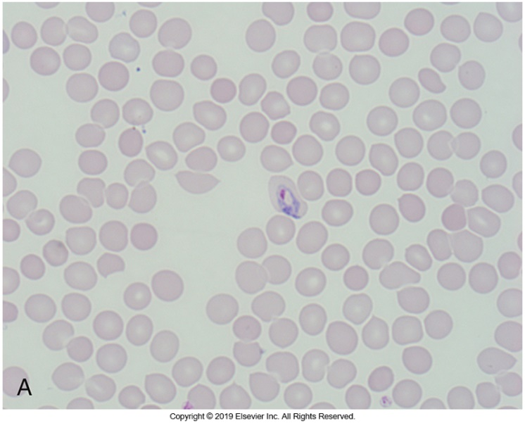
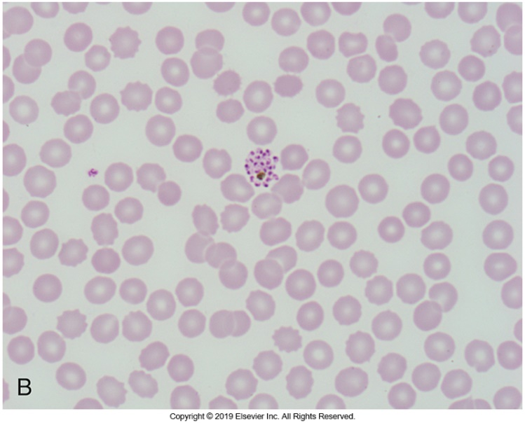
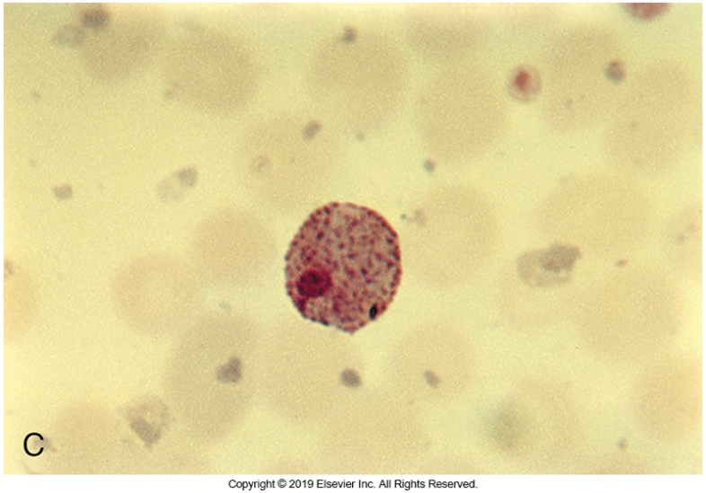
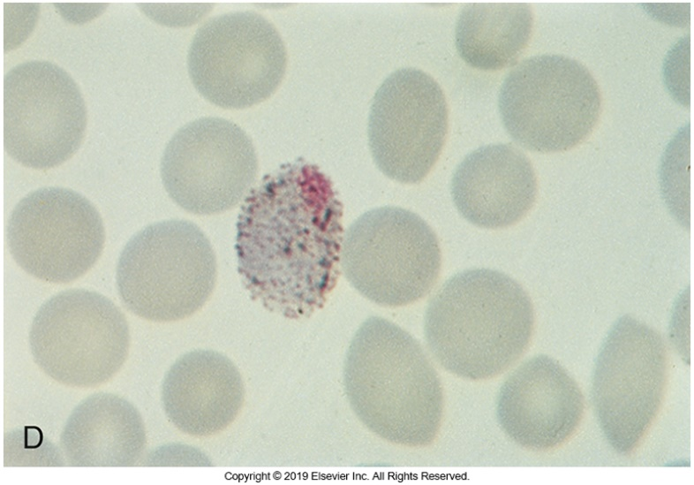
Morphologic Forms of P. vivax

Slide 160
P. malariae
Quartan life cycle
Life cycle takes approximately 72 hours to complete.
Invasion of new RBCs every 4th day
Trophozoite (also known as band form)-compact
Characteristic band form, hence, the form name
Dark, coarse, brown-to-black pigment is seen in the band form
Occasionally a few pink cytoplasmic dots
Ziemann’s dots
Mature schizonts have no more than 6 to 14 merozoites.
Average: 8
Merozoites known to form loose, daisy petal arrangement

Slide 161
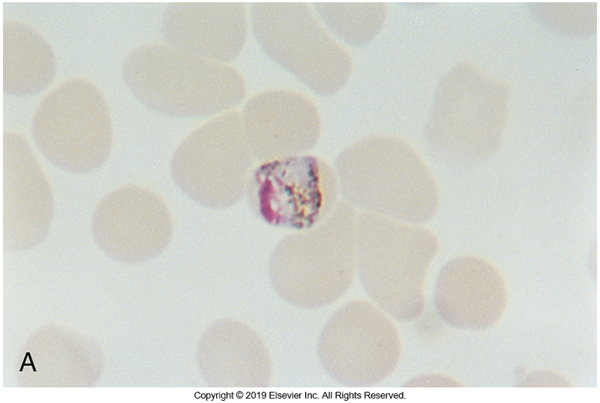
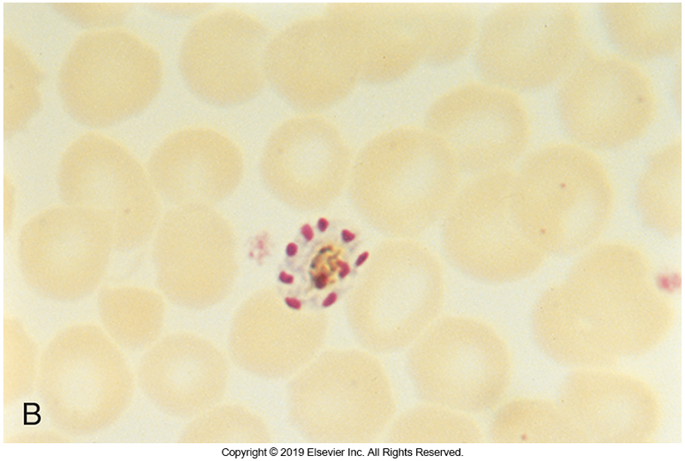
Morphologic Forms of P. malariae

Slide 162
P. ovale
The least commonly seen species
Resembles P. vivax
Infected RBCs are enlarged and may assume oval shape with fringeline edges.
Schüffner’s dots less common than in P. vivax
Can stain almost a bluish pink
Compact cell and fimbriated cell are characteristic
Has a golden brown pigment.
6 to 14 merozoites in mature schizonts
Tertian life cycle

Slide 163
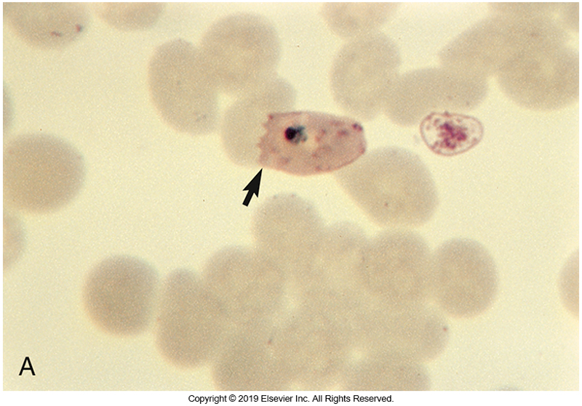
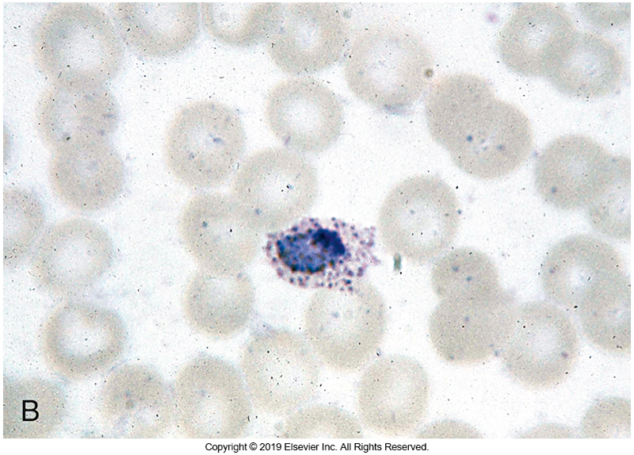
P. ovale

Slide 164
P. falciparum
Identified as having a tertian life cycle but
Often demonstrates an asynchronous life cycle
Rupture of RBCs take place at irregular intervals
Ranging from 36 to 48 hours
The life cycle stages seen in peripheral blood are usually limited to
Ring-form trophozoite and gametocyte.
Other forms are in the venules and capillaries of the major organs.

Slide 165
P. Falciparum (Cont.)
P. falciparum invades RBCs of any age and, for this reason, often exhibits the highest level of parasitemia, reaching 50% in some cases.
The ring forms of P. falciparum
Are more delicate than those of other species and often have two chromatin dots.
Appliqué forms, which are parasites at the edge of the RBC, and multiple ring forms in a single RBC are common.

Slide 166
P. Falciparum (Cont.)
Occasionally, small comma-shaped, red dots, referred to as Maurer dots can be seen in the cytoplasm of infected cells.
The mature trophozoite is small and compact and may have a dark brown pigment.
The schizont (which is rarely seen in peripheral blood) has 8 to 24 merozoites, with an average of 20 to 24.
Gametocytes have a characteristic banana or crescent shape .

Slide 167
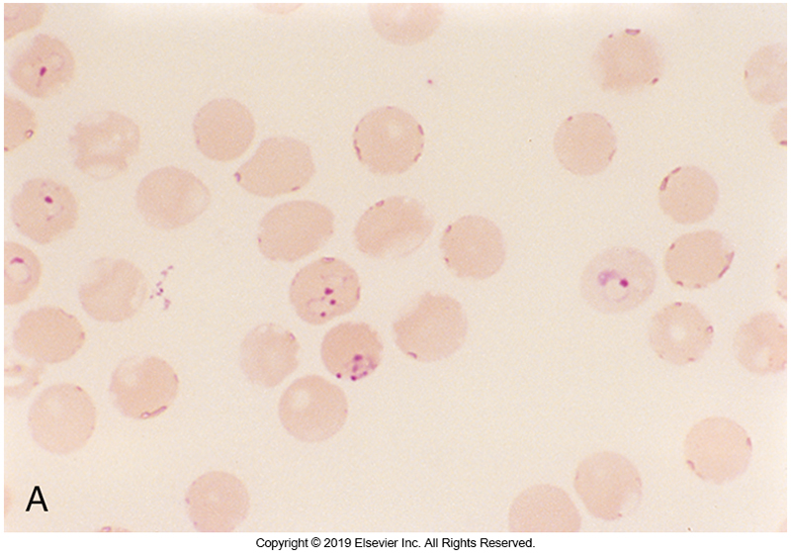
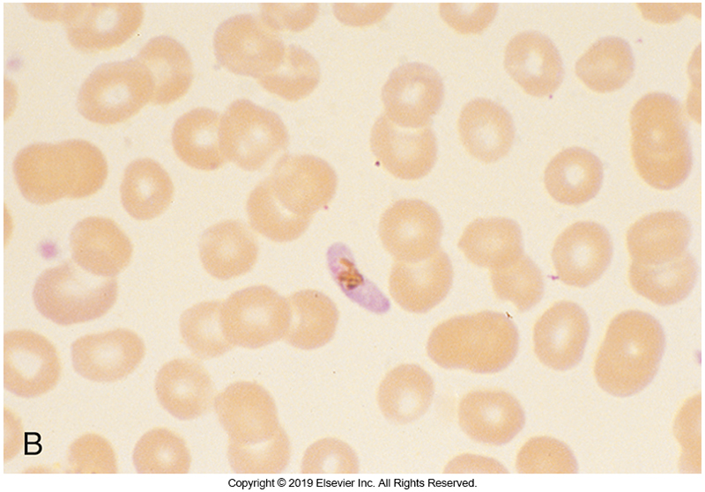
Forms of P. falciparum

Slide 168
A Word About P. knowlesi
P. knowlesi has early life cycle stages that resemble those of P. falciparum.
Mature trophozoites and gametocytes that resemble those of P. malariae.
Therefore, pertinent information, including travel history to an endemic area, is important in making a diagnosis.

Slide 169
Babesia microti
Intraerythrocytic zoonotic parasite causing human infection
Generally, infect cattle and other vertebrates
Tick bites transmit pathogen (Ixodes spp.)
White-footed mice and white-tailed deer are the reservoirs
Other modes of transmission
Transfusion of contaminated transfused blood; most cases were linked to RBC components
Currently, there are no FDA-approved tests for screening donor blood units for antibodies to Babesia spp.
Congenital transmission has been reported

Slide 170
Babesia microti (Cont.)
There have been reports indicating
Simultaneous transmission of B. microti and Borrelia burgdorferi (the causative agent of Lyme disease) because these two organisms have the same tick vector.
In the U.S.-Most cases appear in the Northeast and upper Midwest
Patients often manifest clinical symptoms of one disease but show a concurrent increase and decrease in antibody titers to both Babesia spp. and B. burgdorferi.
Several species are known to infect humans
In the U.S.- B.microti
In Europe- B. divergens

Slide 171
Babesia microti Clinical Infections
Causative agent of babesiosis
Most cases of babesiosis occur from May to September, when outdoor activities peak and exposure to ticks is highest.
Infection is often asymptomatic
Populations at greatest rick of infection
the very young
older adults
immunosuppressed patients

Slide 172
Babesia microti Clinical Infections
Symptoms are related to
the asexual reproductive cycle,
lysis of RBCs,
and the level of parasitemia.
Time from infection to development of symptoms
1 to 6 weeks

Slide 173
Babesia microti Clinical Infections
Symptoms
Malaria-like symptoms
Malaise
Fever
Chills
Sweating
Myalgia
Some patients are asymptomatic

Slide 174
Babesia microti Clinical Infections
Fever is not cyclic as in malaria
Anemia may develop if hemolysis is severe or prolonged.
The clinical course tends to be more severe or have complications if the patient has undergone splenectomy, is immunosuppressed, or is older
Complications
Include respiratory, liver, or renal failure or disseminated intravascular coagulation

Slide 175
Babesia microti Treatment
Treatment includes atovaquone plus azithromycin or clindamycin plus quinine.
In very severe infections, exchange transfusion may be used.

Slide 176
Babesia microti Life Cycle
As with Plasmodium spp., the life cycle of Babesia spp. has alternating sexual and asexual reproduction stages.
Production of the infective stage (sexual reproduction) takes place in the tick.
The zygote migrates to the salivary glands of the tick, where sporozoites are formed.

Slide 177
Babesia microti Life Cycle (Cont.)
These sporozoites enter vertebrates during a blood meal and infect erythrocytes by attaching to a sialoglycoprotein on the erythrocyte membrane.
Inside the cell, they become trophozoites and divide by asexual reproduction (budding) to form pairs and tetrads.
The reproduction time in Babesia infection is approximately 4 to 6 hours.

Slide 178
Babesia microti Life Cycle (Cont.)
The resulting merozoites are released to infect other RBCs, where they use merozoite surface proteins to attach to glycophorin A and glycophorin B on the RBC membrane.
Some merozoites differentiate into gametocytes (larger, more variably shaped), but this is not an easily identifiable stage from the trophozoite.
There is no exoerythrocytic cycle in humans.
Transovarian transmission can occur in the tick, allowing the life cycle to persist without an intermediate host.

Slide 179
Babesia microti Laboratory Diagnosis
Laboratory diagnosis
Wright- or Giemsa-stained thin blood smears
The organisms appear as small, delicate, pleomorphic ring-form trophozoites, about 1 to 2 µm in length, with a prominent chromatin dot and faintly staining cytoplasm.

Slide 180
Babesia microti Laboratory Diagnosis
More mature trophozoites may appear as
Pyriform organisms in single, double, or the classic tetrad (Maltese cross) formation within the RBC
Although they are characteristic for babesiosis, the tetrad forms are not always seen.
The morphology initially may be confused with that of P. falciparum. Lack of pigment, presence of extraerythrocytic organisms, and absence of other life cycle stages serve as keys to differentiate Babesia from P. falciparum

Slide 181
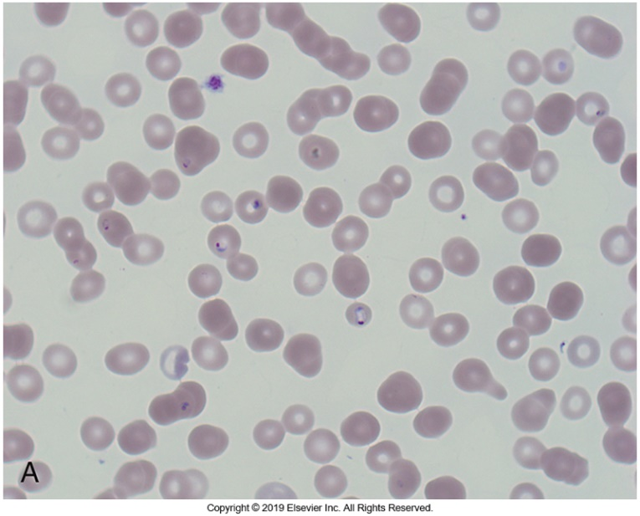
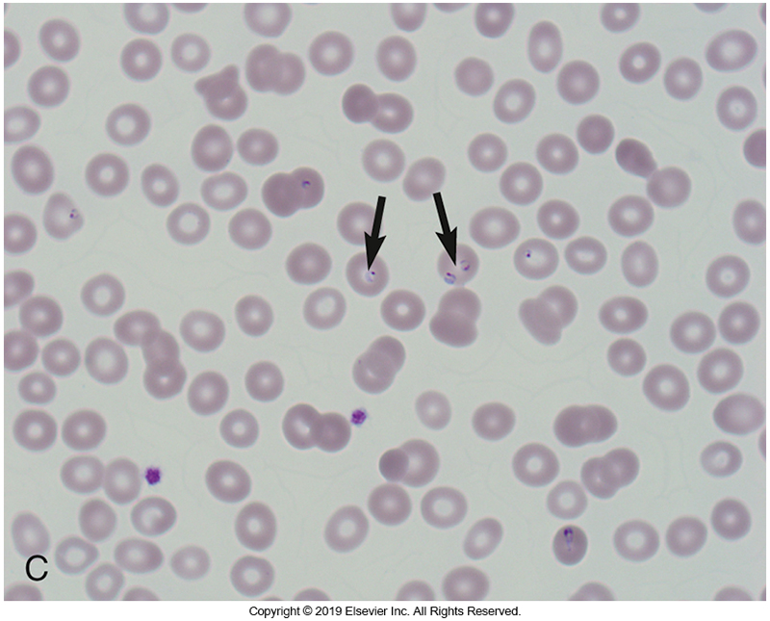
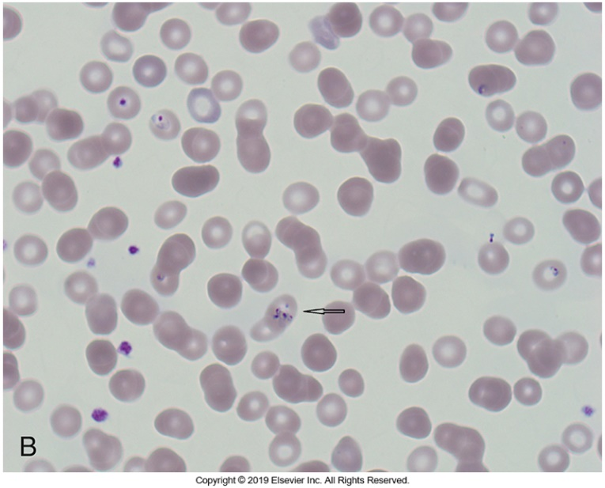
Photographs of B. microti

Slide 182
Babesia microti Laboratory Diagnosis
Patients with a normocytic hemolytic anemia may have decreased haptoglobin and elevated indirect bilirubin levels and reticulocytosis.
Some patients may demonstrate elevated levels of liver enzymes and lactate dehydrogenase, and decreased numbers of platelets.
Serologic studies, such as immunofluorescence assays, can be used to detect circulating antibodies (IgM and IgG).
The levels of IgM antibodies are usually elevated during the first 2 weeks and then decline.
IgG titers greater than 1: 1024 are generally considered indicative of recent or active infection.

Slide 183
Babesia microti Laboratory Diagnosis (Cont.)
Although transfusion-transmitted babesiosis has been reported,
There is no screening test for blood donors
Obtaining a detailed donor history is the only method used to screen donors.
Molecular methods to detect parasite DNA have been developed and may be used when there is a high suspicion of babesiosis, but the smears remain negative.

