Slide 1
Chapter 28
Diagnostic Parasitology
PART THREE

Slide 2
Toxoplasma gondii
Causative agent of toxoplasmosis
Obligate intracellular parasite
Found worldwide
As many as one third of individuals may be infected
More than 20% of the U.S. population shows serologic evidence of infection, but in parts of Europe, the proportion may be as high as 80%.

Slide 3
Toxoplasma gondii (Cont.) Clinical Infections
Clinical presentation differs based on the immunologic status of the infected individual.
Patients with acute infections may be asymptomatic or may have mild flulike or mononucleosis-like symptoms, including low-grade fever, lymphadenopathy, malaise, and muscle pain.
Once the acute infection has resolved, the organism enters a relatively inactive stage, in which tissue cysts containing many slow-growing forms of the organism are found.

Slide 4
Toxoplasma gondii (Cont.) Clinical Infections
May be transmitted congenitally because of a transient parasitemia in pregnant women who have primary infection
Congenital transmission occurs when the tachyzoites, the motile, rapidly dividing morphologys in maternal circulation, cross the placenta and enter fetal circulation and tissues.
Symptoms in children with congenital infection
Intellectual disability
Microcephaly, seizures
Hydrocephalus
Retinochoroiditis
Blindness

Slide 5
Toxoplasma gondii (Cont.) Clinical Infections
If the fetus is exposed to the infection early in the pregnancy, more severe complications are likely to result.
Infections acquired later in pregnancy may result in the child being
Asymptomatic at birth
Develop complications, especially ocular problems, later in childhood.

Slide 6
Toxoplasma gondii (Cont.) Clinical Infections
Immunosupressed patients (especially those with leukemia, lymphoma, undergoing chemotherapy) may experience
A serious primary infection or reactivation of a latent infection.
Fulminating encephalitis and result in rapid death.
Pulmonary toxoplasmosis
May be present in conjunction with CNS infections or
The presenting condition
The organism can spread to any organ in the body

Slide 7
Toxoplasma gondii (Cont.) Clinical Infections
Toxoplasmosis via organ transplantation
The organ may contain bradyzoites, which are slow-growing encysted forms of the parasite responsible for chronic infections that are reactivated in the immunocompromised recipient.
Frequently occurs when the organ recipient is seronegative for T. gondii and the organ donor is seropositive.
Usually occurs within the first 3 months after transplantation and may spread to multiple organs
In the case of a seropositive transplant recipient, immunosuppressive treatment to prevent organ rejection may reactivate a latent infection in the transplant recipient.

Slide 8
Toxoplasma gondii Treatment
Toxoplasmosis in the immunocompetent host is not treated.
When treatment is necessary, a combination of antimicrobials, such as trimethoprim-sulfamethoxazole, is used for treating the infection in the tachyzoite stage.
The drugs are not effective against bradyzoites in cysts located in muscle and brain tissues

Slide 9
Toxoplasma gondii Life Cycle
T. gondii has two life-cycle stages in humans:
Tachyzoite and bradyzoite.
Tachyzoites can invade any nucleated cell and are the actively motile and reproducing forms
They are crescent shaped, are 4 to 6 µm long, and have a prominent nucleus.
Bradyzoites are the slow-growing asexual forms found in a cyst-like structure during the dormant phase of infection

Slide 10
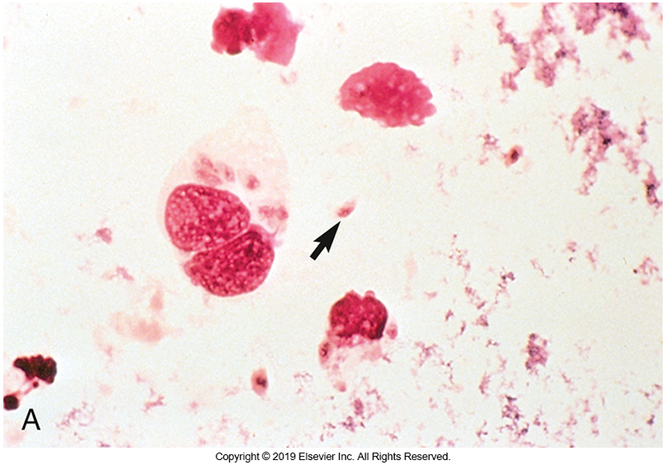
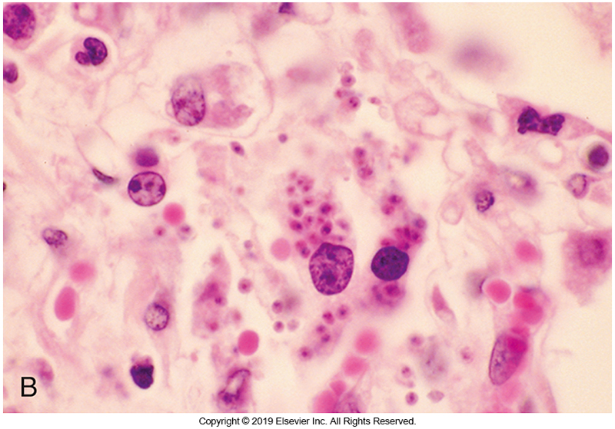
Tachyzoites of T. gondii

Slide 11
Toxoplasma gondii (Cont.)
Modes of transmission
Water
Ingestion of undercooked meat containing the cyst-like structure with bradyzoites
Congenital transmission
Risk factors
Primary risk factors for acquiring the infection
Cleaning a cat litter box, gardening without gloves, and
Eating raw or undercooked meat or unwashed vegetables and fruit.

Slide 12
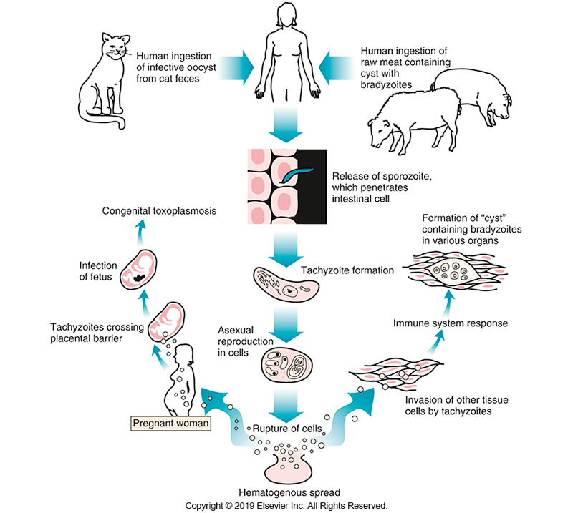
Life Cycle of T. gondii

Slide 13
Toxoplasma gondii Laboratory Diagnosis
Identification of the tachyzoite or pseudocysts with bradyzoites in tissue is very difficult because no single organ is invaded.
In disseminated toxoplasmosis, histologic stains of biopsy materials may demonstrate the cyst or, in some cases, tachyzoites.
Noninvasive techniques, such as magnetic resonance imaging (MRI) and CT, may be used in the diagnosis for patients suspected of having disseminated toxoplasmosis.

Slide 14
Toxoplasma gondii Laboratory Diagnosis (Cont.)
The levels of antibodies to the organism show a rapid increase during infection
Tests for antibodies are most commonly used for diagnosis.
IFAs and EIAs routinely used for diagnosis
Because most patients have an antibody titer to the organism, interpretation of the titer must be linked to clinical symptoms and the patient’s history.

Slide 15
Toxoplasma gondii Laboratory Diagnosis (Cont.)
IgM-specific test
May also be used to diagnose acute infections
Can be useful in the diagnosis of primary toxoplasmosis in pregnant women suspected of having been exposed to the organism
In neonates in whom congenital infection is suspected
Antibody titers may be unreliable in immunocompromised patients

Slide 16
Toxoplasma gondii Laboratory Diagnosis (Cont.)
PCR assays to detect T. gondii DNA may be used for CSF or amniotic fluid and are useful in detecting congenital infection in utero.
Molecular methods are also used in bone marrow transplant recipients to detect infection.

Slide 17
Opportunistic Intestinal Apicomplexa

Slide 18
Cryptosporidium spp.
Recognized for causing self-limiting GI infection in immunocompetent hosts
Identified as opportunistic pathogens in immunocompromised hosts, particularly those with AIDS
Obligate intracellular parasites transmitted by ingestion of the infective oocyst.
Fecal-oral route

Slide 19
Cryptosporidium spp. (Cont.)
Most infections are reported in summer, when there is increased recreational water activity.
Foodborne infections have been associated with ingestion of raw foods or unpasteurized drinks.
Most common species found in humans
Cryptosporidium hominis
Cryptosporidium parvum

Slide 20
Cryptosporidium spp. (Cont.)
Cryptosporidiosis is the leading cause of waterborne disease outbreaks in the United States.
Outbreaks in daycare centers and from environmental contamination of municipal water supplies have been reported.
In the 1980s, cryptosporidiosis was identified as a major opportunistic infection in patients with AIDS and classified as an AIDS-defining illness.

Slide 21
Cryptosporidium spp. Clinical Infections
In immunocompetent patients,
The organisms cause a transient profuse, watery diarrhea along with mild to severe nausea and vomiting, headache, and cramps.
The onset is rapid (within 3 to 7 days after ingestion of the oocyst), but the infection is self-limiting.
Symptoms resolve in several weeks, but infections can last up to 1 month

Slide 22
Cryptosporidium spp. Clinical Infections (Cont.)
Infection begins in the small intestine but may spread to the large intestine.
The first infection occurs in early childhood and is symptomatic
Profuse, watery diarrhea
Subsequent infections are mild to asymptomatic.
The organism alters osmotic pressure in the gut, with a resulting influx of fluid.
Excessive fluid loss=dehydration + electrolyte imbalance

Slide 23
Cryptosporidium spp. Clinical Infections (Cont.)
In patients with AIDS whose cell-mediated immunity is compromised and whose CD4 count is less than 50 cells/μL, the infection is more likely to become fulminant or life-threatening or spread to extraintestinal sites.
Chronic cases
Damage to intestinal permeability can result in decreased uptake of fluids, electrolytes, nutrients
Malabsorption syndrome may occur

Slide 24
Cryptosporidium spp. Treatment
Chronic cases
No antimicrobial is completely effective against this infection.
Paromomycin and azithromycin, which can suppress the infection, have been used, with mixed results.
Nitazoxanide, a relatively new agent, has been used for treating Giardia and Cryptosporidium infections in immunocompetent children and adults

Slide 25
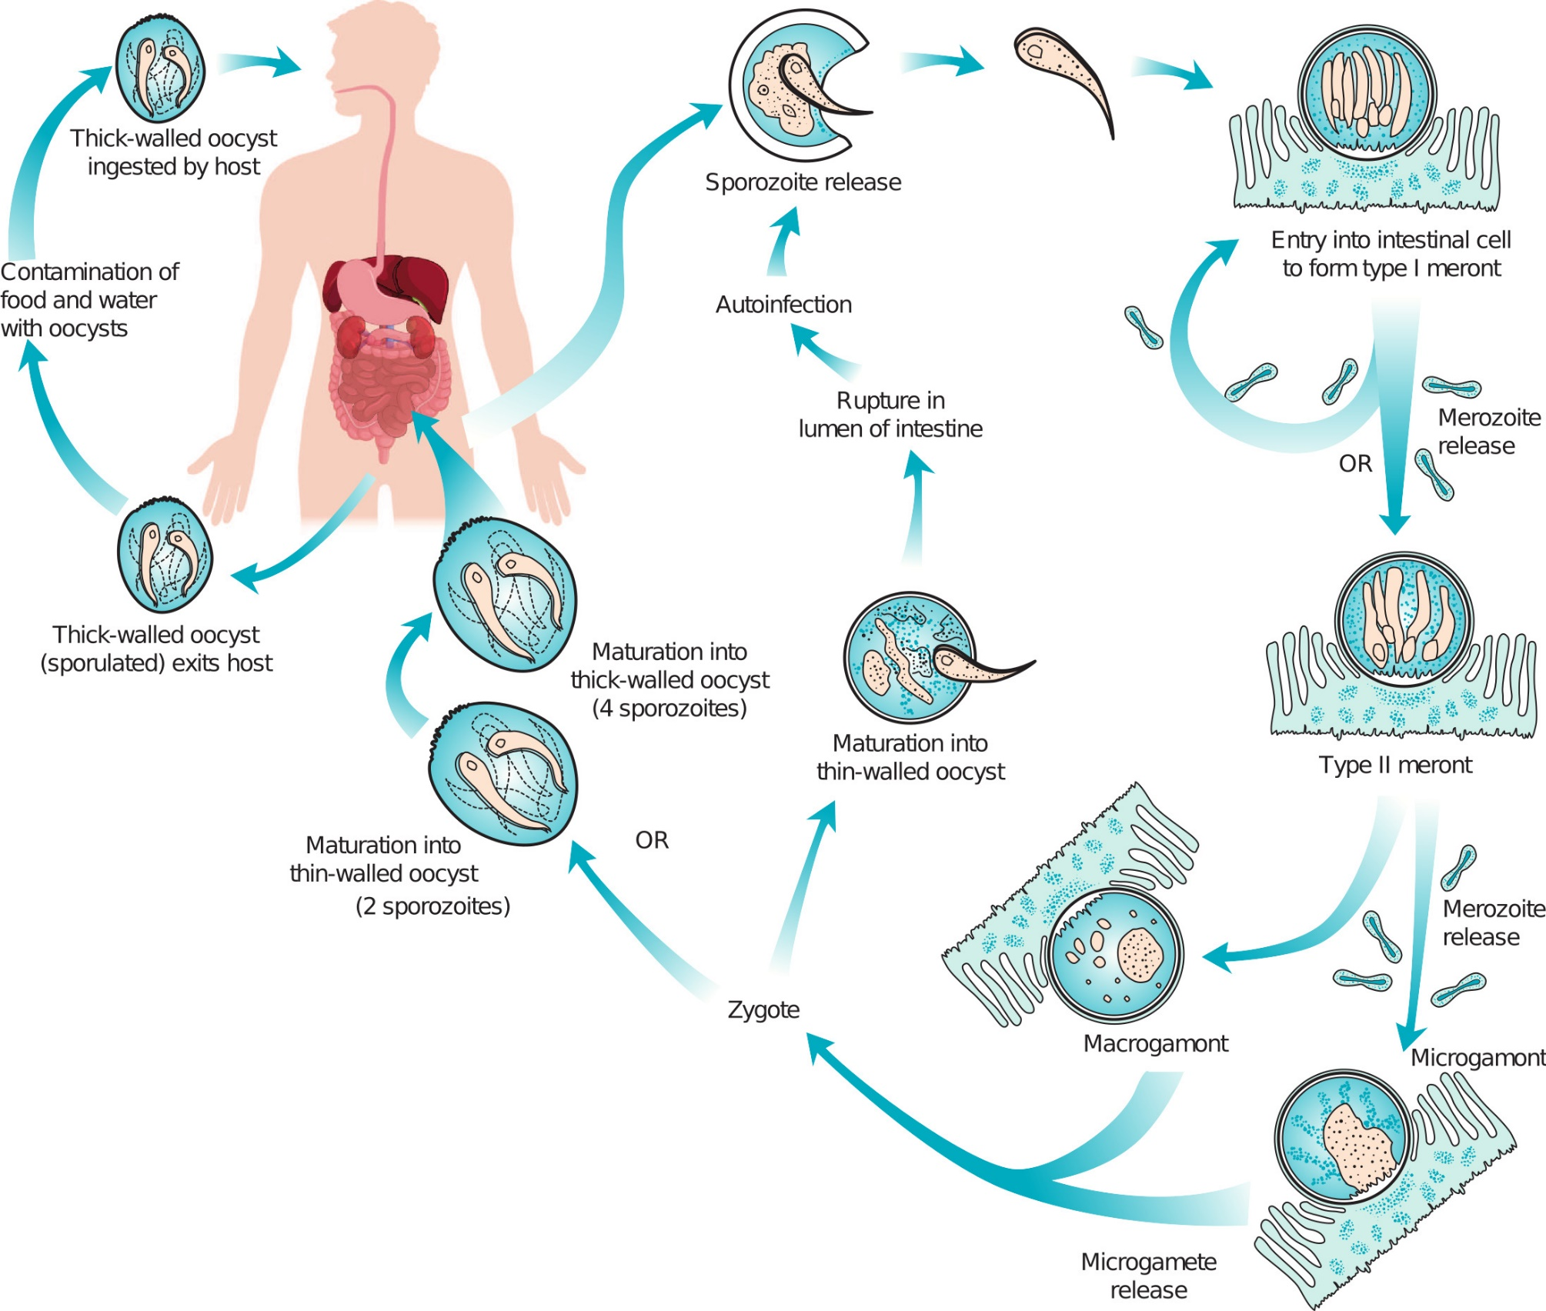
Life Cycle of Cryptosporidium

Slide 26
Cryptosporidium spp. Laboratory Diagnosis (Cont.)
Diagnostic morphology
Oocyst, 4 to 6 µm, refractile appearance, and round shape
Difficult to detect with routine concentration procedures
The organism may resemble a yeast of an RBC
There are more oocysts in liquid stool than in formed stool

Slide 27
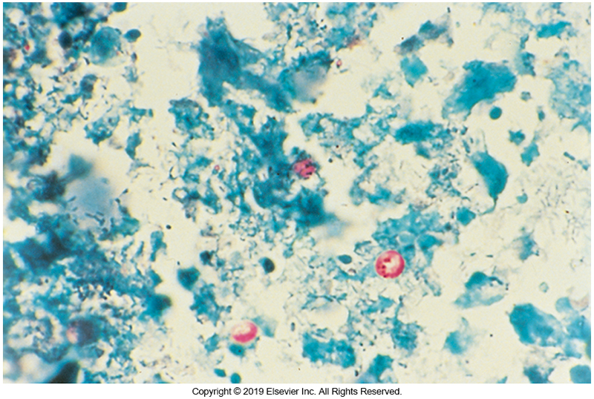
Cryptosporidium Oocysts

Slide 28
Cryptosporidium spp. Laboratory Diagnosis (Cont.)
Recommended detection methods, which do not distinguish organisms to the species level
Modified acid-fast stain
the organism stains a bright red sphere, which distinguishes it from yeasts, which stain green
Antigen detection test
Direct fluorescent antibody (DFA) testing using a monoclonal antibody directed against Cryptosporidium species

Slide 29
Cryptosporidium spp. Laboratory Diagnosis (Cont.)
Studies indicate that antigen detection by monoclonal antibody tests demonstrates greater sensitivity and specificity than the modified acid-fast stain.
EIA methods can also be used but are less sensitive (sensitivity of 70%) than fluorescent antibody methods.
More recently, lateral-flow immunochromatographic assays have become available

Slide 30
Cystoisospora belli
Formerly Isospora belli
Opportunistic pathogen
Acute infections are clinically indistinguishable from C. parvum
The infection is self-limiting and usually resolves in several weeks in an immunocompetent host.
More serious in immunocompromised patients
Watery diarrhea, concurrent weight loss or chronic infection development
Treatment with trimethoprim-sulfamethoxazole has been effective in eliminating diarrhea, but patients often show recurrence of infection when therapy is discontinued.

Slide 31
Cystoisospora belli (Cont.)
General Symptoms
Asymptomatic or
Low-grade fever, headache, diarrhea, and colicky abdominal pain
Life cycle of C. belli
Similar to that of Cryptosporidium spp. in that it requires only one host but occurs within the cytoplasm of epithelial cells of the small intestine.
The oocyst of this organism is not infective when passed in the feces and requires 24 to 48 hours outside the body to become infective.
There is no thin-walled oocyst to cause continued autoinfection.

Slide 32
Cystoisospora belli (Cont.)
Mature oocyst of C. belli
Oval, 20 to 33 µm by 10 to 19 µm, with a hyaline cell wall.
The immature oocyst usually shows a single sporoblast (an early stage in the development of a sporocyst, before differentiation of the sporozoites).
The mature oocyst has two sporocysts, which are walled bodies.

Slide 33
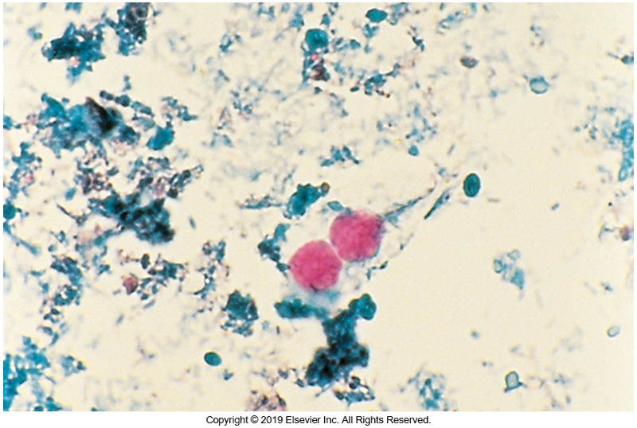
C. belli Oocysts

Slide 34
Cystoisospora belli (Cont.)
Mature oocyst
Each sporocyst contains four elongated sporozoites.
Oocysts can be seen in wet mounts.
The modified acid-fast stain has been used to detect C. belli.
The oocyst wall does not stain but often shows a faint outline because of precipitated stain, and the sporoblasts or sporocysts stain dark red.
Organism will autofluoresce bluish at 365 nm and bight green at 405 nm.

Slide 35
Cyclospora cayetanensis
Transmission- contaminated food and water
Humans are the only known host.
Most commonly encountered in immunocompetent patients
May be considered an opportunistic infection in patients with AIDS
Symptoms vary and are based on age, infective dose, and host immune status

Slide 36
Cyclospora cayetanensis (Cont.)
Incubation period- approximately 1 week
The organism infects cells in the upper portion of the small intestine
Causes frequent, watery, but nonbloody stools that may alternate with bouts of constipation.
Other symptoms
Often flulike before onset of diarrhea
Anorexia, fatigue, weight loss, abdominal cramping and bloating, vomiting, low-grade fever, and nausea

Slide 37
Cyclospora cayetanensis (Cont.)
In immunocompetent hosts, the symptoms are self-limiting and persist for several weeks but may occur in a relapsing pattern for up to 2 months.
Immunocompromised patients have prolonged course and can be
Symptomatic for as long as 4 months.
In some patients, malabsorption caused by inflammation and damage to the intestinal villi
A few cases of extraintestinal infection

Slide 38
Cyclospora cayetanensis (Cont.)
In endemic areas, infections are common in children 2 to 10 years of age, and most infections resolve spontaneously.
Trimethoprim-sulfamethoxazole is used to treat the infection
When treatment is started, symptoms usually abate within several days.
Shares general life cycle characteristics of the other intestinal Apicomplexa species

Slide 39
Cyclospora cayetanensis (Cont.)
Oocyst
Similar to C. parvum but larger, 8 to 10 μm
Sporocyst contains two sporozoites.
In wet mounts
Nonfractile, spherical, unsporulated, with multiple internal globules or granules
Autofluorescent under ultraviolet lite
Bright blue at 365 nm
bright green at 450 to 490 nm
Stains
Modified acid fast

Slide 40
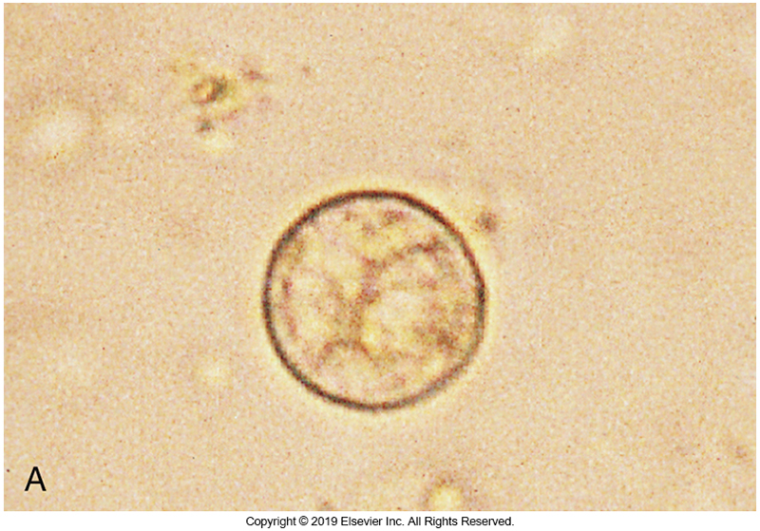
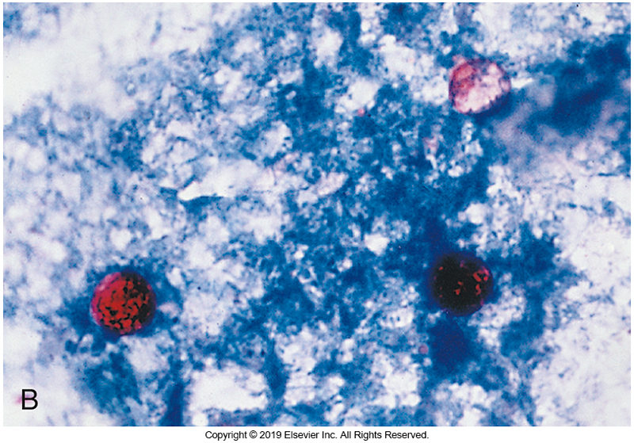
C. cayetanensis Oocysts

Slide 41
Microsporidia

Slide 42
Microsporidia
Collective name for a category of parasites in more than 200 genera and 1500 species
Obligate intracellular parasites common to invertebrates and other animals
Originally considered protists, they have been reclassified as fungi based on chitin present in the spore wall and rRNA sequencing
There are at least nine genera implicated in human infections.

Slide 43
Microsporidia
Often linked to HIV infection
Have also be identified in
Organ transplant recipients
Older adults
Patients with traveler’s diarrhea
Capable of infecting a wide variety of human organs, including intestine, eyes, muscles, liver, kidneys, and CNS

Slide 44
Microsporidia Clinical Infections
Symptoms differ with the species and organ infected.
Intestinal infections are most often caused by Enterocytozoon bieneusi or Encephalitozoon intestinalis
Infection in immunocompetent hosts is characterized by
Diarrhea, cramps, loss of appetite, and fatigue.
Dehydration and weight loss are sometimes seen
Four to eight liquid stools a day
Symptoms may persist for up to 8 months with spontaneous exacerbations and remissions.

Slide 45
Microsporidia Clinical Infections(Cont.)
In patients with AIDS, infection is chronic
Diarrhea may persist for several years, with malabsorption of fats and vitamin B12 and cachexia as additional complications.
Risk factors in patients with AIDS
Sexual transmission
CD4 cell count of less than 100/μL
Exposure to water during swimming and
Contact with animals
Dissemination of E. intestinalis, especially to the urinary tract, gallbladder, or respiratory tract.

Slide 46
Microsporidia Clinical Infections (Cont.)
In patients with AIDS
Dissemination to muscles may result in weakness and pain.
Can develop encephalitis, nephritis, or keratoconjunctivitis.
Contact lens wear is a risk factor for corneal infection.

Slide 47
Microsporidia Treatment
Albendazole has been used to treat infections with Encephalitozoon spp., but most other microsporidial organisms are resistant to this and other drugs.
Metronidazole may provide some relief, but the symptoms recur when use of the drug is discontinued.
Disseminated infections have also been reported.

Slide 48
Microsporidia Life Cycle
The infective stage for humans is the environmentally resistant spore, which can survive outside the host for as long as 1 year.
Once the infective spore is ingested, shifts in pH and ionic concentration in the intestinal tract trigger infection.
The organism gains access to host cells by emergence of a polar tube through the spore wall and its insertion through the cell membrane

Slide 49
Microsporidia Life Cycle (Cont.)
The contents of the spore (sporoplasm containing a nucleus, ribosomes, Golgi apparatus) are then transferred into the cell.
Within the host cell, the sporoplasm divides and develops into meronts.
These structures subsequently develop into sporoblasts that differentiate into sporonts.

Slide 50
Microsporidia Life Cycle (Cont.)
As these structures mature into spores, they develop a thick membrane and the polar tube.
The host cell ruptures, and spores are released to penetrate other host cells to repeat the reproductive cycle or be passed out of the body.
In the case of intestinal infection, spores are passed in feces; in infection of the urinary tract, they can be detected in urine

Slide 51
Microsporidia Laboratory Diagnosis
Microsporidia can be found in
stool, bronchoalveolar lavage fluid, sputum, CSF, conjunctival swabs, corneal scrapings, and other specimens.
Electron microscopy must be used to identify the species of the organism.
Speciation is based on the number of coils in the polar tubule, septations in the spore, and size.
Routine O & P examination will not detect the spores in a fecal specimen.

Slide 52
Microsporidia Laboratory Diagnosis (Cont.)
Stain formalin preserved feces using
Weber modification of the trichrome stain
Ryan trichrome blue stain
The small size of the spores, however, makes them easy to overlook in clinical specimens.
Spores range in size from 1.5 to 4.0 µm.
Calcofluor white can be used to screen specimens for the microsporidial spores.

Slide 53
Microsporidia Laboratory Diagnosis
Electron microscopy required to speciate
Spores
Tiny and difficult to identify using conventional techniques
1.5 to 4 μm in size
Contain polar tubules for delivery of sporoplasm to host cell
Staining
Weber’s stain or Ryan trichrome stain
Calcofluor white

Slide 54
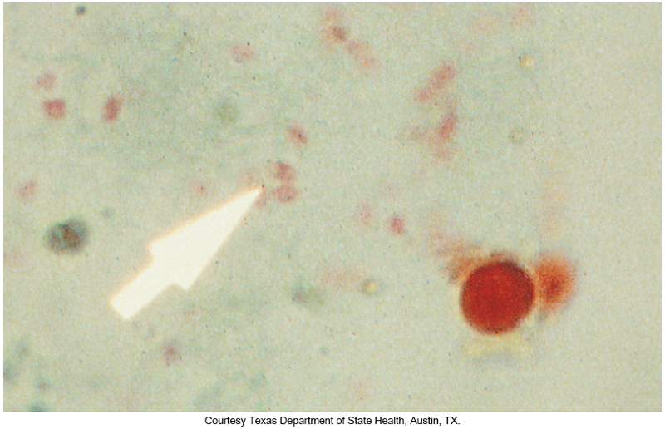
Microsporidia Spores

Slide 55
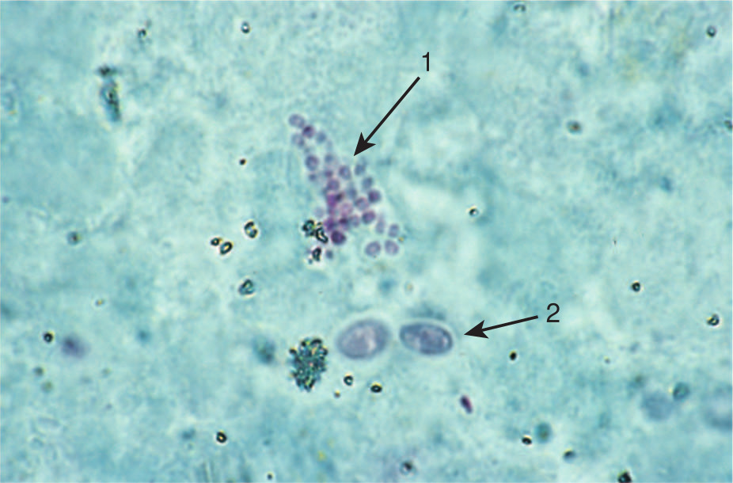
Diarrheic stool, smear, modified Weber stain, light microscopy
Morphology consistent with Enterocytozoon spp.

Slide 56
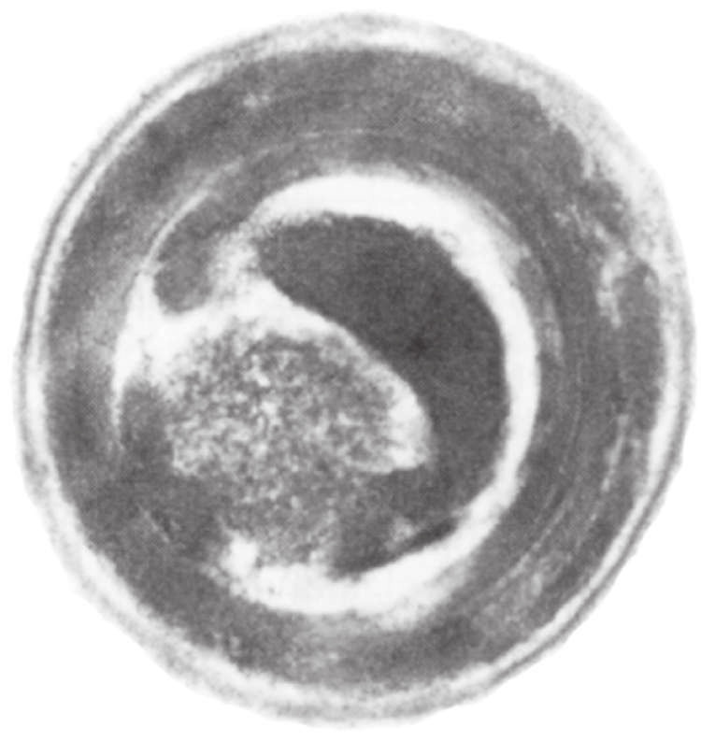
Diarrheic Stool From Concentration, Transmission Electron Microscopy
Morphology consistent with Enterocytozoon bieneusi.

Slide 57
Helminths

Slide 58
Helminths Overview
Helminth infections in humans are caused by flukes, tapeworms, or roundworms.
Modes of transmission
Directly ingesting eggs (ova)
By ingesting larvae in an intermediate host
Through direct larval penetration of the skin

Slide 59
Helminths Overview
Adult worms do not multiply in the human body.
The number of worms is related to the number eggs or larvae ingested.
The pathologic consequences and severity of infection are related to the number of adults present, commonly referred to as the “worm burden”.

Slide 60
Helminths Overview
Patients with only a few adult worms are usually asymptomatic, whereas a patient with a large number of adults often shows clinical symptoms.
Most of the parasites inhabit the intestinal tract, but species also infect the liver, lungs, lymphatics, and blood vessels

Slide 61
Flukes

Slide 62
Scientific and Common Names Fukes (Trematodes)
Scientific Name | Common Name
Fasciolopsis buski | Giant intestinal fluke
Fasciola hepatica | Sheep liver fluke
Clonorchis sinensis | Oriental liver fluke
Paragonimus westermani | Lung fluke
Schistosoma species | Blood flukes

Slide 63
Flukes General Characteristics
Adults can range in size from a few millimeters to almost 8 cm.
Except for blood flukes, adult flukes are
Dorsoventrally flattened
Have an oral sucker at the anterior end
Have a ventral sucker located midline, posterior to the anterior sucker.
Hermaphroditic, possessing male and female reproductive organs.

Slide 64
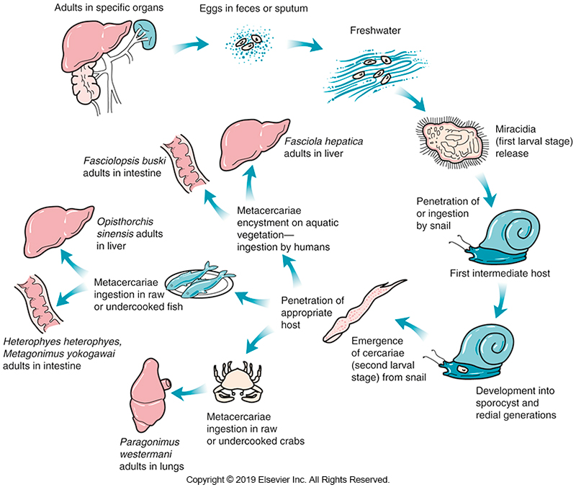
Life Cycle of Liver, Lung, and Intestinal Flukes

Slide 65
Flukes Laboratory Diagnosis
The egg is the primary diagnostic stage. It is best detected on a wet mount of a concentrated specimen.
Routine concentration procedures for feces, such as FES, may be used.
The zinc sulfate method is not satisfactory, however, because all eggs except those of schistosomes are operculated.
With the zinc sulfate method, the operculum might open and release the contents or cause the egg to sink.

Slide 66
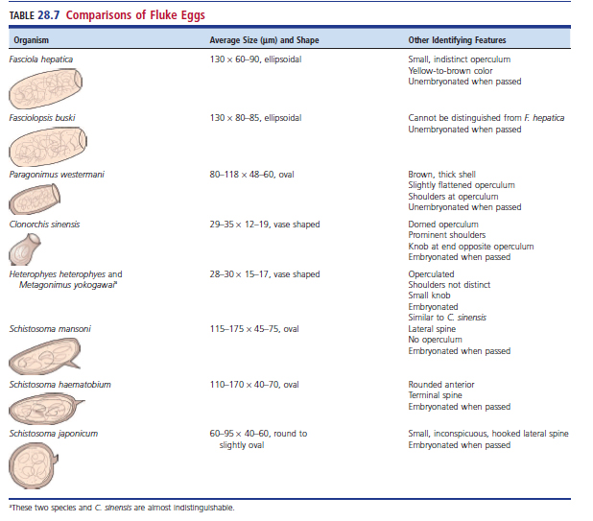
Comparisons of Fluke Eggs

Slide 67
Intestinal Flukes

Slide 68
Fasciolopsis buski
Giant intestinal fluke
Dogs and pigs are reservoir hosts.
Transmission
Eating metacercaria on raw vegetation
Bamboo shoots
Water chestnuts
Live in duodenum
Symptoms of heavy infections
Persistent diarrhea, anorexia, edema, ascites, nausea, vomiting, or intestinal obstruction

Slide 69
Fasciolopsis buski Laboratory Diagnosis
Adult morphology
Flattened
2 to 7 cm long
Lacks the cephalic cone seen in Fasciola hepatica
Usually not seen stool samples; unless it is a purged specimen
Egg morphology
Indistinguishable from Fasciola hepatica
Report as Fasciolopsis buski/Fasciola hepatica eggs
Most commonly seen in stool samples
Unembryonated when passed
Yellow-brown, 130 to 140 μm by 80 to 85 μm
Small, relatively inconspicuous operculum

Slide 70
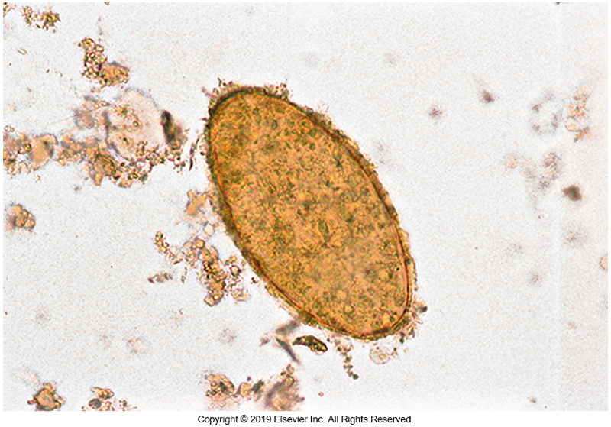
F. hepatica/F. buski egg

Slide 71
Other Intestinal Flukes
Metagonimus yokogawai and Heterophyes heterophyes
Small flukes found in the Far East and Middle East regions of the world
Transmitted by consuming infected, undercooked or raw fish
Adults live in the small intestine and produce few symptoms
Heavy worm burden symptoms
Diarrhea, colic, and loose stools, with a large amount of mucus
Adult morphology
Both species are small (1 to 2 mm) and delicate

Slide 72
Other Intestinal Flukes (Cont.)
Metagonimus yokogawai and Heterophyes heterophyes
Eggs serve as primary diagnostic stage
28 to 30 µm long
Vase or flask shape
Embryonated
Operculated, with inconspicuous shoulders at the operculum.
Eggs of these species resemble each other and those of Clonorchis sinensis.

Slide 73
Liver Flukes

Slide 74
Fasciola hepatica
Sheep liver fluke
Causes disease known as liver rot, characterized by liver destruction
Transmission
Eating raw vegetation, especially watercress
Heavy infection symptoms
Diarrhea, upper right quadrant abdominal pain, hepatomegaly, cirrhosis, and liver obstruction, with resulting jaundice.
Tissue damage during migration through the liver can result in eosinophilia, an inflammatory reaction, secondary bacterial infection, and fibrosis in the biliary ducts.
Chronic infections are usually asymptomatic.

Slide 75
Fasciola hepatica Laboratory Diagnosis
Adult morphology
Approximately 3 cm long
Prominent cephalic zone
Unembryonated egg morphology
130 to 150 µm × 60 to 90 µm
Indistinguishable from F. buski
Reported as F. buski/F. hepatica eggs

Slide 76
F. hepatica/F. buski egg

Slide 77
Clonorchis sinensis
Oriental liver fluke
Transmission
Ingestion of metacercariae in raw, undercooked, or pickled fresh-water fish
Far East
Dogs and cats are reservoir hosts.
Symptoms
Light infections, usually asymptomatic
Repeated/heavy infections show inflammation, fever, diarrhea, pain, fibrotic changes, or obstruction of the bile ducts

Slide 78
Clonorchis sinensis Laboratory Diagnosis
Diagnosis is made by finding ova in feces or, occasionally, in duodenal aspirates.
Adult morphology
Thin, tapered at both ends, and 1 to 2.5 cm long
Resides in distal portion of bile ducts
Egg morphology
29 to 35 μm long
Embryonated when passed
Flask-shaped
Operculated with prominent shoulders at the operculum
Knob at opposite end of operculum

Slide 79
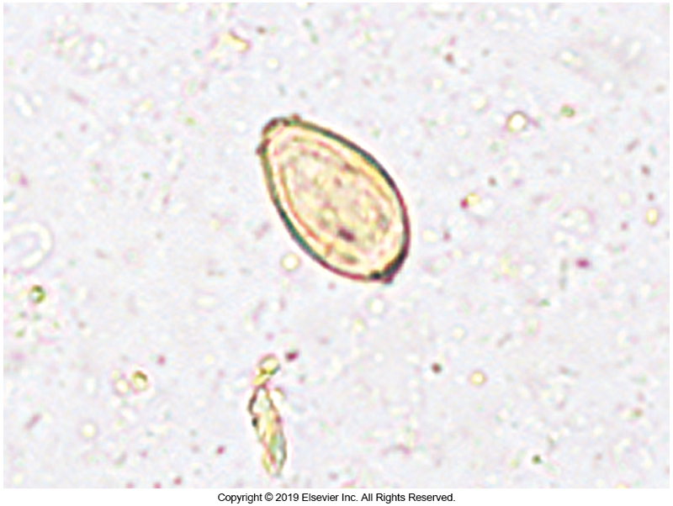
Clonorchis sinensis Egg

Slide 80
Lung Flukes

Slide 81
Paragonimus westermani
Primarily found in the Southeast Asia, focal areas of Latin America and Africa
Oriental lung fluke
Transmission
Eating raw, undercooked, or pickled fresh-water crabs or crayfish
Major symptoms associated with lung habitation
Nonspecific, often include persistent cough, chest pain, hemoptysis

Slide 82
Paragonimus westermani Laboratory Diagnosis
Adult morphology
Reddish brown, ~1 cm long
Reside within capsules of the bronchioles
Egg morphology
Broadly oval and 80 to 115 μm long by 48 to 60 μm wide.
Flattened operculum
Slight shoulders
These eggs can appear similar to those of Diphyllobothrium latum and must be carefully examined when seen in the feces

Slide 83
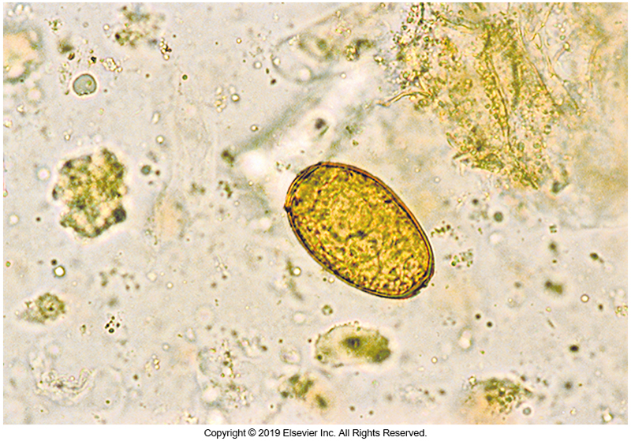
P. westermani Egg

Slide 84
Blood Flukes

Slide 85
Schistosoma Species
Causative agent of schistosomiasis
Different from other flukes
Separate male and female adults
Other flukes are hermaphroditic.
Eggs are unoperculated
Infection by direct cercarial penetration of the skin
Cylindrical shape rather than being dorsoventrally flattened
Three primary species
S. mansoni
S. haematobium
S. japonicum

Slide 86
Schistosoma Species (Cont.)
Adult male morphology
7 to 20 mm
Adult female morphology
7 to 26 mm
Location of adult worms
S. mansoni
Venules of the mesentery and large intestines
S. japonicum
Venules of the small intestines
S. haematobium
Veins surrounding the bladder

Slide 87
Schistosoma spp. Clinical Infections
Schistosomiasis (bilharziasis) affects approximately 200 million people worldwide.
Symptoms are related to the
Phases of the fluke’s life cycle
Location of the adult worms
Cercarial penetration
May cause self-limiting local dermatitis
Persists for approximately 3 days
Irritation, redness, rash

Slide 88
Schistosoma spp. Clinical Infections (Cont.)
Larval migration
Generalized symptoms
Urticaria, fever, malaise
Can last up to 4 weeks
The presence of the migrating larvae and adults in the veins causes little inflammatory damage seemingly because they acquire host HLAs and ABO blood group antigens on their surface that diminish the host’s immune response.

Slide 89
Schistosoma spp. Clinical Infections
Egg production and egg migration through the tissues are responsible for most of the immediate damage because the eggs are highly immunogenic.
After eggs are released by the adult female,
Eggs secrete enzymes and begin to penetrate vessel walls and tissue.
Eggs subsequently find their way into the lumen of the intestines of bladder.

Slide 90
Schistosoma spp. Clinical Infections (Cont.)
The egg spines cause trauma to the tissues and walls of the vessels during the early stage of acute infections and can result in gross or microscopic hematuria (S. haematobium) or diarrhea (S. mansoni and S. japonicum)
Those heavily infected with S. japonicum
Experience an acute serum sickness-like illness (Katayama fever) during initial egg-laying period.
Induced by antigenic response to the egg
Characterized by increased circulating levels of immune complexes and eosinophils

Slide 91
Schistosoma spp. Clinical Infections (Cont.)
Chronic infections
Eggs remaining in the tissue induce an immune response resulting in granuloma formation
Thickening and fibrotic changes
Scarring of the veins, development of ascites, pain, anemia, hypertension, hepatomegaly, and splenomegaly are also seen.
Urinary schistosomiasis
Acute phase- bleeding
Chronic stages- dysuria, urine retention, UTIs

Slide 92
Schistosoma spp. Clinical Infections (Cont.)
Penetration of humans by cercariae of the flukes of birds and other mammals causes schistosomal dermatitis, commonly referred to as swimmer’s itch.
Foreign proteins from these cercariae elicit a tissue reaction
characterized by small papules 3 to 5 mm in diameter, edema, erythema, and intense itching.
Symptoms last about 1 week and disappear as cercariae die and degenerate.

Slide 93
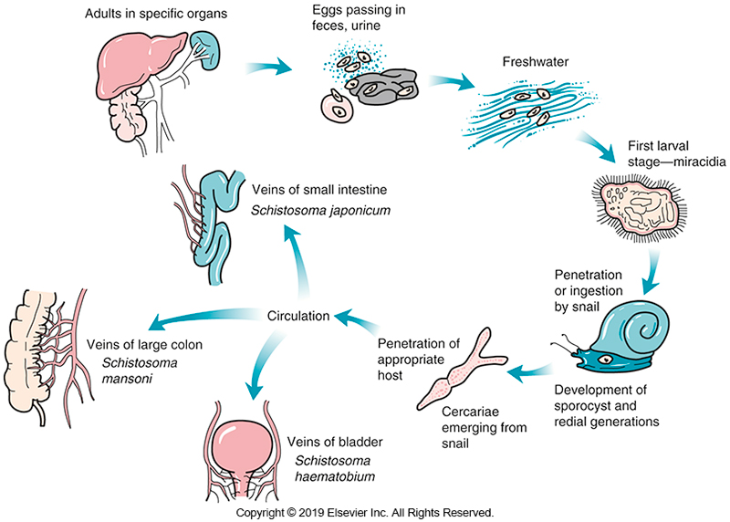
Life Cycle of Blood Flukes

Slide 94
Schistosoma Species Laboratory Diagnosis
Diagnosis-finding embryonated eggs in feces
Eggs are oval shaped with spines located on the eggs.
S. mansoni
Embryonated and found in feces
Yellowish oval eggs 115 to 175 μm long by 45 to 75 μm wide found in fecal material
Prominent lateral spine clearly visible and no operculum

Slide 95
Schistosoma Species Laboratory Diagnosis (Cont.)
S. haematobium
Found in urine
Oval 110 to 170 μm long by 40 to 70 μm wide in urine
Terminal spine clearly visible and no operculum
S. japonicum
Found in feces
Oval 60 to 95 μm long by 40 to 60 μm wide in fecal material
Small, curved, often obscure, rudimentary spine and no operculum

Slide 96
Schistosoma Species Laboratory Diagnosis
Best time to collect eggs in urinary schistosomiasis
During peak excretion time in the early afternoon (noon to 2 pm).
Biopsy may also be used in the diagnosis of schistosomiasis.

Slide 97
Schistosoma Species Laboratory Diagnosis (Cont.)
Serodiagnosis can be useful to diagnose infection in patients from nonendemic countries who develop symptoms after visiting endemic areas.
In areas of endemicity, serum antibody testing cannot differentiate between active and nonactive infections.
A urine-based rapid test strip for the detection of parasite antigen
Commercially available and useful in field screening

Slide 98
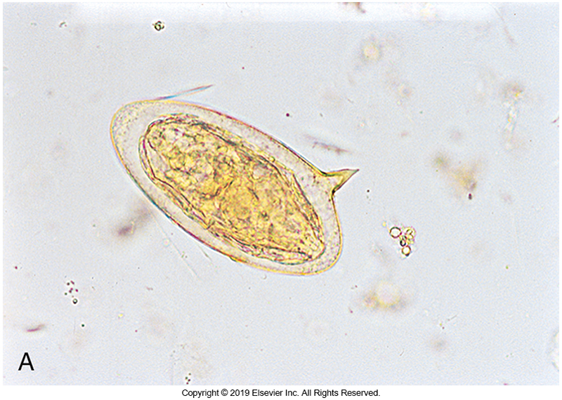
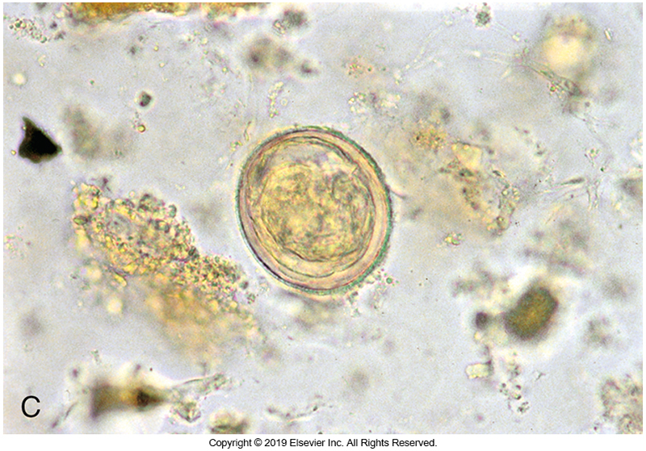
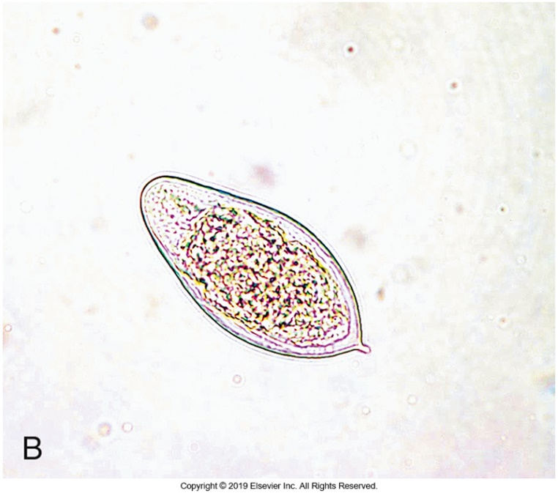
Schistosoma Species Eggs

Slide 99
Tapeworms

Slide 100
Scientific and Common Names Tapeworms (Cestodes)
Scientific Name | Common Name
Diphyllobothrium latum | Fish tapeworm
Taenia saginata | Beef tapeworm
Taenia solium | Pork tapeworm
Hymenolepis nana | Dwarf tapeworm
Hymenolepis diminuta | Rat tapeworm
Dipylidium caninum | Dog tapeworm

Slide 101
Tapeworms General Characteristics
Cestodes
Platyhelminthes
All require an intermediate host
Adult morphology
From 3 mm to 10 m in length
Ribbonlike with head-like scolex and suckers for attachment to the host
Segmented, segments are called proglottids
Hermaphroditic (self-fertilizing)

Slide 102
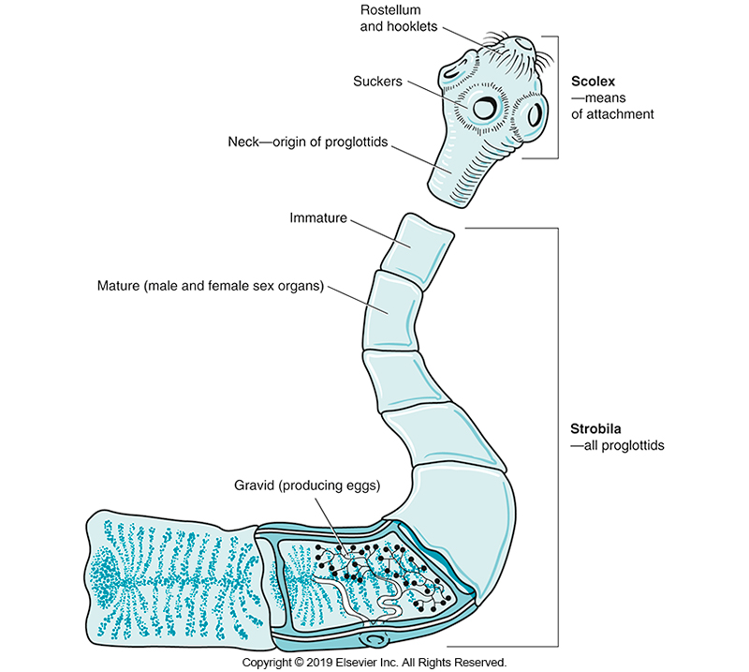
Diagram of a Tapeworm

Slide 103
Tapeworms General Characteristics (Cont.)
Egg morphology
Most eggs in this group contain a tapeworm embryo with
Three pairs of hooks that is infective for the intermediate host
Known as a hexacanth embryo or onchosphere
Transmission
Ingestion of a larval stage, called the cystercercus
Larva consisting of a fluid-filled sac containing invaginated scolex), cystercoid, or plerocercoid larva
Found in raw meat or fish or of insects harboring the larval stage.

Slide 104
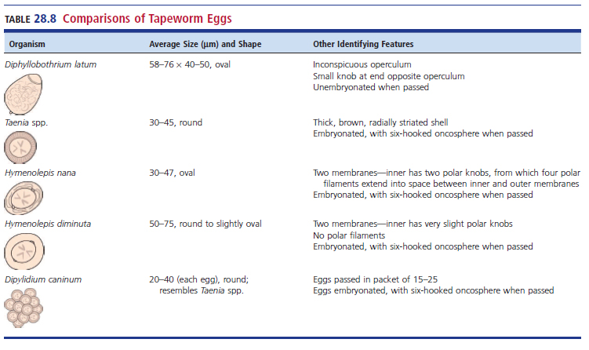
Comparisons of Tapeworm Eggs

Slide 105
Tapeworms General Characteristics (Cont.)
The diagnosis of tapeworm infection is usually made by finding eggs in feces, although proglottids can be used if they are passed intact.
Intestinal tapeworm infections are usually treated with praziquantel; alternatively, they can be treated with niclosamide, albendazole, or nitazoxanide.

Slide 106
Diphyllobothrium latum
Fish tapeworm
Adults can be 10 m long
Ingest larvae in pickled or raw freshwater fish.
Found in Great Lakes areas
Humans usually only harbor a single worm
Attaches to the jejunum
Clinical infection
Usually asymptomatic
Sometimes nausea, vomiting, intestinal irritation
Vitamin B₁₂ deficiency leading to megaloblastic anemia

Slide 107
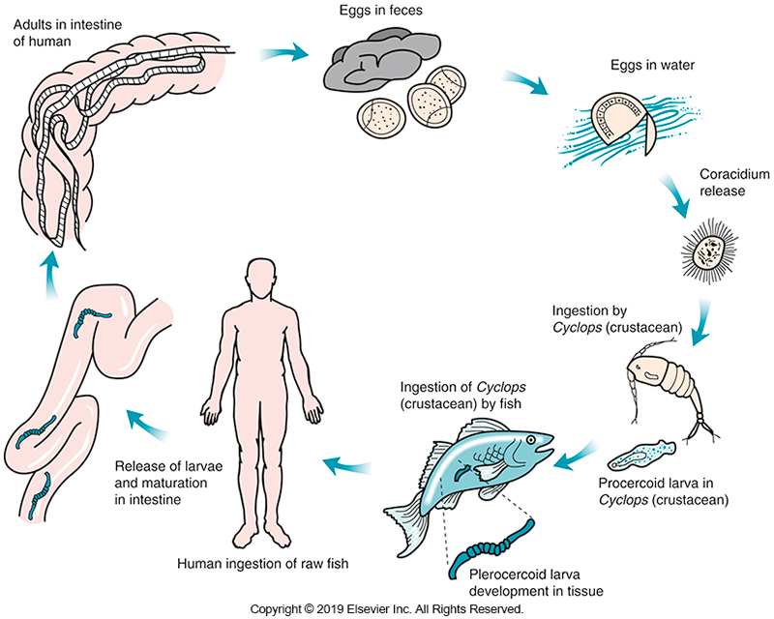
Life Cycle of D. latum

Slide 108
Diphyllobothrium latum Laboratory Diagnosis
Diagnostic structures that can be found in fecal samples
Scolex
Proglottid
Egg- the morphology usually seen
Egg morphology
About 58 to 76 µm × 40 to 50 µm in size
Small, knoblike protuberance at the end opposite the operculum

Slide 109
Diphyllobothrium latum Laboratory Diagnosis
Diagnostic structures that can be found in fecal sample
Egg morphology
Knob may not be seen on all eggs, so size and lack of shoulders must be used to distinguish the egg from that of Paragonimus westermani.
Proglottid morphology
Wider than it is long
Characteristic rosette-shaped or coiled uterus

Slide 110
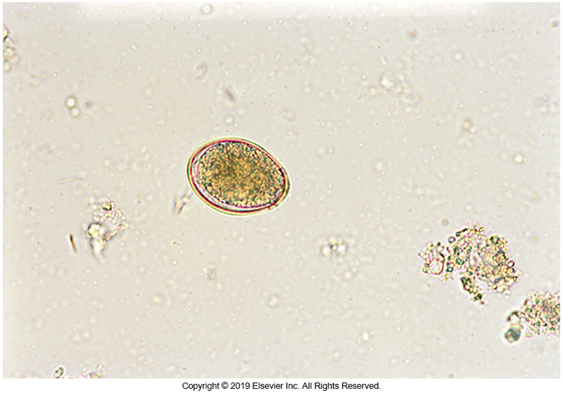
D. latum Egg

Slide 111
Diphyllobothrium latum Laboratory Diagnosis (Cont.)
Scolex morphology
2 to 3 mm long
Elongated has two sucking grooves, one located on the dorsal surface and the other on the ventral surface
No hooks.

Slide 112
Taenia
Two Taenia spp. infect humans:
(1) Taenia saginata, the beef tapeworm, which is found primarily in beef-eating countries of the world, and
2) Taenia solium, the pork tapeworm, which is found in areas of the world with a high consumption of pork, such as Latin America.
Both organisms attach to the intestinal mucosa of the small intestine.

Slide 113
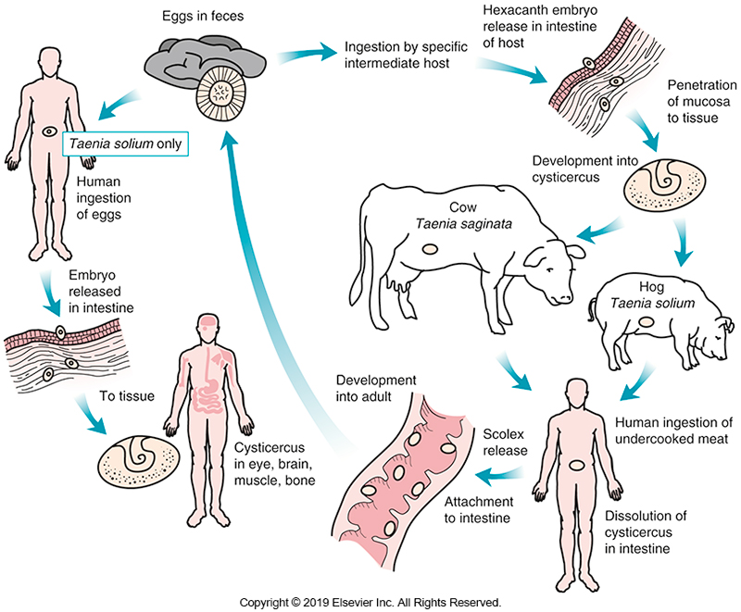
Life Cycle of Taenia spp.

Slide 114
Taenia (Cont.)
Length of adult worms
T. saginata can reach a length of 10 m
T. solium may reach only 7 m
Symptoms
Infection with the adult tapeworm of either species usually causes few clinical symptoms, although vague abdominal pain, indigestion, and loss of appetite may be present.
The major complication of infection with T. solium is cysticercosis, in which the infected individual becomes the intermediate host and harbors the larvae in tissues.

Slide 115
Taenia (Cont.)
Eggs are indistinguishable
Gravid proglottid morphology
T. solium has 7 to 13 primary uterine branches on each side of the main uterine trunk
T. saginata shows 15 to 20 primary uterine branches per side

Slide 116
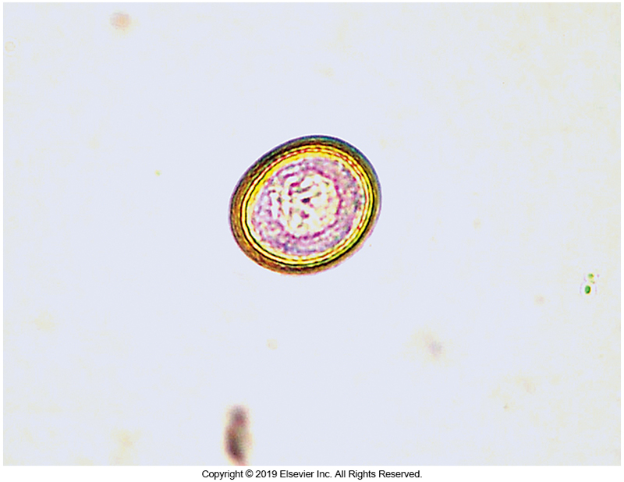
Taenia Laboratory Diagnosis
Primary method
Eggs in stool
Eggs are indistinguishable
Embryonated egg morphology
Round, 30 to 35 μm
Smooth, thick shell with radial striations in the shell
Six-hooked oncosphere
Reported as Taenia sp. eggs

Slide 117
Taenia Laboratory Diagnosis (Cont.)
Adult morphology
The scolex, if found, can also be used to distinguish the organisms.
The scolex of T. saginata is less than 5 mm long and has four suckers,
T. solium has a rostellum, with a double row of 25 to 30 hooklets in addition to the four suckers.

Slide 118
Hymenolepis
The dwarf tapeworm, Hymenolepis nana
Found worldwide
Common tapeworm in children
Hymenolepis diminuta, the rat tapeworm
Seen less frequently
Light infections are usually asymptomatic.
Large numbers of worms may cause abdominal pain, diarrhea, irritability, and headache.

Slide 119
Hymenolepis (Cont.)
H. nana easily transmitted among children
An intermediate host is not required
H. nana life cycle
Direct fecal-oral egg transmission of egg
Development of cysticercoid in intestinal tissue of the host
Reentry into the lumen for development into an adult
This autoinfective cycle is most common although an insect vector may serve as an intermediate host in an alternative morphology of the life cycle.

Slide 120
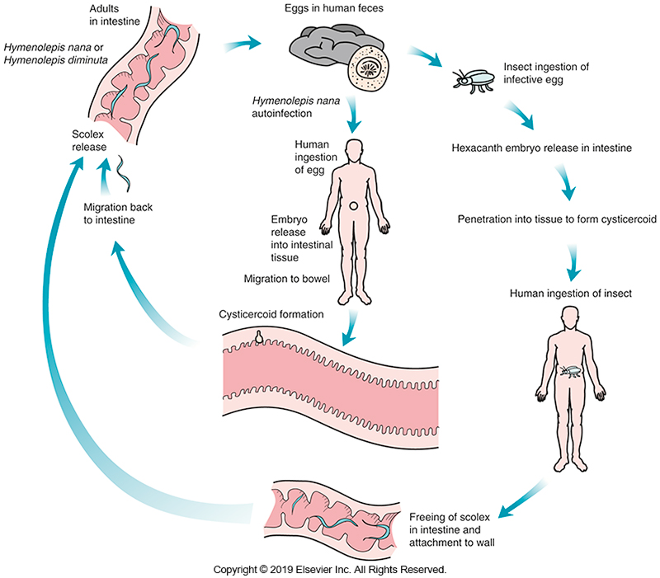
Life Cycle of Hymenolepis spp.

Slide 121
Hymenolepis (Cont.)
Adult H. nana morphology
Approximately 40 mm long
Small scolex
Four suckers
Rostellum with spines

Slide 122
Hymenolepis
Primary diagnosis method
Eggs in stool
H. nana egg morphology
Egg is 30 to 47 μm with a grayish color.
hexacanth embryo is contained within an inner membrane
the area between the inner membrane and egg wall contains two polar thickenings from which four to eight polar filaments extend

Slide 123
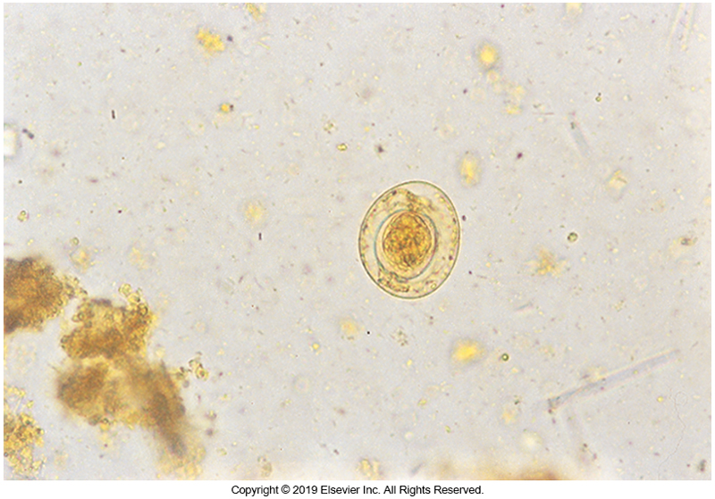
Hymenolepis nana Egg

Slide 124
Hymenolepis
Hymenolepis diminuta adult morphology
20 to 60 cm long
Hymenolepis diminuta egg morphology
50 to 75 µm
gray or straw colored
Oval
An inner membrane with inconspicuous polar thickenings but no polar filaments surround the oncosphere

Slide 125
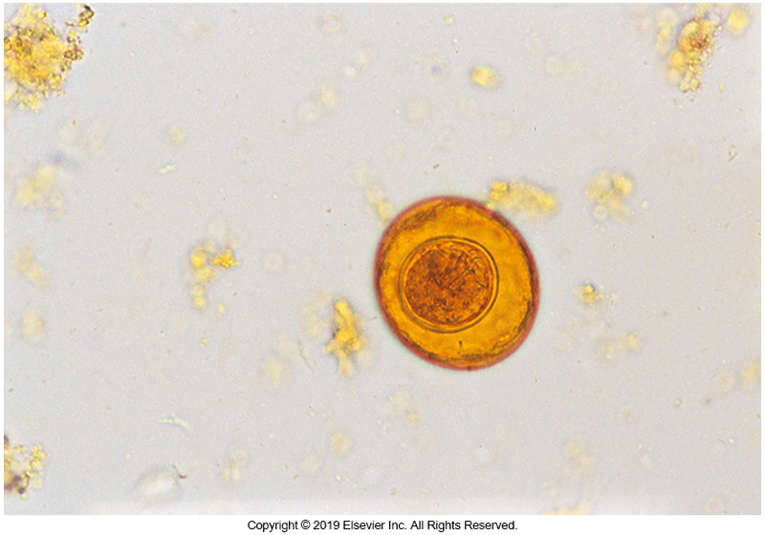
H. diminuta Egg

Slide 126
Dipylidium caninum
Humans serve as accidental hosts for Dipylidium caninum, the dog tapeworm.
Children are usually infected by ingesting fleas containing the larval stage.
Resulting infections generally, do not cause any symptoms.

Slide 127
Dipylidium caninum
Proglottid morphology
Pumpkin-seed shape
Twin genitalia
Two genital pores, one on each side of the proglottid
Egg morphology
Seen in packets of 15 to 25 eggs.
Individual eggs are 20 to 40 µm in size and
Resemble those of Taenia spp.

Slide 128
Dipylidium caninum
Tapeworm of dogs
Clinical infection
Children
Ingesting fleas containing larval stage
Usually asymptomatic
Eggs
Large egg packet
15 to 25 eggs
Each 20 to 40 μm in size resembling those of Taenia species

Slide 129
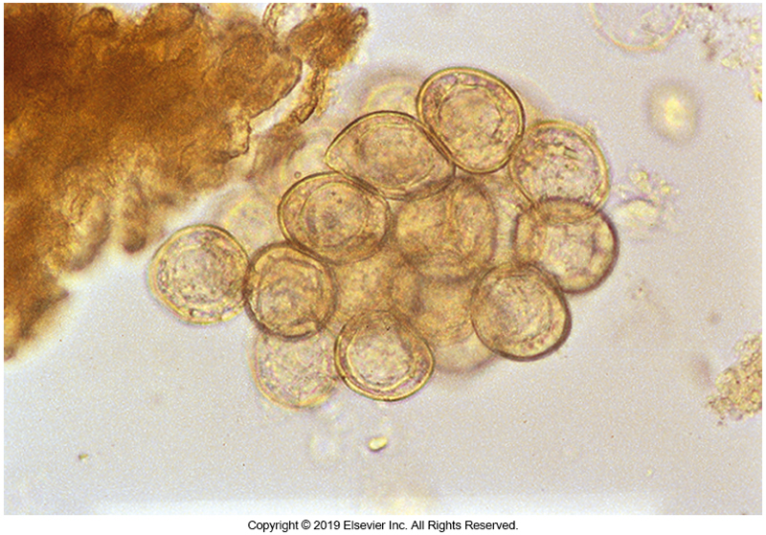
D. caninum Egg Packet

Slide 130
Tissue Infections with Cestodes

Slide 131
Tissue Infections with Cestodes
Cysticercosis, sparganosis, and hydatid cyst disease are the major diseases caused by the tissue stage of a tapeworm.
They originate when a human accidentally becomes the intermediate host for the parasite

Slide 132
Cystercosis
Cysticercosis results when a human ingests the infective eggs of T. solium, the pork tapeworm, thus, becoming an intermediate host.
Geographic distribution
Endemic in rural Latin America, Asia, and Africa
Reemerging as a zoonosis in the U.S. as a result of the immigration of persons from endemic areas

Slide 133
Cystercosis (Cont.)
Contributing factors for infection
Poor hygiene
Poor sanitary habits
Residence in rural areas
Hog farming
Life cycle notes
Egg is ingested
Hexacanth embryo is released into the intestines and penetrates the intestinal wall entering circulation
Develops into a cystercosis in any tissue/organ

Slide 134
Cystercosis (Cont.)
The larva can live up to 7 years and elicits a host tissue reaction, resulting in production of a fibrous capsule.
Once the organism dies and releases larval antigens, there is an intense host inflammatory reaction that leads to tissue damage in the area.
Eventual calcification of the cysticercus will occur.
The most commonly infected sites are the striated muscle, eye, and brain.
Light infections usually cause no clinical symptoms.
Symptoms depend on the organ affected and the size and number of cysticerci present.

Slide 135
Cystercosis (Cont.)
In striated muscle
Muscular pain, weakness, cramps
In the eye
Cysticercus can morphology in the vitreous or subretinal space of the eye
Retinal detachment, intraorbital pain, flashes of light, and blurred vision may occur

Slide 136
Cystercosis (Cont.)
Neurocysticercosis
Most serious manifestation
The causative agent for up to 30% of epilepsy cases seen in patients in countries where the disease is endemic.
Other possible manifestations
Headaches, symptoms resembling those seen in meningitis or a brain tumor, convulsions, or a variety of motor and sensory problems

Slide 137
Cystercosis (Cont.)
Appearance of cysticersus
Oval, translucent, and about 5 to 18 mm in size
Contains an invaginated scolex containing four suckers and a circle of hooklets on the rostellum
Diagnosis
Radiography to detect calcified cysts
Ophthalmoscopic examination of the eye
Imaging techniques (CT, MRI)
Histologic tissue staining
Serologic tests

Slide 138
Sparganosis
Human infection with the plerocercoid larva (sparganum) of a dog or cat tapeworm can result in sparganosis.
Modes of transmission
Ingesting a copepod containing the procercoid larva
Ingesting reptiles, amphibians, or other animals containing the larva
Through invasion of the plerocercoid larva when the raw tissue from the second intermediate host is used as a poultice

Slide 139
Sparganosis
Disease is common in Southeast Asia.
Infection is often seen in the eye after a poultice has been applied to relieve an infection.
The organism may also cause migratory subcutaneous nodules, itching, and pain.
Diagnosis
Finding a small, white, ribbonlike organism with a rudimentary scolex
Size range- few millimeters to 40 cm
Organism may be removed surgically.

Slide 140
Echinococcosis
Also known as the hydatid cyst disease
Infection caused by Echinococcus granulosus
Normally involves a dog or other member of the family Canidae as the definitive host
Usual host of the larval stage (hydatid cyst)
Sheep and other herbivores

Slide 141
Echinococcosis
The adult worm is approximately 5 mm long and contains only three proglottids.
Eggs
Found in the feces of dogs or other definitive hosts
Resemble those of Taenia spp.
Human becomes intermediate host by ingestion of eggs

Slide 142
Echinococcosis (Cont.)
The onchosphere
Emerges from the egg in the intestine
Penetrates the mucosa
Enters circulation
Lodges in the liver
The embryo develops a central cavity–like structure lined with a germinal membrane, from which brood capsules and protoscolices (hydatid sand) develop.

Slide 143
Echinococcosis (Cont.)
Size of hydatid cyst is limited by the organ in which it develops
In bone, a limiting membrane never develops
The cyst fills the marrow and eventually erodes the bone
Symptoms differ, depending on the organ infected

Slide 144
Echinococcosis (Cont.)
Pressure from the increasing size of a cyst may cause necrosis of surrounding tissue.
Rupture of the cyst liberates large amounts of foreign protein (allergin) that may elicit an anaphylactic response.
In addition, freed germinal epithelium may serve as a source of new infection.

Slide 145
Echinococcosis (Cont.)
Diagnosis
Radiologic examination
Ultrasonography
Other imaging techniques
Aspiration of the cyst contents usually reveals the presence of protoscolices

