Slide 1
Chapter 28
Diagnostic Parasitology
PART FOUR

Slide 2
Round Worms

Slide 3
Scientific and Common Names
Scientific Name | Common Name
Enterobius vermicularis | Pinworm
Trichuris trichiura | Whipworm
Ascaris lumbricoides | Intestinal roundworm
Necator americanus | New World hookworm
Ancylostoma duodenale | Old World hookworm
Strongyloides stercoralis | Threadworm

Slide 4
Roundworms General Characteristics
Human roundworms include those that infect the intestinal tract and blood and tissue.
Distribution- worldwide
Most common of the helminths to cause human infections in the U.S.
Modes of transmission
Ingestion of an embryonated egg
Direct penetration of skin by larvae in the soil
Via an insect vector

Slide 5
Roundworms General Characteristics
Life cycle notes
Roundworms are characterized by
The presence of two sexes
A life cycle that may involve larval migration throughout the body
Adult worms obtain nourishment by
Absorbing nutrients from partly digested intestinal contents or
By sucking blood

Slide 6
Roundworms General Characteristics
Patients may be asymptomatic or symptomatic
Severity of symptoms is related to
Worm burden
Host’s nutritional status and age
Duration of infection
Most roundworm infections can be treated with oral administration of albendazole or mebendazole.

Slide 7
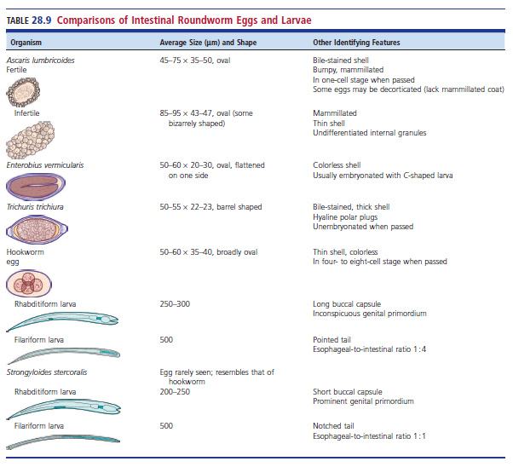
Comparison of Roundworm Eggs and Larvae

Slide 8
Enterobius vermicularis
Known as pinworm, causes pinworm infection
Common in children 5 to 10 years old
Key risk factors
Inadequate personal hygiene
Inadequate community hygiene
Populations at risk
Families
Kindergartens
Daycare centers
Crowded conditions

Slide 9
Enterobius vermicularis (Cont.)
Egg characteristics
Resistant to drying
Easily spread in the environment
Areas where adult worms may be found
Live in the large intestine (cecum)
Occasionally found in the appendix or vagina
Possible outcomes of ectopic infections
Endometriosis, urethritis, salpingitis
There is evidence that pinworm is associated with UTIs in young girls.

Slide 10
Enterobius vermicularis (Cont.)
Often asymptomatic
Symptoms
Loss of appetite
Abdominal pain
Loss of sleep
Nausea
Vomiting
Anal pruritis, caused by migration of the female adult worm through the anus at night to lay eggs in the perianal area

Slide 11
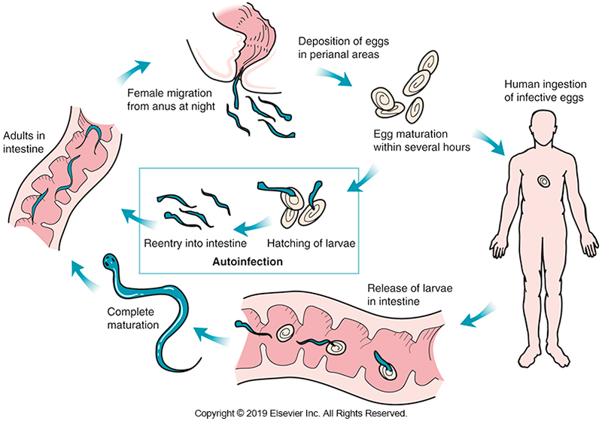
Life Cycle of E. vermicularis

Slide 12
Enterobius vermicularis (Cont.)
Laboratory diagnosis
Cellophane tape preparation
Commercially available sticky paddle
Because the gravid female can migrate into the vagina, eggs can also be seen in vaginal specimens.

Slide 13
Enterobius vermicularis (Cont.)
Adult female morphology
8 to 13 mm long
Pointed tail resembling a pin
Three cuticle lips with alae at the anterior end
Adult male morphology (less commonly seen)
2 to 5 mm long with curved posterior
Egg-usually seen embryonated
50 to 60 μm long by 20 to 30 μm wide
Oval, colorless shell flattened on one side
C-shaped Larva may be visible

Slide 14
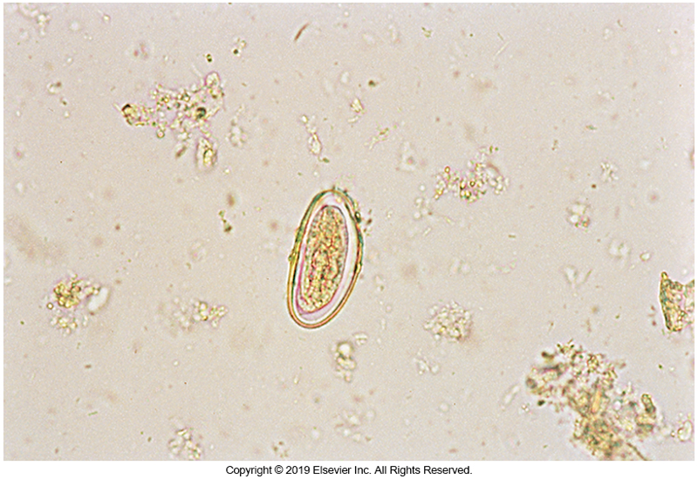
E. vermicularis Egg

Slide 15
Trichuris trichiura
Soil transmitted
Along with the two species of hookworm and Ascaris
Strongyloides stercoralis
Worldwide distribution and are major causes of morbidity, rather than death, in developing areas of the world
It is estimated that 25% of the world’s population is infected with one or more of these organism.

Slide 16
Trichuris trichiura (Cont.)
Also known as whipworm, causative agent of trichuriasis
Moist warm, climates are the environment of choice
Often presents as a co-infection with Ascaris

Slide 17
Trichuris trichiura (Cont.)
Chronic infection can adversely affect physical and mental development in children.
Heavy worm burden likely to result in complications
Risk factors
Poor sanitation (personal and community)
Poverty
Occupation
Climate

Slide 18
Trichuris trichiura (Cont.)
Light infections
Usually, asymptomatic
Heavy infections result in colitis or diarrhea with blood-tinged stools
Rectal prolapse can be the result of repeated heavy infections in undernourished children.

Slide 19
Trichuris trichiura (Cont.)
In children with inadequate iron and protein intake in the presence of constant, low-level bleeding with chronic infection
Hypochromic anemia
Treatment
Mebendazole or albendazole

Slide 20
Trichuris trichiura (Cont.)
Life cycle notes
Eggs passed in stool
Require at least 14 days in warm, moist soil for embryonation to occur
Humans ingest the infective egg
Larva is released in the small intestine
Undergoes several molts before maturing
Adult worm emerges in the cecum

Slide 21
Trichuris trichiura (Cont.)
Diagnosis- eggs, and less commonly adult males in stool
Adult male morphology
measures 30 to 45 mm and has a
thin anterior and a thick, coiled posterior.
Adult female morphology
30 to 50 mm long
thin anterior and thick, straight posterior

Slide 22
Trichuris trichiura (Cont.)
Egg morphology
The typical diagnostic form
Brown
Barrel-shaped
Unembryonated when passed
50 to 55 µm × 22 to 23 µm in size,
Thick wall
Hyaline polar plugs at each end

Slide 23
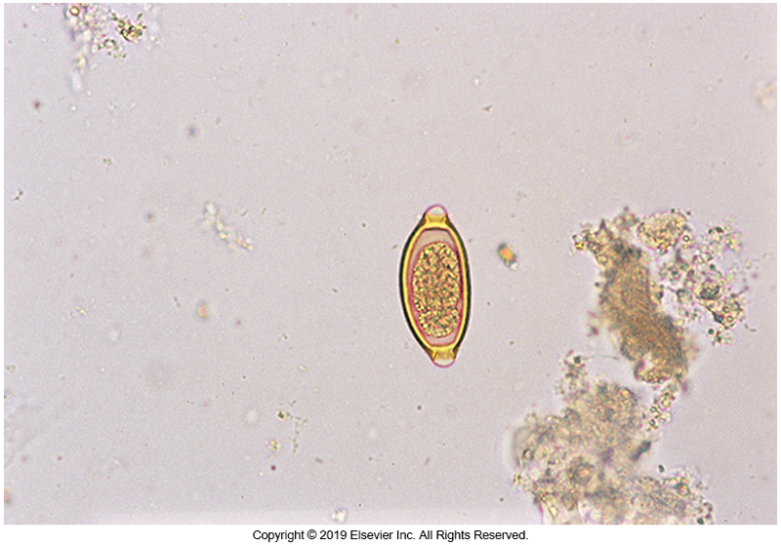
Trichuris trichiura Egg

Slide 24
Ascaris lumbricoides
More than 1 billion people infected worldwide
Most common in tropical and subtropical areas, and in areas of poor sanitation
Uncommon in U.S. but is seen in rural parts of the Southeast
Mode of transmission
Fecal-oral route
Often found concurrently with whipworm

Slide 25
Ascaris lumbricoides (Cont.)
Known as the intestinal roundworm, causative agent of ascariasis
Clinical symptoms may be related to the different phases of the life cycle.
Symptoms when adult worms are in the intestine
Abdominal discomfort, loss of appetite, colicky pains
Heavy infections are thought to contribute to Lactose intolerance and malabsorption of some vitamins (e.g., vitamin A)

Slide 26
Ascaris lumbricoides (Cont.)
In children
Large numbers of adult worms can cause intestinal obstruction.
Because the worms feed on liquid intestinal contents, chronic infection with A. lumbricoides may hamper growth and development.
Larval migration through the lungs cause an immune response in the host
Asthma, edema, pneumonitis, eosinophilic infiltrations
Rarely, larvae are seen in sputum in heavy infections.

Slide 27
Ascaris lumbricoides (Cont.)
Occasionally, fever or other disease conditions cause the adult worms to migrate from the intestine and invade other organs, resulting in peritonitis, liver abscess, or secondary infection in the lungs.
Adults may also exit through the mouth, tear duct, or nose
Have been reported to enter and block catheters.

Slide 28
Ascaris lumbricoides (Cont.)
Eosinophilia may be present.
Albendazole or mebendazole are the drugs of choice for treating infection with Ascaris.

Slide 29
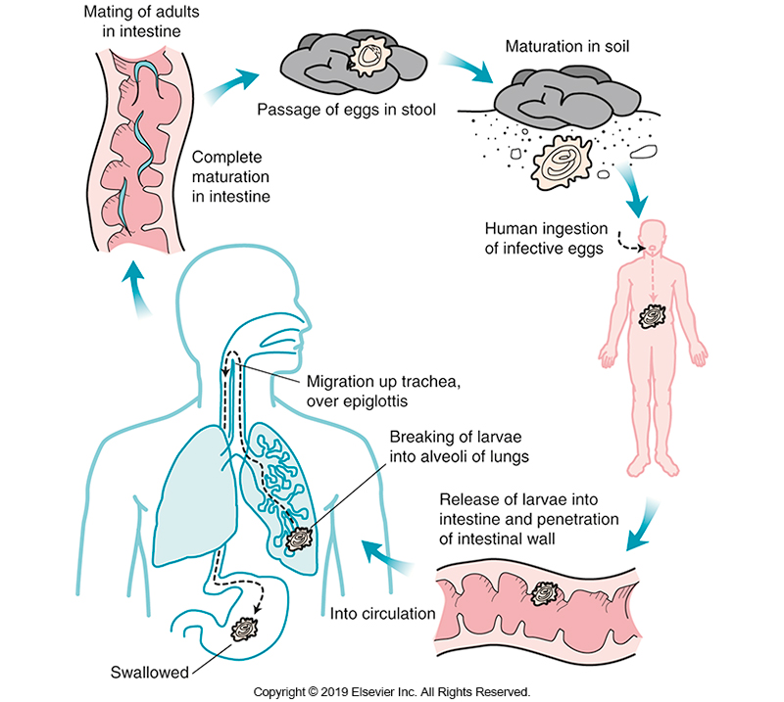
Life Cycle of A. lumbricoides

Slide 30
Ascaris lumbricoides (Cont.)
Usual diagnostic stage is the egg
Fertile egg morphology
oval
measure 45 to 75 µm × 35 to 50 µm
thick hyaline wall surrounding a one-cell–stage embryo
Most eggs have a brown, bile-stained, mammillated outer layer

Slide 31
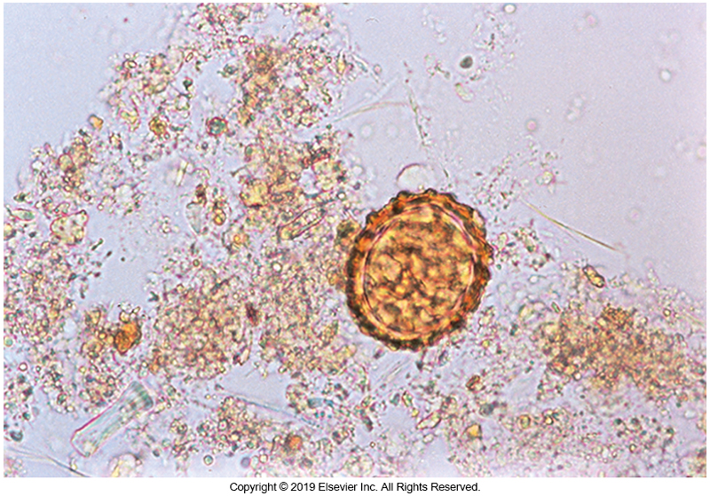
A. lumbricoides Egg (Fertile)

Slide 32
Ascaris lumbricoides (Cont.)
Some eggs, described as decorticated, lack the mammillated outer coat.
Infertile egg morphology
up to 90 µm in length
often elongated
contain a mass of highly refractile granules

Slide 33
Ascaris lumbricoides (Cont.)
Adult morphology
15 to 35 cm long
about the diameter of a lead pencil
may be seen in stool sample
three anterior lips with small, toothlike projections
The female has a straight posterior, and the male has a curved posterior.

Slide 34
Hookworms

Slide 35
Hookworms
Worldwide, about 740 million people are estimated to be infected with hookworms.
Greatest incidence-tropics, subtropics, Latin America, the Caribbean, Sub-Saharan Africa
In the U.S.
Hookworm infection was common in the 1950s.
Improved sanitation greatly reduce the incidence.

Slide 36
Hookworms
Hookwom is the causative agent of hookworm infection.
Unlike the other helminths
The hookworm burden often increases with age.
There are two species of hookworm associated with human infection.
Ancylostoma duodenale (Old World hookworm)
Necator americanus (New World hookworm)

Slide 37
Hookworms (Cont.)
Geographic distribution
Ancylostoma duodenale (Old World hookworm)
Southern Europe and northern Africa along the Mediterranean, parts of Southeast Asia and South America
Necator americanus (New World hookworom)
Africa, Southeast Asia, South and Central America
Endemic in rural areas of the southeastern U.S.
Anclyostoma ceyanicum, an animal parasite (prevalent in Southeast Asia, Australia, and the Pacific Islands) was recognized as a human pathogen.

Slide 38
Hookworms (Cont.)
Adult worms of the three hookworm species can be differentiated by the buccal cavity morphology, or in the male, the copulatory bursa.
The eggs of these three species are identical.

Slide 39
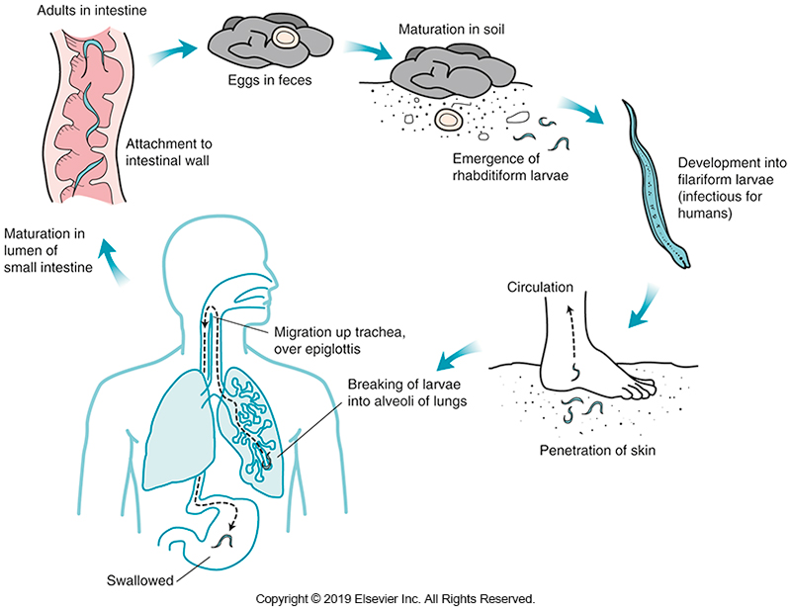
Life Cycle of Hookworm

Slide 40
Hookworms (Cont.)
Clinical symptoms differ according to the phase of the life cycle and the worm burden.
A small, red, itchy papule, referred to as ground itch, develops at the site of larval penetration.
If large numbers of larvae are present during the lung phase of migration, patient may have
Bronchitis
No host sensitization occurs.

Slide 41
Hookworms (Cont.)
Most severe symptoms associated with the adult worm
Nonspecific symptoms- diarrhea, fever, nausea, vomiting
Eosinophilia is often present
A few patients may experience pica and then ingest dirt (geophagia).

Slide 42
Hookworms (Cont.)
Blood loss ranges from 0.03 to 0.2 mL per worm per day
Primarily the result of ingestion of blood by the adult worm
Hemorrhages at the attachment site can also contribute to total blood loss.
Chronic heavy infections
Can lead to hypochromic anemia, especially in malnourished children (low iron and protein)
May affect the mental and physical development of a child because of anemia and malnutrition.

Slide 43
Hookworms (Cont.)
Infection is usually treated with albendazole or mebendazole.
Supportive therapy
Iron and protein supplements, may be needed in severe cases, especially if the child shows evidence of anemia or
If the infection occurs in a pregnant woman
Vaccine development using hookworm antigens is being targeted as a way to help control infections.

Slide 44
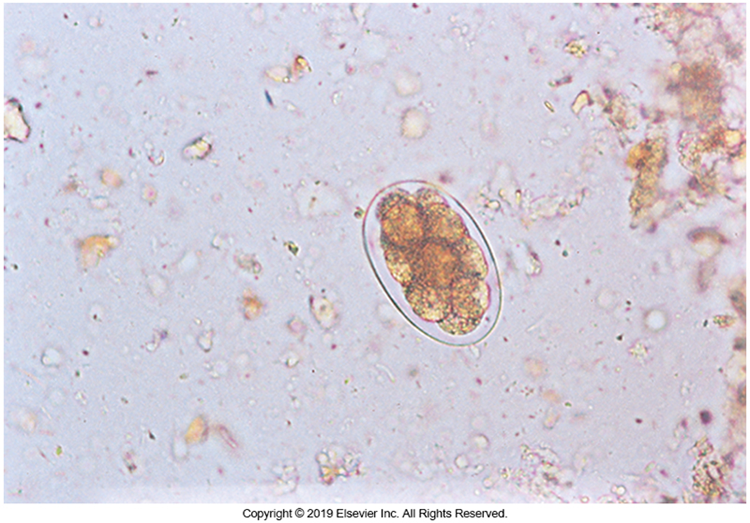
Hookworm Egg (Cont.)
Egg morphology
Oval
Colorless
Thin shelled
50 to 60 µm long
Usually contains an embryo in the four-to eight-cell stage of cleavage

Slide 45
Hookworms (Cont.)
Distinguishing features in adult worms
Rarely seen in stool specimens
Anterior buccal capsules
N. americanus has flat tetrad cutting plates.
A. duodenale has four pointed teeth.
Rhabditiform larvae – non-infective, feeding stage
Larvae of the three species indistinguishable
250 to 300 μm long
Small, inconspicuous, genital primordium
Long buccal capsule

Slide 46
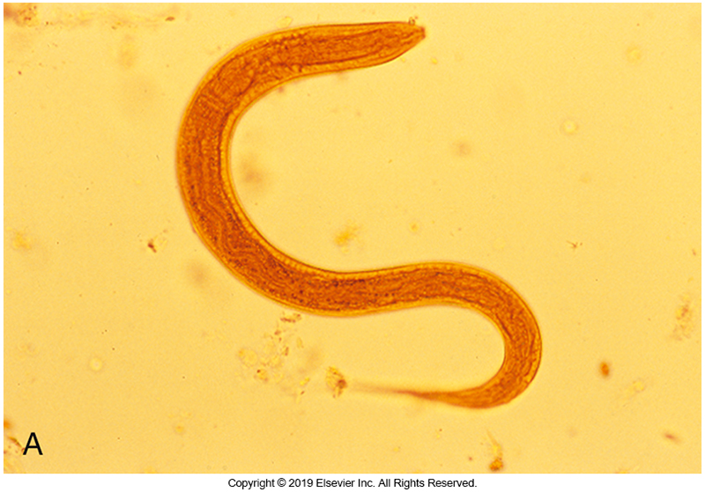
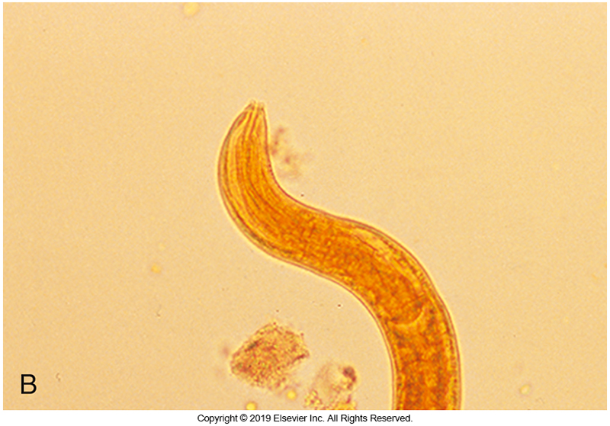
Hookworm Rhabditiform Larva

Slide 47
Hookworms (Cont.)
Filariform larvae- infective stage
500 µm long, with a pointed tail
Esophageal-intestinal ratio of 1 :4.
The hookworm filariform larva must be distinguished from that of S. stercoralis.

Slide 48
Strongyloides stercoralis

Slide 49
Strongyloides stercoralis
Known as the threadworm
Inhabits small intestine but is also capable of existing as free-living worm
Endemic in the tropics and subtropics
Southeast Asia, Latin America, sub-Saharan Africa
Found on all continents except Antarctica
It is estimated that 30 million to 100 million people are infected worldwide.

Slide 50
Strongyloides stercoralis (Cont.)
Patients may be asymptomatic
When symptomatic
Fever, nausea and vomiting, tracheal irritation
Sharp, stabbing pains that resemble those of an ulcer or other GI disease, including pancreatitis
Eosinophil count is often elevated
Larval penetration does not cause a prominent papule
Migration through the lungs rarely elicits pneumonitis
Patient may have wheezing and a mild cough

Slide 51
Strongyloides stercoralis (Cont.)
Severe infections referred to as disseminated strongyloidiasis or hyperinfection may develop in patients with
Drug-induced immunocompromised state (corticosteroids)
Lymphoma
Human T-lymphotropic virus 1 (HTLV-1) infection
Malignancy
Other conditions that cause T-cell depletion

Slide 52
Strongyloides stercoralis (Cont.)
In this population,
Large numbers of the filariform larvae develop in the intestine in an autoinfective cycle
Larvae migrate from the intestine into the lungs and other organs, such as the liver, heart, and CNS, causing a fulminating, often fatal infection.
Shortness of breath and coughing are common symptoms in this group of patients.

Slide 53
Strongyloides stercoralis (Cont.)
Most infections in organ transplant recipients are caused by reactivation of latent or chronic infection, although some cases may result from primary infection.
Secondary bacterial infections that occur because of massive larval migration
May be seen in up to 40% of patients with disseminated strongyloidiasis and can delay diagnosis of the underlying infection.

Slide 54
Strongyloides stercoralis (Cont.)
The mortality rate in immunocompromised patients is over 80%;
The usual causes of death are complications resulting in respiratory failure.
Disseminated strongyloidiasis, however, is not common in patients with advanced AIDS, despite their immunocompromised status.

Slide 55
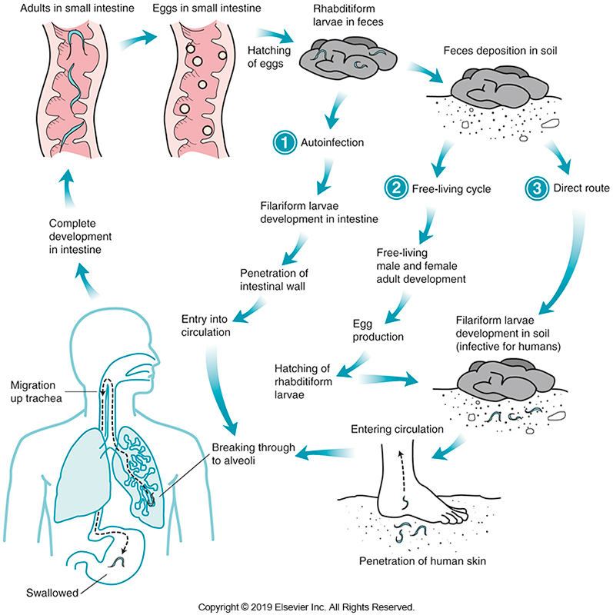
Life Cycle of S. stercoralis

Slide 56
Strongyloides stercoralis (Cont.)
Adult female morphology
Small at 2.5 mm
Rarely seen in stool samples
No male has been identified in intestinal infections
Primary diagnostic stage in humans
Rhabditiform larva

Slide 57
Strongyloides stercoralis (Cont.)
Rhabditiform larva morphology
200 to 250 μm long
Short buccal capsule
Large bulb in esophagus
Large genital primordium located in its posterior half to posterior third
Eggs rarely if ever found, and they look like hookworm eggs
54 by 32 μm and often segmented
May be seen in cases of severe diarrhea

Slide 58
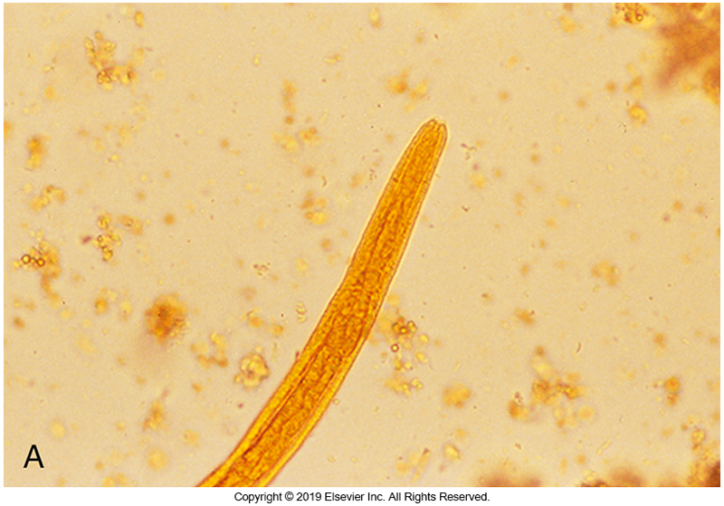
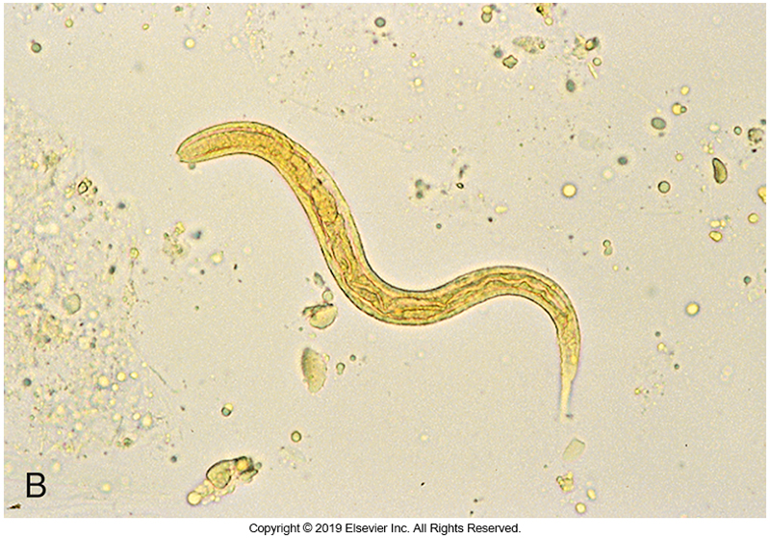
S. stercoralis Rhabditiform Larva

Slide 59
Strongyloides stercoralis (Cont.)
Filariform larva morphology
Notched tail
500 µm long
Esophageal-to-intestinal ratio of 1 : 1
May be seen in the sputum of patients with hyperinfection

Slide 60
Strongyloides stercoralis (Cont.)
Filariform larvae may be found in patients with hyperinfection
Sputum specimens inoculated onto sheep blood agar (SBA) after 24-hour incubation with 5% carbon dioxide in air reveal heavy bacterial growth in the area of primary inoculation
Thin trails of colonies lacing the surface of the agar due to motile larva

Slide 61
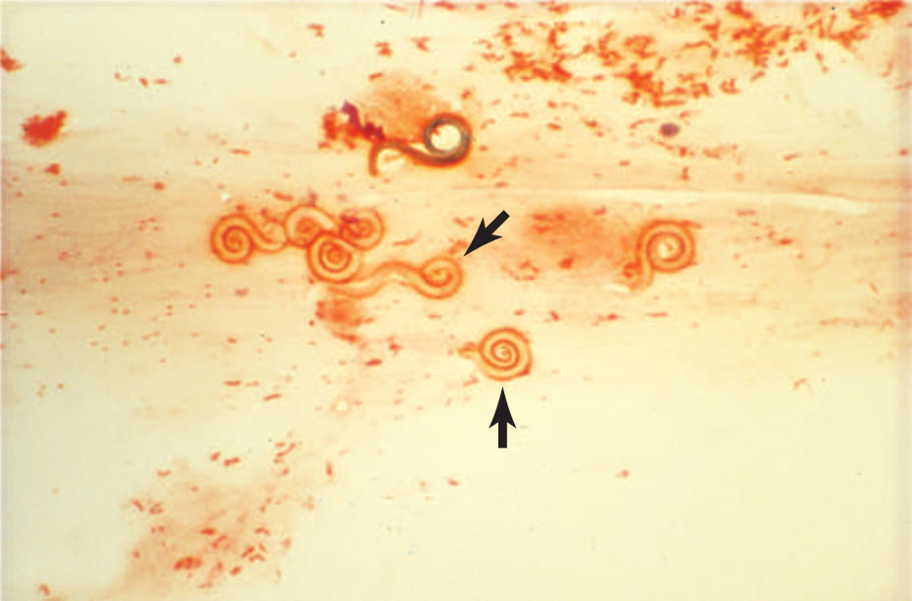
Sheep Blood Agar Plate Inoculated with Expectorated Sputum
Note heavy bacterial growth in the area of primary inoculation with thin trails of colonies (arrows) lacing the surface of the agar

Slide 62
Strongyloides stercoralis (Cont.)
Diagnosis relies on identification of larva in stool.
If clinical symptoms suggest Strongyloides infection but multiple stool specimens test negative for the larvae, a duodenal aspirate or biopsy specimen may be used for diagnosis. The organism lives in the upper small intestine.
No specific antigen tests available
Antibody tests
Cannot distinguish current from past infection
Prone to false-positive results from infections with other helminths

Slide 63
Strongyloides stercoralis (Cont.)
Recommended therapy
Ivermectin with albendazole as an alternative
In hyperinfection or disseminated infections, it is recommended that immunosuppressive therapy be reduced if possible

Slide 64
Blood and Tissue Roundworm Infections

Slide 65
Trichinella spiralis
Causative agent of trichinosis
Infection of muscle tissue with the larval form of T. spiralis
Adult stages live in the human intestine
Mode of transmission
Consuming contaminated undercooked meat, particularly pork
Life cycle notes
After ingestion, larvae are released from the tissue capsule in the intestine

Slide 66
Trichinella spiralis (Cont.)
Life cycle notes
Larvae mature into adults in the intestine
Female worms produce liveborn larvae
Liveborn larvae penetrate the intestinal wall, enter the circulation, and are carried through the body.
Liveborn larvae enter striated muscle and begin maturation cycle that is completed in about 1 month.
Liveborn larvae coil and become encapsulated
Remaining viable for years
Eventually the capsules calcify, and the liveborn larvae die.

Slide 67
Trichinella spiralis (Cont.)
Few symptoms occur during the intestinal phase.
Diarrhea
Abdominal discomfort
Most symptoms occur during the migration and encapsulation periods.

Slide 68
Trichinella spiralis (Cont.)
The severity of symptoms depends on
number of parasites,
tissues invaded
person’s general health.
Symptoms that occur during the larval phase are the result of an intense inflammatory response by the host.

Slide 69
Trichinella spiralis (Cont.)
Common symptoms include
Periorbital edema, fever, muscular pain or tenderness, headache, and general weakness.
Muscle enzyme levels may be elevated.
Splinter hemorrhages beneath the nails can be seen in many patients.
Increase in eosinophils is common.

Slide 70
Trichinella spiralis (Cont.)
Patients with symptoms should be treated with analgesics and general supportive measures.
Steroids are given only in rare cases.
The use of albendazole or mebendazole is effective when administered early in the infection, before the release of larvae.
If diagnosis is delayed, the impact of antiparasitic drugs is less effective.

Slide 71
Trichinella spiralis (Cont.)
It is difficult to recover adults or larvae in stool in a stool
This diagnosis is often based on clinical symptoms and the patient’s history.
Biopsy of muscle tissue and identification of the encapsulated, coiled larva is the definitive diagnostic method.
The presence of calcified larvae on a radiographic film indicates infection.
Serologic tests are available.

Slide 72
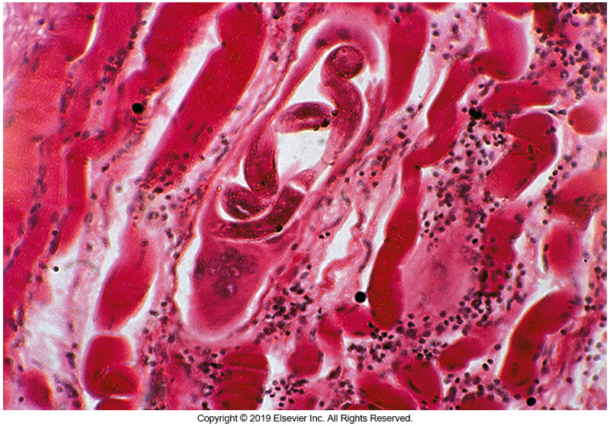
T. spiralis Larva

Slide 73
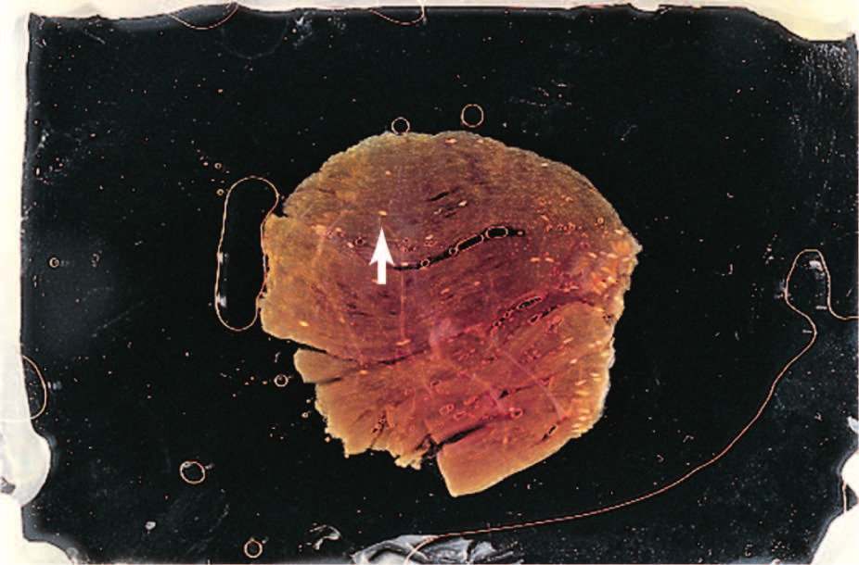
Muscle Tissue, Directly Viewed Encysted Calcified Larvae
Morphology consistent with Trichinella spiralis

Slide 74
Larva Migrans
Two forms of larva migrans exist in humans:
Cutaneous (creeping eruption)
Visceral
Humans are the accidental hosts for nonhuman nematode larvae in both cases.
In the United States, cutaneous larva migrans occurs primarily in the Southwest, MidAtlantic, and Gulf Coast areas
Most commonly caused by the filariform larva of the dog or cat hookworm (Ancylostoma braziliense).

Slide 75
Larva Migrans (Cont.)
Cutaneous larva migrans life cycle notes
The larva penetrates skin through a hair follicle, a break in skin, or unbroken skin.
Once inside the body the larva wanders through subcutaneous tissue, creating long, winding tunnels.
Secretions from the larva create a severe allergic reaction, with intensely itchy skin lesions that are vesicular and erythematous.
Secondary bacterial infections can result from scratching.
The infection resolves within several weeks when the larva dies.
Diagnosis is based primarily on history and clinical symptoms.

Slide 76
Larva migrans (Cont.)
Visceral larva migrans
Human accidentally ingests eggs of the
Dog roundworm (Toxocara canis) or
Cat roundworm (Toxocara cati).
Larvae hatch in the intestine, penetrate the intestinal mucosa, and wander through the abdominal cavity.
Larvae can enter the lung, eye, liver, or brain
Infection seen primarily in children ages 1 to 4

Slide 77
Larva migrans (Cont.)
Visceral larva migrans
Clinical symptoms
Malaise, fever, pneumonitis, hepatomegaly
Increase in eosinophils
CNS complications may develop.
Eye invasion is known as ocular larva migrans, eosinophilia is absent
Diagnosis is made on the basis of clinical findings and results of serologic tests using Toxocara-specific antigens.

Slide 78
Filarial Worms

Slide 79
Scientific Names and Descriptions
Scientific Name | Description
Wuchereria bancrofti | Bancroftian filariasis, lymphatic filariasis
Brugia malayi | Brugian filariasis, lymphatic filariasis
Loa loa | African eye worm
Onchocerca volvulus | Onchocercosis / river blindness
Mansonella species | Usually not associated with serious infections
Drancunculus medinensis | Guinea worm, serious infections in the Middle East, parts of Africa, and India

Slide 80
Filarial Worms
Filarial worms are roundworms of blood and tissue
Found primarily in tropical areas of the world.
At least eight species infect humans.
Most pathogenic are
Brugia malayi
Wuchereria bancrofti
Onchocerca volvulus
Loa loa.
Lymphatic filariasis (caused by W. bancrofti, B. malayi, and Brugia timori) second most common mosquito-borne disease after malaria.

Slide 81
Filarial Worms
Adult filarial worms give birth to liveborn larvae referred to as microfilariae
Identification depends on
Morphology of the microfilaria
Periodicity (microfilaria migration)
Location of the worms in the host

Slide 82
Filarial Worms
Microfilariae morphology
Characteristics used in identification
Presence or absence of a sheath (the remnant of the egg from which the larva hatched)
Arrangement of nuclei in and near the tail
Some microfilariae migrate in the blood during certain times during the day/night (periodicity).
Adult filarial morphology
Range in size from 2 to 50 cm
Live in lymphatics, muscles, or connective tissue
Mature females produce microfilariae (larval, infective stage).

Slide 83
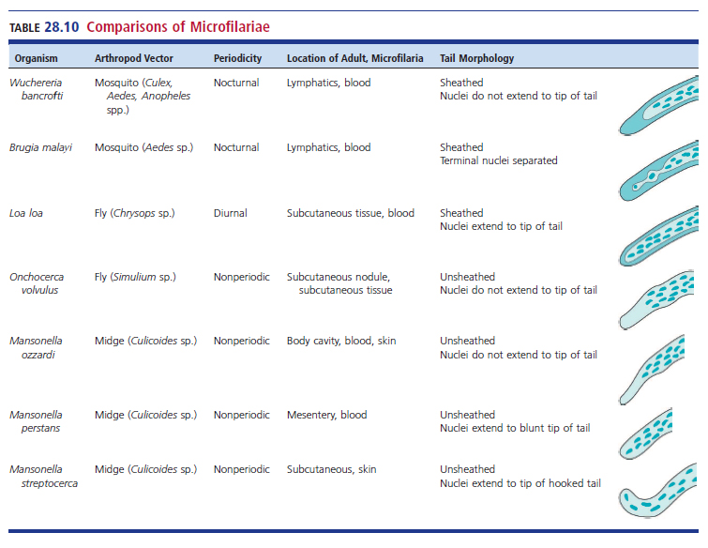
Comparisons of Microfilariae

Slide 84
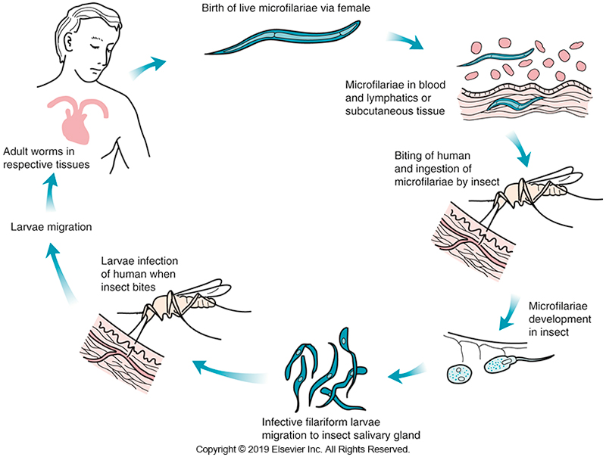
General Life Cycle of Microfilaria

Slide 85
Wuchereria bancrofti
Causative agent of bancroftian filariasis
Adult worms
Live in the lymphatics and lymph nodes especially in the lower extremities
The presence of the adults initiates an immunologic response consisting of cellular reactions, edema, and hyperplasia.

Slide 86
Wuchereria bancrofti
A strong granulomatous reaction with production of fibrous tissue around dead worms ensues.
The resulting reaction causes the small lymphatics to become narrowed or closed, causing increased hydrostatic pressure, with subsequent leakage of fluid into the surrounding tissue.
During this time, patient may experience generalized symptoms
Fever, headache, chills, localized swelling, redness, lymphangitis

Slide 87
Wuchereria bancrofti (Cont.)
The affected sites in the male and female
Genitalia
Extremities
Elephantiasis
Debilitating and deforming complication, occurs in less than 10% of infections, usually after many years of continual filarial infection.

Slide 88
Wuchereria bancrofti (Cont.)
Chronic obstruction to the lymphatic flow results in lymphatic varices, fibrosis, and proliferation of dermal and connective tissue.
The enlarged areas eventually develop a hard, leathery appearance.

Slide 89
Wuchereria bancrofti (Cont.)
Diagnosis
Examination of a blood specimen obtained at night (10 pm to 2 am) for the presence of microfilariae.
Blood specimens may be examined immediately for live microfilariae or may be pooled on a slide and stained.
Filtration of up to 5 mL of blood through a 5-µm nuclepore filter can detect light infections.

Slide 90
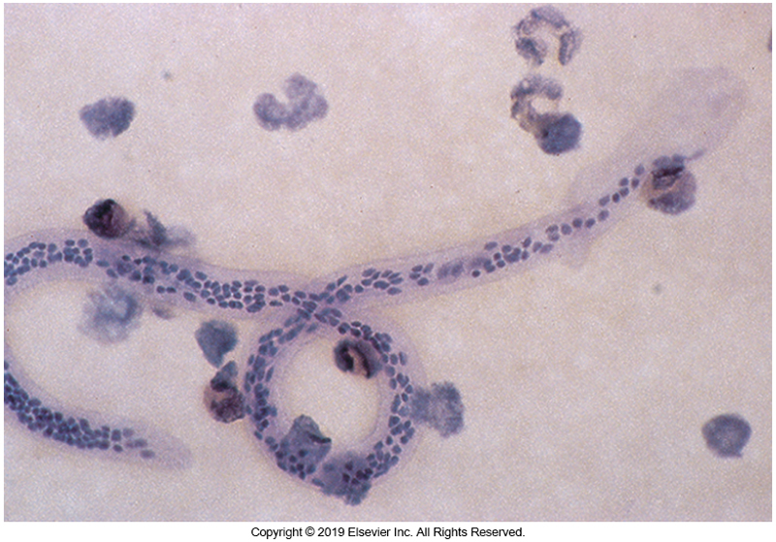
Wuchereria bancrofti Microfilaria (Cont.)
Microfilariae morphology
Sheathed
Nuclei do not extend to the tip of the tail
Three antigen detections assays are available but none have U.S. FDA approval.
No antibody detection tests are available

Slide 91
Brugia malayi
Geographic distribution
Limited to the Far East, including Korea, China, and the Philippines.
The genera Mansonia and Aedes mosquitoes transmit the organism
The pathologic aspects of the disease and the clinical symptoms are the same as those seen with W. bancrofti infections

Slide 92
Brugia malayi (Cont.)
Microfilaria morphology
Presence of a sheath
Arrangement of tail nuclei—
The nuclei extend to the tip, but a space separates the two terminal nuclei

Slide 93
Loa loa
Known as the African eye worm
Causative agent of loasis
Geographic distribution
Limited to the African equatorial rainforest, where the fly vector (Chrysops) breeds
Adult worms may live in humans for as long as 15 years,
Migrate through the subcutaneous tissue, causing temporary inflammation reactions called Calabar swellings

Slide 94
Loa loa
Calabar swellings
Can cause pain and pruritis that last about 1 week before disappearing
Reappear in another part of the body
The adult worm can often be seen as it migrates across the surface of the eye.

Slide 95
Loa loa
Diagnosis
Based on the presence of Calabar swellings or of the adult worm in the conjunctiva of the eye.
Microfilariae may be seen in a blood specimen if it is taken during the day, especially around noon, when migration peaks.
The microfilaria is sheathed, and nuclei extend to the tip of the tail.

Slide 96
Onchocerca volvulus
Causative agent for onchocercosis, also known as river blindness
Geographic distribution
Africa and South and Central America
Mode of transmission
Bite of the black fly (Simulium)
Adult worms are encapsulated in fibrous tumors in the subcutaneous tissues of humans.

Slide 97
Onchocerca volvulus
Microfilariae can be isolated from the
Subcutaneous tissue
Skin
The nodule itself
Rarely found in blood or lymphatic fluid
The nodules in which the adults live
May measure up to 25 mm
Can be found on most parts of the body
A result of an inflammatory and granulomatous reaction (around the adult worms)

Slide 98
Onchocerca volvulus (Cont.)
The most serious complication
Blindness results when microfilariae collect in the cornea and iris causing hemorrhage, keratitis, and atrophy of the iris.
The presence of endosymbiotic bacteria of the genus Wolbachia has been linked to stimulation of the host immune response and may contribute to the inflammatory tissue reaction.

Slide 99
Onchocerca volvulus (Cont.)
Diagnosis
Clinical symptoms
Presence of nodules
Microscopic identification of microfilariae
Diagnostic method used to isolate microfilariae
Skin snip, a process in which a small slice of skin is obtained and placed on a saline mount
Skin snips pose a risk of infection

Slide 100
Onchocerca volvulus (Cont.)
Diagnosis
Microfilariae with no sheath and with nuclei that do not extend into the tip of the tail are characteristic of Onchocerca.
NAATs are being used in research laboratories.
Serologic assays using recombinant antigens have demonstrated high sensitivity and specificity

Slide 101
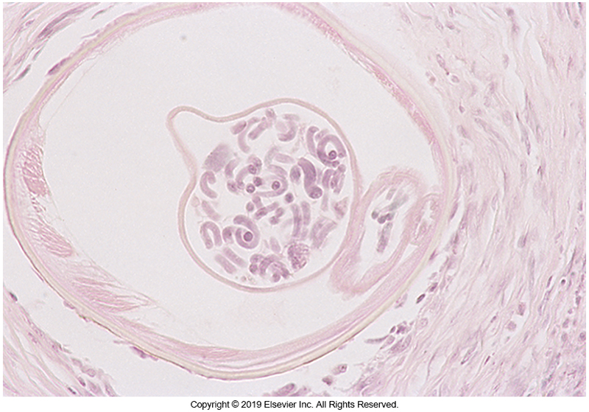
Tissue Infected with O. volvulus

Slide 102
Mansonella spp.
Three species, none of which are known to cause serious infections
M. ozzardi, M. streptocerca, and M. perstans
Mode of transmission
Midges belonging to the genus Culicoides
The microfilariae of M. streptocerca are found in skin.
Unsheathed
Nuclei extend to the end of the so-called shepherd’s crook tail

Slide 103
Mansonella spp. (Cont.)
Microfilariae of M. ozzardi and M. perstans are found in blood as unsheathed organisms.
M. ozzardi microfilariae have tails with nuclei that do not extend to the tips,
The nuclei in the tail of an M. perstans microfilaria extend to the tip.

Slide 104
Dranculus medinensis
Known as the guinea worm
The Israelites described this organism as the fiery serpent in the Bible
Historically caused serious infections in the Middle East, parts of Africa and India
It is often found in areas where step-down wells are used.

Slide 105
Dranculus medinensis
An eradication program was launched in 1986, a time when an estimated 3.5 million people were infected.
By 2012, only 542 cases were reported, and infection was limited to four African countries.
In 2020, only 27 cases were reported, raising hopes that the disease may be totally eradicated.

Slide 106
Dranculus medinensis
Adult worms
Mature in the deep connective tissue.
Gravid females migrate to the subcutaneous tissue.
Initially, a painful, blister-like, inflammatory papule appears on the leg in the area where the gravid female is present.
Papule ulcerates

Slide 107
Dranculus medinensis
When person’s body comes in contact with water,
the female worm exposes her uterus through the ulceration and releases larvae into the water.
Patients may experience
Nausea and vomiting, urticaria, and dyspnea before the rupture of the worm’s uterus.
If the worm is broken during an attempt to remove it, the patient may experience a severe inflammatory reaction and secondary bacterial infection.

Slide 108
Dranculus medinensis
Life cycle notes
Humans acquire the infection by ingesting a copepod (cyclops) that contains an infective larva.
Larva is released in the intestine, penetrates the intestinal wall, and migrates to the body cavity.
Male and females mature and mate.
The gravid female migrates through the subcutaneous tissue to the arm or leg to release live larvae into the water.
The rhabditiform larvae are then ingested by the copepod.

Slide 109
Dranculus medinensis
Diagnosis
Made from the typical appearance of the lesion.
Although organism-specific antibodies develop with infection, immunity does not develop, and an individual can be infected multiple times.
Treatment is based on the extraction of the adult worm
The worm can be wound around a stick and eased out a few centimeters each day.

Slide 110
Dranculus medinensis
Treatment
Analgesics and topical agents, such as metronidazole or thiabendazole can help in the removal process, although they do not kill the adult worm.
Because this method can rupture the worm, surgical excision is preferred

Slide 111
Points to Remember
There are numerous points to remember, so much so that is it impractical to list them all here.
Learners are encouraged to review the list of points to remember in the course textbook.

