Slide 1
Clinical Laboratory Hematology
Primary Hemostasis
Copyright © 2020, 2015, 2012 Pearson Education, Inc. All Rights Reserved

Slide 2
Objectives-Level I One
31.1.1. Define hemostasis, blood coagulation, and thrombosis.
31.1.2. Explain the general interaction of the systems involved in maintaining hemostasis.
31.1.3. Differentiate the primary hemostatic plug from the secondary hemostatic plug.
31.1.4. Name the three types of blood vessels and explain the general roles of the vasculature and normal endothelial cells in aiding and preventing the activation of the hemostatic system.
31.1.5. Describe the role of the primary hemostatic plug in the cessation of bleeding
31.1.6. Identify and define the steps in the normal sequence of events of platelet activation following injury to the endothelium.
31.1.7. Distinguish the events that occur in primary hemostasis from those that occur in secondary hemostasis.

Slide 3
Objectives-Level II Two
31.2.1. Identify key histological features of each type of blood vessel, and explain the metabolic functions of endothelial cells in hemostasis.
31.2.2. Correlate various platelet ultrastructural features with their functions.
31.2.3. Identify three key substances stored in platelet dense granules and five key substances stored in platelet ɑ-granules and explain the role of each in hemostasis.
31.2.4. Describe the biochemical roles of the secreted contents of the platelet granules in hemostasis.
31.2.5. Outline steps platelets undergo in forming the primary hemostatic plug, including the biochemical mediators necessary for platelet adhesion, platelet aggregation, and platelet secretion.
31.2.6. Identify platelet agonists and predict their effect on platelet function.
31.2.7. Correlate activation with changes in the platelet ultrastructure and biochemistry.
31.2.8. Describe the roles of the platelet in secondary hemostasis.

Slide 4
Hemostasis (1 of 3)
Hemostasis
Circulation property that maintains blood as a fluid within the blood vessels
Prevents excessive blood loss upon injury
Blood coagulation
Mechanism whereby the fluid plasma is transformed to a gel
Conversion of soluble protein fibrinogen to insoluble fibrin
Fibrinolysis
Dissolution of the fibrin clot

Slide 5
Hemostasis (2 of 3)
Hemostasis depends on interaction of:
Blood vessels
Platelets
Soluble plasma proteins
Fibrin-forming
Fibrin-lysing
Inhibitors

Slide 6
Hemostasis (3 of 3)
Primary hemostasis
Formation of “platelet plug”
Initially halts loss of blood
Secondary hemostasis
Reinforcement of platelet plug by fibrin formation

Slide 7
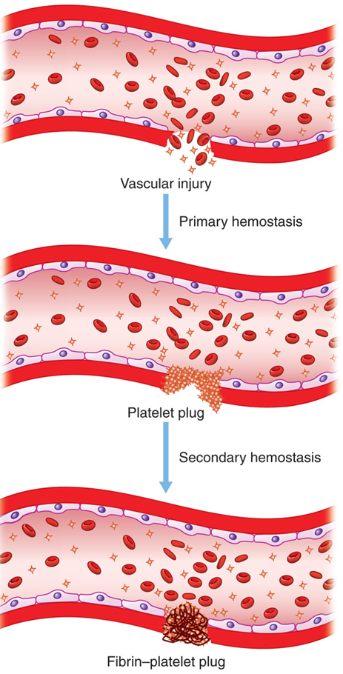
Figure 31-1 Stages of Hemostasis After Vascular Injury
Notes:
Bleeding occurs after an injury to a blood vessel. The hemostatic system is activated to prevent excessive blood loss. Hemostasis occurs in two stages: (1) primary hemostasis when the platelets aggregate at the site of the injury and form the platelet plug (primary hemostatic plug) and (2) secondary hemostasis when fibrin develops to strengthen the platelet plug forming the fibrin-platelet plug (secondary hemostatic plug).

Slide 8
Table 31-1 Components of Hemostasis
Vasculature Arterioles Venules Capillaries | Cellular Elements Endothelial cells Platelets | Proteins Fibrin-forming proteins Fibrinolytic proteins Inhibitors

Slide 9
Role of the Vascular System

Slide 10
Vasculature
Forms an extensive distribution system for blood
Serves as a conduit in the body for
Distribution of nutrients
Transport of waste products
Allows for uninterrupted flow of blood
Maintains blood in a fluid state

Slide 11
Vasculature System
Consists of three types of blood vessels
Arteries
Veins
Capillaries
Vessels in which hemostasis occurs are primarily
Smallest veins (venules)
Smallest arteries (arterioles)

Slide 12
Table 31-2 Structure and Functions of Blood Vessels of the Microcirculation (1 of 2)
Blood Vessel | Structural Characteristics | Functions
Arterioles | 20-200 microMeter in diameter | Serve as site of hemostatic activity following injury
Arterioles | Basement membrane | Regulate blood pressure by change in diameter and chemical mediators
Arterioles | Primary components: Smooth muscle cells Fibroblasts Thicker wall of collagen and extracellular matrix | Perform endothelial cell hemostatic functions
Venules | 20-200 microMeter in diameter | Serve as major site of hemostatic activity following traumatic injury
Venules | Basement membrane | Exchange nutrients, oxygen, and waste products
Venules | Primary components: Few smooth muscle cells | Regulate vascular permeability

Slide 13
Table 31-2 Structure and Functions of Blood Vessels of the Microcirculation (2 of 2)
Blood Vessel | Structural Characteristics | Functions
Venules | Few fibroblasts Thin layer of collagen and extracellular matrix Minimal elastin fibers | Perform endothelial cell hemostatic functions
Capillaries | 5-10 microMeter in diameter | Provide hemostatic effects by endothelial cell function
Capillaries | Primary components: Endothelial cell monolayer, Surrounding Pericytes | Exchange nutrients, oxygen, and waste products
Capillaries | Basement membrane | Blank
Capillaries | No smooth muscle cells | Blank
Capillaries | No collagen fibers, elastin fibers | Blank

Slide 14
Structure of Blood Vessels
Central cavity
Lumen
Lined with single layer of flattened endothelial cells
Separates blood from underlying tissues
Provides protective environment for cellular elements of blood
Vessel wall of arteries and veins
Three tissue layers
Tunica intima
Tunica media-thicker in arteries than veins
Tunica adventitia

Slide 15
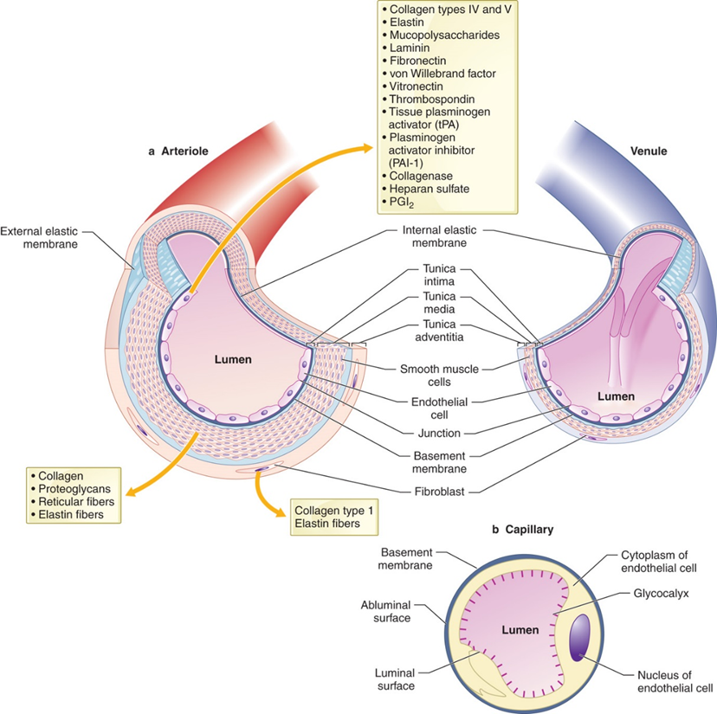
Figure 31-2
Notes:
Structure and function of the blood vessel wall, comparing and contrasting arterioles, venules, and capillaries. (a) Arterioles and venules. Endothelial cells, smooth muscle cells, and fibroblasts synthesize and secrete the components of the subendothelial matrix of connective tissue and the basement membrane proteins. The wall of arterioles is primarily composed of smooth muscle cells and contains elastin in contrast to the venule, which has only sparse smooth muscle cells. The media of arterioles is the most prominent layer; the adventitia layer is the largest in venules. (b) A capillary consists primarily of endothelial cells and basement membrane with very little connective tissue.

Slide 16
Functions of Blood Vessels
Following an injury:
Vasoconstriction
Narrows vessel lumen to minimize blood loss
Brings hemostatic components (platelets and plasma proteins) into closer proximity to vessel wall
Complex mechanism which involves
Neurogenic factors
Regulatory substances
Serotonin
Thromboxane A2

Slide 17
Functions of Endothelial Cells (1 of 3)
Intact endothelial cell lining
Non-thrombogenic, antithrombotic, profibrinolytic
Negatively charged-repels proteins and platelets
Inhibits platelet activation/vasoconstriction by secretion of
P G I₂(prostacyclin), nitrous oxide and A D Pase
Inhibits coagulation
Thrombomodulin/protein C, heparan-S O₄, T F P I
Activates fibrinolysis
t P A, u P A, and u P A R

Slide 18
Functions of Endothelial Cells (2 of 3)
Endothelial cell lining injury
Thrombogenic, antifibrinolytic
Secretion of V W F-primary hemostasis
Production of tissue factor-secondary hemostasis
Exposure of collagen and secretion of P A F, T X A2, E T-activate platelets and bind them to vessel wall
Release of P A I-1-inhibits fibrinolysis

Slide 19
Functions of Endothelial Cells (3 of 3)
Non-hemostatic functions
Blood/tissue barrier
Processing of blood-borne antigens
Synthesis/secretion of
Collagen, elastin, fibronectin, laminin, vitronectin, and thrombospondin
Damaged endothelium
Thrombogenic, produces substances that
Activate platelets, coagulation proteins
Inhibit fibrinolysis
Activate platelet function and/or vasoconstriction

Slide 20
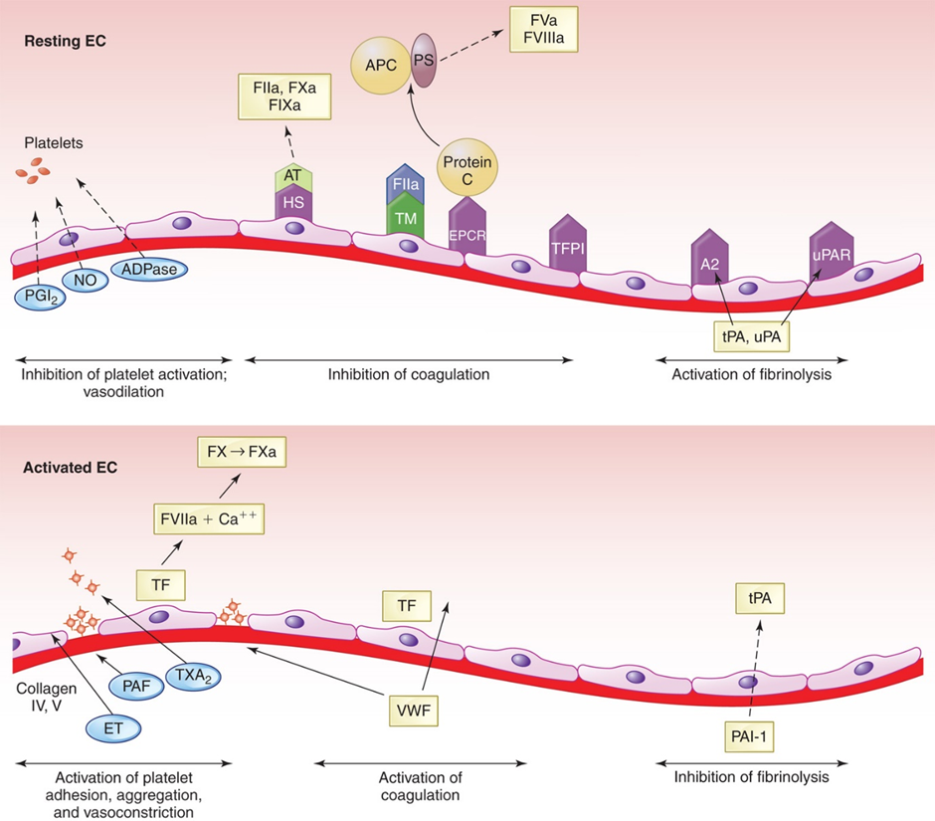
Figure 31-3
Notes:
Antithrombotic characteristics of resting endothelium versus the prothrombotic effects of damaged or activated endothelium. Resting endothelium provides an environment that inhibits activation of hemostasis. This includes secretion of substances that (1) inhibit platelet activation (PGI₂, NO, ADPase); (2) inhibit coagulation (heparan sulfate as a cofactor for AT; TM for activation of protein C, which inactivates activated FVa and FVIIIa; and TFPI), and EPCR; and (3) activate fibrinolysis (tPA, A2, uPA, uPAR). When endothelium is damaged, it secretes substances that (1) activate platelets (TXA₂ PAF, ET) and bind them to the vessel wall (VWF), (2) activate coagulation (TF, which initiates formation of fibrin), and (3) inhibit fibrinolysis (PAI-1). EC, endothelial cells; ET, endothelin; PGI₂, prostacyclin; NO, nitric oxide; HS, heparin sulfate; AT, antithrombin; TM, thrombomodulin; APC, activated protein C; F IIa, factor IIa (thrombin); EPCR, endothelial cell protein C receptor; PS, protein S; TXA₂, thromboxane A₂; tPA, tissue type plasminogen activator; A2, annexin A2; uPA, urinary-type plasminogen activator; uPAR, uPA receptor; PAF, platelet activating factor; TF, tissue factor; TFPI, tissue factor pathway inhibitor; VWF, von Willebrand factor; PAI-1, plasminogen activator inhibitor-1; →, stimulation; - - -> , inhibition.

Slide 21
Table 31-3 Functions of Endothelial Cells (1 of 3)
Hemostatic Functions
Component/Characteristic | Function
Non-thrombogenic/antithrombotic | Blank
Negatively charged surface | Repels platelets and hemostatic proteins
Heparan sulfate (H S) | Inhibits fibrin formation (cofactor for antithrombin)
Thrombomodulin (T M) | Binds thrombin, enhances activation of protein C
Endothelial protein C receptor (E P C R) | Binds protein C; facilitates P C activation
Tissue factor pathway inhibitor (T F P I) | Binds T F/F V I I a/F X a complex; inhibits extrinsic pathway of coagulation
Prostacyclin (P G l₂) | Promotes vasodilation; inhibits platelet activation
Tissue plasminogen activator (t P A) | Activates fibrinolytic system

Slide 22
Table 31-3 Functions of Endothelial Cells (2 of 3)
Component/Characteristic | Function
Annexin A2 (t P A receptor) (A2) | Binds t P A and plasminogen; activates fibrinolysis
Urinary-type plasminogen activator receptor (u P A R) | Binds u P A and plasminogen; activates fibrinolysis
Nitric oxide (NO) | Promotes vasodilation; inhibits platelet recruitment and accumulation
A D Pase (C D39) | Degrades A T P and A D P to A M P and adenosine
Thrombogenic | Blank
Endothelin (E T) | Promotes vasoconstriction
von Willebrand factor (v W F; production and processing) | Carries factor Eight (F V I I) in plasma; facilitates platelet adhesion
Tissue factor (T F) | Initiates fibrin formation, activates F V I I
Plasminogen activator inhibitor (P A I-1) | Inhibits activation of fibrinolytic system

Slide 23
Table 31-3 Functions of Endothelial Cells (3 of 3)
Non-hemostatic Functions
Component/Characteristic | Function
Selective blood/tissue barrier | Keeps cells and macromolecules in vessels; allows nutrient and gas exchange
Processing of blood-borne antigens | Contributes to cellular immunity
Synthesis and secretion of connective tissue: | Blank
Basement membrane collagen | Provides backup protection for endothelial cells
Collagen of the matrix | Induces platelet adhesion
Elastin | Mediates vasodilation and vasoconstriction
Fibronectin | Binds cells to one another
Laminin | Contributes to platelet adhesion after injury
Vitronectin | Binds cells to one another; possibly promotes platelet adhesion
Thrombospondin | Binds cells to one another; possibly promotes platelet adhesion

Slide 24
Platelets in Hemostasis

Slide 25
Primary Hemostasis
Platelets
Interact with injured vessel wall
Interact with one another
Produce the primary hemostatic plug
Primary platelet plug
Fragile
Can easily be dislodged from the vessel wall

Slide 26
Platelets
Anucleate cytoplasmic fragments with azurophilic granules
Released into circulation from B M megakaryocytes
Production regulated by T P O
7-10 day life span
Circulate in “resting” state-disc shaped with smooth regular surface
Repel one another and have minimal interaction with vessel wall

Slide 27
Platelet Activation
On injury
Platelets become “activated”
Undergo shape and biochemical changes
Interact with vessel wall and other platelets
Form primary hemostatic plug

Slide 28
Platelet Ultrastructure
Four zones
Peripheral
Structural
Organelle
Membrane systems

Slide 29
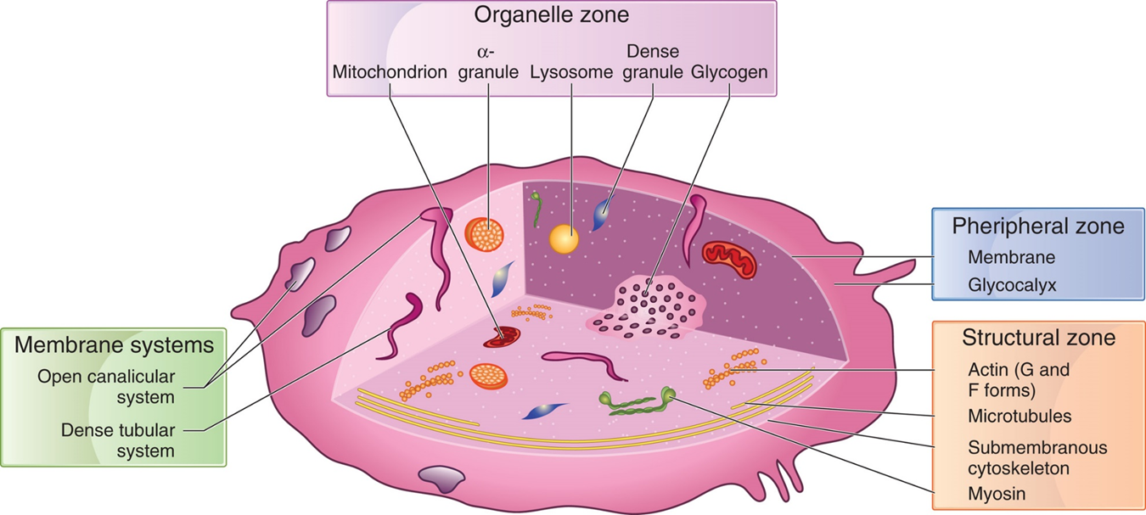
Figure 31-4 Diagram of Platelet Ultrastructure

Slide 30
Table 31-4 Platelet Ultrastructure and Functions (1 of 2)
Zone and Component | Function/Role
Peripheral zone | Adhesion and aggregation
Glycocalyx Proteins, glycoproteins, mucopolysaccharides Phospholipid bilayer Phospholipids | Asymmetric arrangement; source of arachidonic acid
Integral proteins Glycoproteins I b/I X, I I b/I I I a, G P I a/I I a, G P V I | Adhesion and aggregation
Enzymes | Activation
Zone and Component | Function/Role
Structural zone | Structure and support
Microtubules (tubulin) Cytoskeletal network Microfilaments (actin) Intermediate filaments (filamin/actin-binding protein, talin, vimetin) | Blank

Slide 31
Table 31-4 Platelet Ultrastructure and Functions (2 of 2)
Zone and Component | Function/Role
Organelle zone | Storage and secretion
Granules Dense granules α - granules Lysosomes Peroxisomes Mitochondria Glycogen | Non-protein mediators (A D P, A T P, and serotonin) Protein mediators Enzymes Lipid metabolism Oxidative energy metabolism
Zone and Component | Function/Role
Membrane systems | Storage and secretion
Open canalicular system Dense tubular system | Secretion of granule contents Storage of calcium

Slide 32
Platelets-Peripheral Zone (1 of 4)
Glycocalyx (surface coat)
Made up of:
Glycolipids
Glycoproteins
Mucopolysaccharides
Adsorbed plasma proteins
Factor V, vWF, fibrinogen
Responsible for negative charge of platelet surface
Some proteins act as receptors for platelet activation

Slide 33
Platelets-Peripheral Zone (2 of 4)
Plasma membrane-phospholipid bilayer
Asymmetric arrangement
Negatively charged phospholipids on inner bilayer
Neutral phospholipids on outer bilayer
During activation
Scramblase moves negatively charged phospholipids to platelet surface
Facilitates interaction with plasma proteins
Contains integral proteins
Receptors for V W F, fibrinogen, collagen, thrombin, fibronectin, and vitronectin

Slide 34
Platelets-Peripheral Zone (3 of 4)
Membrane receptors
G P I b
Complexed with G P I X and G P V
G P I b together with G P I X is the major platelet receptor for V W F
Composed of an α-chain and a β-chain
Major receptor for V W F; receptors for thrombin and ristocetin
Binding sites located on major extracellular portion-glycocalicin
Functions in platelet adhesion

Slide 35
Platelets-Peripheral Zone (4 of 4)
Membrane receptors
G P I I b/I I I a complex
Major receptor for fibrinogen
Also binds V W F and other adhesive proteins
Inactive in resting platelets
Association of I I b and I I I a occurs after platelet activation

Slide 36
Table 31-5 Platelet Receptors (1 of 2)
Blank | Receptor(s) Nomenclature: | Receptor(s) Nomenclature: | Receptor(s) Nomenclature:
Ligand | Glycoprotein | Integrin | C D
Collagen | G P I a/I I a | (α₂β₁) | C D49b/C D29
Collagen | G P I I b/I I I a, | Alpha sub I I b beta sub 3 | C D41/C D61
Collagen | G P I V | Blank | C D36
Collagen | G P V I | Blank | Blank
Fibrinogen | G P I I b/I I I a, | Alpha sub I I b beta sub 3 | C D41/C D61
Fibrinogen | Vitronectin receptor | Alpha sub v beta sub 3 | C D51/C D61
Fibronectin | G P I c/I I a | (α₅β₁) | C D49e/C D29
Fibronectin | G P I I b/I I I a | Alpha sub I I b beta sub 3 | C D41/C D61
Thrombospondin | Alpha sub v beta sub 3 | Blank | C D51/C D61

Slide 37
Table 31-5 Platelet Receptors (2 of 2)
Blank | Receptor(s) Nomenclature: | Receptor(s) Nomenclature: | Receptor(s) Nomenclature:
Ligand | Glycoprotein | Integrin | C D
Thrombospondin | G P I V | Blank | C D36
Vitronectin | Alpha sub v beta sub 3 | Blank | C D51/C D61
Vitronectin | G P I I b/I I I a, | Alpha sub I I b beta sub 3 | C D41/C D61
von Willebrand factor | G P I b/I X/V | Blank | C D42a-d
von Willebrand factor | G P I I b/I I I a, | Alpha sub I I b beta sub 3 | C D41/C D61
Laminin | G P I c/I I a | (α₆β₁) | C D49e/C D29
Laminin | G P I a/I I a | (α₂β₁) | C D49b/C D29
G P, glycoprotein; C D, cluster of differentiation

Slide 38
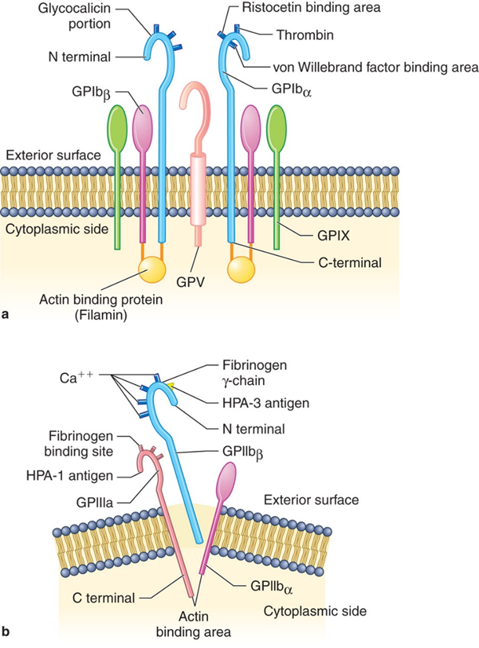
Figure 31-5 Structure of Platelet Membrane Glycoproteins
Notes:
(a) Glycoprotein Ib is composed of an α- and a β-chain. Both span the phospholipid bilayer. The α-chain is larger and contains the binding sites for thrombin, ristocetin, and VWF. Actin-binding protein (filamin) is attached to the cytoplasmic side. Glycoprotein IX and glycoprotein V associate with glycoprotein Ib in the platelet membrane. (b) Glycoproteins IIb and IIIa associate in a complex after platelet activation. Binding sites for fibrinogen as well as platelet-specific antigens are present. Cytoplasmic portions of each component have binding areas for actin.

Slide 39
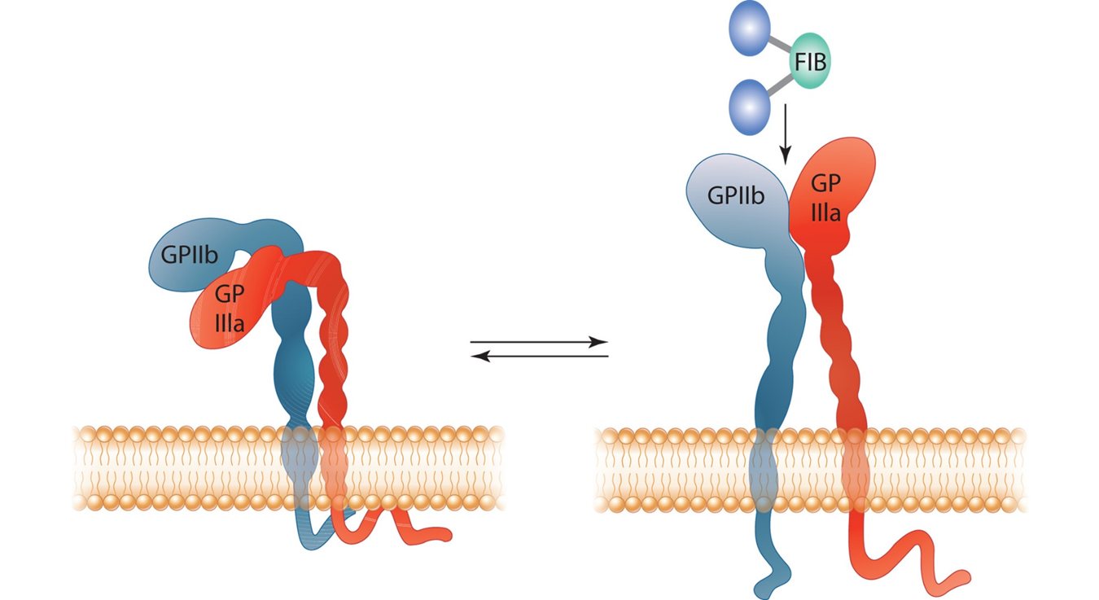
Figure 31-6 Activation of G P I I b/I I I a
Notes:
(a) Inactive GPIIb/IIIa as found in inert platelets: complex is bent or folded in an inactive conformation and has low affinity for fibrinogen in solution. (b) Activated form of GPIIb/IIIa displays significantly enhanced fibrinogen-binding affinity: activated GPIIb-IIIa exists as an “open” conformation, with the receptor “head” extended and the two “tails” separated further apart.

Slide 40
Platelets-Structural Zone
Supports membrane and stabilizes shape
Consists of
Microtubules (M T)
Composed of tubulin
Stabilize discoid shape
Consists of:
Microfilaments and intermediate filaments
Composed primarily of actin
Form cytoskeleton which forms pseudopods during platelet activation and shape change

Slide 41
Platelets-Organelle Zone (1 of 2)
Granules
Dense granules
Appear dense in electron microscopy
Contain A D P/A T P, C a⁺⁺, serotonin
α-granules (α G)
Most numerous
Contain hemostatic/inhibitor/adhesive proteins
Fibrinogen, F V, F X I, F X I I I, P A I, V W F
Other proteins
P F4, V E G F

Slide 42
Table 31-6 Composition and Functions of Platelet Dense Granule Contents
Component | Role
A D P (non-metabolic) | Agonist for platelets
A T P (non-metabolic) | Agonist for cells other than platelets; activates C a⁺⁺ influx channel in plasma membrane
Polyphosphates | Acceleration of factor five activation
Calcium | Platelet activation
Serotonin | Vasoconstriction; platelet agonist

Slide 43
Table 31-7 Composition and Functions of Platelet α-Granule Proteins (1 of 2)
Protein | Role
Group One-Hemostatic Proteins | Group One-Hemostatic Proteins
Fibrinogen F V, F X I, F X I I I Protein S, tissue factor pathway inhibitor,α₁ protease inhibitor, C1 inhibitor, α₂-macroglobulin | Platelet aggregation; conversion to fibrin Fibrin formation Inhibition of coagulation
von Willebrand factor Plasminogen Plasminogen activator inhibitor-1, α₂-plasmin inhibitor | Platelet adhesion; carrier of F V I I I in plasma Conversion to plasmin (fibrinolysis) Fibrinolytic inhibitors
GroupTwo-Non-hemostatic Proteins | GroupTwo-Non-hemostatic Proteins
Platelet specific | Platelet specific
β-thromboglobulin Platelet factor 4 Multimerin | Chemoattractant for neutrophils, fibroblasts; neutralizer of heparin Neutralizer of heparin; weak neutrophil and fibroblast chemoattractant Complex with factor Vive

Slide 44
Table 31-7 Composition and Functions of Platelet α-Granule Proteins (2 of 2)
Protein | Role
Mitogenic factors | Mitogenic factors
P D G F, T G F β, E G F, I G F V E G F | Promotion of regrowth of smooth muscle cells (wound repair) Angiogenic factor
Miscellaneous | Miscellaneous
Albumin, immunoglobulins Thrombospondin, fibronectin, vitronectin | Unknown Adhesive glycoproteins
P D G F, platelet-derived growth factor (P D G F)’ T G F β), transforming growth factor-β; E G F, epidermal growth factor; I G F, insulin-like growth factor; V E G F, vascular endothelial growth factor.

Slide 45
Platelets-Organelle Zone (2 of 2)
Lysosomes
Contain hydrolytic enzymes
Release associated with strong platelet agonists
Peroxisomes
Involved in fatty acid oxidation, synthesis of platelet activating factor (P A F)

Slide 46
Platelets-Membrane Systems
Open canalicular system (O C S)
Series of surface connected channels
Originate from invagination of plasma membrane
Provides route for substances entering and leaving platelet interior
Dense tubular system (D T S)
Originates from endoplasmic reticulum of M K
Storage site for C a⁺⁺
Major site of prostaglandin and T X A2

Slide 47
Platelets-Functions (1 of 11)
Maintain vascular integrity
Contain cytokines and growth factors that are released upon activation
Form primary hemostatic plug when activated
Provide surface for coagulation protein interaction and fibrin generation
Secondary hemostatic plug
Promote tissue repair and healing
Inflammation
Innate and adaptive immune responses
Interact with leukocytes

Slide 48
Platelets-Functions (2 of 11)
Primary hemostatic plug formation
Platelet activation-vessel injury
Adhesion
Activation and shape change -“contraction”
Secretion
Aggregation

Slide 49
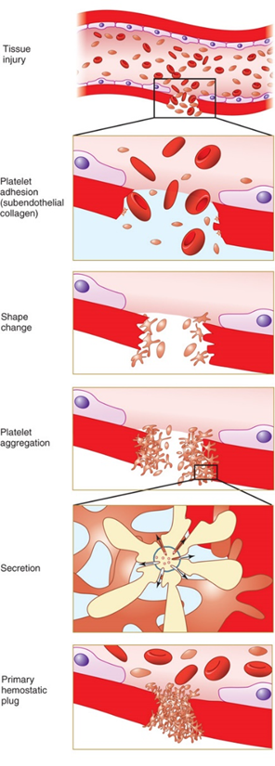
Figure 31-8 Diagram of Platelets Forming the Primary Hemostatic Plug
Notes:
Tissue injury causes platelets to adhere to subendothelial structures including collagen. Shape change, secretion of granule contents, and aggregation follow. Additional platelets become activated by the secreted substances and clump together, eventually forming a mechanical barrier that halts the flow of blood from the wound.

Slide 50
Platelets-Functions (3 of 11)
Adhesion
Initial response to vessel wall injury
Attachment of platelets to subendothelial collagen via platelet membrane receptors
G P I a/I I a and G P V I mediate binding at low shear rates
High shear rates require V W F and G P I b/I X
V W F
Multimeric protein stored in Weibel-Palade bodies of E Cs and α-granules
Has binding sites for G P I b/I X and collagen
Passive process

Slide 51
Platelets-Functions (4 of 11)
Activation
Includes:
Shape change and membrane phospholipid reorganization
Biochemical changes
Results in:
Generation of active G P I I b/I I I a receptors for fibrinogen-needed for aggregation
Secretion of granule content
Synthesis by platelets of T X A2 from A A

Slide 52
Platelets-Functions (5 of 11)
Agonists
Bind to platelet surface via receptor
Induce platelet activation
Platelet derived agonists
A D P
Serotonin
P A F (platelet activating factor)
T X A₂-produced by activation of platele cyclooxygenase/arachidonate pathway

Slide 53
Platelets-Functions (6 of 11)
Agonists
Nonplatelet derived agonists
Collagen
Thrombin
Epinephrine

Slide 54
Platelets-Functions (7 of 11)
Strong agonists-collagen, thrombin
Can activate full range of platelet functions
Do not require
Cyclooxygenase activity
Release of A D P from dense granules
Weak agonists
Initiate platelet activation
Require platelet release of A D P and/or synthesis and release of endogenous T X A₂

Slide 55
Table 31-8 Platelet Agonists and Their Platelet Receptors
Agonists | Agonist Receptors
Platelet-derived agonists | Platelet-derived agonists
A D P Serotonin Platelet-activating factor (P A F) Thromboxane A₂ (T X A₂) | P2Y₁, P2Y₁₂ 5H T_{2A} P A F receptor (P A F R) Thromboxane receptor (T P)
Other (non-platelet-derived) agonists | Other (non-platelet-derived) agonists
Collagen* Thrombin* Epinephrine | G P I a/I I a, G P V I Protease-activated receptor (P A R)1, P A R4 α₂-adrenergic receptors
*Strong agonists (full activation of platelet does not require A D P release or cyclooxygenase activity).

Slide 56
Platelets-Functions (8 of 11)
Shape change
Change in morphology
Flattened disc-shaped cells to spiny spheres with long projections from the surface
Pseudopods, filapodia
Reorganization of cytoskeletal proteins in structural zone
Platelet organelles concentrated in center
Granules move closer to O C S
Facilitates secretion
Reorganized actin cytoskeleton provides a basis for “contraction” between platelets

Slide 57
Platelets-Functions (9 of 11)
Platelet secretion
Follows shape change and requires A T P
α G and D B contents released into O C S and surrounding area
A D P, T X A₂, along with other products from damaged tissue and E Cs
Recruit and activate additional platelets
Results in aggregation-platelet plug formation

Slide 58
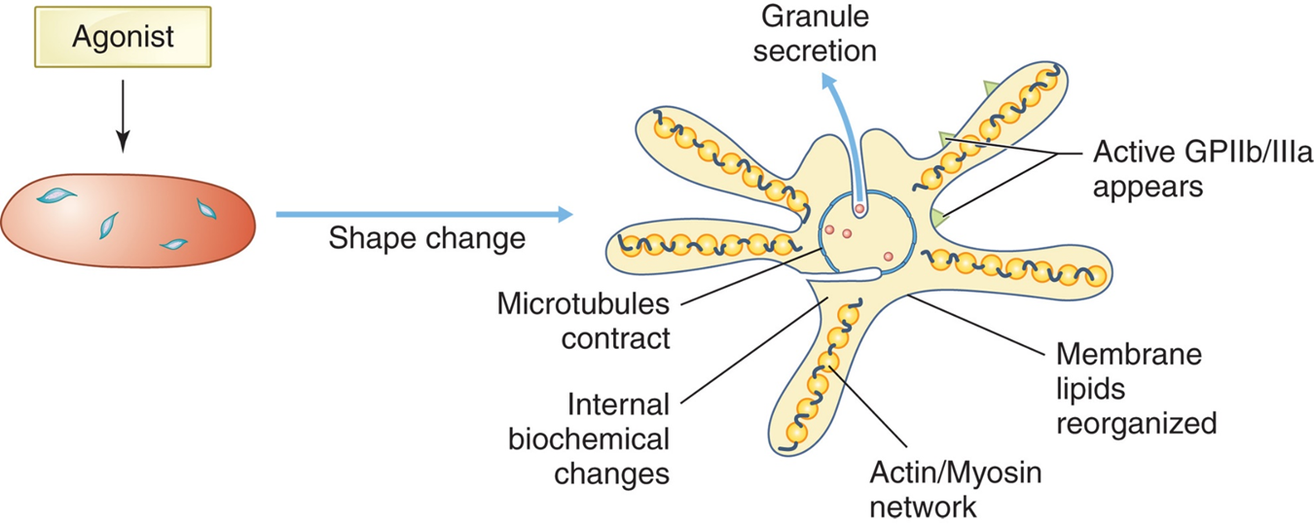
Figure 31-9 Platelet Shape Change After Stimulation by an Agonist
Notes:
Pseudopods develop on the platelet surface and contain a network of actin and myosin; the microtubule circumferential ring contracts; the membrane phospholipids are activated; activated glycoprotein IIb/IIIa receptors appear; internal biochemical changes occur; and granule secretion follows.

Slide 59
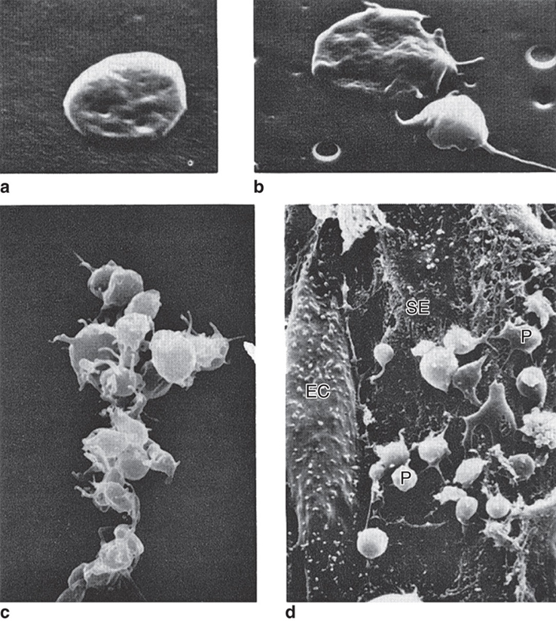
Figure 31-7 Stages of Platelet Activation
Notes:
(a) “Resting,” disc-shaped platelet. (b) Partially activated platelet (upper left) and fully activated platelet (spiny sphere-lower right). (c) Aggregate of activated platelets. (d) Platelets (P) adherent to exposed subendothelium (SE). EC, intact endothelial cells.

Slide 60
Platelets-Functions (10 of 11)
Aggregation
Platelets sticking to one another
Triggered by number of agonists
A D P, T X A₂, thrombin
Switch from “adhesion” (G P I b/I X) to “aggregation” (G P I I b/I I I a)
Requires C a⁺⁺

Slide 61
Platelets-Functions (11 of 11)
Aggregation
Requires association of fibrinogen with active G P I I b/I I I a receptor
G P I I b/I I I a exists in “inactive” state
Adhesion/activation convert G P I I b/I I I a to “active” conformation
Capable of binding fibrinogen
Fibrinogen serves as bridge
Connects two adjacent platelets via interaction with active G P I I b/I I I a complexes on each
Fibrinogen and C a⁺⁺ required for aggregation

Slide 62
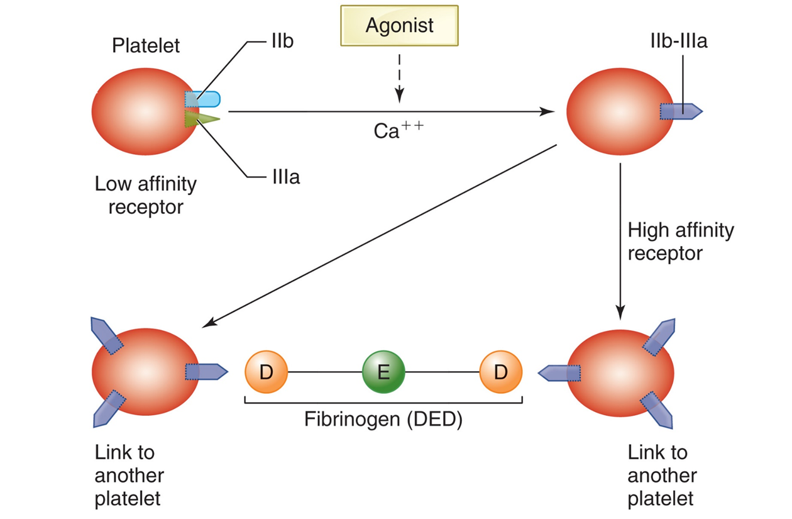
Figure 31-10 Platelet Aggregation
Notes:
Agonist stimulation in the presence of Ca⁺⁺ causes high-affinity fibrinogen receptors, activated glycoprotein IIb/IIIa, to form on the platelet surface. Fibrinogen binds horizontally to two platelets by peptide sequences at the terminal end of its γ- and α-chains in the D domains, one γ-chain to GPIIb/IIIa receptors on each platelet. Fibrinogen thus becomes a bridge between the two platelets.

Slide 63
Biochemistry of Platelet Activation

Slide 64
G Proteins
Guanine nucleotide-binding proteins
Inner side of platelet phospholipid membrane
Inactive when G D P is bound
Active after G T P is bound
Function to facilitate the response to extracellular stimuli
Activated G-proteins activate platelet enzymes
“Second messengers”

Slide 65
Phospholipase C/Phosphoinositide Pathway
Activated G-proteins activate phospholipase C(P L C)
P L C
Hydrolyzes phospholipids between the glycerol backbone and the phosphate moiety
Leads to activation of phosphoinositide pathway
Promotes
Release of C a⁺⁺
Granule secretion
Activation of signaling enzymes and proteins involved in cytoskeletal reorganization

Slide 66
Figure 31-11 Phospholipase C/Phosphoinositide Pathway

Slide 67
Role of C a⁺⁺
Platelet activation
Transient increase in cytosolic free C a⁺⁺
C a⁺⁺ ions serve as:
Intracellular second messengers
Affect enzyme activity and protein-protein interactions
C a++ ion concentration increases due to:
Release from the D T S (triggered by I P3)
Influx across the plasma membrane
Effect of increased C a⁺⁺
Enzymes not optimally active at resting cell C a⁺⁺ levels become active
P L A₂, P L C, P I kinase, M L C K

Slide 68
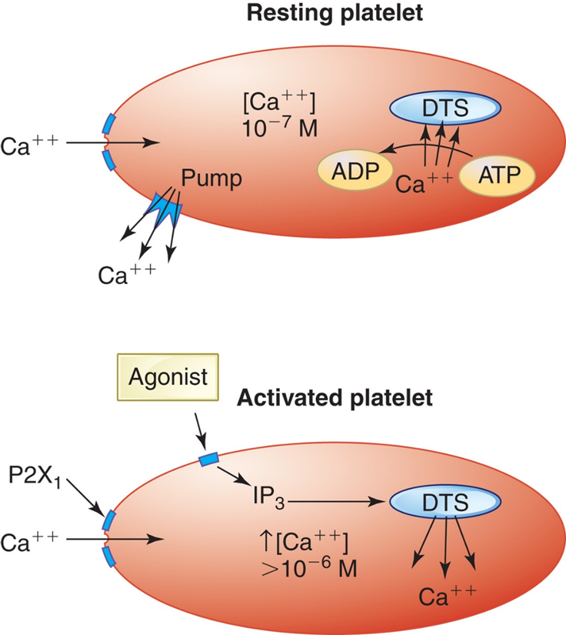
Figure 31-12 C a⁺⁺ Regulation in Platelets
Notes:
Resting platelets maintain low levels of cytoplasmic Ca⁺⁺ via active uptake by the DTS and active extrusion from the cell, probably via a Ca⁺⁺ pump. These mechanisms counter a passive diffusion of Ca⁺⁺ into the platelet along a concentration gradient. With activation, platelets increase intracellular cytoplasmic Ca⁺⁺ due to release from the DTS (by IP₃) and increase Ca⁺⁺ influx (probably mediated via ATP and the P2X₁ receptor). DTS, dense tubular system.

Slide 69
Arachidonate Pathway
Arachidonic acid (A A)
Liberated from membrane phospholipids by hydrolytic action of phospholipase (P L A₂)
Activation of P L A ₂ is regulated by increase in cytosolic C a⁺⁺
Cyclo-oxygenase and thromboxane synthetase convert A A to T X A ₂
T X A ₂ is an agonist and also enhances vasoconstriction
Aspirin irreversibly blocks cyclooxygenase and prevents synthesis of T X A ₂
Cyclo-oxygenase and prostacyclin synthetase converts A A to prostacyclin (P G I₂) in the E Cs
P G I2 inhibits platelet activation by increasing c A M P

Slide 70
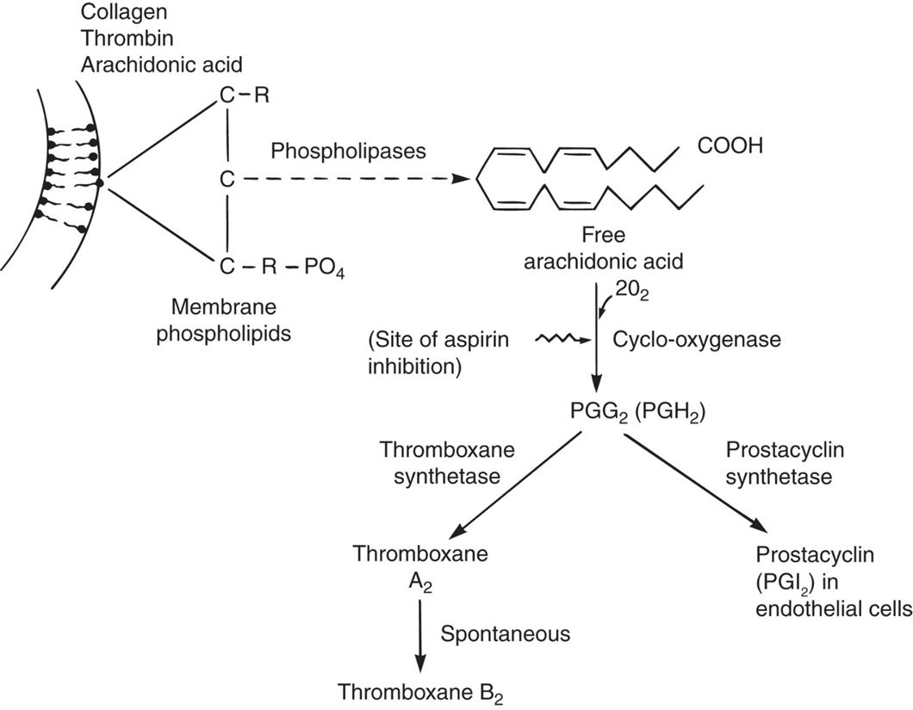
Figure 31-13 Biochemical Pathways of T X A₂ Formation in the Platelet
Notes:
Stimulation of platelet membranes (both intracellular granule and cytoplasmic membranes) by agonists (e.g., collagen, thrombin, arachidonic acid) liberates arachidonic acid from membrane phospholipids. Cyclo-oxygenase incorporates two molecules of oxygen, forming prostaglandin PGG₂ (PGH₂ in the reduced form). Thromboxane synthetase converts PGG₂ to TXA₂, and TXA₂ is spontaneously converted to inactive thromboxane B₂. Alternatively, PGG₂ can be converted to PGI₂, a powerful platelet inhibitor, in endothelial cells. TXA₂, thromboxane A₂; PGI₂, prostacyclin.

Slide 71
c A M P
Important negative regulator of platelet activation
Inhibits
Shape change
Platelet secretion
Integrin activation
conversion of G P I I b/I I I a to active form

Slide 72
Figure 31-14 Role of c A M P in Platelets
Notes:
. cAMP is a negative regulator of platelet function, inhibiting various steps of platelet activation. Adenyl cyclase converts ATP or ADP to cAMP. Subsequently, phosphodiesterase degrades cAMP to inactive AMP. PGI₂, a platelet-activation antagonist, activates adenyl cyclase, whereas ADP, a potent platelet agonist, inhibits adenyl cyclase. Dipyridamole, a platelet inhibitory drug, functions by inhibiting phosphodiesterase, thereby stabilizing cAMP and preventing platelet activation. cAMP, cyclic AMP; →, stimulation; Т , inhibition.

Slide 73
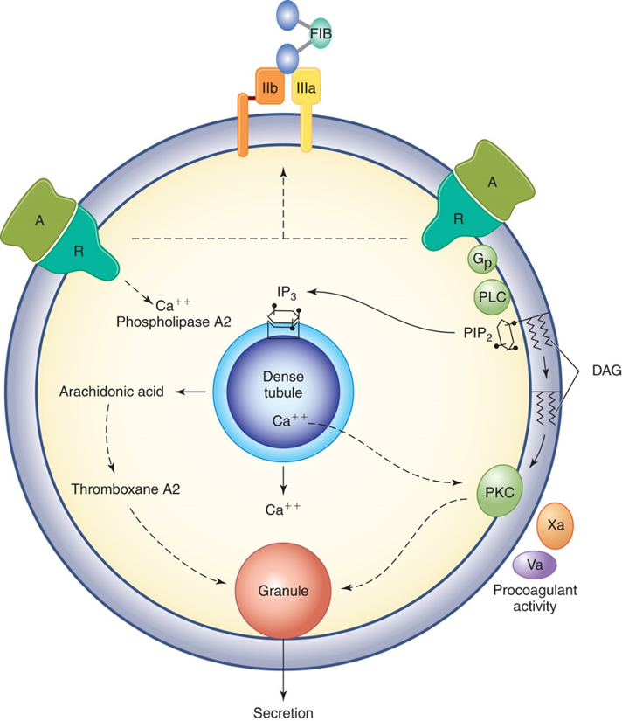
Figure 31-15 Schematic Diagram Showing Platelet Biochemical Changes After Activation
Notes:
An agonist (A) binds to a receptor (R) on the platelet. The GPIIb/IIIa complex appears soon after platelet activation with an agonist. G-proteins (Gp) on the inner part of the phospholipid membrane (linked with R) become activated and in turn activate PLC, which cleaves PIP₂ to form IP₃ and DAG. Subsequently, Ca⁺⁺ is mobilized into the cytoplasm from the DTS. Many enzymes are activated by the increase in Ca⁺⁺ including phospholipase A2. Arachidonic acid released from the membrane phospholipids is converted to thromboxane, which stimulates platelet secretion. DAG activates PKC, which contributes to granule secretion. Coagulation factors (e.g., FXa, FVa) bind to the platelet surface leading to fibrin formation. GP IIb, IIIa, GPIIa/IIIa receptor; FIB, fibrinogen; DAG, diacylglycerol; Gp, guanine nucleotide binding protein (G protein); IP₃, inositol-3-phosphate; PLC, phospholipase C; PKC, protein kinase C; PIP₂, phosphatidylinositol bisphosphate.

Slide 74
Platelets and Secondary Hemostasis (1 of 2)
Primary platelet plug
Unstable and easily dislodged
Secondary hemostasis
Fibrin forming proteins (coagulation factors) assemble on phospholipid membrane surface of aggregated activated platelets
Stabilizes platelet plug
Localizes clotting process

Slide 75
Platelets and Secondary Hemostasis (2 of 2)
Procoagulant proteins cannot bind to resting platelets
Negatively charged P Ls hidden in inner half of membrane bilayer in resting platelets
Move to outer half of bilayer with platelet activation
P L rearrangement
Provides surface for coagulation factors to bind and become activated
Results in fibrin formation
Platelet-fibrin mass contracts (clot retraction)
Requires adequate number of platelets

Slide 76
Physiologic Controls of Platelet Activation and Aggregation
Endothelial cells
Minimize platelet contact with agonists
Produce N O and P G I₂
Inhibit platelet activation
Have A D Pase which cleaves A T P and A D P
Flowing blood-dilutional affect
Short half-life of agonists
Tight controls on cytosolic [C a⁺⁺]
Inability of “resting” G P I I b/I I I a to bind fibrinogen

Slide 77
Table 31-9 Physiologic Controls of Platelet Activation and Aggregation
Physical Controls | Chemical and Protein Controls | Platelet Structural Controls
Endothelial cell barrier limits contact with agonists Flowing blood dilutes agonists | Endothelial cell production of: N O P G I₂ →↑c A M P A D Pase Antithrombin Short agonist T½ | Regulation of intracellular [C a⁺⁺] Inability of “resting” G P I I b/I I I a to bind fibrinogen Limited duration of agonist receptor activity

