Slide 1
Clinical Laboratory Hematology
Secondary Hemostasis & Fibrinolysis

Slide 2
Hemostatic Balance (1 of 2)
Involves interaction of four components/systems
Platelets
Vascular endothelial cells
Coagulation proteins
Fibrinolytic proteins
Requires balance between:
Activators of clotting and fibrinolysis
Inhibitors of clotting and fibrinolysis
Systems out of balance
Excessive clotting
Excessive bleeding

Slide 3
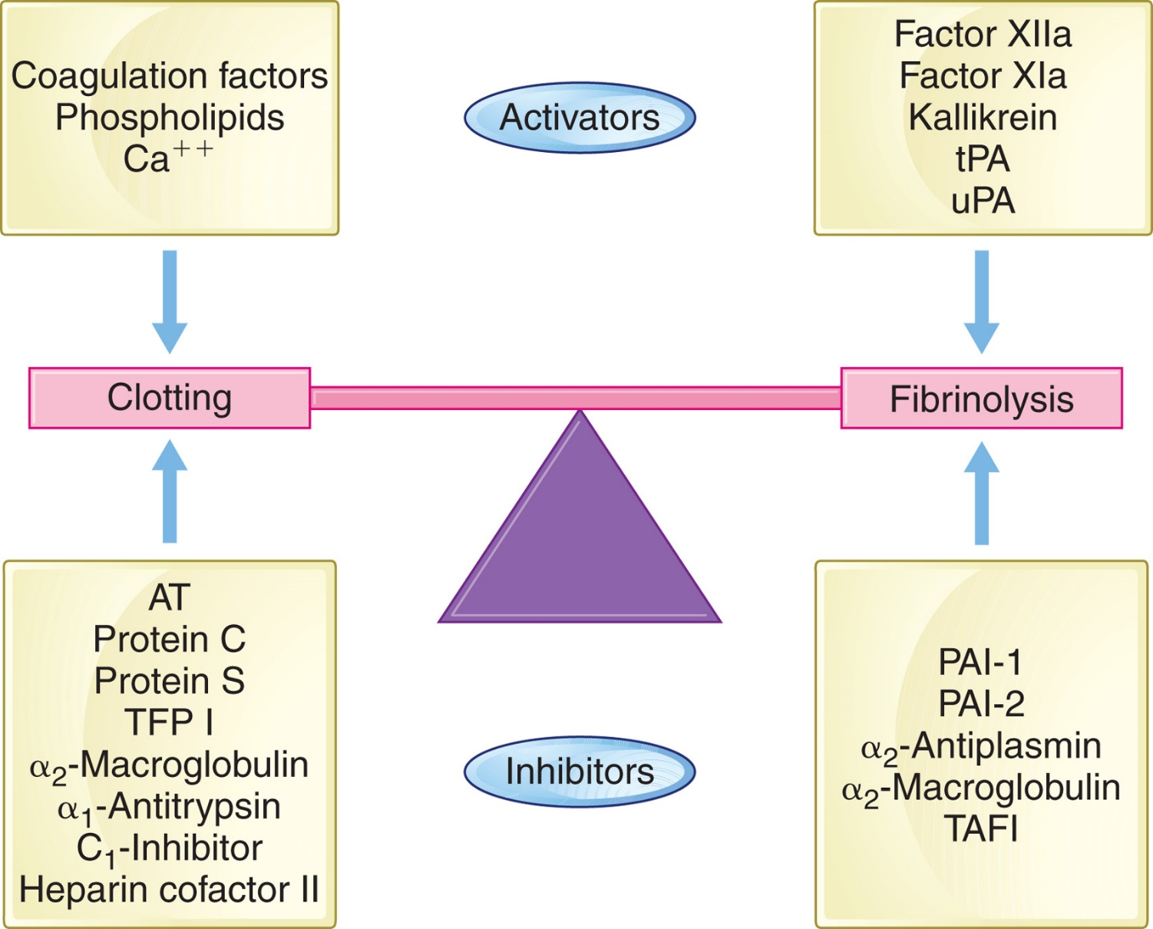
Figure 32-1 The Coagulation System
Notes:
Activators and inhibitors of clotting and fibrinolysis keep the coagulation system in balance. Clotting occurs when blood vessels are damaged and activators of coagulation factors are exposed or released. Clotting is controlled because fibrinolysis is initiated in response to clotting activation. Inhibitors of both clotting and fibrinolysis serve to bring the system back into balance. An imbalance in the activation or inhibition of either clotting or fibrinolysis causes thrombosis or bleeding.

Slide 4
Hemostatic Balance (2 of 2)
Two stages of clot formation
Primary hemostasis
Formation of unstable platelet plug
Secondary hemostasis
Requires a series of enzyme-mediated reactions which lead to
Conversion of soluble fibrinogen to insoluble fibrin
Reinforcement of platelet plug

Slide 5
Coagulation System

Slide 6
Coagulation Pathways (1 of 2)
Traditional cascade theory of clotting
Interaction of three pathways
Intrinsic pathway
Factors and cofactors all present in plasma
Extrinsic pathway
Factors and cofactors present in plasma
Tissue factor-not present under normal conditions
Common pathway
Convergence of two pathways
Factors and cofactors all present in plasma

Slide 7
Coagulation Pathways (2 of 2)
Separation of clotting cascade into pathways
Does not represent in vivo coagulation
Useful for understanding and interpreting in vitro clotting assays
P T-evaluates extrinsic and common pathways
A P T T-evaluates intrinsic and common pathways

Slide 8
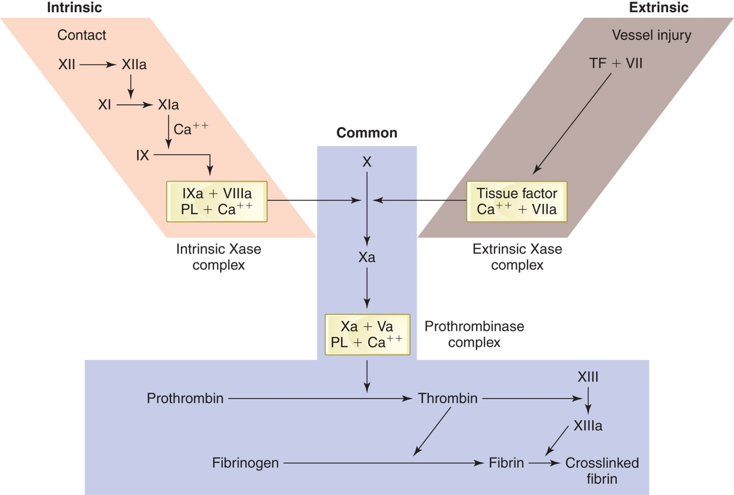
Figure 32-2
Notes:
A simplified version of the coagulation cascade showing the cascade or waterfall-like sequence of reactions. The tan boxes indicate complex formation. PL, platelet phospholipid; TF, tissue factor.

Slide 9
Coagulation Proteins (1 of 2)
Most circulate as “zymogens”
Inactive precursor proteins
Represented by Roman numerals- I-XIII
Assigned in order of discovery, not place in reaction sequence
Each has one or more common names or synonyms
Roman numeral followed by letter “a” indicates activated form of factor

Slide 10
Coagulation Proteins (2 of 2)
Exceptions to general rules of terminology:
Roman numerals seldom used
Prothrombin (Factor I I) → Thrombin (Factor I I a)
Fibrinogen (Factor I) → Fibrin (Factor I a)
Tissue Factor (Factor I I I) and Calcium (Factor I V) (no “activated” forms)
Factor V I-does not exist (actually Factor V a)
H K and P K-never assigned Roman numerals

Slide 11
Table 32-1 Coagulation Factors in Intrinsic, Extrinsic, and Common Pathways
Intrinsic Pathway | Extrinsic Pathway | Common Pathway
Prekallikrien (P K) | Seven | Ten
High-molecular-weight kininogen (H K) | Three, Tissue factor (T F) | Five
Twelve | Blank | Two
Eleven | Blank | One
Nine | Blank | Blank
Eight | Blank | Blank

Slide 12
Table 32-2 Summary of the Properties of Coagulation Factors (1 of 3)
Factor | Common Name(s) | Circulating Form (Molecular weight in kilodaltons [k D a]) | T_{½} (hours) | Role | Chromosome (gene symbol)
One | Fibrinogen | 6-chain glycoprotein (340 kiloDaltons) | 72-120 | Substrate; fibrin precursor | 4 q23-q32 (F G A, F G B, F G G)
Two | Prothrombin | Single-chain glycoprotein (72 kiloDaltons) | 60-70 | Serine protease; thrombin precursor | 11p11.2 (F2)
Three | Tissue factor | Single-chain, transmembrane glycoprotein (47 kiloDaltons) | N A | Cofactor in extrinsic Xase; complex not found in circulation | 1p21-22 (F3)
Four | Calcium | Element | N A | Cofactor in some coagulation reactions | -
Five | Proaccelerin | Single-chain glycoprotein (330 kiloDaltons) | 12-36 | Cofactor in prothrombinase complex | 1q23 (F5)
Seven | Proconvertin, stable factor | Single-chain glycoprotein (50 kiloDaltons) | 3-6 | Serine protease; constituent of extrinsic Xase complex | 13q34 (F7)

Slide 13
Table 32-2 Summary of the Properties of Coagulation Factors (2 of 3)
Factor | Common Name(s) | Circulating Form (Molecular weight in kilodaltons [k D a]) | T_{½} (hours) | Role | Chromosome (gene symbol)
Eight | Antihemophilic factor | Heterodimer glycoprotein (170-280 kiloDaltons) | 8-12 | Complex with V W F in the circulation; cofactor in intrinsic Xase complex | X q28 (F8)
V W F | von Willebrand factor | Multimeric glycoprotein; subunit (500-20,000 kiloDaltons) | 8-12 | Platelet adhesion; stabilization of circulating F V I I I | 12p13.3 (V W F)
Nine | Plasma thromboplastin component | Single-chain glycoprotein (55 kiloDaltons) | 18-24 | Serine protease; constituent of intrinsic Xase complex | X q27.1 (F9)
Ten | Stuart factor | Two-chain glycoprotein (59 kiloDaltons) | 34-40 | Serine protease; constituent of prothrombinase complex | 13q34 (F10)
Eleven | Plasma thromboplastin antecedent | Two-chain glycoprotein (143 kiloDaltons) | 60-80 | Serine protease; contact factor | 4q35 (F11)

Slide 14
Table 32-2 Summary of the Properties of Coagulation Factors (3 of 3)
Factor | Common Name(s) | Circulating Form (Molecular weight in kilodaltons [k D a]) | T_{½} (hours) | Role | Chromosome (gene symbol)
Twelve | Hageman factor | Single-chain glycoprotein (80 kiloDaltons) | 60 | Serine protease; contact factor | 5q35.3 (F12)
Thirteen | Fibrin-stabilizing factor | Heterotetramer glycoprotein (320 kiloDaltons) | 240 | Transglutaminase; fibrin stabilizer | A-chain: 6p25.1 (F13A1); B-chain: 1q31.3 (F13B)
H K | Fitzgerald factor, Williams factor, Flaujeac factor | Single-chain glycoprotein (120 kiloDaltons) | 150 | Cofactor; complexed with P K and F X I; contact factor | 3 (K N G 1)
P K | Fletcher factor | Single-chain glycoprotein (88 kiloDaltons) | 35 | Serine protease complexed with H K; contact factor | 4q35.2 (K LK B 1)
T_{½}, biologic half-life; H K, high-molecular-weight kininogen; P K, prekallikrein.

Slide 15
Properties of the Blood Coagulation Factors (1 of 3)
Prothrombin group
Vitamin K-dependent
All synthesized by liver
All contain γ-carboxyglutamic acid
Critical for C a⁺⁺ binding properties
Need C a⁺⁺ to bind to phospholipid surface
All but factor
found in serum (not consumed in
clotting)

Slide 16
Properties of the Blood Coagulation Factors (2 of 3)
Fibrinogen group
Not found in serum (consumed in clotting)
All cleaved by thrombin

Slide 17
Properties of the Blood Coagulation Factors (3 of 3)
Contact group
Involved in earliest phases of clotting
Deficiencies with exception of
are asymptomatic
Do not appear to be essential to in vivo hemostasis
Partially consumed during coagulation
Found in serum in reduced amounts
Also play role in:
Fibrinolysis, kinin formation, activation of complement, inflammation

Slide 18
Table 32-3 Coagulation Factor Groups Based on Physical Characteristics
Blank | Contact Group | Prothrombin Group | Fibrinogen Group
Characteristics | Requires contact with a negatively charged surface for activation | Requires vitamin K for synthesis; needs C a⁺⁺ to bind to a phospholipid surface | Large molecules; absent from serum (consumed in clotting)
Factors/Proteins included | Twelve, Eleven, P K, H K | Two, Seven, Nine, Ten, P C, PS, PZ | One, Five, Eight, Thirteen
P C, protein C; P S, protein S; P Z, protein Z.

Slide 19
Mechanism of Action
Cofactors for activated proteases
Enzymes (zymogens-proenzymes)
Serine proteases
X I I a, X I a, X a, I X a , V I I a, I I a
Transglutaminase
X I I I a
Substrate
Fibrinogen

Slide 20
Vitamin K-Dependent Factors (1 of 2)
Vitamin K
A fat soluble vitamin
Reduced vitamin K (hydroquinone)
Functions as a cofactor for carboxylase
Responsible for γ-carboxylation of glutamic acid
residues in the G L A domains of factors
and proteins C, S, and Z
Essential for C a⁺⁺ binding which enables factors to bind to negatively charged phospholipid surface
Carboxylation reaction converts reduced vitamin K to the epoxide form

Slide 21
Vitamin K-Dependent Factors (2 of 2)
Vitamin K
Vitamin K epoxide reductase
Converts vitamin K epoxide back to reduced form

Slide 22
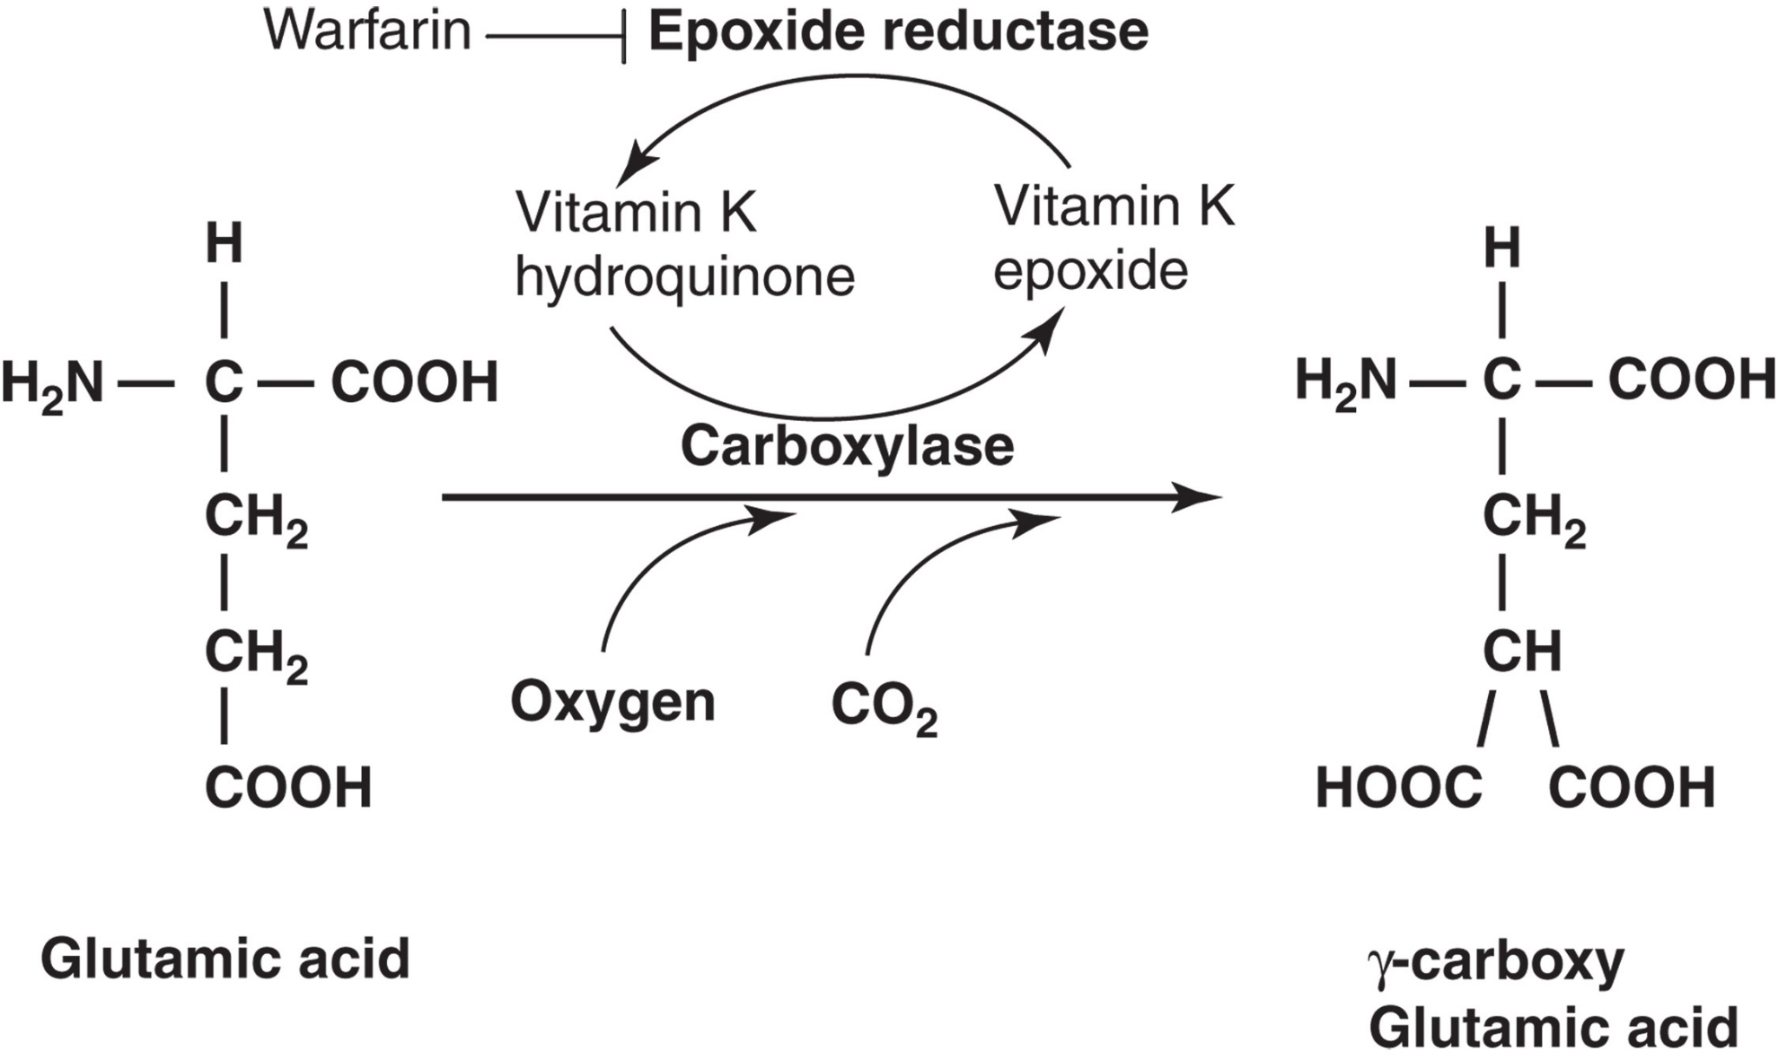
Figure 32-3
Notes:
The vitamin K–dependent γ-carboxylation of glutamic acid. The coagulation factors in the prothrombin group must undergo this post-ribosomal carboxylation of glutamic acid residues in order to become functional. A specific carboxylase converts glutamic acid residues to γ-carboxyglutamic acid residues in a reaction requiring oxygen, carbon dioxide, and reduced vitamin K (hydroquinone). In the process, reduced vitamin K is converted to an epoxide and must be recycled to its reduced form by the enzyme epoxide reductase. This latter reaction is blocked by vitamin K antagonist drugs such as warfarin or Coumadin.

Slide 23
Vitamin K Antagonists
Warfarin/Coumadin
Inhibit activity of the vitamin K reductase
Prevent recycling back to the reduced forms
In absence of vitamin K, or presence of Coumadin
Proteins are synthesized
γ-carboxylation does not occur
Proteins produced are called P I V K A (proteins induced by vitamin K absence or antagonists)
“acarboxy” proteins

Slide 24
Structure of Blood Coagulation Proteins
Domains
Catalytic domain
Cleaves peptide bond
Converts inactive zymogen to active enzyme
Noncatalytic domains
Regulatory segments
Bind C a⁺⁺ and promote interaction with P L, cofactors, receptors and substrates

Slide 25
Coagulation Cascade

Slide 26
Introduction-Coagulation Cascade
Composed of four interacting sets of reactions
Complex formation on phospholipid surface
Intrinsic pathway
Extrinsic pathway
Common pathway

Slide 27
Complex Formation on Phospholipid Surfaces (1 of 2)
Occurs on cell surface membranes
Localizing clotting to the site of injury
Clotting factors
Bind to the phospholipid membrane surface of activated platelets at injury site
Localizes reaction
Form a complex including
Enzyme, substrate, cofactor

Slide 28
Complex Formation on Phospholipid Surfaces (2 of 2)
Subendothelial tissue
Exposed when blood vessel injury occurs
Provides surface for platelet adhesion, activation, and aggregation
Three procoagulant complexes
Assembled on P l t phospholipid membranes
Extrinsic Xase
Intrinsic Xase
Prothrombinase

Slide 29
Table 32-4 Coagulation Protease-Cofactor Complexes
Protease | Cofactor | Substrate | Cellular Location
Factor V I I a Factor I X a | Tissue Factor Factor V I I I a | Factor Nine Factor Ten | Many Cells Platelets
Factor X a | Factor V a | Prothrombin | Platelets
Thrombin | Thrombomodulin | Protein C | Endothelium
Activated Protein C | Protein S | Factors V a, V I I I a | Endothelium

Slide 30
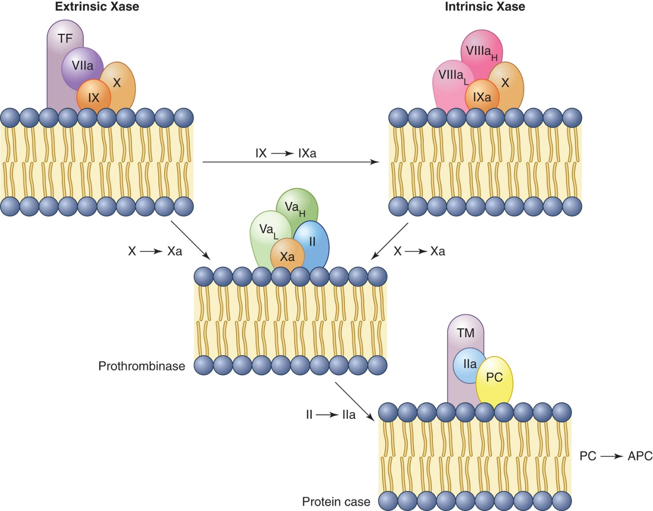
Figure 32-4
Notes:
Schematic illustration of the coagulation complexes forming on a phospholipid surface. The vitamin K–dependent proteases (FVIIa, FIXa, FXa, and thrombin) are shown associated with their cofactors (tissue factor [TF], FVIIIa, FVa, and thrombomodulin [TM], respectively) and substrates (FIX, FX, prothrombin, and protein C [PC], respectively) on the membrane surface. APC, activated protein C.

Slide 31
Intrinsic System Pathway (1 of 3)
Contact factors
Activated when exposed to negatively charged surfaces
Glass, kaolin, celite, ellagic acid
Does not require C a⁺⁺
Other factors
Evaluated by A P T T

Slide 32
Intrinsic System Pathway (2 of 3)
Patients with deficiencies of
Markedly prolonged A P T T
No bleeding phenotype
T F:V I I a activates
deficiency
Variable bleeding phenotype
Importance of F X I uncertain

Slide 33
Intrinsic System Pathway (3 of 3)
Surface-mediated activation
Probably not essential in vivo
Patients with congenital deficiencies have no apparent clinical bleeding disorder
deficiency may be associated with bleeding
abnormality, but not always

Slide 34
Factor Twelve -Hageman Factor (1 of 2)
Synthesized by the liver
Autoactivation by proteolytic cleavage upon contact with negatively charged surfaces
In vivo-collagen, basement membrane
In vitro-glass, kaolin, and so on

Slide 35
Factor Twelve -Hageman Factor (2 of 2)
X I I a
converts X I to X I a
cleaves P K to kallikrein
Kallikrein with cofactor H K activates more X I I to X I I a
Activated by plasmin
Activates complement systems
Further cleaved to smaller fragments (X I I f) by kallikrein

Slide 36
Prekallikrein
Synthesized by the liver
Circulates
Bound to H K (~75%)
Free (~25%)
Activated by X I I a to kallikrein
Kallikrein can activate
X I I to X I I a
Plasminogen to plasmin
Kinin, fibrinolytic, and complement systems
Cleaves bradykinin (B K) from H K

Slide 37
H M W Kininogen (H K)
Synthesized by the liver
Binds to E Cs, platelets, and granulocytes
Circulates in plasma as “carrier” for
Cleaved by kallikrein
Gives rise to B K
Increases vessel permeability, dilates small vessels
Increases blood flow
Contracts smooth muscle
Causes pain
Stimulates E C P G I₂, N O, and t P A synthesis and secretion

Slide 38
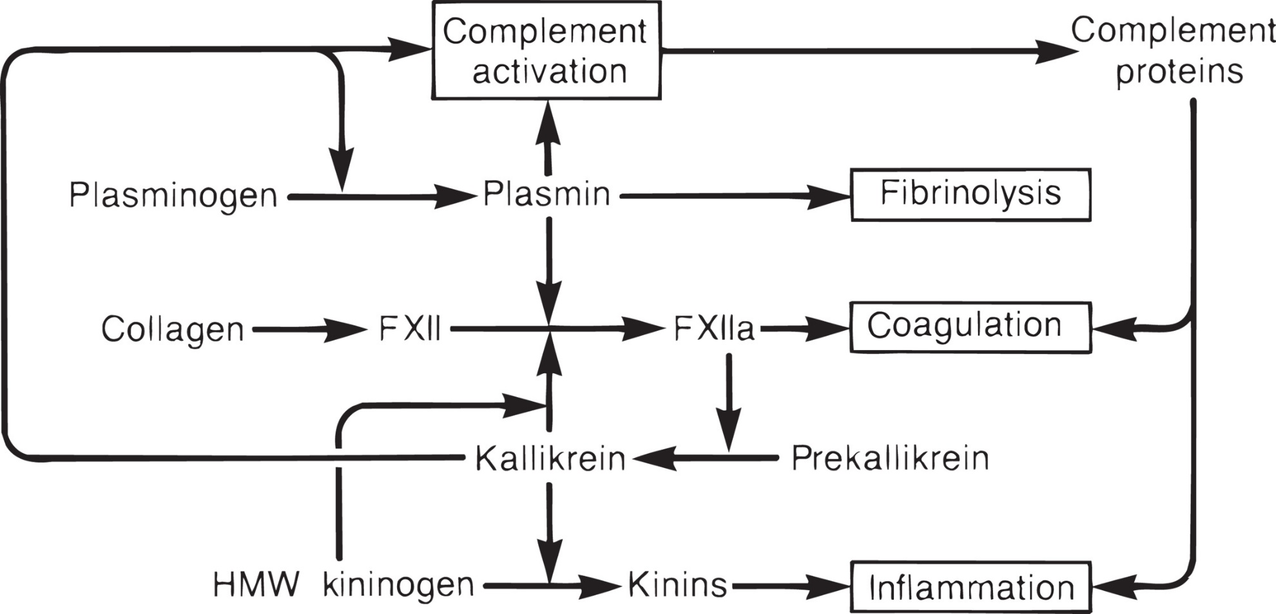
Figure 32-5 Role of Contact Factors in Physiologic Systems

Slide 39
Factor Eleven
Synthesized by the liver
Circulates complexed with H K
Activated by X I a, X I I a, thrombin (I I a)
Likely that major site of generation of X I a is surface of activated platelets
Only contact factor associated with abnormal bleeding (50%)

Slide 40
Factor Nine
Synthesized by the liver
Also called Christmas factor
Gene located on X chromosome
Vitamin K-dependent factor
Activated by X i a
I X a
Two chain molecule
Forms complex (intrinsic Xase) with V I I I a and C a⁺⁺ on surface of activated platelets
Intrinsic Xase activates X to X a

Slide 41
Factor Eight (1 of 2)
Antihemophilic factor
Deficiency results in hemophilia A
Synthesized primarily in the liver by E c s
With a small amount of extrahepatic synthesis from endothelial cells of many tissues
Gene located on X chromosome
Consists of A, B, and C domains

Slide 42
Factor Eight (2 of 2)
Circulates in plasma as complex with V W F
Stabilizes
Protects
from inhibition or degradation
Regulates
activity
Labile factor
→ V I I I a by thrombin (also X a)
Functions as cofactor in the intrinsic Xase complex

Slide 43
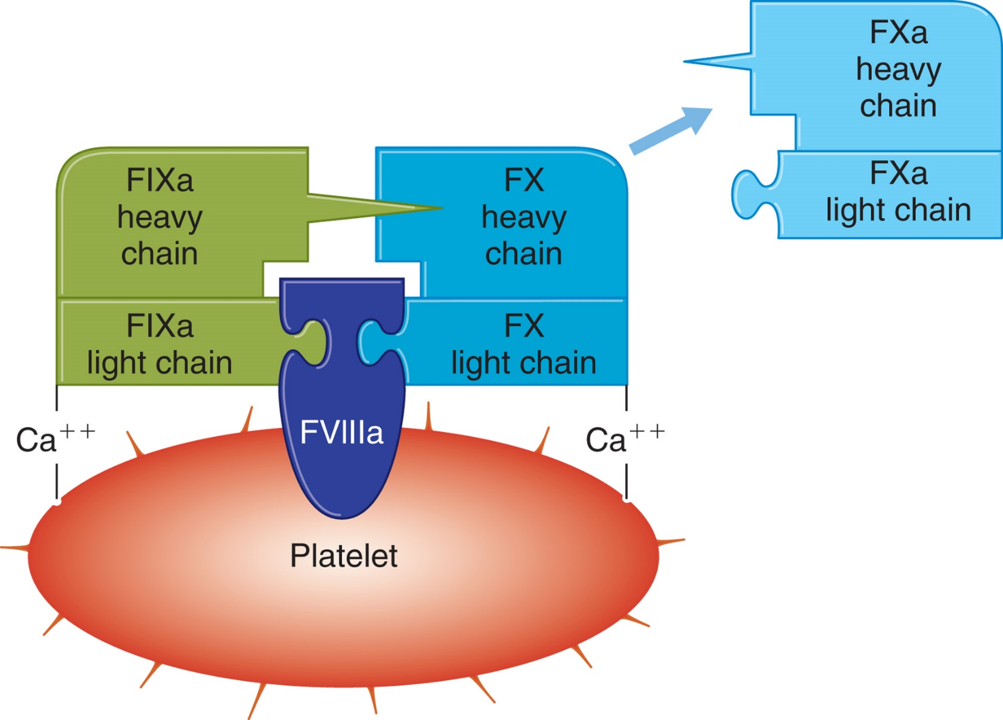
Figure 32-6
Notes:
The complex formed by the sequential activation of the intrinsic pathway (FIXa, FVIIIa, Ca⁺⁺) activates FX. The cofactor, FVIIIa, binds to the platelet phospholipids and orients FIXa and FX to enhance activation of FX. FIXa and FX are bound to the platelet surface via Ca⁺⁺ bridges. Spikes on platelet indicate activated platelet.

Slide 44
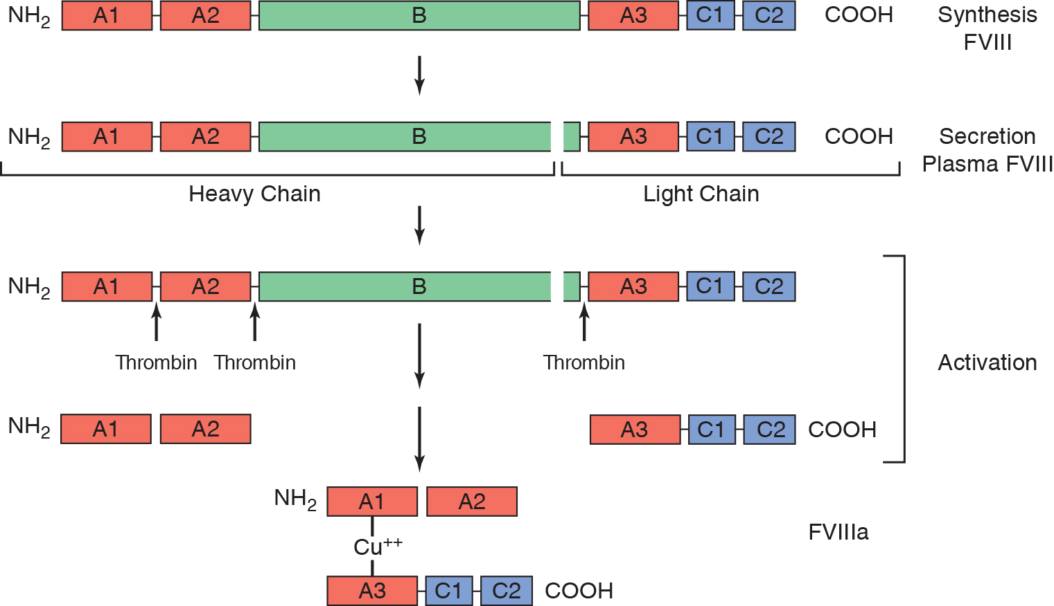
Figure 32-7
Notes:
Synthesis, processing, and activation of FVIII. FVIII is synthesized as a large precursor protein. When secreted from the endothelial cell into the circulation, FVIII is cleaved within the B domain, resulting in a heavy chain (A1:A2 and the majority of the B domain) and a light chain (A3:C1:C2 domains). FVIII is activated to FVIIIa when thrombin cleaves the heavy and light chains of FVIII and releases the B domain from both. The active FVIIIa consists of the A1 and A3:C1:C2 domains which are associated in a copper-dependent manner, and A2 which is associated by weak electrostatic interactions.

Slide 45
von Willebrand Factor (1 of 2)
Large multimeric glycoprotein
Ultralarge multimers in platelets and E Cs (U L V W F)
Smaller multimers in plasma
Binds to
in a 1:1 molar ratio
Synthesized by E Cs and M Ks
Stored in secretory granules (Weibel-Palade bodies, α-granules)
Release induced by:
Thrombin, A D P, epinephrine, histamine, D D A V P

Slide 46
von Willebrand Factor (2 of 2)
U L V W F
Tethered to E C surface
Cleaved by A D A M T S-13
V W F cleaving protease
Can cause spontaneous aggregation if released directly into plasma
V W F promotes platelet adhesion to subendothelium via G P I b/I X receptor
V W F also promotes aggregation via G P I I b/I I I a receptor

Slide 47
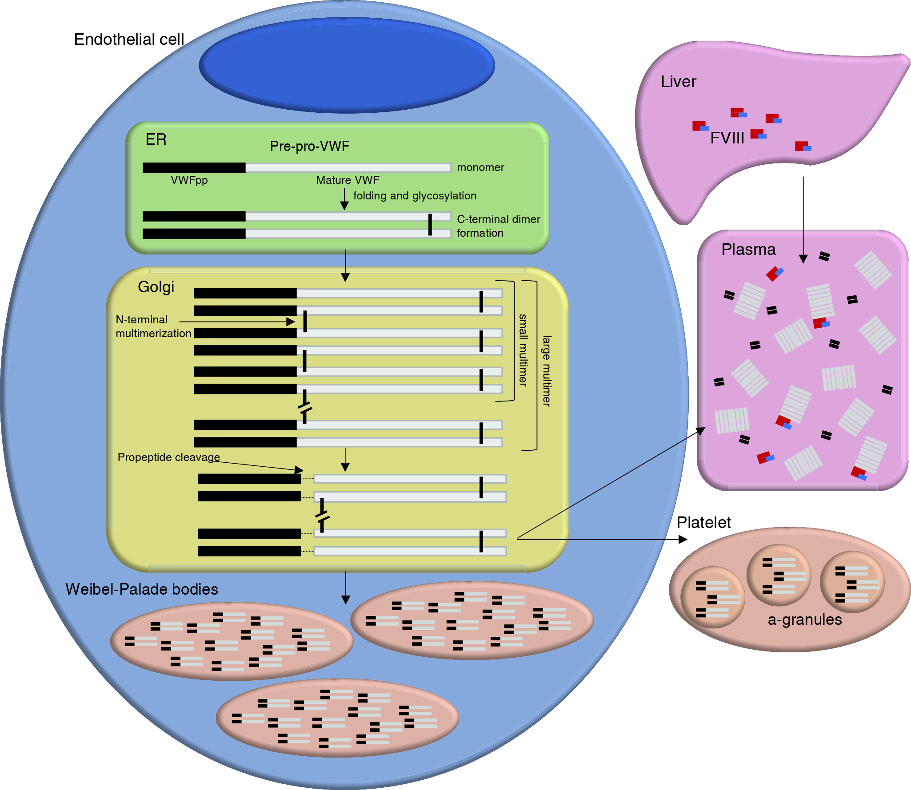
Figure 32-8 Synthesis and Secretion of F V I I I/von Willebrand Complex
Notes:
VWF mRNA is transcribed in the nucleus of megakaryocytes and endothelial cells (chromosome 12). The pre-pro-VWF is translated in the ER (green) and undergoes glycosylation and dimer formation. In the Golgi (yellow), additional glycosylation and sulfation occurs, VWF is multimerized, and the propeptide is cleaved. VWF is spontaneously secreted or stored in Weibel-Palade bodies of endothelial cells or platelet α-granules before release into plasma (orange), where VWFpp and VWF dissociate and circulate independently. Synthesis of FVIII occurs in the liver (blue). Both VWF and FVIII are secreted into the plasma where they bind together.

Slide 48
Figure 32-9
Notes:
A diagrammatic depiction of the domain structure of a VWF monomer precursor protein. Domains D1 and D2 are the propeptide removed during processing; domain D’ plus part of domain D3 are the binding site for FVIII; domain A1 contains binding sites for GPIb, heparin, and collagen; domain A3 contains the major binding site for collagen; domain C1 contains the binding site for GPIIb/IIIa; disulfide bridges at D3 and the C terminal end are the sites of attachment when forming multimers and dimers, respectively.

Slide 49
Extrinsic Pathway
Vessel injury
Nonvascular cells (fibroblasts, smooth muscle cells) with T F on their surface are exposed to blood
T F binds
and V I I a in the presence of C a⁺⁺
Forms V I I a/T F complex
Initiates extrinsic pathway
Converts
to X a (extrinsic Xase complex)
Also activates
of the intrinsic pathway

Slide 50
Tissue Factor
Also known as thromboplastin or F I I I
Cellular receptor and cofactor for
and V I I a
Transmembrane glycoprotein
Normally not expressed on cells in direct contact with flowing blood
Present in monocytes and E Cs
Can be induced to produce T F by endotoxin, I L-1, T N F, complement, thrombin

Slide 51
Factor Seven
Synthesized by the liver
Vitamin K-dependent factor
Circulates in two forms
Inactive form-majority
Active form (V I I a)-~1%
No coagulant activity in absence of T F
Trace levels sufficient to initiate clotting cascade when T F is exposed following vessel injury

Slide 52
Common Pathway
Intrinsic and extrinsic pathways
Converge on the common pathway
Both pathways activate factor

Slide 53
Factor Ten
Synthesized by the liver
Vitamin K-dependent
Activation via two mechanisms
T F/V I I a/C a⁺⁺ (extrinsic Xase )
I X a/V I I I a/P L/C a⁺⁺ (intrinsic Xase)

Slide 54
Factor Five
Synthesized by the liver
Labile factor
20% in platelet α G s
Protein structure similar to
Same A1, A2, B, A3, C1, C2 domain configuration
Activated primarily by thrombin to V a
Serves as attachment site for X a
V a functions as cofactor in “prothrombinase” complex

Slide 55
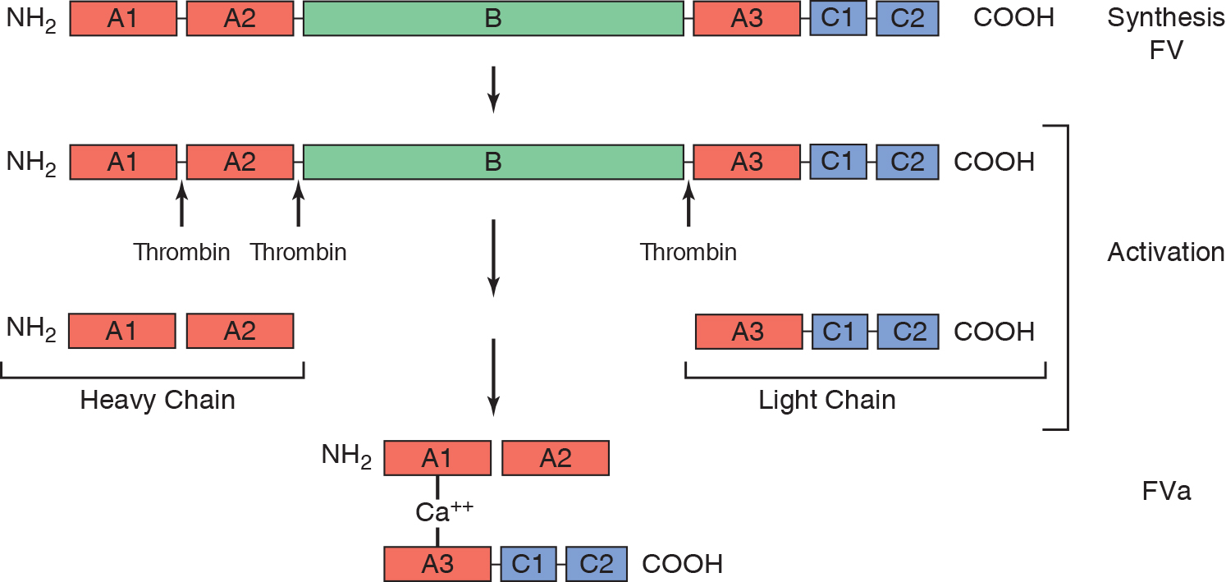
Figure 32-10 Synthesis, Processing, and Activation of F V
Notes:
The letters A, B, and C indicate the identity of the domains. Up arrows indicate sites for thrombin (primarily) cleavage. Cleavage releases the B domain and produces a two-chain heterodimer consisting of a heavy chain (A1 and A3) and a light chain (A3:C1:C2), which are noncovalently linked through Ca⁺⁺.

Slide 56
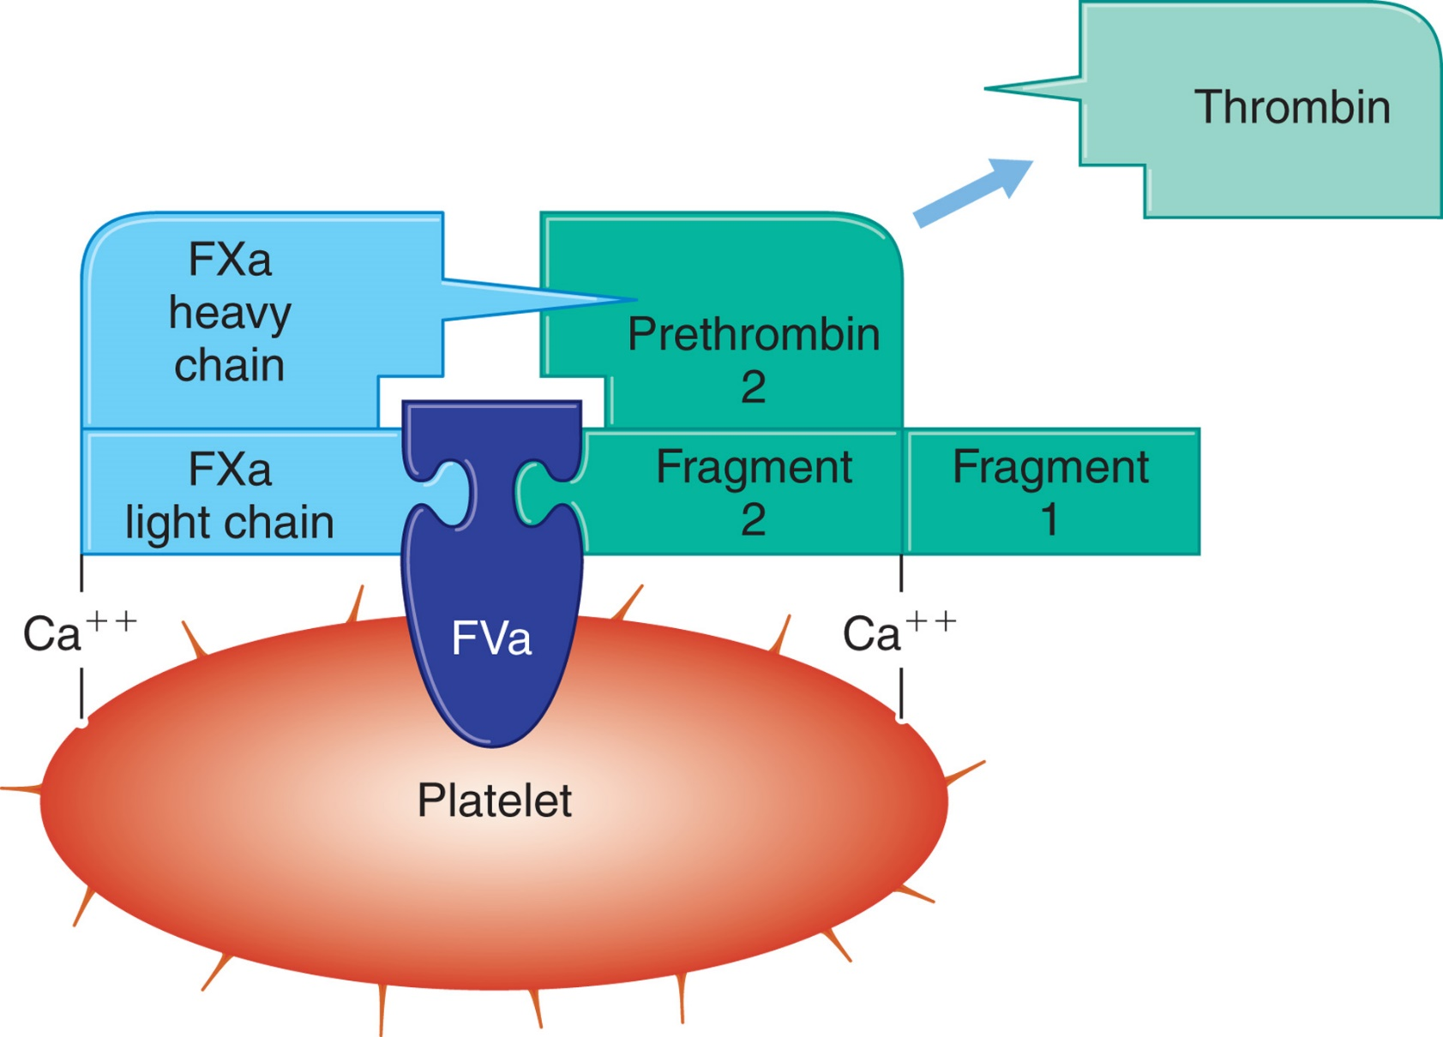
Figure 32-11 The Prothrombinase Complex (F X a, F V a, C a⁺⁺) Activates Prothrombin to Thrombin
Notes:
FVa binds to the platelet phospholipid surface and orients FXa and prothrombin to enhance the formation of thrombin. FXa and prothrombin are bound to the platelet surface via Ca⁺⁺ bridges. This complex is very similar to the complex formed by the intrinsic pathway (FIXa, FVIIIa, Ca⁺⁺$,$ PL). Spikes on platelet indicate activated platelet.

Slide 57
Prothrombin-Factor Two
Synthesized by the liver
Vitamin K-dependent
Cleaved by prothrombinase complex to thrombin (I I a)
V a binds to platelet surface and orients X a
X a and prothrombin
are bound to platelet surface
via C a⁺⁺ bridges
Requires two cleavages by X a

Slide 58
Roles of Thrombin (1 of 2)
Procoagulant activities
Cleaves fibrinopeptides A and B from fibrinogen
Creates fibrin monomer
Activates factors
Stimulates E C to release V W F, plasminogen activator inhibitor and express T F
Activates platelets-stimulates platelet aggregation

Slide 59
Roles of Thrombin (2 of 2)
Anticoagulant activities
Suppresses fibrinolysis by activating T A F I
Binds to T M
Activates P C
Stimulates E Cs to release t P A, prostacyclin, N O
Also plays role in inflammation, wound healing, angiogenesis, atherothrombosis

Slide 60
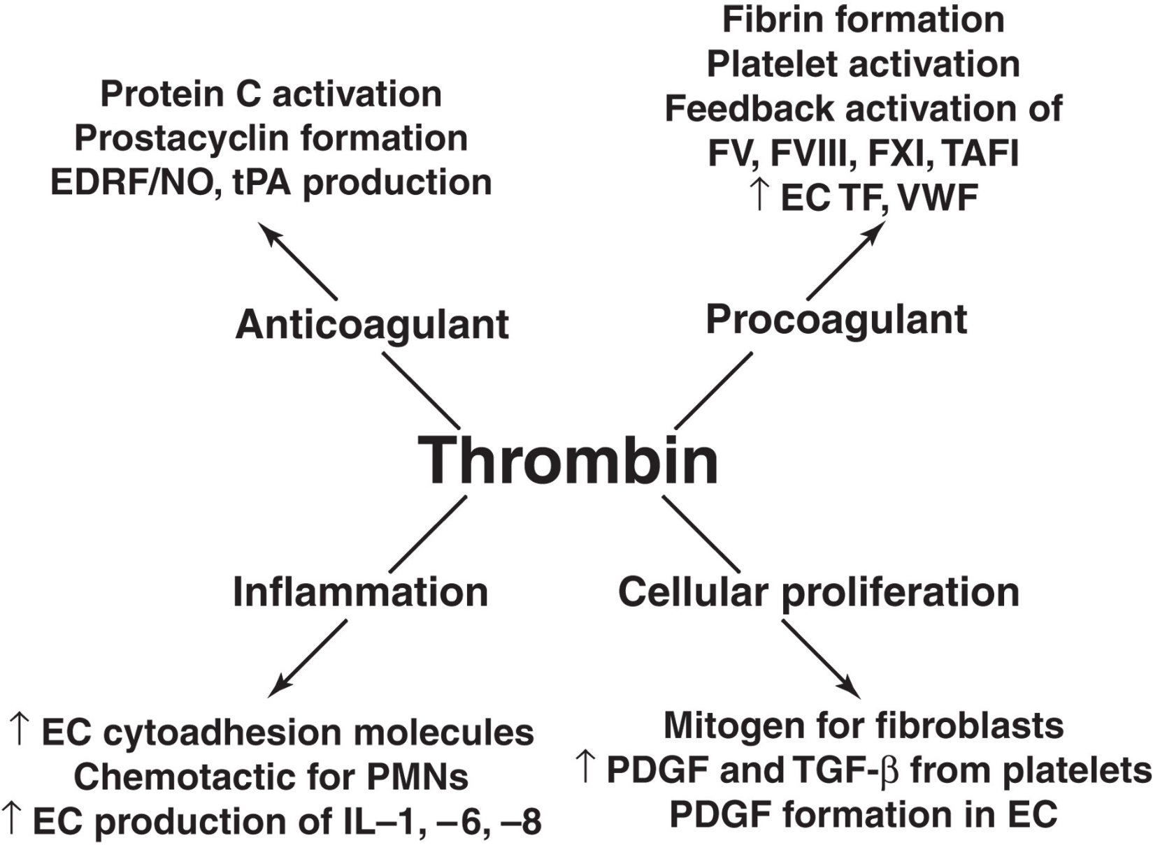
Figure 32-12 The Multifactorial Roles of Thrombin
Notes:
In addition to its multiple roles as a procoagulant protease, thrombin also has anticoagulant functions and important activities in promoting inflammation and cellular proliferation. EDRF, endothelium-derived relaxing factor; NO, nitric oxide; tPA, tissue plasminogen activator; TAFI, thrombin activatable fibrinolysis inhibitor; EC, endothelial cell; TF, tissue factor; VWF, von Willebrand factor; PMNs, polymorphonuclear neutrophils; PDGF, platelet-derived growth factor.

Slide 61
Fibrinogen (1 of 2)
Synthesized by the liver
Acute-phase reactant
Most abundant coagulation protein
Dimeric
Three pairs of different polypeptide chains
A α 2, B β 2, γ 2 (i.e., dimeric structure)
Small polypeptides
Fibrinopeptides A and B
Released from A α and B β chains by thrombin
Molecules devoid of F P A and F P B are called fibrin monomers (α ₂ β ₂ γ ₂)

Slide 62
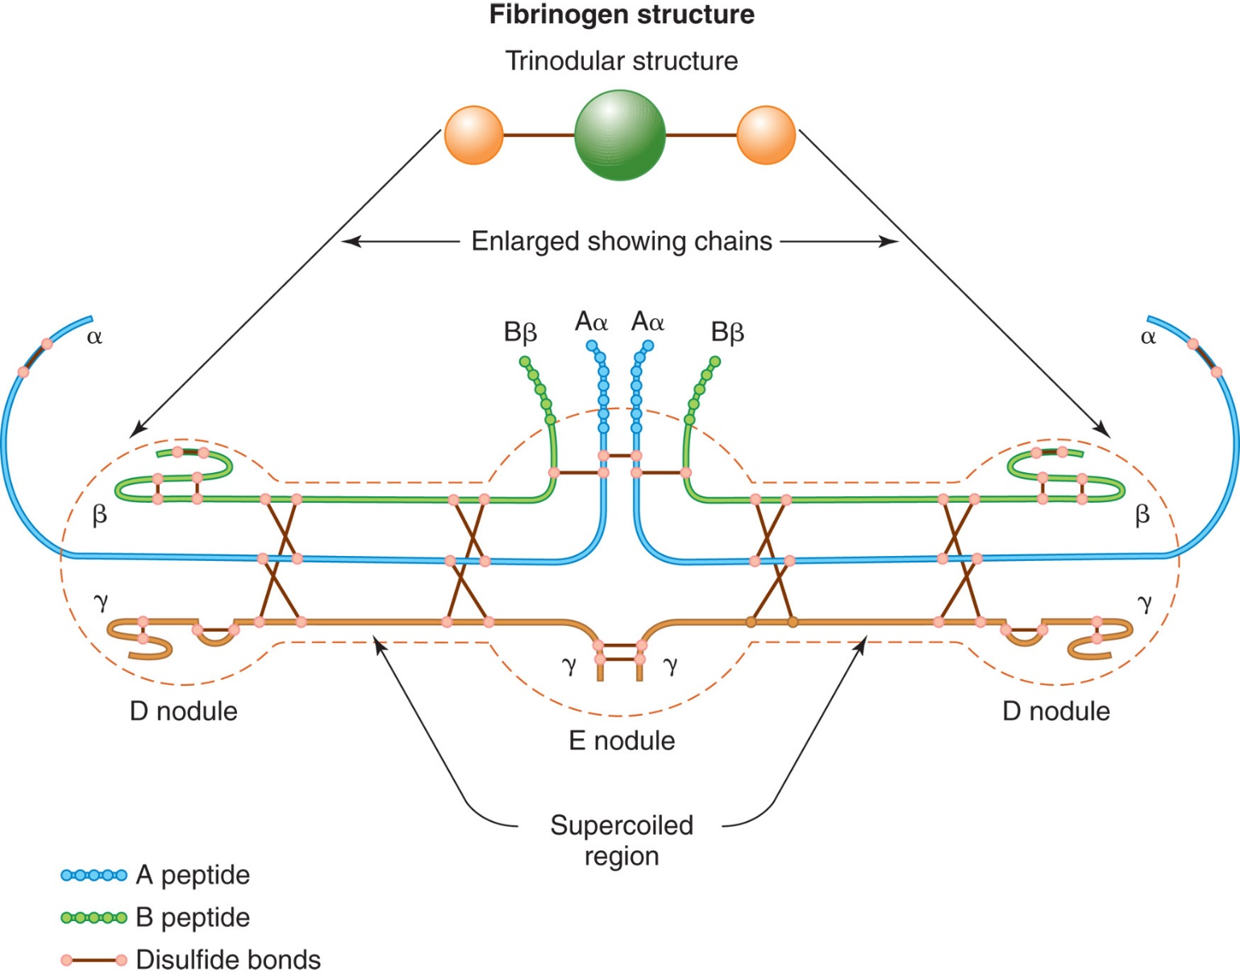
Figure 32-13 Formation of Fibrin Polymer
Notes:
Formation of fibrin polymer. Fibrinogen is a trinodular structure composed of three pairs (Aα, Bβ, γ) of disulfide-bonded polypeptide chains. The central nodule is the E nodule. Thrombin cleaves small peptides, A and B, from the α- and β-chains in this region to form fibrin. The central nodule is joined by supercoiled α-helices to the terminal nodules, the D nodules.

Slide 63
Fibrinogen (2 of 2)
Three stages-conversion of fibrinogen to fibrin
Proteolysis
Thrombin cleaves F P A (16 A A) and F P B (14 A A) from α- and β-chains
Results in fibrin monomers
Polymerization
Spontaneous self-assembly into fibrin polymers
Stabilization
Introduction of covalent bonds into fibrin polymers by X I I I a (active transamidase/transglutaminase)
Fibrin forms the structural meshwork that stabilizes the primary platelet plug, achieving secondary hemostasis

Slide 64
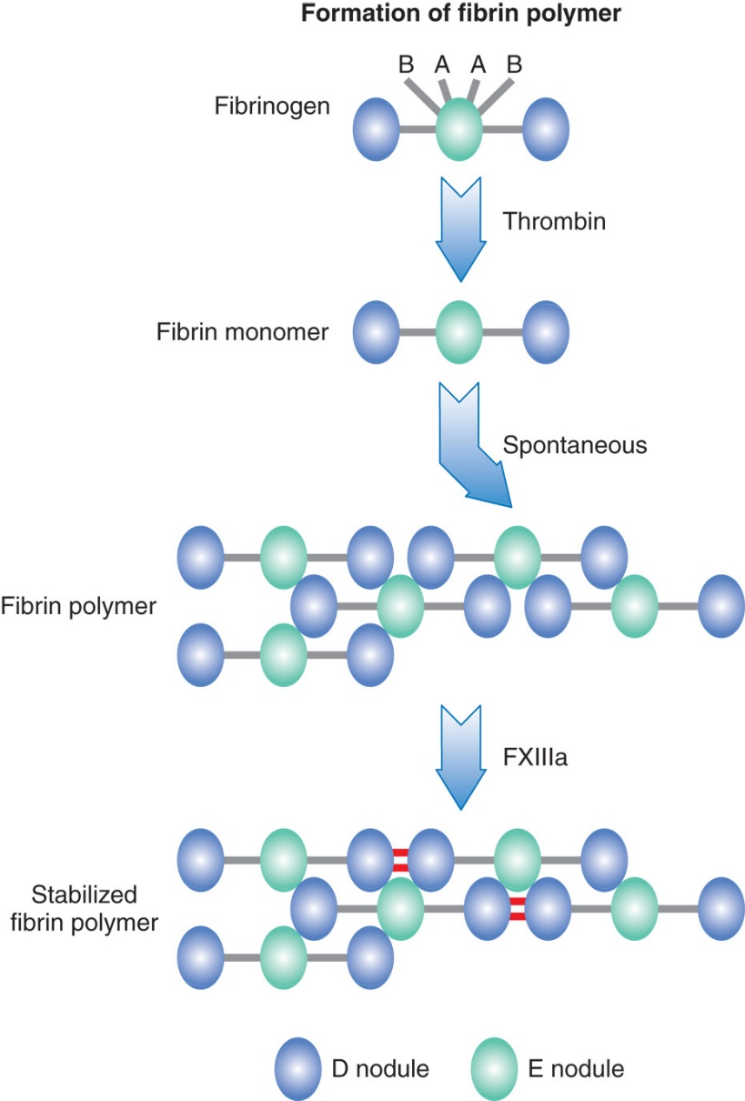
Figure 32-14 Formation of Fibrin Polymer
Notes:
Thrombin cleaves the A and B fibrinopeptides from the E nodule of fibrinogen to form fibrin monomer. The cleavage permits the spontaneous growth of fibrin polymers as the E nodule assembles with the D nodules of other fibrin monomers. Hydrogen bonds initially join the polymer. FXIIIa in the presence of Ca⁺⁺ is responsible for catalyzing the formation of covalent bonds between glutamine and lysine residues of adjacent monomers (D nodules), thus stabilizing the lattice formation.

Slide 65
Factor Thirteen
Fibrin stabilizing factor
Circulates as a heterotetramer (A ₂ B ₂)
Evenly distributed between plasma and platelets
Activated to X I I I a by thrombin
Fibrin needed as cofactor for activation to occur
Activation also requires C a⁺⁺ (C a⁺⁺ dependent transglutaminase)

Slide 66
Roles of X I I I a
Catalyzes formation of peptide bonds which cross-link D regions of fibrin monomers
Linked D regions known as D-dimers
Not soluble in 5M urea
Cross-links fibrinolytic inhibitors
α2-antiplasmin
P A I-2
T A F I
Promotes wound healing by cross-linking fibrin to extracellular matrix

Slide 67
Primary and Secondary Hemostasis (1 of 2)
Sequence after vessel injury
Vasoconstriction
Controlled by vessel smooth muscle; enhanced by chemicals secreted by platelets
Platelet adhesion
Adhesion to exposed subendothelial connective tissue
Platelet aggregation
Interaction and adhesion of platelets to one another to form initial plug at injury site

Slide 68
Primary and Secondary Hemostasis (2 of 2)
Sequence after vessel injury
Fibrin-platelet plug
Coagulation factors interact on platelet surface to produce fibrin; fibrin-platelet plug then forms at site of vessel injury
Fibrin stabilization
Fibrin clot must be stabilized by F X I I I a

Slide 69
Physiologic Hemostasis
Key to initiation of coagulation is T F
Exposure of cell surfaces expressing T F to plasma proteins
Leads to binding of V I I a to T F
Activates
combines with cofactor
to also activate
and cofactor
convert prothrombin to thrombin
Thrombin converts fibrinogen to fibrin
Thrombin activates
to crosslink and stabilize
fibrin monomers

Slide 70
Fibrinolytic System

Slide 71
Fibrinolysis
Process of digesting and removing fibrin
Activated in response to cascade activation and fibrin formation
Regulated and limited to area of fibrin formation
Represents balance between
Pro- and antihemostatic mediators
Pro- and antifibrinolytic mediators
Excessive fibrinolysis
Bleeding
Inadequate fibrinolysis
Excess clotting

Slide 72
Table 32-5 Summary of Properties of the Components of the Fibrinolytic System (1 of 3)
Component | Description (Molecular weight in kilodaltons [k D a]) | Role | T_{½} | Chromosome (gene symbol)
One. Fibrinolytic component | One. Fibrinolytic component | One. Fibrinolytic component | One. Fibrinolytic component | One. Fibrinolytic component
Plasminogen (P L G) | Single-chain glycoprotein (92 kiloDaltons) | Zymogen; precursor of plasmin | 2.0 days | 6q26-27 (P L G)
Plasmin (P L N) | Dimeric glycoprotein (92 kiloDaltons) | Serine protease; cleaves fibrin | 0.1 second | -
Two. Activators of plasminogen | Two. Activators of plasminogen | Two. Activators of plasminogen | Two. Activators of plasminogen | Two. Activators of plasminogen
Tissue plasminogen activator (t P A) | Glycoprotein (72 kiloDaltons) | Serine protease; complexed with inhibitor P A I-1; plasminogen activator | 5 minutes | 8p11.2 (P L A T)
Urokinase-type plasminogen activator (u P A) | (s c u P A) M W (54 kiloDaltons) | Serine protease; low enzymatic activity until cleaved to t c u P A by P L N; plasminogen activator | 8 minutes | 10q22.2 (P L A U)
Factor Twelve | Single-chain glycoprotein (80 kiloDaltons) | Serine protease | 2-3 days | 5q35.3 (F-12)
Prekallikrein | Single-chain glycoprotein (88 kiloDaltons) | Serine protease | 7-10 days | 4q35.2(K L K B 1)
Three. Inhibitors | Three. Inhibitors | Three. Inhibitors | Three. Inhibitors | Three. Inhibitors

Slide 73
Table 32-5 Summary of Properties of the Components of the Fibrinolytic System (2 of 3)
Component | Description (Molecular weight in kilodaltons [k D a]) | Role | T_{½} | Chromosome (gene symbol)
Plasminogen activator inhibitor-1 (P A I-1) | Single-chain glycoprotein (52 kiloDaltons) | Serine protease inhibitor (Serpin): t P A and u P A inhibitor | 8 minutes | 7q22.1 (SERPIN E1)
Plasminogen activator inhibitor-2 (P A I-2) | Glycoprotein-(two forms, (60 kiloDaltons [secreted], 47 kiloDaltons [intracellular]) | Serine protease inhibitor (Serpin): t P A, u P A inhibitor | - | 18q21-23 (SERPIN E2)
α₂₋ antiplasmin(A P) | Single-chain glycoprotein (70 kiloDaltons) | P L N, kallikrein, thrombin, t P A inhibitor | 24 hour | 17p13.3 (SERPIN F2)
Thrombin-activatable fibrinolysis inhibitor (T A F I) | Single-chain protein MW (60 kiloDaltons) | Carboxypeptidase B: plasminogen activation inhibitor by cleaving lysine A A from fibrin | 10 minutes | 13q14.11 (C P B2)
C-1 esterase inhibitor (C-I N H) | Single-chain glycoprotein (105 kiloDaltons) | C 1 r and C 1 s, F X I I a, F I X a, kallikrein, plasmin inhibitor | 70 hour | 11q12.1 (SERPIN G1)
α₂₋ Macro globulin | Glycoprotein: four identical chains (725 kiloDaltons) | Inhibitor of multiple proteases by “trapping” | 2-4 minutes | 12p13.31 (A2M)
Four. Cell surface receptors | Four. Cell surface receptors | Four. Cell surface receptors | Four. Cell surface receptors | Four. Cell surface receptors

Slide 74
Table 32-5 Summary of Properties of the Components of the Fibrinolytic System (3 of 3)
Component | Description (Molecular weight in kilodaltons [k D a]) | Role | T_{½} | Chromosome (gene symbol)
u P A receptor (u P A R) | Glycoprotein receptor (55 kiloDaltons) | u P A receptor on surface of EC, monocytes, and macrophages | - | 19q13.31 (P L A U R)
Annexin 2 | Heterotetramer (38 kiloDaltons) | t P A, P L G receptor on E C, monocytes, and macrophages, S M C | - | 15q22.2 (A N X A2)
Low-density-lipoprotein receptor-like protein (L R P) | (600 kiloDaltons) | Clearance receptor for u P A/P A I-1 and P A I-2, t P A/P A I-1, | - | 12q13.3 (L P R1)
Serpin, serine protease inhibitor; S M C, smooth muscle cells

Slide 75
Plasminogen (P L G) and Plasmin (P L N)
Circulates as a single polypeptide chain
Synthesized by the liver
Activated by plasminogen activators (P A s) to plasmin (P L N) by proteolytic cleavage
Substrates include
Fibrin, fibrinogen,
V W F, complement, several
hormones, and platelet surface receptors

Slide 76
Activators of Fibrinolysis
Two major P A s in circulation
t P A and u P A (Urokinase)
Serine proteases
Convert P L G to P N
Other activators are also produced from contact phase of coagulation

Slide 77
Contact Pathway Plasminogen Activators
P As generated during contact phase of intrinsic pathway
X I I a, X i a, and kallikrein
Account for ~15% of P L N generating activity
Kallikrein also converts H K to Bradykinin (B K) which stimulates release of t P A from E C

Slide 78
Tissue-Type Plasminogen Activator (t P A)
Released from E Cs in vivo as single chain molecule (s c t P A)
Does Not circulate as a zymogen
Fully active in single chain form
Binds to fibrin surface
Low protease activity in absence of fibrin
Intracellular stores released when stimulated
Thrombin, B K, histamine, exercise, D D A V P, and so on
Can also bind to E C surface via receptor-annexin
Activation of t P A and P L G by endothelial cell A2
Maintains fibrinolytic potential on undamaged vascular surfaces

Slide 79
Urinary-Type T P A (u P A)
Found in urine and plasma
Functions mainly in tissue
Digests extracellular matrix
Enables cell migration
Important in wound healing, inflammation, cancer metastasis
Converted to two-chain active form by P L N, X I I a, or kallikrein
Does not need fibrin as cofactor
u P A receptor (u P A R)
Important role in localizing u P A-catalyzed P L G activation
Plays a role in cell migration and tumor metastasis

Slide 80
Exogenous Activators
Activation of plasminogen by pathogens promotes dissemination of the pathogens within the host
Streptokinase
Derived from β-hemolytic strep
Staphylokinase (S A K)
Produced by Staph aureus

Slide 81
Fibrin/Fibrinogen Degradation (1 of 2)
Plasmin
Responsible for degradation of fibrin (or fibrinogen)
Fibrinogenolysis
Distinct protein fragments produced
Fibrin degradation products (F D Ps)
Sites of plasmin cleavage
Similar in fibrin and fibrinogen

Slide 82
Fibrin/Fibrinogen Degradation (2 of 2)
Products formed from fibrinogen cleavage
Fragment X (trinodular structure)
Fragment Y (binodular D + E)
Fragments D and E (uninodular)
Products formed from fibrin cleavage
Essentially the same, except:
X I I I a-crosslinked fibrin releases
“D-D” dimer (held together by covalent bonds)
Larger molecules of varying composition
D D/E; Y D/D Y; Y Y/D X D

Slide 83
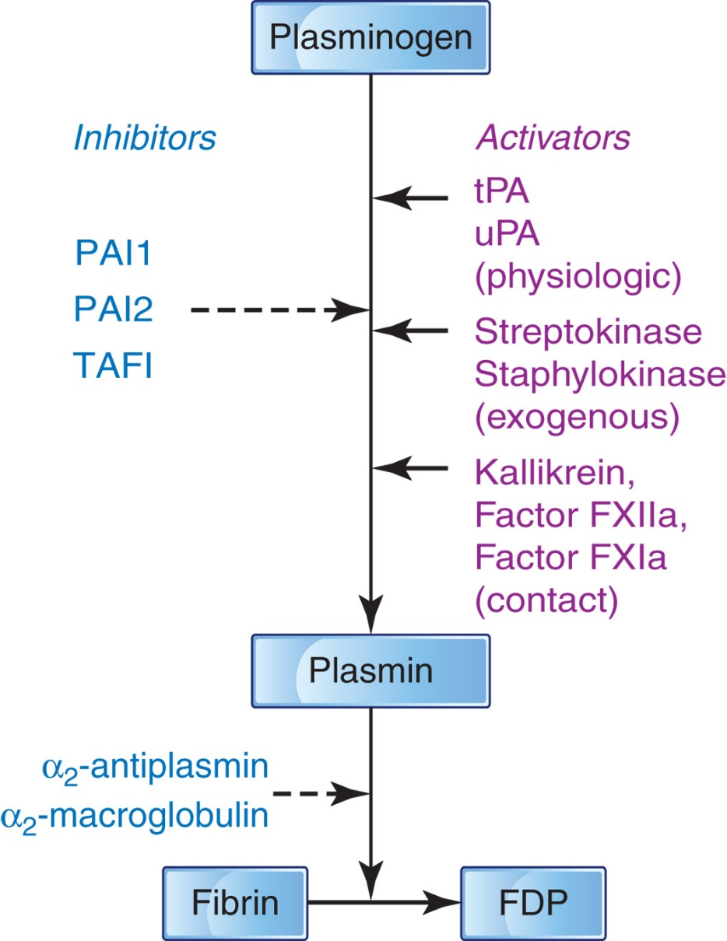
Figure 32-15 The Fibrinolytic System
Notes:
This system can be activated by the physiologic activators, tissue plasminogen activator (tPA) derived from endothelial cells, and urinary-type plasminogen activator (uPA) or the contact activators, kallikrein, FXIIa, and FXIa. Exogenous activators, streptokinase and staphylokinase, can also activate the system. Plasmin, the product of activation, breaks down the fibrin clot by digesting fibrin to fibrin degradation products (FDPs). The inhibitors of plasminogen activation, plasminogen activator inhibitor-1 (PAI-1), plasminogen activator inhibitor-2 (PAI-2), and thrombin-activatable fibrinolysis inhibitor (TAFI), and the inhibitors of plasmin (α₂-antiplasmin and α₂ -macroglobulin) control the fibrinolytic system. The fibrinolytic system, like the clotting system, is intricately regulated by these activators and inhibitors.

Slide 84
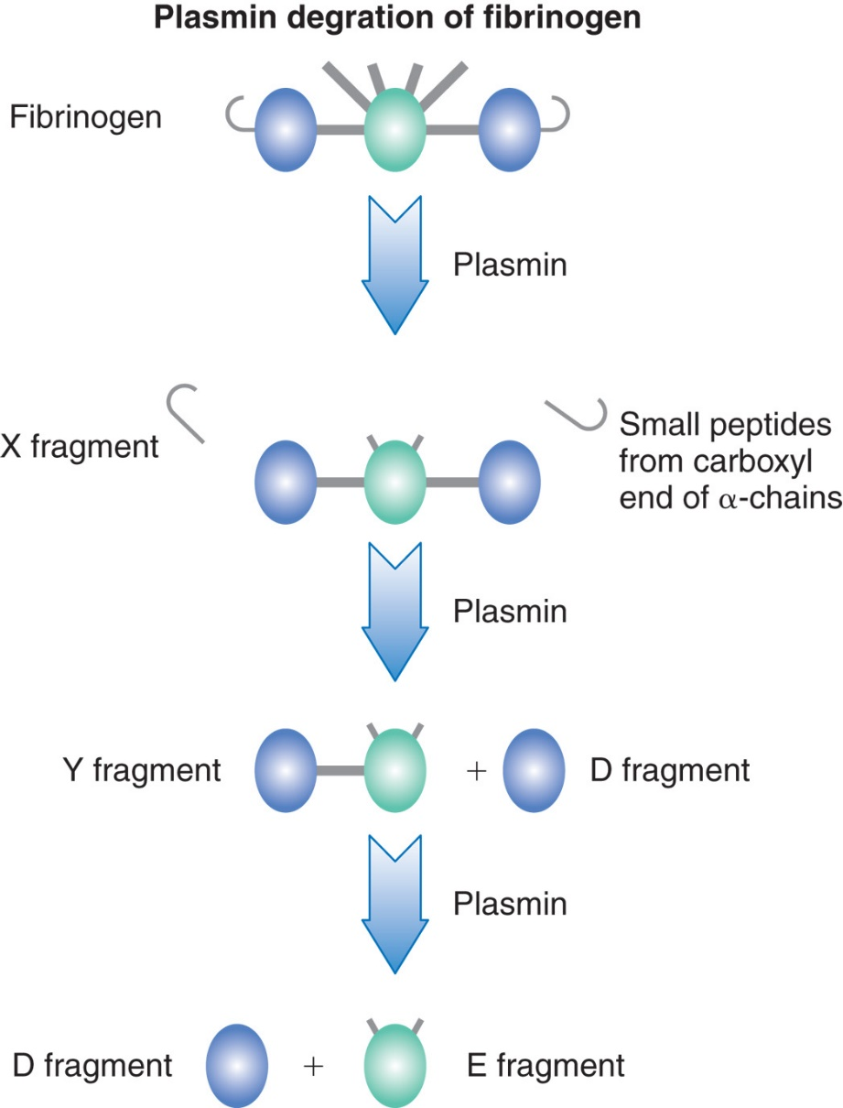
Figure 32-16 Plasmin Degradation of Fibrinogen
Notes:
The degradation of fibrinogen by plasmin occurs in well-defined sequential steps. First, small peptides are cleaved from the carboxyl ends of α-chains producing fragment X. The E nodule retains the A and B peptides. The fragment X is still capable of reacting with thrombin to form fibrin. Next one of the D nodules is cleaved from the fragment X, producing fragment Y (D-E) and a free fragment D. Additional cleavage of the fragment Y produces D and E fragments.

Slide 85
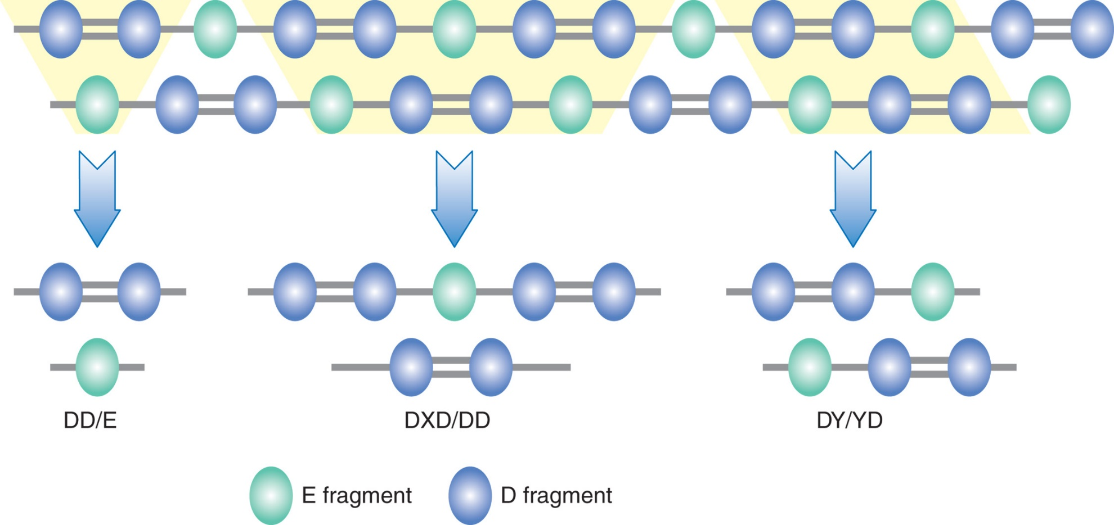
Figure 32-17
Notes:
Plasmin digestion of fibrin occurs at cleavage sites identical to those of fibrinogen. However, because of the covalent bonds of the FXIIIa-stabilized polymer, digestion is slower. Derivatives also are different; some sites are not accessible in the lattice formation. This schematic drawing depicts some of the derivatives of plasmin digestion of fibrin.

Slide 86
Systemic Effects of Plasmin
If not controlled, plasmin can degrade
Fibrinogen,
Components of kinin and complement systems

Slide 87
Inhibitors of Fibrinolysis (1 of 4)
Prevent systemic proteolysis
Act at the
P L G activation step
Plasminogen activator inhibitors/P A I
Directly on plasmin
α₂-antiplasmin

Slide 88
Inhibitors of Fibrinolysis (2 of 4)
Plasminogen activator inhibitor-1 (P A I-1)
Primary physiological inhibitor of t P A and u P A
Acute-phase reactant
Decreased levels shift hemostatic balance toward hypercoagulability
Plasminogen activator inhibitor-2 (P A I-2)
High levels in pregnancy
Plasminogen activator inhibitor-3 (P A I-3)
Now thought to be activated protein C(A P C) inhibitor

Slide 89
Inhibitors of Fibrinolysis (3 of 4)
Lipoprotein receptor-related protein (L R P)
Mediate clearance of P As
Thrombin-activatable fibrinolysis inhibitor (T A F I)
Activated by the thrombin/thrombomodulin complex
Inhibits fibrinolysis
Inhibits plasmin formation
Short half-life (~10 minutes)
Degrades bradykinin, C3a and C5a, resulting in a reduced immune response
T A F I links the coagulation, fibrinolysis and immune systems

Slide 90
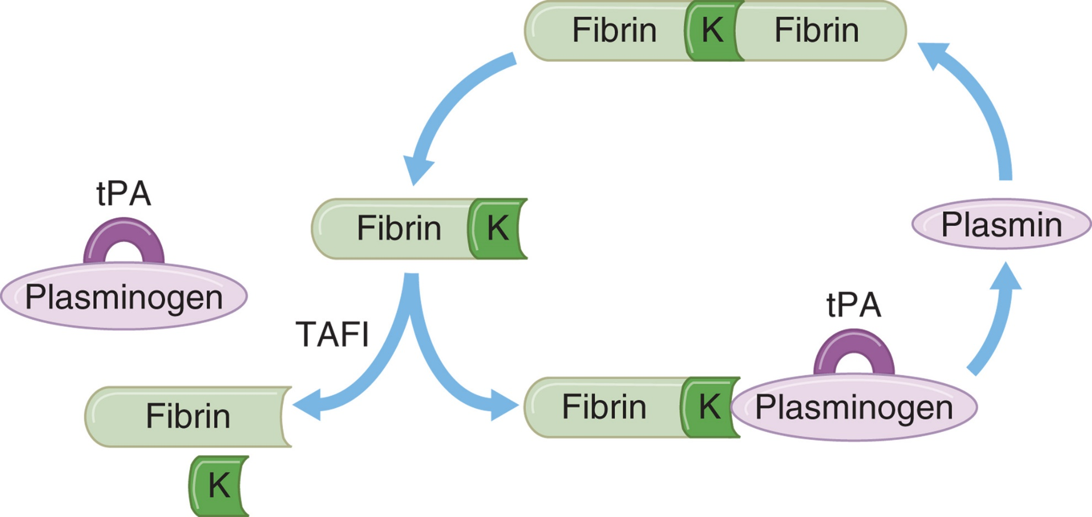
Figure 32-18 Downregulation of Plasmin Formation by T A F I
Notes:
Fibrinolysis is initiated when plasminogen is converted to plasmin by tPA. Both plasmin and tPA preferentially bind to carboxy-terminal lysine (K) residues of fibrin. The formation of plasmin is enhanced by a positive feedback loop. New C-terminal lysine residues generated after limited plasmin cleavage provide new binding sites for continued tPA and plasminogen binding. TAFIa cleaves off the C-terminal lysine residues from partially degraded fibrin and thereby eliminates/decreases the fibrin cofactor function in the tPA/plasminogen/fibrin complex, inhibiting further formation of plasmin and the degradation of the fibrin clot. TAFI, thrombin-activatable fibrinolysis inhibitor; tPA, tissue plasminogen activator; TAFIa, activated TAFI.

Slide 91
Inhibitors of Fibrinolysis (4 of 4)
α₂-antiplasmin (A P)
Principle inhibitor of P L N
Cross-linked to fibrin by X I I I a
Increases resistance of fibrin to P L N
α₂-macroglobulin (α₂M)
Back-up inhibitor for P L N and other serine proteases

Slide 92
Control of Hemostasis

Slide 93
Blood Flow
Vasoconstriction, activation of clotting factors
Necessary for clot formation to begin
Vessel constriction initially enhances clot formation
Slows blood flow through the injured vessel
Platelets, coagulation factors are brought into proximity with the vessel wall
Promotes initiation of primary and secondary hemostasis
Return to normal blood flow through an area of injury
Limits coagulation by diluting the concentration of activated factors

Slide 94
Liver Clearance
The liver is the site of production of many clotting factors
Removes
Activated coagulation factors complexed with their inhibitors
Plasmin-antiplasmin complexes (P A P) and F D Ps.
Liver disease can result in hemorrhage from decreased production of coagulation factors
Can also contribute to systemic fibrinolysis or thrombosis associated with the failure to remove activated proteases

Slide 95
Positive Feedback Amplification
Thrombin
Major activator of platelets
Promotes release of platelet F V a
Activates F V a , F V I I I a, F X I a, and F X I I I a
F X a
Activates V I I a and V I I I a

Slide 96
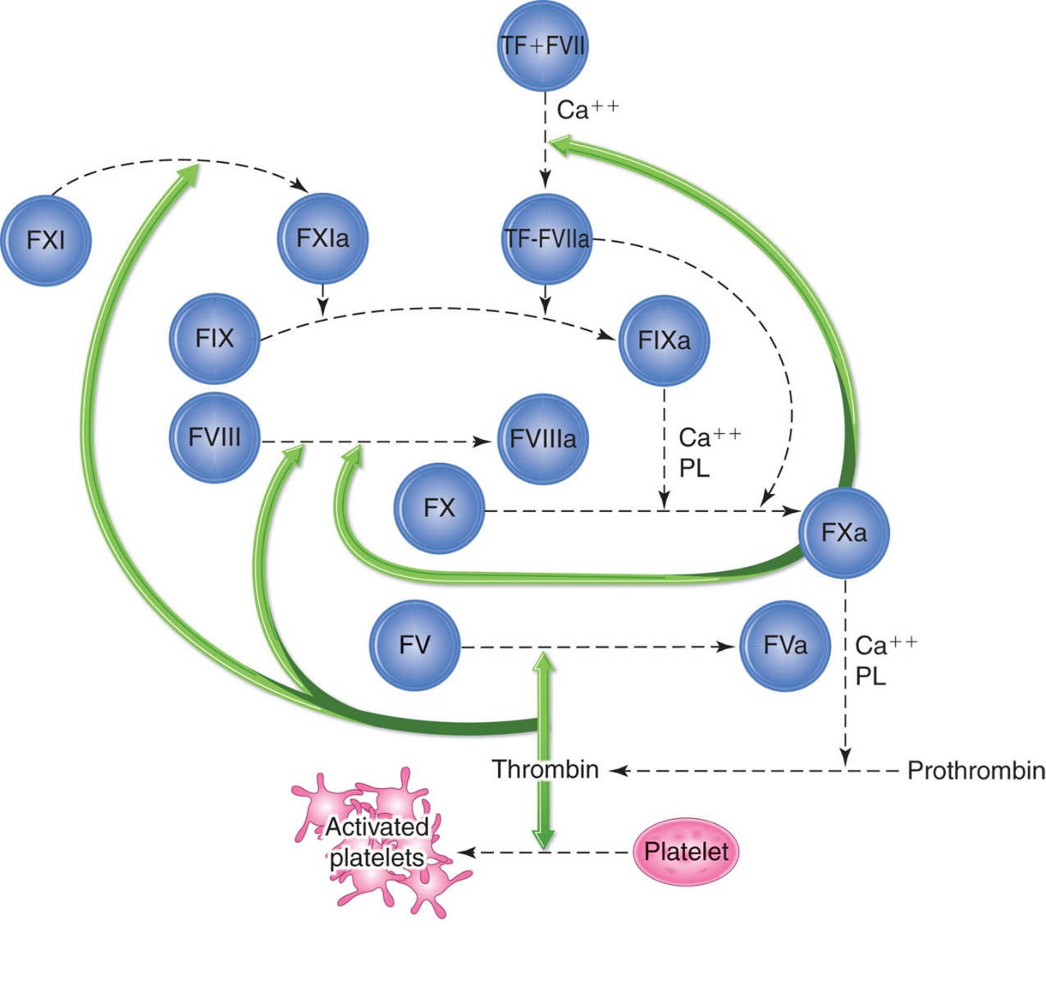
Figure 32-19 Positive Feedback Loops in Coagulation
Notes:
Heavy arrows indicate positive feedbacks. Shaded circles indicate targets.

Slide 97
Negative Feedback Inhibition
Some activated factors have the potential to destroy other factors in the coagulation cascade.
Thrombin
Activate or inactivate F V a and F V I I I a
Fibrin
Indirectly controls clotting
Has a strong affinity for thrombin
Limits the amount of thrombin available to cleave more fibrinogen to fibrin
F D Ps produced by P L N digestion function as inhibitors of fibrin formation

Slide 98
Biochemical Inhibitors
Naturally occurring
Regulate serine proteases by preventing initiation or amplification of cascade

Slide 99
Table 32-6 Summary of Blood Coagulation Regulatory Molecules (1 of 2)
Component | Description (Molecular weight in kilodaltons [k D a]) | Role | T_{½} | Chromosome (gene symbol)
Protein C (P C) | Two-chain glycoprotein (62 kiloDaltons) | Serine protease: F V a and F V I I I a inactivation | 6 hour | 2q13-14 (P R O C)
Protein S (P S) | Single-chain glycoprotein (75 kiloDaltons) | Cofactor for A P C inactivation of F V a and F V I I I a | 42 hour | 3p11.1-11.2 (P R O S1)
Thrombomodulin (T M) | Transmembrane protein (60-105 kiloDaltons) | Cofactor/modulator: E C receptor for thrombin; cofactor for thrombin activation of P C; stimulator of E C to release t P A and E D R F | - | 20p11.2 (T H B D)
Antithrombin (A T) | Single-chain glycoprotein (58 kiloDaltons) | Serpin: inhibitor of thrombin, factors X a, I X a X I a, X I I a, kallikrein, plasmin, t P A | 61-72 hour | 1q23-25 (S E R P I N C1)
Heparin cofactor Two (H C I I) | Glycoprotein (66 kiloDaltons) | Serpin: inhibitor of thrombin | 60 hour | 22q11 (S E R P I N D1)
C1-esterase inhibitor (C-I N H) | Single-chain glycoprotein (105 kiloDaltons) | Serpin: inhibitor of kallikrein, plasmin, C1, F X I I a, F X I a | 70 hour | 11q11-13.1 (S E R P I N G1)
Protein C inhibitor (P A I-3) | Single-chain protein (57 kiloDaltons) | Serpin: inhibitor of A P C; also inhibits F V I I a, F I X a, thrombin | 23 days | 14q32.13 (S E R P I N A5)
Protease Nexin 1 (P N 1) | Single-chain protein (45-50 kiloDaltons) | Cell-surface associated inhibitor of thrombin | - | 2q33-35 (S E R P I N E2)
α₁ - antitrypsin (α₁ - proteinase inhibitor, α₁PI) | Protein (55 kiloDaltons) | Serpin: inhibitor of F X I a, thrombin, kallikrein, plasmin, t P A | 144 hour | 14q32.1 (S E R P I N A1)

Slide 100
Table 32-6 Summary of Blood Coagulation Regulatory Molecules (2 of 2)
Component | Description (Molecular weight in kilodaltons [k D a]) | Role | T_{½} | Chromosome (gene symbol)
Tissue factor pathway inhibitor (T F P I) | Single-chain glycoprotein (34 kiloDaltons) | Inhibitor of F V I I a and F X a | 1-2 minutes | 2q31-32 (T F P I)
α₂ - macroglobulin (α₂ -M) | Tetrameric protein (725 kiloDaltons) | Proteinase inhibitor: inhibitor of kallikrein, plasmin, thrombin, t P A | - | 12p13.3 (A2M)
Endothelial protein C receptor (E P C R) | Single-chain glycoprotein (46 kiloDaltons) | Receptor for P C, A P C | - | 20q11.2 (P R O C R)
Protein Z-dependent protease inhibitor (ZPI) | Single-chain glycoprotein (72 kiloDaltons) | Serpin: inhibitor of F X a with cofactor protein Z; inhibitor of F X I | - | 14q32.13 (SERPIN A10)
Protein Z | Vitamin K-dependent glycoprotein (62 kiloDaltons) | Cofactor for Z P I inhibition of F X a | 60 | 13q.34 (P R O Z)
Serpin, serine protease inhibitor; t P A, tissue plasminogen activator; A P C, activated protein C; E C, endothelial cells; P A I, plasminogen activator inhibitor; E D R F, endothelium-derived relaxing factor.

Slide 101
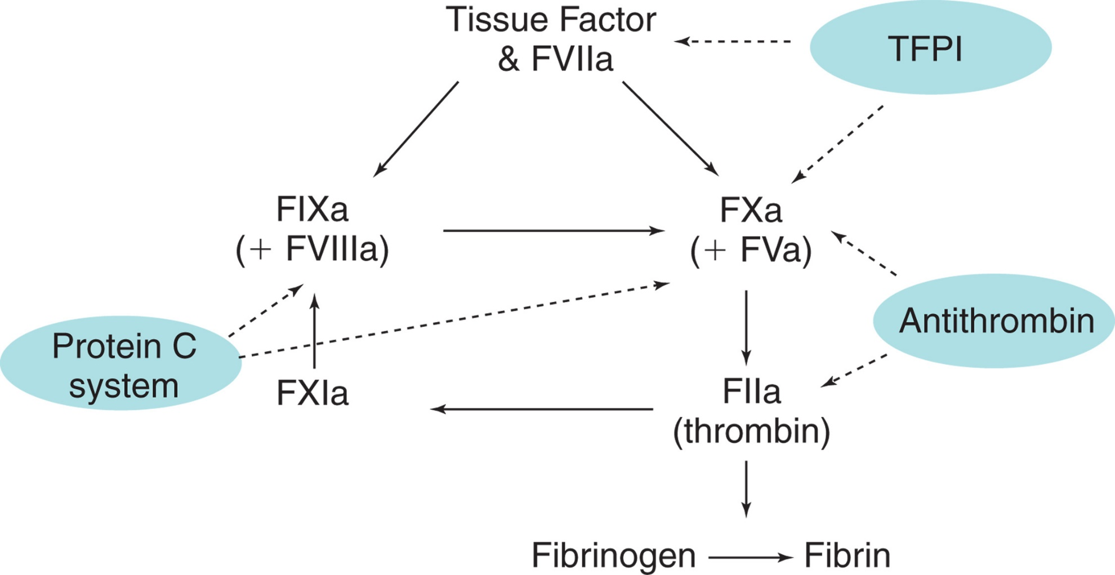
Figure 32-20 Major Naturally Occurring Inhibitors of Coagulation
Notes:
Solid lines indicate proteolytic pathways. Dashed lines show direction of inhibition. Shaded ovals indicate inhibitors. TFPI, tissue factor pathway inhibitor.

Slide 102
Blood Coagulation Regulatory Molecules (1 of 8)
Antithrombin
Plasma proteinase inhibitor (serpin)
Inactivates thrombin and enzymes responsible for the generation of thrombin
Activation of A T by vessel wall heparan sulfate proteoglycans (H S P Gs)
Inhibits free F Xa and free thrombin more efficiently than F Xa and thrombin bound to activation complexes or clots
Most important inhibitor of serine proteases
Inactivates thrombin and other enzymes responsible for thrombin generation
Activity enhanced three- to four-fold by heparin or heparan sulfate (glycosaminoglycan found in E Cs)

Slide 103
Blood Coagulation Regulatory Molecules (2 of 8)
Heparin cofactor
Protease inhibitor
Activity accelerated by heparin
Inhibits thrombin but not X a or other clotting enzymes
Extravascular dermatan sulfate-potent activator of H C I I
May function primarily to inhibit thrombin in extravascular locations
Levels rise during pregnancy
Protection from thrombosis

Slide 104
Blood Coagulation Regulatory Molecules (3 of 8)
Protein C
Vitamin K-dependent protein
Synthesized by liver
Activated by thrombin/thrombomodulin complex on surface of E C
Complexes with protein S
Activated P C (A P C)/P S complex inactivates V a and V I I I a

Slide 105
Blood Coagulation Regulatory Molecules (4 of 8)
Protein S
Vitamin K-dependent protein
Synthesized by liver (and multiple other cell types)
Functions as a cofactor for A P C
Inactivation of F V a and F V I I I a

Slide 106
Blood Coagulation Regulatory Molecules (5 of 8)
Thrombomodulin
Integral membrane protein on E C
Binds thrombin
Converts it from a “procoagulant” protein to an “anticoagulant” protein
Via its acquired ability to activate P C
Net effect
Blocks fibrinogen clotting and platelet activation, while generating A P C

Slide 107
Blood Coagulation Regulatory Molecules (6 of 8)
Endothelial protein C receptor (E P C R)
Single-chain transmembrane protein
Found mainly on E Cs of large blood vessel
Minimal amounts in the microcirculation
Increases affinity of T/T M complex for P C
A P C bound to E P C R
Anti-inflammatory and antiapoptotic activities
Stabilizes endothelial barriers

Slide 108
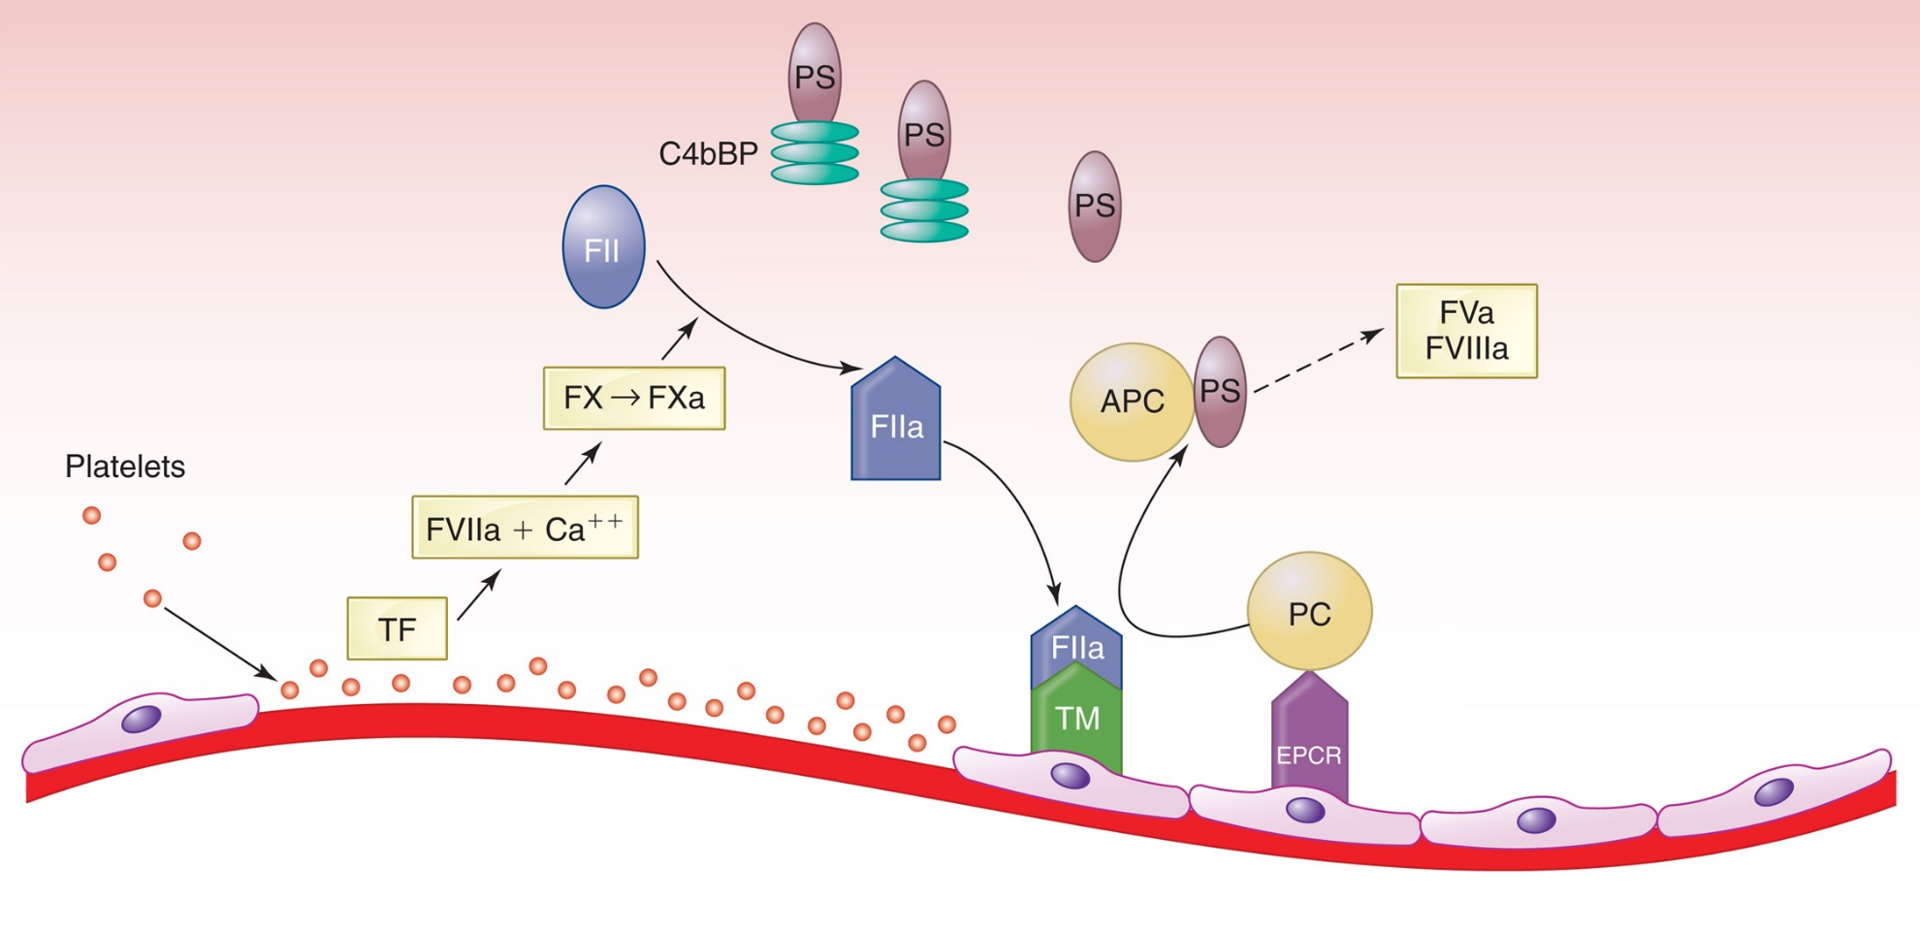
Figure 32-21 Protein C (P C) Pathway
Notes:
Thrombin (FIIa) forms on the vessel wall at the site of injury. Thrombomodulin (TM) on the adjacent endothelial cell forms a complex with thrombin. This complex activates PC, which then in association with free protein S (PS) inactivates FVa and FVIIIa. TF, tissue factor; FII, prothrombin; APC, activated protein C; C4BP, complement 4b binding protein; EPCR, endothelial cell protein C receptor.

Slide 109
Blood Coagulation Regulatory Molecules (7 of 8)
Tissue factor pathway inhibitor (T F P I)
Synthesized by endothelial cells, megakaryocytes, and smooth muscle cells
Released from platelet alpha granules during platelet activation
Inhibits extrinsic pathway proteases
Initially binds F X a
T F P I/F X a complex associates with cell membrane
Inactivates F V I I a/T F
T F P I/F X a/F V I I a/T F complexes cleared by L R P

Slide 110
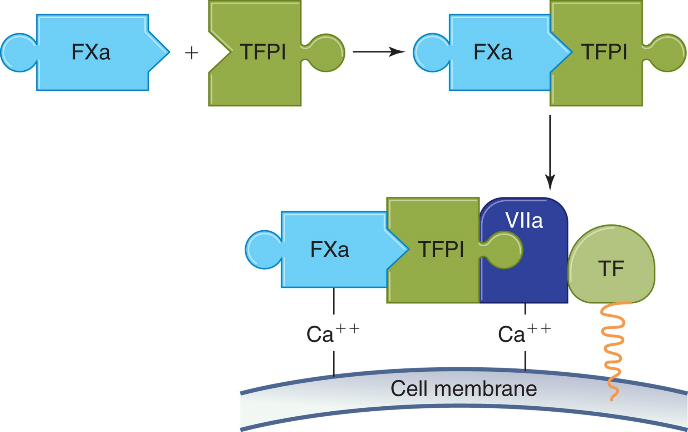
Figure 32-22
Notes:
The inhibition of FVIIa/TF by tissue factor pathway inhibitor (TFPI) occurs as the result of a multistep process. First, TFPI binds to FXa and neutralizes it, resulting in a conformational change of TFPI that promotes binding of the FXa/TFPI complex with the FVIIa/TF complex in a calcium-dependent reaction.

Slide 111
Blood Coagulation Regulatory Molecules (8 of 8)
Protease Nexin-1 (P N1)
Important regulator of vascular thrombosis
Inhibitory activity for target proteases is enhanced by heparin
Inhibits thrombin, trypsin, t P A, u P A, plasmin, F X a, F X I a, A P C
Anticoagulant and antifibrinolytic activities
α₂-macroglobubin
Inhibits several serine proteases
Back-up inhibitor
Traps enzyme and prevents binding to substrate
Enzyme-inhibitor complex removed via L R P

Slide 112
Physiologic Hemostasis (1 of 2)
Coagulation is a cell-based system
Intrinsic and extrinsic systems work together and not independently of each other
Key initiator of in vivo coagulation is T F
T F/V I I a activates both
Referred to as tissue factor pathway
Does Not make the activation of X by intrinsic Xase (I x a/V I I I a/P L, C a⁺⁺) unnecessary

Slide 113
Physiologic Hemostasis (2 of 2)
Coagulation is triggered
Initiation
T F-bearing cells are exposed to blood at a site of vascular injury
Propagation
Activation of (1) platelets, (2) F V, F V I I I, and F X I I I, and (3) F X I, F I X, and F X
Termination
Coagulation reactions subside

Slide 114
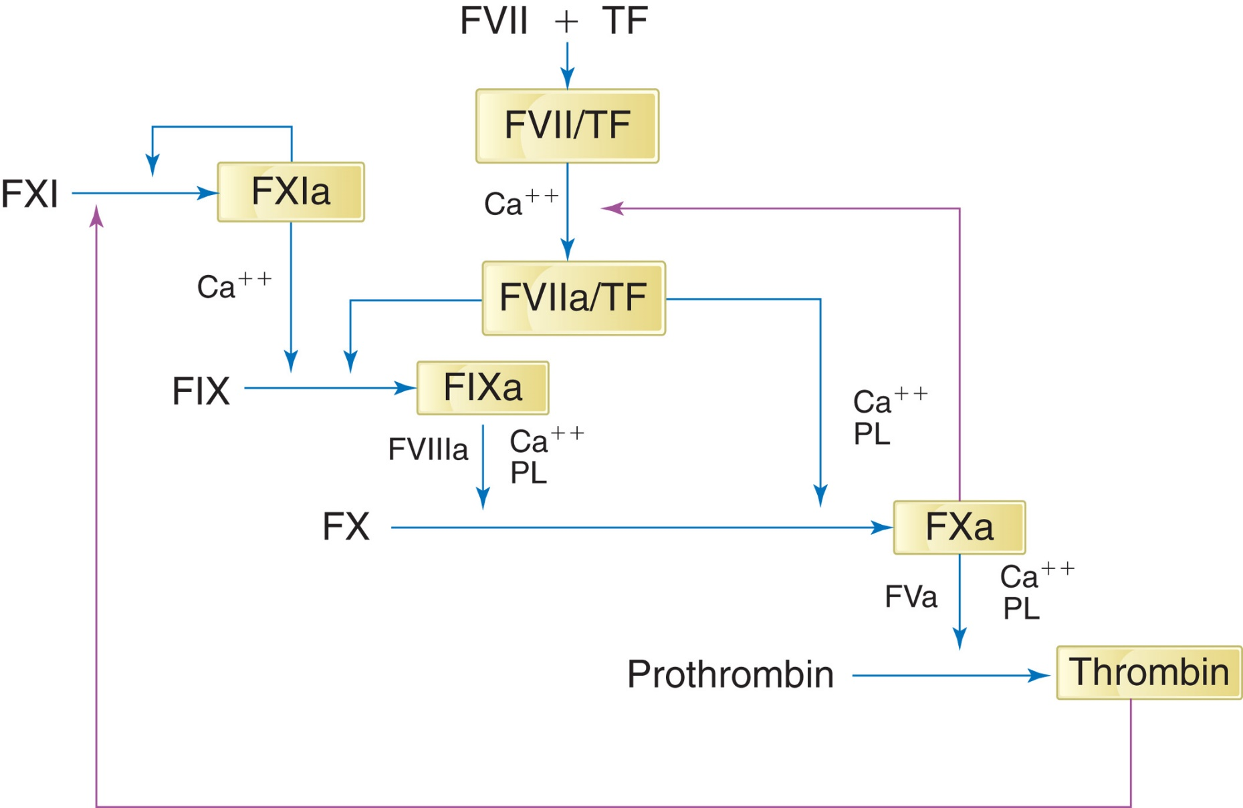
Figure 32-23
Notes:
Tissue factor (TF) initiation of the physiologic pathway by activation of FIX and FX. Purple lines indicate positive feedback activation of TF/FVII by FXa and activation of FXI by thrombin.

Slide 115
Basal Coagulation
Low level of coagulation factor activation may occur at all times
Basal coagulation
Circulating quantities of F P A and F P B, thrombin and F X a activation peptides, and minute levels of F V I I a are measurable in the plasma of normal individuals
Most likely results from minor injuries that occur during normal daily activities
Low circulating levels of the P C activation peptide, t P A activity, and thrombin-antithrombin and plasmin-antiplasmin complexes also observed

Slide 116
Hemostasis in the Newborn
V W F, proportion of high-molecular-weight multimers
Increased
Low levels of the V W F cleaving protease A D A M T S-13
Fibrinogen group
Normal adult levels at birth
Prothrombin, contact factor groups
Decreased (liver immaturity)
Natural inhibitors that the liver synthesizes
Decreased
Clotting factors are usually not low enough to affect hemostasis unless a stressful situation is present

