Slide 1
Clinical Laboratory Hematology
Disorders of Primary Hemostasis
Copyright © 2020, 2015, 2012 Pearson Education, Inc. All Rights Reserved

Slide 2
Clinical Manifestations of Primary Hemostasis Bleeding Disorders
Defect in primary hemostasis
Skin or mucous membrane bleeding (e.g., nose, gums)
Petechiae (<3 millimeter)
Hallmark manifestation in disorders of primary hemostasis
Blood leakage through capillaries
Purpura (3 millimeter-1 centimeter)
Intermediate lesions
Commonly seen in disorders involving the blood vessels
Ecchymoses (>1 centimeter)
Blood leakage into subcutaneous tissue from larger vessel

Slide 3
Clinical Manifestations of Secondary Hemostasis Bleeding Disorders
Usually internal, involving deeper tissues and joints
Bleed from the rupture of small arterioles rather than from capillaries
Hematoma-blue or purple raised area
Blood leakage from vessel and collecting below intact skin
Delayed bleeding
Bleeding is initially stopped by primary platelet plug
Fibrin stabilization does not occur
Plug becomes dislodged at later time

Slide 4
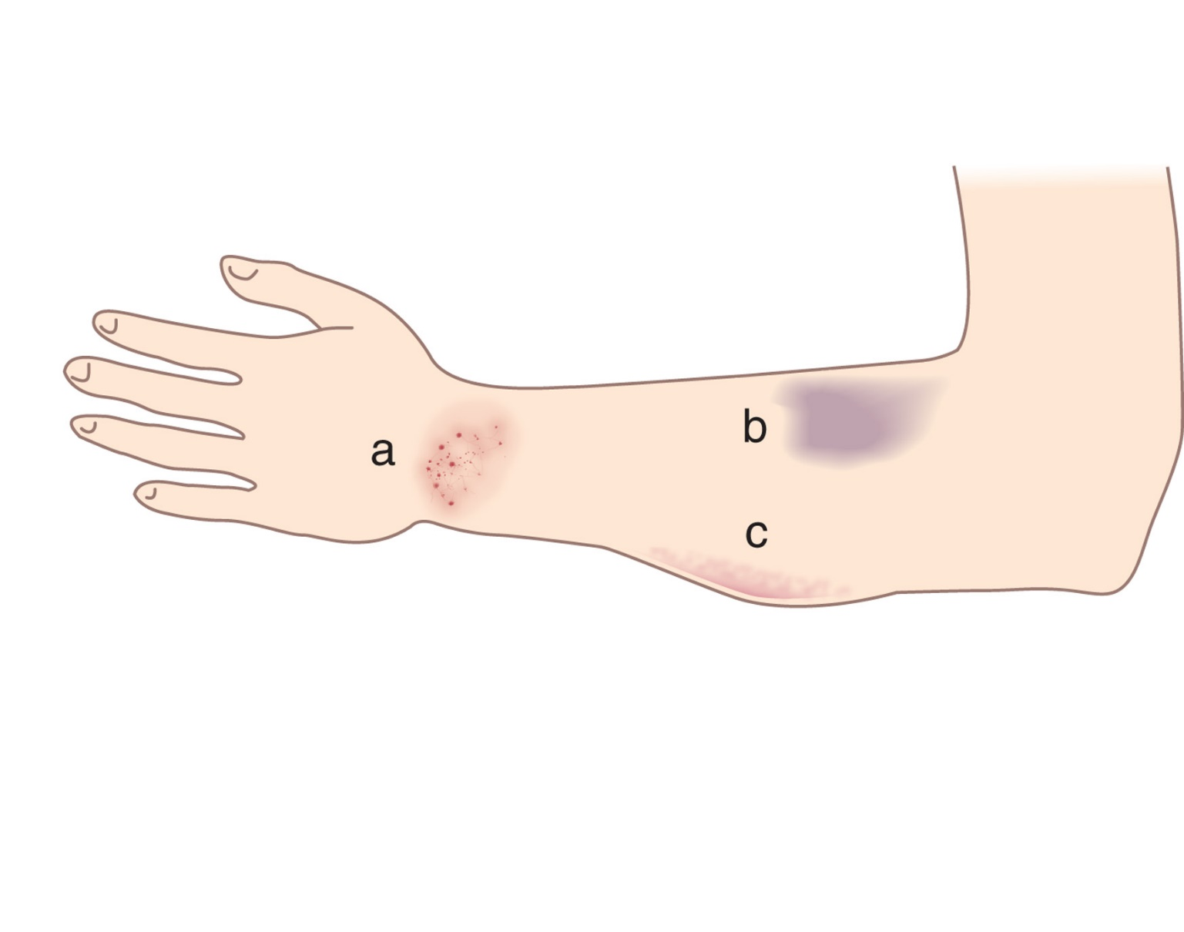
Figure 33-1 Schematic Drawing of Bleeding Manifestations in Intact Skin
Notes:
(a) Petechiae. (b) Ecchymosis. (c) Hematoma.

Slide 5
Easy Bruisability
Nonspecific bleeding symptoms
Can be seen in disorders of primary or secondary hemostasis
Excessive and prolonged bleeding from cuts may be present
Includes
Gastrointestinal bleeding
Hematuria
Hypermenorrhea
Gingival bleeding
Intracranial bleeding
Epistaxis

Slide 6
Patient History
Age of onset of hemorrhagic symptoms
Type of symptoms
Family history
Presence of other diseases
Complete drug history
Exposure to toxins

Slide 7
Laboratory Evaluation of Abnormal Bleeding (1 of 3)
Laboratory tests of coagulation and hemostasis
Should not be a substitute for clinical assessment
Screening tests
No single test can fully evaluate defective hemostasis
Not helpful in predicting bleeding risk
Correlated with clinical evaluation findings
Helps determine
If a detectable hemostatic abnormality is present
What confirmatory tests need to be ordered

Slide 8
Laboratory Evaluation of Abnormal Bleeding (2 of 3)
Prothrombin time (P T)
Activated partial thromboplastin time (A P T T)
Quantitative platelet count

Slide 9
Laboratory Evaluation of Abnormal Bleeding (3 of 3)
Screening tests are often normal
May need confirmatory platelet function tests
Closure time (platelet function analyzer)
Platelet aggregation tests
Flow cytometry for platelet antigens

Slide 10
Table 33-1 Clinical and Laboratory Findings in General Hemostatic Disorders
P l t, platelet count; N, normal; A, abnormal.
*One or both of the P T and A P T T will be abnormal depending on the the coagulation factor(s) involved.
Condition | Bleeding Symptoms | Screen Test Results P l t | Screen Test Results P T | Screen Test Results A P T T | Further Lab Testing
Normal | Absent | N | N | N | None
Mild hemostatic disorder | Typically absent | N | N | N | None in the absence of bleeding
Vascular disorder | Present | N | N | N | Tests to rule out a platelet function disorder
Platelet function disorder | Present | N or A | N | N | Closure time, platelet aggregation tests, flow cytometry
Quantitative platelet disorder | Present | A | N | N | Often none; variable dependent on cause of quantitative defect
Disorder of secondary hemostasis | Present | N | N or A* | N or A* | Thrombin time, mixing studies; factor assays; others (see Chapter 34 and 36)
Factor Thirteen deficiency | Present | N | N | N | Clot solubility or F X I I I assay

Slide 11
Vascular System Disorders

Slide 12
Primary Vascular Disorders
Most are not associated with platelet or plasma defects
Most common symptom
Abnormal bleeding into or under the skin
Laboratory tests used to exclude
Coagulation or platelet disorders
Confirmation
Usually requires histologic evaluation of vessel or connective tissue

Slide 13
Vascular Disorders-Inherited (1 of 2)
Hereditary hemorrhagic telangiectasia (H H T)
Arteriovenous malformations- Hemangiomas
Ehlers-Danlos Syndrome
Joint hypermobility
Osteogenesis imperfecta
Defective bone matrix
Pseudoxanthoma elasticum
Calcification of elastic fibers
Marfan syndrome
Overgrowth of long bones

Slide 14
Table 33-2 Characteristics of Inherited Disorders of the Connective Tissue
B T, bleeding time.
Disorder | Gene | Effect | Chromosome | Laboratory Findings
Hereditary hemorrhagic telangiectasia (H H T) | Endoglin/E N G (H H T-1) A C V R L-1 (H H T-2), S M A D 4, G D F 2 | Arteriovenous malformations; ↑ V E G F | 9q (H H T-1) 12q (H H T-2) | Usually normal
Ehlers-Danlos syndromes | C O L1A1, C O L1A2, C O L3A1, C O L5A1, C O L5A2, T N X-B, A D A M T S2 | Fragility of blood vessels and tissues; joint hypermobility and instability | Multiple | B T can be increased
Marfan syndrome | Fibrillin-1 (F B N 1) | Overgrowth of long bones, arachnodactyly, joint hypermobility, decreased strength of blood vessels | 15 | Usually normal
Osteogenesis imperfecta | Type One procollagen (C O L A 1 and A 2) | Secondary dysregulation of connective tissue composition; defective bone matrix; brittle bones that fracture easily; intracerebral hemorrhage | 2 | Usually normal
Pseudoxanthoma elasticum | A B C C 6 | Mineralization and degeneration of elastic fibers; retinal and G I bleeding; premature atherosclerosis | 16 | Usually normal

Slide 15
Vascular Disorders-Inherited (2 of 2)
Hemangiomas
Composed of tangled masses of dilated thin-walled venules (arteriovenous malformations)
Usual causes
Upregulation of growth-promoting factors and/or inhibition of apoptosis
Strawberry hemangiomas
Superficial, located in the skin, occur early in life, often regress by adolescence

Slide 16
Vascular Disorders-Acquired (1 of 3)
Purpura from decreased supportive connective tissue
Senile purpura-degeneration of skin matrix
Cushing syndrome-excess glucocorticoids
Scurvy-Vitamin C deficiency
Purpura associated with dysproteinemias
Paraproteins-affect platelets, coagulation factors, bind C a ⁺⁺, and so on
Amyloidosis-vessel fragility with bleeding and thrombosis

Slide 17
Vascular Disorders-Acquired (2 of 3)
Purpura from vasculitis
Vasculitis
Inflammation of small blood vessels
Immune complexes form
Attach to vessel and activate complement
May cause platelet aggregation, F X I I and kallikrein activation with release of kinins from H K
Vessel damage with edema and inflammation
Results in purpura-palpable purpura (nodules form at site)
Causes
I g A vasculitis, infections, drugs, idiopathic

Slide 18
Vascular Disorders-Acquired (3 of 3)
Miscellaneous causes of purpura
Mechanical purpura
Increased pressure in vessel lumen
Artificially induced purpura
Self-inflicted
Easy Bruising Syndrome
Occurs mostly in young women as result of vascular fragility
Purpura Fulminans
Abnormalities of clotting factors or their inhibitors

Slide 19
Table 33-3 Classification of Acquired Vascular System Disorders
Disorder | Examples
Purpura resulting from decreased connective tissue | Senile purpura Cushing syndrome and glucocorticoid therapy Scurvy (vitamin C deficiency)
Purpura associated with dysproteinemias | Paraproteins (cryoglobulinemia, cryofibrinogenemia) Amyloidosis
Purpura resulting from vasculitis | Immunoglobulin A (I g A) Vasculitis Infections Drugs
Miscellaneous causes of purpura | Mechanical purpura Artificially induced purpura Easy bruising syndrome Purpura fulminans

Slide 20
Platelet Disorders

Slide 21
Table 33-4 Bleeding Sites in Disorders of Primary Hemostasis
Cutaneous | Mucous Mebranes | Organs
Petechiae | Epistaxis | Retinal bleeding
Ecchymoses | Gingival bleeding (gums) | Intracranial bleeding
Excessive bleeding from superficial wounds | Increased bleeding after tooth extraction | Blank
Blank | Gastrointestinal bleeding | Blank
Blank | Urinary tract bleeding | Blank
Blank | Hypermenorrhea | Blank

Slide 22
Introduction-Platelet Disorders
Quantitative
Thrombocytopenia
Thrombocytosis
Qualitative
Morphologic abnormalities
Macrothrombocytes (giant platelets)
Microthrombocytes
Hypogranular or agranular platelets

Slide 23
Figure 33-2
Notes:
(a) Platelets with normal size and granulation. (b) Many large platelets, including a giant platelet identified by the arrow, and a few hypogranular platelets. (c) A large, agranular platelet. (peripheral blood, Wright-Giemsa stain, 1000× magnification)

Slide 24
Quantitative Platelet Disorders

Slide 25
Table 33-5 Classification of Quantitative Platelet Abnormalities
Thrombocytopenia | Thrombocytosis
Increased destruction Immune Nonimmune | Primary thrombocytosis Secondary thrombocytosis Transient thrombocytosis
Decreased production Megakaryocyte hypoplasia Replacement of normal marrow Ineffective thrombopoiesis Inherited disorders | Blank
Abnormal distribution of platelets Increased splenic sequestration Dilutional thrombocytopenia Hypothermia | Quantitative artifacts in the measurement of platelets
Conditions with multiple mechanisms of thrombocytopenia | Blank

Slide 26
Thrombocytopenia (1 of 2)
Platelet count
Usually no ↑ risk of bleeding unless
Risk of severe and spontaneous bleeding when platelet
count is
Bleeding from mucous membranes
G I, G U tract, and so on
Bleeding into C N S

Slide 27
Thrombocytopenia (2 of 2)
Laboratory evaluation
Platelet count
Platelet maturity
Immature platelet fraction (reticulated platelet)
↑ suggests platelet destruction in the circulation as the primary dysfunction
N/↓ platelet production problem in the bone marrow
P F A-100® closure time

Slide 28
Table 33-6 Classification of Thrombocytopenia Caused by Increased Destruction
Immune Mechanisms of Destruction | Nonimmune Mechanisms of Destruction
Immune thrombocytopenic purpura Acute Chronic Transplacental Alloimmune thrombocytopenia Neonatal alloimmune thrombocytopenia (N A I T) Post-transfusion purpura Drugs Quinidine/quinine Heparin Other diseases | Disseminated intravascular coagulation Thrombotic thrombocytopenic purpura Hemolytic uremic syndrome Mechanical destruction by artificial heart valves Thrombocytopenia of pregnancy (H E L L P syndrome, preeclampsia)

Slide 29
Increased Destruction
Immune-mediated
Fc-independent
Fc-dependent
Antibodies
Bind to epitopes on G P I I b/I I I a or G P I b/I X
Attach to platelet Fc receptors
P l t s sensitized with Ab are removed in spleen/liver
No routine tests to evaluate immunoglobulin on platelets
B M-↑ M Ks; ↑ ploidy; ↑platelet production
Stimulation by T P O

Slide 30
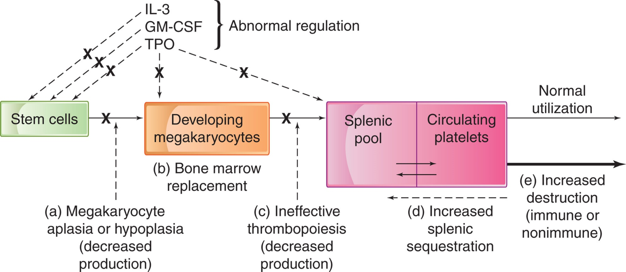
Figure 33-3 Schematic Drawing Showing Various Causes of Thrombocytopenia
Notes:
IL-3, interleukin-3; GM-CSF, granulocyte macrophage colony-stimulating factor; TPO, thrombopoietin; X, abnormal or absent.

Slide 31
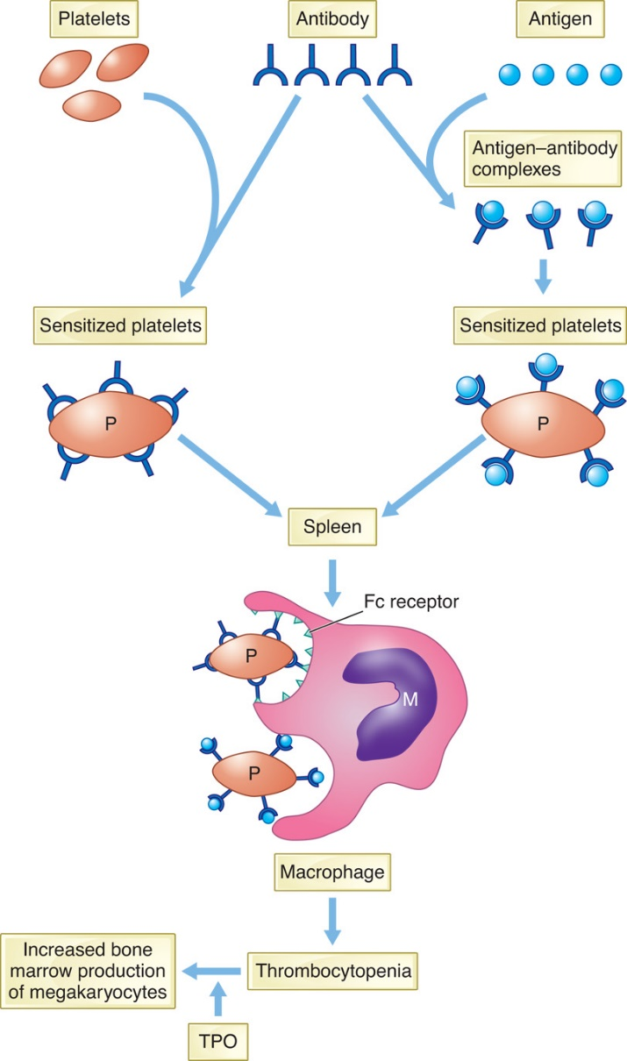
Figure 33-4 Mechanisms of Thrombocytopenia Caused by Immune Destruction of Platelets
Notes:
In immune thrombocytopenia, Fc receptors of the splenic macrophages (M) recognize antibody-sensitized platelets and eliminate them from the circulation. The bone marrow is stimulated by thrombopoietin (TPO) and produces increased numbers of megakaryocytes. Thrombocytopenia develops if immune destruction exceeds the compensatory capacity of the marrow. The antibody can also injure megakaryocytes.

Slide 32
I T P (1 of 4)
Immune thrombocytopenia
Formerly called immune thrombocytopenia purpura
Most common form of thrombocytopenia
Primary/idiopathic or secondary
Autoreactive antibodies from B lymphocytes bind to platelet
Shorten life span
Abnormal regulatory T-cells and loss of T-cell tolerance
Accumulation of cytotoxic T-cells

Slide 33
I T P (2 of 4)
Diagnosis of exclusion based on:
Patient history
Physical examination
Platelet count
Other C B C parameters-normal
Elevated I P F strongly correlates with a diagnosis of I T P
Three phases:
Newly diagnosed (up to 3 months)
Persistent (3 month s to 1 year)
Chronic (>1 year)-more often seen in adults

Slide 34
I T P (3 of 4)
Most often seen in children 5-6 years old
Often follows viral infection
Mild to moderate bleeding with bruising, petechiae, mucous membrane bleeding
Spontaneous remission
85% children and 15% of adults
Antiplatelet antibodies
Found in 58-80% of patients with chronic I T P
Directed toward epitopes on G P I I b/I I I a or G P I/I X

Slide 35
I T P (4 of 4)
Treatment
Usually not required for children
P l t count
-threshold for treatment
Corticosteroids, I V I g, or anti-D
Splenectomy-increases patient risk of infection
Rituximab-anti-C D20 antibody destroys B lymphocytes
Chemotherapy
Immunosuppressive therapy

Slide 36
Table 33-7 Comparative Features of Childhood and Adult I T P
I V Ig, intravenous immunoglobulin.
Feature | Childhood | Adult
Peak age of incidence | 5-6 years | 20-40 years
Platelet count, initial | Less than 20 times ten cubed per micro liter | 30 to 80 times ten cubed per micro liter
Onset of symptoms | Abrupt | Insidious
Type of bleeding | Petechiae and superficial | Petechiae and superficial
Antecedent infection | Common 1-3 weeks prior | Unusual
Gender predilection | None | Females 3:1
Eosinophilia | Common | Rare
Lymphocytosis | Common | Rare
Hemorrhagic bullae in mouth | Present in severe cases | Usually absent
Duration | 2-6 weeks | Months or years (lifetime)
Spontaneous remissions | Up to 95% of cases | Rare (less than 15% of cases); course of disease fluctuates
Therapy | Corticosteroids, anti-D, I V I g | Corticosteroids, splenectomy, Rituxi-mab

Slide 37
Alloimmune Thrombocytopenias (1 of 2)
Neonatal alloimmune thrombocytopenia (N A I T)
Maternal I g G alloantibodies produced against paternal antigens on fetal platelets
H P A-1a-platelet antigen most often associated with N A I T (80% of cases)
Symptoms are self-limited
Bleeding in ~20% of cases
Most serious risk: bleeding into C N S
Most common cause of intracranial hemorrhage in full-term infants

Slide 38
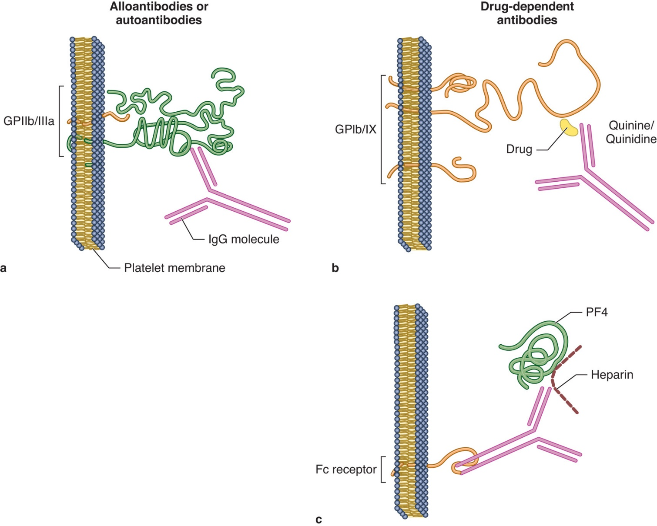
Figure 33-5 Variations in Antibody Binding to Platelets
Notes:
(a) Platelet autoantibodies or alloantibodies bind to epitopes on GPIIb/IIIa, GPIb/IX, most frequently, or to other glycoproteins resulting in ITP. (b) Quinine-/quinidine-dependent antibodies bind to a complex of drug and glycoprotein, usually either GPIb/IX or GPIIb/IIIa. (c) Heparin binds platelet factor 4, and the heparin/PF4 complex attaches to IgG antiheparin antibodies via the Fab combining site. The Fc portion of the antibody binds to platelet FcγIIa receptors.

Slide 39
Alloimmune Thrombocytopenias (2 of 2)
Post-transfusion purpura
90% are females
Most are homozygous for H P A-1b and produce an alloantibody to H P A-1a
Previously sensitized, pregnancy, or transfusion
Thrombocytopenia
5-10 days after
Recipient’s antigen-negative platelets
Destroyed by autologous antibody

Slide 40
Drug-Induced Thrombocytopenias (1 of 3)
Many drugs implicated
Symptoms of excess bleeding
Usually appear suddenly and can be severe
Platelet count can be very low-
Removal of drug
Usually halts thrombocytopenia and bleeding symptoms
Etiology of thrombocytopenia
Generalized hematopoietic suppression
Selective suppression of platelet production
↑ platelet destruction via I g-coated platelets

Slide 41
Drug-Induced Thrombocytopenias (2 of 3)
Pathways
Hapten theory (large doses penicillin)
Drug binds to platelets → drug-platelet A g complex
Drug-dependent Ab binds to complex
Innocent bystander mechanism (H I T)
Drug binds plasma protein
A b response → A b binds drug
Immune complex nonspecifically binds circulating platelets

Slide 42
Drug-Induced Thrombocytopenias (3 of 3)
Pathways
Drug-dependent A b s against epitopes
Epitopes created by assoc. of drug with proteins on platelet surface
Drug binds proteins on platelet surface → neoepitopes (e.g., quinidine and quinine)

Slide 43
Heparin and Thrombocytopenia (1 of 2)
Heparin-associated thrombocytopenia (H A T)
Nonimmune-mediated mechanism
Heparin causes direct platelet activation
Thrombocytopenia

Slide 44
Heparin and Thrombocytopenia (2 of 2)
Heparin-induced thrombocytopenia (H I T)
Immune-mediated destruction of platelets
Heparin-dependent platelet activating I g G antibodies
Ab binds heparin-P F 4 complex
Attaches to platelet surface via platelet F c γ-I I a receptors
↑ platelet clearance and thrombocytopenia
Can induce platelet activation, activation of clotting system, and thrombosis

Slide 45
Miscellaneous Immune Thrombocytopenias
Secondary feature in many diseases
Collagen diseases
Other autoimmune disorders (S L E, R A)
Lymphoproliferative disorders (H D, C L L)

Slide 46
Nonimmune Mechanisms of Destruction
Disseminated intravascular coagulation (D I C)
Thrombotic thrombocytopenic purpura (T T P)
Hemolytic uremic syndrome (H U S)
Mechanical destruction-artificial heart valves
Pregnancy
Normal platelet distribution changes
Preeclampsia, acute fatty liver of pregnancy, H E L L P syndrome

Slide 47
Decreased Production
Failure of B M to deliver adequate platelets to the peripheral blood
Hypoplasia of M K in the B M
Ineffective thrombopoiesis
Hereditary conditions

Slide 48
Table 33-8 Causes of Decreased Platelet Production
Hypoplasia of Megakaryocytes | Ineffective Thrombopoiesis | Hereditary Thrombocytopenia
Decreased megakaryocyte proliferation | Megaloblastic anemia | Wiskott-Aldrich syndrome/X-linked thrombocytopenia
Chemotherapy and radiation therapy for malignant disease | Blank | Bernard-Soulier syndrome
Aplastic anemia Acquired Congenital/hereditary Fanconi anemia Congenital amegakaryocytic thrombocytopenia (C A M T) Congenital thrombocytopenia with radioulnar synostosis (C T R U S) Isolated megakaryocyte hypoplasia Thrombocytopenia with absent radii (T A R) X-linked thrombocytopenia (X L T) X-linked thrombocytopenia with thalassemia (X L T T) | Blank | May-Hegglin anomaly
Replacement of normal marrow Leukemias and lymphomas Myelodysplastic syndromes Other neoplastic diseases at times Fibrosis or granulomatous inflammation | Blank | Blank

Slide 49
Megakaryocyte Hypoplasia Syndromes (1 of 3)
Decreased megakaryocyte proliferation
Chemotherapy/radiation therapy for malignant disease most often cause
Usually, all three lineages affected
M Ks often last to recover
Aplastic anemia-M P V usually normal
Acquired
Congenital/hereditary
Fanconi anemia
Defective D N A repair mechanism, chromosomal instability, B M failure

Slide 50
Megakaryocyte Hypoplasia Syndromes (2 of 3)
Congenital/hereditary
Congenital amegakaryocytic thrombocytopenia (C A M T)
Hypomegakaryocytic thrombocytopenia in first year
Develop B M aplasia (3-5 years → 2nd decade)
Mutation in T P O receptor gene, M P L
Congenital thrombocytopenia with radioulnar synostosis (C T R U S)
Mutation within the H O X A 11 gene
Ulna and radius union and other skeletal deformities

Slide 51
Megakaryocyte Hypoplasia Syndromes (3 of 3)
Thrombocytopenia with absent radii syndrome (T A R)
Isolated hypoplasia of megakaryocytic lineage
Thrombocytopenia and bilateral radial aplasia
Other skeletal abnormalities may be seen
Thrombocytopenia severe only during first years of life
Gradual improvement
Platelet count returning to within normal values in adulthood
Possible a mutation in R B M 8 A
Defect in the exon-junction complex
Involved with essential R N A processing tasks

Slide 52
Decreased Production Due to Replacement of Normal Marrow
Leukemias/lymphomas
Myelodysplastic syndromes
Fibrosis or granulomatous inflammation
Other neoplastic processes

Slide 53
Decreased Production Due to Ineffective Thrombopoiesis
Megaloblastic anemia
Deficiency of vitamin B₁₂ or folic acid
Ineffective thrombopoiesis
Ineffective erythropoiesis and granulopoiesis
Pancytopenia

Slide 54
Hereditary Thrombocytopenias (1 of 3)
Inherited thrombocytopenia with other abnormalities
Wiskott-Aldrich syndrome (W A S)
X-linked thrombocytopenia (X L T)
Bernard-Soulier syndrome (B S S)
May-Hegglin anomaly (M H A)

Slide 55
Hereditary Thrombocytopenias (2 of 3)
Wiskott-Aldrich syndrome (W A S)
X-linked disorder
Small platelets, thrombocytopenia and severe immune dysregulation
Recurrent infections, eczema
Progressive decline in T lymphocyte number and function

Slide 56
Hereditary Thrombocytopenias (3 of 3)
Bernard-Soulier syndrome (B S S)
Thrombocytopenia
Dysfunctional platelets
May-Hegglin anomaly (M H A)
Moderate macrothrombocytopenia
Döhle body-like inclusions in leukocytes
M Y H 9 gene abnormality

Slide 57
Thrombocytopenia Due to Increased Splenic Sequestration
Splenic pool
Contains ⅓ of platelets released by B M
In equilibrium with circulation platelets
Hypersplenism
Spleen is enlarged and hyperactive
Increased numbers of platelets are pooled and circulating number decreases
Usually complicated by other factors
Cirrhosis, hemolytic anemia, infections, B M infiltration, storage diseases, and so on

Slide 58
Dilutional Thrombocytopenia
Decrease in platelet count following major surgery
Hemodilution-fluid infusion
Increased consumption during surgery
Massive transfusion-stored bank blood
Platelets have short half-life

Slide 59
Hypothermia
Body temperature less than 25°Celsius
Multiple mechanisms are involved
Increased splenic and hepatic platelet pooling
Platelet counts appear to resolve without treatment within 4 to 10 days after body temperature is restored to normal

Slide 60
Thrombocytopenia-Multiple Mechanisms
Alcoholism
Ethanol decreased platelet number and causes defects in aggregation, secretion, and factor activity and production
Cirrhosis
Associated with enlarged spleens, which contributes to thrombocytopenia
Lymphoproliferative disease
Autoantibody production/enhances platelet destruction
Impaired production secondary B M infiltration
Bypass surgery
I V fluids and donor blood decrease platelet count
Mechanical damage to platelets due to contact with artificial surfaces

Slide 61
Table 33-9 Conditions with Multiple Mechanisms of Thrombocytopenia
Alcoholism | Lymphoproliferative Disease | Cardiopulmonary Bypass Surgery
Suppressed platelet production | Impaired production | Mechanical destruction
Ineffective platelet production | Immune destruction | Increased utilization
Increased destruction | Splenomegaly | Dilutional thrombocytopenia
Splenomegaly | Blank | Inadequate neutralization of heparin

Slide 62
Thrombocytosis (1 of 3)
↑ platelet count above reference interval
Greater than
P B S
>20 platelets per 100× oil immersion field
Result of ↑ production by B M (not prolonged lifespan)
↑ B M megakaryocytes

Slide 63
Thrombocytosis (2 of 3)
Primary thrombocytosis
M K proliferation and maturation bypass normal regulatory mechanisms
Platelet counts often
B M-M K hyperplasia with increased ploidy
Familial
Mutations of T P O production
Acquired
M P Ns, M D S
Essential thrombocythemia
Most common cause of primary thrombocytosis

Slide 64
Thrombocytosis (3 of 3)
Secondary (reactive) thrombocytosis
↑ platelets caused by another disease or condition
Platelet counts usually
Transient thrombocytosis

Slide 65
Table 33-10 Causes of Thrombocytosis
Primary Thrombocytosis | Secondary (Reactive) Thrombocytosis | Transient Thrombocytosis
Familial thrombocytosis | Acute hemorrhage | Vigorous exercise
Essential thrombocythemia | Surgery | Epinephrine
Chronic myelogenous leukemia | Postsplenectomy | Childbirth
Polycythemia vera | Malignant diseases | Blank
Chronic idiopathic myelofibrosis | Chronic inflammatory diseases | Blank
M D S with ring sideroblasts | Iron-deficiency anemia | Blank
M D S with isolated del(5q) | Hemolytic anemia | Blank
Blank | Recovery from thrombocytopenia Alcohol-induced thrombocy-topenia Chemotherapeutic drugs Therapy of cobalamin deficiency | Blank

Slide 66
Qualitative (Functional) Platelet Disorders

Slide 67
Qualitative Platelet Disorders (1 of 2)
Clinical symptoms vary
Asymptomatic → mild, easy bruisability → severe, life-threatening hemorrhaging
Type of bleeding
Petechiae
Easy and spontaneous bruising
Bleeding from mucous membranes
Prolonged bleeding from trauma

Slide 68
Qualitative Platelet Disorders (2 of 2)
Laboratory screening tests results
Similar to those found in thrombocytopenia but platelet count usually normal
P T, A P T T, and tests for fibrinolysis-normal
Platelet function tests-reflect nature of platelet defect

Slide 69
Table 33-11 Inherited Disorders of Platelet Function
Disorders of Adhesion (Defects in Platelet-Vessel Wall Interaction) | Disorders of Aggregation (Defects in Platelet-Platelet Interaction) | Disorders of Platelet Secretion and Abnormalities of Granules | Disorders of Platelet Secretion and Signal Transduction | Disorders of Platelet Coagulant-Protein Interaction
von Willebrand disease (deficiency/defect in plasma V W F) | Congenital hypo- or afibrinogenemia (deficiency of plasma fibrinogen) | Storage pool deficiency (δ S P D; α S P D) | Receptor defects (defective platelet-agonist interaction: receptors for T X A₂ , A D P, collagen, epinephrine, serotonin) | Scott syndrome
Bernard-Soulier syndrome (deficiency/defect in G P I b/I X) | Glanzmann thrombasthenia (deficiency/defect in G P I I b/I I I a) | Quebec platelet disorder | Defects in G-protein activation | Blank
Deficiency/defect of collagen receptors (G P I a/I I a, G P V I) | Blank | Blank | Defects in phosphatidylinositol metabolism (phospholipase C deficiency) | Blank
Blank | Blank | Blank | Defects in protein phosphorylation (P K C deficiency) | Blank
Blank | Blank | Blank | Abnormalities in arachidonic acid pathways and T X A₂, synthesis (deficiency of phospholipase A2, cyclooxygenase, thromboxane synthase) | Blank

Slide 70
Inherited Qualitative Platelet Disorders (1 of 3)
Disorders of adhesion
von Willebrand disease
Deficiency or defect in plasma V W F
Bernard-Soulier syndrome
Deficiency or defect in G P I b/I X/V
Defects in collagen receptors
G P I a/I I a; G P V I

Slide 71
Bernard-Soulier Syndrome (1 of 2)
Rare autosomal recessive disorder
Characterized by:
Decreased or abnormal G P I b/I X/V complex
Moderate to severe thrombocytopenia
Giant platelets
Bleeding symptoms
Similar to those described for thrombocytopenia
Severity ranges from mild bruising to severe, recurrent muccocutaneous bleeding

Slide 72
Bernard-Soulier Syndrome (2 of 2)
Laboratory evaluation
Moderate to severe thrombocytopenia
Large platelets with heterogeneous size distribution
Increased P F A closure time
Normal platelet aggregation in response to A D P, collagen, and epinephrine
Absent platelet agglutination by ristocetin and V W F (not corrected by normal plasma)
Decreased or abnormal G P I b/I X (C D42b/C D42a) by flow cytometry

Slide 73
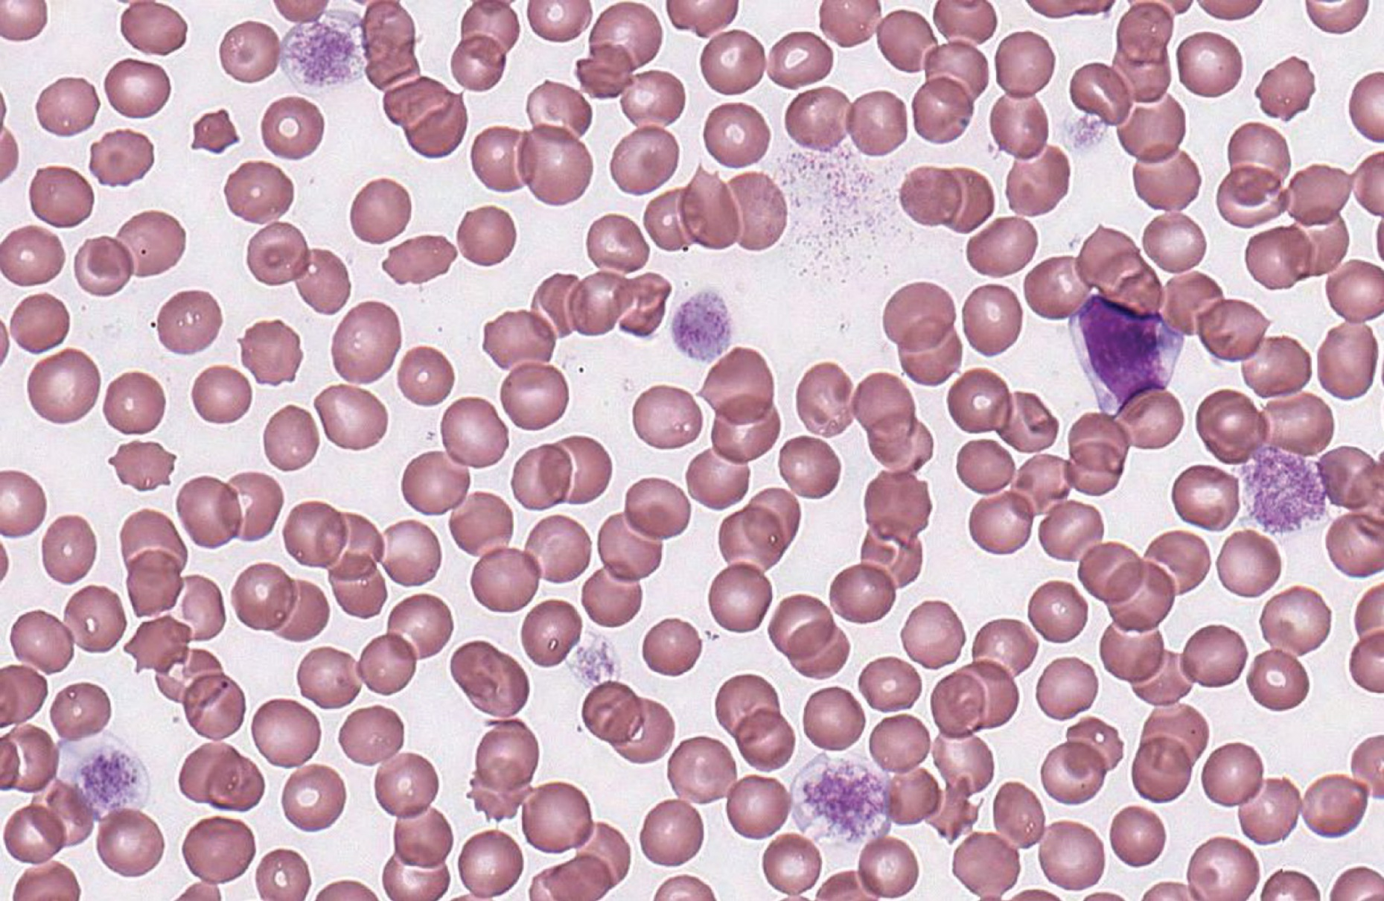
Figure 33-7 Macrothrombocytopenia in Bernard-Soulier Syndrome
Notes:
(peripheral blood, Wright-Giemsa stain, 1000× magnification)

Slide 74
Inherited Qualitative Platelet Disorders (2 of 3)
Defects of collagen receptors
Disorders of aggregation
Congenital afibrinogenemia
Deficiency of plasma fibrinogen
Glanzmann thrombasthenia
Deficiency or defect in G P I I b/I I I a

Slide 75
Glanzmann Thrombasthenia (1 of 2)
Diagnostic criteria
Autosomal recessive trait
Bleeding symptoms (homozygotes)
Purpura, epistaxis, gingival bleeding, menorrhagia
Bleeding severity
Ranges from mild bruising to severe, recurrent mucocutaneous bleeding beginning at birth
Menorrhagia is common to most female patients

Slide 76
Glanzmann Thrombasthenia (2 of 2)
Laboratory evaluation
Normal platelet count and morphology
P F A closure time increased
Absent or severely diminished
Platelet aggregation in response to A D P, collagen, thrombin, and epinephrine
Clot retraction
Normal agglutination by ristocetin
Decreased G P I I b/I I I a by flow cytometry (C D 4 1 and C D 6 1)

Slide 77
Inherited Qualitative Platelet Disorders (3 of 3)
Disorders of platelet secretion, granule abnormalities and signal transduction
Impaired secretion of granule contents
Abnormal aggregation during platelet activation
Reduced or absent second wave
Moderate to mild bleeding
Easy bruising, hemorrhage and excess bleeding after surgery or childbirth

Slide 78
δ-Storage Pool Disease
Dense granule deficiency
Normal platelet morphology
P F A closure times variable
Abnormal aggregation tests with A D P, epinephrine, and collagen
Normal primary wave, absent/blunted secondary wave
E M-dense granules decreased
Ratio of total platelet A T P:A D P ↑(>2.5)

Slide 79
Dense Granule Deficiencies
Associated with other disorders
Chédiak-Higashi syndrome
Hermansky-Pudlak syndrome
Wiskott-Aldrich syndrome
T A R (thrombocytopenia, absent radii) syndrome

Slide 80
α-Storage Pool Disease
Also known as grey platelet syndrome
Deficiencies in platelet α-granules
Gray appearance of platelets with absence of α-granules on P B smears
Autosomal recessive disorder with lifelong bleeding diathesis
Mild clinical manifestations
E M-absent or markedly decreased α-granules
P F A closure time variable
Aggregation studies generally normal

Slide 81
Quebec Platelet Disorder
Rare autosomal dominant disorder
Abnormal proteolysis of α-granule proteins
Increased levels of platelet u P A
α-granule structure preserved
Platelets morphologically normal (light microscopy)
Variable bleeding diathesis

Slide 82
Abnormalities of Platelet Secretory Mechanism
Mild to moderate bleeding history
Absence of second wave of platelet aggregation with A D P, epinephrine
Decreased aggregation with collagen
Must be differentiated from acquired drug-induced secretion abnormalities (e.g., aspirin)

Slide 83
Defective Thromboxane A₂ (T X A ₂) Synthesis
P F A closure time increased
Platelet aggregation pattern similar to δ-storage pool disease
Absence of platelet secretion and secondary aggregation
Defects in
Liberation of A A from P L
T X A ₂ synthesis (cyclooxygenase or thromboxane synthase deficiency)

Slide 84
Signal Transduction Defects
Defects in:
Impaired platelet response to single agonist
Defects in receptors for:
T X A ₂, collagen, epinephrine, serotonin

Slide 85
Disorders of Platelet Procoagulant Activity
Scott syndrome
Rare autosomal recessive disorder
Abnormal C a ⁺⁺ induced P L scrambling
Platelets secrete and aggregate normally, but fail to transport phosphatidyl serine to outer P L membrane layer-scramblase activity
Needed for assembling of prothrombinase and tenase
Defective thrombin formation
Associated with mutations in T M E M 1 6 F gene

Slide 86
Table 33-12 Laboratory Test Results in Selected Platelet Disorders
P F A, platelet function analyzer.
Disorder | Defective Platelet Component | Platelet Count | Platelet Aggregation | Closure Time (P F A) | Other
Bernard-Soulier syndrome | Glycoprotein I b/I X | Normal or decreased | Abnormal with ristocetin Normal with A D P, collagen, epinephrine | Increased | Giant platelets
Glanzmann thrombasthenia | Glycoprotein I I b/I I I a | Normal | Abnormal with A D P, collagen, epinephrine Normal with ristocetin | Increased | Blank
δ-storage pool disease | Dense granule deficiency | Normal | Abnormal secondary aggregation with A D P, epinephrine; abnormal with collagen Normal primary aggregation | Variable | Blank
Gray platelet syndrome | α - granule deficiency | Variably decreased | Normal | Variable | Agranular platelet
Defective thromboxane A₂ synthesis | Deficiency of cyclooxygenase or T X A ₂ synthase | Normal | Abnormal secondary aggregation with A D P, epinephrine; abnormal with collagen Normal primary aggregation | Increased | Blank

Slide 87
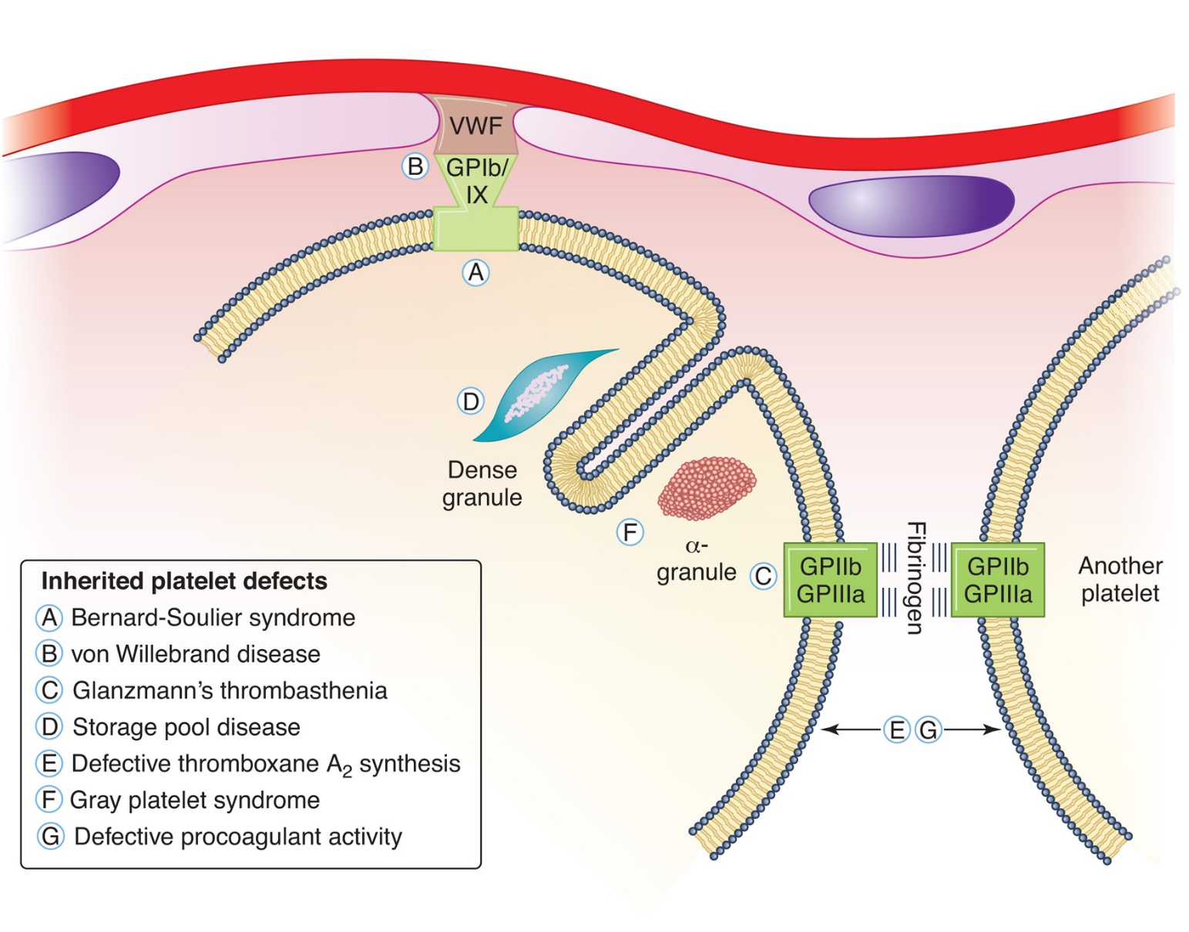
Figure 33-6 Ultrastructural Components Associated with Inherited Disorders of Platelet Function

Slide 88
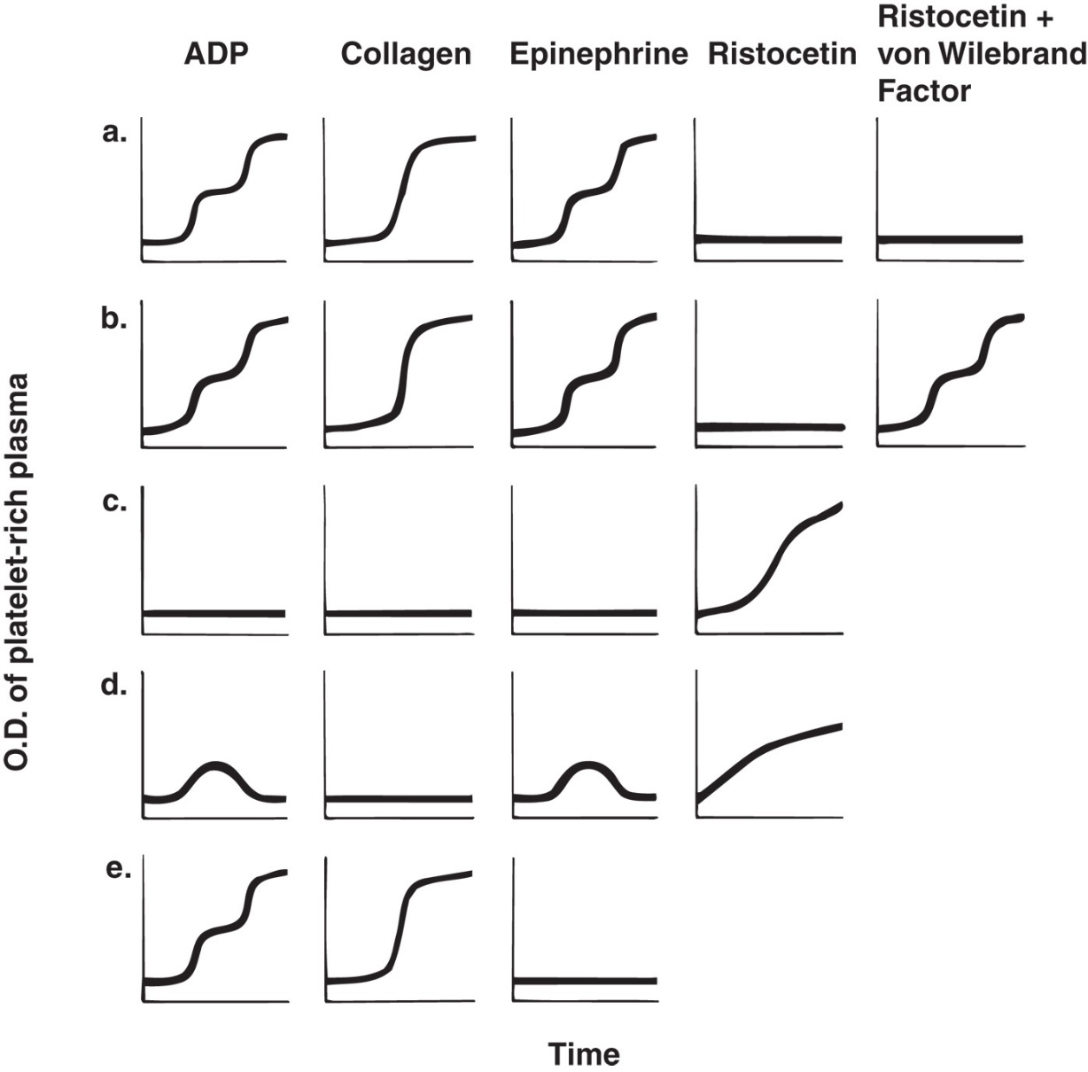
Figure 33-8 Platelet Aggregation Patterns in Disorders of Platelet Function
Notes:
(a) Bernard-Soulier syndrome. (b) von Willebrand disease. (c) Glanzmann thrombasthenia. (d) δ-storage pool disease, aspirin ingestion, uremia, thromboxane A₂ deficiency. (e) Myeloproliferative neoplasm.

Slide 89
Acquired Disorders of Platelet Function (1 of 2)
Bleeding less severe than seen in B S S and G T
Seen in:
Setting of trauma or surgery
Presence of additional hemostatic defects
Detected by abnormal platelet function test
B T, platelet aggregation
Defects quantified by laboratory tests do not correlate precisely with risk for bleeding

Slide 90
Acquired Disorders of Platelet Function (2 of 2)
Chronic renal failure
Hematologic disorders
Drugs
N S A I Ds
Alcohol
Antibiotics
Cardiopulmonary bypass surgery

Slide 91
Chronic Renal Failure
Platelet defects associated with uremic plasma
Dialysis corrects abnormal test results
Severe bleeding symptoms
Platelet aggregation
Abnormal with collagen and abnormal secondary aggregation with A D P and epinephrine-abnormal secretory response
Defective platelet procoagulant activity

Slide 92
Systemic Conditions (1 of 2)
Cardiopulmonary bypass surgery
Thrombocytopenia
Abnormal platelet function
Correlates with duration of the bypass procedure
Excessive bleeding is uncommon
Prolonged B T, abnormal platelet secretion and aggregation tests
Platelet defect likely due to
Effects of platelet activation
Fragmentation in extracorporeal circulation

Slide 93
Systemic Conditions (2 of 2)
Antiplatelet antibodies
I g molecules bind to the platelet surface in several pathologic conditions
I T P, S L E, platelet alloimmunization
Result accelerated platelet destruction, thrombocytopenia
Antiplatelet Abs bind and impair platelet function
Autoantibodies to G P I I b/I I I a-acquired G T
Autoantibodies to G P I b/I X/V-acquired B S S

Slide 94
Hematologic Disorders That Affect Platelet Function (1 of 2)
Chronic myeloproliferative neoplasms
P V, E T, C I M F
Usually abnormal platelet function
Abnormal aggregation to epinephrine, A D P, collagen often seen
Can see either bleeding or thrombosis
Leukemias and myelodysplastic syndromes
Bleeding usually due to thrombocytopenia
Occasionally abnormalities of platelet function

Slide 95
Hematologic Disorders That Affect Platelet Function (2 of 2)
Dysproteinemias
M M and Waldenström macroglobulinemia
Paraprotein coats platelet surface and interferes with membrane reactions and fibrin polymerization
Thrombocytopenia-major cause of bleeding
Abnormal platelet aggregation and procoagulant activity

Slide 96
Drugs That Alter Platelet Function
Aspirin (acetylsalicylic acid)
Impairs acetylation and irreversible inhibition of platelet cyclooxygenase (C O X-1 inhibitor)
Prevents formation and release of T X A ₂
Effects last entire circulating life span (~9-10 days)
Interferes with platelet aggregation-reflects lack of T X A ₂ synthesis
See primary wave with A D P and E P I
No secondary wave
No aggregation with collagen
Normal with ristocetin

Slide 97
N S A I Ds, Alcohol, and Antibiotics
N S A I Ds-Ibuprofen, naproxen, and others
Inhibit C O X-1
Reversible and short-lived (<72hours)
Alcohol
Heavy usage can lead to platelet dysfunction
Decreased primary aggregation with A D P
Antibiotics (penicillins and cephalosporins)
Coat platelet membrane and block A D P and epinephrine receptors-no primary or secondary aggregation wave

