Slide 1
Clinical Laboratory Hematology
Thrombophilia

Slide 2
Introduction (1 of 2)
Thrombosis
Formation of a platelet and/or fibrin mass within a vessel
Occurs when activation of blood coagulation exceeds the ability of the natural protective mechanisms to prevent fibrin formation
Can form in any part of the cardiovascular system
Composition of a thrombus differs in arterial and venous vessels
Difference between a “clot” and a “thrombus”
Clot forms extravascularly either in vitro or from bleeding into tissues
Thrombus-intravascular

Slide 3
Table 35-1 Physiologic Alterations Contributing to Thrombosis
Thrombogenic Alterations | Loss of Protective Mechanisms
Damage/activation of endothelial cells | Antithrombotic factors released from intact endothelium (prostacyclin, nitric oxide)
Exposure of subendothelium (loss of endothelial cells) | Neutralization of activated coagulation factors by endothelial components (thrombomodulin, heparan sulfate)
Activation of platelets (circulating agonists, interaction with subendothelium) | Inhibition of activated coagulation factors by naturally occurring plasma protease inhibitors (A T, T F P I, H C I I)
Activation of plasma coagulation proteins | Degradation of coagulation factors by inhibiting proteases (A P C)
Inhibition of fibrinolysis | Dilution of activated clotting factors and disruption of platelet aggregates by unimpeded blood flow
Stasis | Breakdown of fibrin thrombi by the fibrinolytic system
A T, antithrombin; T F P I, tissue factor pathway inhibitor; H C I I, heparin cofactor
A P C, activated protein C.

Slide 4
Introduction (2 of 2)
Thrombus may enlarge
Local obstruction of the blood vessel (ischemia)
Death of the tissue supplied by that vessel (necrosis)
Piece of thrombotic material (embolus)
May dislodge
Travel through circulatory system
Lodge at distant site and obstruct blood flow-embolism
When blockage originates from a thrombus-thromboembolism/T E

Slide 5
Thrombus Formation

Slide 6
Atherosclerosis and Atherothrombosis
Atherosclerosis
Gradual, progressive disease process
Lipids accumulate in the arterial intima
An inflammatory and prothrombotic process
Atherothrombosis
Begins with atherosclerosis
Advances through atherosclerotic plaque formation
Results in thrombosis upon atherosclerotic lesions in the artery
Plaques are composed of extracellular lipids, fibrous connective tissue, and foam cells

Slide 7
Arterial Thrombi-Formation (1 of 2)
“White thrombi”
Composed primarily of platelets and fibrin
Variable number of leukocytes, little erythrocytes and fibrin
Usually form at:
Regions of abnormal blood flow
Branch points
Sites of damage to endothelium
Atherosclerotic plaques
Endothelium dysfunction a result of cardiovascular risk factors

Slide 8
Arterial Thrombi-Formation (2 of 2)
“White thrombi”
Plaque ruptures
Exposing thrombogenic material in subendothelium to blood
Activation of platelets and plasma coagulation factors
Fibrin formation → thrombus
Embolization
Myocardial or cerebral infarction
Therapy
Platelet-inhibiting drugs (aspirin, clopidogrel, ticlopidine) or thrombolytic therapy

Slide 9
Arterial Thrombi-Risk Factors (1 of 2)
Traditional risk factors
Increasing age
Hypercholesterolemia
Hypertension
Smoking
Physical inactivity
Obesity
Diabetes
More recently recognized risk factors
H I V, chronic renal disease, hyperhomocysteinemia, ↑L p(a), o x L D L

Slide 10
Arterial Thrombi-Risk Factors (2 of 2)
Endothelial dysfunction
Loss of endothelial vasodilator activities (N O, P G I₂)
Also associated with loss of platelet inhibitory functions
Genetics
Development of arterial vascular disease
Multiple genes, environmental factors identified
Inflammation
Initiation and progression of atherothrombosis.
Linked to cardiovascular risk
Biomarkers of inflammation
I L-1, I L-6, h s C R P, fibrinogen, serum amyloid

Slide 11
Arterial Thrombi-Laboratory Evaluation
Standard laboratory tests of hemostasis
Neither sensitive nor specific
“New” potential tests
Sensitive, still not specific
Hyperhomocysteinemia
↑ Elevated L p(a)
↑ fibrinogen
↑ D-dimer
↑ P A I-1 or ↓ t-P A
↑ high sensitivity C R P (h s C R P)

Slide 12
Venous Thrombi-Formation (1 of 3)
“Red thrombi”
Composed primarily of red blood cells
Trapped in the fibrin mesh
Fewer platelets and leukocytes
Usually form in regions of
Slow or disturbed blood flow, lower shear rates
Often in venous segments exposed to trauma

Slide 13
Venous Thrombi-Formation (2 of 3)
“Red thrombi”
Most commonly occur in veins of lower limbs
Thrombophlebitis
Superficial veins of legs
Usually benign
Deep vein thrombosis (D V T)
Deep veins of legs
Distal thrombi-less serious than thrombi in proximal veins (popliteal, femoral, oriliac)

Slide 14
Venous Thrombi-Formation (3 of 3)
Serious potential complication
Pulmonary embolism (P E)
D V T → P E: V T E
Venous thrombosis
Occurs when activation of blood coagulation exceeds the ability of the natural protective mechanisms to prevent fibrin formation

Slide 15
Venous Thrombi-Risk Factors (1 of 2)
Venous stasis
Vessel wall damage
Factor V Leiden (F V L) and A P C resistance
Deficiency of protease inhibitors (A T, P C, P S, H C I I)
Elevated prothrombin levels (Prothrombin 20210)
Antiphospholipid antibodies

Slide 16
Venous Thrombi-Risk Factors (2 of 2)
Hyperhomocysteinemia
Decreased fibrinolytic activity
Malignancy
Surgery
Miscellaneous
Advanced age, obesity, blood type, pregnancy, O C/H R T, smoking, hypertension, hyperlipidemia

Slide 17
Venous Thrombi-Laboratory Evaluation
D V T
Laboratory diagnosis difficult
Objective diagnostic tests-visualization of thrombus
Diagnostic imaging
Noninvasive venous compression ultrasonography (C U S)
Spiral computerized tomography (s-C T)
P E
Computed tomography of the pulmonary arteries

Slide 18
Microparticles in Thrombosis (1 of 2)
Microparticles (M P s)
Cell-derived products which play key role in thrombus formation
Released from cell membrane during apoptosis or activation
Derived from platelets, E Cs, R B Cs, W B Cs, cancer cells
Differ in expression of phosphatidyl serine and/or T F
Controversy-cause or consequence of thrombosis?

Slide 19
Microparticles in Thrombosis (2 of 2)
Microparticles (M Ps)
Several roles
Have procoagulant potential
Play role in inflammation, angiogenesis, and immune response
Promote anticoagulant functions and fibrinolytic response

Slide 20
Table 35-2 Risk of Clinical Venous Thromboembolic Disease (1 of 2)
Blank | Low | Moderate | High | Excessive
Hereditary | Heterozygous A P C R | Heterozygous A T deficiency | Double heterozygous A P C R/prothrombin G 2 0 2 1 0 A | Homozygous or double heterozygous A T, P C, P S
Hereditary | Heterozygous prothrombin 20210 | Heterozygous P C or P S deficiency | Homozygous prothrombin G 2 0 2 1 0 A | Blank
Hereditary | Heterozygous H C I I | Blank | Homozygous factor V Leiden (A P C R) | Blank
Hereditary | Sickle cell anemia | Blank | Blank | Blank
Hereditary | Blood group A, B, A B | Blank | Blank | Blank
Hereditary | Dysfibrinogenemia | Blank | Blank | Blank
Acquired | General surgery | Sepsis | Hip fracture | Mucin-secreting adenocarcinoma
Acquired | Oral contraceptives pregnancy | Surgery for malignancy | Total hip or knee replacement | Blank
Acquired | Long trips | Prolonged immobilization | Acute promyelocytic leukemia | Blank

Slide 21
Table 35-2 Risk of Clinical Venous Thromboembolic Disease (2 of 2)
Blank | Low | Moderate | High | Excessive
Acquired | Elevated F V I I I | Antiphospholipid A b | T T P | Blank
Acquired | Elevated L p(a) | Myeloproliferative neoplasms | Blank | Blank
Acquired | H I T | P N H | Blank | Blank
Acquired | Blank | Major surgery/major trauma | Blank | Blank
A P C R, activated protein C resistance; A T, antithrombin; P C, protein C; P S, protein S; H C I I, heparin cofactor
methyltetrahydrofolate; A b, antibody; T T P, thrombotic thrombocytopenia purpura; L p(a), lipoprotein A; H I T, heparin-induced thrombocytopenia; P N H, paroxysmal nocturnal hemoglobinuria

Slide 22
Thrombophilia

Slide 23
Thrombophilia (1 of 3)
Any disorder associated with ↑ tendency to venous thrombosis (V T E)
Also referred to as hypercoagulability
“Thrombophilia”
Generally used for describing laboratory abnormalities that increase the risk of V T E
May be inherited or acquired
Thrombosis at young age
Most important feature of inherited thrombophilia
Risk varies from low to modest to high

Slide 24
Thrombophilia (2 of 3)
Hereditary thrombophilia
Predisposing genetic defects result in a tendency to thrombosis
Most inherited alterations associated with:
↑ in procoagulant potential
↓ in natural inhibitors of clotting
Abnormalities of fibrinolysis or platelet activation

Slide 25
Thrombophilia (3 of 3)
Inherited thrombophilic defect
Places individual at risk for thrombosis
Does not inevitably lead to thrombosis
Often requires some other (acquired) risk factor
Surgery, pregnancy, immobilization, estrogen therapy, obesity, trauma, infection
Combination of hereditary predisposition and acquired predisposition
Accelerates and exaggerates thrombotic process
“Multiple hit” theory of thrombosis
Gene-gene and/or gene-environment interactions

Slide 26
Hereditary Thrombophilia (1 of 2)
Inherited thrombotic disorders
Usually associated with venous thrombosis
Usually suggested by:
Venous thromboembolism at a young age
Prior to age 50
Recurrent venous thromboembolism
Strong family history of venous thromboembolism
Thrombosis in an unusual site
Cervical or visceral vein
Not considered a major risk factor for arterial cardiovascular disease

Slide 27
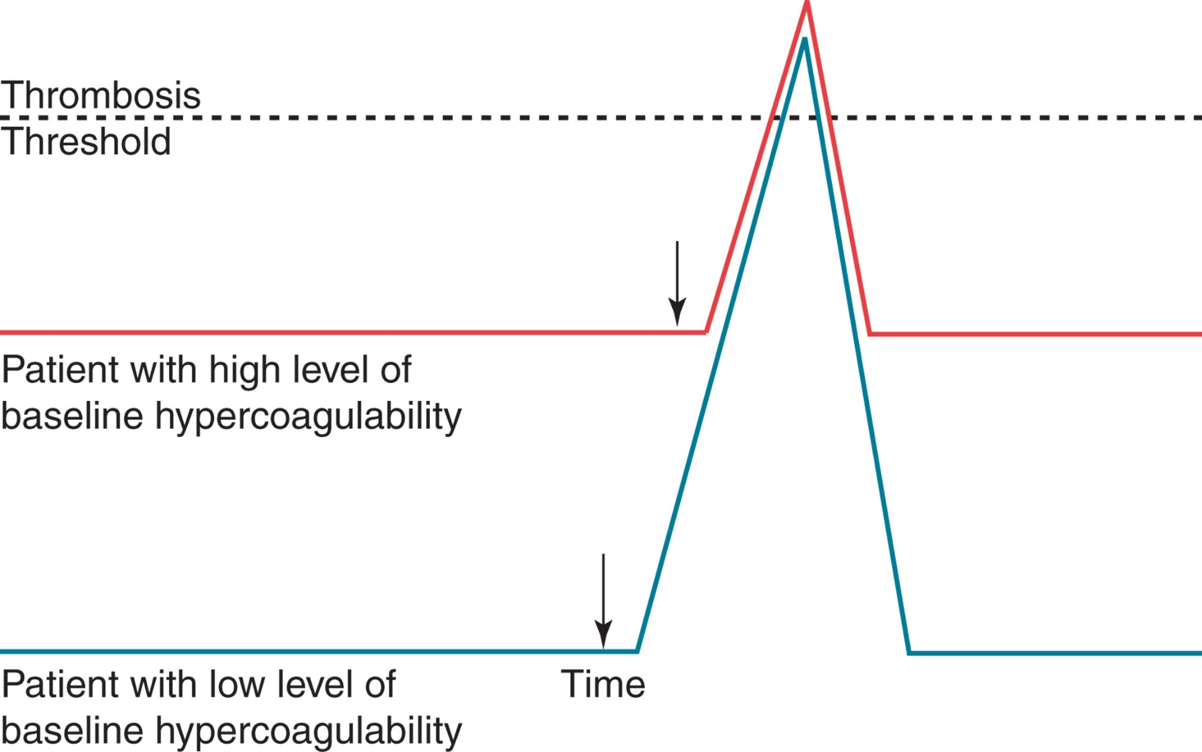
Figure 35-1
Notes:
Interaction of acquired thrombotic triggers with individual baseline hypercoagulability. Individuals with hereditary mutations resulting in thrombophilia have a higher baseline level of hypercoagulability (red line) compared with normal individuals (blue line). As a result, the introduction of an identical acquired prothrombotic stimulus will more easily push the thrombophilic individual into an overt acute thrombotic event (dotted line), compared with a normal individual.

Slide 28
Table 35-3 Hereditary Conditions Associated with Thrombosis
Factor | Biochemical Inhibitors | Fibrinolysis | Other
Elevated F V I I I | Antithrombin deficiency | Plasminogen deficiency | Hyperhomocysteinemia Cystathionine synthase deficiency Methylenete-trahydrofolate reductase deficiency
F X I I deficiency | H C I I deficiency | Plasminogen activator deficiency | A B O blood type
Dysfibrinogenemia/ hyperfibrinogenemia | P C deficiency | Elevated P A I-1 | Blank
Prothrombin mutation G 2 0 2 1 0 A | P S deficiency | Blank | Blank
Blank | Activated protein C resistance (A P C R) | Blank | Blank
Blank | Tissue factor pathway inhibitor variant | Blank | Blank
H C I I, heparin cofactor
plasminogen activator inhibitor; P C, protein C; P S, protein S.

Slide 29
Hereditary Thrombophilia (2 of 2)
Most common inherited abnormalities
Factor
Leiden, defective or decreased P C, P S, or
antithrombin and prothrombin G20120A mutation
Account for 30% of initial D V T cases
50% normal levels-associated with ↑ risk
Deficiencies of A T, P C or P S
Associated with a
Quantitative decrease of the protein (type I deficiency)
Qualitative deficiency due to synthesis of a defective
protein (type
deficiency)

Slide 30
Antithrombin Deficiency (1 of 5)
Pathophysiology
Reduction of A T levels
To ~50% of normal predisposes to venous thrombosis
Rare
>300 different mutations described
Type
deficiency-quantitative deficiency
Type
deficiency-qualitative defect
Mutation of either heparin binding site or thrombin binding site

Slide 31
Antithrombin Deficiency (2 of 5)
Type
Heterozygous
30-60% of normal
Rarely develop thrombosis before puberty
Risk ↑ with advancing age (55% lifetime risk)
Homozygous
Incompatible with fetal survival

Slide 32
Antithrombin Deficiency (3 of 5)
Type
Heterozygous
Thrombotic episodes before puberty-rare
Risk increases with age
Homozygous
Severe, life-threatening thrombotic problems in perinatal period

Slide 33
Antithrombin Deficiency (4 of 5)
Acquired
Associated with variety of clinical conditions
Decreased production
Severe liver disease
Increased consumption
Acute thrombosis, D I C
Increased clearance or loss
Nephrotic syndrome
Heparin administration
High dose O Cs and late pregnancy

Slide 34
Antithrombin Deficiency (5 of 5)
Laboratory evaluation
Functional assays
Progressive A T assay, heparin cofactor assay
Antigenic assays (nonfunctional)
Immunologic
Treatment
Heparin
A T concentrates
Prophylactic therapy usually unnecessary

Slide 35
Table 35-5 Laboratory Classification of Congenital Antithrombin Deficiency
Blank | Concentration | Functional Activity for Heparin Cofactor | Functional Activity for Progressive A T
Type One | Decreased | Decreased | Decreased
Type Two | Blank | Blank | Blank
Active site defect (I I a) | Normal | Decreased | Decreased
Heparin-binding site defect (I I b) | Normal | Decreased | Normal

Slide 36
Protein C Deficiency (1 of 4)
Pathophysiology
Reduction of P C
To ~50% of normal predisposes to venous thrombosis
A D inheritance
~6% of familial thrombophilia cases
>350 different mutations described
Type
deficiency-quantitative deficiency
Type
deficiency-qualitative deficiency

Slide 37
Protein C Deficiency (2 of 4)
Predisposes to thrombosis because
↓ capacity to destroy F V a and F V I I I a
Results in an ↑ generation of thrombin and fibrin
Loss of cytoprotective effects (anti-inflammatory and anti-apoptotic) of A P C binding to E P C R

Slide 38
Protein C Deficiency (3 of 4)
Heterozygotes
40-60% of normal
May experience purpura fulminans-like episode with initiation of Coumadin therapy
Transient hypercoagulable state
Due to shorter half-life of P C compared to vitamin K-dependent procoagulant proteins
Homozygotes and double heterozygotes
Purpura fulminans (usually associated with <5% P C activity)
Require P C replacement/lifetime anticoagulation

Slide 39
Protein C Deficiency (4 of 4)
Acquired deficiencies
Newborns, hepatic disease, D I C, severe infection, septic shock, post-operative, oral anticoagulation, vitamin K deficiency
Treatment
Heparin, followed by oral anticoagulant
Prophylactic R x if repeated T E

Slide 40
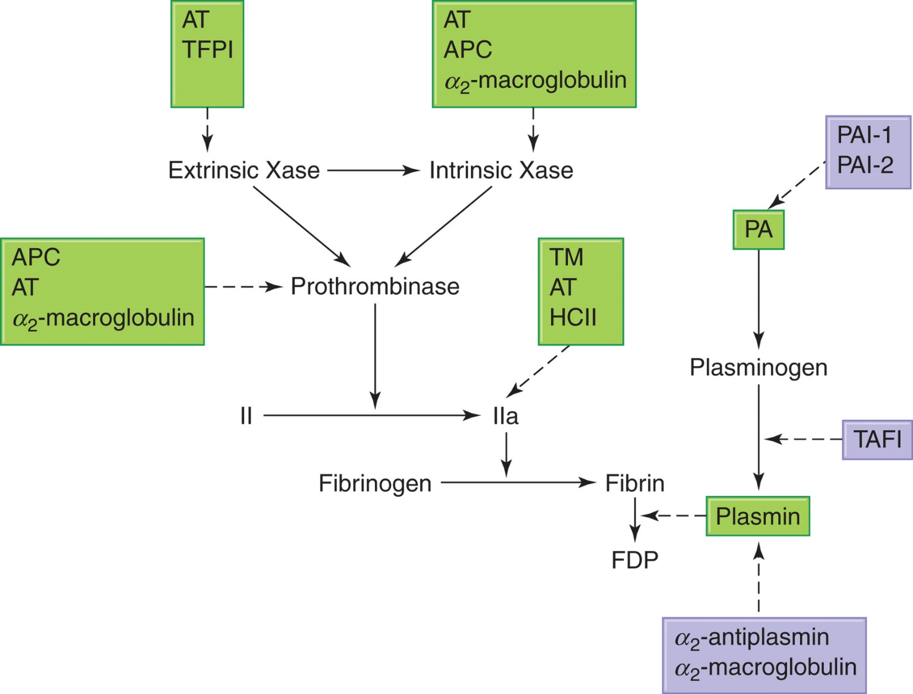
Figure 35-2 Physiologic Control of the Hemostatic Process
Notes:
The extrinsic Xase and intrinsic Xase activate FX, which forms the prothrombinase complex with FVa, Ca⁺⁺, and phospholipid. The prothrombinase complex cleaves prothrombin (II) to form thrombin (IIa). Thrombin cleaves fibrinogen to form fibrin. Plasmin cleaves fibrin and forms fibrin degradation products (FDPs). The inhibitors of each of these pathways are depicted in boxes with broken arrows to show the site of inhibition. If there is a defect or deficiency in any of the procoagulant inhibitors, the hemostatic control mechanism is tipped in favor of thrombosis. AT, antithrombin; TFPI, tissue factor pathway inhibitor; APC, activated protein C; TM, thrombomodulin; HCII, heparin cofactor II; TAFI, thrombin activatable fibrinolysis inhibitor; PA, plasminogen activator; PAI, plasminogen activator inhibitor.

Slide 41
Table 35-6 Laboratory Classification of Protein C Deficiency
Blank | Concentration | Functional Activity
Type One | Decreased | Decreased
Type Two | Normal | Decreased

Slide 42
Protein S Deficiency (1 of 3)
Pathophysiology
Protein S circulates in 2 forms
Inactive form bound to C4b-B P (60%)
Unbound or free form (40%)
Only free P S has P C cofactor activity
Absolute and relative amounts of free P S
Determined by plasma concentration of C 4 b B P
↓ free P S
Prothrombotic tendency due to inadequate A P C inactivation of F V a and F V I I I a

Slide 43
Protein S Deficiency (2 of 3)
Pathophysiology
Type
deficiency-quantitative deficiency
Type
deficiency-qualitative deficiency
Type
deficiency-↓ free P S (normal total P S)

Slide 44
Protein S Deficiency (3 of 3)
Clinical presentation
Similar to that of P C deficiency
~6% of familial thrombophilia cases
Acquired deficiencies
Same as P C deficiencies
Laboratory evaluation
Measure both total and free P S antigen levels
Functional assay based on ability to serve as cofactor for anticoagulant effect of A P C
Treatment
Similar to P C deficiency

Slide 45
Table 35-7 Laboratory Classification of Protein S Deficiency
Blank | Total Protein S | Free Protein S | Protein S Activity
Type One | Decreased | Decreased | Decreased
Type Two | Normal | Normal | Decreased
Type Three | Normal | Decreased | Decreased

Slide 46
Activated Protein C Resistance (1 of 3)
Most common hereditary thrombophilia
Pathophysiology
Inability of A P C to prolong clotting tests when added to a test system
Due to a diminished ability to destroy F V a
In vivo-inadequate F V a inactivation
↑ production of thrombin and possibly thrombosis

Slide 47
Activated Protein C Resistance (2 of 3)
Pathophysiology
90% of cases of A P C R due to F V Leiden
A r g → G l3n mutation
Mutant F V a protein resistant to A P C inactivation because A P C cleavage site is altered
10% of patients
Have an alternate mutation
F V I I I gene
No genetic abnormalities have been identified as cause of A P C R

Slide 48
Activated Protein C Resistance (3 of 3)
Prevalence of F V L
Varies with geographical population
Homozygotes are at higher thrombotic risk than heterozygotes
Accounts for 40% of familial thrombophilia cases
Laboratory evaluation
Requires both clot-based functional assay (A P C R) and P C R-based molecular assay for F V L
Treatment
Acute thrombosis-same
Prophylactic treatment-only if at increased risk or have recurrent thrombosis

Slide 49
Prothrombin Gene Mutation G20210A (1 of 2)
Pathophysiology
G → A substitution in 3′ untranslated region of the prothrombin gene
Associated with a mild elevation of plasma prothrombin levels (115-130%)
Increased risk of thrombosis due to:
Increased prothrombin causing increased thrombin generation

Slide 50
Prothrombin Gene Mutation G20210A (2 of 2)
Clinical presentation
Prevalence varies with geographical population
Accounts for ~18% of familial thrombophilia cases
Laboratory evaluation
G → A substitution
Screening for this mutation using coagulation testing is unreliable
Molecular testing for the single point mutation is required

Slide 51
Table 35-4 Inherited Thrombophilia: Characteristics of the Five Most Studied Defects^{43,44}
Blank | Factor V Leiden | Prothrombin G20210A | P C Deficiency | P S Deficiency | Antithrombin Deficiency
Occurrence | Blank | Blank | Blank | Blank | Blank
General population | 4-10% | 2-4% | 0.2-0.4% | 0.03-0.1% | 0.02%
First D V T | 20% | 7% | 3% | 2-3% | 1-2%
Thrombophilic families | 40% | 18% | 6% | 4% | 4%
Physiologic effect | F V a resistant to cleavage by A P C | ↑ Prothrombin ↑ Thrombin formation | ↓ Inactivation of F V a, F V I I I a | ↓ Cofactor for A P C ↓ A P C function | ↓ Inhibition of F X a, thrombin
Blank | Blank | Blank | Unregulated coagulation | Blank | Unregulated coagulation
Clinical presentation | Blank | Blank | Blank | Blank | Blank
Homozygous | ↑ ↑ Risk V T E | ↑ Risk V T E | Purpura fulminans | Purpura fulminans | Lethal in utero
Blank | Blank | Possible ↑ arterial T E | Blank | Blank | Blank
Heterozygous | ↑ Risk V T E (4 − 7 × ) | ↑ Risk V T E (3 − 4 × ) | ↑ Risk V T E (4 − 8 × ) | ↑ Risk V T E (4 − 8 × ) | ↑ Risk V T E (10×)
P C, protein C; P S, protein S; D V T, deep vein thrombosis; V T E, venous thromboembolism; A P C, activated protein C; T E, thromboembolism; ↑, slightly-moderately increased; ↑↑, highly increased; ↓, decreased.

Slide 52
Heparin Cofactor Two Deficiency
A3D disorder
Many individuals asymptomatic
Heterozygous state-thrombotic risk only if combined with second thrombotic risk
Acquired H C I I deficiency
D I C, liver disease, and so on
Laboratory evaluation
No F D A approved test available

Slide 53
Tissue Factor Pathway Inhibitor Variant
T F P I
Cannot be measured by plasma assays
Exists bound to endothelial cells
Candidate mutation in T F P I gene
Associated with ↑ risk of V T E
Limited usefulness at present in clinical screening

Slide 54
A B O Blood Group
Non-O blood groups
B and A1 blood groups
Higher risk for V T than O and A2 groups
A B O locus glycosyltransferases on V W F and F V I I I
Results in higher levels of V W F and F V I I I in B and A 1 groups

Slide 55
Hyperhomocysteinemia (H C) (1 of 5)
Homocysteine
Normally metabolized by either:
Cystathionine β synthase (C B S)
Methylene tetrahydrofolate reductase (M T H F R)
Metabolism impaired → hyperhomocysteinemia

Slide 56
Hyperhomocysteinemia (H C) (2 of 5)
Pathophysiology
Severe hyperhomocysteinemia
Rare inborn error of metabolism
Most often associated with homozygous mutations in C B S gene
Less common-M T H F R gene mutation
Excretion of H C in urine-homocystinuria
Associated with premature atherosclerosis and thrombosis

Slide 57
Hyperhomocysteinemia (H C) (3 of 5)
Pathophysiology
Mechanism linking H C to thrombosis not fully understood
Affects vessel wall
Considered an independent risk factor for arterial and venous thrombotic disease

Slide 58
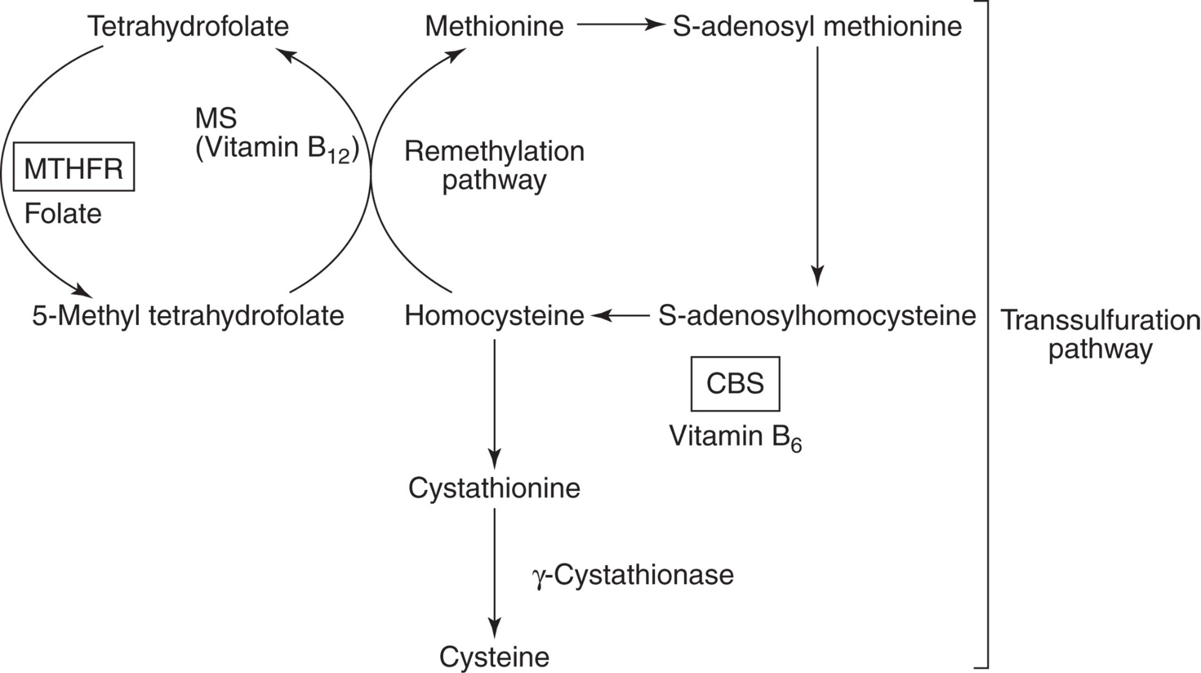
Figure 35-3 Homocysteine Metabolism
Notes:
Mutations of MTHFR and CBS are associated with hyperhomocysteinemia. Deficiencies of vitamin B₁₂, vitamin B₆, and folate are associated with acquired hyperhomocysteinemia. Hyperhomocysteinemia can lead to increased risk for thrombosis. MTHFR, methylene tetrahydrofolate reductase; MS, methionine synthetase; CBS, cystathionine β-synthase.

Slide 59
Hyperhomocysteinemia (H C) (4 of 5)
Clinical presentation
Genetic mutations of C B S and/or M T H F R
30-40% of Caucasians heterozygous for mutation of M T H F R
Usually no hyperhomocysteinemia or↑ risk of vascular disease, unless combined with second risk factor
Acquired hyperhomocysteinemia
Deficiencies of vitamin B₆, B₁₂, folate, smoking, drugs, aging, diabetes, renal disease

Slide 60
Hyperhomocysteinemia (H C) (5 of 5)
Laboratory evaluation
Measure H C by gas chromatography, ion exchange chromatography, and H P L C
M T H F R mutation testing not recommended as part of a thrombophilia workup
Treatment
Dietary/vitamin therapy
Administration of B₆, B₁₂, folate

Slide 61
Fibrinogen Disorders (1 of 2)
Dysfibrinogenemias
Pathophysiology
A D qualitative defects
Altered structure which leads to altered function
Decreased fibrinolysis due to:
Fibrin resistance to lysis by plasmin
Reduced plasminogen activation
Mutated fibrinogen which forms high fiber density clots

Slide 62
Fibrinogen Disorders (2 of 2)
Clinical presentation
No symptoms
Bleeding problems
Thrombotic problems
Related to pregnancy
Spontaneous abortions, postpartum T E
Laboratory evaluation
Functional - T T and reptilase time
Quantitative - immunologic assays
Characterization of the molecular defect
Gold standard

Slide 63
Elevated Factor Eight and V W F
↑ plasma F V I I I and/or V W F (>150%)
↑ risk of thrombotic disease
Enhanced thrombin formation or
Specific polymorphisms of F V I I I and V W F genes
Associated with increased V I I I and V W F levels
Dose-response relationship between F V I I I level and V T E risk

Slide 64
Factor twelve and Thromboembolic Disease
F X I I deficiency
May contribute to embolic disease due to defective thrombus stability
May provide thromboprotection

Slide 65
Fibrinolytic System Disorders (1 of 2)
Dysfibrinogenemia
Plasminogen deficiency
Quantitative
Qualitative
Clot lysis or chromogenic (functional) assays and immunologic assays available

Slide 66
Fibrinolytic System Disorders (2 of 2)
t P A and P A I
Inadequate stores or release of t P A
Inappropriate/excess release of P A I
Either could contribute to thrombosis
Both likely play a greater role in acquired thrombophilia than in hereditary
Chromogenic (functional) and E L I S A (quantitative) assays available

Slide 67
Acquired Thrombohemorrhagic Conditions
Heterogeneous group of disorders
Associated with ↑ risk for developing T E
Vary widely in tendency to cause venous and arterial thrombotic disease
Acquired defects as common as inherited
Clinical presentation can range from thrombosis to bleeding-thrombohemorrhagic conditions

Slide 68
Table 35-8 Secondary Disorders and Other Factors Contributing to Acquired Thrombophilia
Secondary Disorders | Other Factors
Fibrinolytic system defects | Over 50 years of age
Antiphospholipid antibody syndrome | Obesity
Malignancy | Diet with inadequate folate, vitamin or vitamin B₁₂
Hip, knee surgery | Smoking
Chronic inflammatory disease | Pregnancy, use of oral contraceptives, hormone replacement therapy
Congestive heart failure | Stasis/immobilization (prolonged car or air travel, bedrest)
Atrial fibrillation | Trauma/postoperative state
Hematologic disorders Polycythemia vera/MPNs Acute promyelocytic leukemia Hemolytic anemia Sickle cell anemia Paroxysmal nocturnal hemoglobinuria | Blank
Nephrotic syndrome | Blank
Atherosclerosis | Blank
Hyperlipidemia, hypercholesterolemia, increased lipoprotein (a) | Blank
M P N, myeloproliferative neoplasm

Slide 69
Acquired Fibrinolytic Defects
30-40% of patients with thromboembolic disease
Have impaired fibrinolytic function
Seen post-surgery, coronary disease, O C, third trimester pregnancy, certain infections, drugs, malignancies
↑ plasma P A I-1 most common
+/− ↓ t-P A
Long-lasting inflammatory condition
Elevated P A I-1 (acute-phase reactant)

Slide 70
Antiphospholipid Antibody Syndrome (A P L S) (1 of 5)
Antiphospholipid antibodies
Include:
Lupus anticoagulant (L A)
Anticardiolipin antibodies (a C L)
Several subgroups-antibodies to P Ls and P L binding proteins
Identified in patients with S L E-hence “L A”
Produced after certain infections, exposure to medications, in autoimmune disorders
Most common cause of acquired thrombophilia
5-30% of patients with V T E are positive for L A

Slide 71
Antiphospholipid Antibody Syndrome (A P L S) (2 of 5)
Pathophysiology
Laboratory phenomenon
Prolongation of phospholipid-dependent clotting assays in vitro-hence term “anticoagulant”
Usually no bleeding diathesis
More often associated with increased risk of arterial and venous thrombosis

Slide 72
Antiphospholipid Antibody Syndrome (A P L S) (3 of 5)
Etiology
Not clearly understood
Clinical presentation
Venous thromboembolism (V T E)
D V T, P E
Arterial thromboses
Stroke, T I A, M I
Recurrent miscarriages

Slide 73
Antiphospholipid Antibody Syndrome (A P L S) (4 of 5)
Antigenic specificities of “a P L” antibodies
Usually I g G, can be I g M or mixture
Do N O T recognize P Ls directly
Recognize phospholipid-binding proteins
For example β2
P C, P S, T F P I
a P L antibodies associated with
Autoimmune disorders (S L I, Sjogren syndrome, R A)
Certain infections (malaria, parasitic)
Drugs ( neuroleptics, quinidine, etc.)
a P L antibodies in the general population (~3-10%)

Slide 74
Antiphospholipid Antibody Syndrome (A P L S) (5 of 5)
Laboratory evaluation
Immunoassays
Originally designed to detect Abs that recognize P L components
For example, E L I S A for anticardiolipin Abs, anti-P S
New assays designed to detect Abs recognizing phospholipid cofactors (e.g., anti-β 2 G P I)
Coagulation assays
Ab reacts with phospholipids in the test system and prolongs clotting
Sensitivity of assay influenced by reagent used

Slide 75
Identifying a P L Antibodies
Four-step approach:
Prolongation of a P L-dependent coagulation test (e.g., A P T T, d R V V T, K C T)
Evidence of inhibitor activity (lack of correction by a 1:1 mix with normal plasma)
Confirmation that inhibitory effect blocks P L-dependent coagulation (i.e., neutralization of inhibitor effect by addition of excess P L s or changing P L source)
Absence of specific inhibitor against a coagulation factor

Slide 76
Table 35-9 Recommended Approach for Identifying the Lupus Anticoagulant (1 of 2)
Screening procedures-two or more using single concentration of phospholipid
Demonstrate at least one prolonged phospholipid-based clotting test (e.g., A P T T).
Demonstrate at least one additional prolonged L A screening test (e.g., d R V V T, P C T, dilute prothrombin time [d P T])
Additional requirements for documenting L A
Mixing studies with normal platelet-free plasma not corrected (confirms presence of inhibitor)
Exclusion of presence of heparin in the sample (e.g., normal thrombin time/reptilase time)
Proof that another coagulopathy is not present or concurrent; specific factor assay to rule out a factor deficiency; detailed clinical history

Slide 77
Table 35-9 Recommended Approach for Identifying the Lupus Anticoagulant (2 of 2)
Confirmatory procedures-modify abnormal screening procedure by altering phospholipid content of the test procedure, which demonstrates that the inhibitory factor depends on phospholipid
Reducing phospholipid concentration in test reagent to accentuate prolonged test (e.g., diluting the test reagent)
Neutralizing the effect of the L A by increasing the phospholipid in the test system (e.g., frozen-thawed platelets [platelet neutralization procedure], platelet vesicles hexagonal phase array)
L A, lupus anticoagulant; A P T T, activated partial thromboplastin time; d R V V T, dilute Russell’s viper venom time; P C T, plasma clotting time

Slide 78
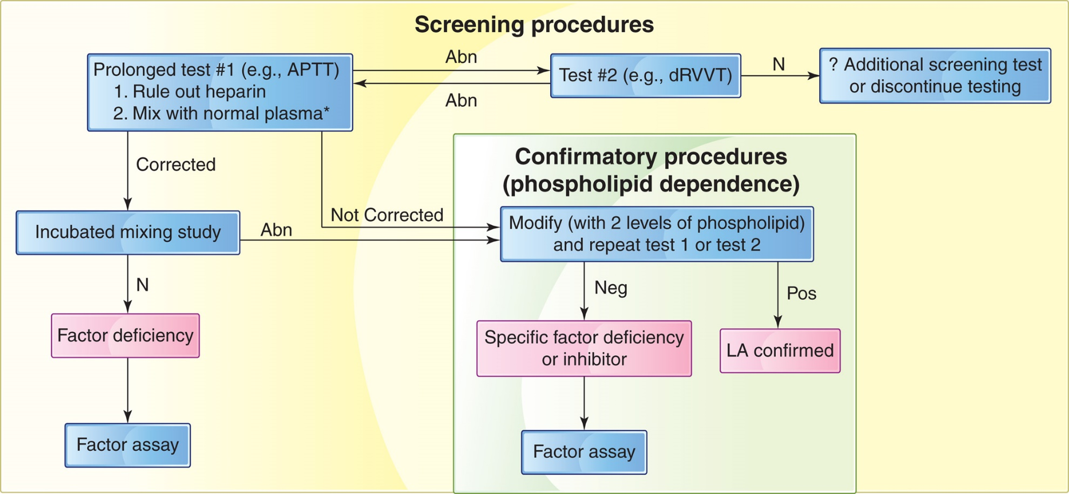
Figure 35-4
Notes:
A flow chart for an approach to the diagnosis of the lupus anticoagulant (LA). At least two phospholipid-based screening tests based on two different principles must be prolonged. Mixing studies must be uncorrected with normal plasma. The presence of heparin must be ruled out. Confirmatory tests are performed by modifying the abnormal screening tests with two levels of phospholipid. Plasma samples must be platelet free. Cor, corrected; N, normal; Abn, abnormal; LA, lupus anticoagulant; APTT, activated partial thromboplastin time; dRVVT, dilute Russell’s viper venom time.

Slide 79
Heparin and Thrombocytopenia
Heparin-associated thrombocytopenia (H A T)
Type
Nonimmune-mediated mechanism
Heparin causes direct platelet activation
Thrombocytopenia
Not associated with increased risk of thrombosis
Heparin-induced thrombocytopenia (H I T)
Type
Immune-mediated destruction of platelets
Autoantibody against P F4/heparin complex

Slide 80
H I T (1 of 5)
Pathophysiology
P F 4 released from α-granules during activation
Nonspecific binding to circulating heparin
Antibodies produced to heparin/P F 4 complex and attach to platelet surface via FcγI I a receptors
Results in:
Increased platelet clearance and thrombocytopenia
Platelet activation and aggregation

Slide 81
H I T (2 of 5)
Pathophysiology
Immune response to heparin exposure
Directed against heparin-platelet factor 4 complexes
Results in thrombin-driven coagulopathy
Thrombosis
Associated with high morbidity and mortality
May present with thrombocytopenia
With thrombotic complications (H I T T)
Without thrombosis (isolated H I T)

Slide 82
H I T (3 of 5)
Clinical presentation
Activation of coagulation system and thrombosis
3% of patients on U F H will develop thrombocytopenia
Risk is greater with use of U F H than L M W H
⅓ develop thrombosis
Platelet count ↓ → discontinue heparin
Most common complications
Venous-D V T and P E
Arterial-acute limb ischemia or thrombotic stroke

Slide 83
H I T (4 of 5)
Laboratory evaluation
Requires evidence of anti-P F 4/heparin antibodies
Functional platelet activation assays-measure ability of H I T-I g G to activate platelets
S R A-Serotonin release assay
Flow cytometry
Heparin-induced platelet activation assay (H I P A)
Immunoassays
E L I S A assays for anti-P F 4/heparin antibodies
Both assays have similar sensitivity
Functional assays have greater specificity, lower sensitivity

Slide 84
H I T (5 of 5)
Therapy
Monitor platelet count
If count falls, discontinue heparin and use another anticoagulant
L M W H cannot be used
Establish adequate anticoagulation and normal platelet count before starting oral anticoagulants

Slide 85
Thrombotic Microangiopathies
T M A
Clinical disorders characterized by presence of
Microangiopathic hemolytic anemia (M A H A)
Thrombocytopenia
Microvascular thrombotic lesions
T M A includes:
Disseminated intravascular coagulation (D I C)
Thrombotic thrombocytopenic purpura (T T P)
Hemolytic uremic syndrome (H U S)

Slide 86
T T P (1 of 6)
“Classic pentad”
M H A
Thrombocytopenia
Neurologic symptoms
Fever
Renal dysfunction
Less stringent criteria for diagnosis today
M H A and thrombocytopenia in absence of another clinically apparent cause

Slide 87
T T P (2 of 6)
Pathophysiology
Systemic platelet activation and aggregation with microvascular thrombosis
Primarily composed of platelets
No activation of coagulation cascade
Triggered by ultralarge V W F multimers (U L V W Fs)
Deficiency/dysfunction of antibodies to A D A M T S-13
a disintegrin-like and metalloprotease with
thrombospondin
Cleaves U L V W F

Slide 88
T T P (3 of 6)
Pathophysiology
Uncleaved U L V W f
Bind tightly to platelets, forming aggregates that can embolize and occlude downstream small arterioles
Microvascular thrombosis, tissue ischemia, and infarction
Schistocytes
Severe thrombocytopenia
Neurologic defects

Slide 89
T T P (4 of 6)
Clinical presentation
Familial T T P (Upshaw-Shulman syndrome)
A R disorder
Repeated episodes of T M A during childhood (chronic, relapsing T T P)
Inherited deficiency/dysfunction of A D A M T S-13 (9q34)
Failure to cleave U L V W F multimers
Platelet-rich microvascular thrombosis → T T P
Treatment
Historically, plasma infusion
Recombinant A D A M T S-13, antagonists

Slide 90
T T P (5 of 6)
Clinical presentation
Acquired T T P ( previously idiopathic T T P)
Female:male = 3:2
More common in African ancestry, obesity
Also associated with pregnancy, drugs, cancer, tissue transplantation
Autoantibodies against A D A M T S-13
Mortality >90% without treatment
65%-single episode; 35%-recurrent disease
Treatment-plasma exchange
F F P or cryosupernatant

Slide 91
T T P (6 of 6)
Laboratory evaluation
Evidence of M A H A
Most coagulation screening tests are normal (P T, A P T T, T T)
To confirm diagnosis
A D A M T S-13 assay
Antibody or inhibitor activity measured by Bethesda-type methodology
Plasma exchange should begin immediately

Slide 92
Figure 35-5 V W F Processing by A D A M T S-13
Notes:
(a) Normal ADAMTS-13 proteolytically cleaves ultralarge von Willebrand factor multimers (ULVWFs) into smaller subunits. (b) In the absence of ADAMTS-13 activity, ULVWF multimers persist, inducing platelet agglutination and the formation of platelet thrombi.

Slide 93
H U S (1 of 6)
Hemolytic Uremic Syndrome (H U S)
Multisystem disorder characterized by triad of clinical features:
Hemolytic anemia with R B C fragmentation, thrombocytopenia, acute nephropathy (can include acute renal failure)
Two group categorization (D+ H U S, D− H U S) no longer recommended
Subdivided into:
S T E C-H U S
Secondary H U S
Atypical H U S

Slide 94
H U S (2 of 6)
S T E C-H U S
Presence of Shiga-like toxin producing organism
Non-Shiga-like toxin producing organisms may also cause H U S
90% of cases, most in children ≤5
G I infections-Shiga toxin producing E. coli
E. coli O157:H7 most common in U S
Most other cases associated with Shigella dysenteriae Type 1

Slide 95
H U S (3 of 6)
Atypical H U S
Inherited or familial
H U S caused by mutations in:
Complement regulatory proteins
Alternate complement pathway protein mutations
Factor H, M C P/C D 4 6),
Autoantibody against factor H
Defective regulation of complement activation results in
Cell membrane damage, R B C fragmentation, platelet activation and aggregation

Slide 96
H U S (4 of 6)
Secondary H U S
Post-infectious H U S not caused by S T E C
Streptococcus pneumoniae infections
Viral infections (Epstein-Barr virus, human immunodeficiency virus, cytomegalovirus)
Noninfectious causes

Slide 97
H U S (5 of 6)
Clinical presentation
Microthrombi usually rich in fibrin and platelets
P T, A P T T are usually normal
Procoagulant activation is not sufficient to induce a consumptive coagulopathy
Thrombocytopenia and neurologic manifestations are less common and less severe in H U S than in T T P
Renal involvement is more severe than in T T P
60% of patients require renal dialysis
40-50% develop chronic renal insufficiency

Slide 98
H U S (6 of 6)
Therapy
S T E C-H U S is usually a self-limiting syndrome
Children are usually managed by supportive care only
Plasma exchange or infusions
Individuals with inherited deficiencies of complement regulatory proteins
Eculizumab
Effective for a H U S, not S T E C-H U S
Acts by suppressing complement activation

Slide 99
Table 35-10 Comparison of T T P and H U S
Feature | T T P | H U S
M A H A | Yes | Yes
Thrombocytopenia | Severe | Moderate to severe
Age | Peak incidence less than 40 years | Childhood, less than 5 years
Gender | Female predominance | Equal
Epidemic | No | Yes
Recurrence | Common | Rare
Link to E. coli O157:H7 | Occasional | Yes
Renal failure | Uncommon | Common
Neurologic symptoms | Common/severe | Uncommon/mild
Organ involvement | Multiple | Limited to kidney
VWF multimer | Ultralarge forms present | “Normal” multimers predominate
A D A M T S-13 activity | Deficient | Normal
T T P, thrombotic thrombocytopenic purpura; H U S, hemolytic uremic syndrome; M A H A, microangiopathic hemolytic anemia; V W F, von Willebrand factor.

Slide 100
D I C
Normal balance of hemostasis is altered
Uncontrolled inappropriate formation and lysis of fibrin systematically within blood vessels
Clotting proteins, inhibitors and platelets are consumed faster than they are synthesized (consumption coagulopathy)
Fibrinolysis follows fibrin formation
Patient generally bleeds at same time that disseminated clotting is occurring

Slide 101
D I C-Incidence and Etiology
1 in 1000 hospitalized patient
Group of symptoms secondary to a primary condition
Most involve introduction of T F into vascular system
Most common-severe infections (septicemia)
Bacterial toxins and inflammatory cytokines (I L-1, I L-6, T N F) activate E C to express T F
Others
Pregnancy (thromboplastin from amniotic fluid)
Massive tissue or blood cell injury
Malignancy (chemo, ↑ T F in the blood stream)

Slide 102
Table 35-11 Clinical Conditions Associated with the Development of Disseminated Intravascular Coagulation (D I C) (1 of 2)
Infections | Bacterial (gram positive and gram negative)
Blank | Viral
Blank | Fungal
Blank | Rickettsial
Blank | Protozoal
Complications of pregnancy | Abruptio placentae Amniotic fluid embolism Retained placenta Preeclampsia/eclampsia H E L L P (hemolysis, elevated liver enzymes, and low platelet count) syndrome Intrauterine fetal death Septic abortion
Neoplasms (malignant) | Solid tumors
Blank | Leukemia, particularly acute promyelocytic
Massive tissue injury | Burns

Slide 103
Table 35-11 Clinical Conditions Associated with the Development of Disseminated Intravascular Coagulation (D I C) (2 of 2)
Blank | Trauma
Blank | Brain injury
Blank | Extensive surgery
Blank | Extracorporeal circulation
Vascular injury | Shock
Blank | Hypotension
Blank | Hypoxia
Blank | Acidosis
Miscellaneous | Snake bite
Blank | Heat stroke Hemolytic transfusion reactions
Blank | Any disease

Slide 104
D I C-Pathophysiology (1 of 3)
Initiating event
Generalized or systemic (Not localized) formation of thrombin and activation of coagulation
Circulating thrombin acts on its substrates
Unregulated overexpression of thrombin
Consumption of its substrates
Fibrinogen, F V, F V I I I, F X I I I
Depletion of prothrombin, activation and aggregation of platelets

Slide 105
D I C-Pathophysiology (2 of 3)
Thrombin
Activates E C release of t-P A
Activating plasminogen → plasmin
Triggering aggressive secondary fibrinolysis
D I C results from:
Failure of the mechanisms that limit blood clotting and thrombin generation
The normal inhibitory pathways to prevent the systemic effects of thrombin fail

Slide 106
D I C-Pathophysiology (3 of 3)
Coagulation inhibitors
A T, H C I I, T M are overwhelmed
Deficiencies of A T, P C, P S develop
I L-1, T N F → ↓ E C T M
↓ P C/P S inhibitory system
↑ fibrinopeptides A and B
↑ D-dimer
Result
Consumption of procoagulants and bleeding

Slide 107
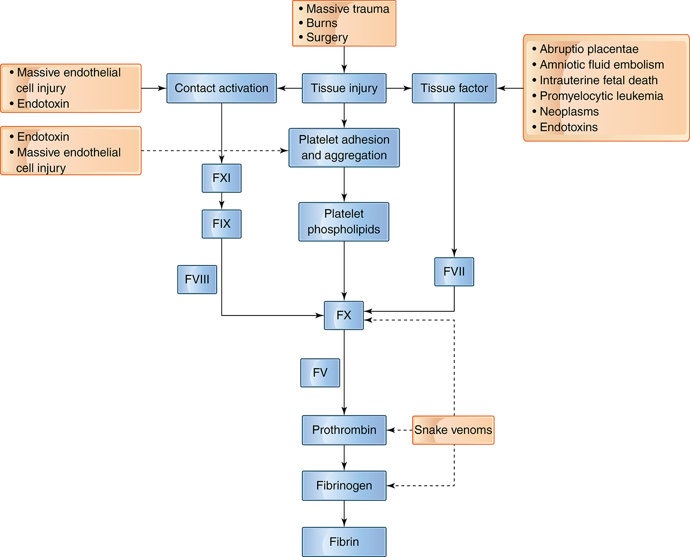
Figure 35-6
Notes:
Conditions that initiate DIC activate the hemostatic pathways in a variety of ways. Solid arrows show normal hemostasis. Processes that trigger DIC are shown in the boxes, and broken arrows indicate proposed sites of activation.

Slide 108
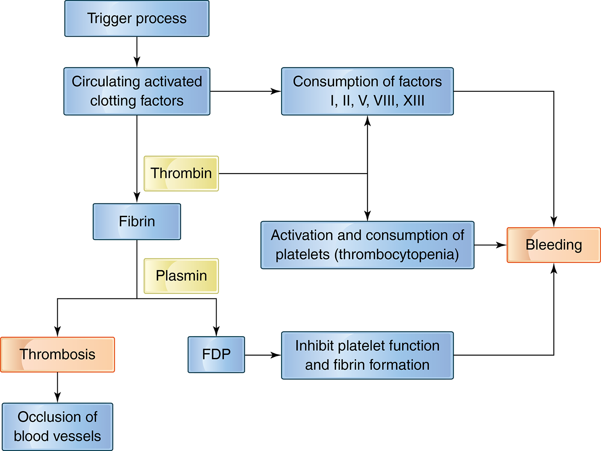
Figure 35-7 Pathogenesis of D I C
Notes:
Activation of hemostasis by triggering processes leads to clotting and bleeding simultaneously. Intravascular fibrin formation results in occlusion of vessels. During clotting, coagulation factors and platelets are consumed, leading to bleeding.

Slide 109
D I C-Clinical Presentation (1 of 2)
D I C can be a(n):
Acute process-80-90% of patients
Usually hemorrhagic symptoms
Chronic process-10-20% of patients
Thrombosis more likely to predominate
Clinical symptoms include:
Bleeding (from multiple sites)
Predominantly in the microvasculature
Often more than one site simultaneously

Slide 110
D I C-Clinical Presentation (2 of 2)
Fibrin strands within small vessels result in traumatic destruction of R B Cs
Microangiopathic hemolytic anemia
Formation of schistocytes
Fibrin deposition in and obstruction of microvasculature
Tissue anoxia/microinfarcts
Renal failure, liver failure, respiratory failure, skin necrosis, gangrene, thromboembolism

Slide 111
D I C-Laboratory Evaluation (1 of 2)
Laboratory diagnosis is difficult
Available tests are nonspecific
No single or combination of tests can establish the definitive diagnosis of D I C
P T, A P T T, and T T-prolonged
↓ fibrinogen, A T
D-dimer + (not specific for D I C)
Platelet count ↓; platelet function tests abnormal
Schistocytes, thrombocytopenia on P B smear
Molecular markers of coagulation ↑
Prothrombin fragment 1, 2; F P A and B; T A T

Slide 112
D I C-Laboratory Evaluation (2 of 2)
Scientific Standardization Committee of I S T H
Diagnostic scoring system
Algorithms which allow diagnosis and ongoing assessment of D I C patient

Slide 113
D I C-Therapy (1 of 2)
Eliminate underlying cause, if possible
Support vital functions
Acute D I C is often self-limited
Will disappear when fibrin is lysed
Replacement therapy
Platelets, R B Cs, cryoprecipitate or F F P
L M W heparin used when:
Predominant thromboembolic manifestation
Replacement therapy fails to alleviate excessive bleeding

Slide 114
D I C-Therapy (2 of 2)
Newer approaches
Replace depleted inhibitors (A T, P C, T F P I)
Fibrinolytic inhibitors should not be used in most cases

Slide 115
Malignancy and Thrombosis (1 of 2)
Thrombotic disease in cancer patients
Second most common cause of death
Up to 50% show activation of hemostatic system
Increased T A T complexes, D-dimer
Cancers with highest thrombotic risk
Tumors of brain, pancreas, kidney, stomach, lung, bladder, and hematologic malignancies
Thrombosis may manifest prior to diagnosis of malignancy (even by years)

Slide 116
Malignancy and Thrombosis (2 of 2)
Causes may include:
Prolonged immobilization
Release of coagulation activating factors by malignant cells
Reduction of natural anticoagulants (A T, P C)
Defects in fibrinolytic system
Chemotherapy, surgery
Microparticles shed by platelets, endothelial cells, W B Cs, and cancer cells

Slide 117
Pregnancy and Oral Contraceptives (1 of 3)
Pregnancy
Risk factors
Advanced maternal age
C-section
Prolonged immobilization
Obesity
Prior T E
A P S and inherited thrombophilia

Slide 118
Pregnancy and Oral Contraceptives (2 of 3)
Pregnancy-induced alterations
Levels of most coagulation proteins ↑ during pregnancy
Particularly fibrinogen and F V I I I; also ↓ in A T, free and total P S, and t P A (coupled with ↑ P A I-1)
Net effect
Promote coagulation (may represent mechanism to control bleeding at time of placental separation?)

Slide 119
Pregnancy and Oral Contraceptives (3 of 3)
Estrogen therapy, high dose O C
Increase risk of thrombosis related to dose
Changes in levels of many coagulation proteins
Individuals with thrombotic risk factors
Evaluate before estrogen R x begun

Slide 120
Postoperative State and Trauma
D V T and P E
Occur in postoperative patients (depending on type of surgery)
Influenced by patient age, previous V T E, coexistence of malignancy, inherited thrombophilia, prolonged surgical and immobilization times
Encountered after major trauma
Possible causes: exposure of T F, elevated fibrinogen, ↓ A T, P C

Slide 121
Hematologic Disorders
Several hematologic disorders are associated with thrombosis
Myeloproliferative neoplasms
P M F, E T, P V,
Sickle cell anemia
Acute promyelocytic leukemia
P N H

Slide 122
Laboratory Testing in Patients with Suspected Thrombosis

Slide 123
Laboratory Evaluation-Thrombosis
Differentiate
Inherited versus acquired thrombophilia
Hereditary defects → lifelong risk of developing thrombosis
Clinical circumstances (pregnancy, O C use) can trigger event
Samples should not be drawn during a thrombotic episode
Note anticoagulant therapy
Can effect levels of various clotting proteins
Guidelines for thrombotic risk assessment
Based on outcomes assessment
Functional assays generally better screening tests than immunologic assays

Slide 124
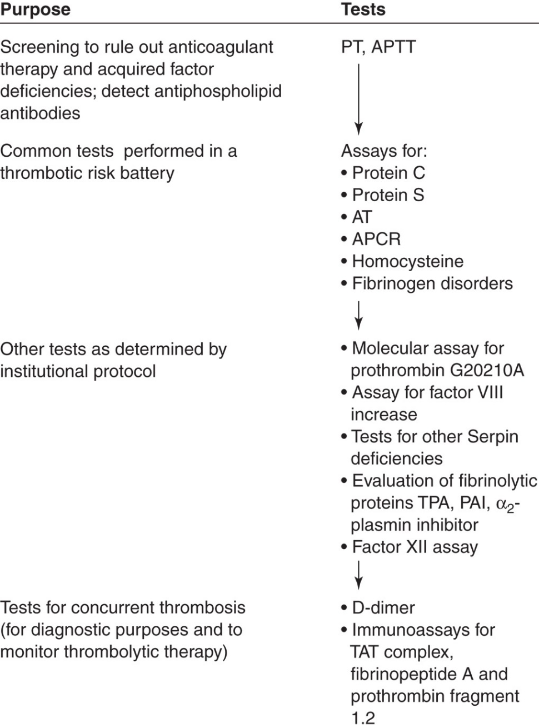
Figure 35-8 Protocol for Thrombotic Risk Testing
Notes:
Testing begins with coagulation screening tests and proceeds according to the protocol established by the institution. Serpin, serine proteinase inhibitors (antithrombin, heparin cofactor II); TPA, tissue plasminogen activator; PAI, plasminogen activator inhibitor; AT, antithrombin; PT, prothrombin time; APTT, activated partial thromboplastin time; APCR, activated protein C resistance; TAT, thrombin–antithrombin complex.

Slide 125
Table 35-12 Laboratory Tests Used to Diagnose Thrombophilia (1 of 2)
Blank | Functional | Antigenic | Molecular
Antithrombin | X | X | Blank
Heparin cofactor IITwo | X | X | Blank
Protein C | X | X | Blank
Protein S | Free P S | Total P S | Blank
Blank | Blank | Free P S | Blank
A P C R | X | Blank | X
Prothrombin G20210A | Blank | Blank | X
Tissue factor pathway inhibitor | X | X | X
Hyperhomocysteinemia | Blank | X | X

Slide 126
Table 35-12 Laboratory Tests Used to Diagnose Thrombophilia (2 of 2)
Blank | Functional | Antigenic | Molecular
C B S mutations | Blank |  | X
M T H F R mutations | Blank |  | X
Fibrinogen | X | X | Blank
Factor XII Twelve | X |  | Blank
Plasminogen | X | X | Blank
Tissue plasminogen activator | X | X | Blank
Plasminogen activator inhibitor | X | X | Blank
Antiphospholipid antibodies | Screening with A P T T; specific confirmatory tests including platelet neutralization and dilute Russell’s viper venom | Blank | Blank
A P C E, activated protein C resistance; C B S, cystathionine β synthase; M T H F R, methylene tetrahydrofolate reductase; A P T T, activated partial thromboplastin time.

Slide 127
Anticoagulant Therapy

Slide 128
Introduction-Anticoagulant Therapy
Arterial thrombosis
Interaction of platelets with vessel wall atherosclerotic plaques
Treat with antiplatelet drugs
Thrombolytic therapy can be used for
Acute arterial thrombosis
Rapid clot lysis and restoration of blood flow may minimize tissue damage

Slide 129
Laboratory Evaluation-Therapy
Venous thrombosis
Abnormalities of plasma coagulation system
Treatment
Heparin or heparin-derived components for several days, followed by oral anticoagulant (Coumadin) therapy 3-6 months
Direct inhibitors of thrombin and F X a

Slide 130
Heparin (1 of 4)
Administered parenterally
Does Not have direct effect on blood clotting
↑ A T’s ability to neutralize serine proteases
Extracted from porcine intestinal mucosa or bovine lung
U F H-M W between 5,000 and 30,000 Da
L M W H-M W between 4500-5000 Da
Prepared by enzymatic/chemical depolymerization of U F H
Heparin does not cross placenta
Has not been associated with fetal malformations
Treatment of choice for V T E during pregnancy

Slide 131
Heparin (2 of 4)
Standard/unfractionated heparin (U F H)
Catalyzes inhibition of most serine proteases
Influenced by “heparin-binding proteins” (acute-phase reactants) and high F V I I I levels
Dose for therapeutic effect varies from patient to patient
Monitored by:
A P T T
Therapeutic range ~1.5-2.0 × patient’s baseline A P T T

Slide 132
Heparin (3 of 4)
L M W H and fondaparinux (similar to L M W H)
Produces majority of its effect by catalyzing interaction of A T and F X a
More reliable pharmacokinetics because
Significantly less binding to heparin-binding proteins
Typically does not require routine laboratory monitoring
If monitoring needed (obese patients, renal disease, etc.)-use anti-F X a assay

Slide 133
Heparin (4 of 4)
Complications
Bleeding (most common toxic effect)
Heparin-induced thrombocytopenia (H I T)
Develops in ~3% of patients receiving U F H
Most common clinical symptom is arterial thrombosis, which can be life-threatening
L M W H less frequent inducer of H I T than U F H
Once antibodies form, neither can be used
Patients must be switched to:
Direct thrombin inhibitors
Anti-X a inhibitors

Slide 134
Oral Anticoagulants (1 of 4)
Coumadin drugs
Sodium warfarin or dicoumarol
Inhibit coagulation by interfering with vitamin K action in the liver
Blocks vitamin K-dependent carboxylation of target proteins
Resulting in release of nonfunctional molecules in the plasma
γ carboxylated proteins
Biologic effect-takes several days to be achieved
Half-life of preformed biologically active “normal” clotting factors
F V I I disappears most rapidly (T_{½}~6 hours)

Slide 135
Oral Anticoagulants (2 of 4)
Coumadin
Does not lead to “instantaneous” anticoagulation
Must be administered 4-5 days before therapeutic anticoagulation is achieved
During which time patient must be on heparin
Once oral anticoagulation has been achieved, heparin can be discontinued

Slide 136
Oral Anticoagulants (3 of 4)
Coumadin
Post P E or D V T
3-6 months of Coumadin
Complications
Bleeding (10-20% of patients)-monitor closely
50% occur despite having P T within therapeutic range
Genetic factors which influence effect of Coumadin
C Y P 2 C 9 or V K O R C 1 genes-can lead to altered pharmacokinetics and variable dose response

Slide 137
Oral Anticoagulants (4 of 4)
Laboratory monitoring
P T/I N R
Adjusts for variation in thromboplastin potencies used by various manufacturers

Slide 138
New Oral Anticoagulants (N O A C)/Direct Oral Anticoagulants (D O A C)
Direct inhibitors
Bind directly to target enzymes and block interaction with substrate
F X a inhibitors
Rivaroxaban/Xarelto, apixaban/Eliquis, edoxaban/ Savaysa
Indirect inhibitors
Bind plasma cofactors (such as A T) and accelerate interaction with clotting enzymes
Relatively short half-life
Do not require routine laboratory monitoring
Has not been universally accepted

Slide 139
Thrombolytic Therapy (1 of 3)
Purpose is to reestablish vascular perfusion
Plasminogen activators (P A s)
Thrombolytic agents lyse thrombi in vivo
Therapeutic doses convert virtually all plasma plasminogen to plasmin
Overwhelming neutralizing capacity of A P → fibrinogenolysis (lytic state)

Slide 140
Thrombolytic Therapy (2 of 3)
Laboratory monitoring
“Lytic State”
Effects of plasmin on components of circulating blood
Monitored by ↓ in plasma fibrinogen (prolonged T T) and ↑ F D Ps
Other plasma proteins also degraded (e.g., F V, F V I I I)
Can also monitor
↓ plasminogen and A P
Generation of P A P complexes
Assay for free circulating plasmin
Lytic state thus induced “hypocoagulability”

Slide 141
Thrombolytic Therapy (3 of 3)
Complications
Lysis of physiologic hemostatic plugs and resultant bleeding
Blood hypocoagulability secondary to fibrinogenolysis
Platelet dysfunction

Slide 142
Antiplatelet Therapy (1 of 3)
Aspirin
Blocks T X A ₂ synthesis in platelets
Irreversibly inhibiting cyclooxygenase
(C O X-1 enzyme)
Inhibits C O X-1 in E C-blocking P G I₂ synthesis
E C resynthesizes new C O X-1 enzyme
Modest effect on platelet function

Slide 143
Antiplatelet Therapy (2 of 3)
N S A I Ds
Nonsteroidal anti-inflammatory drugs
Most are competitive inhibitors of C O X-1 and C O X-2 (except aspirin)
Not irreversible inhibitors-effect is transient
Include ibuprofen, flurbiprofen, sulfinpyrazone
Acetaminophen does not affect platelet function

Slide 144
Antiplatelet Therapy (3 of 3)
A D P receptor antagonists
Ticlopidine, clopidogrel, prasugrel
Modify platelet A D P receptor, blocking P 2 Y ₁₂ receptor activity
Drugs have been linked to T T P in small # of patients
Dipyridamole
Inhibits phosphodiesterase → ↑ c A M P levels → inhibition of platelet activation
Limited effectiveness alone, usually used with other drugs

Slide 145
Intravenous Antiplatelet Agents
Inhibitors of G P I I b/I I I a
Requires intravenous administration
ReoPro/abciximab-may cause thrombocytopenia
Integrilin/eptifibatide-generally not associated with thrombocytopenia
Blockade of G P I I b/I I I a almost completely eliminates platelet function

