Slide 1
Clinical Laboratory Hematology
Hemostasis: Laboratory Testing & Instrumentation
Copyright © 2020, 2015, 2012 Pearson Education, Inc. All Rights Reserved

Slide 2
Specimen Collection and Processing

Slide 3
Specimen Collection (1 of 8)
Accuracy of testing
Relies on proper
Collecting of specimen
Processing of specimen
Storing of specimen

Slide 4
Specimen Collection (2 of 8)
Blood collection for coagulation testing
Two-syringe or two-tube technique
Blood in first syringe or tube was discarded to minimize contamination with T F
Current guidelines no longer require discard tube for P T and A P T T testing
Coagulation testing tubes should not be drawn after tubes with additives (e.g., heparin or E D T A)
Direct venipuncture is preferred

Slide 5
Specimen Collection (3 of 8)
Blood collection for coagulation testing
Butterfly needles of 21-22 gauge with polystyrene tubing attached to syringe or vacutainer system for patients with difficult venous access
Two-tube technique used to eliminate problem of under filling tube due to air in tubing (proper 9:1 blood to anticoagulant ratio)

Slide 6
Specimen Collection (4 of 8)
Blood collection for coagulation testing
Indwelling catheter
Must avoid heparin contamination
Catheter line should be flushed with saline
Adults-first 5 milliLitre of blood should be discarded
Heparin contamination
Commercial heparinase can be added to the plasma to remove heparin

Slide 7
Specimen Collection (5 of 8)
Anticoagulant of choice
3.2% buffered sodium citrate
Ratio of whole blood:anticoagulant-9:1
>55% hematocrit
Smaller volume of plasma relative to citrate
Excess free citrate binds calcium in the test procedure
Falsely prolonged clotting times
Adjust citrate concentration
Citrate tubes are available that draw 4.5 milliLitre, 2.7 milliLitre, 1.8 milliLitre

Slide 8
Specimen Collection (6 of 8)
Anticoagulant to blood ratio
9:1 ratio critical for valid results
If underfilled-↑ citrate, binds calcium in test procedure
Falsely prolonged test results
If overfilled-insufficient calcium bound
Clotting can occur in tube
Falsely prolonged results

Slide 9
Figure 36-1
C = Volume of sodium citrate
V = Volume of whole blood drawn
H c t = Patient hematocrit
For example, to draw 5 milliLitre of blood from a patient with a hematocrit of 63% you calculate the amount of sodium citrate to use as follows:
So mix 5 milliLitre of blood with 0.34 milliLitre of sodium citrate
Notes:
A correction formula to adjust the citrate/blood ratio is recommended when the hematocrit is greater than 55%. When blood is drawn for coagulation testing in a patient with a hematocrit that is more than 55%, the reduced plasma volume (exceeds the 1:9 ratio of buffered sodium citrate to blood) can affect coagulation testing.

Slide 10
Specimen Collection (7 of 8)
Accurate labeling of tube is critical
Include
Appropriate identifiers according to institutional and regulatory agencies guidelines in patient’s presence
Additional info for further identification
For example: time of draw, before or after transfusion

Slide 11
Specimen Collection (8 of 8)
Check patient history of receiving blood products and other medications/supplements
If testing done within the half-life of administered clotting factor then test may measure transfused component as well as the patient’s component
Dietary supplements and drugs can affect hemostasis
Fibrinolytic factors-diurnal variability
Platelet studies-medication history

Slide 12
Specimen Processing (1 of 6)
Plasma for coagulation testing
Routine hemostasis testing
Performed on citrated platelet-poor plasma (P P P)
Platelet function testing
Performed on platelet-rich plasma (P R P) and whole blood

Slide 13
Specimen Processing (2 of 6)
P P P
Citrated specimen centrifuged for 15 minutes at 1500-2500g
Depending on coagulation instrumentation
Leave plasma on top of packed cells or
Remove plasma with plastic pipette and place in plastic tube with cap
Leave small amount of plasma over packed cell layer-no platelet contamination

Slide 14
Specimen Processing (3 of 6)
Use platelet-poor plasma because platelets contain
P F 4
Neutralizes heparin
Phospholipids
Affect L A testing and factor assay testing
Proteases
Alter results for von Willebrand testing

Slide 15
Specimen Processing (4 of 6)
Any clot in specimen
Specimen unacceptable
After removing P P P, twirl applicator stick in packed cells to detect clots
Fresh platelet-poor plasma best
Separated plasma
Stored at 18-24°Celsius or 2-8°Celsius for up to 4 hours
If testing is delayed >4 hours
Store at −70° Celsius for up to 6 months

Slide 16
Specimen Processing (5 of 6)
Platelet-poor plasma (P P P)
Frozen specimens
Thawed rapidly at 37°Celsius
Excessive heating can destroy F V and F V I I I
Never store in self-defrost freezers
Special testing may require special collection and storage procedures
Platelet-rich plasma (P R P)
Needed for platelet function studies
Centrifuge at low spins to yield platelet concentration of

Slide 17
Specimen Processing (6 of 6)
Citrated whole blood
Platelet function testing (using P F A)
Whole blood platelet aggregation
Global tests of coagulation (T E G, T E M)
Check for clots
Platelets can become activated by foreign surfaces
Wooden applicator stick inserted after testing to detect clots
All whole blood specimens should be allowed to equilibrate at room temperature for 30 minutes before testing

Slide 18
Table 36-1. Potential Sources of Error in Coagulation Testing
Specimen | Reagents | Procedure
Inappropriate ratio of anticoagulant to blood | Incorrect preparation of reagents | Incorrect temperature
Failure to correct citrate volume if hematocrit is > 55% | Failure to properly store reagents | Incorrect incubation times
Clotted, hemolyzed, icteric, or lipemic specimen | Use of reagents beyond reconstituted stability time | Incorrect volumes of sample, reagents, or both
Poor aspiration of plasma off of cells so that sample is not P P P | Use of reagents beyond expiration date | Improperly functioning instrument
Delay in processing or testing | Contaminated reagents | Blank
Inappropriate storage | Blank | Blank
P P P, platelet poor plasma

Slide 19
Laboratory Investigation of Primary Hemostasis

Slide 20
Laboratory Investigation of Primary Hemostasis (1 of 2)
Evaluation of primary hemostasis includes
Complete blood count
Blood smear evaluation
For platelet morphology
Platelet function

Slide 21
Laboratory Investigation of Primary Hemostasis (2 of 2)
Platelet function assays
Specific drugs can affect platelet function for the life span of platelet (7-10 days)
Screening tests
In vivo testing using the B T
Considered obsolete by most investigators
In vitro function testing using the P F A
Definitive/specialized tests
Platelet aggregation using P R P and/or whole blood
Flow cytometry

Slide 22
Bleeding Time (B T)
In vivo measurement of primary hemostasis
Affected by Plt number, function, and vascular integrity
Measures time required for bleeding to cease from a standardized skin incision
No longer recommended by C L S I

Slide 23
Platelet Function Analyzer (P F A) (1 of 3)
In vitro method
Evaluate platelet function
Standardized technique
Eliminates variables associated with B T

Slide 24
Platelet Function Analyzer (P F A) (2 of 3)
P F A-100®, 200®; Siemens Healthcare, Inc.
Platelet function in whole blood
Measured at a high shear rate
Instrument aspirates citrated blood to three reservoirs
Collagen/epinephrine
Collagen/adenosine diphosphate (A D P)
Low concentration of A D P and prostaglandin E1 (P G E1)
Assessing P2Y12 inhibitors
Pressure sensor detects formation of platelet plug

Slide 25
Platelet Function Analyzer (P F A) (3 of 3)
P F A-100®, 200®; Siemens Healthcare, Inc.
Closure time
Time to occlude the aperture
Function of platelet count, platelet activity, V W F activity, and hematocrit
Sensitive to
V W D, aspirin-induced platelet dysfunction, clopidogrel interference, and aggregation defects

Slide 26
Table 36-2 Expected Results with the P F A
Condition or Therapy | Substance Used to Coat Aperature Collagen/Epinephrine | Substance Used to Coat Aperature Collagen/A D P | Substance Used to Coat Aperature P G E1/A D P
Normal | Normal | Normal | Normal
Acetylsalicylic acid (A S A) | Abnormal | Normal | Normal
V W D | Abnormal | Abnormal | Unknown
Glanzmann’s thrombasthenia | Abnormal | Abnormal | Abnormal
Clopidogrel | Variable; not recommended | Variable; not recommended | Abnormal

Slide 27
P O C Platelet Aggregation
Verify Now Accumetrics Assay System
Turbidimetric optical detection
Measures P l t aggregation by light transmission aggregometry (L T A)
3.2% sodium citrated collection tube
Blood is dispensed into designated cartridges
Microbead agglutination technology
Cartridges contain fibrinogen-coated beads with
A A-aspirin testing
A D P and P G E1-clopidogrel testing
Thrombin receptor-integrilin testing

Slide 28
Platelet Aggregometry
Comprehensive studies of platelet function
Specimen
3.2% sodium citrated blood
Can use whole blood or P R P
Pre-examination variables
Recent (within 7-10 days) medications
Food, exercise
Tourniquet use
Needle size
Temperature, equilibration time
Centrifugation processing

Slide 29
P R P Light Transmission Aggregometry (1 of 6)
P R P
Carefully prepared from a citrated blood sample
Adjust platelet count with patient’s own P P P to a standard number
Usually 200,000/microLiter
Some investigators do not recommend adjustment
Can cause spontaneous aggregation
>600,000/μ L requires adjustment with the patient’s own P P P
Sample stirred, warmed to 37°Celcius in an aggregometer

Slide 30
P R P Light Transmission Aggregometry (2 of 6)
P R P
Aggregating reagent (agonist) is added
Platelets aggregate
Change in O D of the P R P
Recorded as a graph (curve)
Depending on the agonist used and its concentration
Primary and/or secondary wave of aggregation
Common platelet agonists
A D P, epinephrine, collagen, ristocetin, arachidonic acid

Slide 31
P R P Light Transmission Aggregometry (3 of 6)
Primary wave
Direct response of the platelets to the aggregating reagent
Represents
Platelet shape change
Formation of small aggregates
Secondary wave
Complete aggregation response
Result of endogenous A D P being released from the activated platelet dense bodies

Slide 32
P R P Light Transmission Aggregometry (4 of 6)
Biphasic curve
Aggregating reagent that results in both primary and secondary wave
Monophasic curve
Aggregating reagent that results in one wave
Changes in platelet aggregation curves
Identify qualitative platelet disorders

Slide 33
P R P Light Transmission Aggregometry (5 of 6)
Ristocetin
Action depends on
Interaction of plasma V W F and
Platelet membrane glycoprotein I b/I X/V
Represents platelet agglutination
R I P A abnormal
V W F
Corrected by adding normal plasma to patient’s P R P (plasma defect)
B S S
Not corrected by adding normal plasma (platelet defect)

Slide 34
P R P Light Transmission Aggregometry (6 of 6)
Arachidonic acid (A A)
Screening for patient’s ingestion of aspirin (or aspirin containing products) and N S A I Ds within past 7-10 days
No secondary wave of aggregation with A D P or epinephrine
Should not be used for assessing patients at risk for thrombosis

Slide 35
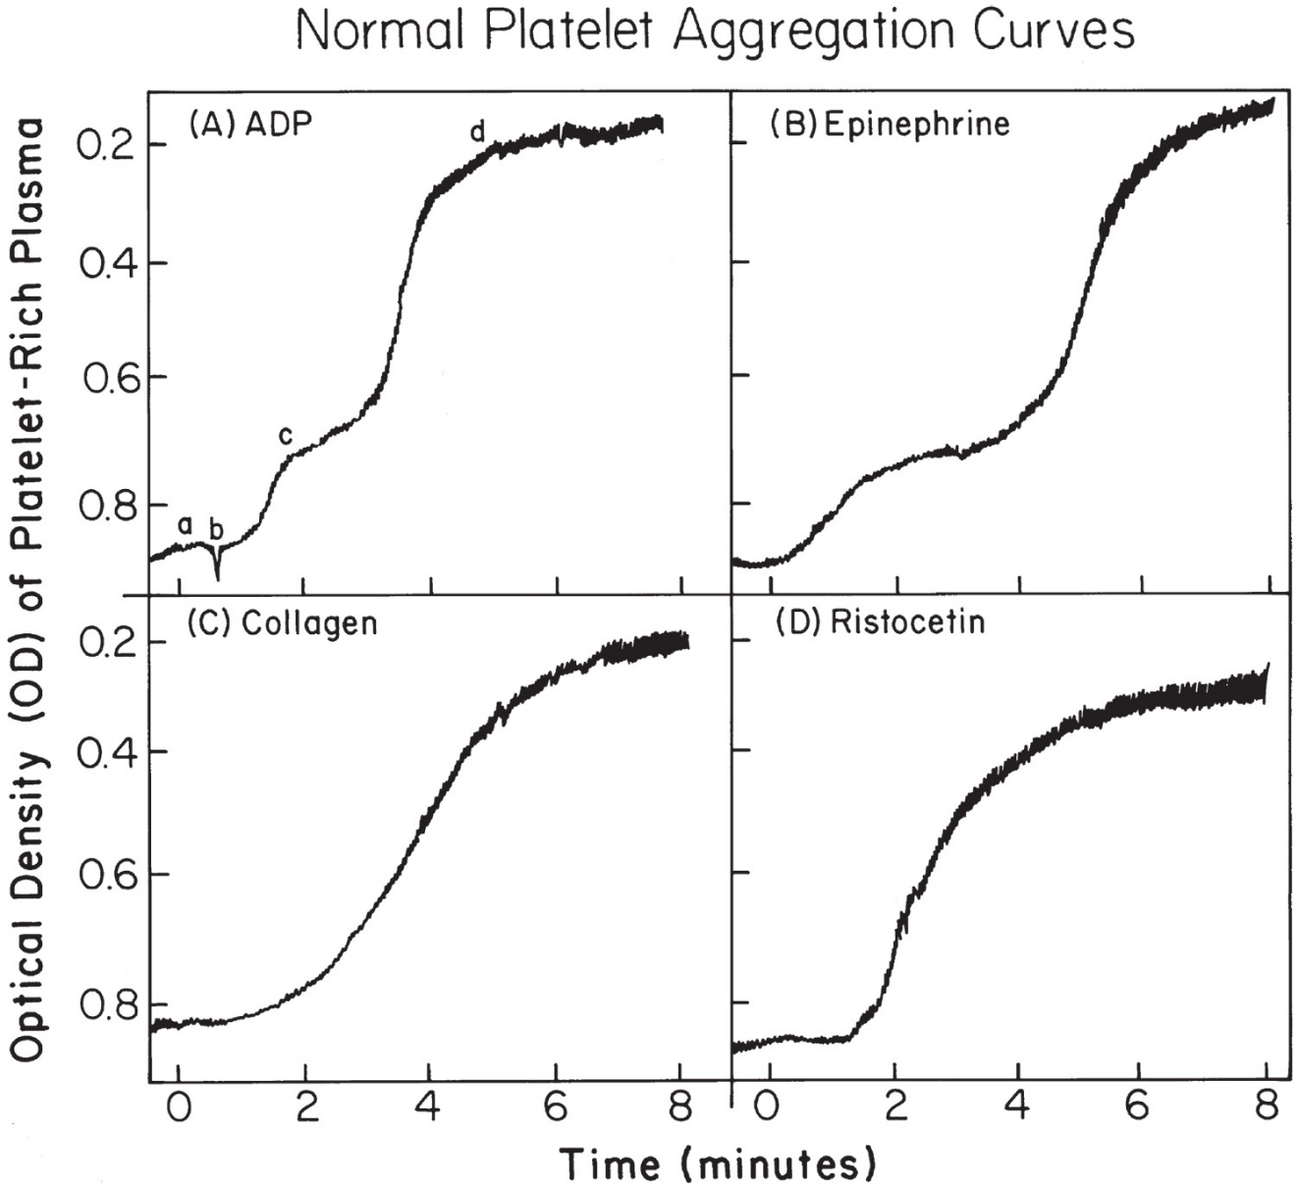
Figure 36-2 Normal Platelet Aggregation Curves
Notes:
Normal responses to the commonly used aggregating reagents: ADP, epinephrine, collagen, ristocetin. (a) Baseline before addition of the reagents. (b) Initial increase in absorbance that occurs immediately following the addition of reagent, representing a change in platelet shape. (c) The primary wave of aggregation. (d) Secondary wave of aggregation.

Slide 36
Table 36-3 Typical Pattern of Response to Aggregating Reagents in Qualitative Platelet Disorders ª (1 of 2)
Qualitative Platelet Disorders | Aggregating Reagents Collagen | Aggregating Reagents A D P | Aggregating Reagents Epinephrine | Aggregating Reagents Ristocetin | Aggregating Reagents Arachidonic Acid
Normal | Monophasic curve (secondary wave only): representing secondary platelet aggregation associated with release of endogenous A D P | Biphasic curve with 2 times 10 to the power negative 5 M A D P: demonstrating primary and secondary waves of platelet aggregation | Biphasic curve: demonstrating primary and secondary waves of platelet aggregation | Biphasic curve: demonstrating primary wave resulting from immediate platelet agglutination; secondary wave associated with platelet release induced by platelet agglutination | Monophasic curve (secondary wave only): representing effect of thromboxane A₂ on secondary platelet aggregation
von Willebrand disease | Normal | Normal | Normal | No response | b
Bernard-Soulier syndrome | Normal | Normal | Normal | No response | b

Slide 37
Table 36-3 Typical Pattern of Response to Aggregating Reagents in Qualitative Platelet Disorders ª (2 of 2)
Qualitative Platelet Disorders | Aggregating Reagents Collagen | Aggregating Reagents A D P | Aggregating Reagents Epinephrine | Aggregating Reagents Ristocetin | Aggregating Reagents Arachidonic Acid
Glanzmann’s thrombasthenia | No response | No response | No response | Normal | b
Storage pool disease | No response | Primary wave only | Primary wave only | Normal | Normal
Aspirin ingestion | No response | Primary wave only | Primary wave only | Normal | Suppressed response
Clopidogrel ingestion | Normal | No response | Primary wave only | Normal | Normal
ª See Chapter 33
^{b} Not applicable. Arachidonic acid evaluates the thromboxane A₂ synthetic path-way.

Slide 38
Figure 36-3 Platelet Aggregation Patterns in Various Disorders
Notes:
Typical tracings obtained using concentrations of collagen, ADP, and ristocetin illustrate the differences between platelet aggregation in normal subjects and that in patients with VWD, BSS, TSA, SPD, and aspirin ingestion and ASAs. Impaired release of ADP accounts for the SPD and ASA defects. VWF corrects the defective ristocetin aggregation in VWD but not in BSS. ADP, adenosine diphosphate; VWD, von Willebrand disease; BSS, Bernard-Soulier syndrome; TSA, thrombasthenia; SPD, storage pool disease; ASA, aspirine-like disorders; VWF, von Willebrand factor.

Slide 39
Whole Blood Aggregation
Allows for a smaller sample size
Assay
Measures electrical resistance across two metal wires (probes)
Whole blood sample exposed to small electric current-coats wire with monolayer of platelets
Upon the addition of an agonist
Platelets form aggregates on the probes
Change in impedance measured as function of time
Citrated sample challenged with ristocetin, A D P, collagen, A A, thrombin

Slide 40
Platelet Aggregometer (1 of 2)
Multiplate® platelet function analyzer
Detects effects of antiplatelet inhibitors (aspirin, clopidogrel, and G P I I b/I I I a)
Uses a disposable cuvette with two independent sensors
Assesses three parameters
Velocity of aggregation
Maximum aggregation
Area under curve (A U C)

Slide 41
Platelet Aggregometer (2 of 2)
Multiplate® platelet function analyzer
Calculated results expressed as mean value of parameters determined
Abnormal results
Could indicate that antiplatelet treatment needs to be modified

Slide 42
Additional Tests Evaluating Platelets
Flow cytometry
Monoclonal antibodies directed against glycoproteins on platelets
G P I b/I X (B S S)
G P I I b/I I I a (Glanzmann’s thrombasthenia)
Presence and function can be evaluated
Vasodilator-stimulated phosphoprotein (V A S P) phosphorylation
Clopidigrel resistance
Clot retraction (rarely performed)
Function of activated platelets

Slide 43
Laboratory Investigation of Secondary Hemostasis

Slide 44
Table 36-4 Laboratory Tests in Preterm and Term Infants as Compared with Those of Adults and Older Children
Test | Preterm Infant (28-31 weeks) (Day 1) | Preterm Infant (32-36 weeks) (Day 1) | Term Infant (37-41 weeks) (Day 1) | Adults and Older Children | Age Adult Level Reached
Platelet count times 10 cubed per microlitre | 150-430 | 150-430 | 174-456 | 150-450 | Before birth
Platelet aggregation | Abnormal | Abnormal | Abnormal | Normal | One month
P T, sec | 14.6-16.9 | 10.6-16.2 | 10.1-15.9 | 10.8-13.9 | Comparable at birth
A P T T, sec | 80-168 | 27.5-79.4 | 31.3-54.5 | 26.6-40.3 | By 6 months
T T, sec | Blank | 19.0-30.4 | 23.5 ± 2.38 | 19.7-30.3 | At birth
F D P | Blank | Normal | Normal | Normal | Before birth
P T, prothrombin time; A P T T, activated partial hromboplastin time; T T, thrombin time; F D P, fibrin degradation products

Slide 45
Introduction-Laboratory Investigation of Secondary Hemostasis
Evaluate
Coagulation factors
Coagulation inhibitors
Starts with screening tests
Prothrombin time (P T)
Activated partial thromboplastin time (A P T T)
Thrombin time (T T)
Quantitative fibrinogen

Slide 46
Prothrombin Time (P T) (1 of 4)
Screening test
For inherited and acquired deficiencies in extrinsic pathway (extrinsic X-ase pathway)
Translocation of tissue factor (T F) to the cell surface activates the coagulation cascade by formation of T F/F V I I complex

Slide 47
Prothrombin Time (P T) (2 of 4)
Procedure
Thromboplastin is added to a citrated patient P P P
Record time for fibrin formation (clotting time)
Thromboplastin (rabbit brain and recombinant human tissue factor)
Vary in sensitivity due to differences in thromboplastin source, type, and concentration of phospholipids
Must establish reference interval for reagent/instrumentation combination

Slide 48
Prothrombin Time (P T) (3 of 4)
Clot detection
Optical or electromechanical methods
Manual, automated, P O C devices
General reference interval
12-15 seconds
Prolonged P T
Deficiency in factors
fibrinogen, or presence of
inhibitor, heparinoids, D O A Cs
Proteins induced by vitamin K absence or antagonism (P I V K A)
lack γ-carboxyglutamic acid residues for binding C a⁺⁺ and P L

Slide 49
Prothrombin Time (P T) (4 of 4)
Historically used to monitor oral anticoagulant therapy
Coumadin or warfarin
Results are now reported using the international normalized ratio (I N R)

Slide 50
Activated Partial Thromboplastin Time (A P T T) (1 of 3)
Screen
Inherited or acquired deficiencies of proteins in the intrinsic pathway (intrinsic X-ase pathway)
Circulating inhibitors
Sensitivity of commercial reagents
Varies greatly
Screening tests (P T and A P T T)
Detect factor deficiency only when factor decreases to a level of 25-40% of normal
Monitor unfractionated heparin therapy

Slide 51
Activated Partial Thromboplastin Time (A P T T) (2 of 3)
Procedure
Partial thromboplastin
Provides phospholipid surfaces
Simulates activated platelet surfaces
Activator (kaolin, celite, micronized silica, ellagic acid)
Negatively charged surface for activation of F X I I and P K

Slide 52
Activated Partial Thromboplastin Time (A P T T) (3 of 3)
Procedure
Citrated plasma and A P T T reagent incubated together at 37°Celsius
Optimal activation of contact factors
Calcium chloride is added
Time to fibrin formation is recorded
Clot detection
Optical or electromechanical methods
Manual or automated devices

Slide 53
Thrombin Time (T T) (1 of 2)
Measures conversion of fibrinogen to fibrin when thrombin is added to undiluted citrated P P P
Procedure
Incubate P P P at 37°Celsius and add thrombin
Time to fibrin formation is recorded,
General reference interval 15-19 seconds

Slide 54
Thrombin Time (T T) (2 of 2)
Interference in conversion of fibrinogen to fibrin
Hypofibrinogenemia or dysfibrinogenemia
Presence of heparin, D T I s, or F D Ps
Rare cases
Antibodies against bovine thrombin, paraproteins (myelomas)
Extremely long T T
Usually indicates drug effect (heparin or D T I)
If sample contains heparin, neutralize with
Hepzyme, protamine sulfate

Slide 55
Quantitative Fibrinogen Assay (1 of 2)
Reference method
Clauss assay
Clot-based functional measurement
Adds thrombin to various dilutions of known concentrations of fibrinogen
Clotting times are plotted on a log/log graph
x-axis-known concentrations
y-axis-clotting times
Fibrinogen results for the controls and patient
Determined from the reference curve using their respective C Ts

Slide 56
Quantitative Fibrinogen Assay (2 of 2)
Reference method
Fibrinogen concentration inversely proportional to the clotting time
Reference intervals-200 to 400milligrams/deciLitres
↓ fibrinogen
D I C, primary and secondary fibrinolysis, liver disease, congenital disorders
↑ fibrinogen
Inflammatory disorders, pregnancy, women on oral contraceptives

Slide 57
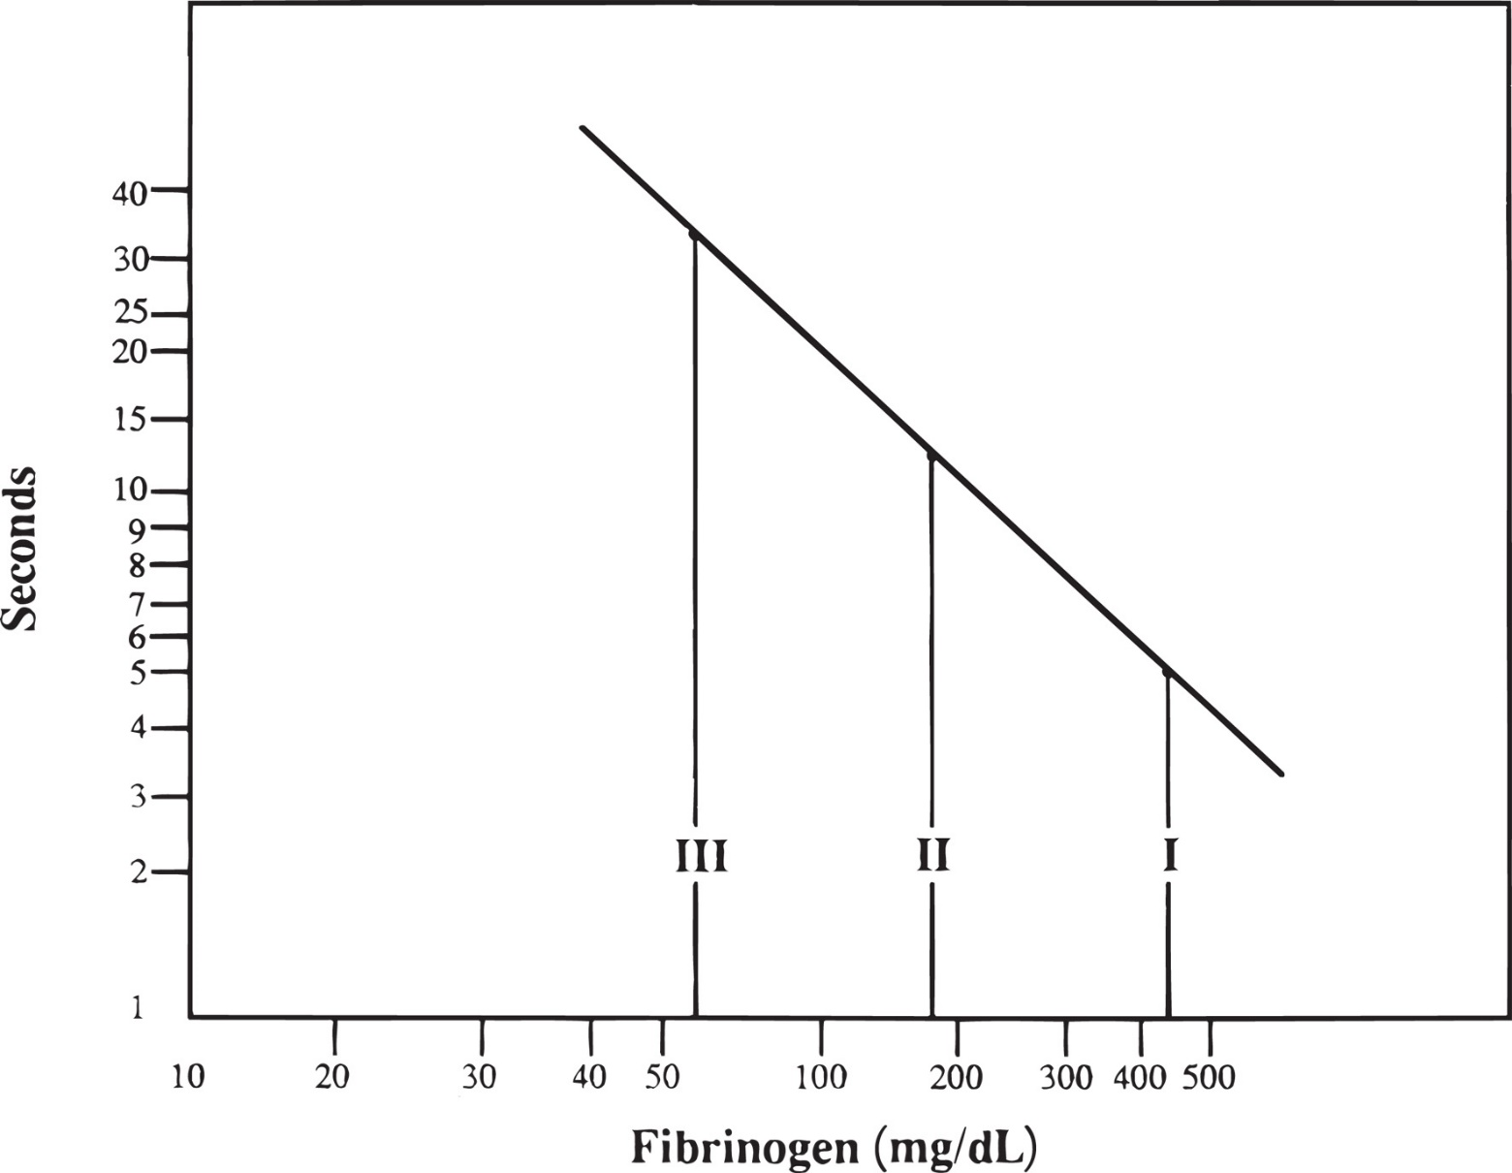
Figure 36-4 Fibrinogen Standard Curve
Notes:
I, II, and III represent reference plasmas of known fibrinogen concentrations. The TT in seconds is on the y-axis, and the fibrinogen concentration in mg/dL is on the x-axis. TT, thrombin time.

Slide 58
Tests to Evaluate Specific Factor Deficiency
Further testing performed if
P T and/or A P T T is prolonged
Mixing studies
Specific coagulation factors
Reptilase time
Prekallikrein screening test
Factor
screening test
V W F tests

Slide 59
Mixing Studies (1 of 2)
Also known as
Circulating anticoagulant screen, or
Screening test for circulating inhibitor
Performed to differentiate
Factor deficiency from presence of circulating inhibitor
Repeat abnormal screening tests (P T, A P T T)
Using several different dilutions of patient’s P P P mixed with normal pooled plasma

Slide 60
Mixing Studies (2 of 2)
Results of mixing study
Patient’s plasma corrected after incubation with normal plasma
Factor deficiency
Normal plasma replenishes the deficient factor in patient’s plasma
Next step perform factor assays
Patient’s plasma not corrected after incubation with normal plasma
Presence of circulating or specific factor inhibitor
Next step perform tests to verify type of inhibitor

Slide 61
Table 36-5 Differentiation of Factor Deficiency from Circulating Inhibitors Using the Mixing Study Procedure
Deficiency or Inhibitor | Immediate P T or A P T T after Mixing | Mix, Perform P T or A P T T after 2-hr incubation at 37°Celsius
Factor deficiency | Correction | Correction
Lupus anticoagulant or heparin | No correction | No correction
F V I I I inhibitor | Correction | No correction
F V inhibitor | No correction | No correction
P T, prothrombin time; A P T T, activated partial thromboplastin time.

Slide 62
Specific Coagulation Factors (1 of 5)
Performed to:
Confirm specific factor deficiency
Determine actual activity of factor
Principle
Ability of patient’s plasma to correct a prolonged P T or A P T T of a known factor-deficient plasma (substrate)
One-stage assays based on the P T
Extrinsic (F V I I) and common pathway (F I I, F V, F X)
One-stage assays based on the A P T T
Intrinsic pathway (F V I I I,F I X, F X I, F X I I)

Slide 63
Specific Coagulation Factors (2 of 5)
Procedure for factor assays
Standard curve constructed from
Clotting times of factor-deficient substrate plasma containing varying dilutions of a reference pooled plasma
Patient’s clotting time
1:10 and 1:20 and/or 1:40 dilutions of patient plasma with specific factor-deficient plasma
Perform P T or A P T T on mixture
Times are converted to % activity from standard curve
Results should be linear
If not-suggests inhibitors

Slide 64
Specific Coagulation Factors (3 of 5)
Procedure for factor assays
Normal factor activity reference interval
~50-150%
Commercial chromogenic kits
F V I I I assay
F V I I I is activated by thrombin
F V I I I a acts cofactor in conversion of F X to F X a by F I X a in presence of C a⁺⁺ and P L
Amount of F X a generated is directly proportional to amount of F V I I I in sample

Slide 65
Table 36-6 Dilutions for Factor Assays
Tube | Buffer (milliLitre) | Plasma (milliLitre) | Activity ª (%) | Dilution ^{b}
1 | 0.9 | 0.1 | 95.0 | 1:10
2 | 1.9 | 0.1 | 48.0 | 1:20
3 | 0.5 | 0.5 milliLitre from tube 2 | 24.0 | 1:40
4 | 0.5 | 0.5 milliLitre from tube 3 | 12.0 | 1:80
5 | 0.5 | 0.5 milliLitre from tube 4 | 6.0 | 1:160
ª The example is based on a reference plasma value of 95.0%. When reference plasma with an assayed value other than 100% is used, the activity would be based on its stated value.
^{b} Additional dilutions are prepared when patient values are less than 1% activity. Clotting times are determined for each dilution and then plotted on the standard curve. The percent activity is plotted on the x-axis and the clotting time on the y-axis (Figure 36-5)

Slide 66
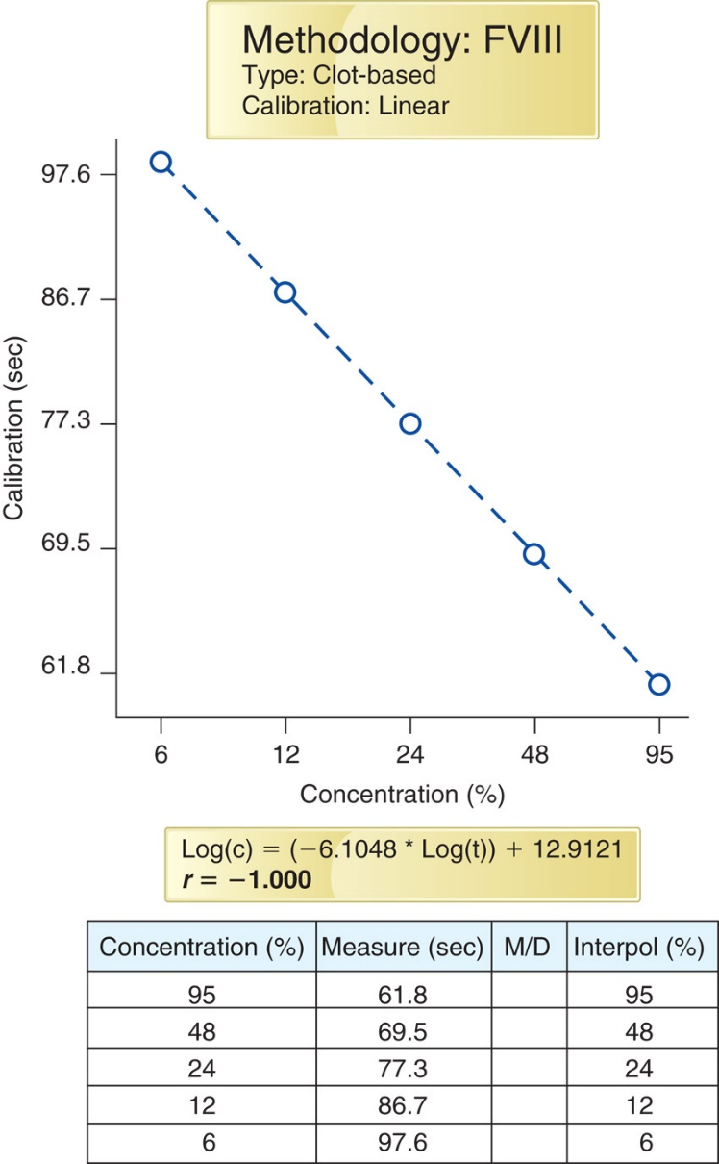
Figure 36-5 Factor Activity Curve Using an F V I I I Reference Plasma Activity of 95.0%
Notes:
The factor activity curve is prepared by plotting the CT in seconds for each reference plasma dilution on the y-axis and the percent factor activity for each dilution on the x-axis. The CT of at least two patient dilutions is measured, and the percent of activity is interpolated from the factor activity curve. The graph includes the r value and the slope information along with the dilution, CT, and measured values. M/D: M is to record when the operator performs a manual rerun of the calibration point and D is a record for a point deletion if necessary. CT, clotting time. Modified from the STA-R Evolution coagulation analyzer.

Slide 67
Specific Coagulation Factors (4 of 5)
Commercial chromogenic kits
Chromogenic F X
Uses R V V to activate F X to F X a
F X a hydrolyses S-2765 and liberates chromophore p N A
Color intensity is proportional to F X concentration
Useful for managing patients with L A receiving warfarin and patients being treated with D T I s

Slide 68
Specific Coagulation Factors (5 of 5)
Commercial chromogenic kits
Less commonly used due to high cost
Not affected by interfering substances that affect clot-based assays
Chromogenic factor
has been shown to be
falsely low in the presence of D O A Cs
P C, P S, A T, and P A I-1 assays available and can be performed with same instruments

Slide 69
Reptilase Time (1 of 2)
Used with T T to detect heparin
Not affected by heparin
In the presence of heparin
R T is normal, T T is increased
Differentiates dysfibrinogenemia from presence of F D Ps and paraproteins
Reptilase is a serine protease
Found in venom of Bothrops atrox snake
Cleaves fibrinopeptide A from fibrinogen
Thrombin cleaves both fibrinopeptide A and B

Slide 70
Reptilase Time (2 of 2)
Addition of reptilase to P P P
Initiates clot formation
Detected by optical or electromechanical methods
Manual, semi-automated, automated methods
General reference interval
18-22 seconds
↑ 25 seconds or longer
Dysfibrinogenemia, hypofibrinogenemia, afibrinogenemia

Slide 71
Table 36-7 Differentiation of Conditions Associated with a Prolonged Thrombin Time Using the Reptilase Time
Condition | Thrombin Time | Reptilase Time
Heparin contamination | Prolonged | Normal
Dysfibrinogenemia | Prolonged | More prolonged
Presence of fibrin degradation products | More prolonged | Prolonged

Slide 72
Prekallikrein Screening Test
Patients with P K (Fletcher factor) deficiency
Have a prolonged A P T T
Correction of prolonged A P T T to normal after
10-minute incubation period before adding calcium chloride
Longer incubation-↑ contact activation of F X I I
Confirmed with specific factor assay using P K-deficient substrate

Slide 73
Factor Thirteen (1 of 2)
F X I I I
Necessary for stable fibrin clot formation
Occurs by forming covalent bonds between fibrin monomers
Routine screening does not detect deficiency
Screening test principle
Fibrin clot has ↑ solubility because of the lack of cross-linking of fibrin polymer in absence of F X I I I

Slide 74
Factor Thirteen (2 of 2)
Procedure
Patient’s P P P is clotted with calcium chloride
Allowed to clot for 1 hour at 37°Celsius
Clot is placed in urea or 1% monochloroacetic acid in 37°Celsius
Factor
deficiency
Patient’s clot dissolves within 24-hour period
Patient’s clot dissolves within 30 minutes
Indicates activity <2%

Slide 75
Laboratory Testing for V W F (1 of 5)
Diagnosis of V W D requires
Quantitative V W F by both functional and antigenic methods
The National Heart Lung and Blood Institute (N H L B I)
Recommends that all initial testing for V W D include
V W F ristocetin cofactor assay (V W F:R C o) or equivalent
V W F antigen levels (V W F:A g)
F V I I I clot-ting activity (F V I I I:C)

Slide 76
Laboratory Testing for V W F (2 of 5)
Variables that affect accurate determination
Difference over time in V W F results in patients with V W D
Sometimes V W F:A g and/or V W F:A levels will be normal
Results of screening tests can be normal in
Endogenous release of V W F
Can result in transient F V I I I and V W F increase
Patient should be calm during phlebotomy
Processing of citrated sample
Reference standard
Patient’s blood type
Variety of clinical disorders

Slide 77
Table 36-8 Relationship between Blood Groups and Von Willebrand Factor Level
Blood Groups | von Willebrand Factor Level (%)
O | 74.8
A | 105.9
B | 116.9
AB | 123.9

Slide 78
Laboratory Testing for V W F (3 of 5)
Treatment for classic V W D
Desmopressin (D D A V P)
Causes two-fold to five-fold ↑ in patients V W F
plasma level in
Test dose of D D A V P is given to patient prior to surgery
Citrated plasma samples are drawn
Preinfusion
30 minutes postinfusion
4 hours postinfusion
Assayed for F V I I I activity, V W F:A g, V W F:A

Slide 79
Laboratory Testing for V W F (4 of 5)
V W F:R C o assay (ristocetin cofactor assay)
In presence of ristocetin
V W F induces platelet agglutination
Measured using aggregometer, automated analyzer
Slope plotted versus percent V W F activity
Results extrapolated from a calibration curve

Slide 80
Laboratory Testing for V W F (5 of 5)
V W F:A g
E L I S A assay
Rapid methods
Automated, immunoturbidimetric assays
Latex immunoassay (L I A) test procedure
Microlatex particles coated with rabbit antihuman V W F antibodies
Produces agglutination when mixed with plasma containing V W F
Extent of agglutination (turbidity) correlates to the level of V W F:A g present in the citrated plasma sample

Slide 81
V W F Multimer Analysis
Determine correct disease subtype
Plasma electrophoresis
Low concentration of agarose (0.65%)
Staining with radiolabeled A b to V W F or
S D S-P A G E
Also useful for diagnosing T T P
Presence of U L-V W F multimers indicates decreased A D A M T S-13 activity
Performed in specialized reference labs or coagulation centers

Slide 82
Collagen-Binding Assays for V W D
Specialized assays
Differentiate V W D type 2A and 2B from 2M
Perform both collagen-binding assays and V W F:R C o assays
Increases ability to differentiate V W D type 2 variants
Only 2A and 2B have abnormal V W F:C B

Slide 83
A D A M T S-13
V W F-cleaving protease
Methodologies
E L I S A, fluorescence resonance energy transfer (F R E T), and other direct or indirect assays available
Measure A D A M T S-13 activity, antigen, or autoantibody levels
Use citrated P P P
Generally performed in specialty labs

Slide 84
Identification of Inhibitors
Most common circulating inhibitors
Lupuslike anticoagulants (L A s) or Antiphospholipid antibodies (a P L s) and
F V I I I inhibitors
Measurement of the inhibitor to F V I I I
Determined with the F V I I I inhibitor assay (Bethesda method or Nijmegen-Bethesda)

Slide 85
L A/Antiphospholipid Antibodies (1 of 6)
Originally described as lupus anticoagulants
Now referred to as a P L
Usually I g G
Directed against the protein component of protein-phospholipid complexes
In vivo-thrombotic tendency
In vitro-prolong phospholipid-dependent clotting assays

Slide 86
L A/Antiphospholipid Antibodies (2 of 6)
Diagnosis requires demonstration of:
Abnormal P L dependent clotting test
Presence of and inhibitor (clotting test does not correct in mixing study)
Phospholipid-dependent inhibitor
Used to evaluate
Patients with history of recurrent abortions, venous or arterial thrombosis
As part of the evaluation of autoimmune disorders
Potential cause for elevated A P T T (with or without elevated P T)

Slide 87
L A/Antiphospholipid Antibodies (3 of 6)
Sample (P P P) integrity important
Two different screening tests recommended
Dilute R V V T (d R V V T)
Recommended as initial screening test
A P T T (silica as activator, low phospholipid content)
Second test for screening
If either test is prolonged
Proceed with designated testing
If patient presents with a positive history of thrombophilia and A P T T is not prolonged
Should proceed with testing for L A/a P L

Slide 88
L A/Antiphospholipid Antibodies (4 of 6)
I S T H guidelines for presence of L A
Double centrifugation to ensure P P P
If testing delayed
Quick freeze; thaw at 37°Celsius
Two clot-based assays using different clotting principles
d R V T T-most robust
Low P L A P T T with silica activator
Perform T T to detect heparin (absorb if necessary)

Slide 89
L A/Antiphospholipid Antibodies (5 of 6)
I S T H guidelines for presence of L A
P N P for mixing studies prepared by double centrifugation and test 1:1 mixture without incubation
Develop cutoff values on at least 40 healthy adult donors <50 years old
Perform mixing studies on donor plasmas and calculate the index of circulating anticoagulant (I C A) as follows:
Perform confirmatory test by increasing concentration of P L in screening test

Slide 90
L A/Antiphospholipid Antibodies (6 of 6)
I S T H guidelines for presence of L A
Confirmatory testing of healthy donor plasma at low (screen) and high (confirm) P L concentrations to obtain C Ts
Cutoff is value corresponding to mean of individual % corrections defined as:
Result is confirmation of L A if percentage correction is above defined cutoff value
Results should be normalized (ratio of result/P N P) and with accompanying interpretation

Slide 91
Dilute Russell’s Viper Venom Test (d R V V T) (1 of 2)
Venom from the Russell viper (Daboia)
Screening reagent
Dilute Russell’s viper venom, calcium chloride, phospholipids (low level)
Added to patient’s P P P
Activates F X to produce clot

Slide 92
Dilute Russell’s Viper Venom Test (d R V V T) (2 of 2)
Determine ratio of patient’s C T to C T of normal control
L A/a P L is present if patient’s d R V V T is longer than normal control
Ratio of patient’s C T to normal control C T is <1.2 normally
Confirmatory test
Use higher P L concentration R V V
Report ratio of high and low P L tests

Slide 93
Hexagonal Phospholipids
Substitutes egg phosphatidylethanolamine in a hexagonal phase configuration (H P P)
a P L Abs recognize the H P P configuration
Addition of H P P
Neutralizes inhibitory effect of the a P L antibodies
Does not neutralize factor-specific antibodies
Incubate test plasma with and without H P P
Perform A P T T on both mixtures
Test with H P P will have a shortened clotting time

Slide 94
Specific Factor Inhibitor Assay (1 of 2)
Nijmegen-Bethesda assay
Developed to measure F V I I I inhibitors
Develop in 3-52% of patients with severe hemophilia A
Can be used for other inhibitors to coagulation proteins
Specific inhibitors
Occur in 10-15% of hemophiliacs at any time after first factor concentrate infusion
Monitor patient’s response to treatment by ordering F V I I I:C assays
If bleeding does not stop-could be presence of inhibitor

Slide 95
Specific Factor Inhibitor Assay (2 of 2)
Nijmegen-Bethesda inhibitor assay
Mix patient’s plasma with equal volume of P N P of known F V I I I activity
Perform F V I I I assay on incubation mixture to measure residual activity
Convert activity to Bethesda units (B U) using standard Bethesda chart
Testing should be performed on pre-infusion trough sample

Slide 96
Laboratory Investigation of the Fibrinolytic System

Slide 97
Introduction-Laboratory Investigation of the Fibrinolytic System
D-dimer
Fibrin degradation products
Euglobulin clot lysis
α₂-antiplasmin activity

Slide 98
D-Dimer (1 of 3)
Specific degradation fragment
Results from plasmin lysis of fibrin clot
Fibrin clot has been cross-linked by F X I I I a
Excellent marker for D I C
Also elevated in
V T E
Pulmonary embolism
Deep vein thrombosis
Trauma, surgery, sepsis

Slide 99
D-Dimer (2 of 3)
D-dimer test
Immunoturbidometric method
Uses monoclonal antibodies against D-dimer fragment
Three methodologies
E L I S A
Manual latex- or hemagglutination
Automated immunoturbidimetric methods

Slide 100
D-Dimer (3 of 3)
D-dimer test
Most laboratories use automated methods
Antibody-coated latex particles aggregate in the presence of D-dimer
Increases turbidity of the sample
Increase in scattered light is proportional to the amount of D-dimer in the sample.
D-dimer level is not elevated
No thrombotic process is ongoing
D-dimer level is elevated
V T E or another condition

Slide 101
Table 36-9 Partial List of Non-Venous Thromboembolism Causes of Elevated D-Dimer
D I C
Trauma
Surgery
Hematoma
Arterial thrombosis
General hospitalization
Pregnancy
Cancer
Diabetes
Thrombolytic therapy
Older age

Slide 102
Fibrin Degradation Products (1 of 2)
↑ fibrinolytic activity
↑ levels of F D Ps
Sample
Special collection tube containing
Thrombin-clots sample and ensures all fibrinogen has been removed
Fibrinolytic inhibitor-prevents in vitro fibrinolysis
Patient’s serum mixed with latex particles coated with antibodies to F D P
Observes reaction mixture macroscopically

Slide 103
Fibrin Degradation Products (2 of 2)
Normal reference interval varies according to manufacturer and sensitivity
Largely replaced by D-dimer
F D P may be useful in acute fibrinogenolysis (increased F D P with discordant or negative D-dimer)

Slide 104
Euglobulin Clot Lysis
Used before specific antibodies to fibrinolytic products
Euglobulin protein fraction is precipitated from plasma
Fibrinolytic inhibitors remain in supernatant
Precipitate is re-dissolved, clotted with thrombin
Observed for clot lysis
Shortened lysis time-indicates ↑ fibrinolytic activity

Slide 105
α₂-Antiplasmin Activity
α₂-antiplasmin
Inhibitor, regulates fibrinolytic system
Congenital deficiencies
Characterized by bleeding occurring some hours after an initial injury
Hemostatic plug breaks down prematurely
Acquired decreases
Observed in liver disease and D I C
Chromogenic method
Can be used with a microtiter plate, test tube, or auto-mated procedures

Slide 106
Laboratory Investigation of Hemostasis (Primary, Secondary, or Fibrinolytic Pathway) Using Global Assays

Slide 107
Global Testing (1 of 4)
Global testing instruments-P O C hemostasis testing
Analyze entire hemostasis process
Coagulation
Anticoagulation effects
Fibrin formation and stabilization
Clot retraction (platelet function)
Fibrinolysis

Slide 108
Global Testing (2 of 4)
Thromboelastography (T E G)
Near-patient testing method, assesses blood coagulability
Evaluates torque created from blood clotting onto a stationary pin in an oscillating cup
Whole blood or citrated whole blood may be used
Manufacturer provides activators
Citrated samples require calcium replacement
T E G® platelet mapping assay
Assess patients who received platelet-inhibiting drugs
Aspirin, N S A I D S, clopidogrel, other P 2 Y₁₂ inhibitors

Slide 109
Global Testing (3 of 4)
R O T E M® (T E M) Haemostasis Whole Blood Analyzer
Computerized device based on T E G
Evaluates the torque created from blood clotted within a stationary cup onto an oscillating pin
Evaluates
Intrinsic pathway (I N T E M, contact factor activation)
Extrinsic pathway (E X T E M, tissue factor activation)
Fibrinogen assessment (F I B T E M, tissue factor activation with platelet inhibition)
Heparin anticoagulation (H E P T E M, contact activation with heparinase)
Whole blood or citrated whole blood may be used

Slide 110
Global Testing (4 of 4)
Calibrated automated thrombogram (C A T)
Thrombin generation test
Monitors the rise and fall of thrombin in clotting plasma
C A T
T G T that can measure both hypercoagulability and hypocoagulability
Sensitive to action of most antithrombotic drugs

Slide 111
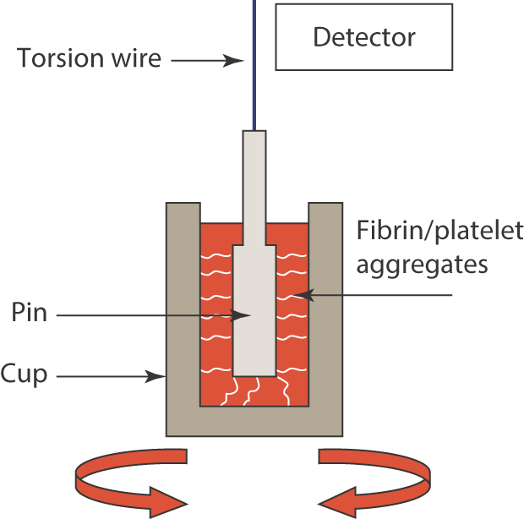
Figure 36-6 Principle of Thromboelastography
Notes:
A blood sample is placed in a cup that has a pin carefully placed within and that is connected to a torsion wire. As the cup rotates in a back and forth movement, the aggregates formed within it cause the wire to become more rigidly placed and reflects the strength of the aggregates formed within the cup. The movement or lack of movement is reflected via either an optical or magnetic detector that produces a graphic presentation.

Slide 112
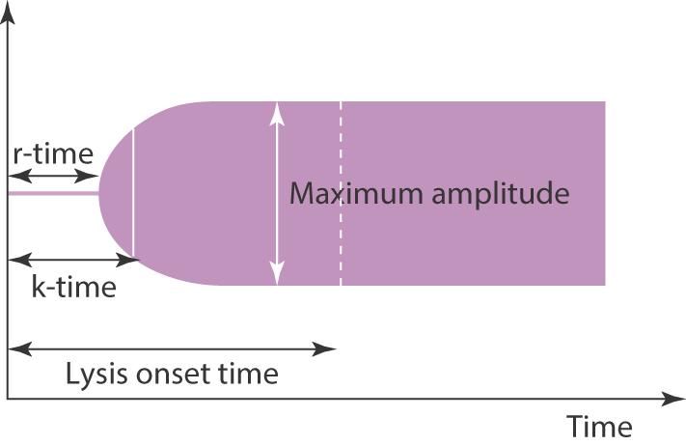
Figure 36-7 Thromboelastography Results
Notes:
The graphic presentation shows the lag phase (r-time) where the blood is still fluid, and therefore the wire hangs freely and is not affected by the rotation of the cup. As thrombin is formed, a thrombus forms in the rotating cup, which transmits its movement onto the suspended sensor. The kinetics time (k-time) is the rate of clot formation and the time necessary for the clot amplitude to increase from 2 to 20 mm. The maximum amplitude reveals the stabilization of clot by platelets and FXIII. Finaly, the lysis onset time measures the degree of fibrinolysis after a set time frame from maximum amplitude completion.

Slide 113
Laboratory Investigation of Hereditary and Acquired Thrombophilia (Hypercoagulable States)

Slide 114
Laboratory Investigation of Hypercoagulable States (1 of 2)
Hypercoagulable state
Patients will have repeated thrombotic episodes
Laboratory tests assist in determining if thrombosis is due to
Hereditary abnormalities
Acquired abnormalities
Methodologies for hypercoagulable state can be
Clotting assays
Chromogenic assays
E L I S A assays
Latex immunoassays

Slide 115
Laboratory Investigation of Hypercoagulable States (2 of 2)
Five clinical categories when to test for these conditions
Individuals with provoked venous thromboembolism
Individuals with venous thromboembolism that is unprovoked
Relatives of subjects who have experienced a thrombotic event
Female relatives of a subject who has experienced thrombosis, and who may be considering the use of estrogen medications
Female relatives of patients who have had a thrombotic event and who are considering becoming pregnant

Slide 116
Antithrombin (A T) (1 of 2)
Previously called antithrombin
Serine protease inhibitor
With heparin, has powerful and immediate antiprotease action
If patient has ↓ A T, poor response to heparin
Chromogenic two-part assay
Measuring A T activity in the presence of heparin
First-plasma incubated with excess thrombin or F x a in the presence of heparin
Second-residual thrombin or F x a activity is measured
Inversely proportional to the test sample A T level

Slide 117
Antithrombin (A T) (2 of 2)
Other tests for A T
Clot-based method
Immunological methods
Congenital deficiencies are rare
Acquired deficiencies
D I C, liver disease, nephrotic syndrome
Heparin decreases plasma A T levels

Slide 118
Protein C (1 of 3)
Activated protein C (A P C)
Anticoagulant that inactivates F V a and F V I I I a
Functional assays of protein C (P C)
Analyzed by measuring
Amidolytic activity using a chromogenic substrate or
Anticoagulant activity in a clot-based assay

Slide 119
Protein C (2 of 3)
Clot-based assay
P T T reagent containing protac (P C activator derived from snake venom)
Activates P C and contact factors of intrinsic pathway
Patient’s plasma incubated with P C-deficient plasma and P T T reagent containing the activator followed by calcium chloride
Time for clot formation is measured
Activation of P C, results in inactivation of F V a and F V I I I a
Prolongation is proportional to plasma P C activity

Slide 120
Protein C (3 of 3)
Chromogenic assay
Widely used
Patient’s plasma is incubated with a specific P C activator (protac)
Chromogenic substrate is added
A P C is measured based by assessing the amount of colored product produced

Slide 121
Protein S (1 of 2)
Circulating protein S (P S)
Exists in two forms
Free (40%)
Serves as a cofactor for A P C
Enhancing anticoagulant activity
Bound to C4b binding protein (60%)

Slide 122
Protein S (2 of 2)
Clot-based assays-free protein S
Based on the ability of P S to serve as a cofactor for the anticoagulant effect of A P C
Patient P P P is mixed with P S-deficient plasma
A P C and F V a are added to mixture and incubated followed by addition of calcium chloride
C T is measured
C T is proportional to P S activity in sample

Slide 123
Activated Protein C Resistance (A P C R)
One of the most common risk factors for thrombosis
Presence of the factor V Leiden (F V L) mutation
Results in resistance of F V a to degradation by A P C
Clot-based assay principle
Addition of A P C to plasma sample induces a prolongation of A P T T mediated by inactivation of F V a and F V I I I a in plasma sample
Screening test-not a diagnostic for F V L
Diagnosis requires clotting and molecular (P C R) testing for F V Leiden mutation
10% of patients with A P C R have mutations other than F V Leiden

Slide 124
Prothrombin G20210A
Prothrombin G20210A mutation
Patients heterozygous for mutation can have prothrombin levels up to 30% higher than noncarriers
Clot-based tests unreliable
Genetic screening

Slide 125
Additional Testing for Thrombosis
Other testing for thrombosis
Plasminogen
α2 antiplasmin activity (α2-antiplasmin)
Plasmin-α2-antiplasmin (P A P) Complex
Plasminogen activator inhibitor (P A I-1)
Tissue plasminogen activator (t P A)
Thrombin activatable fibrinolysis Inhibitor (T A F I)

Slide 126
Molecular Markers of Hemostatic Activation

Slide 127
Molecular Markers of Hemostatic Activation (1 of 2)
Molecular markers of:
Platelet activation
Generation of coagulation enzymes
Products of intravascular fibrin formation or dissolution
Useful for early detection of:
Platelet-driven and coagulation-driven disorders
Improve medical care for:
Thrombotic and fibrinolytic disease
Testing is not routine

Slide 128
Molecular Markers of Hemostatic Activation (2 of 2)
Process of activating coagulation
Converts a number of zymogens to active serine proteases
Direct measurements of most hemostatic enzymes in vivo not possible
Naturally occurring protease inhibitors
Activation peptides released on activation can be measured by immunochemical assays (R I A, E L I S A)
Enzyme-inhibitor complex can be measured by similar immunochemical methods
Routine laboratories do not offer these due to
High cost and low volume of test requests

Slide 129
Table 36-10 Immunochemical Markers of Hemostatic Activation
Coagulation | Blank
Activation peptides | Factor I X activation peptide
Blank | Factor X activation peptide
Blank | Prothrombin activation fragment F1 + 2
Blank | Protein C activation peptide
Blank | Fibrinopeptide A, fibrinopeptide B
Enzyme-inhibitor complexes | Thrombin-antithrombin complex (T A T)
Blank | Factor X a-antithrombin complex
Blank | Factor I X a-antithrombin complex
Blank | Activated protein C-protein C inhibitor complex
Fibrinolysis | Bβ1-42 fragment (plasmin cleavage of fibrin and fibrinogen)
Blank | Plasmin-antiplasmin complex (P A P)
Platelet activation (flow cytometry) | Activated G P I I b/I I I a complex P-selectin (C D62-P) G P I b/I X/V (decrease)

Slide 130
Laboratory Evaluation: Assessment for Pharmaceutical Intervention of Hemostasis

Slide 131
Oral Vitamin K Antagonist Therapy (1 of 5)
Monitoring oral anticoagulant therapy (Coumadin, warfarin)
International normalized ratio (I N R)
Determined from the P T
Used to standardize P T results for various reagents and instruments
W H O international reference standard for thromboplastin reagent
Allows for calibration of commercial thromboplastins

Slide 132
Oral Vitamin K Antagonist Therapy (2 of 5)
International sensitivity index (I S I)
Each manufacturer has an in-house standard
A specific lot of its own thromboplastin
Calibrated against the W H O standard
Calculated as a specific correction factor
I S I for a particular reagent is instrument dependent
Value is listed on each package (lot number) of thromboplastin
Different I S I for different instruments

Slide 133
Oral Vitamin K Antagonist Therapy (3 of 5)
International normalized ratio (I N R)
Most laboratories report both the P T and I N R
I N R is the standard for monitoring long-term anticoagulant therapy
Is independent of reagents and methods
To perform calculations need
Laboratory’s mean value for the P T in at least 20-30 normal control subjects using the specific lot of thromboplastin with the instrument
I S I of reagent used

Slide 134
Figure 36-8 International Normalized Ratio (I N R) Calculation Formula
Where
R = P T ratio obtained with the working thromboplastin
P T ratio = Patient’s P T/Mean normal P T
I S I = International sensitivity index (provided by manufacturer)
Example: Patient’s P T = 21.5 seconds
Mean normal P T = 12.0 seconds
I S I = 1.35

Slide 135
Oral Vitamin K Antagonist Therapy (4 of 5)
Therapeutic ranges
Hypercoagulable state (arterial or venous thromboembolism)
I N R between 2.0-3.0
Mechanical valve replacement
I N R may be higher
Oral anticoagulant treatment influenced by:
Body mass, Vitamin K content in diet, drug interactions and supplements, wellness, hepatic function

Slide 136
Oral Vitamin K Antagonist Therapy (5 of 5)
P O C instruments
Determine P T/I N R from capillary puncture
No C a⁺⁺ required
Blood sample has not been citrated
Used by patients, anticoagulation clinics, and physician office laboratories

Slide 137
Direct Oral Anticoagulants (D O A Cs)
Direct thrombin inhibitor
F X a inhibitors
Stroke prevention, treatment, and prophylaxis of V T E
No known dietary restrictions
Generally do not require routine continuous monitoring
Screening tests (P T, A P T T) have variable sensitivity to D O A Cs
I N R should not be used
As a gauge for anticoagulation
As an indicator for comparing D O A C to oral vitamin K antagonist anticoagulation

Slide 138
Heparin Therapy Monitoring
Two types of heparin
Unfractionated heparin (U H or U F H)
Traditionally monitored by A P T T; can also use T T
Low-molecular-weight heparin (L M W H)
Common treatment for patients with/at risk for thrombosis
Enoxaparin, dalteparin, tinzaparin, nadroparin, and fondaparinux (pentasa)
Cannot be monitored with A P T T
Monitor with X a inhibition assay if necessary

Slide 139
A P T T and Heparin Monitoring
Monitoring U F H therapy
No standardization of the A P T T to normalize differences in reagents and test systems
Weight-based heparin dosing nomogram should be provided to clinicians
Used to determine appropriate rate of heparin infusion to reach and/or maintain a therapeutic range
Great variation in patients’ response to heparin
Many factors can impact heparin monitoring
Anti-X a chromogenic assay
Avoids problems with variables that affect the A P T T
Can be used to monitor U F H and L M W H

Slide 140
Table 36-11 Factors Affecting the Monitoring of Heparin
Conditions that influence the pharmacokinetics or general bioavailability of heparin: heparin binds to various plasma proteins (e.g., platelet factor 4, fibrinogen, V W F, fibronectin, and vitronectin), macrophages, and endothelial cells, resulting in decreased bioavailability
Conditions that alter the characteristics of the A P T T dose-response to heparin
Conditions that cause an abnormal baseline A P T T (factor deficiency, lupus anticoagulant)
Patient’s body weight
Antithrombin level
Increased levels of Fibrinogen and/or F V I I I (heparin “resistance”)
Specimen collection and processing problems
Time of collection (minimum of 4 hours needed to achieve steady state with heparin)
Delayed testing (can result in innacurate results due to factor lability and P F4 release)
Failure to achieve platelet-poor plasma (can result in release of P F4 from activation of residual platelets resulting in underestimation of heparin in the sample)

Slide 141
Heparin Therapy-T T
Less commonly used
Advantage
Not influenced by plasma factor deficiencies
Can be used to detect
Presence of heparin
Exquisitely sensitive to dabigatran, the I I a D O A C
May be useful in patients with elevated baseline A P T Ts
May serve as a surrogate for assessing residual U F H when transitioning to other A P T T monitored therapy

Slide 142
Heparin Therapy-Anti-X a Assay
Anti-X a chromogenic assay
Excess F X a is added to patient’s P P P and incubated
Heparin with A T in patient’s P P P inhibits F X a
Chromogenic substrate is added to mixture
Residual F X a cleaves chromogen and produces yellow color
Measured spectrophotometrically

Slide 143
Hemostasis Instrumentation

Slide 144
Electromechanical Clot Detection Systems (1 of 2)
Electromechanical systems
Measure time for clot to form in plasma
Detect changes in reaction mixture
Are insensitive to lipemia, hemolysis, bilirubin, turbidity
Fibrometer
Detects the completion of an electrical circuit between two electrodes when a clot forms
Largely replaced with more advanced instruments

Slide 145
Electromechanical Clot Detection Systems (2 of 2)
Diagnostica Stago analyzers
Monitors amplitude of steel ball in a magnetic field as plasma viscosity changes during clot formation
Amplitude decreases as viscosity increases and timer stops
Electromechanical systems are insensitive to lipemia, hemolysis, bilirubin, turbidity

Slide 146
Optical/Photometric/Turbidimetric Clot Detection Systems
Measure increase in turbidity when fibrinogen is converted to fibrin
Change in O D and end point of clot formation are measured
A C L T O P C T S analyzer
Beckman Coulter Inc./Instrument Laboratory
671 nm wavelength range L E D light
Significantly eliminates lipemia, hemolysis, and bilirubin interference
Sysmex C As and B C S analyzers
Utilize optical/turbidimetric clot detection methods

Slide 147
Chromogenic Detection Methods
Use chromophore (color-specific generating substance) (e.g., p N A) which has maximum absorbance of 405 nm
Enzyme of interest cleaves chromogenic substrate and releases p N A
Color intensity directly proportional to amount of p N A released
Directly or indirectly related to concentration of the measured substance

Slide 148
Immunologic Detection Methods
Latex microparticles coated with specific antibody against antigen being measured are mixed with test plasma
Agglutination or turbidity results in increased light absorbance
Antigen level is proportional to amount of light absorbed

Slide 149
Selecting a Hemostasis Analyzer (1 of 2)
When selecting an analyzer, consider
Methodologies
Random access testing
Reagent systems
Level sensing
Barcode reading
Tube sampling
Computer and software features

Slide 150
Selecting a Hemostasis Analyzer (2 of 2)
When selecting an analyzer, consider
Reflex testing
Throughput
S T A T processing
Cost savings
Downtime
Footprint
Training and support

Slide 151
Point-of-Care Hemostasis Instrumentation
Bedside or self-monitoring hemostasis testing systems
Portable or handheld
Require very little sample
Features and functions
Multiple specimen types
Integrated Q C with each analysis
Automatic Q C lockout
Onboard system for automatic error detection

