Slide 1
Hemoccult® Single Slides Screening Test For Fecal Occult Blood
Training and Competency Assessment
University of Chicago Medicine
Point-of-Care Testing
This presentation should not be used or copied without the express permission of the UCM Point-of-Care Testing Group.

Slide 2
Background on How Hemoccult Test Works
The Hemoccult® test is a rapid, convenient and qualitative method for detecting fecal occult blood, which may be indicative of gastrointestinal disease. It is not a test for colorectal cancer or any other specific disease. It is for used as a diagnostic aid during examinations, to monitor for bleeding in patients with iron deficiency anemia, peptic ulcer, ulcerative colitis, and other conditions.
The Hemoccult® test is based on the oxidation of guaiac by hydrogen peroxide to a blue-colored compound. The heme portion of hemoglobin, if present in the fecal specimen, has peroxidase activity which catalyzes the oxidation of alpha-guaiaconic acid (active component in guaiac paper) by hydrogen peroxide (active component of the developer) to form a highly conjugated blue quinone compound. The Hemoccult slide contains a specially prepared, stabilized guaiac paper and is ready for use without additional preparation.

Slide 3
Materials and Reagents
Patient Envelopes with instructions for diet and sample collection
Hemoccult Product Instructions
Hemoccult Developer
Hemoccult Slides (Test Cards)
Applicator Sticks

Slide 4
Storage and Stability
Store all test components at controlled room temperature (15 to 30^{৹} C) in original packaging
Protect slides (Test Cards) from heat and light
Do not store near volatile chemicals
Do not use after expiration date
Use Hemoccult Developer (yellow and green striped label with yellow bottle cap) only with Hemoccult slides. Do not interchange with Hemoccult II® SENSA test reagents which are identified by blue and green striped packaging

Slide 5
Specimen Collection and Patient Instructions
Provider preformed specimen collection
Patient Preparation
Eat a well balanced diet, with the following exceptions:
Avoid 7 days prior to and during the test period:
Non-steroidal anti-inflammatory drugs such as ibuprofen, naproxen, or aspirin (more than one adult aspirin a day)
Avoid 72 hours prior to and during the test period:
Vitamin C in excess of 250 mg per day, Red meat, processed meats and livers, and Some raw vegetables and fruits that are high in peroxidase (horseradish, turnips, melons, and radishes)

Slide 6
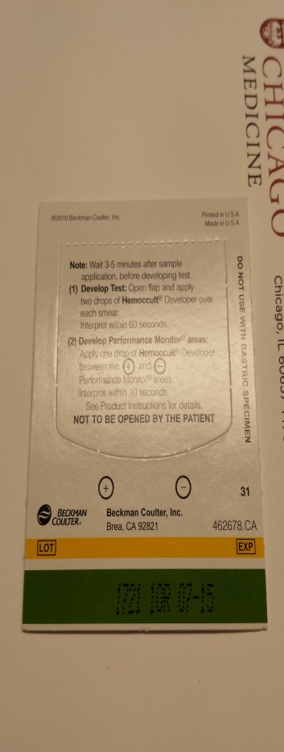
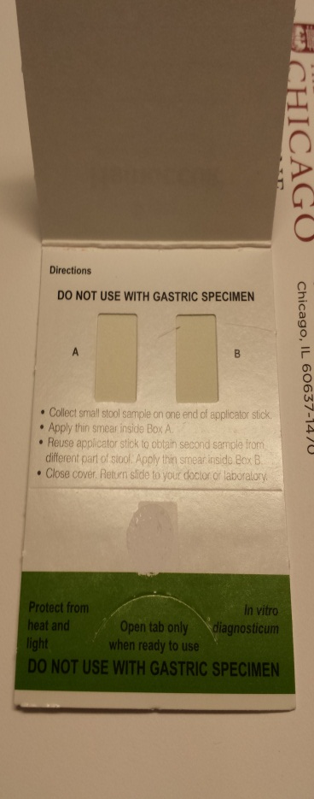
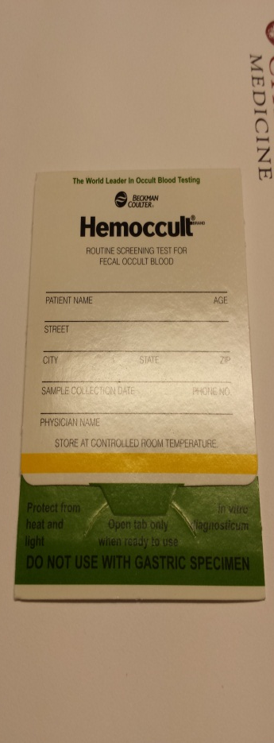
Test Procedure
Preparing the Test
Check expiration date
Label slide card with patient name on front of the card in space provided
Put on gloves
Open the Hemoccult slide packet
Using an applicator stick, collect small fecal sample
Apply thin smear covering Box A
Reuse applicator to obtain second sample from a different part of feces. Apply thin smear covering Box B
Close cover flap. Dispose of applicator in waste container
Wait 3 to 5 minutes to let sample react with guaiac paper
Heinrik Bui
Back Side Front Side

Slide 7
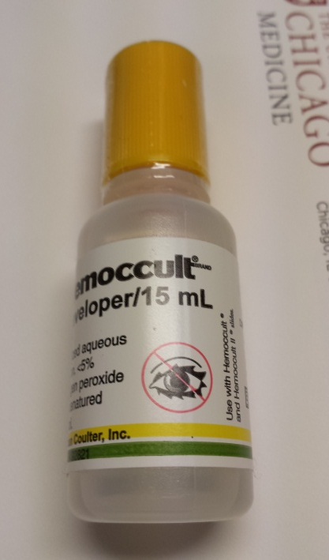
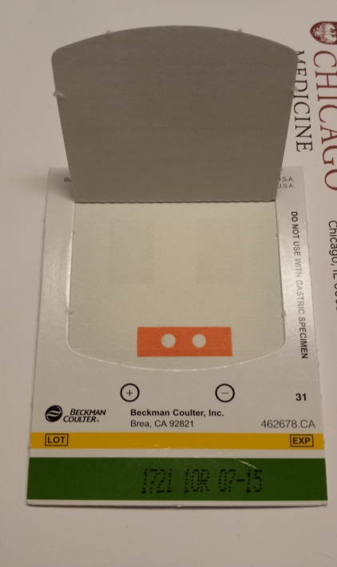
Test Procedure
Developing the Test
Open back of slide and apply two drops of Hemoccult Developer to guaiac paper directly over each smear (Box A and Box B)
Read results within 60 seconds. Observe specimen for color change. Any trace of blue on or at the edge of the smear is positive for occult blood.
Back Side

Slide 8
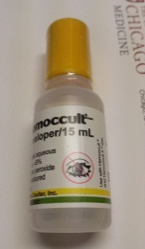
Test Procedure
Developing the Performance Monitors (Internal Quality Control)
Apply one (1) drop of Hemoccult Developer between the positive (+) and negative (–) Performance Monitors areas
Read results within 10 seconds
If the slide developer is functional, a blue color will appear in the positive performance monitor and no blue color will appear in the negative performance monitor
Should internal quality controls (QC) fail to perform properly, specimen collection and test procedure must be repeated with new slide card.
If internal QC fail again, obtain new lot # of slides and new lot # of developer. Repeat the test. Record the corrective action on Hemoccult Quality Control Log. Notify manufacturer and return failed lot of slides and developer to the manufacturer.
Back Side

Slide 9
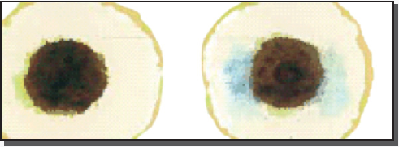
Interpretation
Patient Result
Negative
No detectable blue on or at the edge of the smears indicates the test is negative for occult blood.
Positive
Any trace of blue on or at the edge of one or more of the smears indicates the test is positive for occult blood.

Slide 10
Review
Slide cards are sensitive to heat and light, similar to developer must store at room temperature. Keep developer away from heat and tightly capped when not in use. It is flammable and subject to evaporation.
Wait 3-5 minutes before applying developer directly over each smear
Read test results within 60 seconds
Then develop the on-slide performance monitor (internal quality control) by applying one drop of developer between the positive and the negative Performance Monitor areas on the back of the slide card. Read the results within 10 seconds
Positive (+) should be blue
Negative (–) should be colorless
If performance monitor results are expected, record results in appropriate log
If performance monitor results are not as expected, take appropriate action
Repeat using new slide card, or new card from new box, and/or new developer

