Slide 1
YOU’VE GOT eMAIL! and MEETING INVITES!
What to do with all of these?

Slide 2
Objectives-let’s review
eMail from the Receiver’s Viewpoint
Dealing with a full Inbox
Receiving Calendar Invitations
eMail from the Sender’s Viewpoint
Instant Messaging

Slide 3
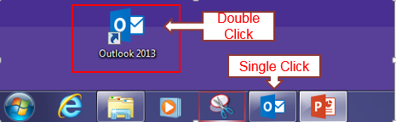
Quick, tell me more, where do I find them?
You can access e-mail from a full PC by either:
the full icon on the desk top
or
the link on the Start bar

Slide 4
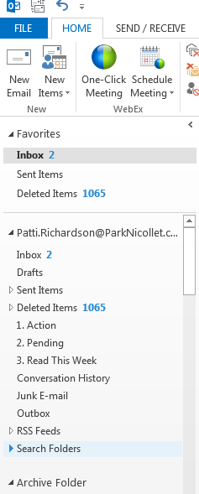


Outlook has many functions
Reading & sending e-mail 1
Calendar-making appointments 2
People-storing contact data 3
Storing e-mails for later reference 4
4
1
2
3

Slide 5
What are the expectations for the receivers?
Check your email every shift that you work!

Slide 6
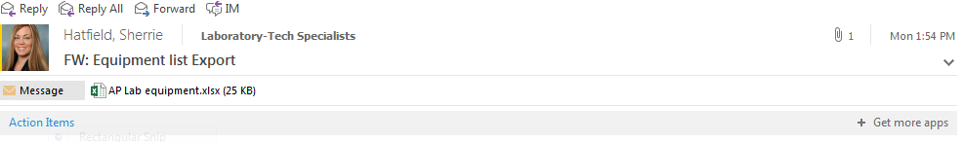
Reading and Replying to eMAIL
Look at Sender and who it was sent to
Look at the attachment
Look at the message
  Is message informative only?
  Do I need to act on it? Now?
  Do I need to respond? To all? To sender only?
  Will I need the information in the future or can it be deleted?

Slide 7
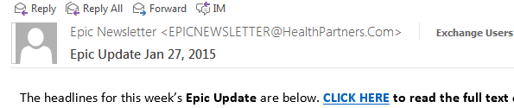
Is it informative only? Read & Delete

Slide 8
Do I need to respond?
Reply to sender or Reply All?
Reply
Reply All
Reply to the sender only when the information is for that person only.
Example: To thank Sherrie for sending this information
Reply to All when the email is a group email that all need to see the responses.
Example to send update information to all Tech Specs

Slide 9
How do I save this email for future reference?
Archive It!

Slide 10
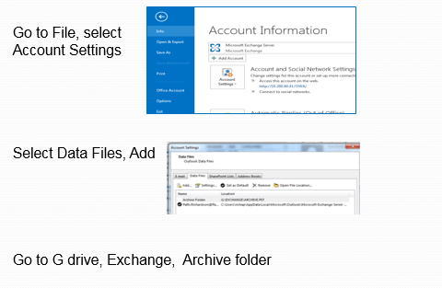
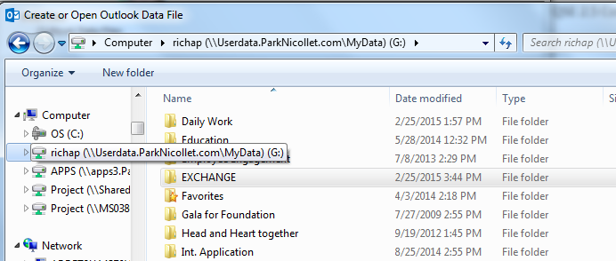
Create an Archive Folder if you do not have one already

Slide 11
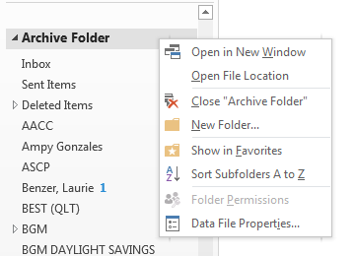
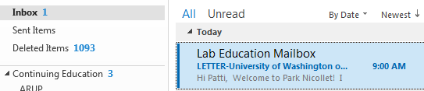
Create Continuing Education File
1. Right Click on Archive Folder
2. Click on New Folder
3. Name the Folder Continuing Education
4. Drag your email about the University of Washington access to this folder
5. Create additional folders as needed.
1
2
4
3
3

Slide 12
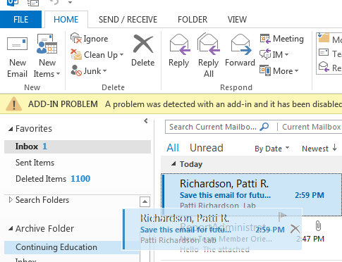
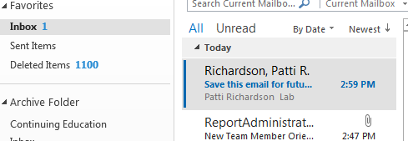
Store eMails for future reference in Archive folders
Drag the email to save to the archive folder

Slide 13
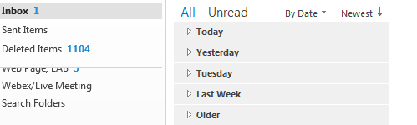
Your inbox should be clean and up-to-date!

Slide 14

Or does your Inbox look like this?

Slide 15
Clean up your inbox!
Delete obvious junk emails first.
Begin dealing with the remainder of your emails.
Rule of thumb: If an item will take less than 2 minutes to deal with just do it.
Delete informational emails that you have read and no longer need.
Deal with emails that need more than a quick response (e.g., C360 survey)
Save any emails for future reference in Archive folders
  Title folders by topic or project
  Title folders completely so they will make sense a few months from now

Slide 16
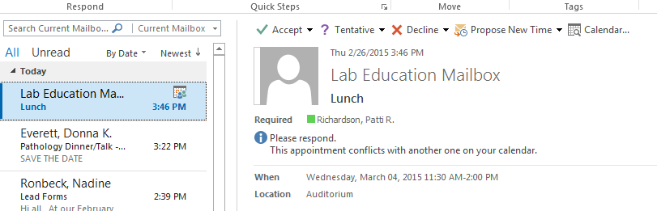
You’ve been invited!

Slide 17
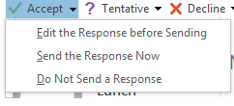
How to respond
Click Accept to attend the meeting
Click Tentative if you are unsure if you can attend
Click Decline if you can’t attend
Click Propose New Time if you want to suggest a new time
  Select:
  Edit the Response before Sending
  Send the Response Now
  Do Not Send a Response

Slide 18
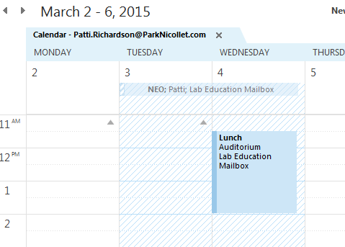
After Accepting the Invite the appointment will appear on your calendar!

Slide 19
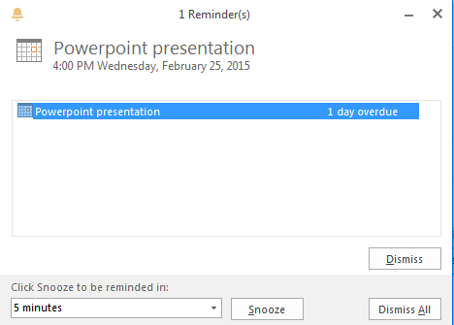
A reminder will be sent to you if Outlook is open.
You can even hit snooze!

Slide 20
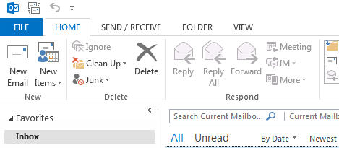
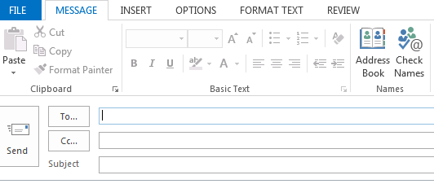
Sending an email
Click on New email
Fill in the boxes:
Add the message
Send the message

Slide 21
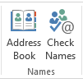

How do you find the information for the TO box?
If you have sent to the person before, start typing their name and their name should pop up for you to select.
If nothing pops up, you can click Check Names
You can also click the Address Book or the TO: button

Slide 22
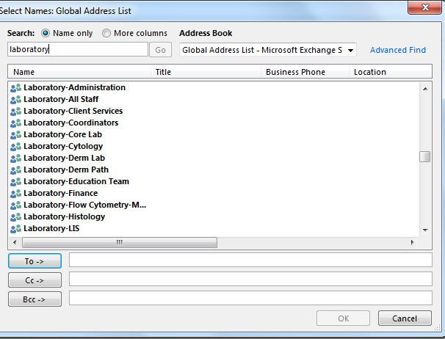
the Address Book will open
Type in the name of the person
Select the person you want the email to be sent
Click on the To button to insert the name
You can Carbon Copy (CC) someone or Blind Carbon Copy (BCC) someone by selecting those buttons
Say OK

Slide 23

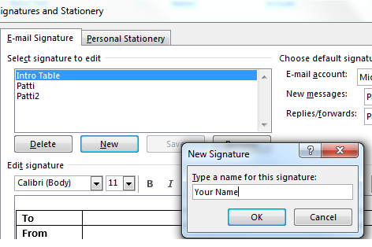
Signatures
Create a Signature for your email.
Use the Park Nicollet format.
  Click on New Email
  Click on Signature
  Select Signatures to create a template.
  Select New
  Name the Signature with your name.
  Click OK

Slide 24
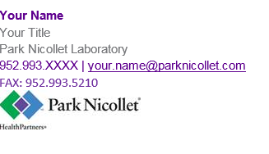

Signatures
Use the Park Nicollet format shown here.
You can create a template to be used on new emails and a different one for responses, maybe just Your Name.

Slide 25
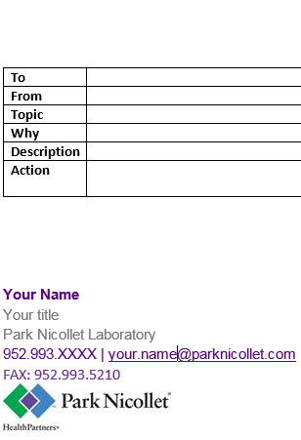
Signatures and Templates
Sending emails to multiple people?
Consider using the multiple template to give your readers a better opportunity to know what is important in the email.
Save this as a Signature so it is readily available for use.
TIP: Save your signatures as a Word document in case your email needs to be rebuilt. You will not lose your signatures!

Slide 26

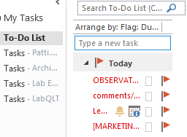
Other Tips
Add or look for Flags that indicate that something is High Importance
Read it right away!
Or, add the flags to emails that you receive that require your attention.
They will be added to your Tasks folder and create a To Do list for you!

Slide 27
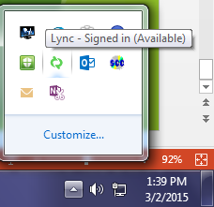


Instant Messaging
In bottom right hand area of your screen, select up arrow and then the Lync icon.
Select OPEN
Put the name of the person that you wish to contact and you will see their availability
1 You can share information back and forth with typing.
2 Click on the Monitor icon to share your desktop.
3 Click on the people to add others to the conversation.
1 2 3

Slide 28
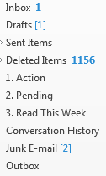
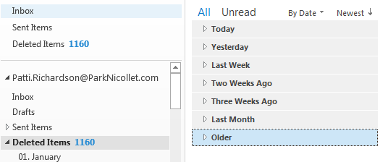

Instant Messaging
When you finish your “conversation”, write down the information. It used to be (before 11/2014) saved in Conversation History in Outlook but is no longer available.
Don’t forget to check your Junk E-mail too.
Empty your deleted items that are more than one month old, right click on the Older folder. Delete.

Slide 29
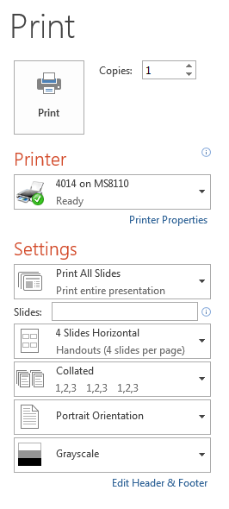
Want to print a handout of this information?
If you are in Full Screen mode, click the ESC button on your keyboard.
Click on File in the upper left corner.
Select Print. Check that the correct printer is here.
Under Settings, select Print all slides (or the slide you want)
Select 4 (or 6) slides per page
Click on Print

Slide 30
Need extra help?
Instant message or request a 1:1 tutorial from your Supervisor or the Lab Education team
Use the extra computers in Meadowbrook W115 Lab Training room.

Slide 31
Kaizen Event 1/26-1/27/2015
Participants
Team Members
Dan Stets
Danielle Baumberger
Jamin Drago
Callie Voigt
Chuck Ehster
Brittany Collatz
David Schleicher
Bridgett Rode
Laura Brigl
Sue Gillespie
Team Leaders
Travis Feuerhake
Andrew Petrenko
Quality Team Sponsor
Pat Croal

Slide 32
