Slide 1
Laboratory Proficiency Testing

Slide 2
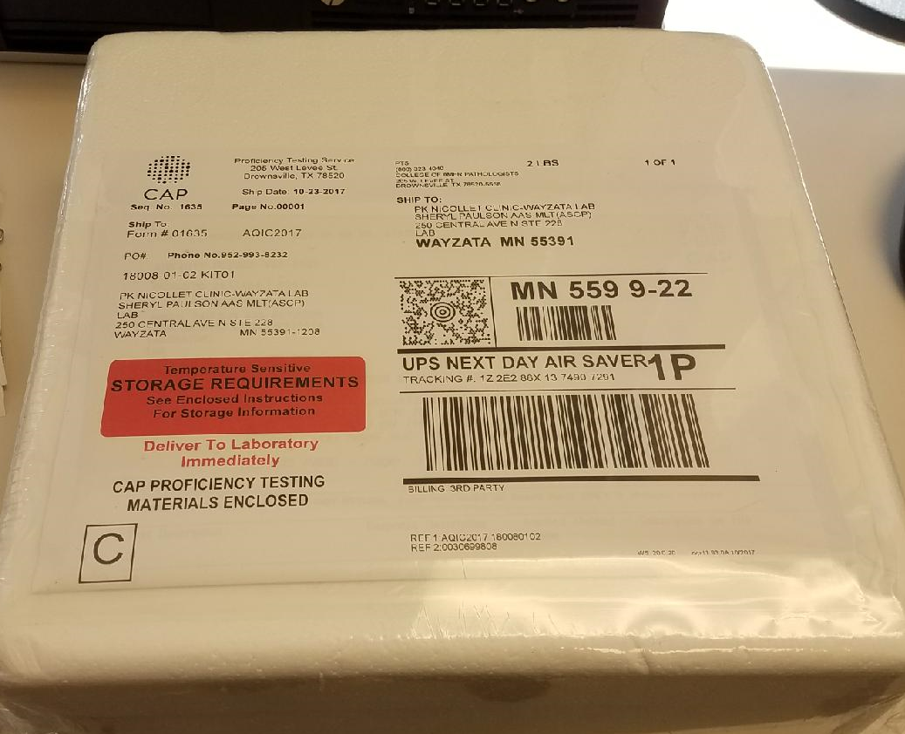
Proficiency Testing

Slide 3
What is Proficiency Testing?
A program that sends specimens with known values to be tested by participating laboratory.
This program is intended to spot check the accuracy of the testing process.
It is our accreditation report card.

Slide 4
Why do we participate in proficiency testing?
Each laboratory is assigned a unique CLIA certificate. PT enrollment and participation is required for each CLIA certificate.
To ensure QUALITY in our laboratories.
Every lab is required to be accredited by a certifying agency.
Park Nicollet is accredited by CAP (College of American Pathologists).
Our labs are required to adhere to CAP guidelines which are spelled out in a variety of checklists.
There are 11 specific checklist items for proficiency testing.

Slide 5
PT Implications
CAP has the authority to cease all laboratory testing if checklist standards are not met or if multiple errors are made.

Slide 6
Park Nicollet Policy
QSE 5.5 Proficiency Testing and Review 104946
Process for PT testing and review of results with responsible parties.
Includes guidance for standard review and trouble shooting of results.
QSE 5.6 Proficiency Testing 104925
Detailed step-by-step process for PT testing and submission.
Notes:
* Both procedures will be sent out as a c360 survey

Slide 7
PT Receipt
Open materials, date and initial.
Check sample integrity and condition.
If sample is compromised, contact individual responsible for PT survey immediately.
If there are time limitations for testing, contact individual responsible for PT survey immediately.
Place samples in appropriate storage conditions.
Place paperwork in designated area.
Start Form: QSE 5.5.1 Proficiency Testing Survey – Event Face Sheet Document #107426

Slide 8
PT Receipt
Communication with the appropriate team members/leaders is essential when receiving a survey.
Individuals responsible for PT distribute the PT materials to pre-assigned employees.
Individual responsible gives copy of paperwork, proficiency test checklist, and sample to assigned employee.

Slide 9
PT Testing
Read and follow all proficiency survey testing, processing and reporting instructions, which may include handling precautions, reconstitution, stability, or pretreatment, if applicable.
Prepare specimen(s) according to instructions; date, initial and add expiration date.
Perform testing on sample (same as patient testing) – must be done on first available work day of the testing personnel.
Record test code, instrument code, method, and test results on survey report copy, attach any instrument printout or test paperwork, and return to individual responsible for proficiency testing.
Sign and date attestation form.
Store remaining sample in appropriate storage location.

Slide 10
PT Testing
Compile PT results for survey.
Submit results online. Instructions for CAP online submission are located in Procedure: QSE 5.6 Proficiency Testing Document # 104925.
Ensure CAP submission page states “received” on all lines.
Assemble event face sheet, original PT paperwork, instrument printout or test paperwork, and final copy of report sheets.
Store with PT records.

Slide 11
PT Due Dates
Every survey has a due date.
The results must be received by CAP by the due date.
If results are not received, alternative assessment must be done and our report will reflect a proficiency failure.

Slide 12
PT Result Receipt
Results are mailed back to the testing lab in a large white envelope with CAP on the return address.
Open these envelopes upon receipt and look at the survey results.
If there is anything other than acceptable for the results, print a Form: QSE: 5.5 Proficiency Test Deficiency Corrective Action Document # 104858.
Notify a leader that proficiency results were received and if there is a deficiency noted.

Slide 13
PT Result Review
Satisfactory results:
Supervisor/TS sign proficiency paperwork.
High complexity testing requires Medical Director’s signature.
PT paperwork filed.

Slide 14
PT Result Review
Unsatisfactory results:
Supervisor/TS works with team members to complete corrective action steps that could include, but not limited to the following:
Rerun PT samples, patient comparisons, review QC and calibration, testing personnel re-education.
If corrective action does not fix the problem, patient testing may need to be ceased pending issue resolution.

Slide 15
Inter-Laboratory Communication
CMS Code of Federal Regulations §493.801(b) Standard:
Testing of proficiency testing samples (b)(3)Laboratories that perform tests on proficiency testing samples must not engage in any inter-laboratory communications pertaining to the results of proficiency testing sample(s) until after the date by which the laboratory must report proficiency testing results to the program for the testing event in which the samples were sent.
CAP Checklist – based on CMS regulation
**REVISED** 08/21/2017
COM.01800 PT Inter-laboratory Communication Phase II
There is no inter-laboratory communication about proficiency testing samples until after the deadline for submission of data to the proficiency testing provider.
Notes:
CAP standards are based on CMS regulations.
CMS Code of Federal Regulations §493.801(b) Standard: Testing of proficiency testing samples (b)(3)Laboratories that perform tests on proficiency testing samples must not engage in any inter-laboratory communications pertaining to the results of proficiency testing sample(s) until after the date by which the laboratory must report proficiency testing results to the program for the testing event in which the samples were sent.

Slide 16
Inter-Laboratory Communication
Park Nicollet Laboratory Policy
QSE 5.6 Proficiency Testing 104925
6. Inter-laboratory communication about proficiency testing is prohibited.
a. PNHS employees who perform, or are involved with any part of a proficiency survey at one site cannot be involved with the same proficiency survey at another site.

Slide 17
Referral
Park Nicollet Laboratory Policy
QSE 5.6 Proficiency Testing 104925
7. Referral of proficiency specimens to another laboratory for any reason is strictly prohibited. Only after the submission deadline has passed can specimens be used for internal purposes such as competency, educational activities, or quality improvement.

Slide 18
PT Expectations
All proficiency testing samples will be assigned to testing personnel.
It is important to perform PT testing when assigned.
If unable to perform PT testing as assigned, a leader must be notified immediately.

Slide 19
PT Expectations
Testing personnel are only allowed to perform a single survey event at one site.
Samples within a testing platform cannot be split among testing personnel.
For example: If there are 5 samples for FLU, one individual has to perform all of them.
Testing platforms within PT survey may be split among testing personnel.
- For example: Urine pregnancy can be done by one individual and urine microscopic can be completed by a different individual.

Slide 20
PT Reporting Expectations
It is expected to report PT results on the CAP website from the instrument printout to decrease the chance of transcription errors.
It is prohibited to enter and/or double check results if you have performed the PT survey at the other site.
Remember, PT testing is treated as a patient, therefore transcription errors are considered a failure.

Slide 21
Thanks
(

