Slide 1
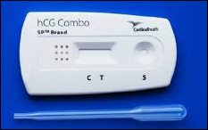
Lot-to-Lot Testing on Non-waived Kit Tests in Beaker

Slide 2
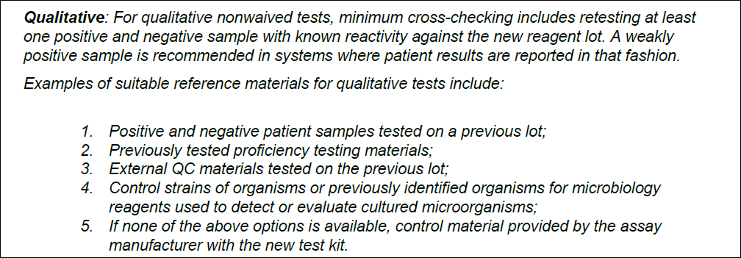
Why Do Lot-to-Lots?
Performed on all nonwaived tests to confirm that new lots are acceptable and will not affect patient testing
Also it is a requirement, CAP COM.30450
Here is the excerpt pertaining to Qualitative testing:

Slide 3
What kits/cartriges do we order lot-to-lot testing on?
Serum Pregnancy
Affirm
Amnisure
Genexpert Strep A (only at sites using green eswabs)
iStat Chem8

Slide 4
How to perform lot-to-lots: 2 Options
Order and Perform QC on the new lot and current lot at the same time
Use previous results from the current lot and perform test on the new kit

Slide 5
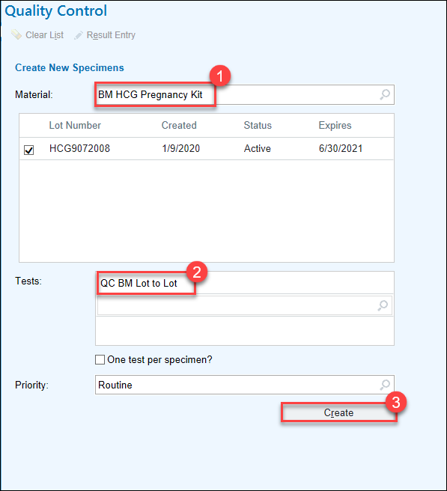
Step 1 for both options, order the lot to lot test
In the Quality Control function select the Kit as the material
For tests with a positive and negative control: Select QC Lot to lot as the test
For Affirm and Chem8 Select QC Affirm lot to lot or QC Chem8 lot to lot

Slide 6
Option 1: Perform QC on current and new lot concurrently
Order the external quality controls, using the control product as the material and the associated QC test, for both the current and new kit lot.
In total you will have ordered 5 QC tests
Perform and result all QC Tests

Slide 7
Option 2: Perform QC on new lot and perform historical lookback for current lot QC
Order the external quality controls, using the control product as the material and the associated QC test, for only the new kit lot
In total you will have 3 ordered QC tests

Slide 8
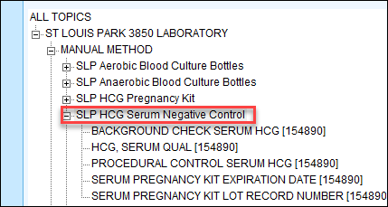
Option 2 cont.
Find previous results in the Result Review (Quality Control) function
Find the last resulted QC of the current lot

Slide 9
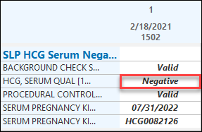
Option 2 Cont.
Double click on any result line to open up Specimen Inquiry
Record the specimen ID or MPI number and record in the CURRENT KIT LOT ORDER NUMBER component line of the Lot to Lot test.
Complete and record other QC tests

Slide 10
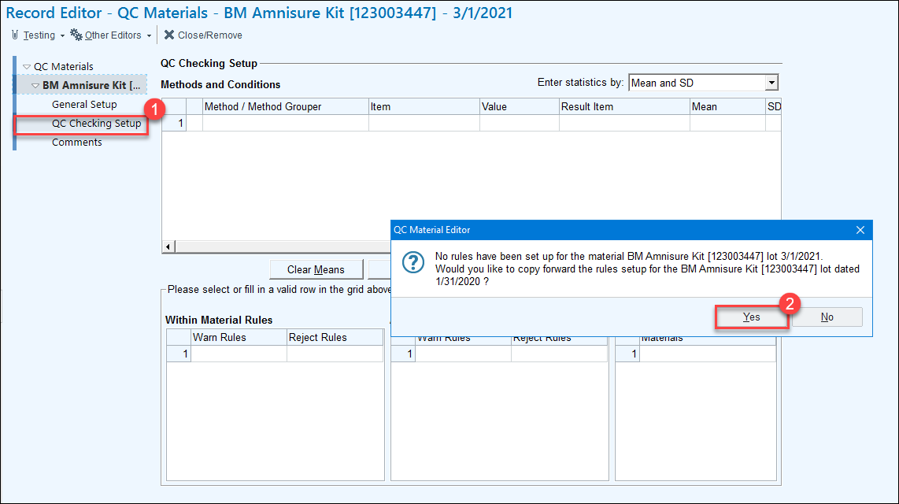
Bringing in New Kits
Since we are now using the kit as the material. We need to apply rules to the kit.
Rules have been applied to current kits, going forward when bringing in new kits QC Checking Setup needs to be selected to carry rules forward.

Slide 11
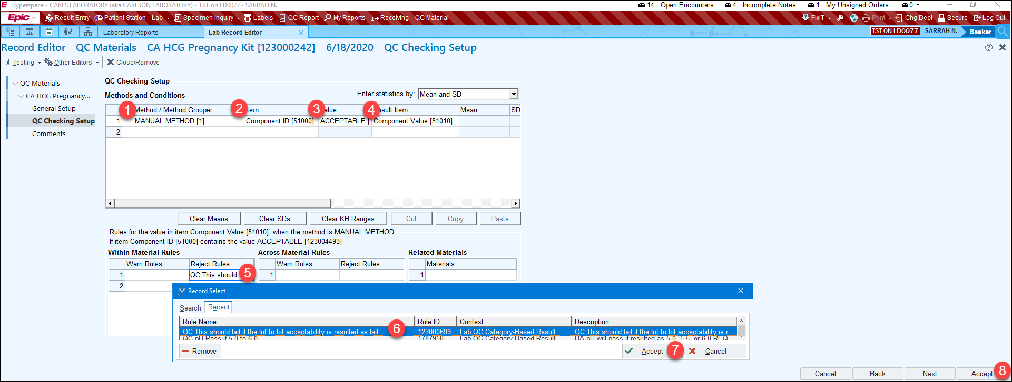
No Rules? No Problem, you can add them.
The following rules should be applied to the kit:

Slide 12
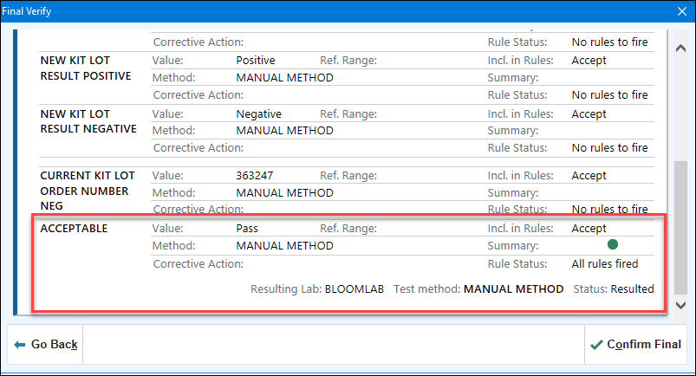
Acceptable Results
When rules are in place you will get a Green dot when the Acceptable line is resulted as Pass

Slide 13
Further Reading
C360:
Lot-to-Lot Comparison107684
QC Materials 107682
QC Result Entry 107656

