Slide 1
RN STAT (Pilot)
Lab Response for Syncopal Episodes
Park Nicollet Urgent Care Sites Only

Slide 2
What: RN STAT for emergent lab response (syncopal events only)
Park Nicollet Urgent Care sites will pilot a new RN STAT response for syncopal events (fainting) in lab starting October 6th, 2021
1 Urgent Care RN will be assigned to respond to RN STAT calls in lab at PN UC locations ONLY. Brookdale, Burnsville, Chanhassen, Plymouth, Maple Grove, St. Louis Park (Carlson and Lakeville- temporarily closed- will remain code blue response)
The RN will provide prompt clinical assessment for a patient, visitor or staff who has fainted and is not rapidly decompensating
RN STAT response to lab utilizes scope of practice, certified skills, triage protocols, standing orders and designated equipment to provide assessment and care

Slide 3
Why start RN STAT calls for Lab?
Syncopal Events in 2020: 59%, 36% happened in LAB
Quarter 2 of 2021:
52%, 26% happened in LAB
Notes:
Code blue data showed that many code blue calls coming from lab are attributed to syncopal events
Total in 2020 Syncope/Dizziness 59% / Lab events 36%
In Q2 of 2021, Syncope/dizziness 52% / Lab events 26%

Slide 4
Why do RN STAT instead of Code Blue in Lab?
Staffing- Each code blue called in the lab pulls one UC clinician and 2 RNs from the urgent care setting and away from patient care along with a Clinic Leader and a PC RN.
Continued support from a Clinic Leader and RN Supervisor or Staff RN along with UC RN and Lab Staff would be sufficient for the needs
Rare to have a full code blue in lab
Patients were typically dispositioned to home, on to clinic appointment or, urgent care
Lab is trained to provide initial interventions for someone who has fainted

Slide 5
Criteria for lab calling RN STAT vs Code Blue
RN STAT available during Urgent Care hours: M-F 8am-8pm and Sat & Sun 8am-5pm | Code Blue
Syncopal event (patient has fainted) | Patient unable to communicate Change of consciousness Seizure Hypoglycemia Severe tachycardia or severe bradycardia Cardiac symptoms, diaphoresis Shortness of breath Cardiac symptoms
 | Anaphylaxis Difficulty breathing
 | Patient in CT/MRI, including possible allergic reaction
 | General impression that patient is quickly de-compensating clinically
RN STAT responder can initiate Code Blue response and/or promptly seek clinician evaluation by following disposition criteria
Table 1. RN STAT vs Code Blue Criteria
Notes:
RN STAT responder can initiate Code Blue response and/or promptly seek clinician evaluation by following disposition criteria

Slide 6
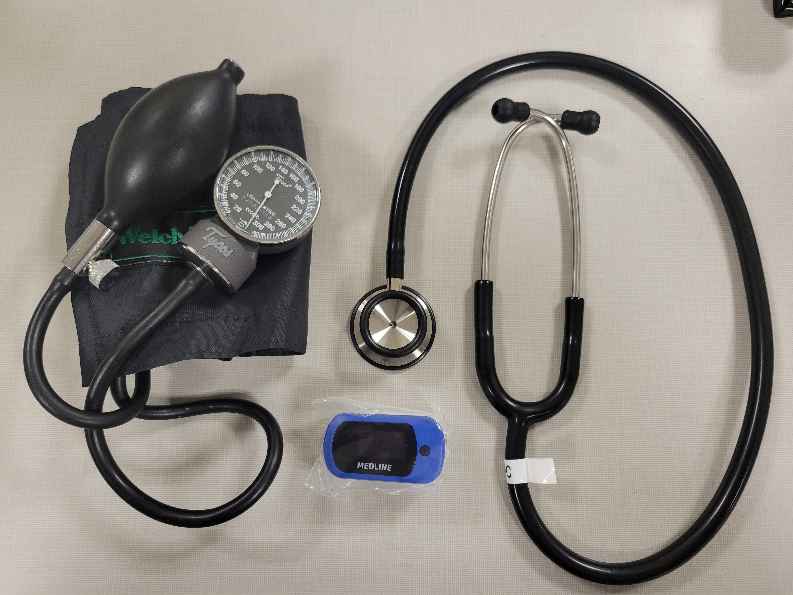
Designated Equipment
Lab to Bring: Lab Kit
Manual Blood Pressure Cuffs with Stethoscope
Oxygen Saturation Monitor
RN STAT Clipboard- RN STAT Response Form, Hypoglycemia SO-07, RN STAT Dispo grid
Cold Packs- Lawson # 8301607
RN STAT to Bring
Donn PPE- eye protection, gown, gloves
Red Box
*UC RN to re-stock Lab Kit and Red box
Lab leaders: designate place to store kit and label cabinet
Notes:
After calling the emergency response RN STAT to lab, the lab team will bring the LAB kit close by the patient. Each lab kit will be the same and will be housed at each lab spot

Slide 7
Lab Calling RN STAT
Emergency Alert:
RN STAT to (Building, floor, LAB)
*Add site specific directions
Repeat 3x clearly
“RN STAT to 14050, 1st floor, lab”
“RN STAT to 14050, 1st floor, lab”
“RN STAT to 14050, 1st floor, lab”

Slide 8
Hypoglycemia Standing Order SO-07
RN will follow standing order criteria for obtaining a stat BGS during an RN stat response in Lab
Lab is responsible for obtaining Stat BGS if RN requests it-may need to use override process as may not have specific beaker label to scan.

Slide 9
Lab Team
Continue to assess for prior fainting episodes with lab draws and take precautions
Call emergency response: RN STAT, Building, Floor, LAB
Direct UC Rn and clinic leaders/RN to location
Locate RN STAT Lab Kit
Interventions:
Lay patient down
Elevate feet
Bring RN STAT Lab Kit near patient
Juice and crackers
Cold pack
Lab is responsible to obtaining Stat BGS if RN requests it-may need to use override process as may not have specific beaker label to scan

Slide 10
Go live: October 6 Educate/train team members on new process prior to go live. Find location to store the RNStat Lab Kit. Ensure all team members know how to override barcode scanning on the Nova Meter.

