Slide 1
YOU’VE GOT eMAIL! and MEETING INVITES!
What to do with all of these?

Slide 2
Objectives-let’s review
eMail from the Receiver’s Viewpoint
Dealing with a full Inbox
Receiving Calendar Invitations
eMail from the Sender’s Viewpoint
Chat-Microsoft Teams (myTeams)

Slide 3
Quick, tell me more, where do I find them?
You can access e-mail from a full PC by either:
the full icon on the desk top
or
the link on the Start bar

Slide 4
Outlook has many functions
Reading & sending e-mail 1
Calendar-making appointments 2
People-storing contact data 3
Keeping a Task List 4
1
2
3
4

Slide 5
What are the expectations for the receivers?
Check your email every shift that you work!

Slide 6
Reading and Replying to eMAIL
Look at Sender and who it was sent to
Look at the attachment
Look at the message
Is message informative only?
Do I need to act on it? Now?
Do I need to respond? To all? To sender only?
Will I need the information in the future or can it be deleted?

Slide 7
Is it informative only? Read & Delete

Slide 8
Do I need to respond? Reply to sender or Reply All?
Reply
Reply All
Reply to the sender only when the information is for that person only.
Example: To thank Sherrie for sending this information
Reply to All when the email is a group email that all will need to see the response.
Example to send update information to all Lab Tech Specs

Slide 9
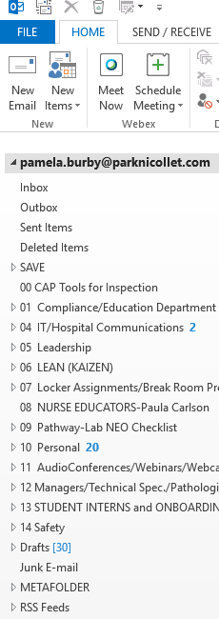
How do I save this email for future reference?
Create folders to store your emails in under your email address

Slide 10
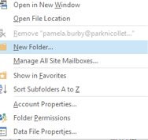
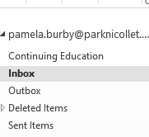
Example: Create a Continuing Education File
1. Right Click on your Email address
2. Click on New Folder
3. Name the Folder Continuing Education
4. Drag your email about the University of Washington access into Continuing Education folder
5. Create additional folders as needed, under your email address and store emails there.
1
5
2
3
4

Slide 11
New Email Retention and Removal Policy
Outlook Folders: As of April 5th, 2021 there will be a new email retention and removal policy in place:
Emails in Outlook will automatically delete after two years from the date emails are sent or received.
Emails in Deleted folder will be automatically removed from Outlook 30 days after being moved to the trash. Calendars, contacts and tasks are not affected by this change
Every department has a designated Record Custodian to provide guidance and support for this change.

Slide 12
Your inbox should be clean and up-to-date!

Slide 13
Or does your Inbox look like this?

Slide 14
Clean up your inbox!
Delete obvious junk emails first.
Begin dealing with the remainder of your emails.
Rule of thumb: If an item will take less than 2 minutes to deal with just do it.
Delete informational emails that you have read and no longer need.
Deal with emails that need more than a quick response (e.g., C360 survey)
Save any emails for future reference in folder created under your email address.
Title folders by topic or project
Title folders completely so they will make sense a few months from now

Slide 15
You’ve been invited!

Slide 16
How to respond
Click Accept to attend the meeting
Click Tentative if you are unsure if you can attend
Click Decline if you can’t attend
Click Propose New Time if you want to suggest a new time
Select:
Edit the Response before Sending
Send the Response Now
Do Not Send a Response

Slide 17
After Accepting the Invite the appointment will appear on your calendar!

Slide 18
A reminder to attend the meeting will be sent to you if Outlook is open.
You can even hit snooze!

Slide 19
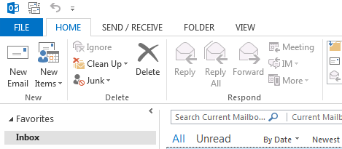
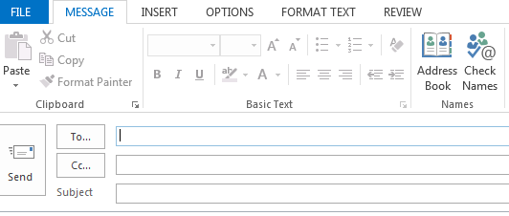
Sending an email
Click on New email
Fill in the boxes:
Add the message
Send the message

Slide 20
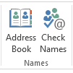
How do you find the information for the To… box?
If you have sent email to the person before, start typing their name and their name should pop up for you to select.
If nothing pops up, you can click Address Book or Check Names :
You can also right click on the To… button:

Slide 21
the Address Book will open
Type in the name of the person
Select the person you want the email to be sent to
Click on the To button underneath list to insert the name
You can Carbon Copy (CC) someone or Blind Carbon Copy (BCC) someone by selecting those buttons
Click OK

Slide 22
Signatures
Use the Park Nicollet format shown here.
You can create a template to be used on new emails and a different one for responses, maybe just Your Name.

Slide 23
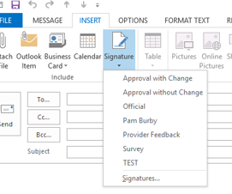
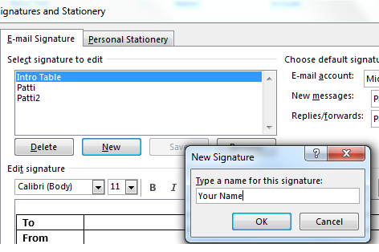
Signatures
Create a Signature to sign your emails with, using the Park Nicollet format.
In Outlook 2013, click on New Email
Click on Insert, then Signature
Next click on Signatures to create a template.
Select New
Name the New Signature with your name.
Click OK and create your signature under Edit signature (paste in signature of someone else and update to your name and contact information)

Slide 24
Signatures and Templates
Sending emails to multiple people?
Consider using the multiple template to give your readers a better opportunity to know what is important in the email.
Save this as a Signature so it is readily available for use.
TIP: Save your signatures as a Word document in case your email needs to be rebuilt. You will not lose your signatures!

Slide 25
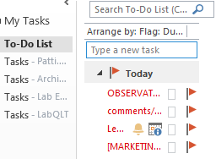
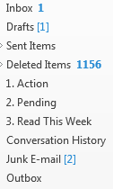
Other Tips
Add or look for Flags that indicate that something is High Importance
Read it right away!
Or, add the flags to emails that you receive that require your attention.
They will be added to your Tasks folder and create a To Do list for you!
Don’t forget to check your Junk E-mail folder.

Slide 26
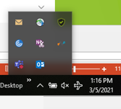
Chat-Microsoft Teams
In bottom right hand area of your screen, select “up” arrow and then click on the MyTeams icon.
Type the name of the person that you wish to contact and you will see their availability. Type a new message and send.
1 Video call
2 Audio call
3 Screen sharing
4 Add people to conversation
1 2 3 4

Slide 27
Want to print a handout of this information?
Click on File in the upper left corner.
On left, click Print.
Check that the correct printer is chosen.
Under Settings, select Print all slides (or the slide you want)
Select 2 slides per page
Select Print on Both Sides
Click Print

Slide 28
Need extra help?
Request a 1:1 tutorial from your Supervisor or the Lab Education team
Use the extra computers in Lab Training area.

Slide 29
Kaizen Event 1/26-1/27/2015 Participants
Team Members
Dan Stets
Danielle Baumberger
Jamin Drago
Callie Voigt
Chuck Ehster
Brittany Collatz
David Schleicher
Bridgett Rode
Laura Brigl
Sue Gillespie
Team Leaders
Travis Feuerhake
Andrew Petrenko
Quality Team Sponsor
Pat Croal

Slide 30
