Slide 1
Scenes from an assessment visit
This scenario mimics an actual assessment visit and describes actual findings by assessors.

Slide 2
How many non-compliances to OLA Standards can you find?
How many inappropriate behavior from the assessors can you find?

Slide 3
Act One: Lab Tour
An assessment team is visiting a community hospital laboratory whose scope of testing includes chemistry, POCT, hematology and transfusion medicine. The laboratory does not have an laboratory director and medical director on site – it is managed remotely by a larger organization – OMNI Hospital. After the opening meeting, the team is taken on a tour of the laboratory. While touring, they note that a staff member leaves the bench from uncapping tubes to answer the phone but doesn’t remove his gloves and another staff member removes lip balm from her lab coat pocket and applies it while at the bench.

Slide 4
Act Two: POCT Performed in the Emergency Room
After the tour the assessment team splits up to conduct their assigned technical assessments. Susie, the assessor assigned to point-of-care heads off to the emergency department with the POCT technologist to view the area. The POCT technologist informs Susie that they only do POCT glucose testing. Susie notes that there are initial training records from five years ago but there are no on-going training records. Susie then reviews recorded POCT glucose results. Several results are missing the reference interval. She proceeds to check reagents in the supply cupboard and a very helpful nurse points out the fecal occult blood kits Dr. Dick brought in from his office so nursing staff could test for that in the emergency room, too.

Slide 5
Act Three: Transfusion Medicine Practices
Red, the transfusion medicine assessor goes to the operating room to look at the blood warmers located there. She notes that the are not monitored for temperature and to ensure they meet applicable safety standards. Back in the laboratory, while reviewing transfusion medicine instructions, she notes that several printed procedures related to antibody identification, dealing with transfusion reactions and performing crossmatches have sections blacked out with a marker. When Red asks the bench technologist why, she is told “OMNI Hospital lab managers maintain our procedures but won’t alter them to match our practices, so we just cross out whatever isn’t done here, on our printed copies”. At the end of the day team meeting Red shares this observation with the rest of the team and discovers this practice of making authorized changes to printed procedures is also carried out in chemistry and hematology.

Slide 6
Act Four: Chemistry Lab
Sugar, the chemistry assessor, discovers several reagents that do not have a recorded “in use” date or expiry date. She also notes several duplicate procedures in the laboratory manual and when she quizzes the technologists working in the area, they tell her that one of the procedures is obsolete and the one with the most recent date is the current procedure.
While assessing the specimen collection area she notes that the pneumatic tube system was installed earlier in the year, but there are no validation records. When she asks the laboratory manager about the validation records, the laboratory manager, an OLA assessor, waits until she is alone and then steps into Sugar’s personal space and starts shouting at her, trying to intimidate her.

Slide 7
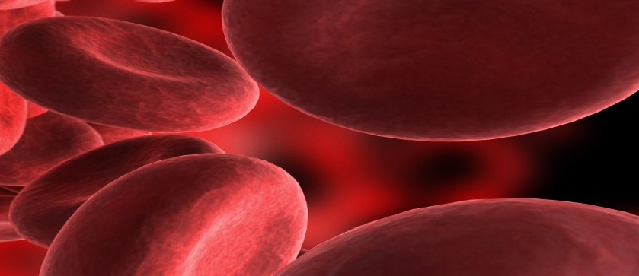
Act Five: Hematology Lab
Ivan Attitude, the hematology assessor starts asking the busy medical laboratory technologist running the automated instrument questions. Before she can answer Ivan asks another question in a very demanding tone of voice. He asks the technologist to see the procedure for the instrument maintenance. After looking at it Ivan states “This is a piece of garbage: - This isn’t what we do in our lab – so it isn’t right. This is going to be a non-conformance for sure!”. He then asks to see the routine procedure for a aPTT assays and asks “how do you ensure that these specimens are tested within 4 hours of collection – I will need to see 100 records to be sure you do what you say. We were cited for this at my lab so I am making sure that you do it.
While making notes on his checklist the senior MLT asks Ivan what he is writing and he replies “none of your business – it’s a secret. By the way can you tell me the name of the technologist running the automated instrument – I need to add her name to the non-conformance”.

