Slide 1
Blood and Blood Product Administration
For Physicians and Nurses

Slide 2
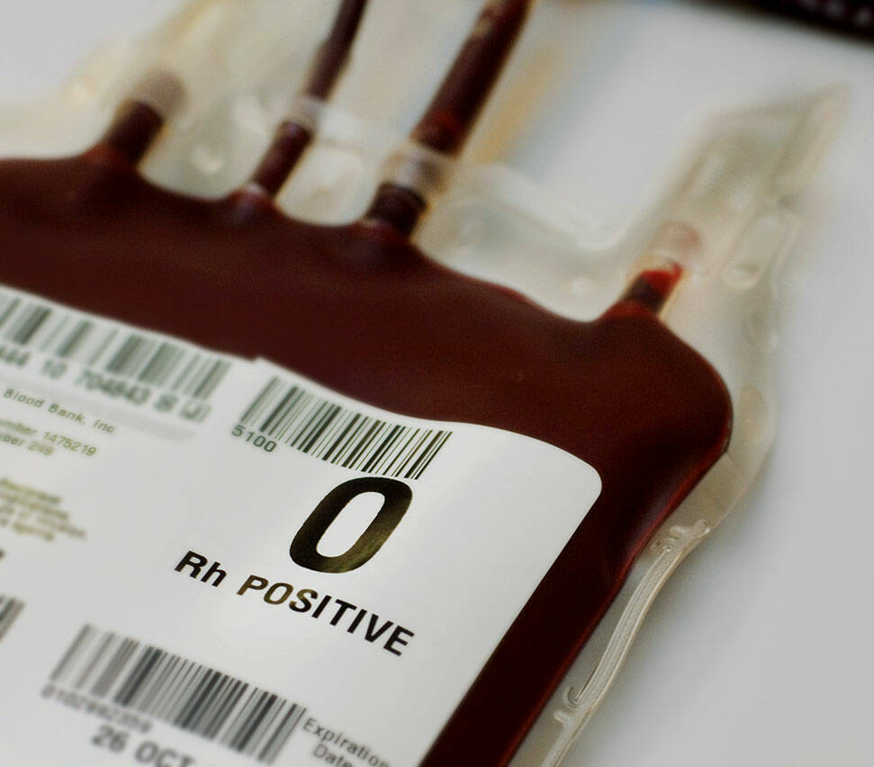
Learning Objectives
Define a group and screen
Describe types of crossmatches
List the indications for red blood cells, platelets, plasma and fibrinogen product
Infusion consent, tubing and flow rates
Estimate the frequencies of transfusion reactions to blood components in Canada
Recognize the signs and symptoms of an adverse reaction to blood and blood components
Summarize measures for the management and prevention of transfusion reactions

Slide 3
Who Regulates Transfusions?
Health Canada regulates blood collection and testing
Canadian Blood Services (CBS):
Collects blood
Screens the donors
Processes the blood/ blood products
Distributes to hospitals, based on need

Slide 4
Informed Consent is a Process
A consent to treatment is informed if the patient receives the following information before giving consent:
Nature of the treatment (transfusion)
Expected material benefits of the treatment
Material risks of the treatment
Material side effects of the treatment
Alternative courses of action
Possible consequences of not having the treatment

Slide 5
Consent for Transfusion of Blood/ Blood Products
Consent is obtained by the physician/ nurse practitioner prescribing the treatment for any patient who receives or is likely to receive a blood product.
For elective surgery, if a group and screen and/or group and crossmatch is ordered, written consent should be obtained
In an emergency, the physician will obtain the written, informed consent from the patient or substitute decision maker within 24 hours after the transfusion
Paper consent is still a requirement for blood and blood products, for crossmatch and for Cerner downtime.

Slide 6
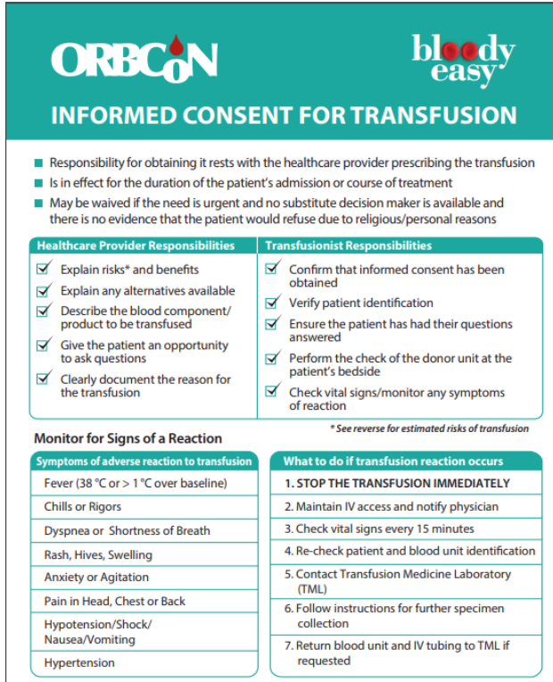
Requirements for a Valid Consent
Must be VOLUNTARY
The patient must have CAPACITY to consent
The patient must be properly INFORMED
Provided in language understood by the patient
Includes all information a reasonable person in similar circumstances would want
Provides an opportunity to ask questions and make sure the explanations are understood

Slide 7
Consent Validity
The consent is valid:
Until the treatment is completed
Until the patient is discharged (length of stay)
For the course of treatment (inpatient or outpatient)- outpatient consent is renewed annually
Unless there is significant changes in the level of patient acuity requiring interventions not anticipated (Physician/ Nurse Practitioner to re-assess the need for new consent)
Unless the consent is revoked by the patient/substitute decision maker

Slide 8
Infusion Rates
Please note:
Physician/ NP orders the rate of infusion/ time frame
All blood/blood products are to be infused slowly the first 15 minutes (50ml/hr) under the close supervision of the nurses
**Note for IVIG refer to the Physician Order Set for infusion instructions**
Watch for signs/ symptoms which may indicate the start of an adverse reaction (may occur within seconds, hours or days)
Watch for changes in BP, diastolic or systolic >20-30 mmHg
Instruct/ educate the patient of the signs and symptoms of reactions during/ following a transfusion

Slide 9
Nursing Responsibilities When a Transfusion is Ordered
Check for the signed, written, informed consent (on paper)
If no consent, the general surgical consent box regarding transfusion should be initiated by MD as applicable
Discuss treatment with patient to elicit understanding
If patient indicates lack of understanding, has questions or concerns, or the consent is not on chart, notify the physician
BRIDGE:
Removes the need for an independent second check in regular transfusion acitivities
Keeps a record of all transfusions
Mandatory documentation, helps standardize transfusion charting

Slide 10
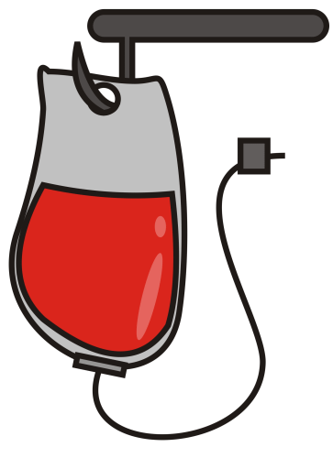
When a Transfusion is Ordered:
Set up an IV with blood tubing and normal saline (100ml, 250ml, 500ml as required), measure and record baseline vital signs and lung sounds
Retrieve blood/blood product from Transfusion Services
Follow Policy “Blood and Blood Components Transfusion Medicine” for completion of transfusion policy requirements/ procedure (Policy available on intranet)
All adverse reactions are documented on Bridge app, or separately in Cerner

Slide 11
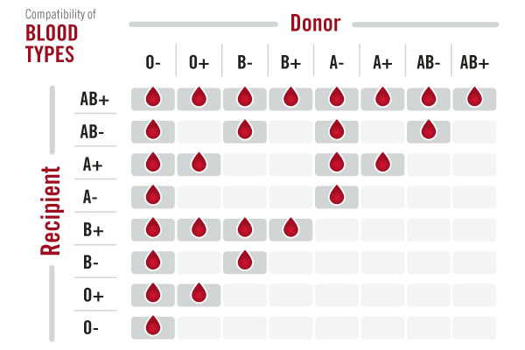
Pre-Transfusion Compatibility Testing
Before a transfusion can be issued, a group and screen must be performed
Group is the recipient’s blood type (O, A, B, or AB) and RhD group (D positive or D Negative)
The ABO is extremely important because ABO incompatible RBC transfusions can cause severe, sometimes fatal, hemolytic transfusion reactions
The RhD antigen is the second most important RBC antigen due to its highly immunogenic properties. RhD negative individuals can develop an anti-D following pregnancy or transfusion.

Slide 12
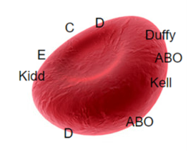
Pre-Transfusion Compatibility Testing
Minor Blood Group Antigens
There are other minor antigens present on the surface of red blood cells that may cause the creation of antibodies from previous immunization (pregnancy or transfusion)
These antibodies tend to cause less severe reactions that ABO incompatible transfusions

Slide 13
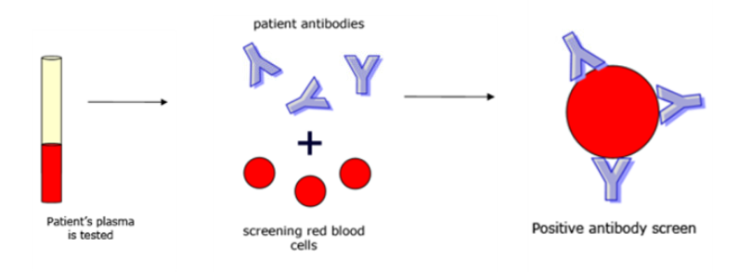
Pre-Transfusion Compatibility Testing
The antibody screen tests the recipient’s plasma for unexpected antibodies to clinically significant minor red blood cell antigens on screening red cells.
Approximately 2% of patients have antibodies, usually formed from a previous exposure to the specific antigen (through pregnancy or transfusion).
The lab will test the group and screen together prior to crossmatching units. If the antibody screen is positive, further testing is required to identify the antibody in order to safely transfuse.

Slide 14
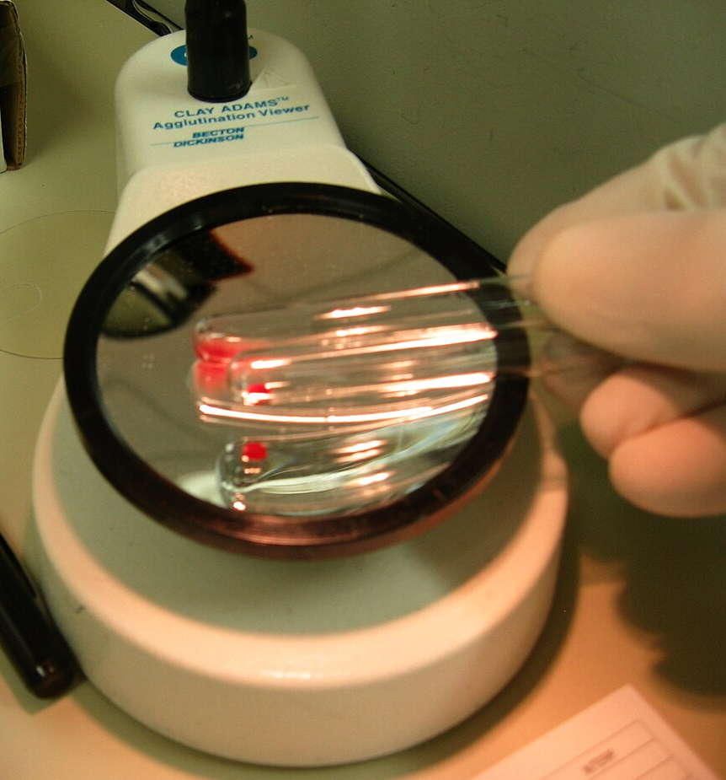
Group and Screen
Requires at least 45 minutes to perform
May take hours or days to complete the antibody investigation, and find antigen negative, crossmatch compatible units if the antibody screen is positive
If a patient has a negative antibody screen, with no history of antibodies, RBC units can be electronically crossmatched within minutes
Additional special transfusion needs (e.g., sickle cell negative units, irradiated blood) may take longer to source

Slide 15
Crossmatch
The final step in confirming RBC unit compatibility with the recipient:
Electronic crossmatch:
Donor units and recipient ABO groups have been double checked, and can safely assume compatibility due to recipient’s negative antibody screen
Immediate spin crossmatch:
Involves mixing donor RBCs with recipient plasma to ensure compatibility is seen
Full antiglobulin crossmatch:
Completed when the antibody screen is positive, or when the patient has special transfusion requirements
Can take 45 minutes or more to complete

Slide 16
Uncrossmatched Blood
When waiting for the group & screen and crossmatch (minimum 45 minutes) is detrimental to the patient, and as determined by the physician, uncrossmatched blood can be issued from the blood bank.
The most important issue to avoid is ABO Incompatibility:
Group O RBCs will be issued if the blood group has not been verified.
Group O RhD Negative RBCs should be reserved for women of childbearing age (to prevent the development of anti-D)
Group specific (ABO/Rh compatible) units will be issued only when the recipient’s ABO/Rh group has been confirmed by a historical result, or a second ABO/Rh group test has been performed.
Once testing has been completed, and if possible, crossmatch compatible blood will be issued.

Slide 17
Indications for RBC Transfusion
Each RBC unit has a volume of ~300ml, with a hematocrit of 65-70%.
Each unit is expected to raise the hemoglobin by about 10g/L in an average sized, non-bleeding adult.
RBC units should be transfused 1 unit at a time in non-urgent situations.
Transfusions should take no more than 4 hours from the moment the RBC unit leaves the blood bank:
Slower transfusion over 3-3.5 hours is indicated in patients over 70 years old, history of heart failure, left ventricular dysfunction, history of myocardial infarction, renal dysfunction, or positive fluid balance.
RBCs should not be removed from the lab until the patient is ready to be transfused

Slide 18
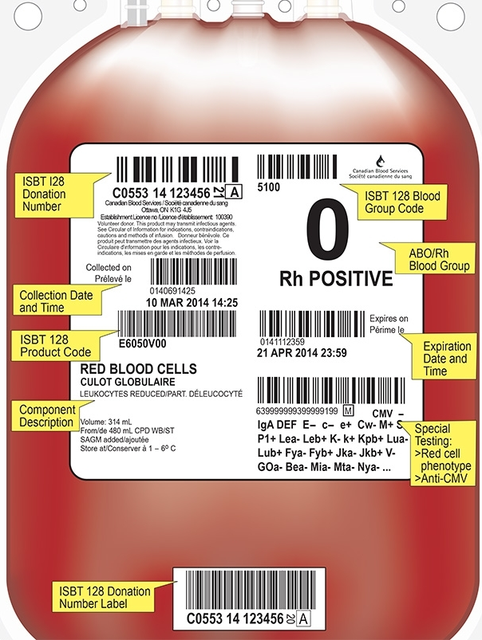
Indications for RBC Transfusion
Acute Blood Loss:
Ensure a group and screen has been performed when the hemoglobin <80g/L
Maintain the hemoglobin >70g/L during active bleeding, or >80g/L for patients with unstable or acute coronary syndrome, coronary artery disease, or uncontrolled/ unpredictable bleeding
Transfusing patients with gastrointestinal hemorrhage results in a higher rate of re-bleeding and mortality when employing liberal transfusion practices (hemoglobin >90 g/L)

Slide 19
Indications for RBC Transfusion
Perioperative patients:
Pre-op:
Alternatives to transfusion should be considered 4-5weeks in advance of the scheduled surgery to try blood conservation measures (e.g., erythropoietin, iron)
Group and screens can be performed prior to the surgery date to ensure blood can be prepared ahead of time
Post-op:
Investigate persistently low hemoglobins (e.g., occult blood loss or hemolysis), and minimize excessive blood draws to prevent iatrogenic anemia
RBC transfusion is advised for hemoglobin <70g/L in non-bleeding and asymptomatic patients

Slide 20
Indications for RBC Transfusion

Slide 21
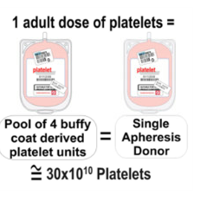
Indications for Platelet Transfusion
Each adult dose of platelets contains ~30x10¹⁰ platelets in 300-350ml and should increase the patient’s platelet count by 15-25x10⁹/L
One dose of platelets should be infused over 1-2 hours (maximum infusion time 3.5hours)
Knowing the underlying cause of thrombocytopenia is important in understanding when to prescribe platelets (e.g., Heparin- induced thrombocytopenia, thrombotic thrombocytopenic purpura, and catastrophic anti-phospholipid antibody syndrome all have an increased risk of thrombosis, even in the presence of thrombocytopenia)
Other modalities like steroids, intravenous immunoglobulin and other therapies may be better indicated in immune thrombocytopenia

Slide 22
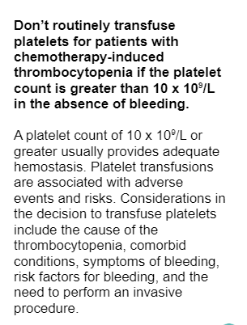
Indications for Platelet Transfusion
Non-immune thrombocytopenia
Failure of bone marrow to produce platelets due to miscellaneous conditions (chemotherapy, bone marrow replacement, aplastic anemia, acute leukemia, etc.)
Prophylactic platelet transfusion support is recommended when platelet count is <10x10⁹/L
If platelet count is <50x10⁹/L, transfuse 1 dose of platelets immediately prior to procedures associated with significant blood loss (anticipated blood loss > 500mL)
If platelet count is <20x10⁹/L, transfuse 1 dose of platelets immediately prior to procedures not associated with significant blood loss
If platelet count is 20-50x10⁹/L, keep 1 dose of platelets on hold, to transfuse in the case of significant, unexpected bleeding

Slide 23
Indications for Plasma Transfusion
Each unit of plasma has an average volume of 250mL, and can take up to 30 minutes to thaw prior to transfusion (Stored as FP- frozen plasma)
Plasma must be ABO compatible
Each unit should be given over 30 minutes-2 hours depending on the urgency of the situation and the patient’s risk for circulatory overload (max 3.5hours)
A single dose of 10-15ml/kg can restore the INR and PTT to 1.3-1.8x the normal.
The effects of plasma only lasts ~6 hours based on the half life of individual coagulation factors
A repeat INR and PTT should be performed post plasma transfusion

Slide 24
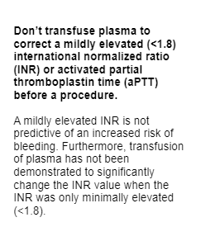
Indications for Plasma Transfusion
Active bleeding, or prior to an operative procedure in patients with INR, PT or PTT 1.8x greater than the normal, and no other coagulation factor concentrates or alternative therapies are present
Active bleeding or prior to an operative procedure in patients with severe liver disease with INR >2X the normal
Massive rapid transfusion (e.g., Code OMEGA (WRH) or Code Transfusion (ESHC) and the patient’s clinical status requires immediate treatment

Slide 25
COUNTERIndications for Plasma Transfusion
Plasma is NOT required:
INR <1.8
Use of 1:1 (FR:RBC) replacement outside of a massive transfusion
Elective reversal of warfarin where time allows for warfarin cessation and/or use of vitamin K
Volume expansion or “nutritional support”
Reversal of anticoagulants other than warfarin (e.g., heparin/LMWH, apixaban, edoxaban, dabigatran, rivaroxaban) because plasma has no effect in reversing or neutralizing heparins or thrombin inhibitors

Slide 26
Reversal of Warfarin Anticoagulant Effect
The warfarin effect should be reversed with vitamin K in a dose of 5-10mg administered intravenously in patients on warfarin who have significant bleeding or requires urgent surgery
Intravenous vitamin K works faster than oral and is safe
This will produce partial reversal within 2 hours and normalization within 6-24 hours
If emergency reversal is required (less than 6 hours) for significant hemorrhage or emergency surgery for life- threatening conditions, then prothrombin complex concentrates (Octaplex) should be used in addition to intravenous vitamin K

Slide 27
Prothrombin Complex Concentrates (Octaplex)
Human derived coagulation factor concentrates that contain factors II, VII, IX, X, Protein C and S
A dose of 1000/IU is generally sufficient for 50-90kg patient with INR in the therapeutic range (INR <3)
Vitamin K (5-10mg IV) should also be given as well to ensure as well to ensure a lasting reversal of warfarin (the effects of PCCs last ~6 hours)
Repeat INR 15 minutes after infusion
DO NOT ADMINISTER PCCs IF:
INR <1.6 as coagulation factor levels are adequate for hemostasis
Patient has a coagulopathy unrelated to warfarin or Vitamin K deficiency
There is a history of heparin induced thrombocytopenia (product contains heparin)

Slide 28
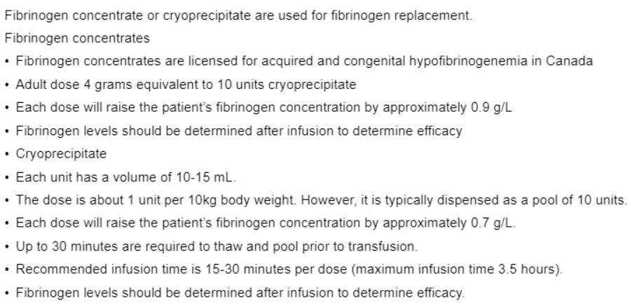
Indications for Fibrinogen Replacement

Slide 29
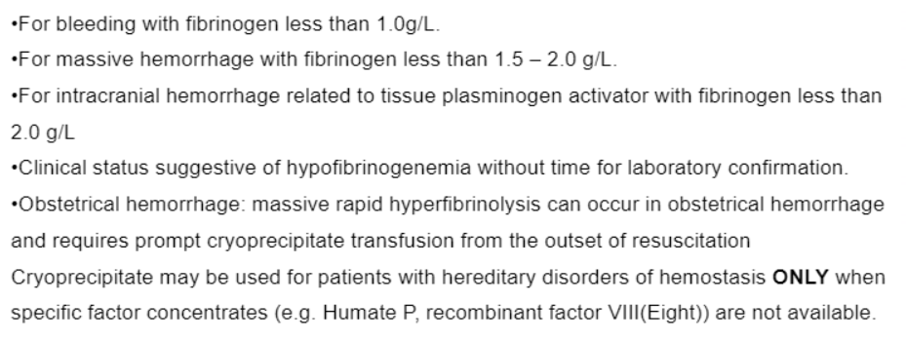
Indications for Fibrinogen Replacement

Slide 30
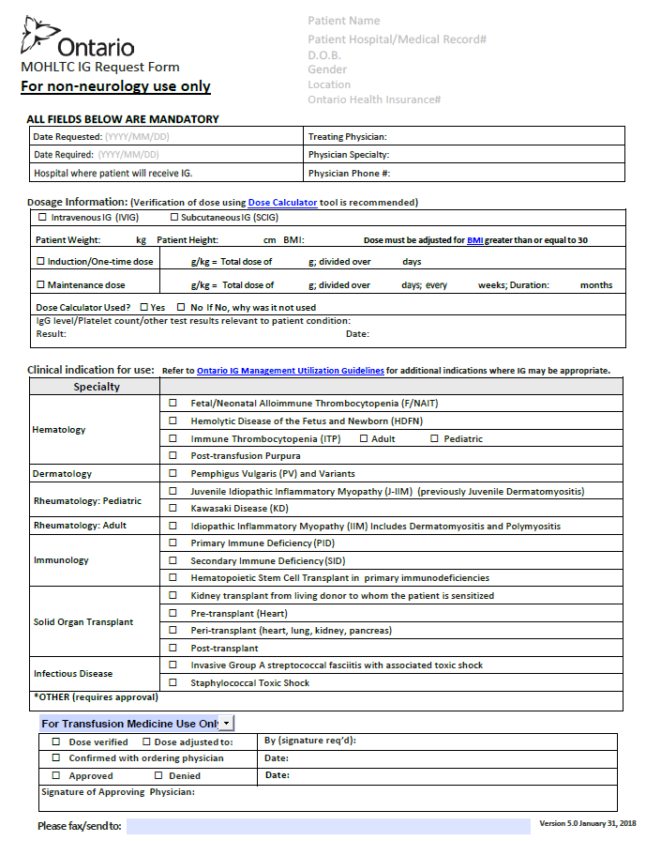
Indications for IVIG
Primary Humoral Immunodeficinecy
Idiopathic Thrombocytic Purpura (ITP)
B-Cell Chronic Lymphocytic Leukemia (CLL)
Allogenic Bone Marrow transplantation (in clients >20 years of age)
Pediatric HIV infection
A MOHLTC IVIG form must be completed (for neurology, or non-neurology)
Order set and infusion guidelines based on patient’s weight
CBS supplies IVIG products as available

Slide 31
IVIG and IV Line Flushes
Any required flushes must be D5W
Flush immediately prior to and/or immediately after administration of IVIG, if required
If a main line is required, use D5W
D5W flush amount will be withdrawn from a 50mL or 100mL bag of D5W, obtained from unit stock
Discard the remainder of the IV bag once flush has been withdrawn
Flushes drawn up by the nurse are only stable for 8 hours

Slide 32
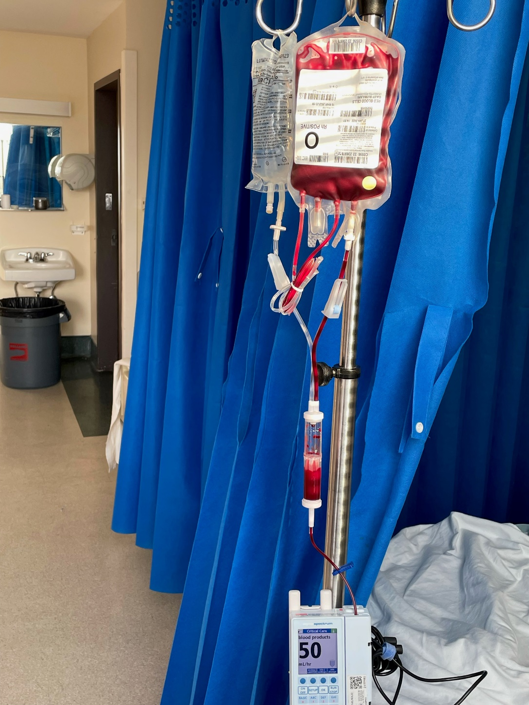
Issuing Blood and Blood Products
See Policy and Procedure
Requires consent
Independent Double Check (IDC) of physician order
IDC of blood product prior to administration
2 Patient Identification
History of patient
Any prior transfusions or reactions?
Vital signs and lung sounds
Venous Access and 0.9% NS (Except with IVIG)- Y type blood set with inline filter
Blood must be started within 10 minutes of pick up
Visually inspect blood

Slide 33
Blood and Blood Product Administration
Use infusion pump
Run at 50 mL/hour for first 15 minutes- Patient to be observed during this time period for reaction
If no reaction rate can be increased to the rate ordered
Each unit must be fully infused within 4 hours or less
Vital signs are reassessed after first 15 minutes and then hourly until completed, upon completion of the unit and another set 4 hours following completion
Infusion set must be changed:
After the infusion of 2 consecutive units of the same blood product
If there is more than 30 minutes lag between consecutive units
Between administration of different blood products

Slide 36
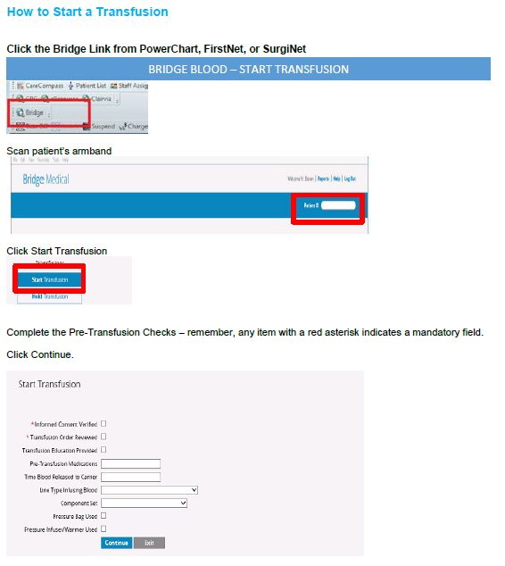

Slide 37
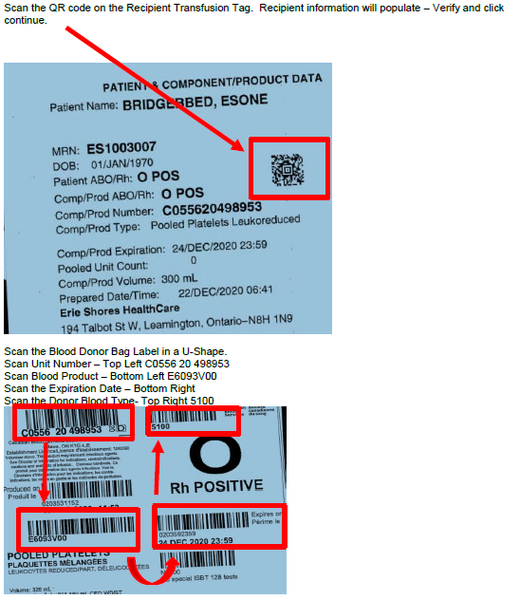

Slide 38
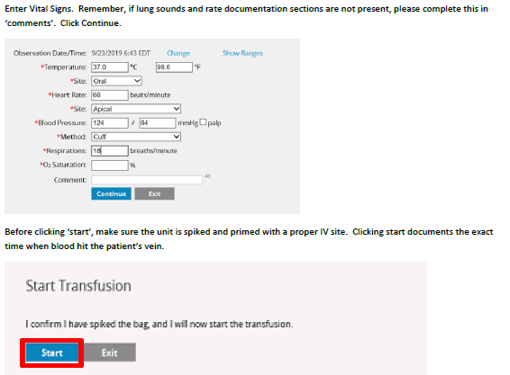

Slide 39
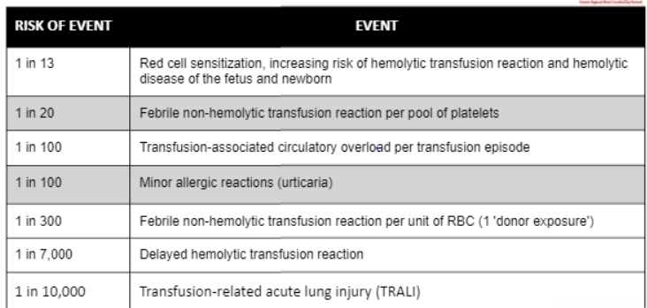
Risk of Events in Transfusion

Slide 40
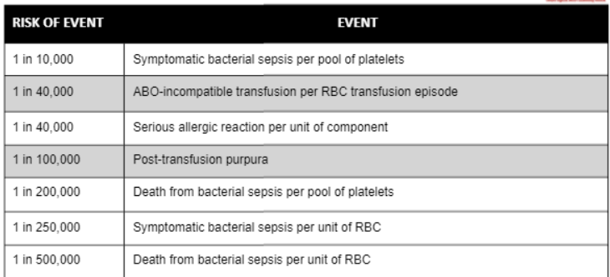
Risk of Events in Transfusion

Slide 41
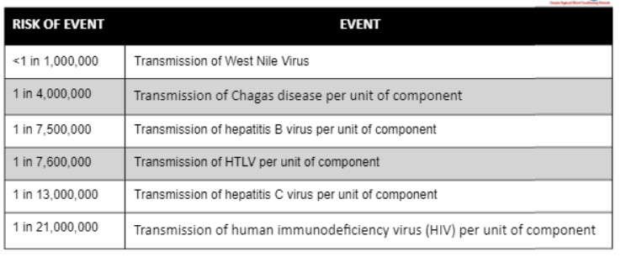
Risk of Events in Transfusion

Slide 42
Reporting Transfusion Reactions
All transfusion reactions (mild to life threatening) and transfusion related errors must be reported to the hospital transfusion service (Blood bank)
The purpose of reporting transfusion reactions to the Blood Bank is to prevent further reactions from occurring by:
Removing companion components (from the same donor) from the blood supply (TRALI or bacterial contamination)
Tracking to identify processes that may mitigate and prevent future transfusion reactions (TACO, acute hemolytic reactions)
The Blood Bank will investigate, assess, and report reactions to the TTISS (Transfusion Transmitted Injuries Surveillance System) at the Public Health Agency of Canada and Health Canada, as required.

Slide 43
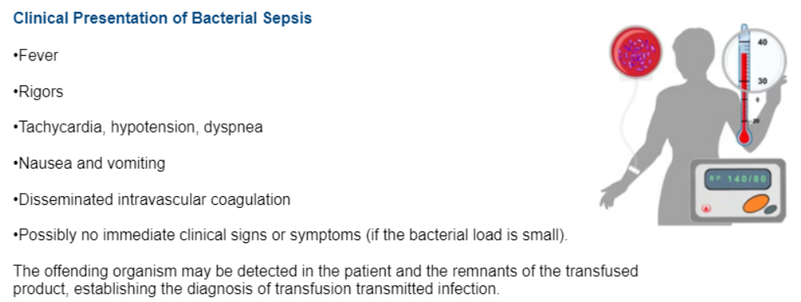
Transfusion Reaction: Bacterial Sepsis

Slide 44
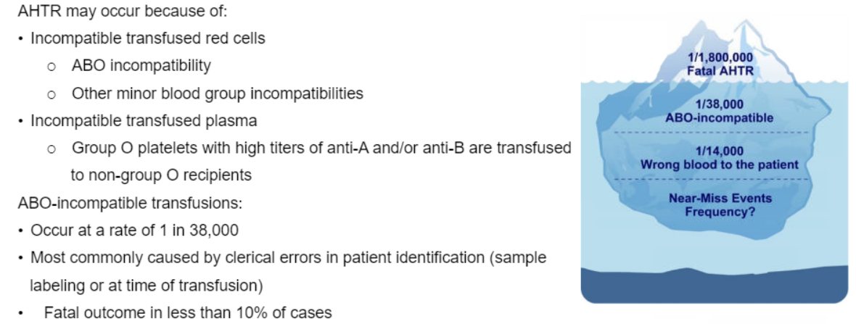
Transfusion Reaction: Acute Hemolytic Transfusion Reaction

Slide 45
Transfusion Reaction: Acute Hemolytic Transfusion Reaction

Slide 46
DYSPNEA: TRALI, TACO, ANAPHYLAXIS
Transfusion related acute lung injury (TRALI):
Acute respiratory distress with hypoxia and bilateral chest X-Ray infiltrates
Dyspnea and hypoxia, pulmonary capillary wedge NOT elevated
May be indistinguishable from acute respiratory distress syndrome
Usually occurs with RBC, PLT, and FP transfusion
Stop transfusion as soon as reaction is identified
Supportive care
Mechanical ventilation required in 75% of cases

Slide 47
DYSPNEA: TRALI, TACO, ANAPHYLAXIS
Transfusion Associated Circulatory Overload (TACO):
Impaired cardiac function, and/or:
Excessively rapid rate of transfusion
Dyspnea, orthopnea, elevated jugular venous pressure (JVP), tachycardia, hypertension
Prevention: | Management:
Pre-transfusion assessment to identify patients at risk of fluid overload Avoid transfusing more than one unit at a time Transfuse over longer periods (e.g., 3.5hours per unit of RBC) Pre-emptive diuretics before the transfusion | Interrupt the transfusion Administer oxygen and diuretics as needed Chest X-RAY Restart the transfusion at a reduced rate if clinical status permits

Slide 48
DYSPNEA: TRALI, TACO, ANAPHYLAXIS
Anaphylaxis (Severe Allergic Reactions):
Reactions usually begin with 1-45 minutes of starting transfusion
Cutaneous reactions (urticarial, flushing) are present in most severe allergic reactions
Airway obstruction with dyspnea, chest pain, chest pain, wheezing, and stridor
Acute anxiety and feeling of “impending doom”
Management:
Stop the transfusion and do not restart Administer 25-50mg diphenhydramine IV Anaphylaxis- prompt administration of epinephrine, corticosteroids, diphenhydramine IV and supportive care including ventilator support as required Epinephrine should be immediately available wherever transfusion is carried out

Slide 49
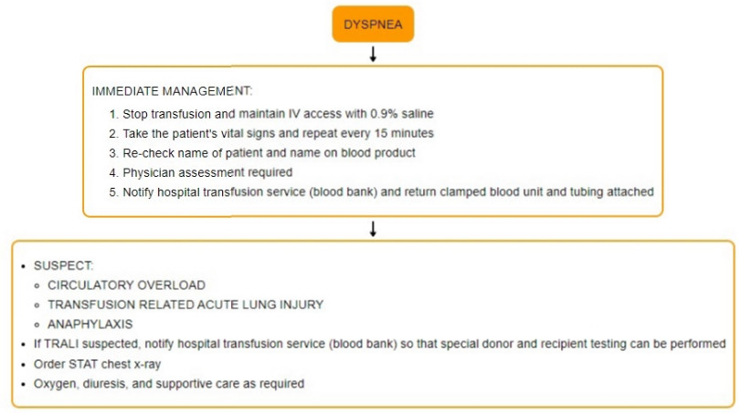

Slide 50
Complications

Slide 51
Nursing Interventions for Transfusion Reaction
Stop Transfusion of blood product
Run NS
Stay with patient and call for RN support
Collaborate with RN for required interventions and physician orders

Slide 52
Code Omega: Windsor Regional Hospital Effective April 1, 2019
Code Omega (Massive Hemorrhage/Massive Transfusion) Policy
Initiated by the Most Responsible Physician (MRP) who contacts Transfusion Medicine to commence this code.
Only initiated in the following locations:
Emergency Department
Obstetrical Units
Endoscopy Suites
Interventional DI
Cardiac Cath Lab
Operating Rooms
Critical Care Units
All other areas call a Code Blue then transfer to appropriate area to follow Code Omega protocols (Physician, Nurse, Lab checklists)
This is a resource intensive emergency Code for many responding departments. Do not contact Lab services for non-urgent issues until the
Code Omega “All Clear”
has been called.

Slide 53
Code Transfusion: Erie Shores Healthcare
Code Transfusion (Massive Hemorrhage/Massive Transfusion) Policy
Initiated by the Most Responsible Physician (MRP) who contacts Transfusion Medicine to commence this code.
Only initiated in the following locations:
Emergency Department
Obstetrical Units
Endoscopy Suites
Interventional DI
Cardiac Cath Lab
Operating Rooms
Critical Care Units
All other areas call a Code Blue then transfer to appropriate area to follow Code Omega protocols (Physician, Nurse, Lab checklists)
This is a resource intensive emergency Code for many responding departments. Do not contact Lab services for non-urgent issues until the
Code Transfusion “All Clear”
has been called.

Slide 54
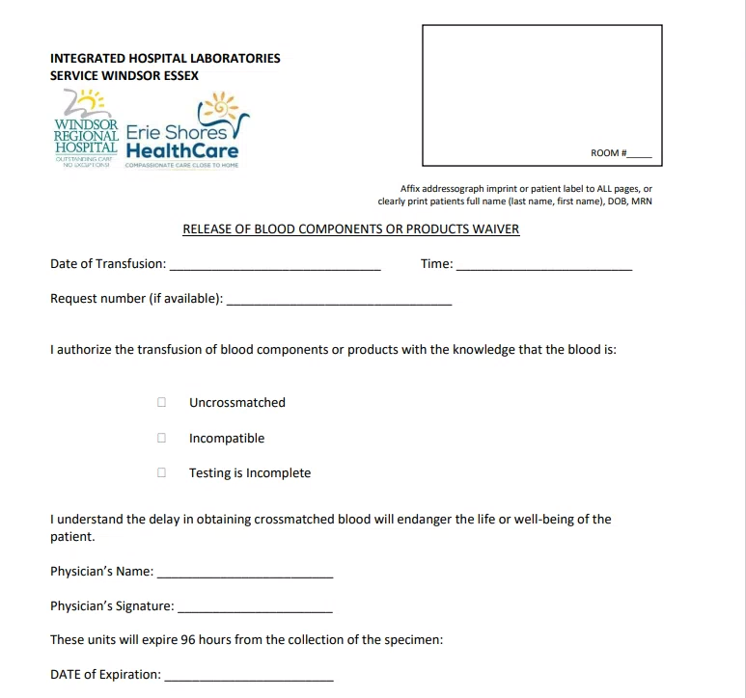
Release of Blood Components or Products WAIVER
TO BE COMPLETED IF:
Compatibility testing has not been completed by the Blood Bank
The unit have been found to be least incompatible
It is emergent, and the risk to the patient receiving this component or product without comprehensive testing is less than the risk of waiting for testing to be complete
A sample of the patient’s blood should be taken BEFORE blood is administered, to ensure that any subsequent units may be properly crossmatched.
The tag attached to the unit of blood must be clearly labeled with the red “UNCROSSMATCHED” sticker.
The technologist will complete a full crossmatch on the released unmatched units, and report any incompatibilities to the attending physician immediately.
The attending physician must sign a “Release of Blood Waiver” or “Uncrossmatched Blood or Multiple Issue of Blood Product” form for Uncrossmatched Blood.

