Slide 1
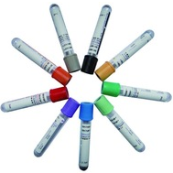
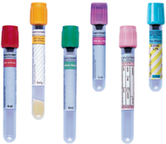
Feature Presentation
Specimen Assessment

Slide 2
MultiCare Motion Picture
This powerpoint has been rated
R
RESTRICTED
TG Lab Employee Under 21 Requires Accompanying Supervisor

Slide 3
MultiCare Motion Picture
presents
Specimen Assessment

Slide 5
This presentation is made to guide the processing staff in assessing the integrity of specimens with confidence and loading the APS line correctly.
APS – Automated Processing System (chemistry track)
SRM – Storage/Retrieval Module (automated refrigerator)
IOM – Input/Output Module (sample loading & unloading area)
PI – Priority Input (lanes for STAT samples)
PO – Priority Output (lanes for exceptions*)
IM – Instrument Manager (middleware that allows tech to file results)
*Exceptions occur when there are errors, warnings, clotted samples, QNS samples, etc. Warning example: storage–temperature out of range.

Slide 6
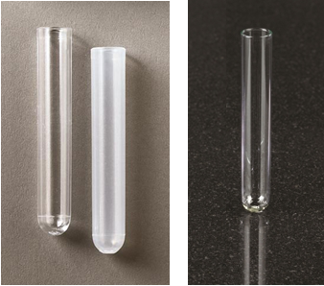
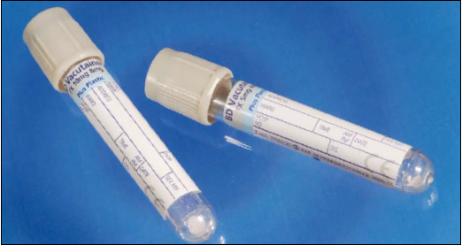
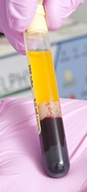
Plastic tubes
Glass tube
To differentiate between a plastic tube and
a glass tube, look at the bottom of the tube:
Plastic tube has a dimple.
Glass tube has no dimple and is smooth.
Polystyrene tube is clear.
No centrifuge.
Polypropylene tube is opaque. OK to centrifuge.
dimple
Reminder: Plasma LD sample must be kept vertical at all times. So don’t tilt the tube.
smooth

Slide 7
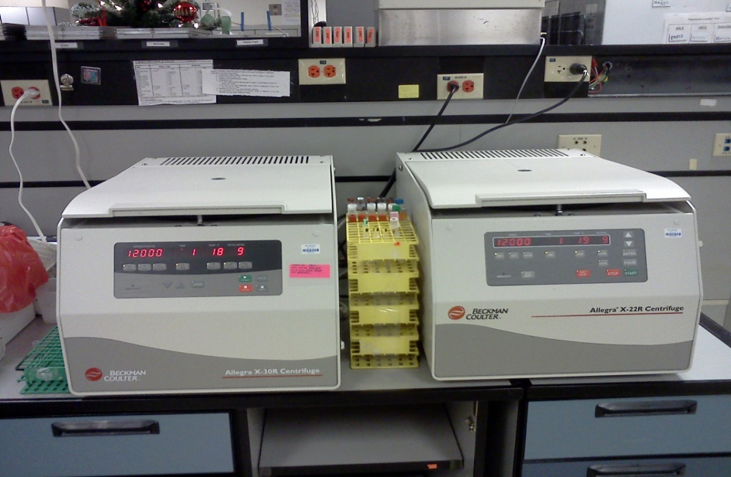
No glass tubes in STAT centrifuges and on IOM due to high speed setting.
It is recommended to use opaque aliquot tubes (not clear aliquot tubes)
for STAT centrifuges due to high speed setting.

Slide 8
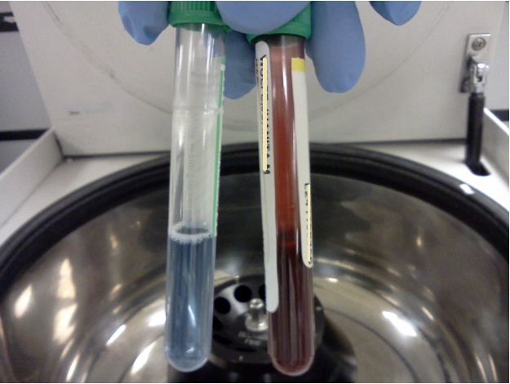
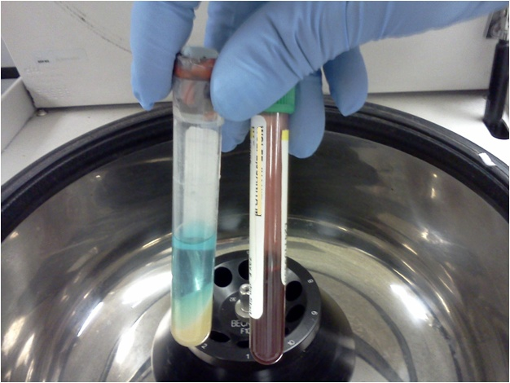
Correct
Wrong
similar volume
similar sizes
When choosing a balancing tube to put in a centrifuge, make
sure the chosen balancing-tube is similar in volume and in size.

Slide 9
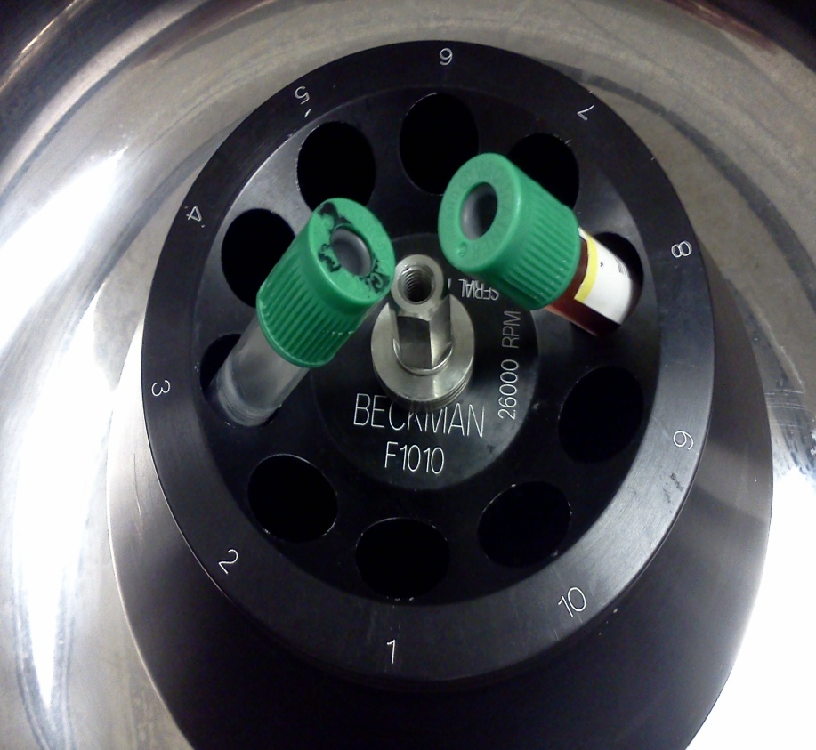
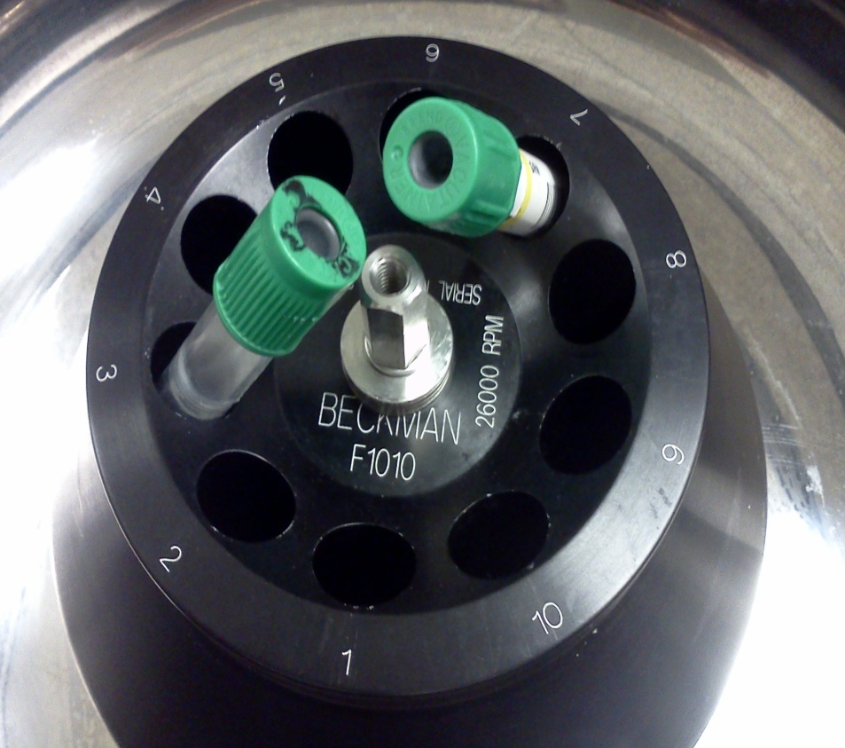
Correct
Wrong

Slide 10
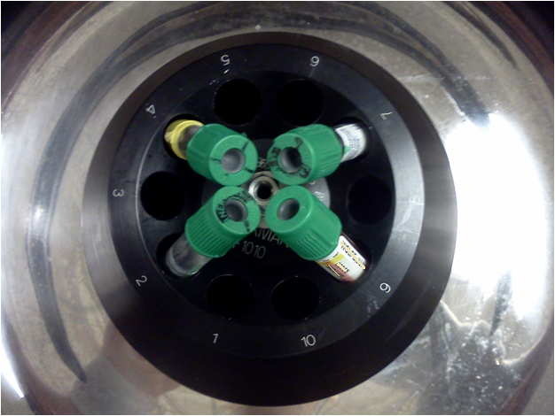
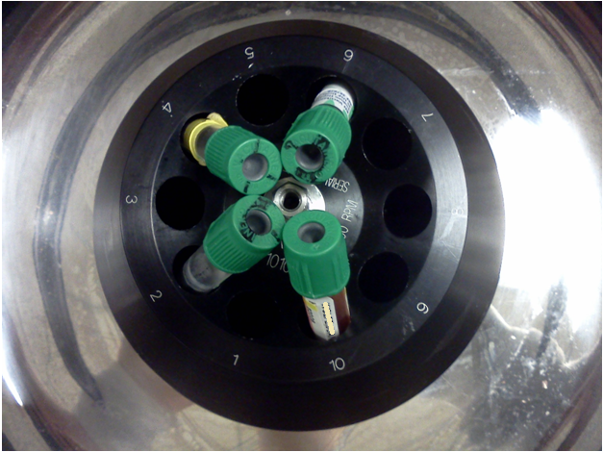
Correct
Wrong

Slide 11
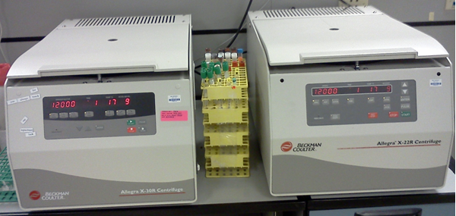
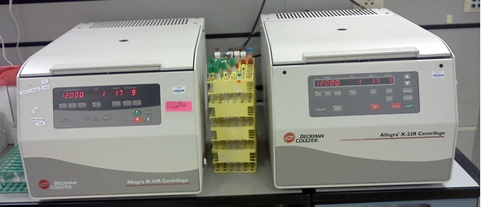

Slide 12
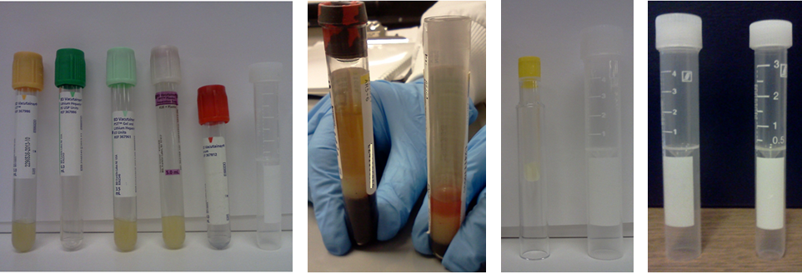
These tubes can be put on IOM with cap on.
Tiger tube with cap on cannot be put on IOM.
Tiger tube with cap off can be put on IOM.
These tubes cannot be put on IOM.
These false bottom tubes are different sizes.

Slide 13
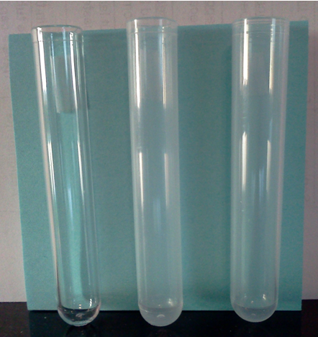
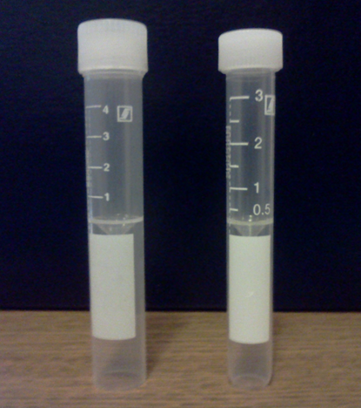
Plastic aliquot tubes
Enlarged image of false bottom tubes
4 mL
3 mL
These tubes are
75 x 12 mm.
This tube is
75 x 13 mm.
slightly curved bottom
These aliquot tubes can be put on IOM.

Slide 14
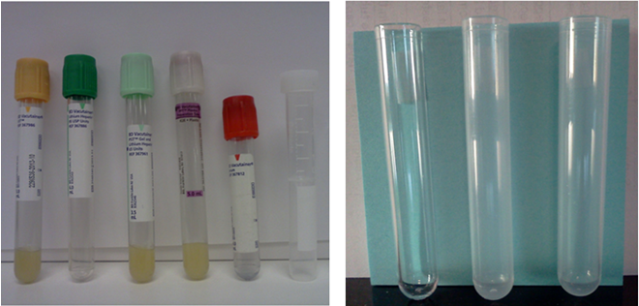
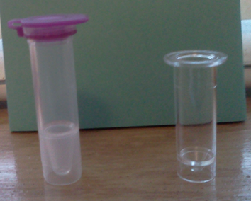
75 x 12 mm
75 x 13 mm
No
No
Yes
Variant cup can be put on IOM when snapped into 75 x 13 mm tube.
This cup cannot be put on IOM.
Yes: Variant cup can be put on 75 x 13 mm tube.
No: Variant cup cannot be put on these tubes.

Slide 15
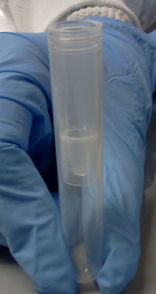
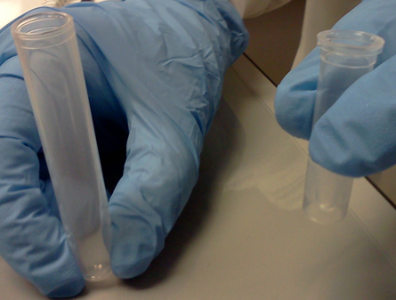
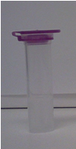
(Variant cup) + (75 x 13 mm tube) = V13 tube
75 x 13 mm
Variant cup with lid on
75 x 13 mm
Variant cup with lid off

Slide 16
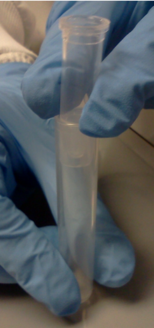
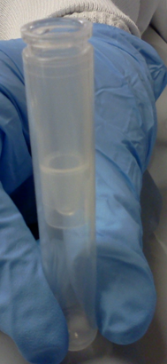
Open lid
Push down lid
Remove lid
gap
no gap
75 x 13 mm
Variant cup
When placing a Variant cup in a 75 x 13 mm tube, make sure it is snapped down tightly.
V13 tube

Slide 17
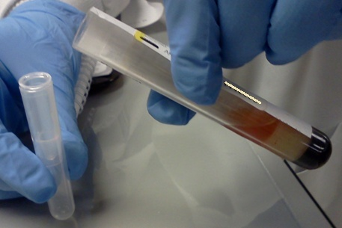
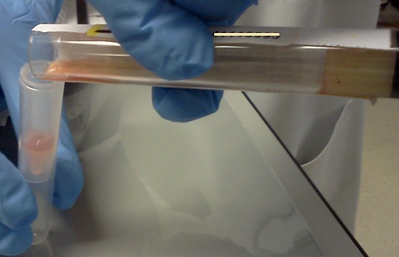
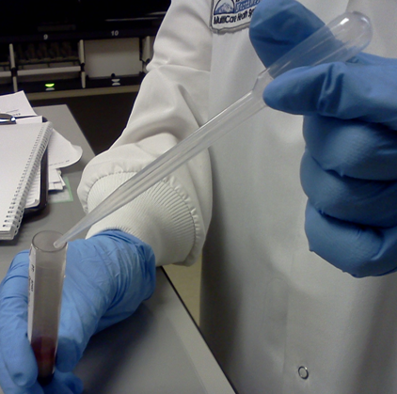
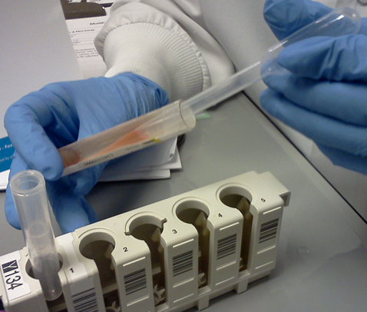
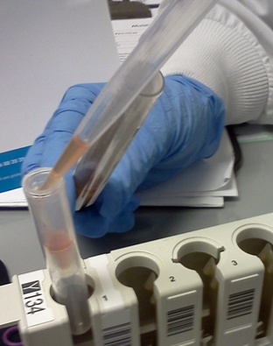
If a sample is QNS, a QNS cup may be used. A QNS sample can be aliquoted by pouring or pipetting. Label and initial all aliquots you create.
V13 tube
V13 tube

Slide 18
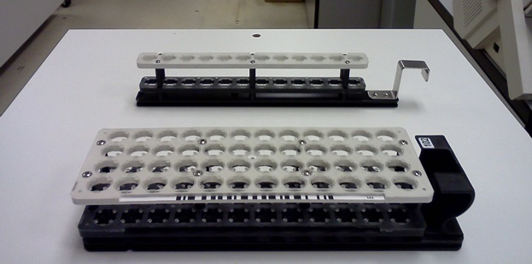
STAT rack
column
Routine rack
row
Barcode
ID
Tubes must be loaded without spaces, starting at the end opposite of the rack handle.

Slide 19
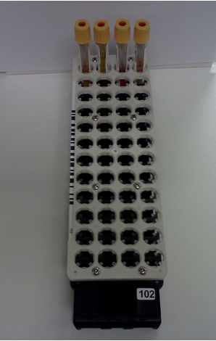
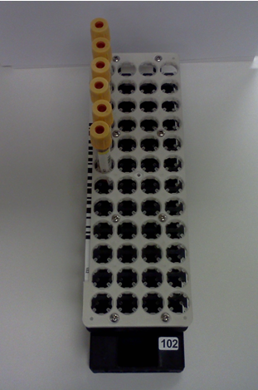
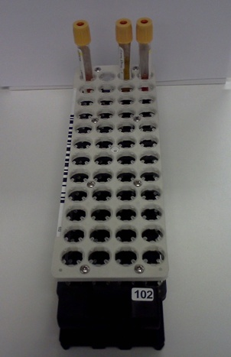
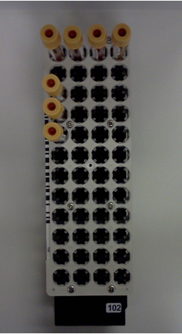
Ex. 1
Ex. 2
Ex. 3
Ex. 4
space
space
Correct
Correct
Wrong
Wrong
Tubes must be loaded without spaces, starting at the end opposite of the rack handle.

Slide 20
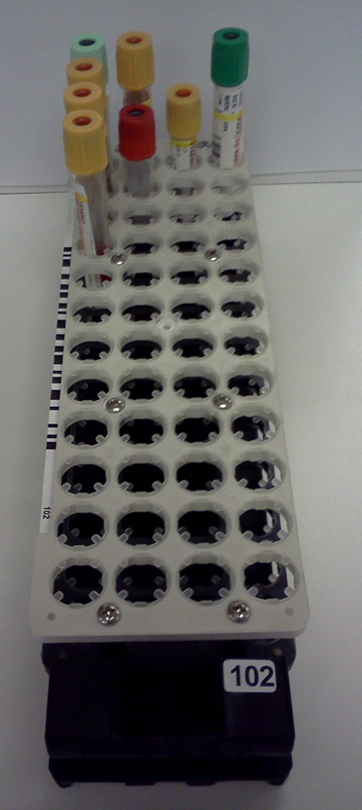
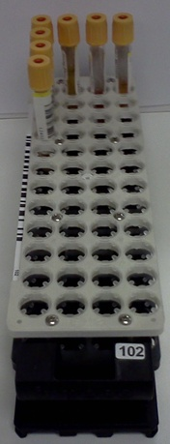
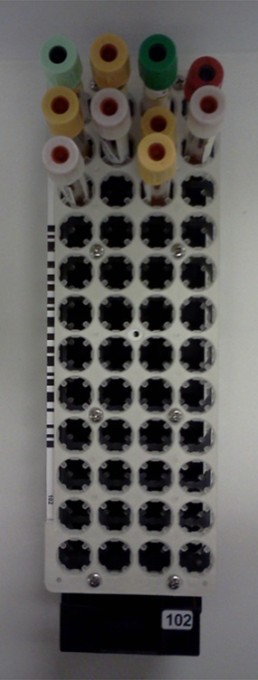
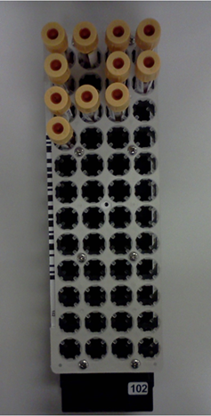
Ex. 5
Ex. 6
Ex. 7
Ex. 8
space
space
Correct
Correct
Wrong
Wrong
Tubes must be loaded without spaces, starting at the end opposite of the rack handle.

Slide 21
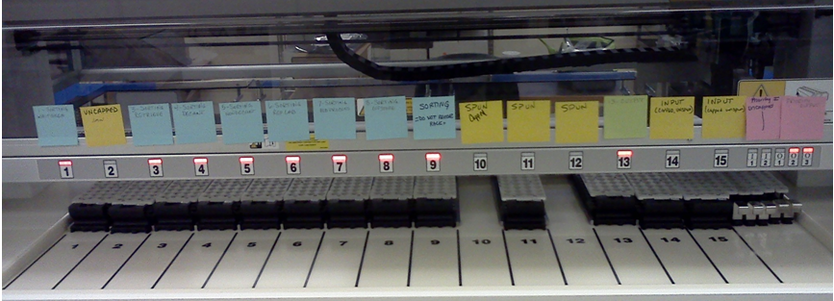
The entire chemistry track is called the Accelerator APS (Automated Processing System). The module of the APS that the processing staff interact with is the IOM. There are post-it notes on the IOM to specifically indicate where specimens must go. Therefore, paying attention to details is crucial. In the future, pictures with words will replace the post-it notes.

Slide 22
Output lanes (used to unload completed samples from track)
Input lanes
3 Types of lanes on IOM
Lanes 1–15 for routine samples
Lanes PI for STAT samples
Lanes PO for exceptions
LED indicators on IOM
Red: rack locked & processing
Green: processing completed

Slide 23
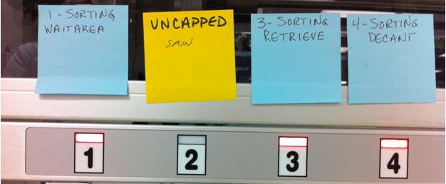
Lane 1
Never remove rack from Lane 1
For samples that need reruns or have add-ons (e.g. ED samples)
Lane 2
Spun uncapped
Lane 3
Tubes removed from SRM and desealed. They must be inspected and then placed in Lane 2.
When “Retrieve” is ordered from IM, tubes will go to Lane 3.
Lane 4
Decant
make sure aluminum foil is removed

Slide 24
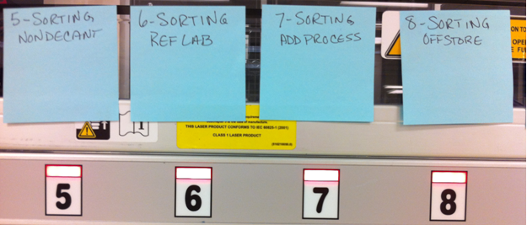
Lane 5
Non-decant (samples that show TDEC on label)
Lane 6
Reference lab
Lane 7
Add-process
Lane 8
Off-store (samples that will not be stored in SRM)

Slide 25
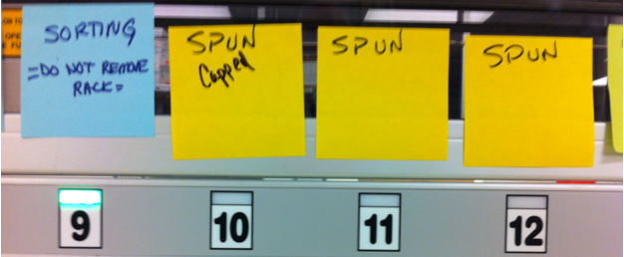
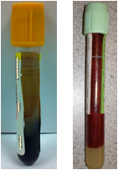
Lane 9
Incomplete testing. Never remove rack from Lane 9.
Lane 10
Spun capped
Lane 11
Spun capped
Lane 12
Spun capped

Slide 26
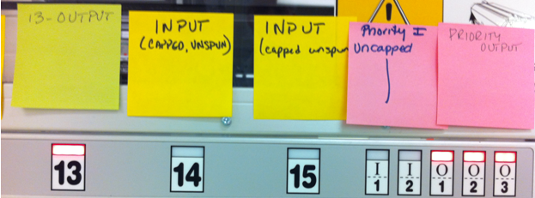
Lane 13
Output of completed samples. Also samples go to Lane 13 if SRM is down.
Lane 14
Unspun capped
Lane 15
Unspun capped

Slide 27
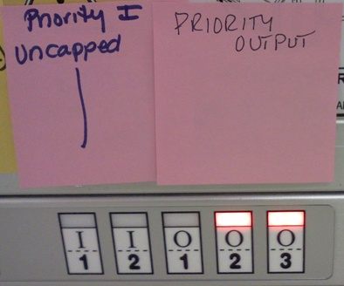
Priority Input
Spun uncapped STAT
Priority Output
Exceptions
Also for “Deliver” requested to return tubes from SRM

Slide 28
The laboratory testing cycle consists of 3 phases: pre-analytics, analytics, and post-analytics. The pre-analytical phase involves specimen collection, transport, and processing. The analytical phase refers to the actual testing analysis. The post-analytical phase includes test interpretation and reporting.
This presentation will focus on the errors of pre-analytics. The causes of pre-analytical errors are hemolysis, clotted samples, and insufficient sample volume.
TG CHEM LAB

Slide 29
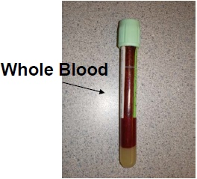
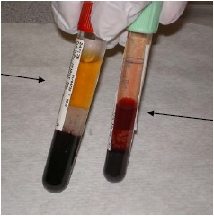
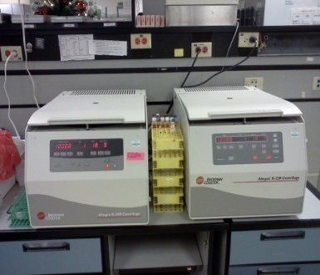
What is ?
release of hemoglobin into plasma from ruptured red cells
mostly occurring when specimen is being drawn
Centrifuge
normal
hemolyzed

Slide 30
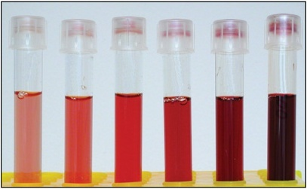
Visual representation of how the hemolytic index correlates to visual hemolysis
Slight Mod Gross
0 or 1+ 2+ 3+ or 4+
When a sample is cherry red, it is at least 2+. So the sample is rejected.
When a sample is borderline (i.e. between 1+ and 2+), tech will run HIL indices
in order to know for sure. HIL stands for Hemolysis, Icterus, and Lipemia.
Certain grossly hemolyzed samples are acceptable (e.g. RHCG).

Slide 31
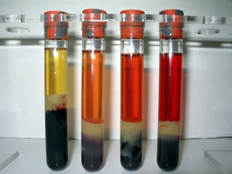
normal
cherry red

Slide 32
normal
lipemic
both hemolyzed and lipemic (notice the color looks like a mixed-strawberry milkshake)
grossly lipemic
In general lipemic samples are acceptable. For the grossly lipemic
samples, they should be airfuged. In this case, inform tech.
Lipemic lactate and ammonia should not be run.

Slide 33
normal
icteric
Icteric samples are deeply intense yellow.
All icteric samples are acceptable.

Slide 34
Clot detection
Camouflage refers to concealment from visual detection. With this in mind, what else do you see in the image above?
Specimen clots vary in their appearance. Some can be easily detected, and some are not obviously visible.

Slide 35
?
Ex. 1
?
Ex. 2
?
?
vs.
Which tube is clotted?
vs.
Which tube is clotted?

Slide 36
Ex. 1
Ex. 2
vs.
Right tube is clotted.
vs.
Both tubes are clotted. Even with light, the clot of left tube is not obviously visible.

Slide 37
before extraction
after extraction
original clot size
clot size reduced
less
more
Clot has a tendency to absorb fluid. Use applicator sticks to
remove clot. Swirl applicator sticks to extract fluid from clot.
Vancomycin often forms clot that is not obviously visible.

Slide 38
When to re-centrifuge?
If removing clot causes the release of red blood
cells, then the serum needs to be re-centrifuged.
Reprint the label, aliquot the serum into
another tube, and initial the aliquot tube.

Slide 39
QNS or not QNS? That’s the question. mmm… not sure.
This sample is QNS.
This sample may or may not be QNS. So judgment call.

