Slide 1
Special Collection:
Transfusion Service
Specimen Collection
Revised January, 2014

Slide 2
Objectives
This module covers the collection of specimens for orders of blood products and compatibility testing, e.g. crossmatches and units of blood (RBCs). These orders and specimens are handled at the Transfusion Services at each hospital laboratory.
MHS Transfusion Services receive the products from our community Blood Banks, including Cascade Regional Blood Bank and Puget Sound Blood Center.
What supplies are needed when collecting Transfusion Services specimens
How to properly identify the patient
How to properly label the blood sample
How to properly transport the sample to the lab
What can cause a sample to be rejected or testing delayed.

Slide 3
Blood Draw for Transfusion
Services Specimens
Venipuncture Materials
6ml PINK - ADULT (4 ml of blood minimum)
2 LAVENDER Microtainers – PEDIATRIC
Ball Point Pen for Labeling
Securline® Blood Band
PATIENT INFORMATION IS HANDWRITTEN DIRECTLY FROM THE WRISTBAND ONTO THE Securline® Blood Bands . THE INFORMATION MUST MATCH EXACTLY.
Always label the specimen in the patient’s presence.
(Note: Securline® Blood Bands are not used at AMC Hospital.

Slide 4
Patient Identification is critical!
Regulatory and accreditation (American Association of Blood Banks) standards require that before a specimen can be used for blood grouping, typing or compatibility testing, a qualified person in the transfusion service shall confirm that all identifying information on the request is in exact agreement with that on the specimen label. In case of discrepancy or doubt, another specimen must be obtained.
Always verify patient ID by comparing information directly with the patient’s hospital armband.

Slide 5
Why is Identification So Important?
Transfusing incompatible blood or blood products into a patient can cause serious harm (transfusion reaction), organ failure, or even death.
The number one cause of incompatible transfusions is misidentification.
Patient and specimen identification is critical in the collection of all laboratory specimens, but because of the potential risks associated with blood products, there are additional safety checks built into the process.

Slide 6
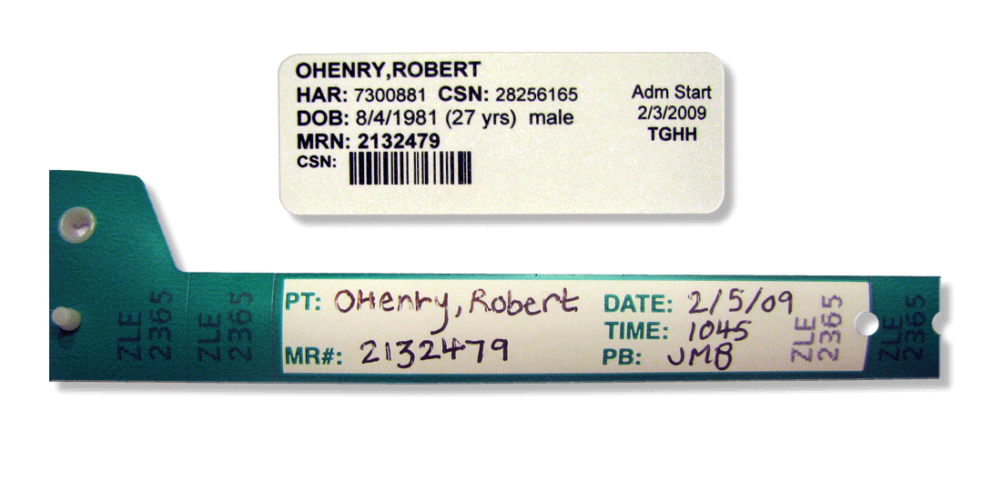
How is identification ensured?
Type and Screen, Cross Match, and other blood product orders require the patient to be “BANDED” with a special blood band
Only the person that collects the sample can place the Securline® Blood Band on the patient.
Auburn General Hospital
Type and Screen and Cross Match collection procedures are different . Refer to your supervisor and Procedure for instructions.

Slide 7
Securline ® Blood Band
Patient Information must be handwritten on the Securline® Blood Band directly from the Patient Identification Wristband, by the person
who collected the blood. Labeling must be complete and match exactly.
2 identifiers include Patient Name (last,first) and either MRN, DOB, or CSN. (HAR is not an acceptable identifier)
(Patient Identification Wristband)
Use a ballpoint
pen!
(Securline® Blood Band with patient label still intact on the band)

Slide 8
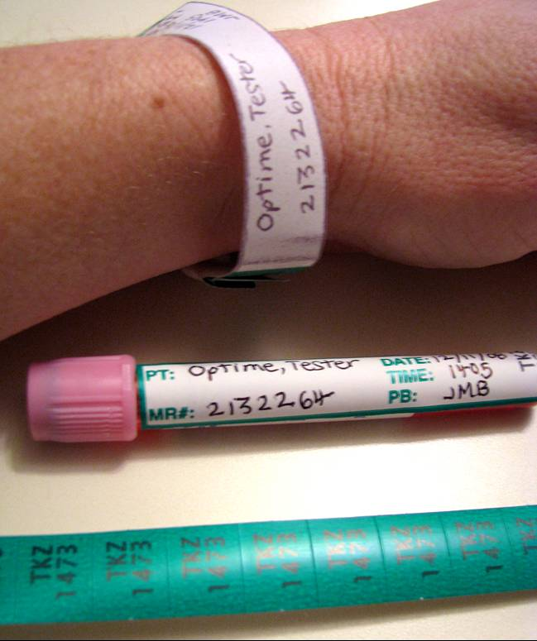
Labeling
Peel off the label sticker from the Securline® blood band. Make sure the writing on the blood band is legible. (If any part of the band is illegible, a new blood band should be obtained and completed. All characters must be visible on the band portion underneath the label.)
Place sticker on tube – lengthwise
  (Do not place lab barcode labels or EPIC visit labels on the tube! )
Compare handwritten Securline® band against patient’s identification wristband once more prior to securely attaching it to patient’s wrist
Tear off tail end of the securline® blood band from the portion wrapped and affixed to the patient’s wrist. Send this along with any lab barcode labels with the blood tube to the laboratory.

Slide 9
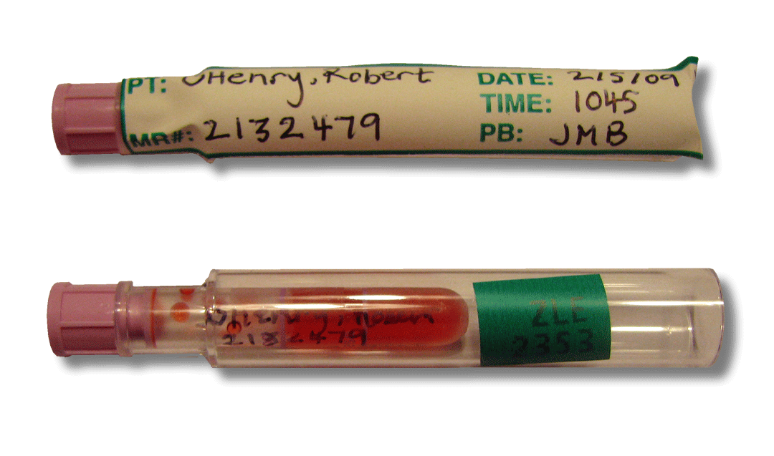
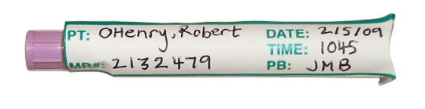
Labeling Pediatric Tubes for Transfusion Services
Place the 1st Microtainer tube in a tube holder and label with the SECURLINE® Blood Band Sticker.
Primary Label the 2nd Microtainer tube and place in a tube holder. A white patient label may also be used.
Place a “tail end” sticker from the SECURLINE® Blood Band on the 2nd microtainer tube
All Labeling Must Match Exactly!

Slide 10
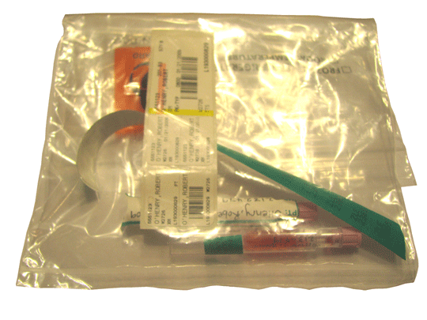
Sending Transfusion Services Specimens
Place Labeled Specimens in the center pocket of the Biohazard Bag and seal the bag.
The Lab Barcode Labels and “tail end” of the SECURLINE® BLOOD BAND is placed in the outside pocket.

Slide 11
Causes for Rejection of Transfusion Specimens
Patient ID (Name or MRN) incomplete or incorrect- Not eligible for correction. Must be recollected
Specimens missing Medical Record Number, DOB, or CSN - Not eligible for correction. Must be recollected
Contaminated Specimens (IV fluids) – Must be recollected
Incorrect Blood Tube Drawn(e.g. Gold tube) – Must be recollected
Hemolyzed Specimen – Redraw if possible
Note: If a rejected specimen would cause a delay the transfusion of blood for a patient in critical need of blood, emergency release of uncrossmatched O negative blood may be used with a physician order.

Slide 12
Test your Knowledge
Who can label the SECURLINE® BLOOD BAND and place it on the patient?
  The band is not necessary
  Only the person that collects the specimen can fill out the band and place it on the patient
  Anyone in the immediate area
What color of tube do you use for a type and cross match or screen for an adult?
  Gold
  Green
  Pink
Missing or incorrect information on the label or band is a reason for rejection of a specimen for transfusion services. True / False

