Slide 1
Infection Control-Laboratory’s Role
Standard Precautions – Every Patient, Every Day
Definition of Isolation and Contact Precaution Rooms
Description of the Proper Use of PPE for Isolation and Contact Precaution Rooms
Powered Air-Purifying Respirator- PAPR

Slide 2
Standard/Universal Precautions
Gel IN and OUT of room and in between patients
Don gloves prior to approaching patients bedside
Gloves are changed immediately if soiled or torn
Lab Coats are worn buttoned up with sleeves down
No Pre-assembling of blood collection equipment
All blood collection material is for one time use only
Prepare paper tape individually per draw (do not take the roll of tape to the patients bedside)
Tourniquets are used once, then discarded
Phlebotomy trays are NOT placed on the patients bed, bedside table, serving tables or floors.
Place Phlebotomy Tray by the sink on paper towels and/or wipe the tray with a disinfectant wipe
PPE:
Wash or Gel Hands
Lab Coats Worn Buttoned Up
Gloves

Slide 3
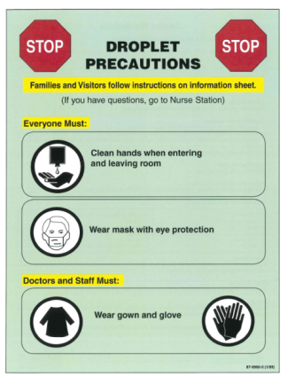
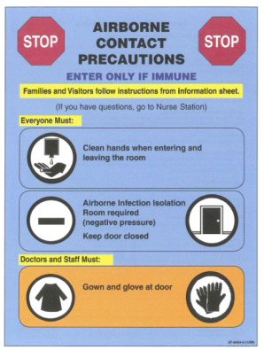
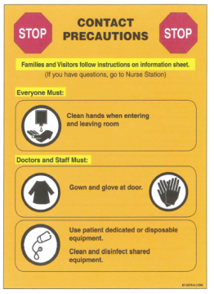
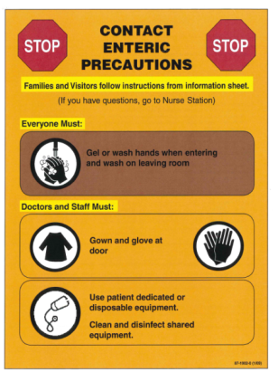
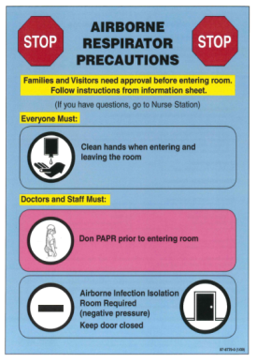
Isolation Rooms- Watch for the Signs!
Infection Control signs are placed on the door to alert staff of the need for additional (PPE) Personal Protective Equipment.
Isolation Precaution Carts are stocked and placed outside of the room with the necessary PPE.

Slide 4
Contact Precautions
Common Conditions:
Multidrug Resistant Organisms (MRSA,GNRs,VRE)
Scabies
Wounds or abscesses with uncontained drainage
PPE:
Wash or Gel Hands
Gown
Gloves

Slide 5
Contact Enteric Precautions
Common Conditions:
Acute diarrhea with unknown etiology
Clostridium Difficile (C.diff)
Norovirus
Rotavirus
PPE:
Wash or Gel Hands
Gown
Gloves

Slide 6
Droplet Precautions
Common Conditions:
Influenza
Meningitis
Pertussis
Respiratory viruses
PPE:
Wash or Gel Hands
Gown
Mask with Eye Protection
Gloves

Slide 7
Airborne Contact Precautions
Common Conditions:
Chickenpox
Disseminated zoster (shingles)
Measles (Rubeola)
PPE:
Wash or Gel Hands
Gown
Gloves

Slide 8
Five Steps in the following order empower us to protect our patients from Hospital Acquired Infections.
Entering the Room:
Wash or Gel Hands
Gown
Mask (if needed)
Eye Cover (if needed)
Gloves
Exiting the Room:
Gloves
Eye Cover (if used)
Mask (if used)
Gown
Must Wash with Soap and Water!
Gel In
Soap and Water Out
Be a Super Hero!

Slide 9
Entering an Isolation Precaution Room
Put PPE ON in this Order:
Wash or Gel Hands
Gown
Mask (if needed)
Eye Cover (if needed)
Gloves

Slide 10
Sanitize Your Hands
Gel IN
Wash OUT

Slide 11
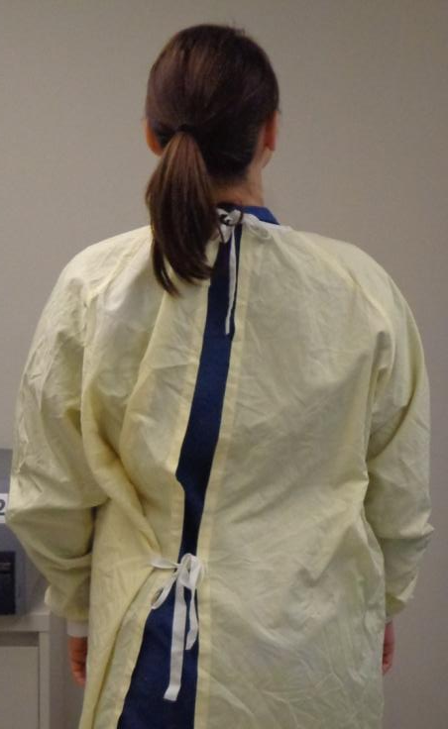
“Good To Go!” Gown
Gowns are worn with the ties in the back.
Tie the gown at both, the neck and waist level.
Sleeves are to be worn down on the wrist.
Nicely Done!

Slide 12
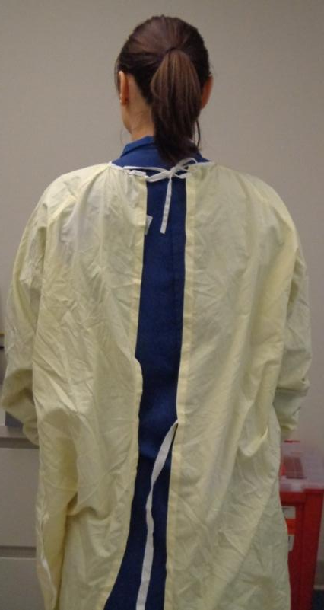
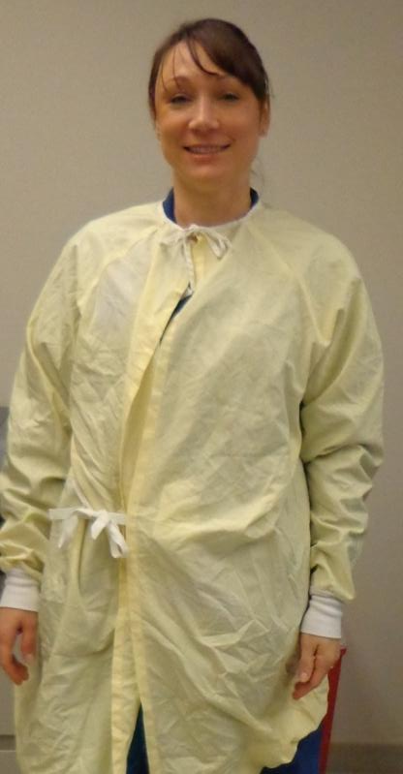
“Two Thumbs Down” for these Gowns
Gowns are worn with the opening in the Back
Secure BOTH Top and
at the Waist.

Slide 13
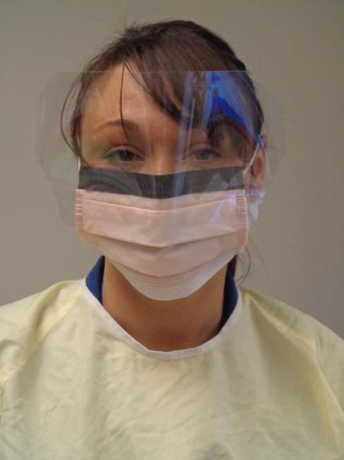
Masks and Eye Cover
Wear mask with eye protection!

Slide 14
“Good Gloves” Gone Bad
With the sleeve of the gown pulled down to the wrists, place the top of the gloves over the cuff of the gown.
We should not be able to see any skin when the gloves and gown are worn properly together.

Slide 15
“Show your Love” for the Gloves
Gloves are to be placed on last when preparing to enter an isolation precaution room.
Gloves must cover the cuff of the yellow gown.
Gloves must remain intact. *Torn gloves are never acceptable.
Nicely Done!

Slide 16
Identifying Our Patient In an Isolation Precaution Room – Take TWO!
Two Identifiers – Patients Full Name and Medical Record Number is used to identify our patients.
This information can be brought into an Isolation Precaution room using a small Sunquest Lab label or the Patient Chart label.
Compare:
Last, First Name
MRN from the small lab label to your patients wristband.

Slide 17
The Tray Stays Outside
Phlebotomy trays and carts are not to be taken into an Isolation Precaution room.
Only the items necessary to collect the specimens are taken inside the room.

Slide 18
Phlebotomy Materials
Prepare Phlebotomy materials outside of the Isolation Room.
Phlebotomy trays are not to be taken in an Isolation Room.
The patient may be a difficult draw (syringe is a good choice).
Remember take in only what you need to perform phlebotomy with.
Other than the filled blood tubes, phlebotomy supplies are not taken back out of the Isolation Precaution Room.

Slide 19
Leaving an Isolation Room
Remove PPE in Order:
Gloves
Eye Cover (if used)
Mask (if used)
Gown
Must wash with soap and water

Slide 20
Leaving a Contact Precaution Room?
OFF in Order:
Gloves
Eye Cover (if used)
Mask (if used)
Gown
Must wash with soap and water
We Must Wash Our Hands with Soap and Water. (NOT GEL)

Slide 21
Clean and Disinfect
Gently wipe down blood tubes with a germicidal wipe
Allow tubes to air dry

Slide 22
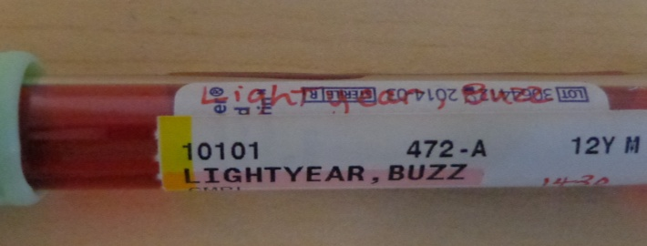
Specimen Labeling Outside of Precaution Rooms
After disinfecting the blood tube, affix the Sunquest barcode label by doing the following:
Compare 2 Identifiers from the primary labeling (i.e. small lab label, handwritten name and MRN or Epic chart label) to the Sunquest barcode label.
Time, Date and Collector Initials are added to the barcode label.
Lab label is placed horizontally on the blood tube directly below the primary labeling

Slide 23
What if…?

Slide 24
What if I Miss on the First Attempt?
If you are not successful on the first attempt, you must follow the steps below in order:
Remove Gloves
Remove Eye Cover (if used)
Remove Mask (if used)
Remove Gown
Wash with Soap and Water
Now you may leave the room to retrieve supplies for your second attempt.
We cannot reach outside
of the room to gather additional supplies!

Slide 25
What if There is a Precaution Cart Outside of the Room but NO Signage on the door?
Contact the Nurse to inquire if the patient is in Isolation.
If so, ask that a sign be placed on the patients door.
Play it Safe! Follow Contact Precautions when in doubt.
Collaboration is one of our Core Values!

Slide 26
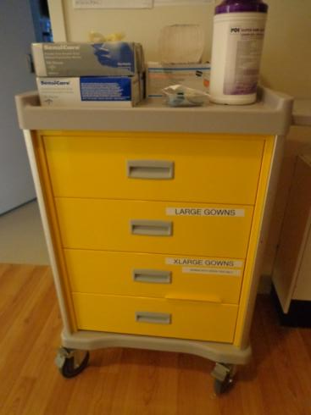
What if my Ascom Phone is Ringing While I’m in an Isolation Room?
Do not use your phone inside of an Isolation Room.
You can check your messages or call the lab back when you have completed your Personal Protective Equipment steps outside of the patients room.

Slide 27
References
Infection Control Signage
Airborne Respirator Precautions 87-8779-0 (1/09)
Airborne Contact Precautions 87-8454-0 (1/09)
Contact Enteric Precautions 87-1902-0 (1/09)
Contact Precautions 87-2275-0 (1/09)
Droplet Precautions 87-8966-0 (1/09)

