Slide 5
Once cuvettes are brought to room temperature, their expiration date changes to 12 weeks.
Example: If cuvettes were removed from fridge on 03/01/2021, they would room temp expire on 06/01/2021
→ Look for the room temp expiration date sticker on each cuvette pouch prior to use. Do not use any room temp expired cuvettes.

Slide 7
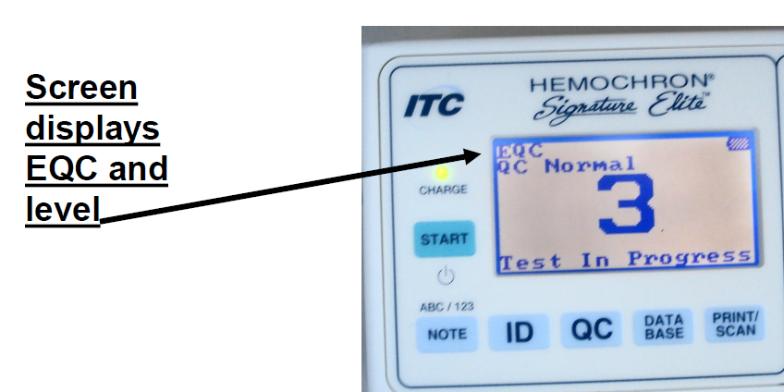

Slide 8
System Self-Check
System self-check is another form of quality control. It takes place in the “background,” it ensures that each cassette has:
1. Adequate battery power
2. Properly functioning LED lights
3. Confirms the internal temperature.

Slide 9
Liquid QC vials are made of plastic dropper vials, with small internal glass ampoule.
The material consists of dried bovine red blood cells, buffered sheep and horse plasma.

Slide 10
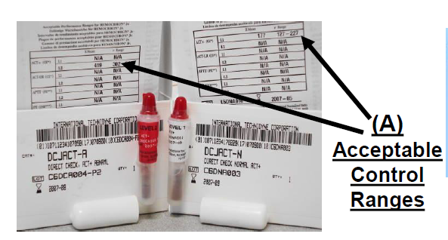
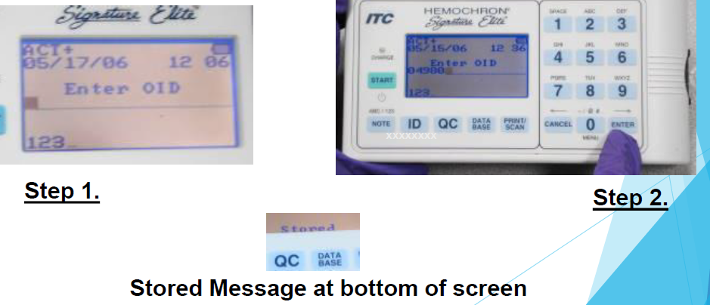
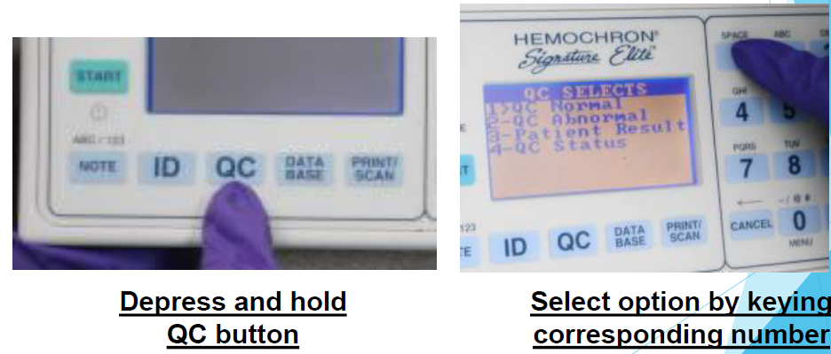
Performing the Liquid Quality Control
(once a week – Mondays)
Obtain a room temp cuvette. Insert it into the instrument.
Using the keypad, enter your Operator ID when prompted or press Print/Scan to scan ID.
Press and hold ENTER until STORED message is displayed.
Depress and hold QC button. Select QC NORMAL (or QC ABNORMAL). Press Print/Scan to scan barcode information from the QC package insert.
Add sample and press START.

Slide 11
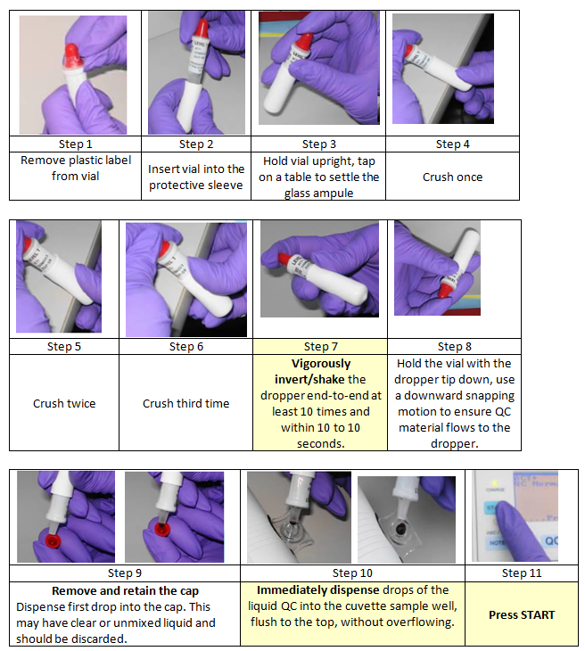
Performing
Liquid
Quality Controls:
(Obtain QC vials from Lab Point-of-Care fridge, allow to vials to get to room temp for at least 60 minutes)

Slide 12
Specimen Collection and Preparation:
The ACT may be performed with fresh whole blood (venous or arterial) collected in a non-heparinized plastic syringe.
Fresh whole blood must be free of tissue thromboplastin, IV fluids or alcohol and tested within 30 seconds of collection.
If collecting from an indwelling catheter, withdraw and discard at least 10 milliliters of blood prior to collecting the sample for the ACT test.
Note: Improperly collected samples from indwelling catheters will cause erroneous results.
Specimens contaminated with saline will dilute the sample causing erroneously extended ACT test results.
Specimens contaminated with heparin will also erroneously extend ACT test results. Note: DO NOT obtain blood from heparinized access line, lock or indwelling heparin lock.
Specimens contaminated with alcohol will cause denaturation of blood proteins and give erroneous ACT results.
Hemolyzed specimens enhance the possibility of decreasing the patient’s hematocrit to such a low level as to become undetectable by the instrument giving error codes of “sample too small” or “sample not seen”.
Hemolysis can also lead to significant platelet activation and the release of PF4, a natural heparin inhibitor that would contribute to erroneous ACT results.
If obtaining sample by venipuncture, use a 23-gauge or larger needle to collect the sample.
Minimum volume of specimen required is 0.2 milliliters of blood.

Slide 13
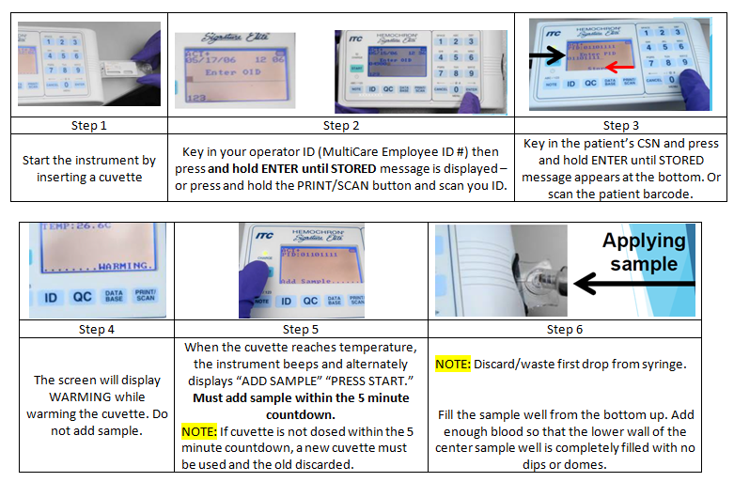
Performing
A Patient Test
Sample should be collected when the 5-minute countdown begins.

Slide 15
Limitations:
ACT-LR values above 400 seconds are above the reportable range of the instrument and will be reported as >400 seconds.
Aprotinin, a protease inhibitor, will artificially prolong the ACT-LR test results. The ACT-LR is not intended for use with patients receiving Aprotinin.
Samples with a hematocrit less than 20% or greater than 55% are not recommended due to an optical density outside the level of detection of the instrument.
The HEMOCHRON Signature Elite ACT-LR is affected by poor technique, including blood collection and the transfer of blood to the sample well. The quality of the blood specimen may be affected by:
1. Foaming or hemolysis of the sample
2. Clotted or partially clotted blood
3. Unsuspected anticoagulation
4. Lupus anticoagulant
5. Using less than 10ml as a waste when drawing the blood.
Any results exhibiting inconsistency with the patient’s clinical status should be repeated or supplemented with additional test data.
If instrument is dropped or damaged, remove from service and contact Point-of-Care.

