Slide 1
Point-of-Care Urine Pregnancy Test
The SureVue Urine Pregnancy Kit
Prepared By Caline LyBarger MLS (ASCP)^{CM}
Deaconess Hospital Point-of-Care

Slide 2
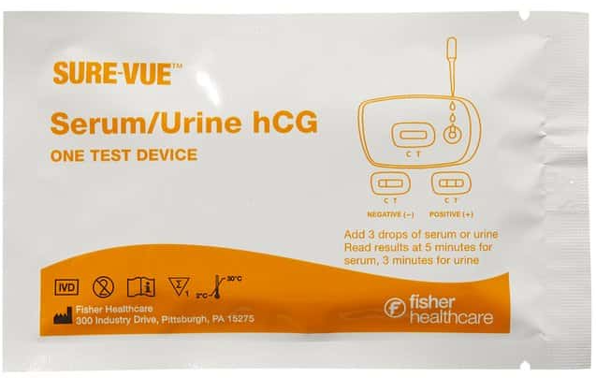
SureVue Urine Pregnancy Test
The Sure-Vue Urine hCG Test is used for the qualitative (i.e. the result is consists of either positive or negative value) detection of human Chorionic Gonadotropin (hCG) in urine for the early determination of pregnancy.
Human Chorionic Gonadotropin (hCG) is a hormone that is secreted by the developing placenta shortly after fertilization.
hCG levels of 25 mIU/mL have been detected as early as 10-12 days after conception so, hCG may be detected using this kit before a first missed menses.

Slide 3
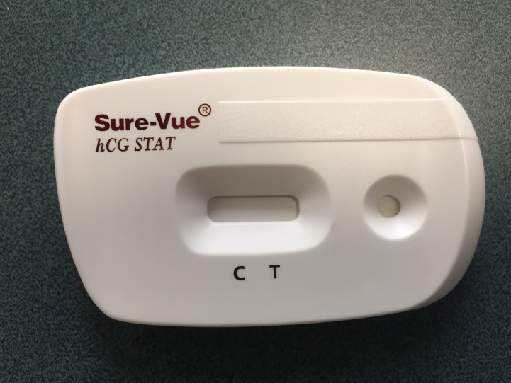
The Sure-Vue Test Cartridge
Test device (50 individually-wrapped cassettes) | Store kit at room temp. Store out of direct sunlight. Test device MUST remain in sealed pouch until use. Kit contents are stable through printed expiration date. Do not use past expiration date. For in vitro diagnostic use.
Disposable pipettes (50) | Provided in kit. Disposable, do not reuse.
Internal Negative QC Area
(white background)
Patient ID
Filter
Sample Well
Internal Positive QC Area (line at the “c”)
Patient Result Area

Slide 4
The Specimen
Specimen | Acceptable: Urine specimens. Unacceptable: Specimens from other sources. Label the patient sample with patient sticker. Two extra patient stickers are needed.
Collection Container | Urine: Clean, dry collection container. A first morning specimen is preferred; however urines collected any time of day may be used. NOTE: Urine specimens exhibiting visible precipitates or elevated turbidity should be allowed to settle to obtain a clear specimen for testing or sent to the Laboratory for analysis.
Specimen Storage | Urine samples for URINE PREGNANCY TEST may be kept at room temperature for up to 8 hours.
Handling Precautions | Handle all specimens as if they contain infectious agents. Gloves must be worn throughout the testing process.

Slide 5
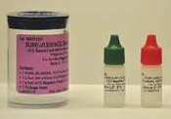
External LIQUID Quality Controls
Store at refrigerated (2-8°C).
Must bring to room temperature prior to use.
Tested on each new kit/shipment.
Do not use past expiration date.
From a patient source, potentially hazardous, should be handles in the same manner as patient (wear gloves!).
Sure-Vue hCG urine Control Set
(Known Positive and Negative)

Slide 6
What Else is Needed For Testing?
Gloves
Timer
To be worn when testing patients AND Liquid QC.

Slide 7
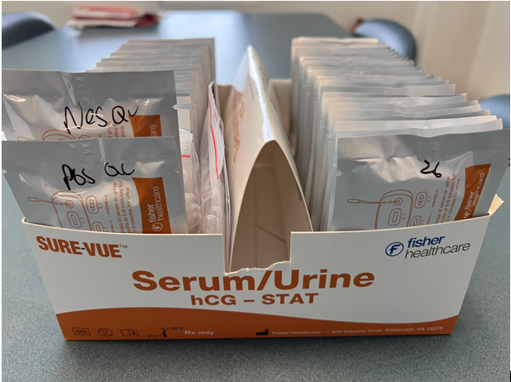
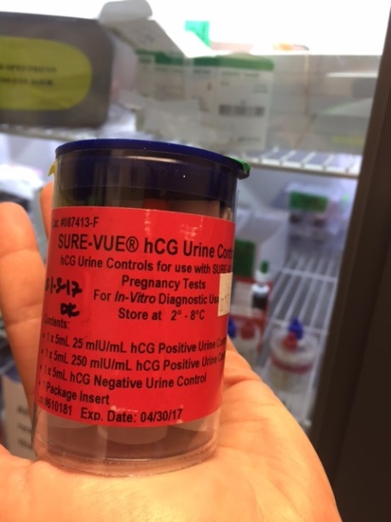
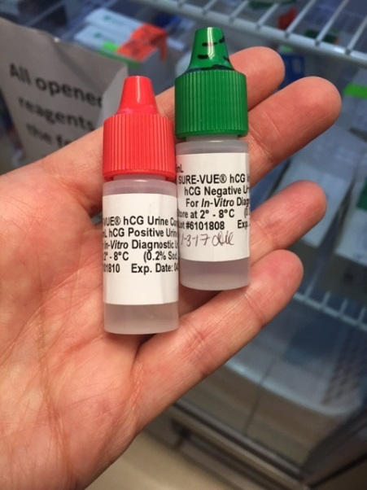
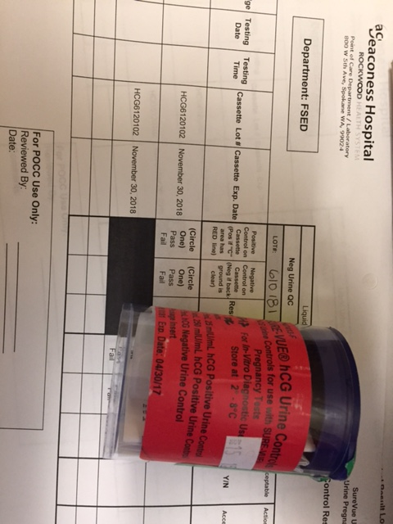
Scenario: You are about to do a pregnancy test, the kit in front of you looks unused (i.e. the first 2 tests cartridges are labeled with “POS QC” and “NEG QC)
Question: What would you first do before testing your patient?

Slide 8
What would you first do before testing your patient?
Answer: Perform External Liquid QC
Question: Why do that?
External controls consist of a known positive and of a known negative. If a “PASS” result is obtained for both levels, patient testing can begin with this kit because:
Assured of proper reagent function (post shipping/storage).
Assured of proper testing technique.
→ Confidence in test results!

Slide 9
QC and Patient Testing Procedure
Remove new cassette from sealed pouch and place on a level surface.
Urine Sample
Patient ID Label
Patient/QC ID Label

Slide 10
Result Interpretation
Internal Controls | Positive Internal Control | The appearance of a red line in the “C” region is indicative of the internal positive control. This confirms that sufficient sample fluid was added for capillary flow to occur and the correct procedural technique was used. If this line does not develop, the test result is considered invalid.
 | Negative Internal Control | A clear background in the test result window indicates an internal negative control. If the test has been performed correctly, the background should be white to light pink within 3 minutes and not interfere with the reading of the test result.
 | Invalid QC | Control “C” red line fails to appear (may be due to insufficient sample volume, incorrect procedural technique, filter is clogged by mucous sample etc.)
Patient Result |  | Positive: A solid red line appears at the “T.” Negative: No line appears at the “T.”

Slide 11
Where are patient and QC Test Results documented?
Quality Control Result Log
Patient Results
Patient result Log
Patient Results in EPIC

Slide 12
quality CONTROL QC RESULTS

Slide 13
Patient Result – the log
→ Each patient result MUST have:
2 Patient Identifiers
Testing Date/Time
Internal QC Results
Patient Result
Tester MultiCare ID#
→ But why?
Because each patient result is manually entered into Meditech by POCC, all listed items are required for the permanent document in the patient’s electronic chart in Meditech.

Slide 14
Patient Result – EPIC Order
Must have provider order 81025A
No other urine pregnancy order codes are acceptable.
Other urine pregnancy order codes are for Lab orders and not Point-of-Care. Lab orders have different $ charges, different reimbursement, and will make results look as though they were tested in a laboratory and not in POC (inaccurate representation).

Slide 15
Patient Result –EPIC Screen (enter/edit screen)
Your last name, first name
For 6 and 7 ☺
Enter “t” for today and “n” for now
→ Do not enter anything here

Slide 16
Common Errors in Epic result entry
Not completing the 4 specimen entries especially collection time.
Adding words under the “Flags” prompt. Nothing should be entered there.
Not “Finalizing” the result under “Status.” Results will not chart when this occurs and the order still hangs out there…
If collection time is missing, the result time will default to 0000 or midnight – this is not correct and is misleading.

Slide 17
Test Limitations
Very dilute urine specimens, as indicated by a low specific gravity, may not contain representative levels of hCG. If pregnancy is still suspected, a first morning urine specimen should be collected 48 hours later and tested.
False negative results may occur when the levels of hCG are below the sensitivity level of the test. When pregnancy is still suspected, an order for a whole blood test should be placed and a sample be sent to the Lab for testing.
A number of conditions other than pregnancy, including trophoblastic disease and certain non-trophoblastic neoplasms including testicular tumors, prostate cancer, breast cancer, and lung cancer, cause elevated levels of hCG.^{6,7} Therefore, the presence of hCG in serum or urine specimen should not be used to diagnose pregnancy unless these conditions have been ruled out.
As with any assay employing mouse antibodies, the possibility exists for interference by human anti-mouse antibodies (HAMA) in the specimen. Specimens from patients who have received preparations for monoclonal antibodies for diagnosis or therapy may contain HAMA. Such specimens may cause false positive or false negative results.
This test provides a presumptive diagnosis for pregnancy. A confirmed pregnancy diagnosis should only be made by a physician after all clinical and laboratory findings have been evaluated.

Slide 18
Thank you for reviewing this PowerPoint presentation.
Your next steps are:
Take the quiz Thank you,
Caline X7131

